Slide 1

Periklis Vyzantios
1893-1972
12 Paintings

Slide 2
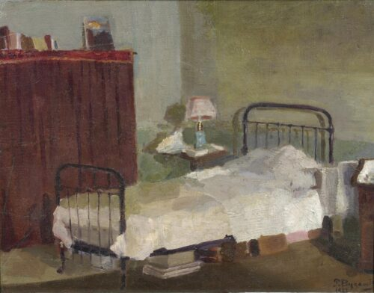
Interior of the Artist’s Room in Paris, 1913
Oil on canvas, 32,6 x 41,2 cm, National Gallery of Greece, Athens, Greece https://www.nationalgallery.gr/en/artist/vyzantios-periclis/

Slide 3
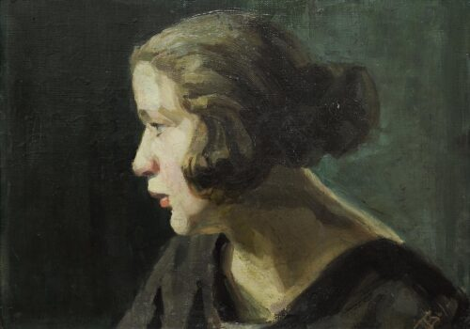
Aurelie, 1914, Oil on plywood, 32 x 45 cm, National Gallery of Greece, Athens, Greece https://www.averoffmuseum.gr/en/paintings/atelier-1927

Slide 4
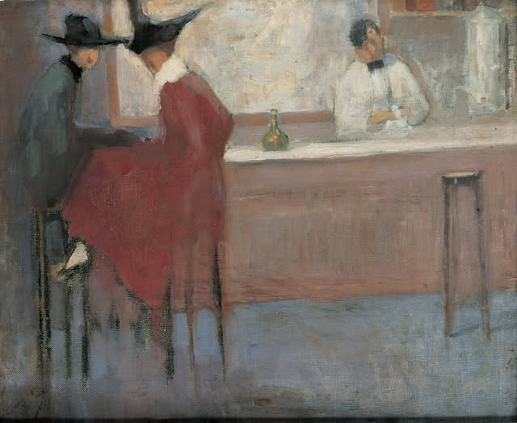
At a Bar in Paris, 1914-15, Oil on Canvas, A. G. Leventis Gallery, Nicosia, Cyprus https://app.smartify.org/en-GB/objects/at-a-bar-in-paris

Slide 5
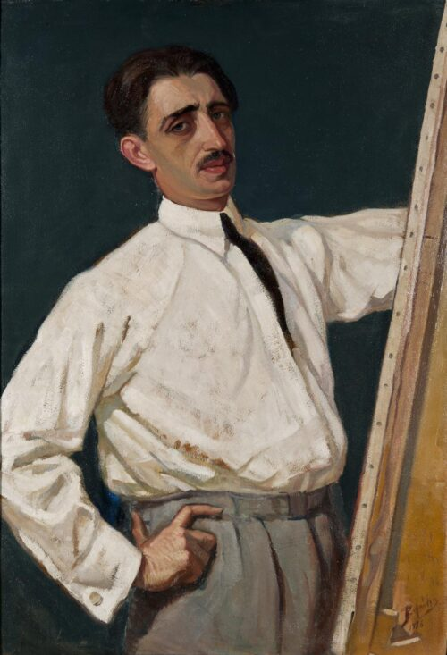
Self-Portrait, 1926, Oil on pasteboard, 105 x 70 cm, National Gallery of Greece, Athens, Greece https://www.averoffmuseum.gr/en/paintings/atelier-1927

Slide 6
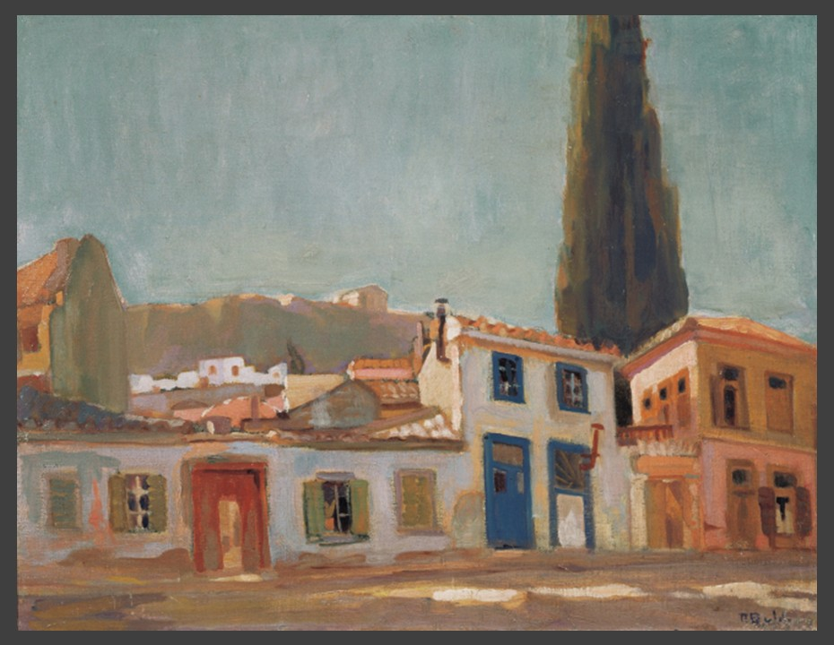
The Atelier, 1927, Oil on Canvas, 44x58 cm, E. Averoff Museum, Metsovo, Greece https://www.averoffmuseum.gr/en/paintings/atelier-1927

Slide 7
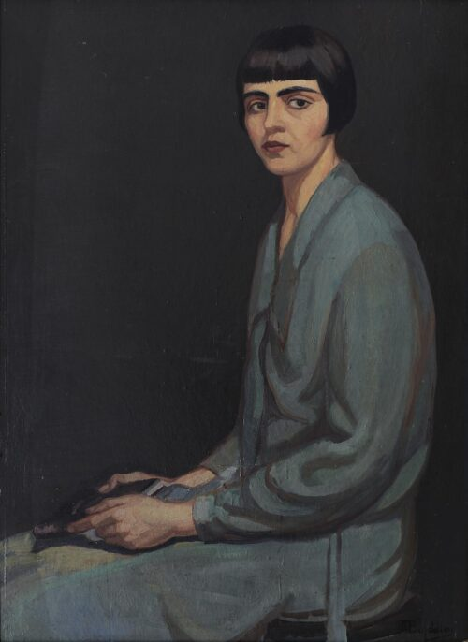
Portrait of the Artist’s Wife Frosso Skoumpourdi, 1928, Oil on canvas, 98 x 72 cm, National Gallery of Greece, Athens, Greece https://www.averoffmuseum.gr/en/paintings/atelier-1927

Slide 8
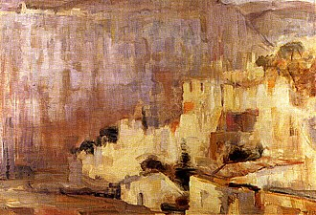
Hydra, 1959, Oil on canvas, 120 x 115 cm, Museum of Koudouriotis Family, Hydra, Greece https://el.wikipedia.org/wiki/%CE%A0%CE%B5%CF%81%CE%B9%CE%BA%CE%BB%CE%AE%CF%82_%CE%92%CF%85%CE%B6%CE%AC%CE%BD%CF%84%CE%B9%CE%BF%CF%82

Slide 9
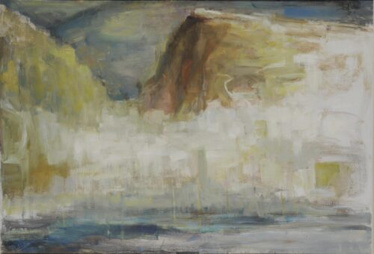
Hydra, 1970, Oil on canvas, 81 x 116 cm, National Gallery of Greece, Athens, Greece https://www.averoffmuseum.gr/en/paintings/atelier-1927

Slide 10
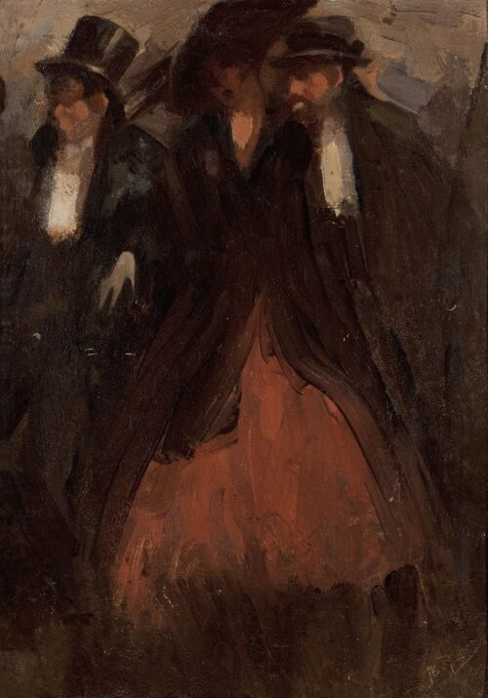
Figures, Undated, Oil on cardboard, 33 x 24 cm, National Gallery of Greece, Athens, Greece https://www.averoffmuseum.gr/en/paintings/atelier-1927

Slide 11
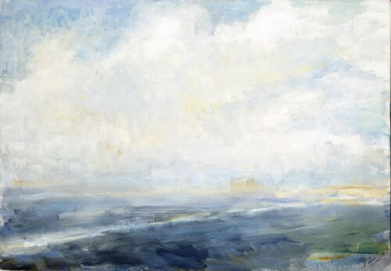
Landscape, Undated, Oil on canvas, 79 x 100 cm, National Gallery of Greece, Athens, Greece https://www.averoffmuseum.gr/en/paintings/atelier-1927

Slide 12
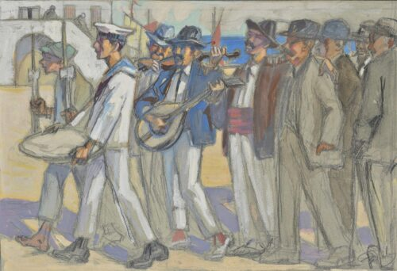
Wedding in Hydra, Undated, Pencil, tempera on paper, 18 x 25 cm, National Gallery of Greece, Athens, Greece https://www.averoffmuseum.gr/en/paintings/atelier-1927

Slide 13
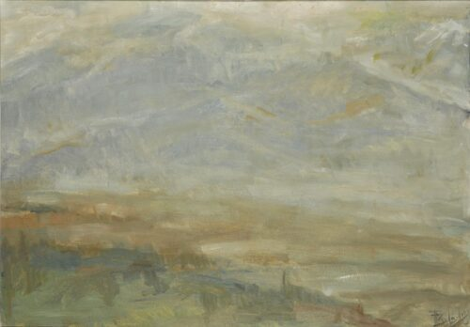
Landscape, Undated, Oil on canvas, 80 x 115,5 cm, National Gallery of Greece, Athens, Greece https://www.averoffmuseum.gr/en/paintings/atelier-1927

Slide 14
The End

