Slide 1
Pierrre-Auguste Renoir, 1841-191
Renoir Paintings of Gabrielle Renard

Slide 2
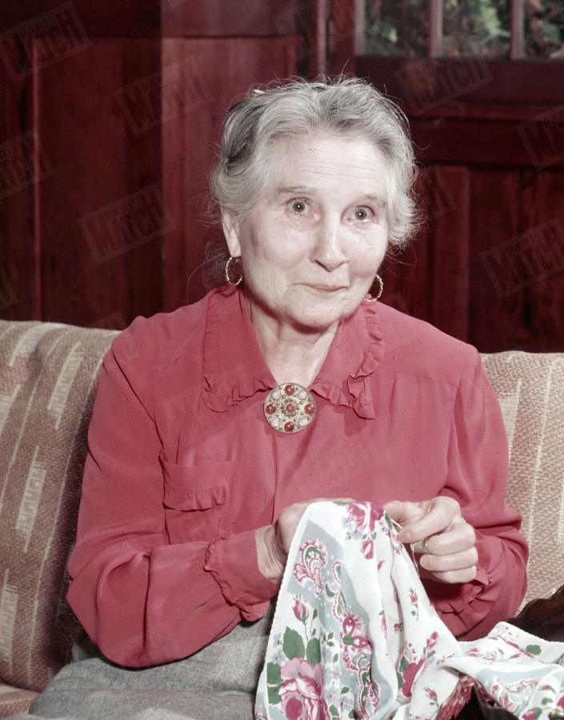
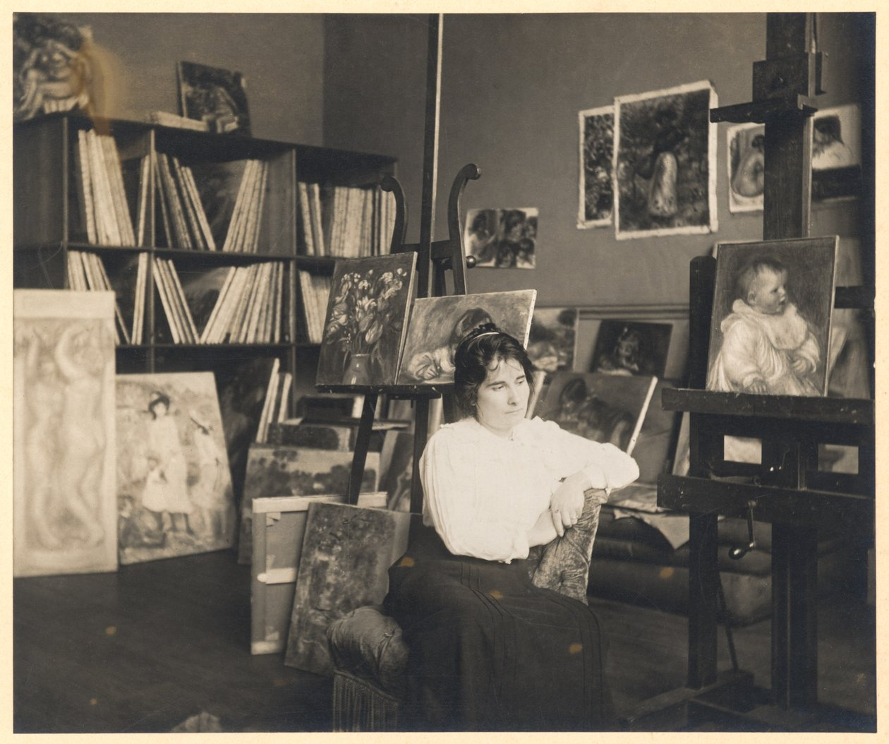
Gabrielle Renard, 1878-1959 https://thearkofgrace.com/2013/05/23/gabrielle-renard/ https://www.meisterdrucke.ie/fine-art-prints/French-Photographer/60212/Portrait-of-Gabrielle-Renard.html

Slide 3
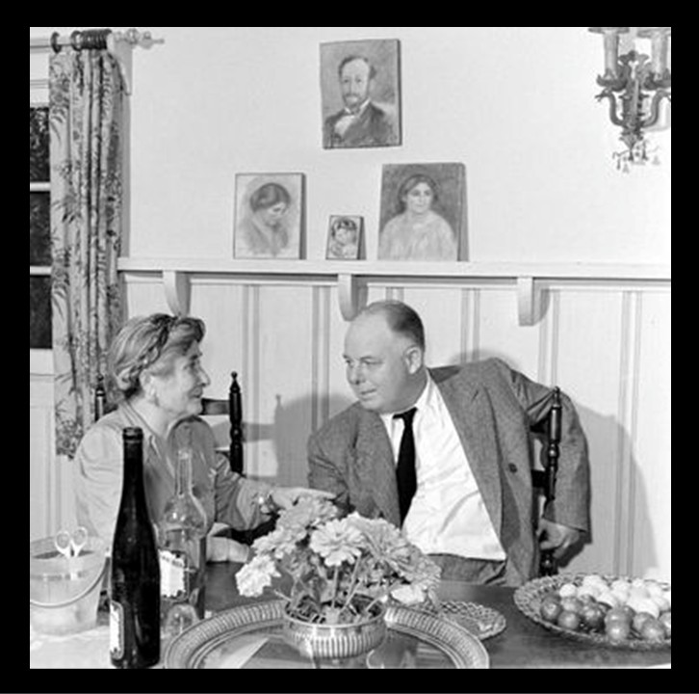
Gabrielle Renard and Jean Renoir https://bonhams.shorthandstories.com/lasting-impression-renoir/

Slide 4
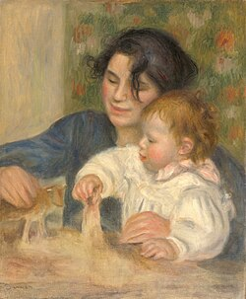
Gabrielle Renard and Jean Renoir, 1895, Oil on Canvas, 65x54 cm, Orangery Museum, Paris, France https://en.wikipedia.org/wiki/File:Gabrielle_et_Jean,_by_Pierre-Auguste_Renoir,_from_C2RMF_cropped.jpg

Slide 5
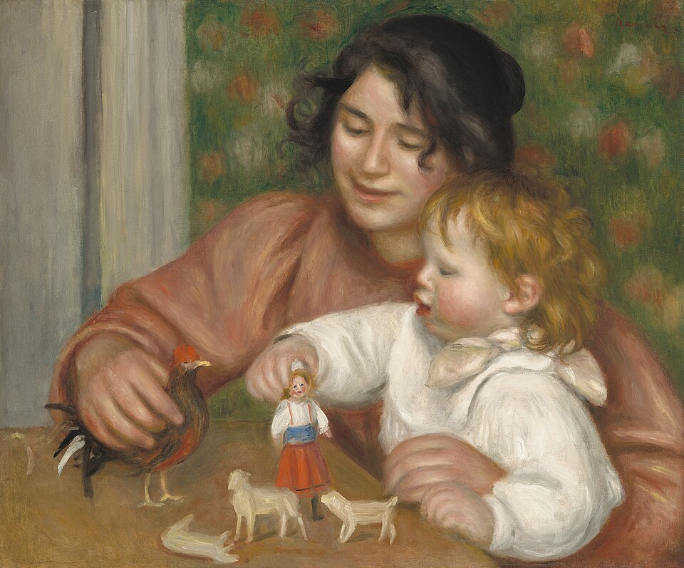
Child with Toys - Gabrielle and the Artist's Son, Jean, 1895-1896, Oil on Canvas, 54.3x65.4 cm, National Gallery of Art, Washington DC, USA https://www.nga.gov/artworks/66434-child-toys-gabrielle-and-artists-son-jean

Slide 6
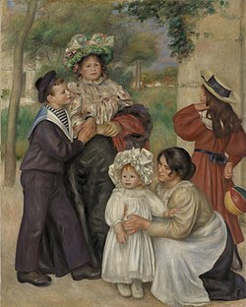
The Renoir Family with Gabrielle Renard, 1896, Oil on Canvas, 173x137.2 cm, The Barnes Foundation, Philadelphia, USA https://commons.wikimedia.org/wiki/File:Pierre-Auguste_Renoir_-_The_Artist%27s_Family_(La_Famille_de_l%27artiste)_-_BF819_-_Barnes_Foundation.jpg

Slide 7
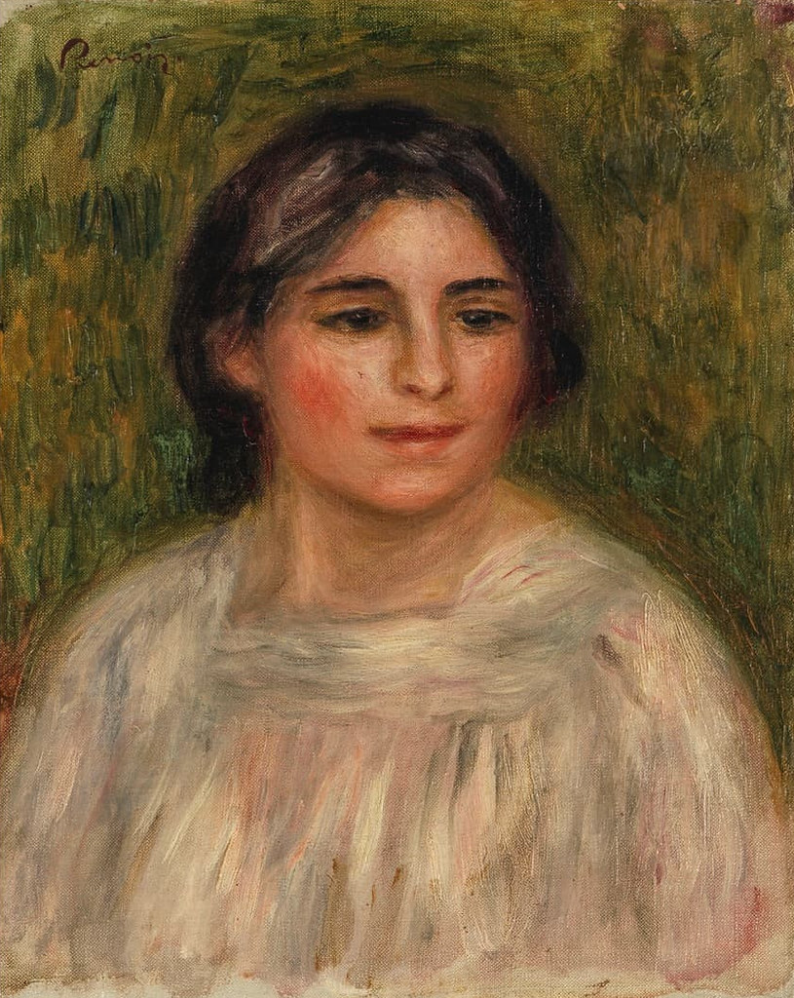
Gabrielle in a white blouse, 1907, Oil on Canvas, 30x24 cm, Private Collection https://www.bonhams.com/auction/32380/lot/1/pierre-auguste-renoir-1841-1919-gabrielle-a-la-blouse-blanche-11-1316-x-9-716-in-30-x-24-cm-painted-in-1907/

Slide 8
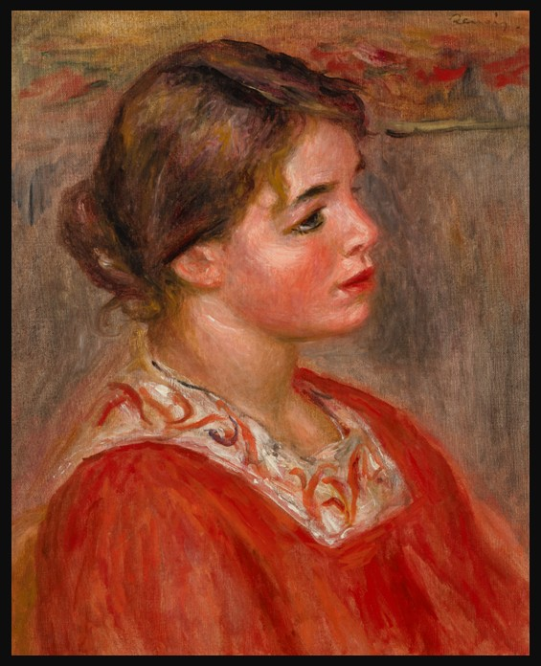
Femme au corsage rouge, ca. 1910, Oil on Canvas, 41.2 x 33.4 cm, Private Collection https://www.christies.com/en/lot/lot-6584150?ldp_breadcrumb=back#lot-essay

Slide 9
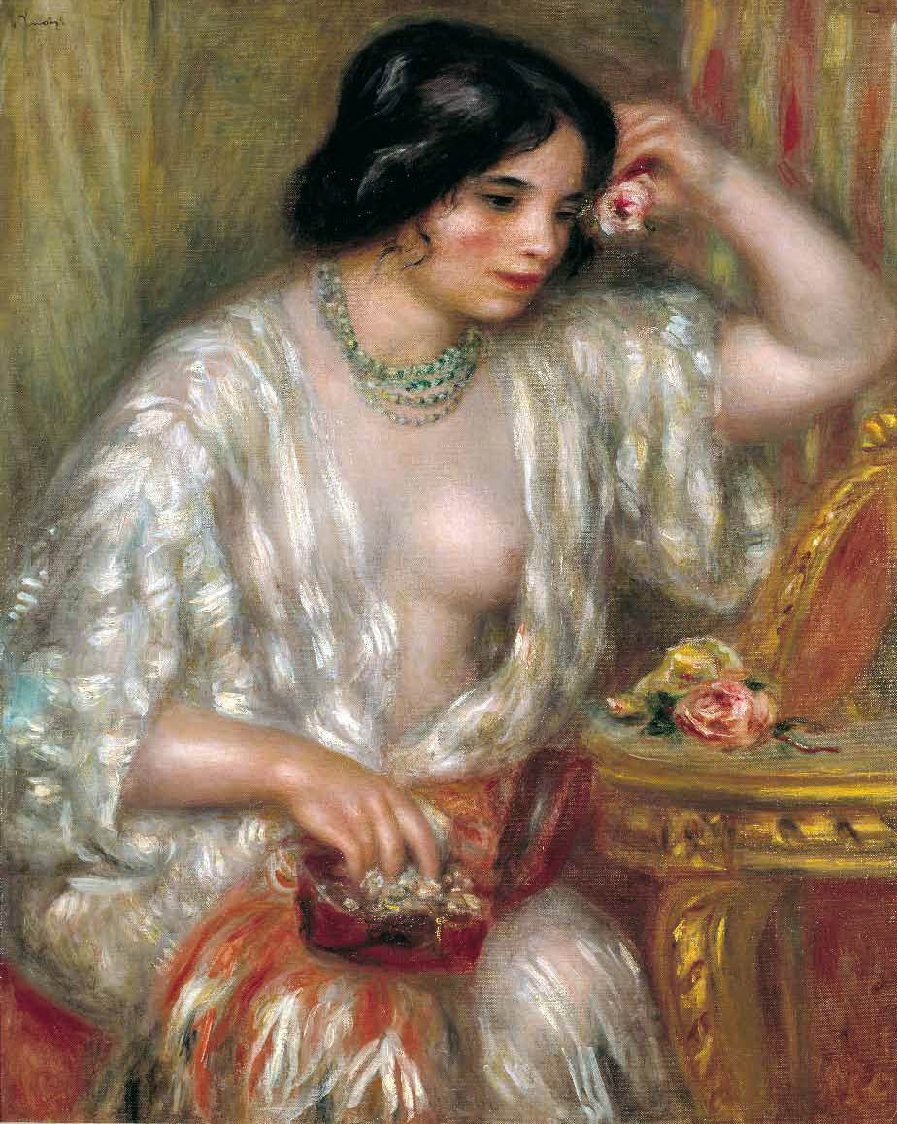
Gabrielle with Jewelry, 1910, Oil on Canvas, 82x66 cm, Private Collection https://www.wga.hu/frames-e.html?/html/r/renoir/4/4renoi16.html

Slide 10
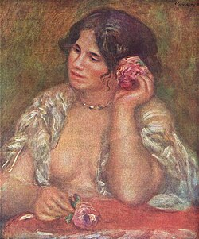
Gabrielle with Rose, 1911, Oil on Canvas, 55x47 cm, Orsay Museum, Paris, France https://commons.wikimedia.org/wiki/File:Pierre-Auguste_Renoir_039.jpg

Slide 11
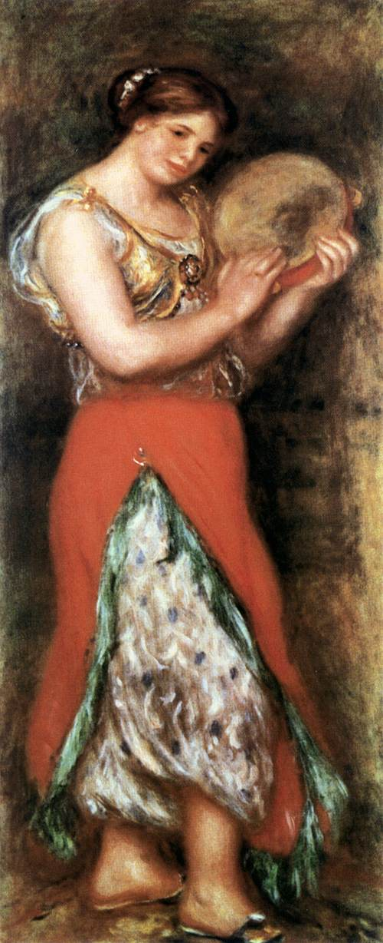
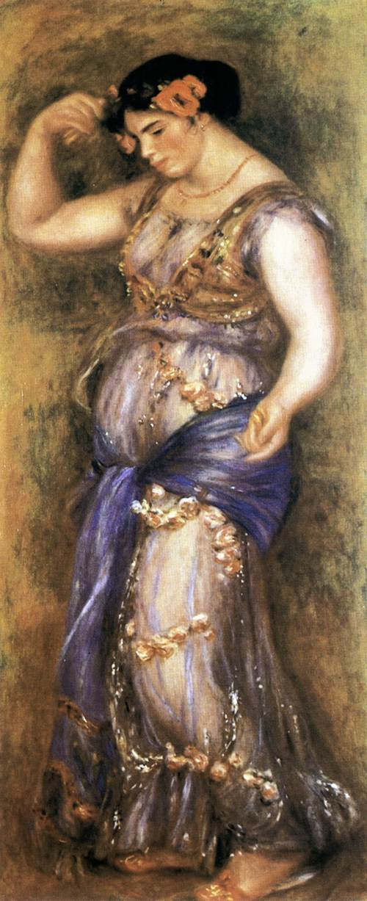
Dancing Girl with a Tambourine, 1909, Oil on Canvas, 155x65 cm, National Gallery, London, UK
Dancing Girl with Castanets, 1909, Oil on Canvas, 155x65 cm, National Gallery, London, UK https://www.wga.hu/frames-e.html?/html/r/renoir/4/4renoi16.html

Slide 12
THE END

