Slide 1
Tiziano Vecellio
(Titian)
ca. 1490-1576
Pudicizia
and
Voluptas

Slide 2
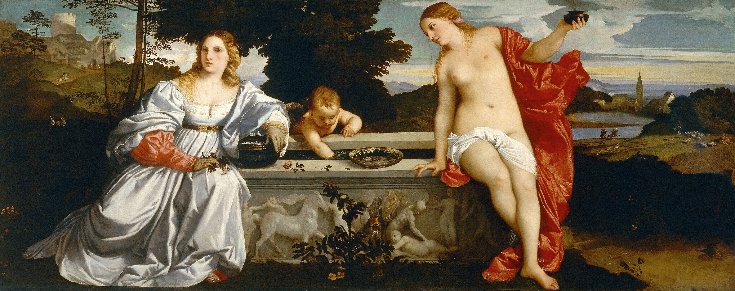
Sacred and Profane Love, 1514, Oil on canvas, 118 x 279 cm, Galleria Borghese, Rome, Italy https://en.wikipedia.org/wiki/Sacred_and_Profane_Love

Slide 3
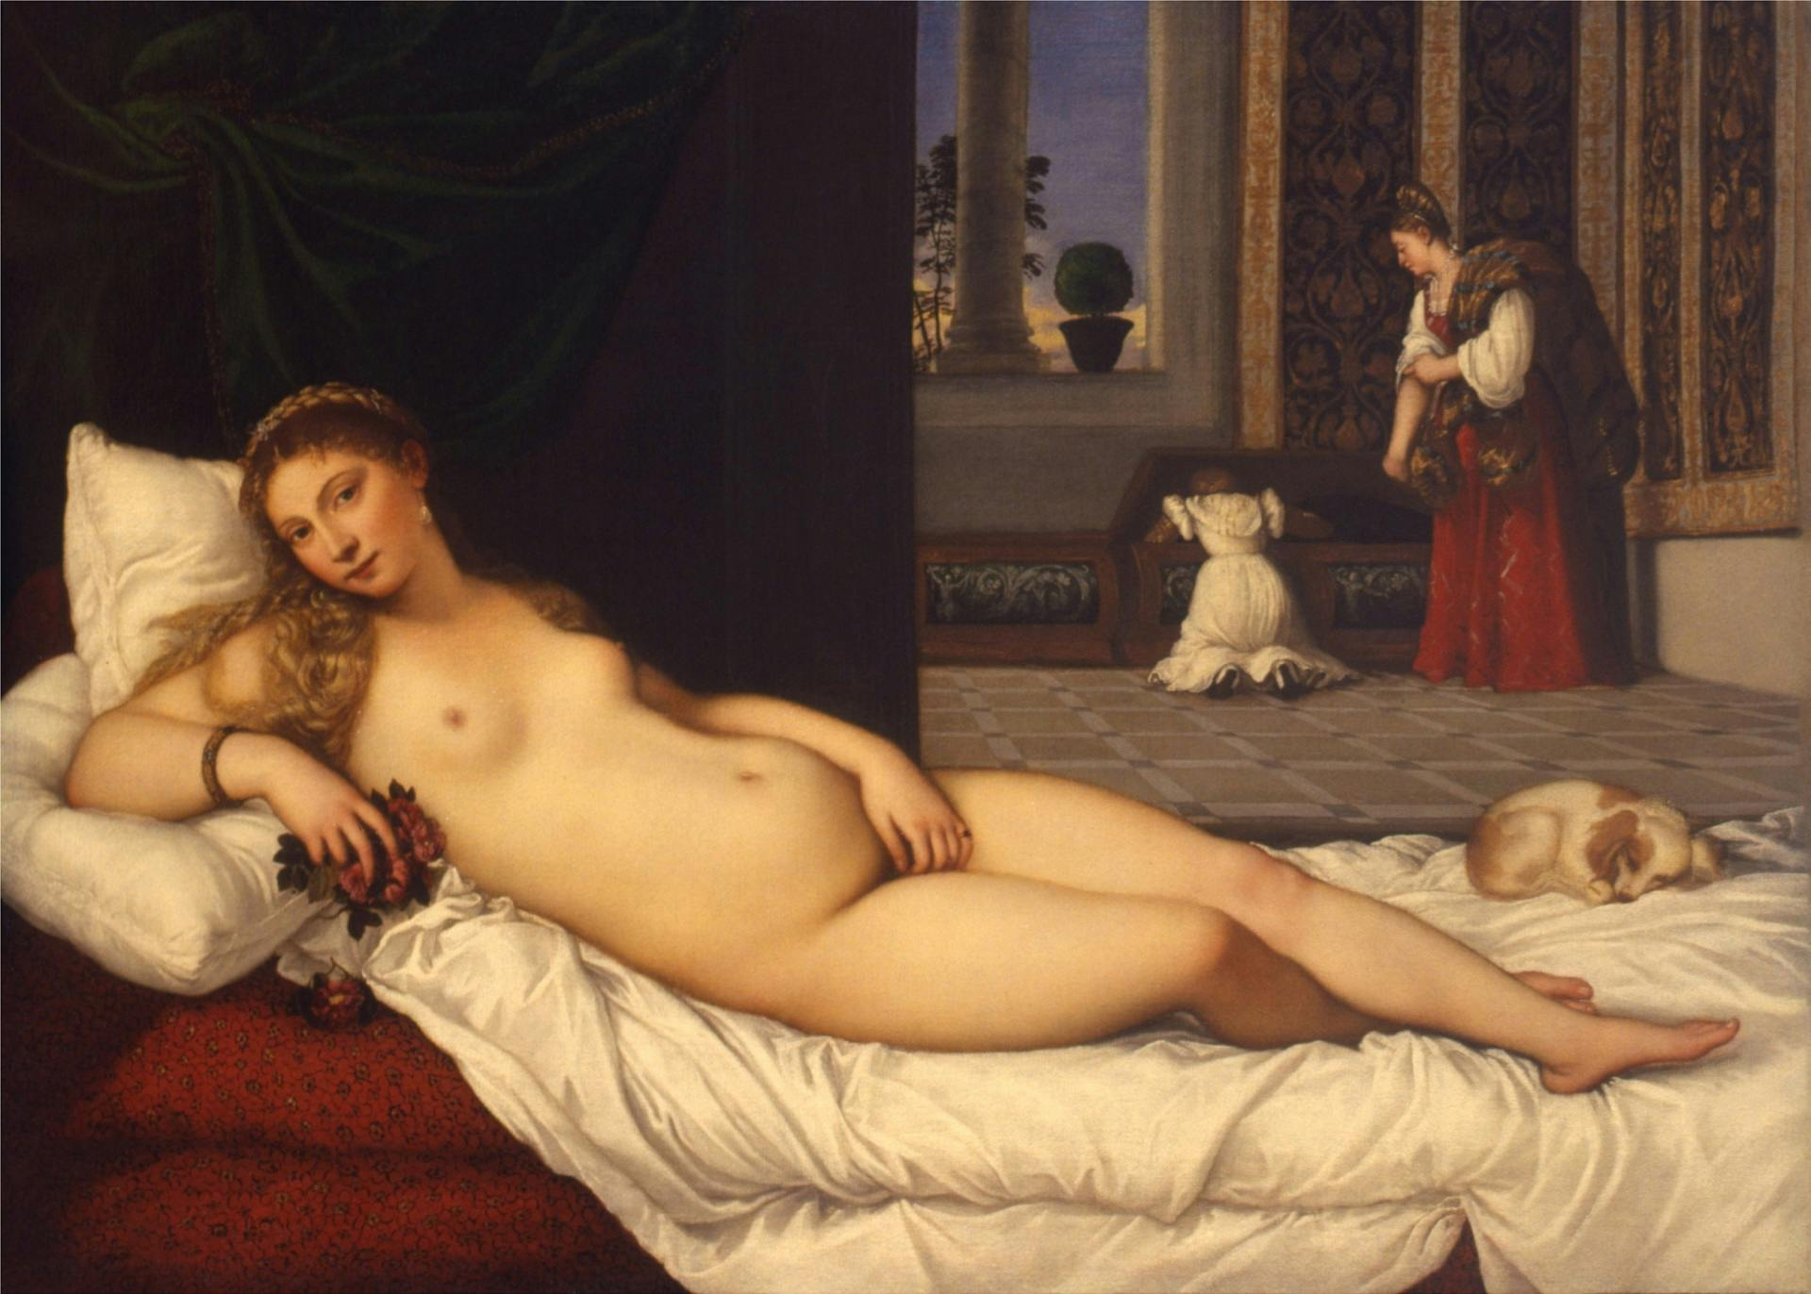
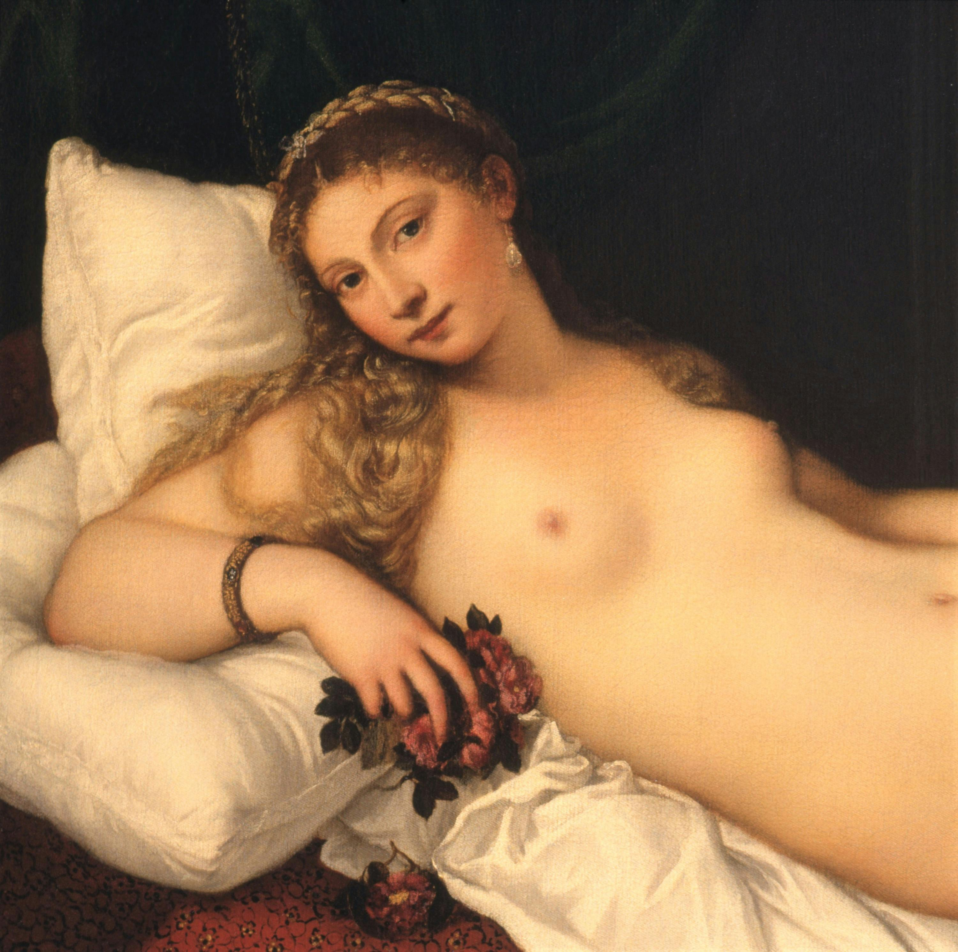
Venus of Urbino, 1538, Oil on canvas, 119 x 165 cm, Galleria degli Uffizi, Florence, Italy

Slide 4
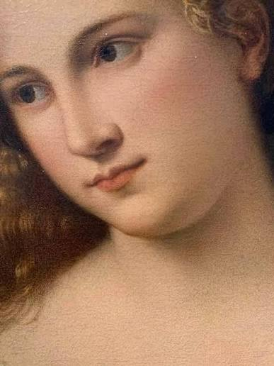
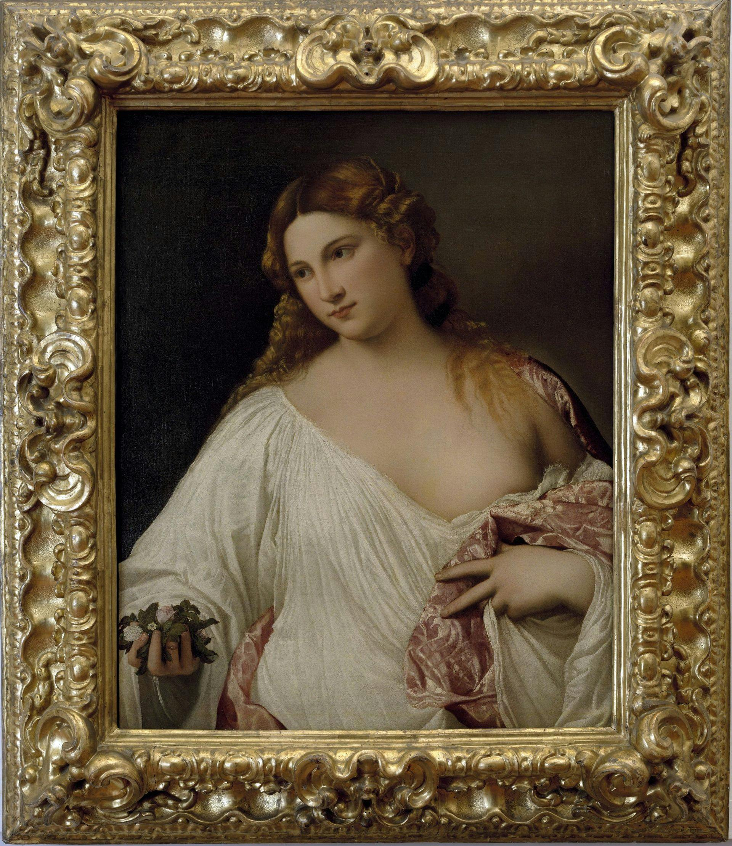
Flora, 1515-20, Oil on canvas, 80 x 64 cm, Galleria degli Uffizi, Florence, Italy https://www.instagram.com/p/DWhaRlsDkFI/ https://www.uffizi.it/en/artworks/titian-flora

Slide 5
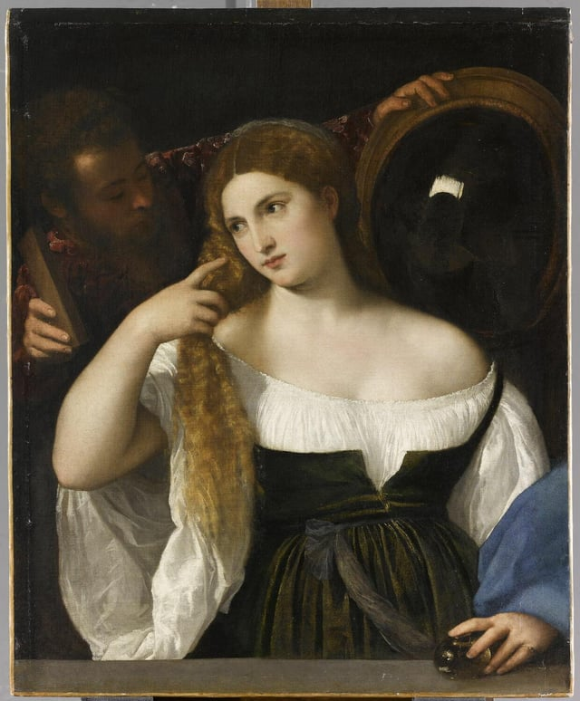
Woman with a Mirror, c. 1514, Oil on canvas, 93 x 76 cm, Musée du Louvre, Paris, France https://www.reddit.com/r/GenreArt/comments/137epm7/titian_woman_with_a_mirror_1514/

Slide 6
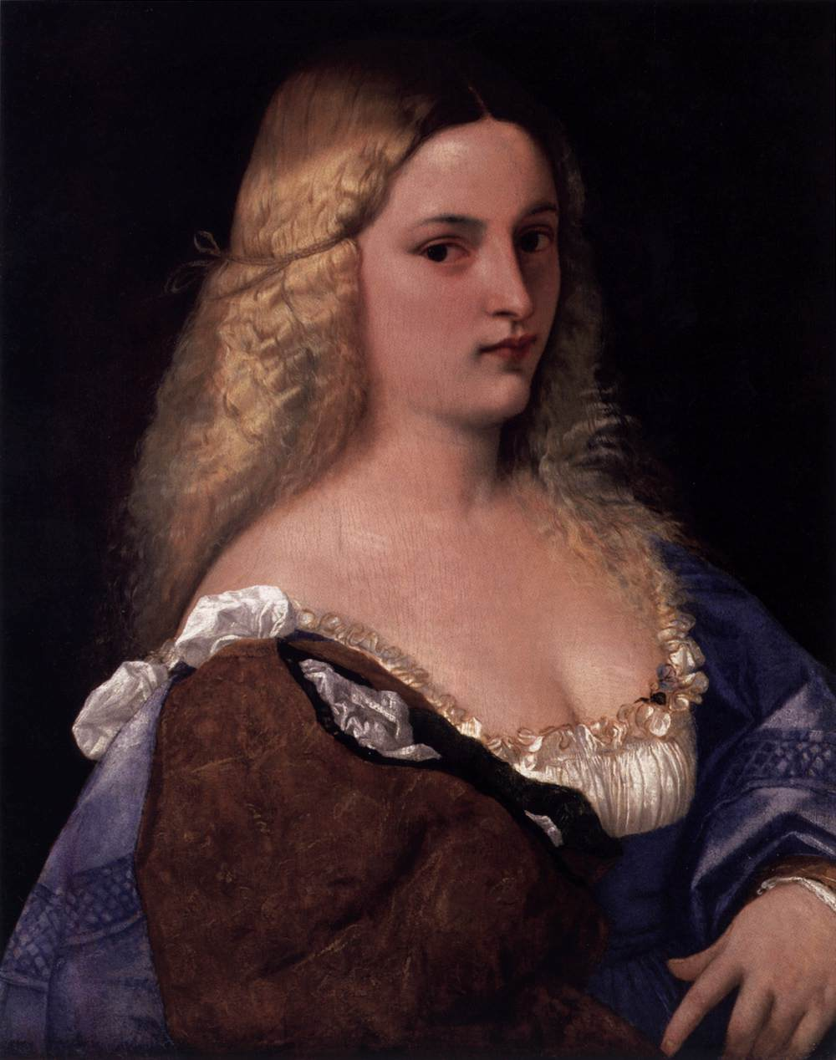
Violante (La Bella Gatta), c. 1514, Oil on canvas, 65 x 51 cm, Kunsthistorisches Museum, Vienna, Austria https://www.wga.hu/html_m/t/tiziano/10/1/03violan.html

Slide 7
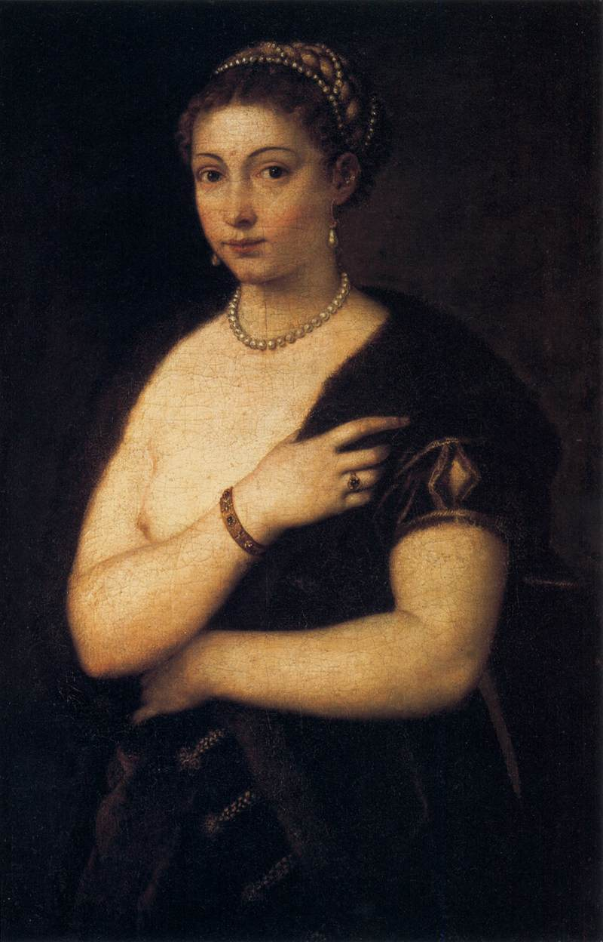
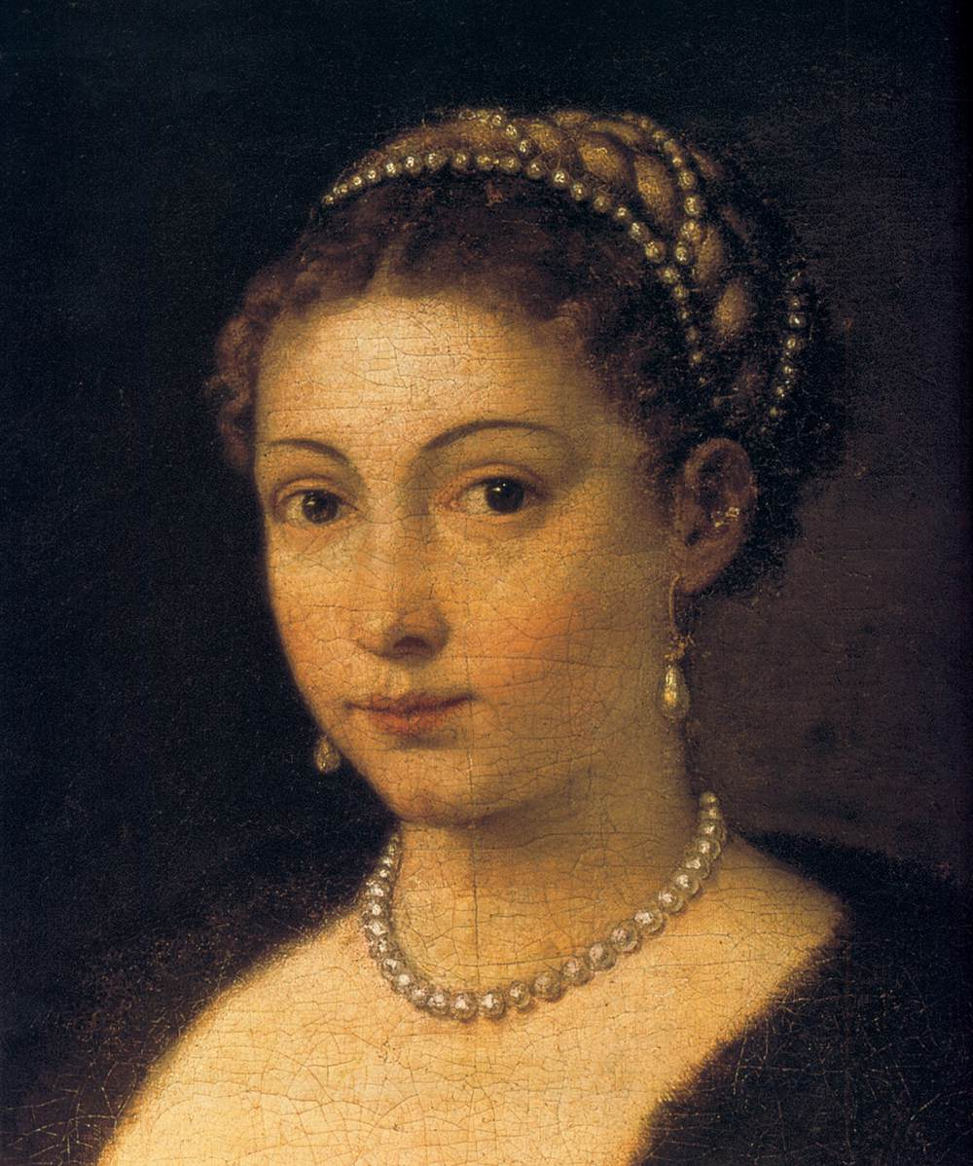
Woman in a Fur Coat, 1536-38, Oil on canvas, 95 x 63 cm, Kunsthistorisches Museum, Vienna, Austria https://www.wga.hu/html_m/t/tiziano/10/1/index.html

Slide 8
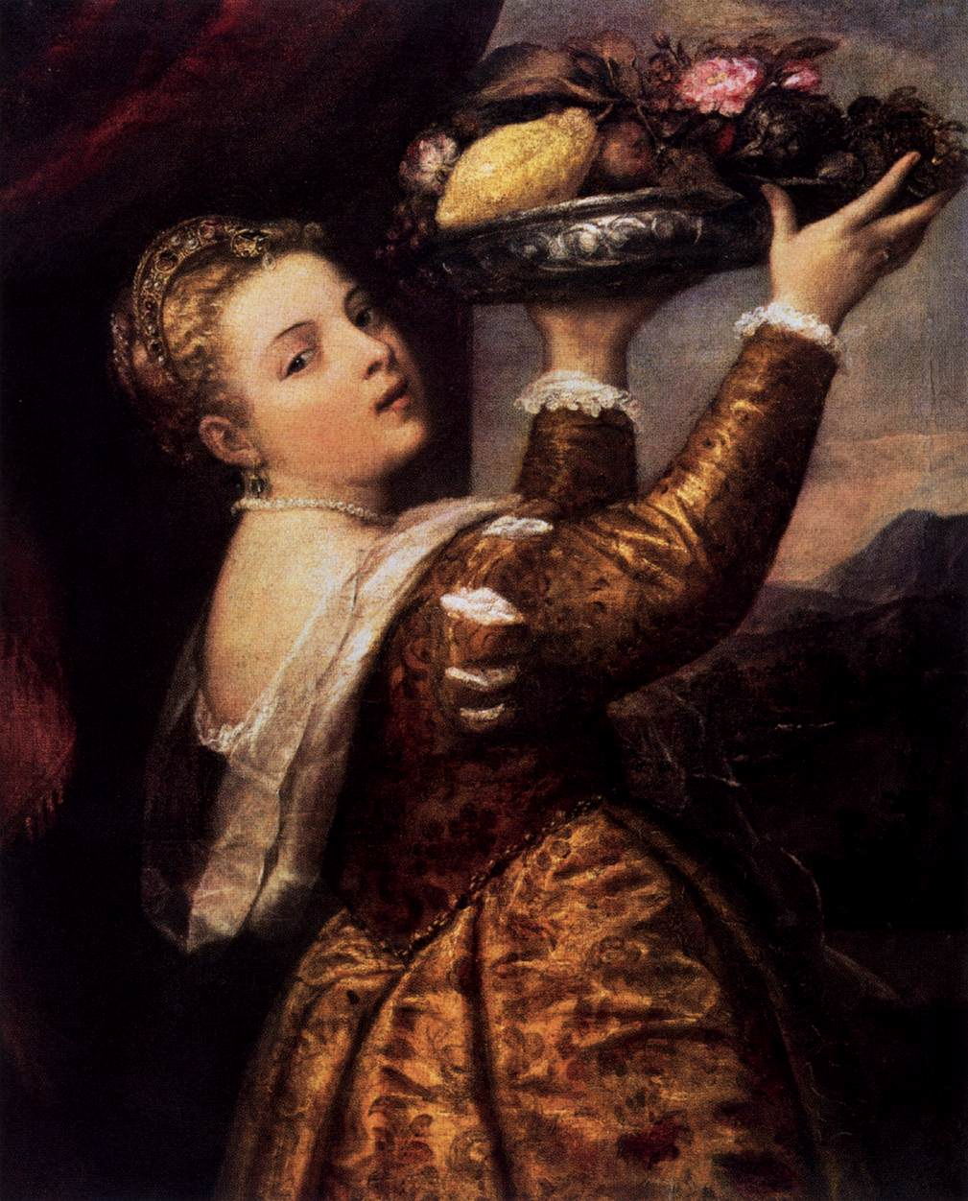
Young Woman with a Dish of Fruit, c. 1555, Oil on canvas, 102 x 82 cm, Staatliche Museen, Berlin, Germany https://www.wga.hu/html_m/t/tiziano/10/1/index.html

Slide 9
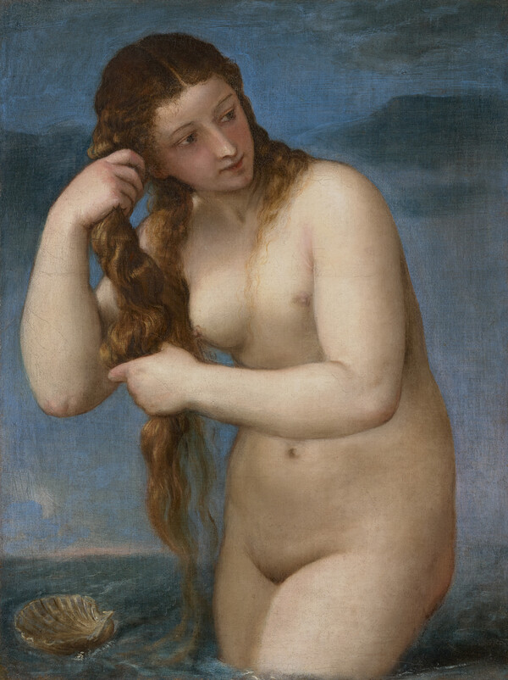
Venus Anadyomene, c. 1520, Oil on canvas, 76 x 57 cm, National Gallery of Scotland, Edinburgh, Scotand https://www.nationalgalleries.org/art-and-artists/8687

Slide 10
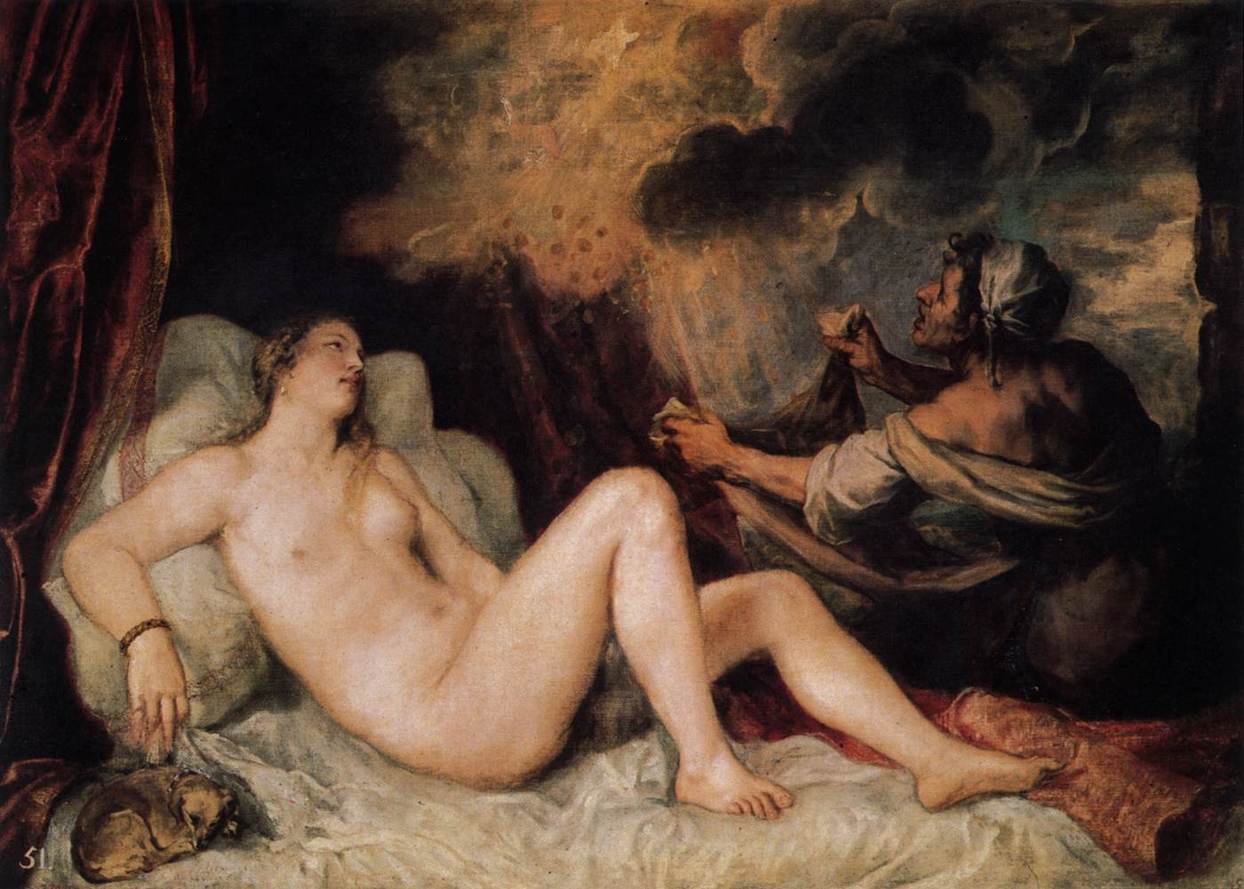
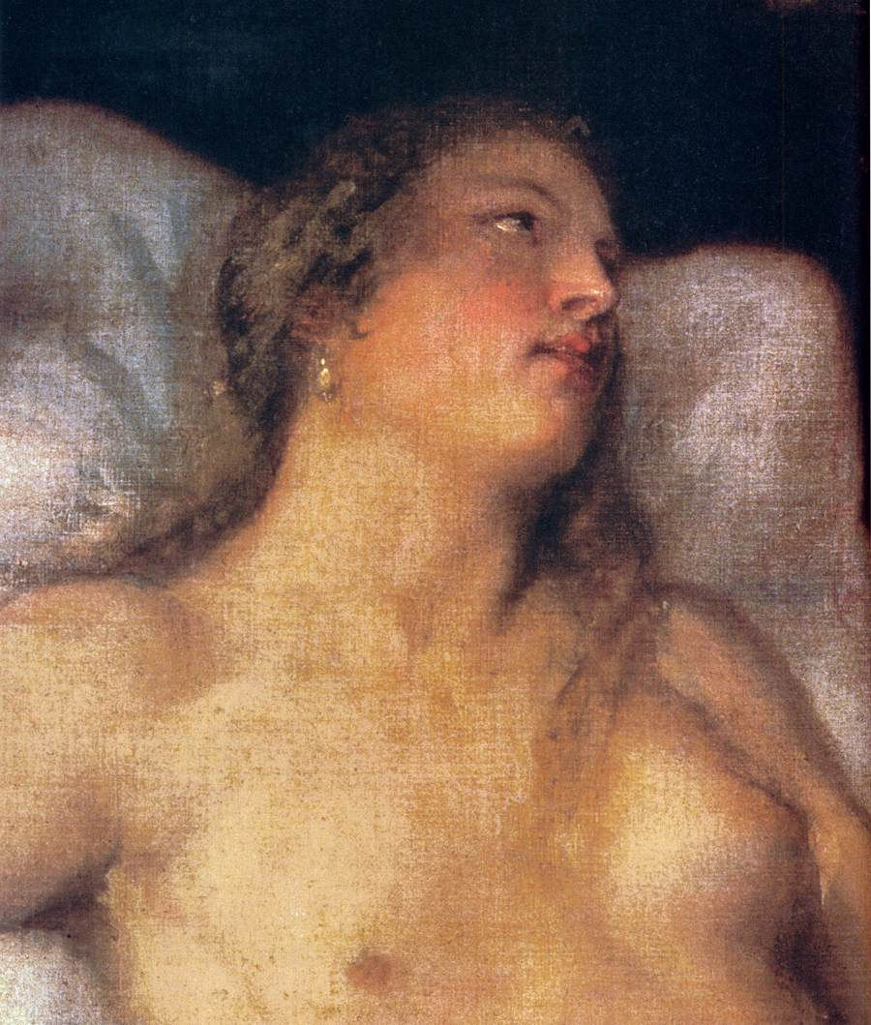
Danaë with a Nurse, 1553-54, Oil on canvas, 129 x 180 cm, Museo del Prado, Madrid, Spain https://www.wga.hu/html_m/t/tiziano/08b/index.html

Slide 11
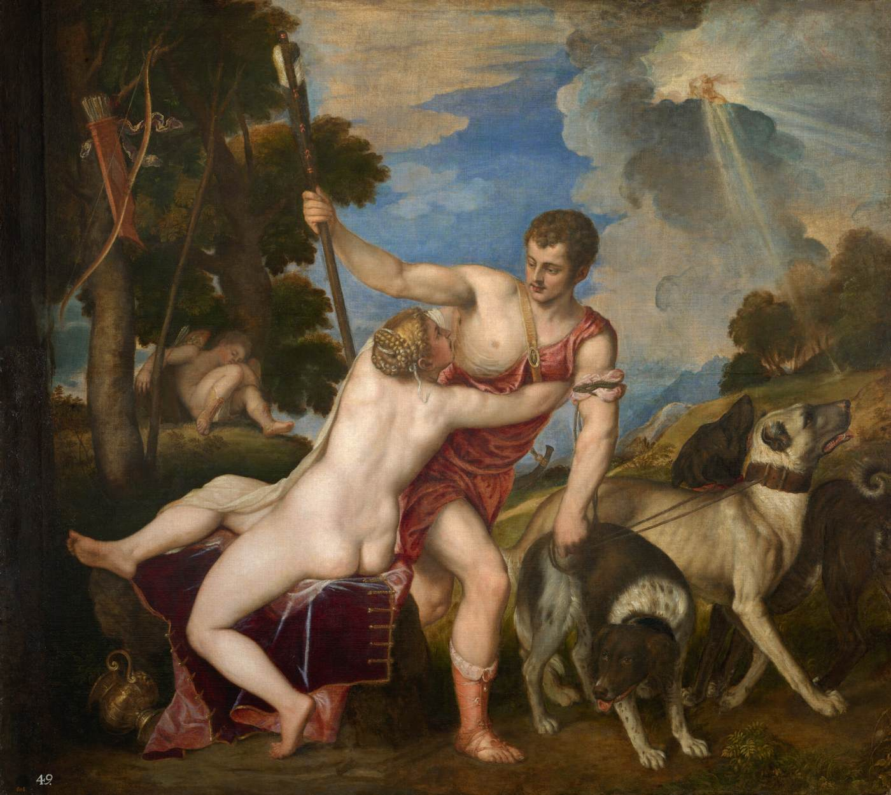
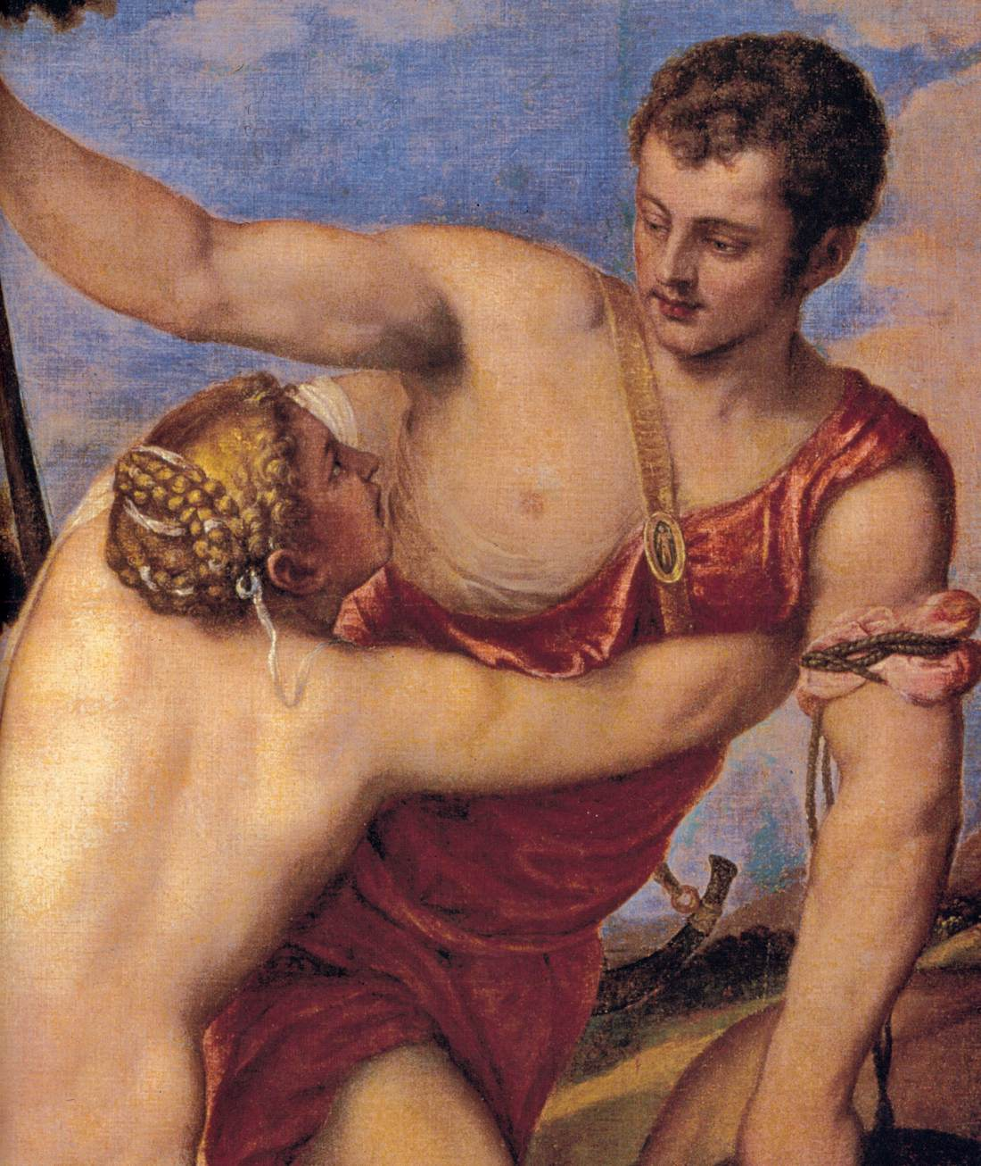
Venus and Adonis, 1554, Oil on canvas, 180 x 207 cm, Museo del Prado, Madrid, Spain https://www.wga.hu/html_m/t/tiziano/08b/index.html

Slide 12
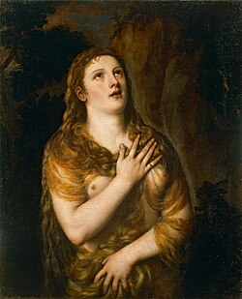
The Penitent Magdalene, c. 1540, Oil on wood, 96 x 74 cm, Pinacoteca Ambrosiana, Milan, Italy https://commons.wikimedia.org/wiki/File:Tiziano_Vecellio_(1480-1576)_e_bottega_-_La_Maddalena_-_208_-_Pinacoteca_Ambrosiana.jpg

Slide 13
The End

