Slide 1
Ashcan Painters and Their Circle
1900-1920

Slide 2
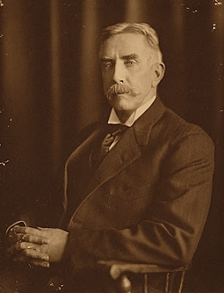
Thomas Anshutz, 1851–1912
Unidentified photographer, Archives of American Art, USA https://commons.wikimedia.org/wiki/File:TPAnshutz.jpg

Slide 3
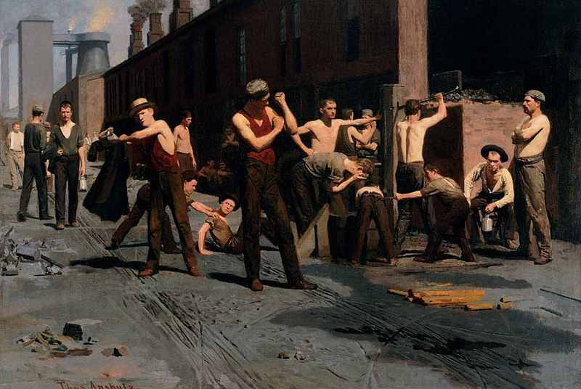
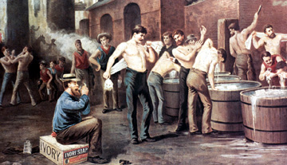
The Ironworker's Noontime,
1880, Oil on canvas,
De Young Museum, USA https://www.famsf.org/artworks/the-ironworkers-noontime
Advertisement for Ivory Soap, c.1890, (colour litho) by Thomas Pollock Anschutz (1851-1912), Private Collection https://www.mediastorehouse.com.au/framed-prints/fine-art-finder/print-ad-ivory-soap-22922188.html

Slide 4
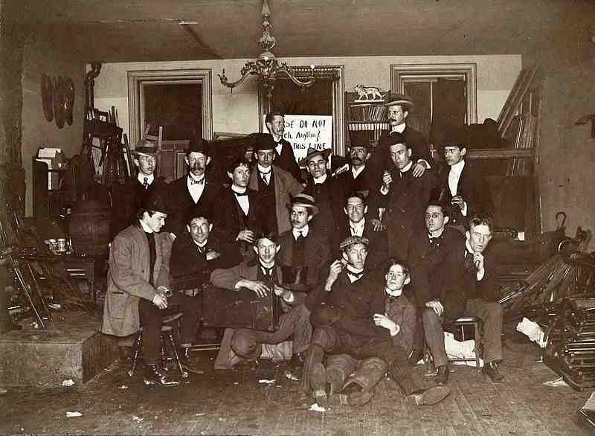
John French Sloan Studio
Ashcan School artists & friends at John French Sloan's Philadelphia Studio, 1898, Private Collection https://flashbak.com/john-french-sloan-new-york-city-and-the-ash-can-school-of-artists-452437/ashcan-school-artists-and-friends-at-john-french-sloans-philadelphia-studio-1898/

Slide 5
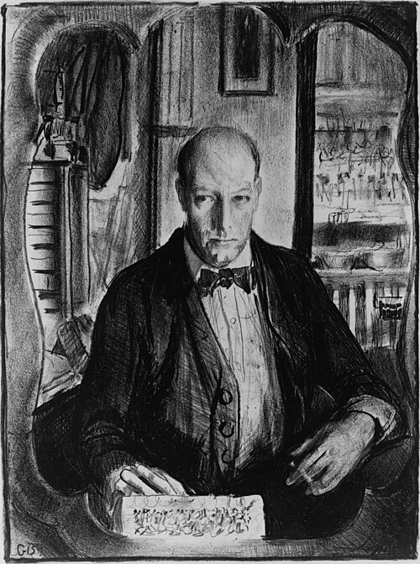
George Wesley Bellows, 1882 – 1925
Self-Portrait, 1921, Lithograph, 26.67 x 20 cm, This image is available from the United States Library of Congress's Prints and Photographs division, USA https://commons.wikimedia.org/wiki/File:George_Bellows_self-portrait.jpg

Slide 6
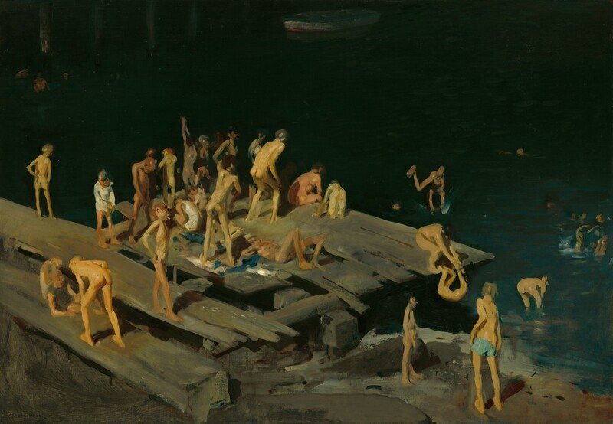
42 Kids, 1907. Oil on canvas, 106.7 x 152.4 cm, Corcoran Gallery of Art, Washington DC, USA https://www.nga.gov/artworks/134485-forty-two-kids

Slide 7
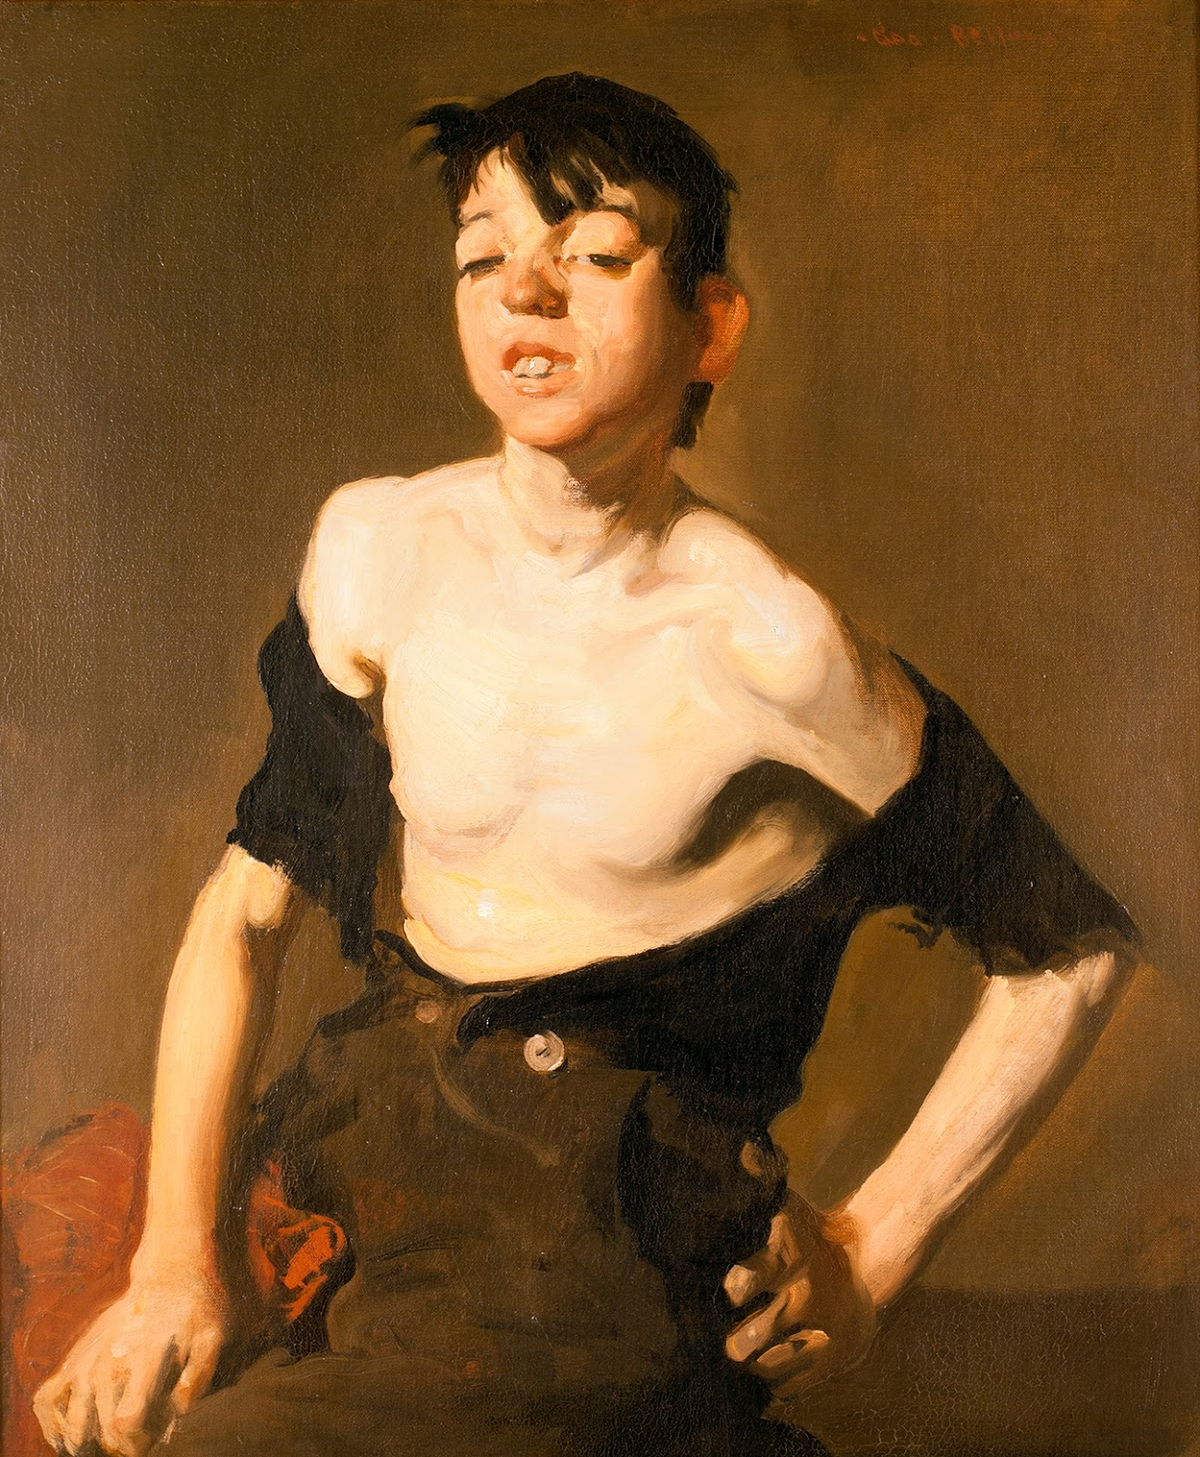
Paddy Flannigan, 1908. Oil on canvas, 76.8 x 63.5 cm, Collection of Erving and Joyce Wolf https://commons.wikimedia.org/wiki/File:George_Bellows_-_Portrait_of_Paddy_Flannigan_(1908).jpg

Slide 8
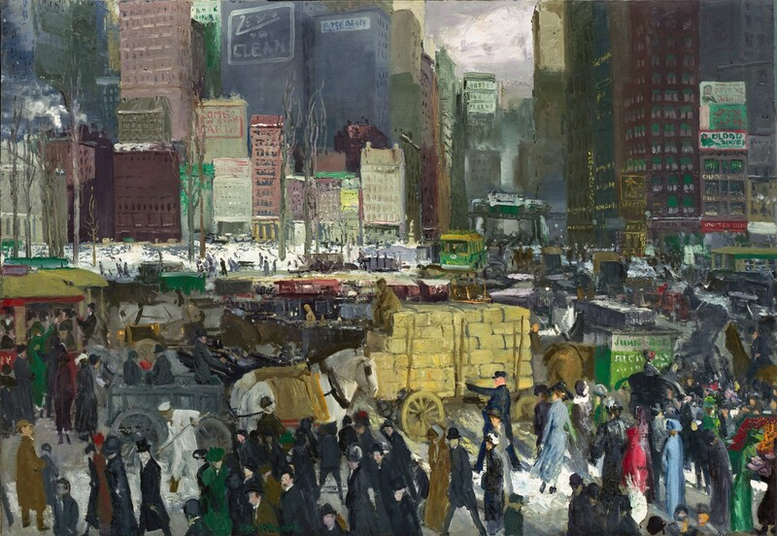
New York, 1911, Oil on canvas. 106.7 x 152.4 cm. National Gallery of Art, Washington DC, USA https://www.nga.gov/artworks/69392-new-york

Slide 9
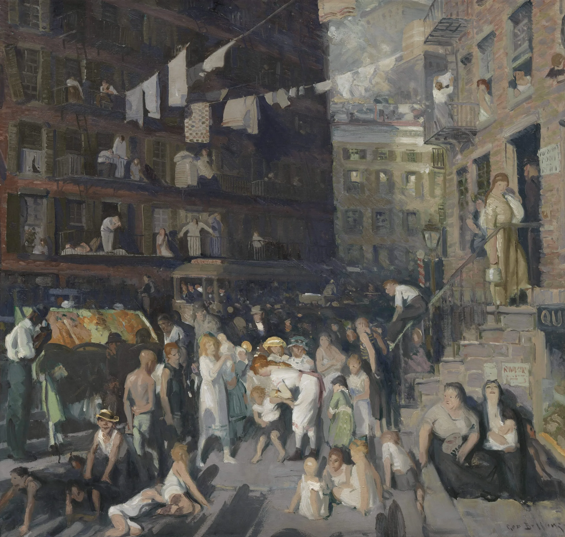
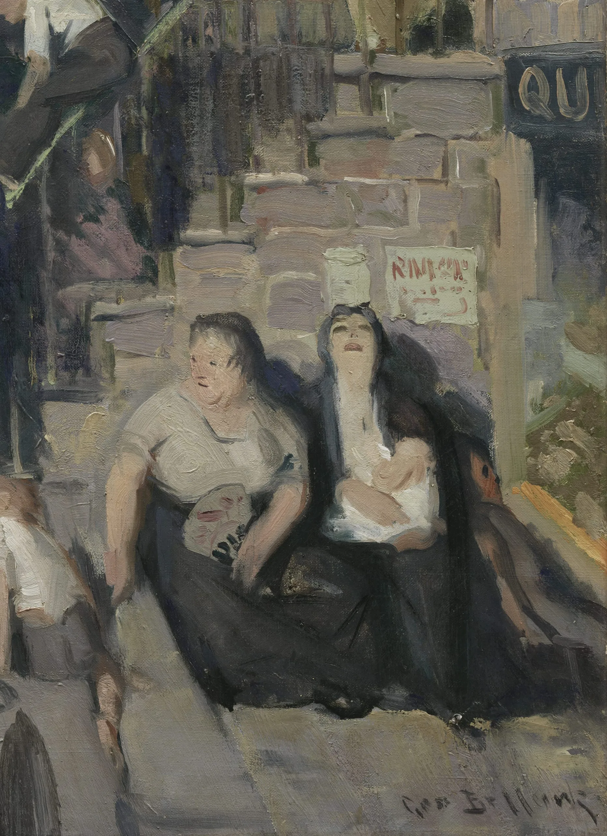
Cliff Dwellers, 1913, Oil on canvas. Los Angeles County Museum of Art, USA https://collections.lacma.org/object/11398

Slide 10
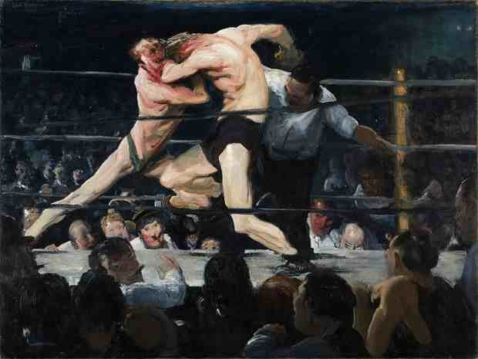
Stag at Sharkeys, 1909, Oil on canvas, 110 x 140.5 x 8.5 cm, The Cleveland Museum of Art, USA https://www.clevelandart.org/art/1922.1133

Slide 11
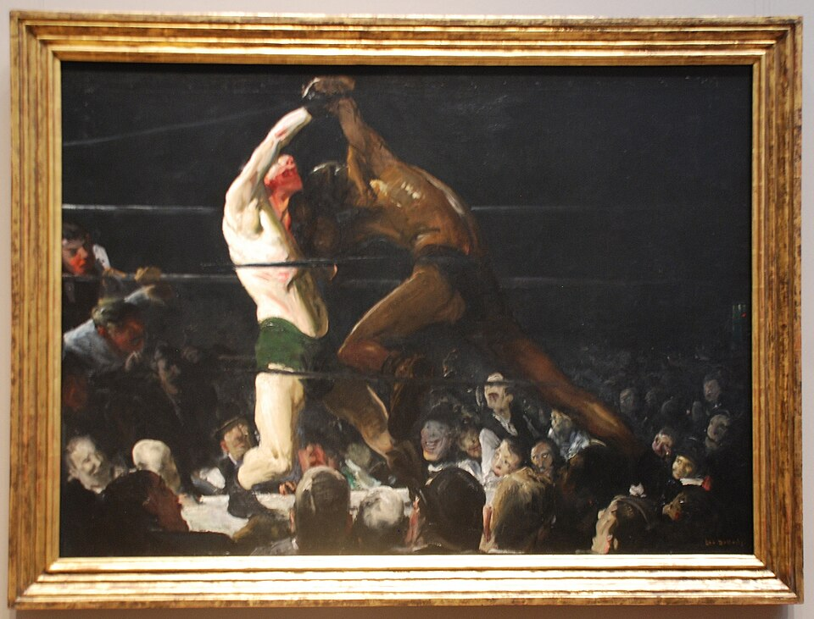
Both Members of This Club, 1909, Oil on canvas, 115 x 160.5 cm, NGA, Washington DC, USA https://commons.wikimedia.org/wiki/File:George_Bellows_-_Both_Members_of_This_Club.jpg

Slide 12
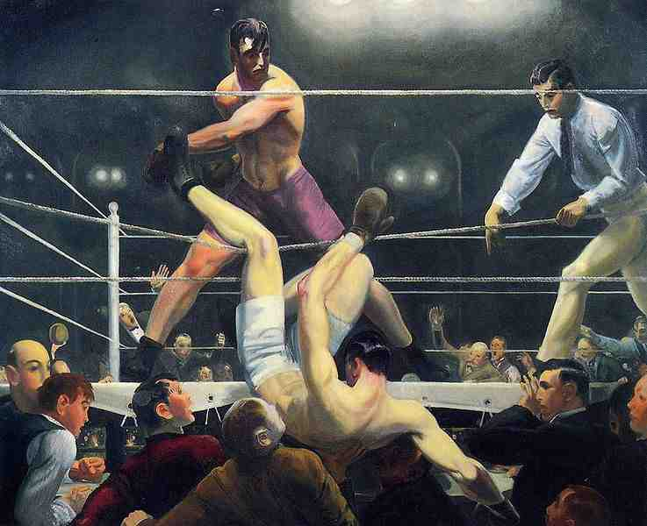
George Dempsey and Firpo, 1924, Oil on canvas, 129.9 × 160.7 cm, Whitney Museum of American Art, NY, USA https://en.wikipedia.org/wiki/Dempsey_and_Firpo#/media/File:Bellows_George_Dempsey_and_Firpo_1924.jpg

Slide 13
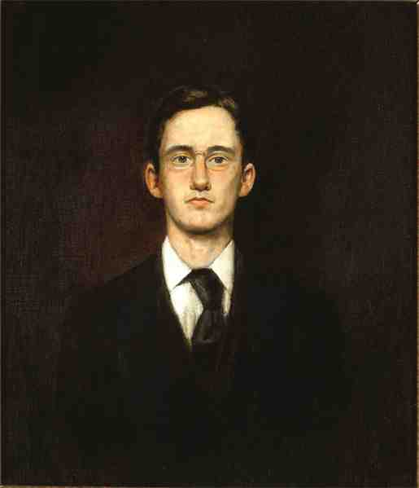
John Sloan,
1871–1951
Self-Portrait, 1890, Oil on panel, 35.6 × 30.2 cm, Delaware Art Museum, USA https://emuseum.delart.org/objects/6818/selfportrait

Slide 14
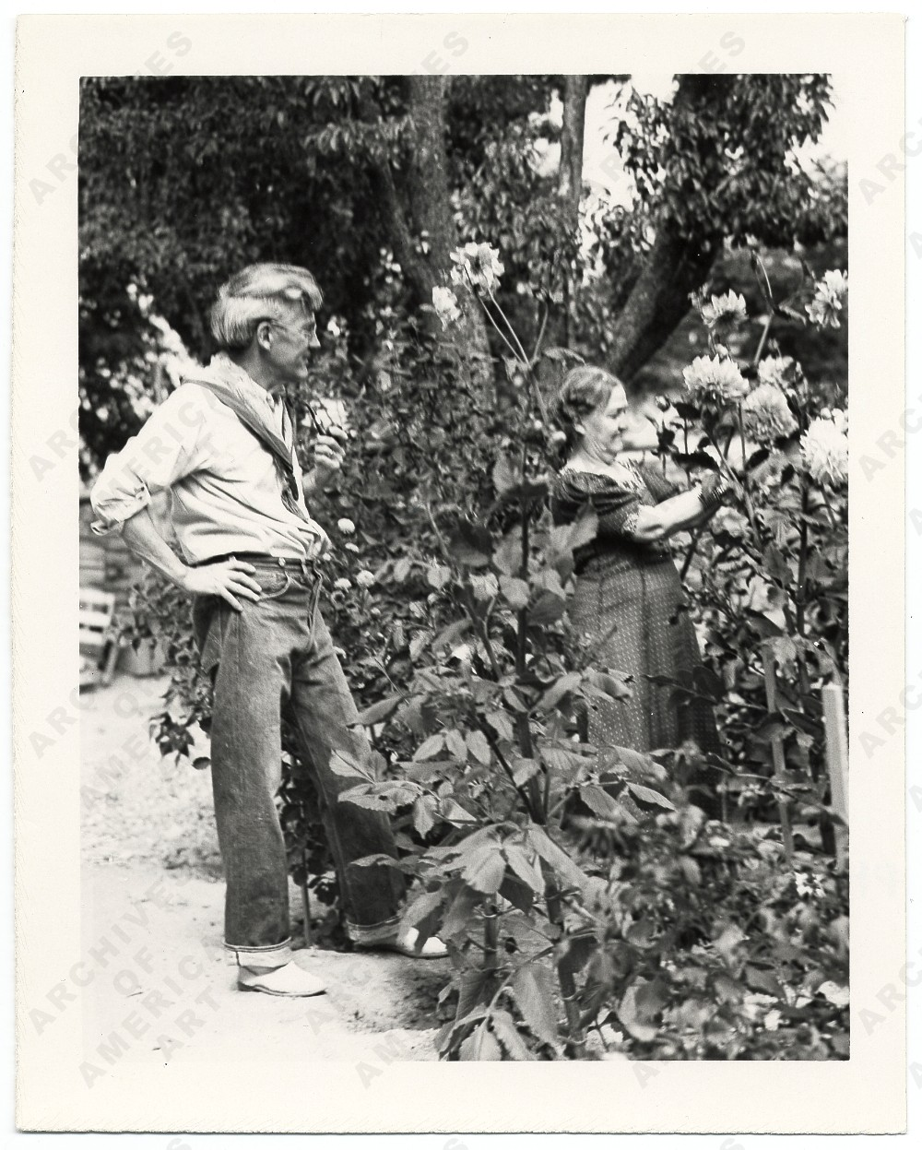
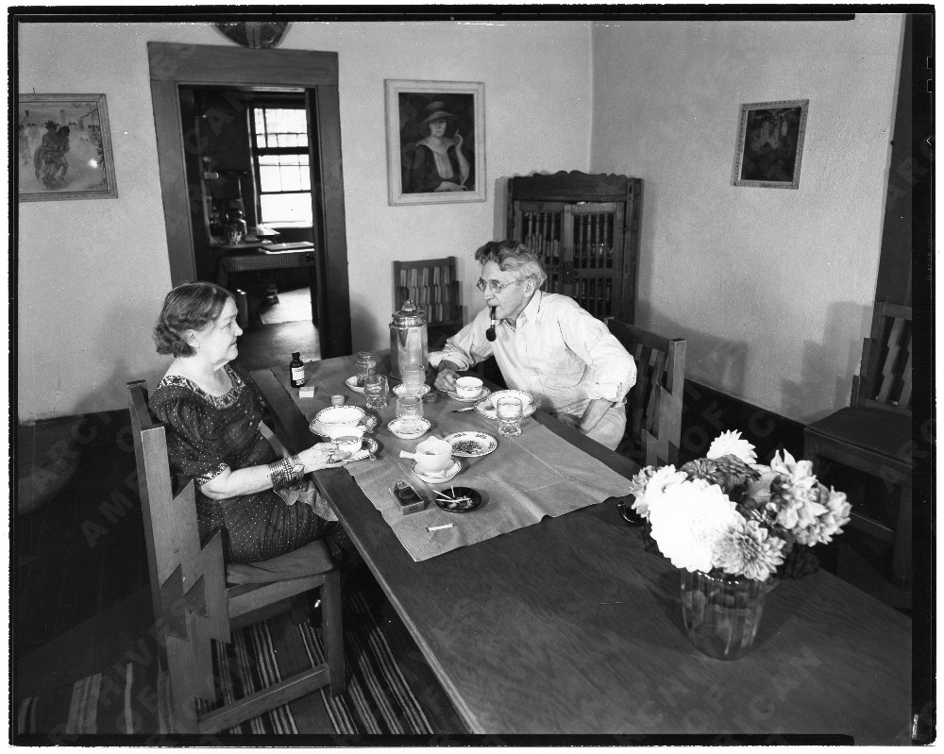
John and Dolly Sloan in their house in Santa Fe, 1939, Smithsonian, USA https://www.aaa.si.edu/collections/items/detail/dolly-and-john-sloan-seated-table-their-santa-fe-home-2709

Slide 15
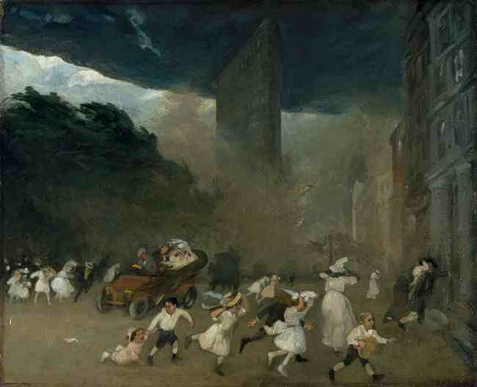
Dust Storm, Fifth Avenue, 1906, Oil on canvas, 55.9 x 68.6 cm, The MET, NY, USA https://www.metmuseum.org/art/collection/search/19264
, NY

Slide 16
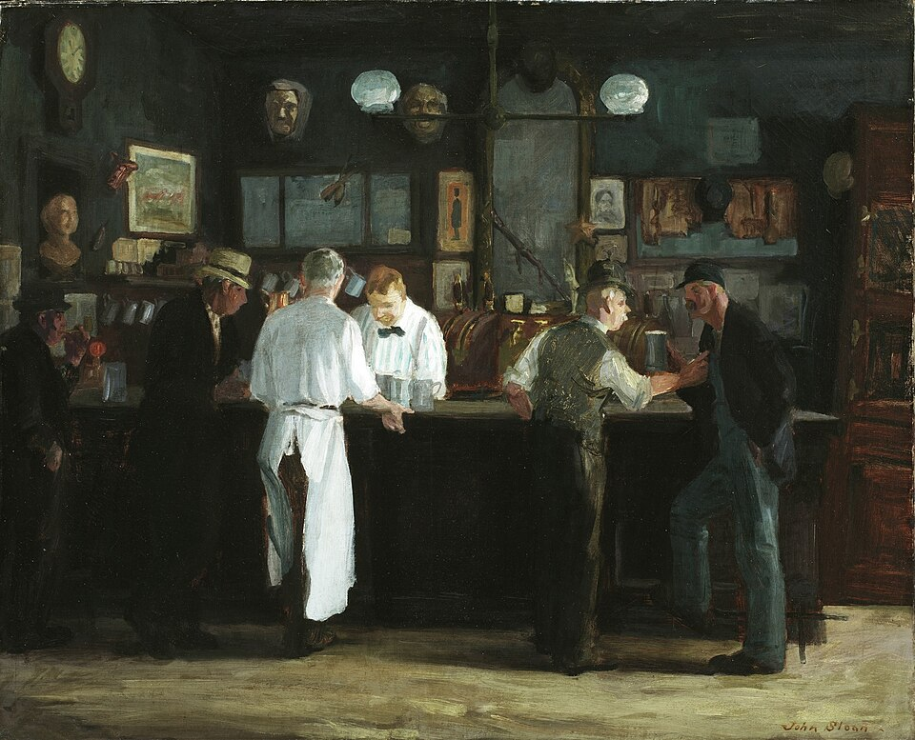
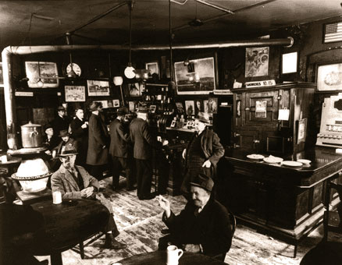
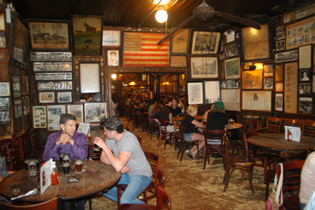
McSorley’s Bar, 1912, 26 x 32 in. 66.0 x 81.3 cm, Oil on canvas, Detroit Institute of Arts, USA
McSorley's Old Ale House, Est. 1854, 15 E. 7th St. Old McSorley's motto: "Good Ale, Raw Onions and No Ladies“ https://commons.wikimedia.org/wiki/File:McSorley%27s_Bar_1912_John_Sloan.jpg

Slide 17
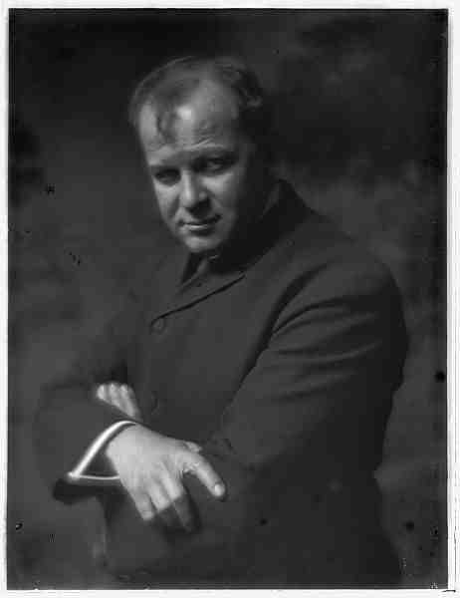
George Luks, 1866–1933
Photo c. 1910 https://www.paulgravett.com/articles/article/george_luks/

Slide 18
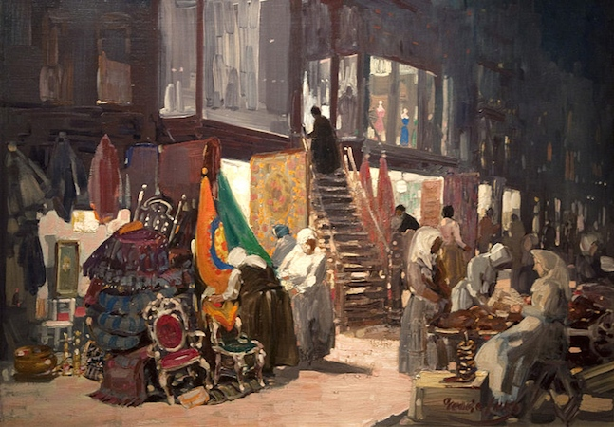
Allen Street, c. 1905, Oil on canvas, 81.3 × 114.3 cm, Hunter Museum of American Art, Chattanooga, Tennessee, USA https://www.wikiart.org/en/george-luks/allen-street-1905

Slide 19
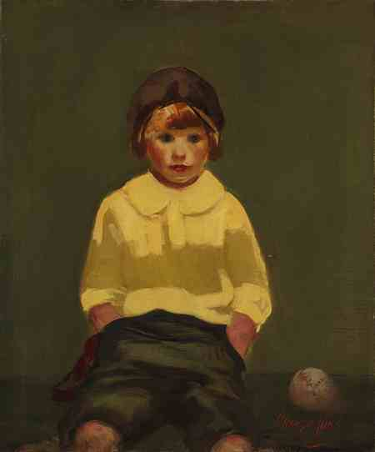
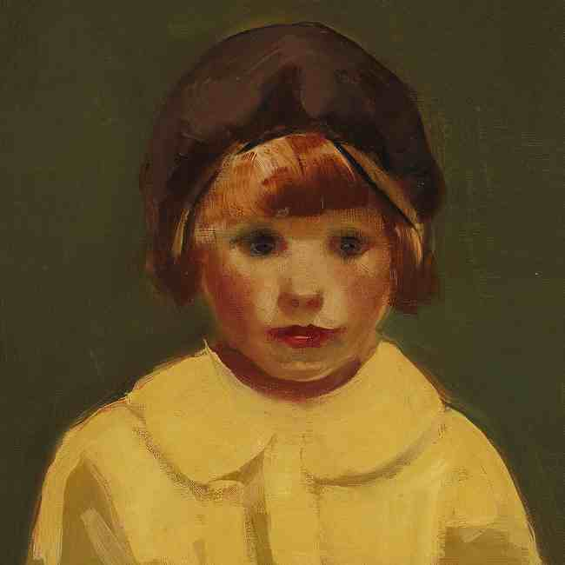
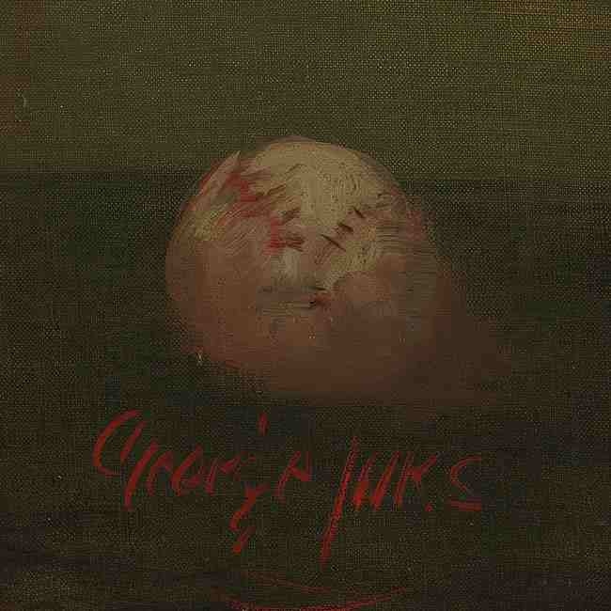
Boy with Baseball, ca. 1925, Oil on canvas, 76.2 x 63.5 cm, The MET, NY, USA https://www.metmuseum.org/art/collection/search/19316

Slide 20
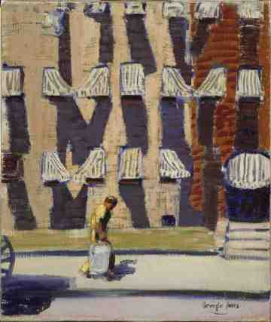
Noontime, St Botolph
Street, Boston, 1923, Oil on canvas, 76.83 x 64.13 cm,
MFA, Boston, USA https://www.wikiart.org/en/george-luks/noontime-st-botolph-street-boston-1928

Slide 21
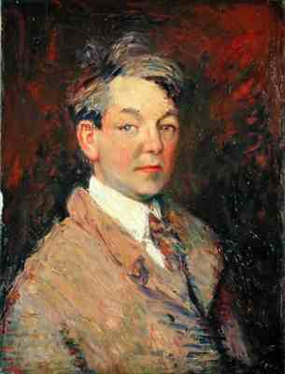
William James Glackens, 1870 – 1938
Self-Portrait, 1908, Oil on canvas, 60.96 cm, The Barnes Foundation, Philadelphia, USA https://collection.barnesfoundation.org/objects/5159/Self-Portrait/

Slide 22
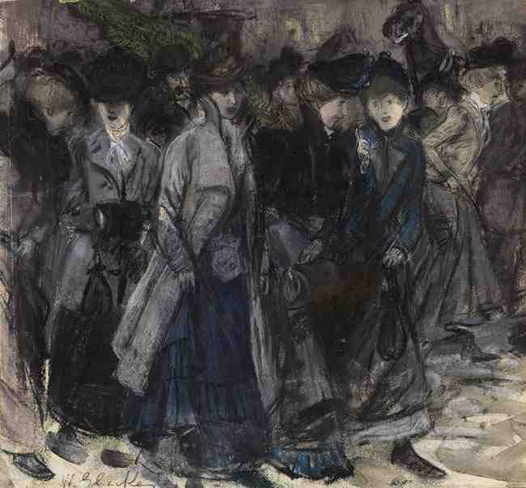
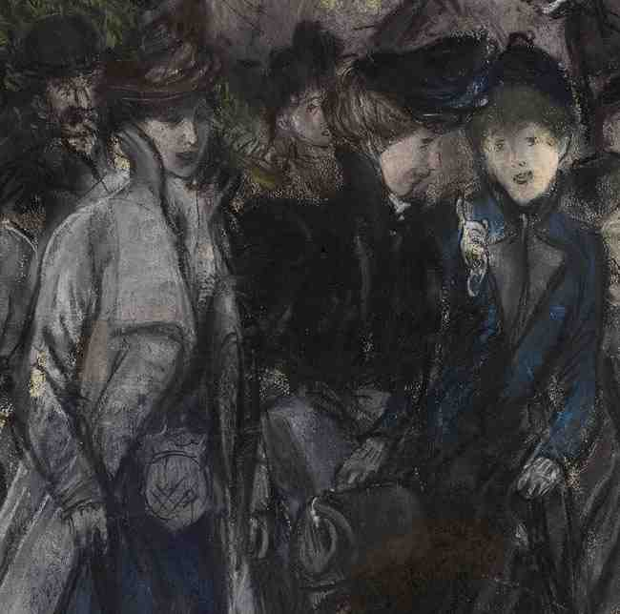
Shop Girls, ca. 1900, Pastel and watercolor on illustration board, 34.6 x 36.5 cm, The MET, NY, USA https://www.metmuseum.org/art/collection/search/19265

Slide 23
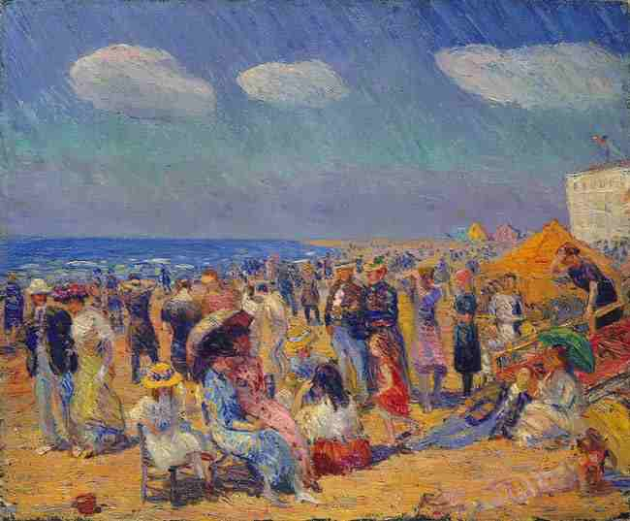
Crowd at the Seashore, ca. 1910, Oil on canvas, 63.5 x 76.2 cm, The MET, NY, USA https://www.metmuseum.org/art/collection/search/19335

Slide 24
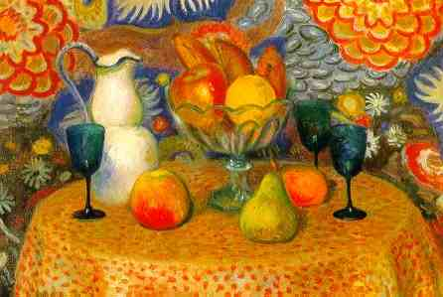
Still Life with Three Glasses, c. mid-1920s,Oil on canvas, 50.80 x 73.66 cm, Butler Institute, OH, USA http://198.199.96.172/museum/details/view/sshow/id/94/pictureId/2482

