Slide 1
Pierre Bonnard
1867 – 1947
17 Paintings

Slide 2
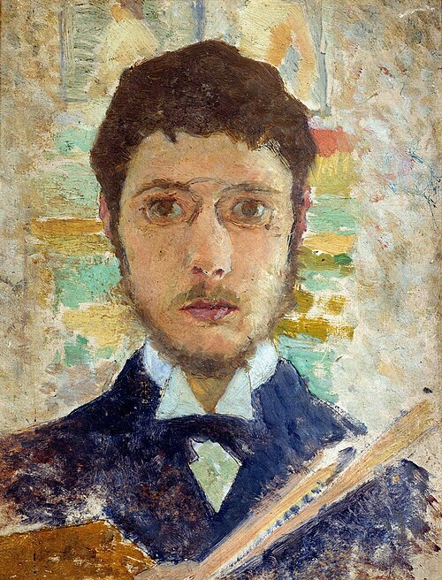
Self-portrait, 1889, tempera on canvas, 21.5x15.8 cm, Private collection https://commons.wikimedia.org/wiki/File:Self-portrait-1889.jpg

Slide 3
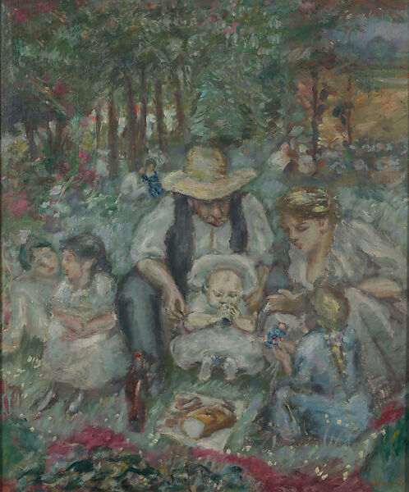
The Family of Claude Terrasse, 1899, oil on canvas, 82.6 × 68.6 cm

Slide 4
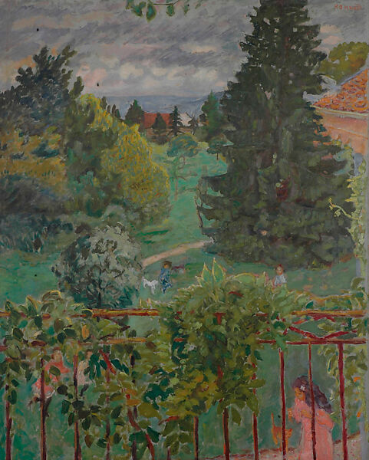
From the Balcony, 1909, oil on canvas, 124.8 × 99.4 cm

Slide 5
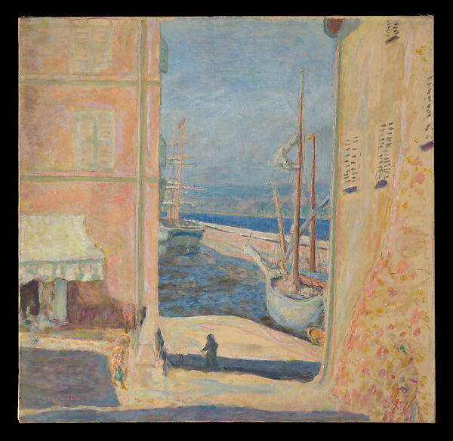
View of The Old Port, Saint-Tropez, 1911, oil on canvas, 84.1 × 86.4 cm

Slide 6
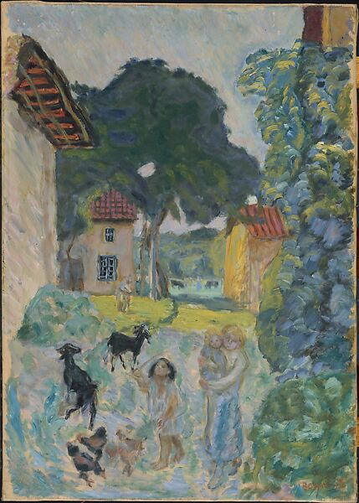
Village Scene, Grasse, 1912, oil on canvas, 73.7 × 52.1 cm

Slide 7
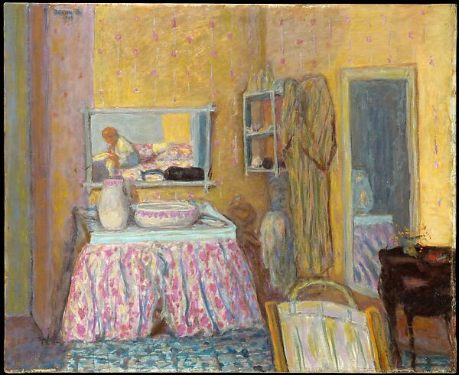
The Dressing Room, 1914, oil on canvas, 72.1 x 88.3 cm

Slide 8
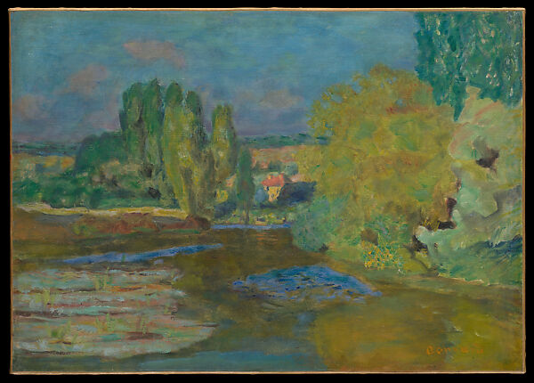
House on the Seine near Vernon, 1916, oil on canvas, 34.9 × 48.3 cm

Slide 9
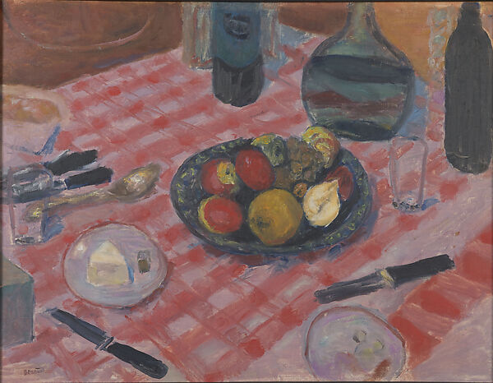
The Checkered Tablecloth, 1916, oil on canvas, 50.8 × 67 cm

Slide 10
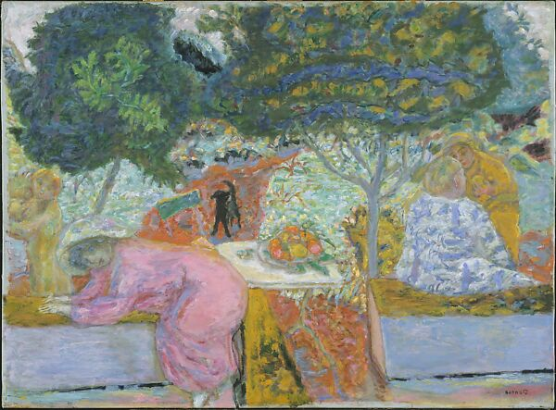
Morning in the Garden at Vernonnet, 1917, oil on canvas, 85.7 x 113.7 cm

Slide 11
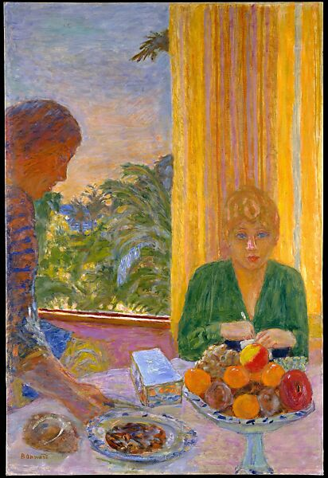
The Green Blouse, 1919, oil on canvas, 102.1 × 68.6 cm

Slide 12
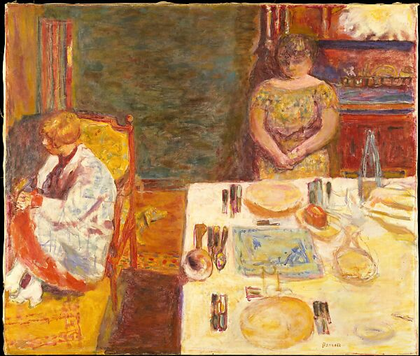
Before Dinner, 1924, oil on canvas, 90.2 x 106.7 cm, the MET, NY, USA

Slide 13
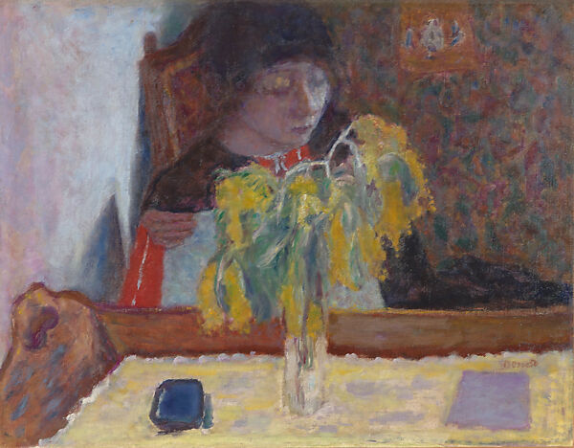
Woman with Mimosa, 1924, oil on canvas, 48.3 × 61.9 cm

Slide 14
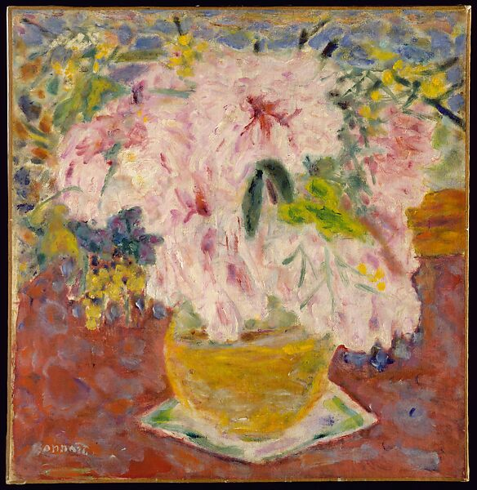
Pink Bouquet, ca. 1930, oil on canvas, 50.8 x 48.9 cm

Slide 15
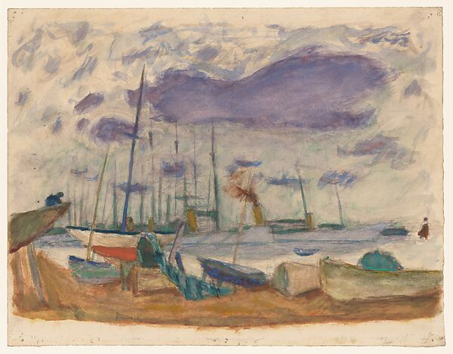
Le Port de Cannes, 1935, watercolor and gouache and graphite on paper, 24.8 x 32.1 cm

Slide 16
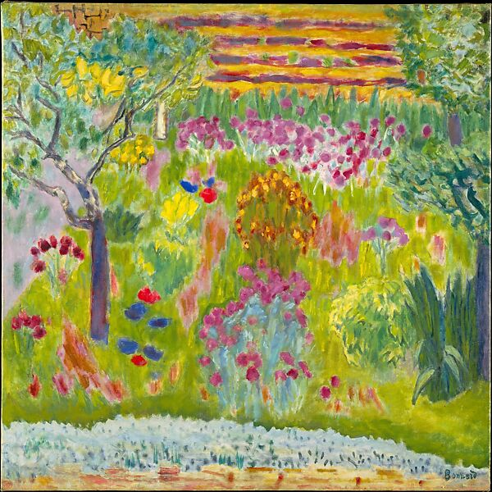
Garden, ca. 1935, oil on canvas,
90.2 × 90.5 cm

Slide 17
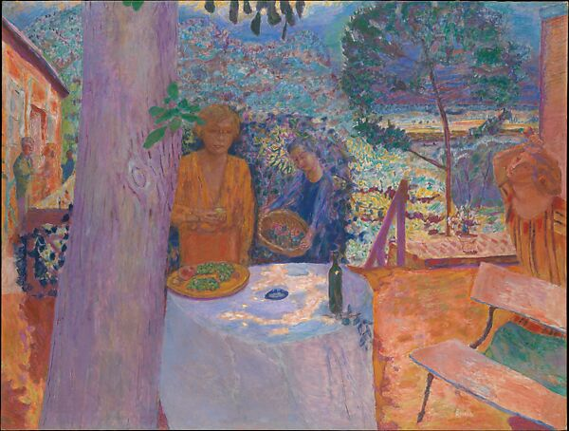
The Terrace at Vernonnet, 1939, oil on canvas, 148 × 194.9 cm

Slide 18
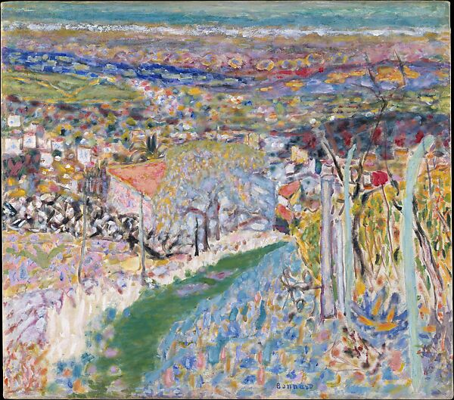
Landscape in the South (Le Cannet), ca. 1943, oil on canvas, 64.1 x 71.1 cm

Slide 19
All paintings by Pierre Bonnard presented in this PowerPoint presentation, with the exception of the Self-Portrait, are housed in the collection of The Metropolitan Museum of Art, New York.
Image & Photo Credits: The Metropolitan Museum of Art — Pierre Bonnard Collection

