Slide 1
Nikos Lytras
1883-1927
10 Paintings

Slide 2
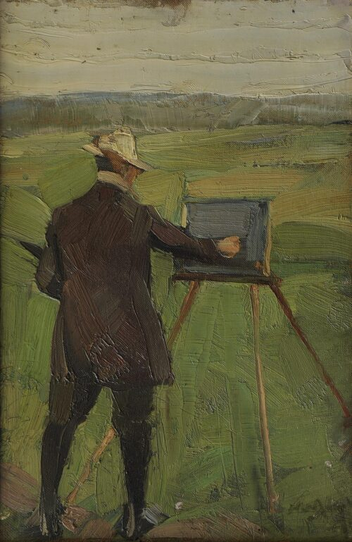
The Painter Umbertos Argyros, 1909 -1910
Oil on pasteboard, 50 x 34 cm

Slide 3
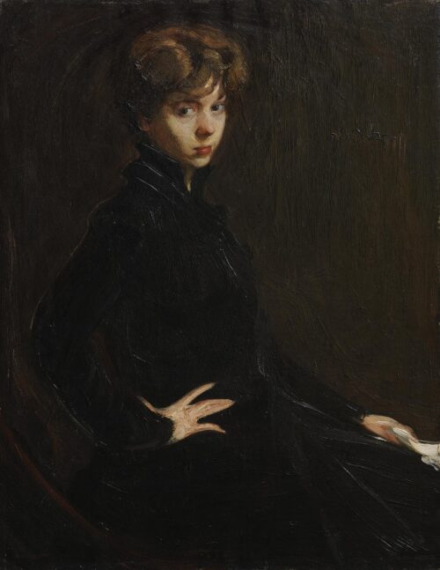
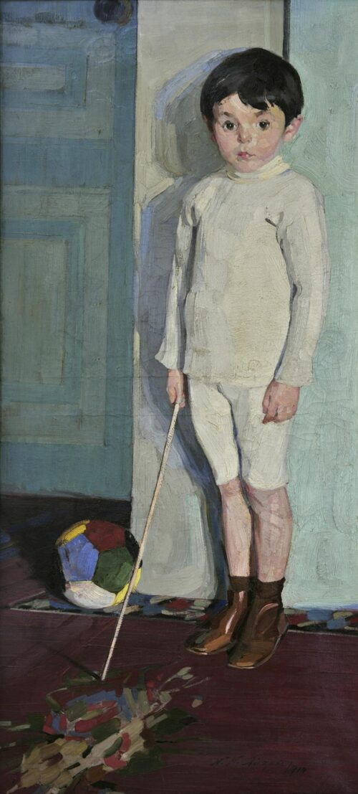
Portrait of Miss M. Horsch, ca. 1916-1917, Oil on canvas, 110 x 84 cm
Portrait of the Little
[Konstantinos] Montesantos, 1914
Oil on canvas, 130 x 60 cm

Slide 4
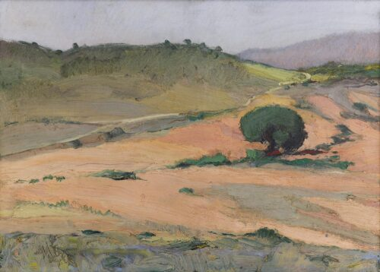
Kokkinaras, 1915 – 1927, Oil on canvas, 50 x 70 cm

Slide 5
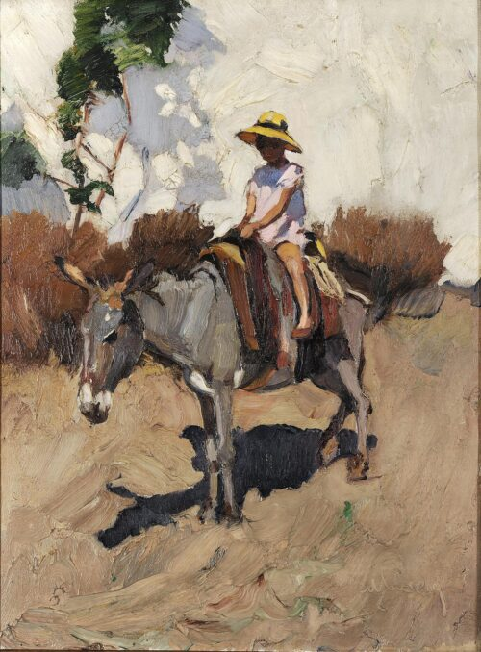
The Donkey, 1923 – 1926, Oil on canvas, 88,7 x 66,2 cm

Slide 6
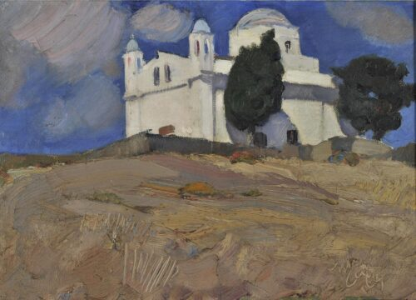
Tinos, Agios Dimitrios, Karia, 1923, Oil on canvas, 53 x 73 cm

Slide 7
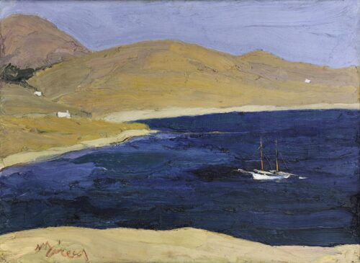
Seascape, ca 1925, Oil on canvas, 53 x 73 cm

Slide 8
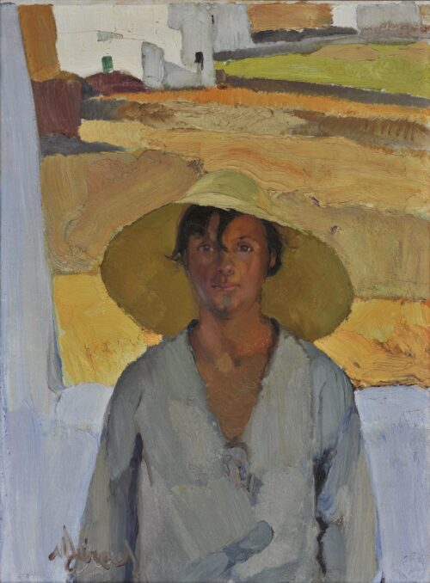
The Staw Hat, ca 1925, Oil on canvas,
86 x 66 cm

Slide 9
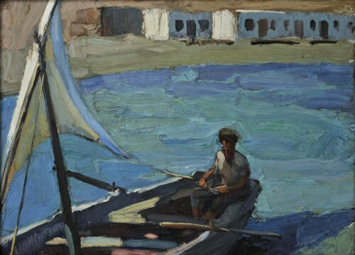
Boat with Sail (Panormos, Tinos), ca 1925, Oil on canvas, 53 x 73 cm

Slide 10
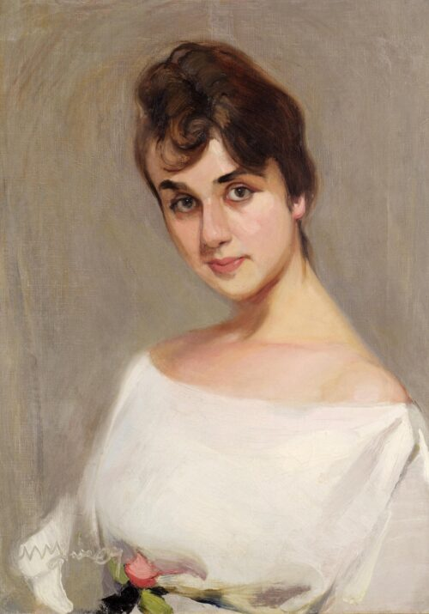
Portrait of Kaiti Katsoyiannis, 1925 – 1926, Oil on canvas, 69,5 x 52 cm

Slide 11
All paintings by Nikos Lytras are part of the Collection of the National Gallery of Greece
Photo Credit: https://www.nationalgallery.gr/en/artist/lytras-nikos/

