Slide 1
Vikentios (Vicenzo) Lanza
1822-1902

Slide 2
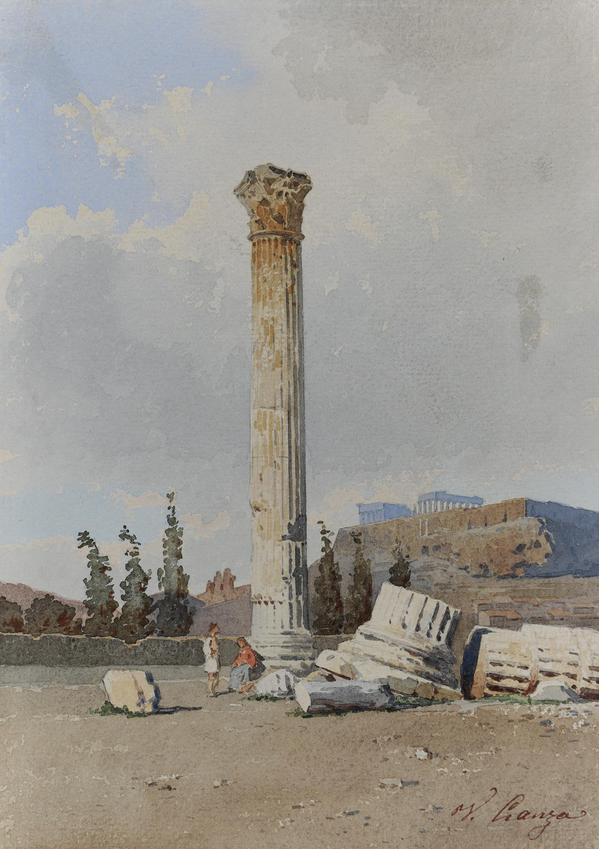
The Temple of Olympian Zeus – The Acropolis, Water colour, 26 x 18 cm, National Gallery of Greece, Athens, Greece https://www.nationalgallery.gr/en/artist/lanza-vicenzo/

Slide 3
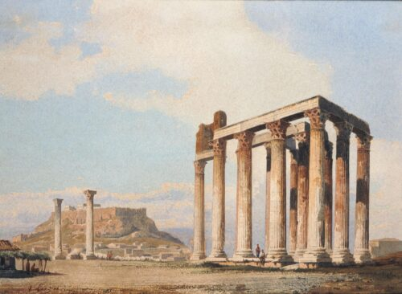
The Columns of the Temple of Olympian Zeus, Watercolour, 18 x 25 cm, National Gallery of Greece, Athens, Greece https://www.nationalgallery.gr/en/artist/lanza-vicenzo/

Slide 4
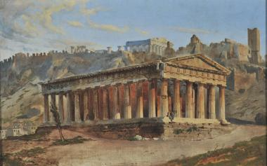
Thision, ca 1860, Oil on canvas, 35 x 55 cm, National Gallery of Greece, Athens, Greece https://www.nationalgallery.gr/en/artist/lanza-vicenzo/

Slide 5
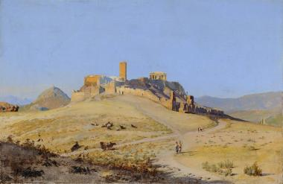
The Acropolis, 1860, Oil on canvas, 37 x 56 cm, National Gallery of Greece, Athens, Greece https://www.nationalgallery.gr/en/artist/lanza-vicenzo/

Slide 6
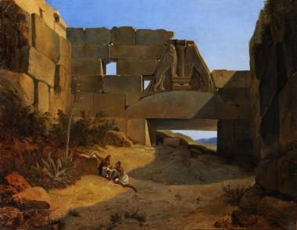
The Lion Gate before the Excavations, 1882, Oil on canvas, 37 x 48 cm, National Gallery of Greece, Athens, Greece https://www.nationalgallery.gr/en/artist/lanza-vicenzo/

Slide 7
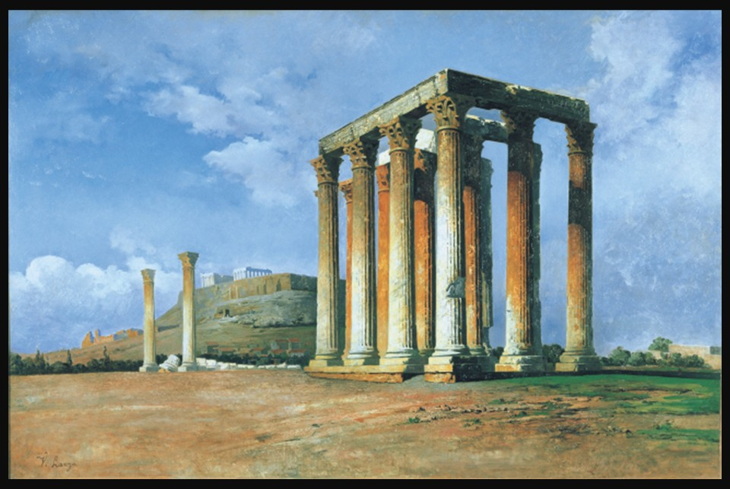
Columns of Olympian Zeus, Oil on canvas, 73x110 cm, The Averoff Museum of Μοdern Greek Art, Metsovo, Greece https://www.averoffmuseum.gr/en/paintings/columns-olympian-zeus

Slide 8
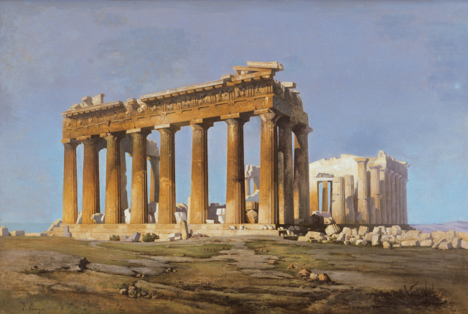
The Parthenon, Oil on canvas, 73x110 cm, The Averoff Museum of Μοdern Greek Art, Metsovo, Greece https://www.averoffmuseum.gr/en/paintings/parthenon-0

Slide 9
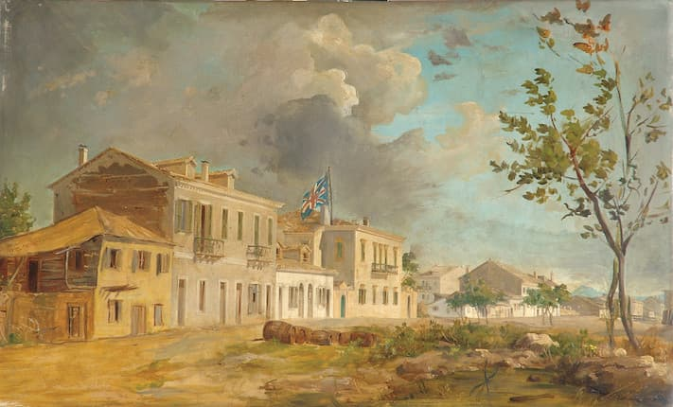
The British consulate at Patras, Oil on panel, 45 x 74 cm, Private Collection https://www.bonhams.com/auction/11461/lot/47/vikentios-lanza-greek-1822-1902-the-british-consulate-at-patras-45-x-74-cm-17-34-x-29-in/

Slide 10
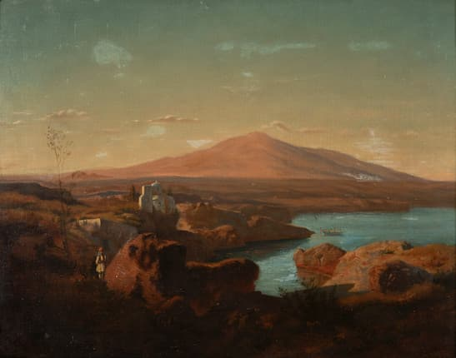
Greek Landscae, Oil on panel, 47 x 60 cm, Private Collection https://www.bonhams.com/auction/27187/lot/67/vicenzo-lanza-italian-1822-1902-paysage-grec-peint-en-1898-signed-and-dated-lower-right-oil-on-canvas/

Slide 11
The End

