Slide 1
John George Brown
1831-1913

Slide 2
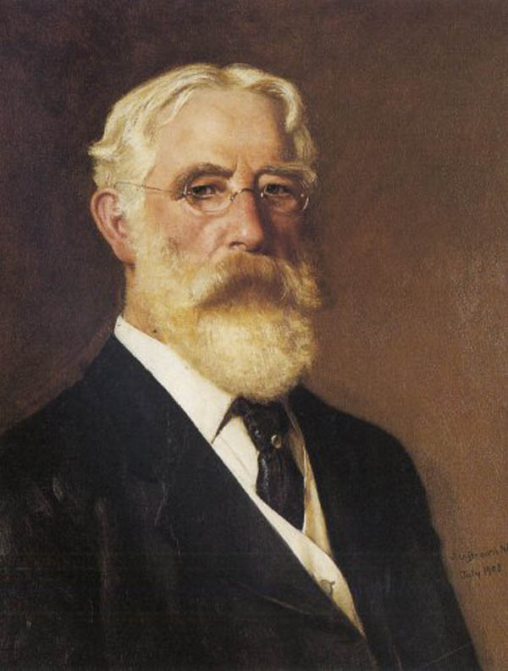
Self-Portrait, 1908, Oil on Canvas, 64.8x50.8 cm, Private Collection https://gr.pinterest.com/pin/411868328407060749/

Slide 3
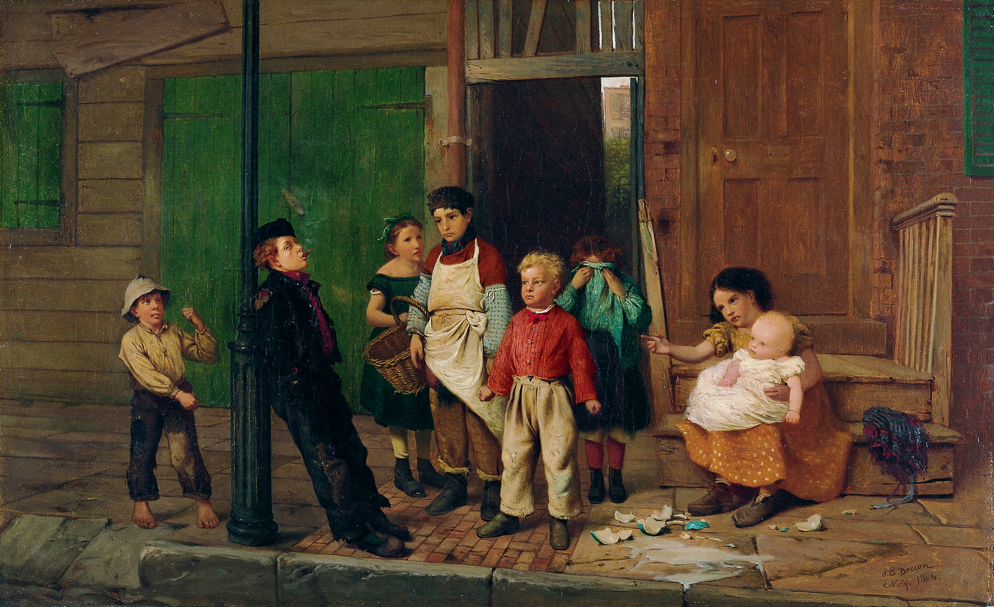
The Bully of the Neighbourhood, 1866, Oil on Canvas. 38.4 x 66.7 cm, Thyssen-Bornemisza National Museum, Madrid, Spain https://www.museothyssen.org/en/collection/artists/brown-john-george/bully-neighbourhood

Slide 4
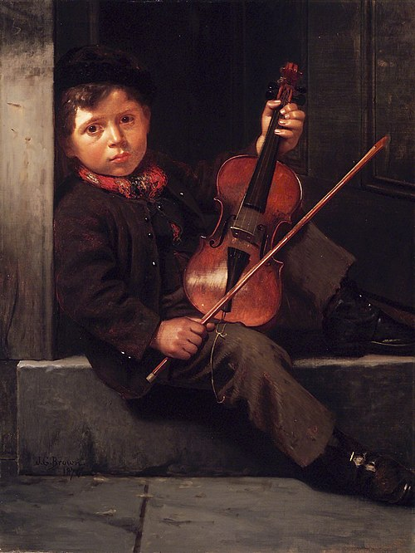
The Boy Violinist, 1874, Oil on Canvas, 101.4x76.7 cm, Brooklyn Museum, NY, USA https://commons.wikimedia.org/wiki/File:Brooklyn_Museum_-_The_Boy_Violinist_-_John_George_Brown_-_overall.jpg

Slide 5
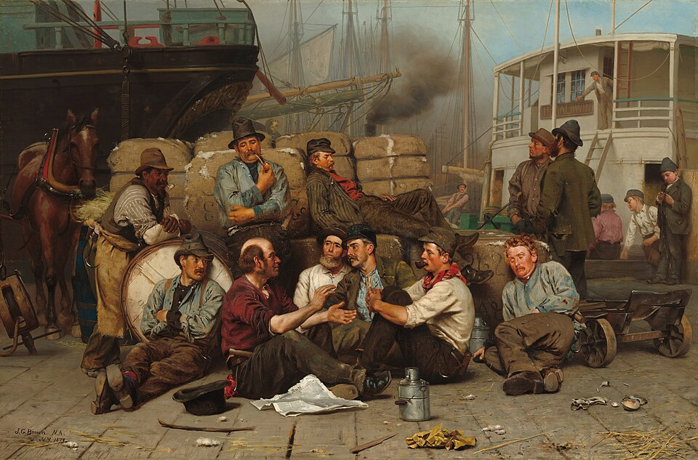
The Longshoremen's Noon, 1978, Oil on Canvas, 84x127.3 cm, National Gallery of Art, Washington DC, USA https://commons.wikimedia.org/wiki/File:John_George_Brown_-_The_Longshoremen%27s_Noon_%281879%29.jpg

Slide 6
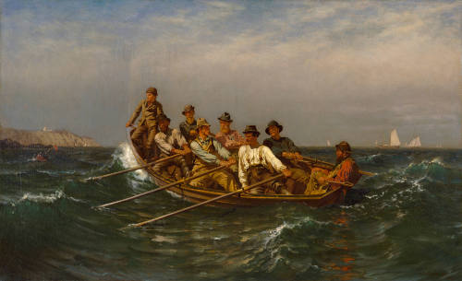
Pull for the Shore, 1878, Oil on Canvas, 86.7 x 142.6 cm, Chrysler Museum of Art, Norfolk, VA, USA https://chrysler.emuseum.com/objects/15524/pull-for-the-shore?ctx=2fae1922763c65ee2bafe7d9dba9a8612877ea02&idx=0

Slide 7
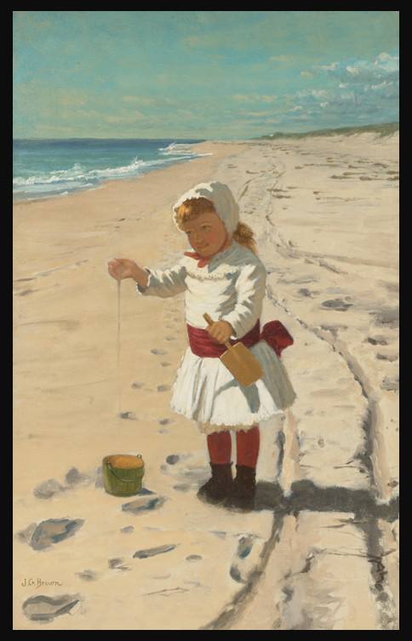
Playing in the Sand at Southampton Beach, 1879-1880, Oil on Canvas, 59.7 x 33 cm, Private Collection https://www.christies.com/en/lot/lot-6570396?ldp_breadcrumb=back

Slide 8
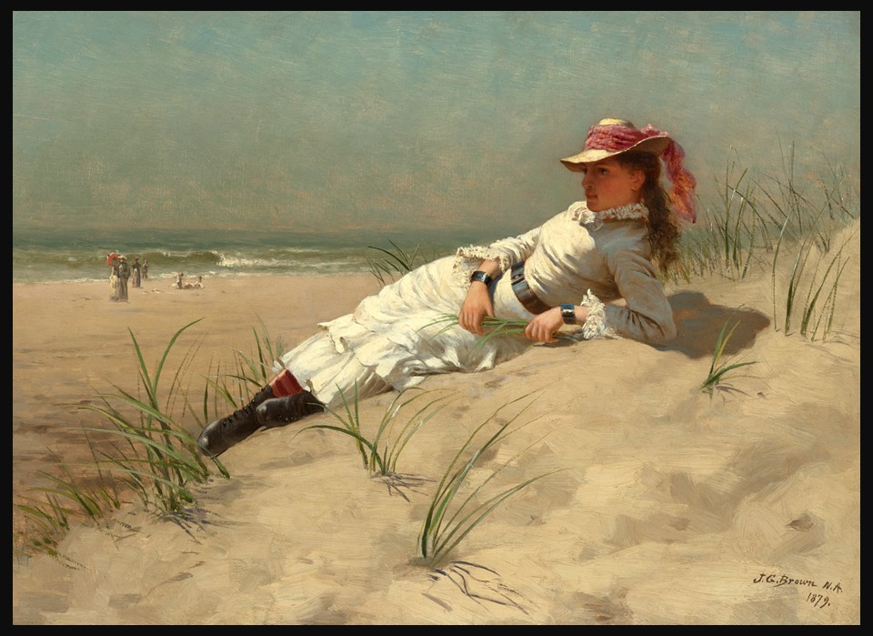
Sunshine, 1879, Oil on Canvas, 35.6 x 50.8 cm, Private Collection https://www.christies.com/en/lot/lot-6519604?ldp_breadcrumb=back

Slide 9
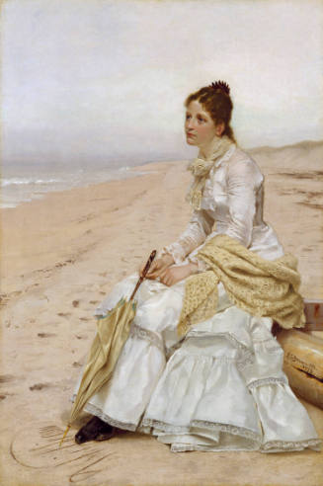
Waiting for William, 1879, Oil on Canvas, 76.2 x 50.8 cm, Chrysler Museum of Art, Norfolk, VA, USA https://chrysler.emuseum.com/objects/6692/waiting-for-william?ctx=2fae1922763c65ee2bafe7d9dba9a8612877ea02&idx=2

Slide 10
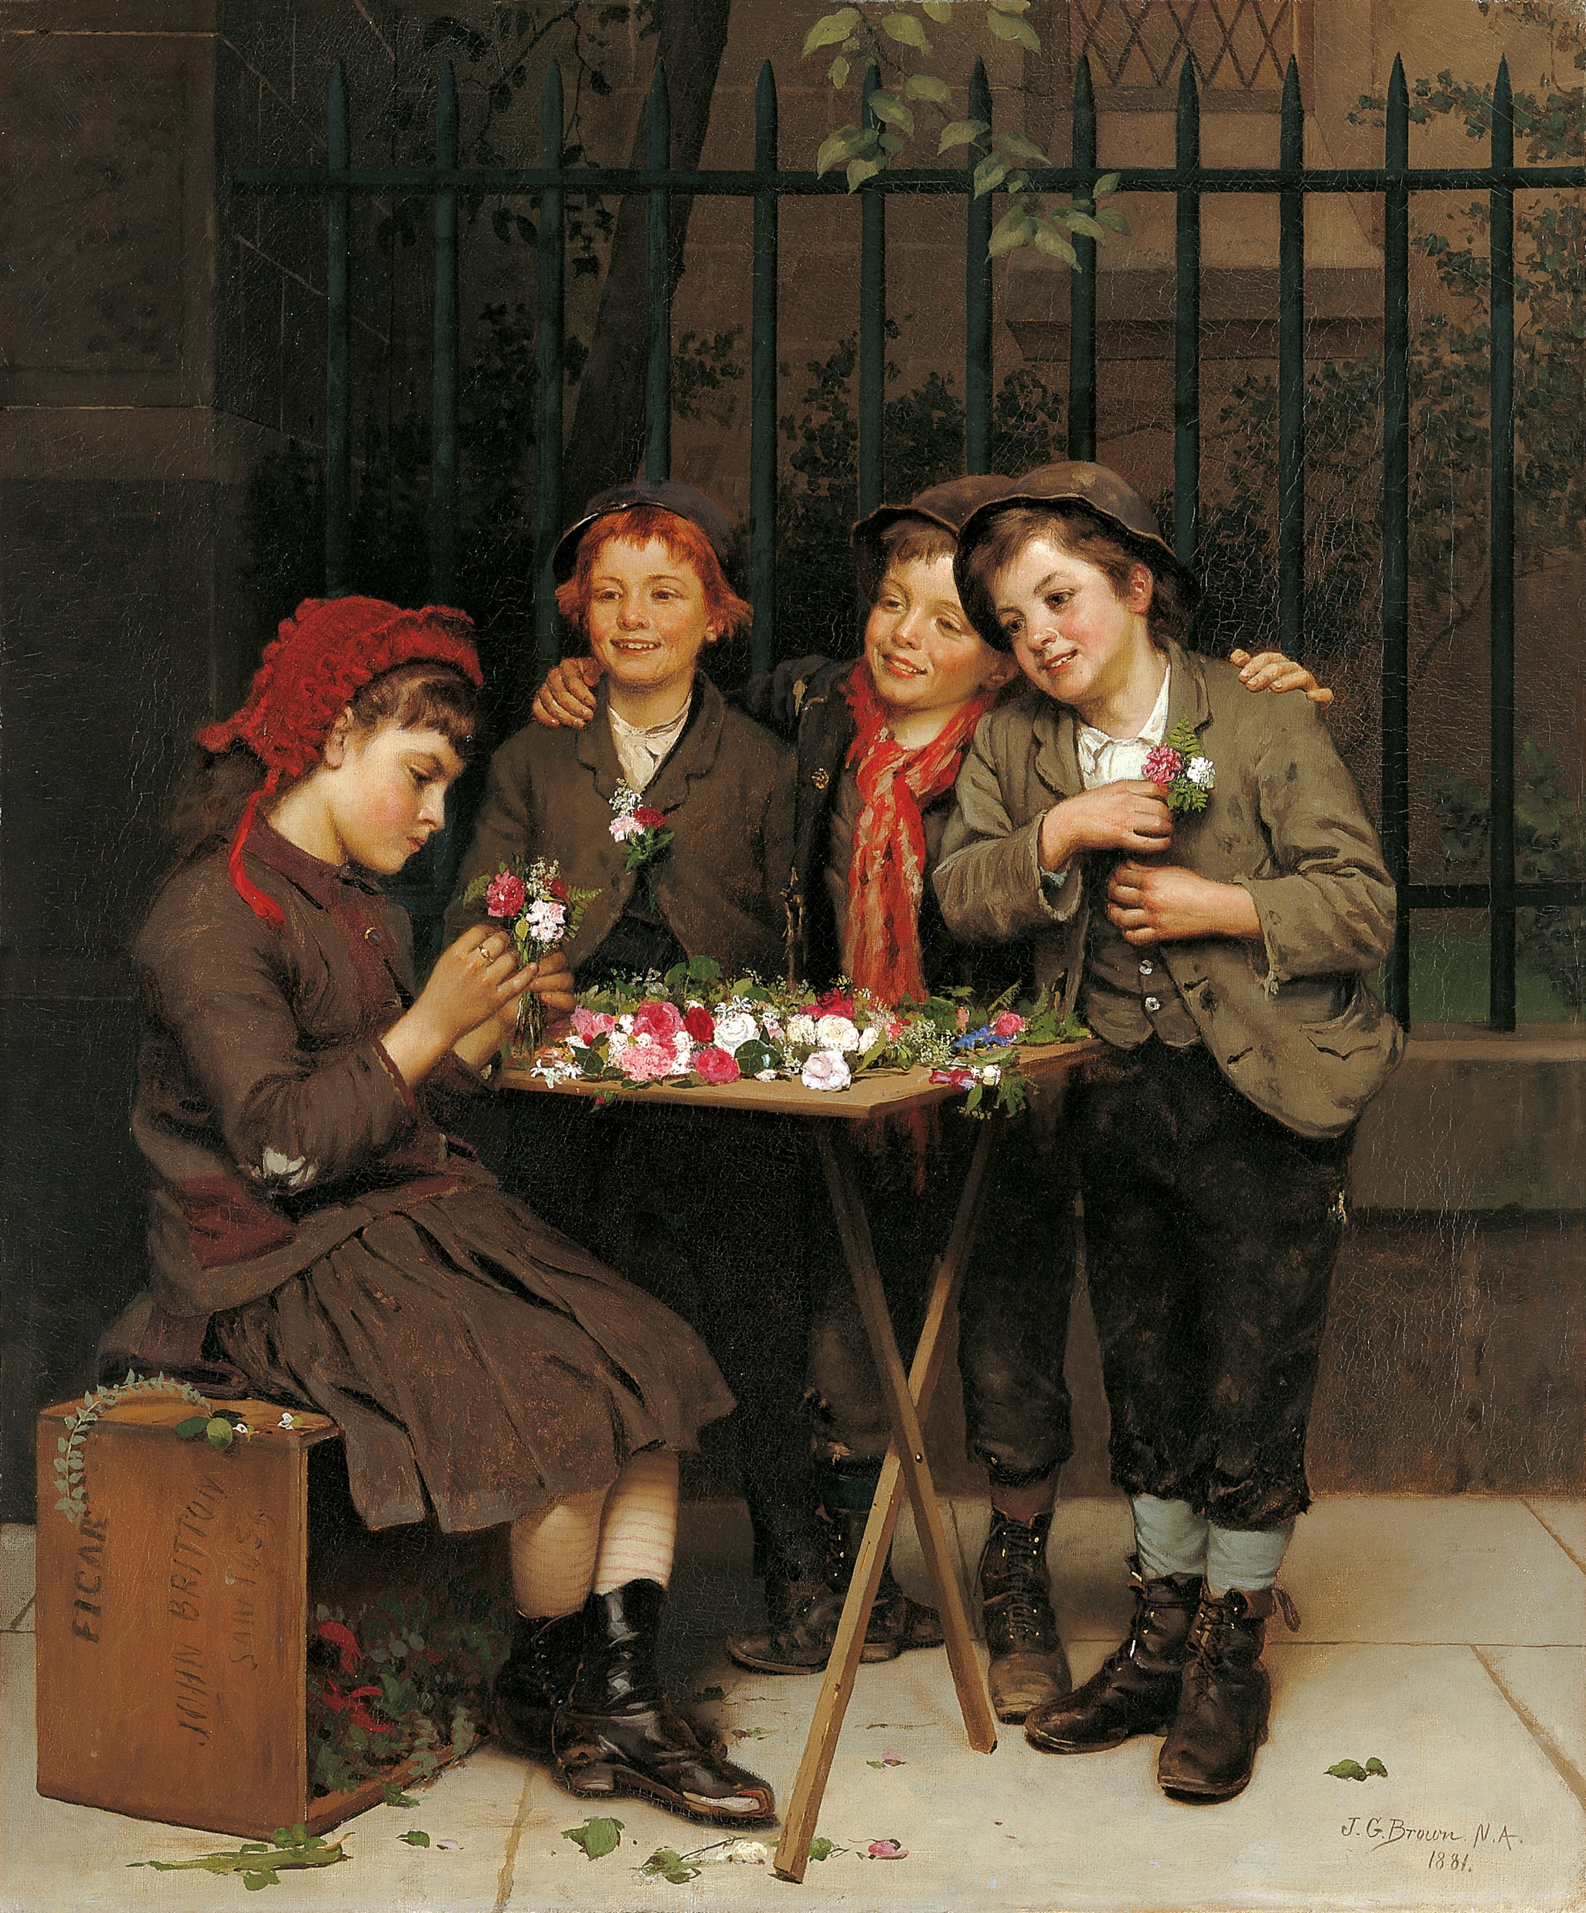
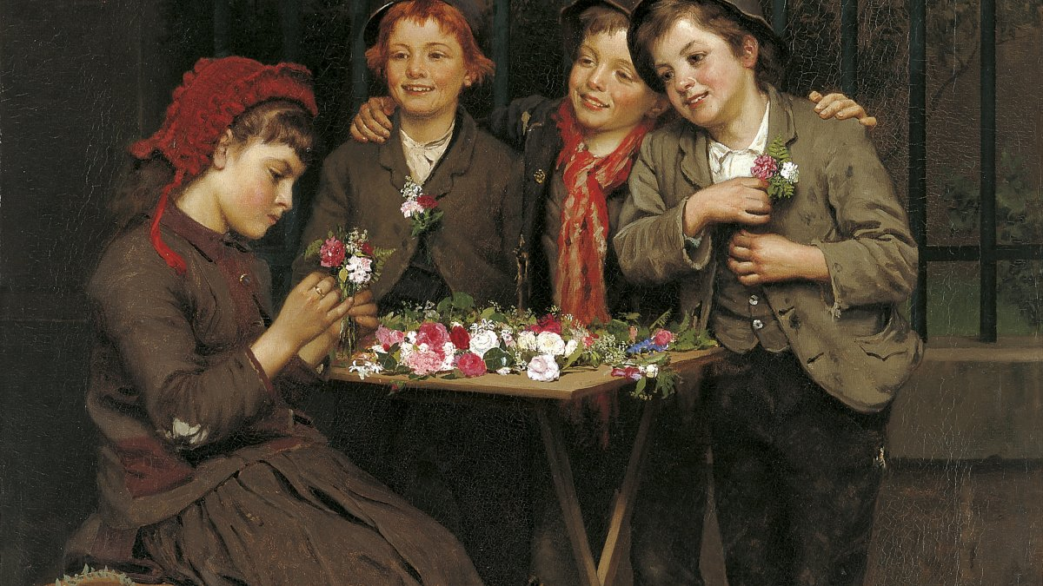
Tough Customers, 1881, Oil on Canvas, 76 x 63.5 cm, Thyssen-Bornemisza National Museum, Madrid, Spain https://www.museothyssen.org/en/collection/artists/brown-john-george/tough-customers

Slide 11
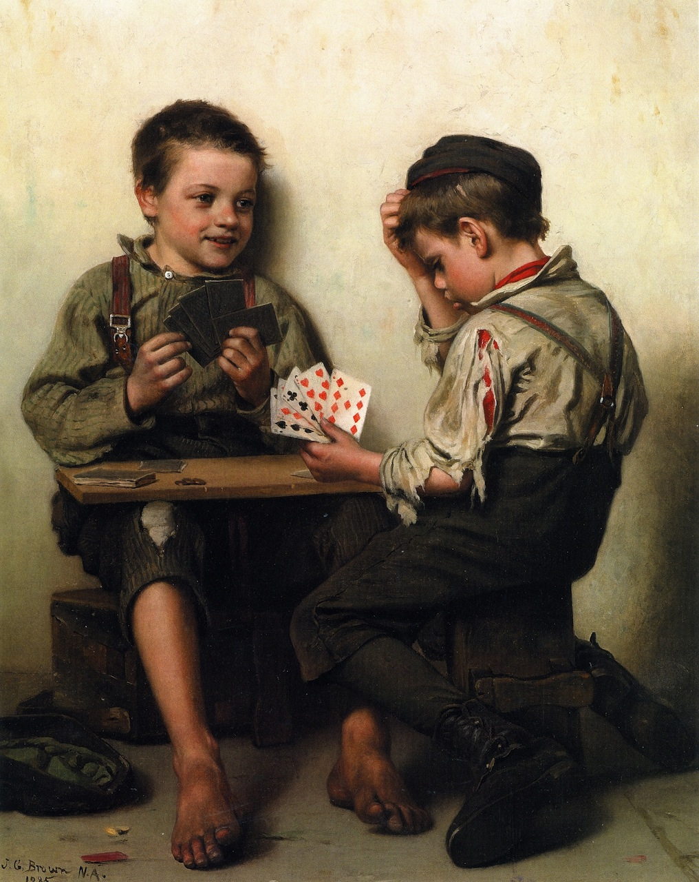
Bluffing, 1885, Oil on Canvas, 63.5 × 26 cm, Private Collection https://upload.wikimedia.org/wikipedia/commons/d/d6/John_George_Brown_-_Bluffing_%281885%29.jpg

Slide 12
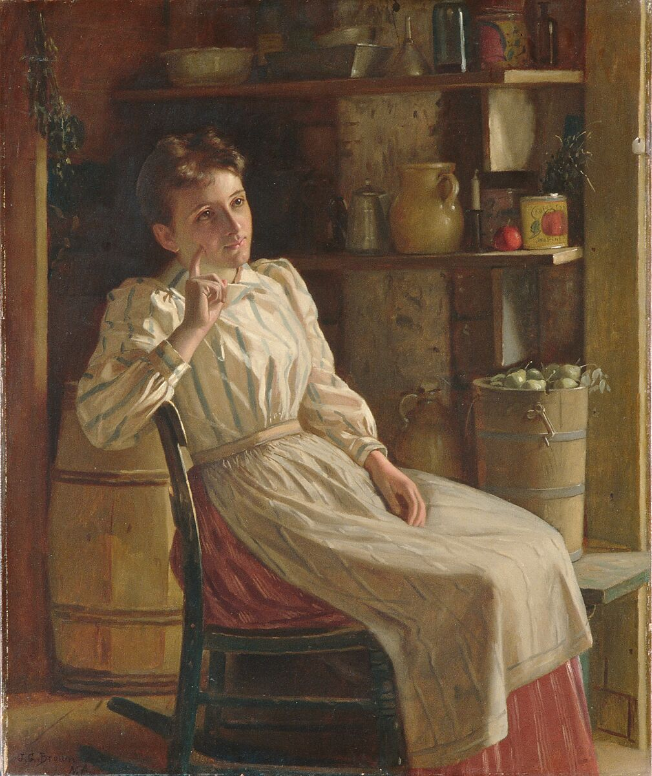
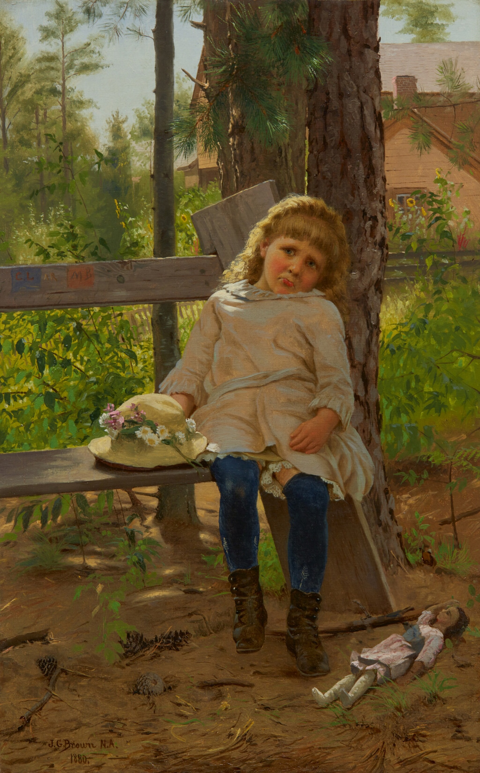
Meditation, ca. 1900–1910, Oil on Canvas, 76.2 x 63.5 cm, the MET, NY, USA https://www.metmuseum.org/art/collection/search/10239
Golden Locks, 1880. Oil on Canvas, 58.7x37.5 cm, Private Collection https://www.sothebys.com/en/buy/auction/2020/american-art/john-george-brown-golden-locks

Slide 13
The End

