Slide 1
Michelangelo Buonarroti,
1475 – 1564
Madonna and Child

Slide 2
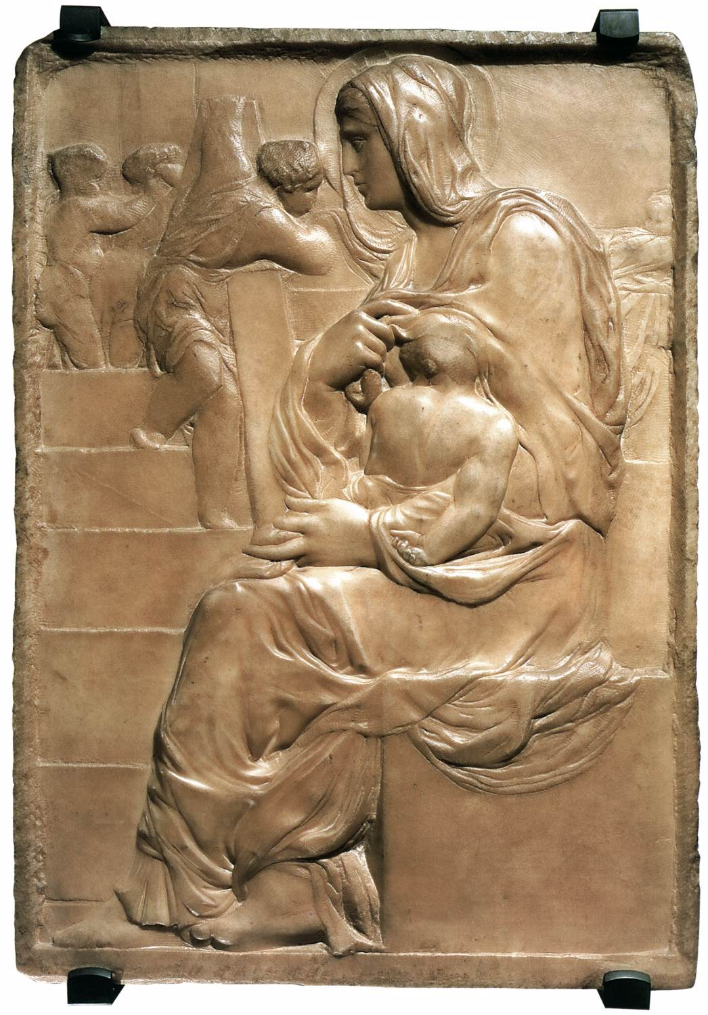
Madonna of the Stairs
1490-92
Marble, 56 x 40 cm
Casa Buonarroti, Florence

Slide 3
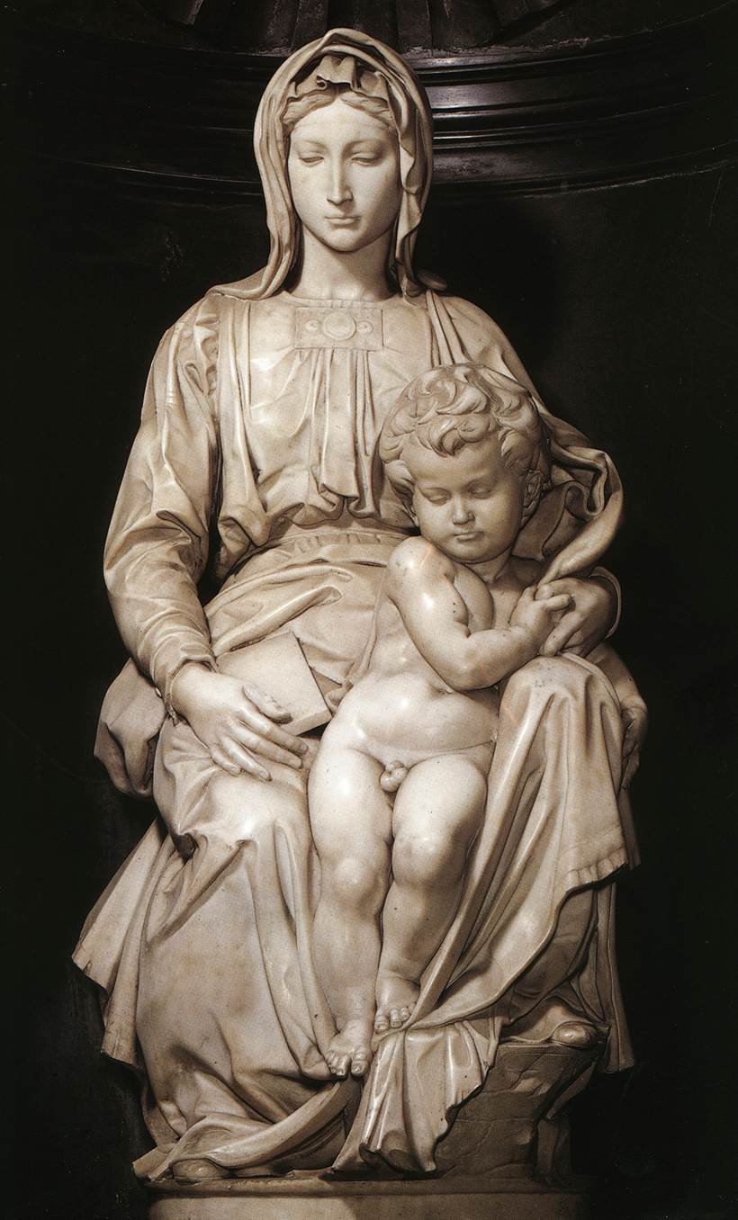
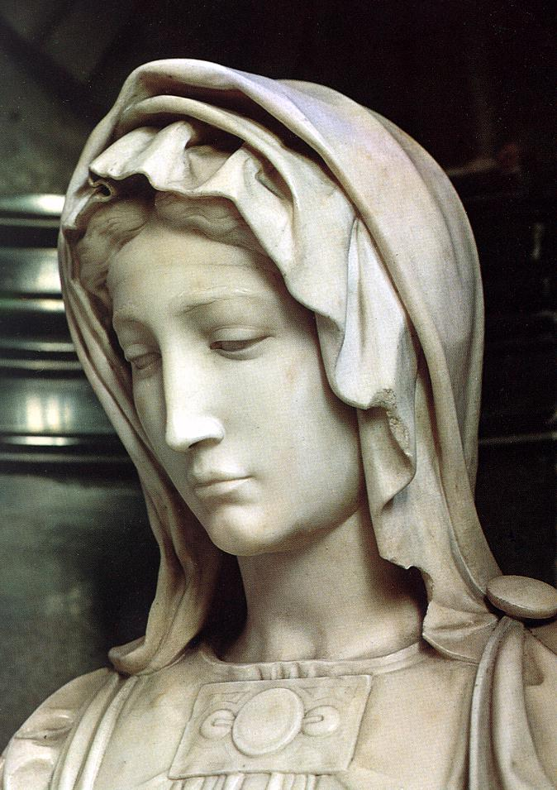
Madonna and Child
1501-05
Marble, height 128 cm (including base)
O.L. Vrouwekerk, Bruges

Slide 4
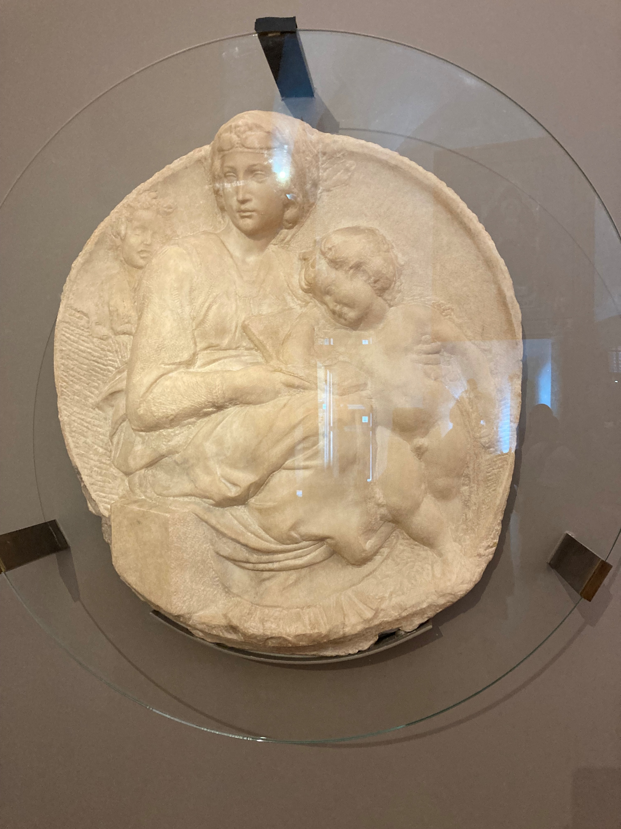
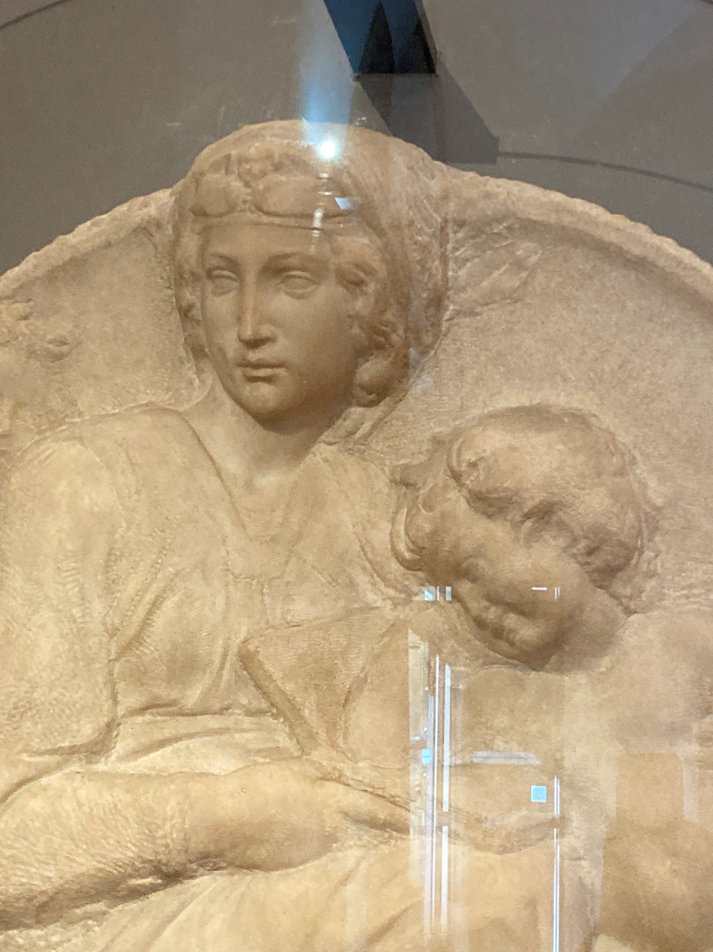
Pitti Tondo (detail), c. 1503–1505, Marble, 82 cm, Museo Nazionale del Bargello, Florence, Italy – Photo Credit: Amalia Spiliakou, 2025

Slide 5
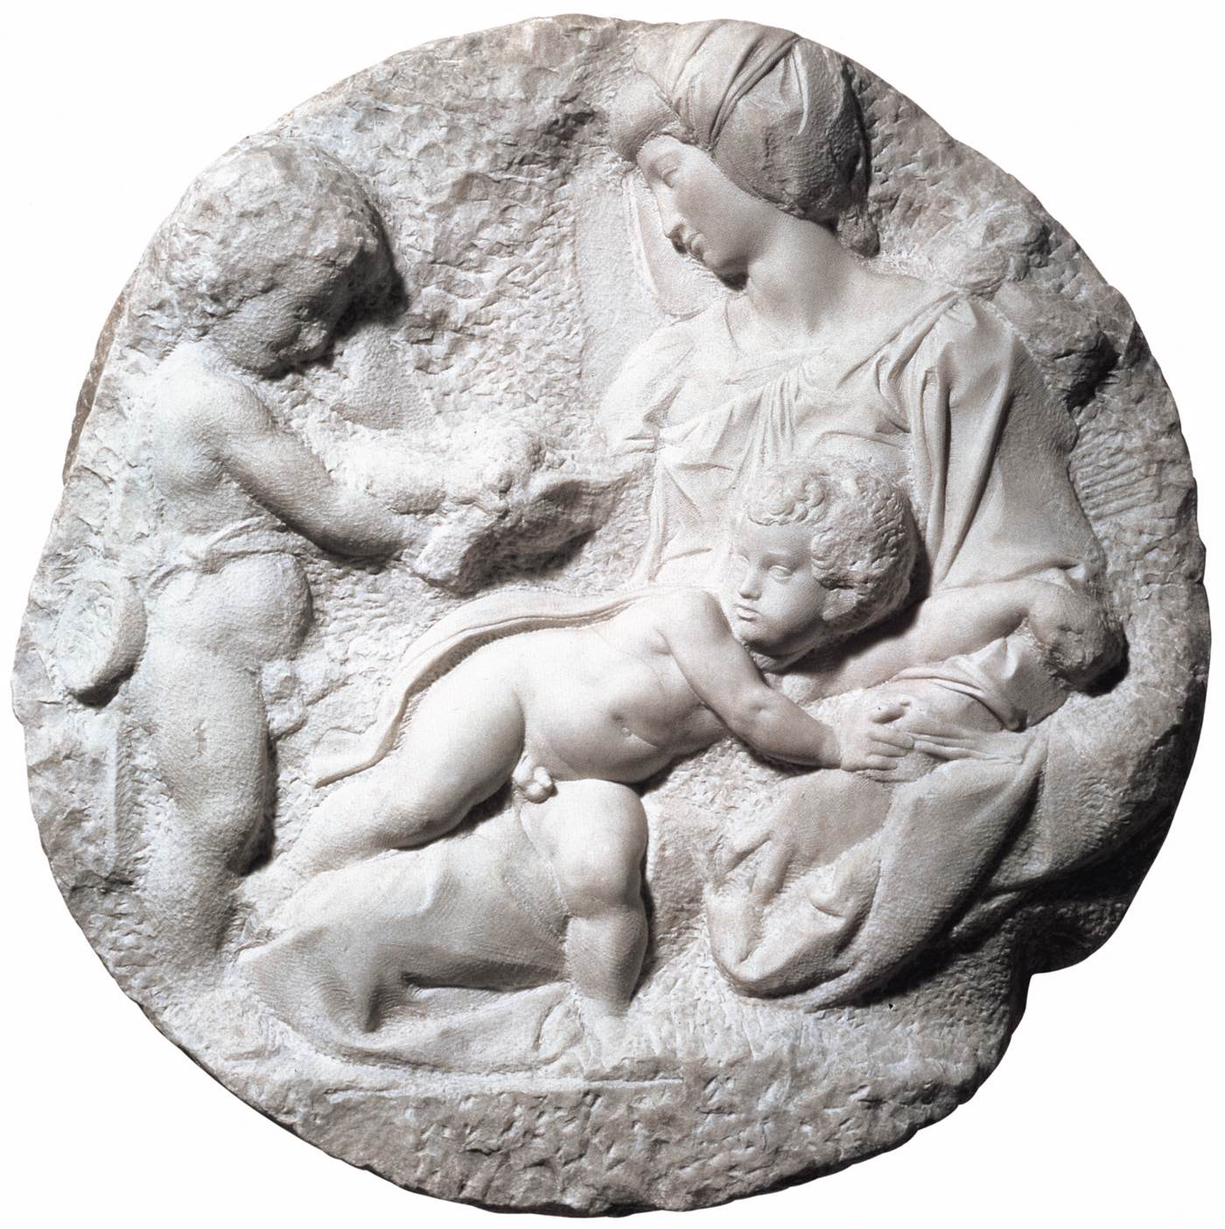
Madonna and Child with the Infant Baptist (Taddei Tondo)
1505-06
Marble, diameter: 82,5 cm
The Royal Academy of Arts, London

Slide 6
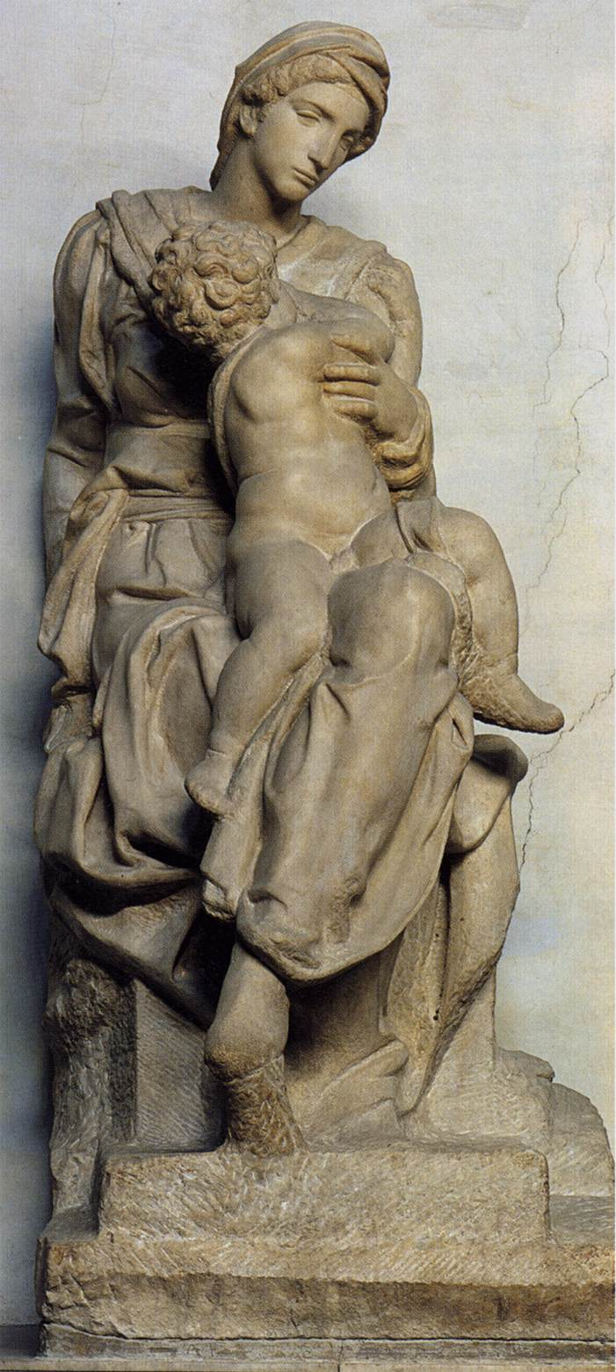
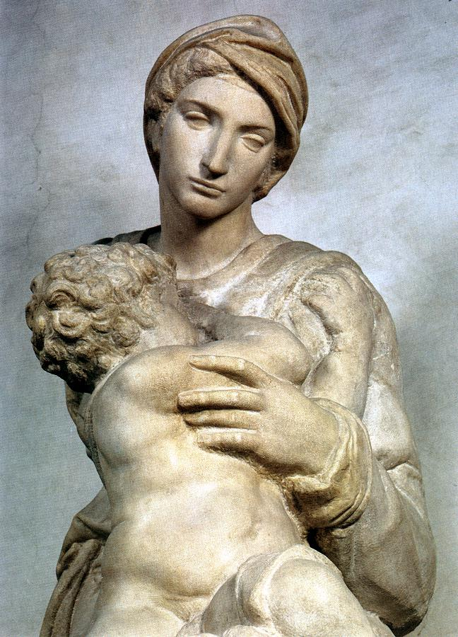
Medici Madonna
1521-31
Marble, height 226 cm
Sagrestia Nuova, San Lorenzo, Florence

Slide 7
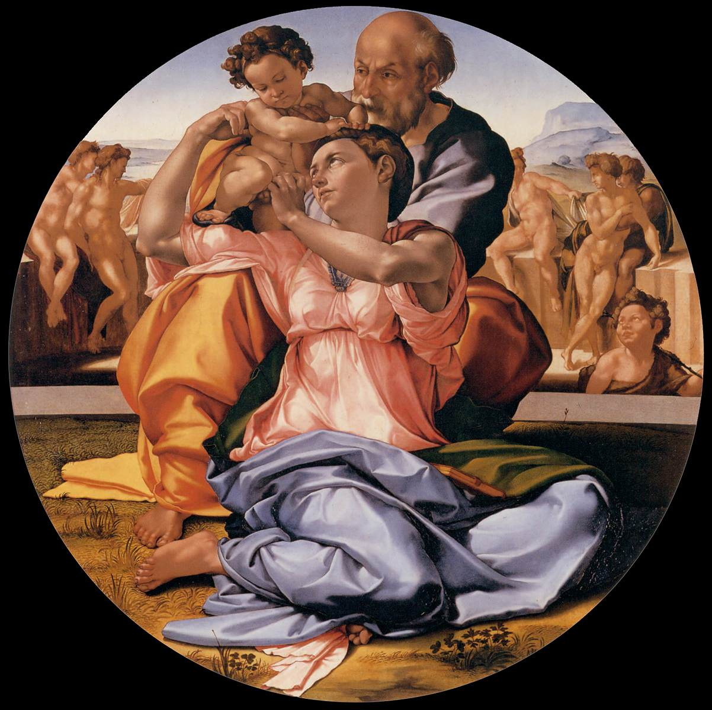
The Holy Family with the infant St. John the Baptist (the Doni tondo) c. 1506
Tempera on panel, diameter 120 cm
Galleria degli Uffizi, Florence

Slide 8
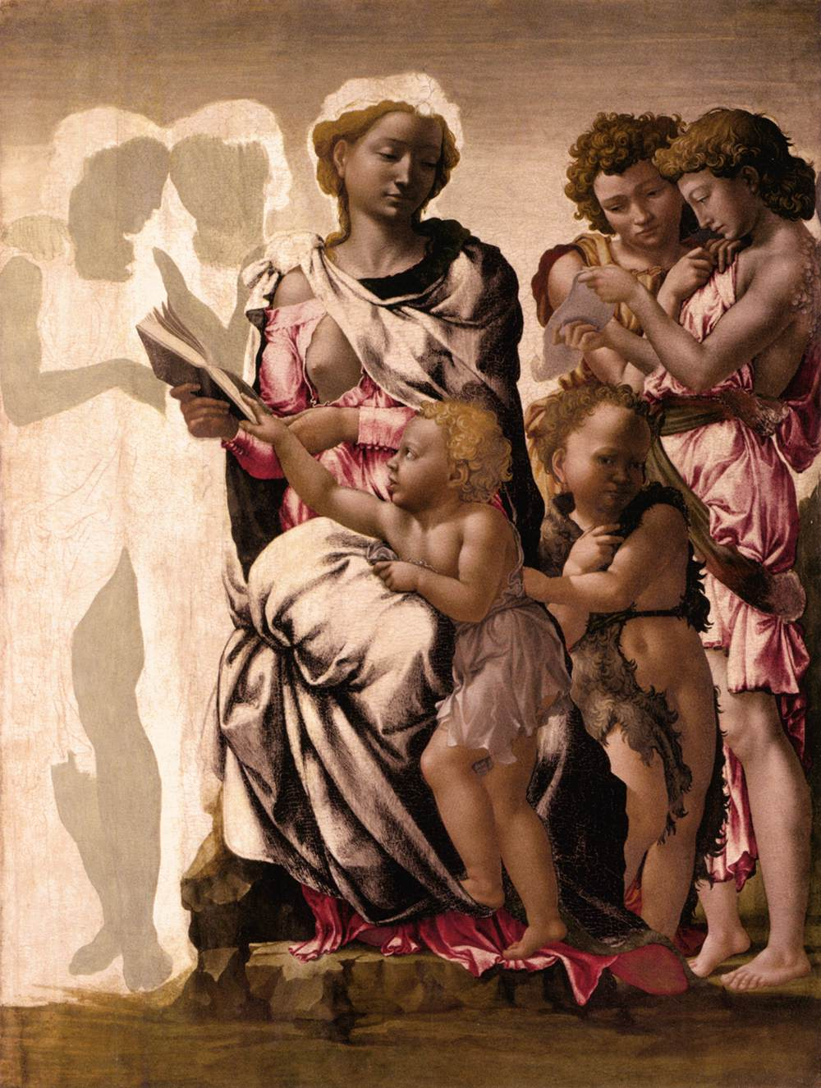
Virgin and Child with St John and Angels c. 1497
Egg tempera on panel, 105 x 77 cm
National Gallery, London

Slide 9
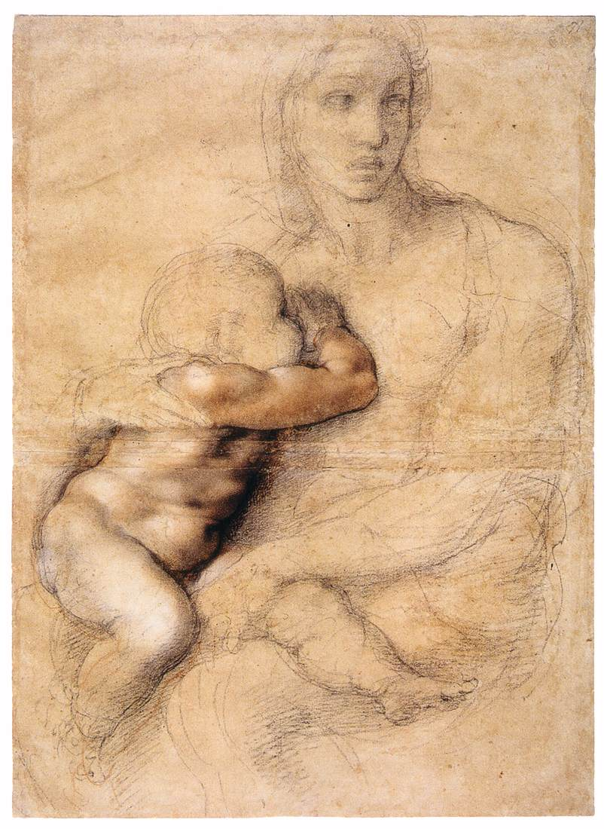
Madonna and Child
1522-25
Black and red chalk, pen and brown ink on brownish paper, 541 x 396 mm
Casa Buonarroti, Florence

Slide 10
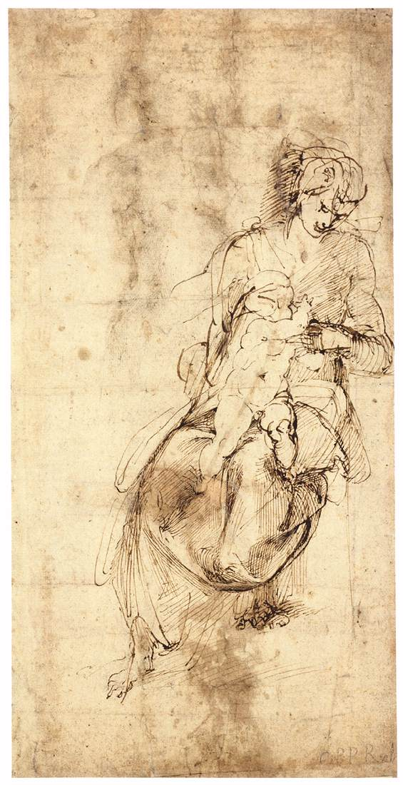
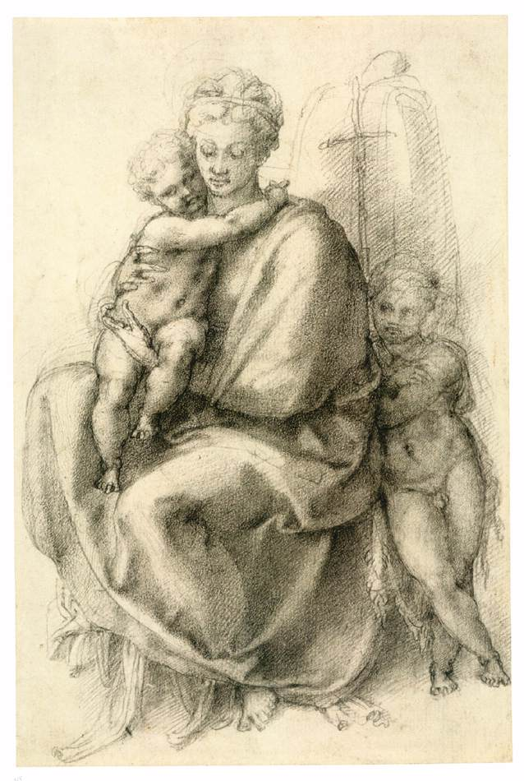
Virgin and Child (verso) c. 1503
Pen and brown ink, 387 x 195 mm
Graphische Sammlung Albertina, Vienna
Madonna and Child with the Infant St John (recto) c. 1532
Black chalk, 317 x 210 mm
Royal Collection, Windsor

Slide 11
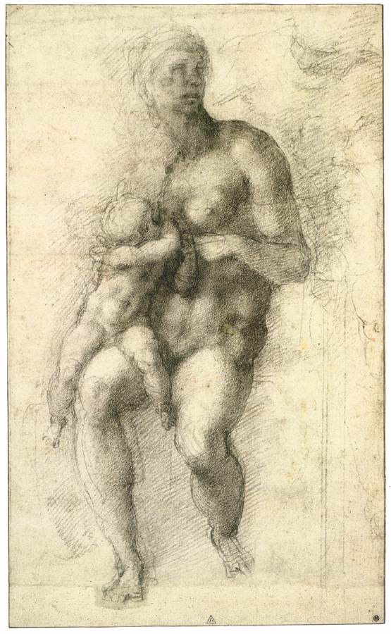
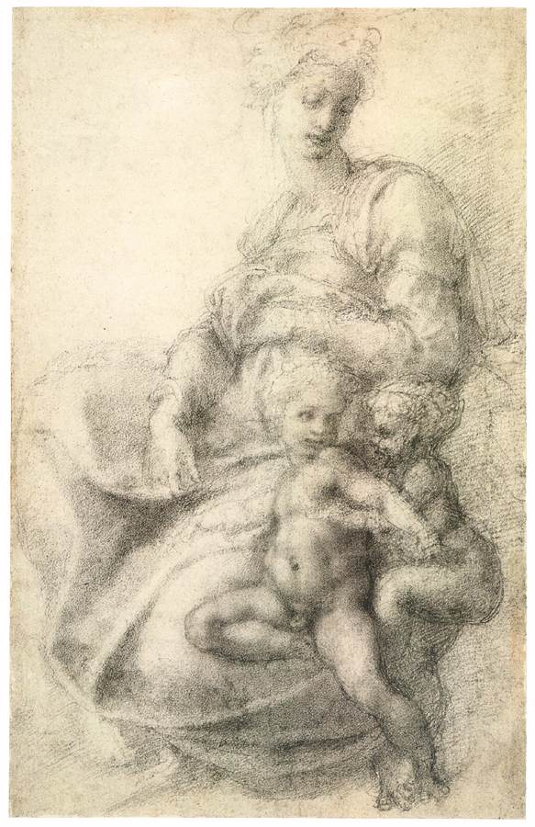
The Holy Family with the Infant St John
1533-34
Black chalk over drawing in stylus, 317 x 191 mm
British Museum, London
Madonna and Child with the Infant St John c. 1533
Black chalk, 314 x 200 mm
British Museum, London

Slide 12
The End

