Slide 1
Spyros Papaloukas
1892-1957
11 Paintings

Slide 2
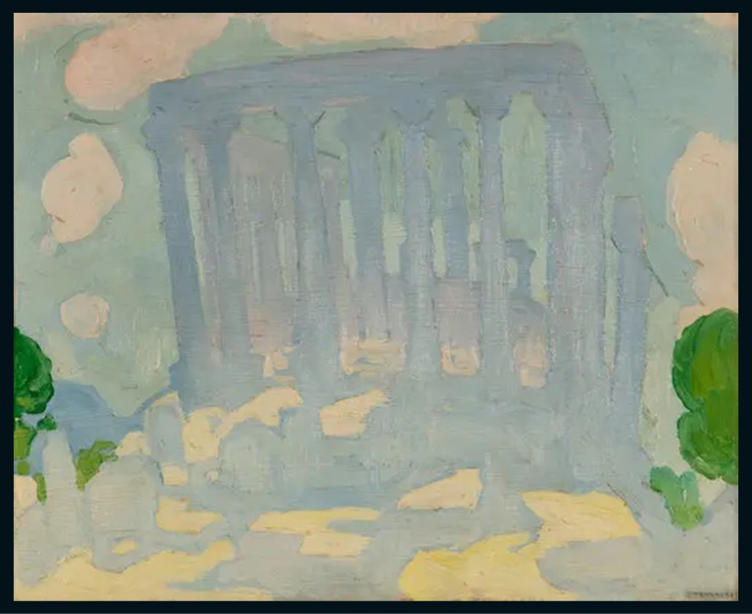
The Temple of Aphaia, Aegina, 1923, Oil on cardboard mounted on canvas, 27.5x33.5 cm, Private Collection https://www.bonhams.com/auction/31745/lot/3/spyros-papaloukas-1892-1957-le-temple-dafea-egine/

Slide 3
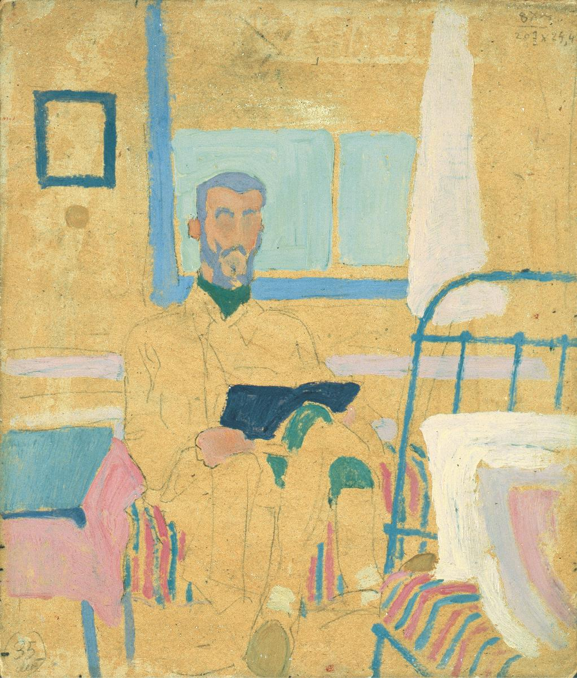
Portrait f Stratis Doukas, 1924, Oil on cardboard, 24 x 20 cm, B&M Theocharakis Foundation, Greece https://www.searchculture.gr/aggregator/portal/collections/theocharakis

Slide 4
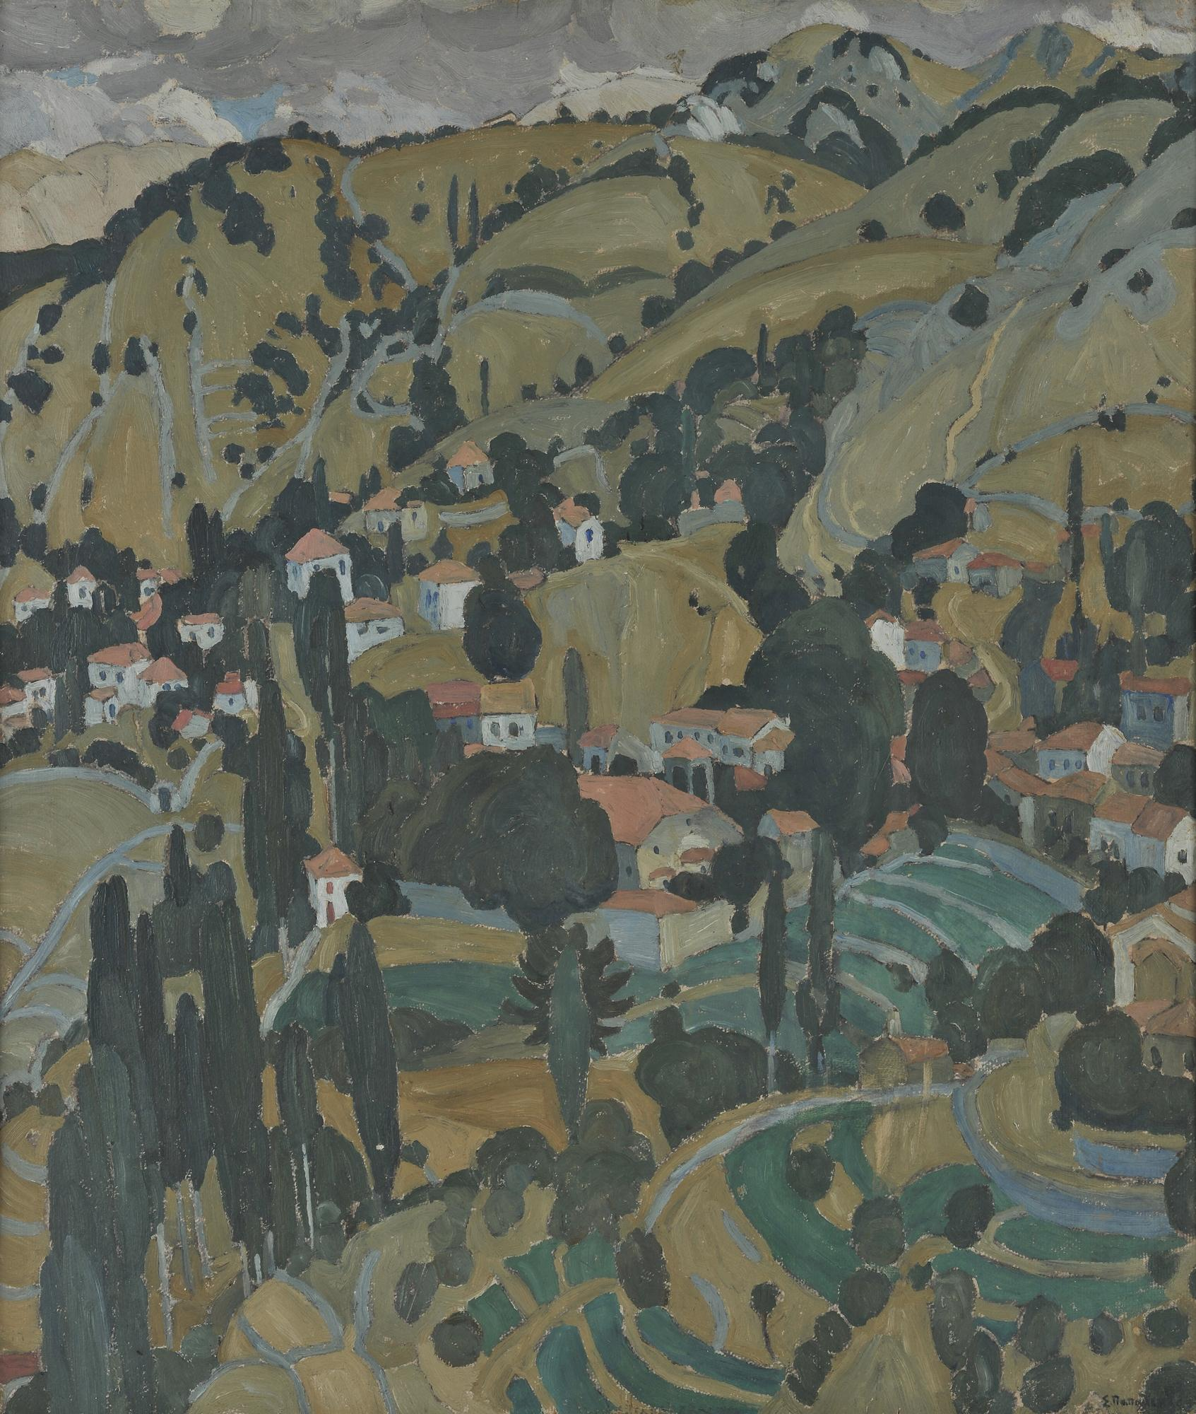
The Village Kameno on Lesbos, ca 1925, Oil on canvas, 59 x 51,5 cm, National Gallery, Athens, Greece https://www.nationalgallery.gr/en/artwork/the-village-kameno-on-lesbos/

Slide 5
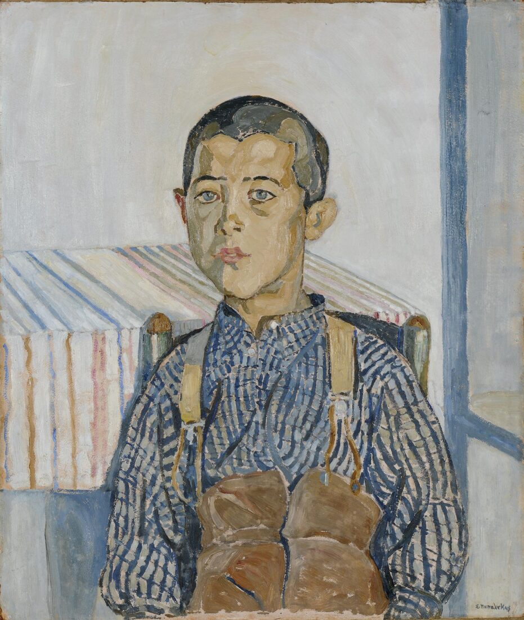
Boy with Suspenders, 1925, Oil on pasteboard, 60,5 x 51 cm, National Gallery, Athens, Greece https://www.nationalgallery.gr/en/artwork/boy-with-suspenders/

Slide 6
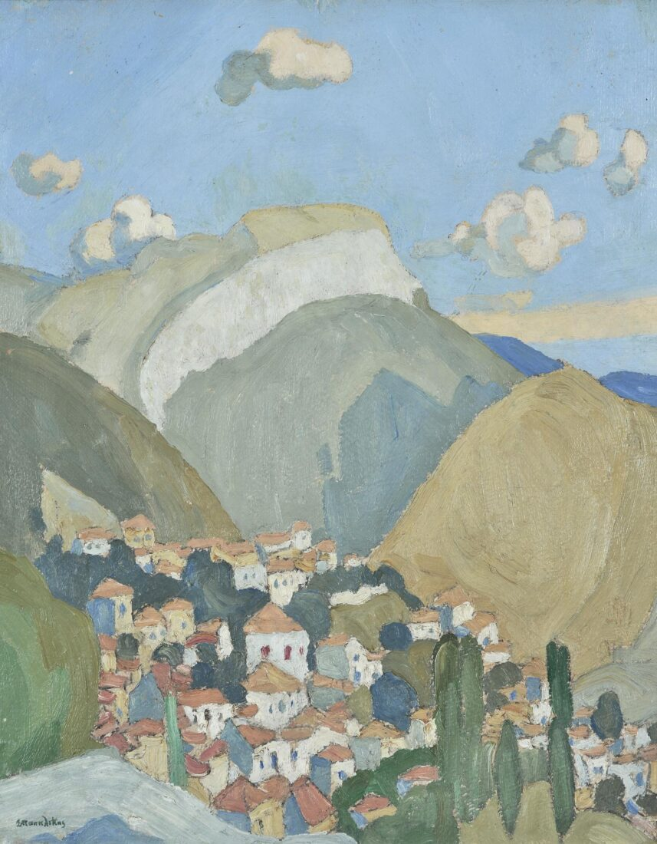
The Village of Yeras on Mytilini, 1925, Oil on canvas, 34 x 28,5 cm, National Gallery, Athens, Greece https://www.nationalgallery.gr/en/artwork/the-village-of-yeras-on-mytilini-2219/

Slide 7
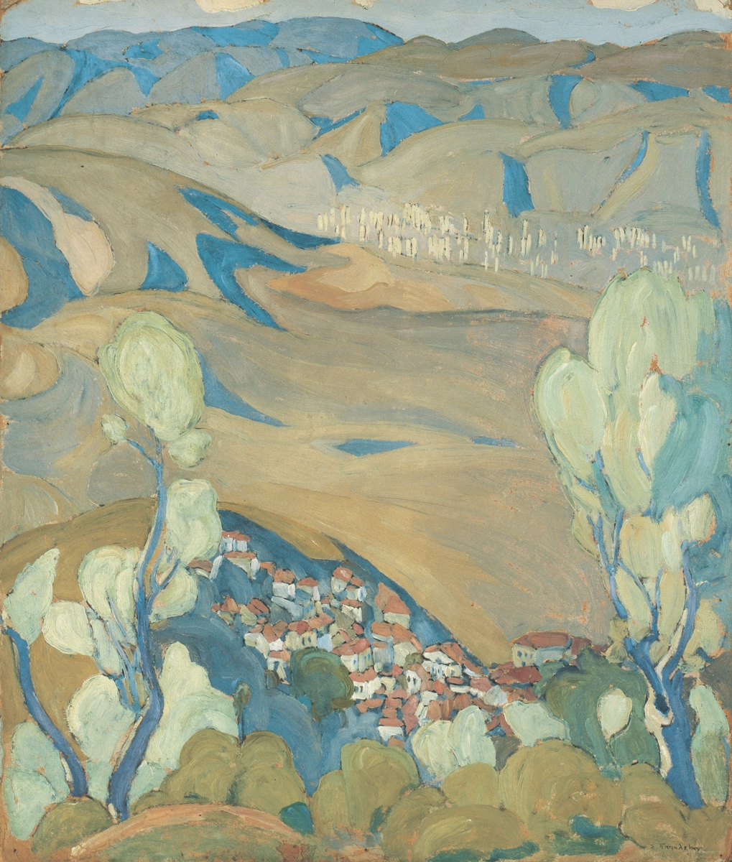
Maintain villages, 1927, Oil on cardboard, 60 x50 cm, B&M Theocharakis Foundation, Greece https://www.searchculture.gr/aggregator/edm/theocharakis/000163-103097

Slide 8
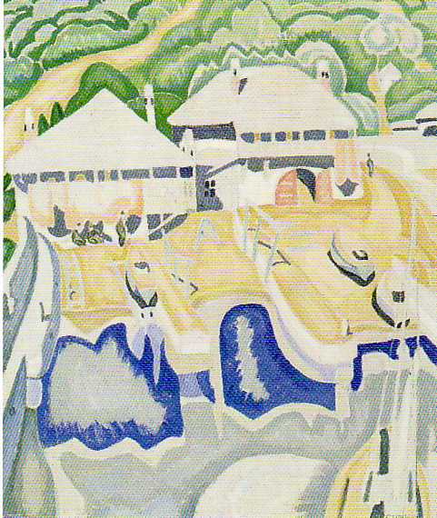
Arsanas of Agios Gregorios Monastery, 1928, Oil on canvas, 58 x 48 cm, Alpha Bank Art Collection, Greece https://www.alphapolitismos.gr/en/art-collection/our-works-of-art/spyros-papaloukas-arsanas-of-agios-gregorios-monastery/

Slide 9
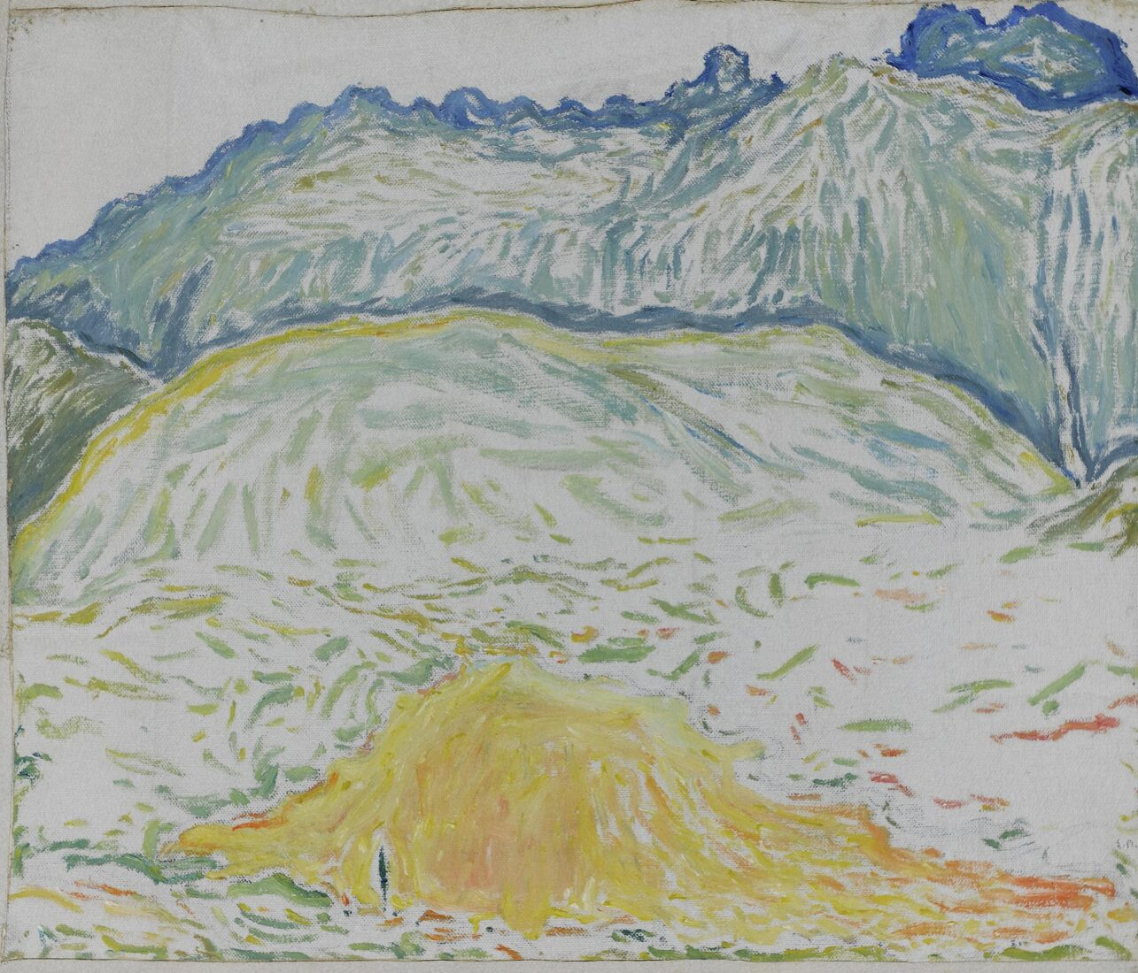
Landscape from Delphi, 1945, Oil on canvas mounted on pasteboard, 43,7 x 50,4 cm, National Gallery, Athens, Greece https://www.nationalgallery.gr/en/artwork/landscape-from-delphi/

Slide 10
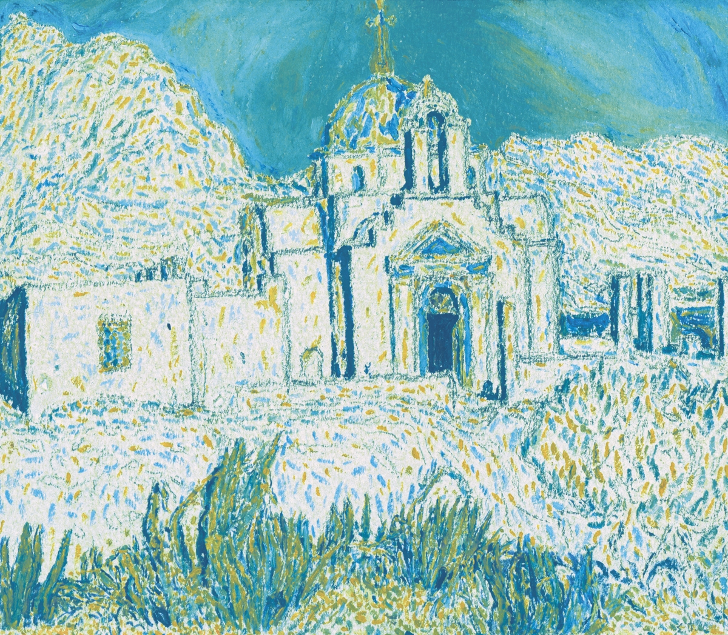
Agios Fokas, Paros, 1948, Oil on cardboard, 20 x24 cm, B&M Theocharakis Foundation, Greece https://www.searchculture.gr/aggregator/edm/theocharakis/000163-103112

Slide 11
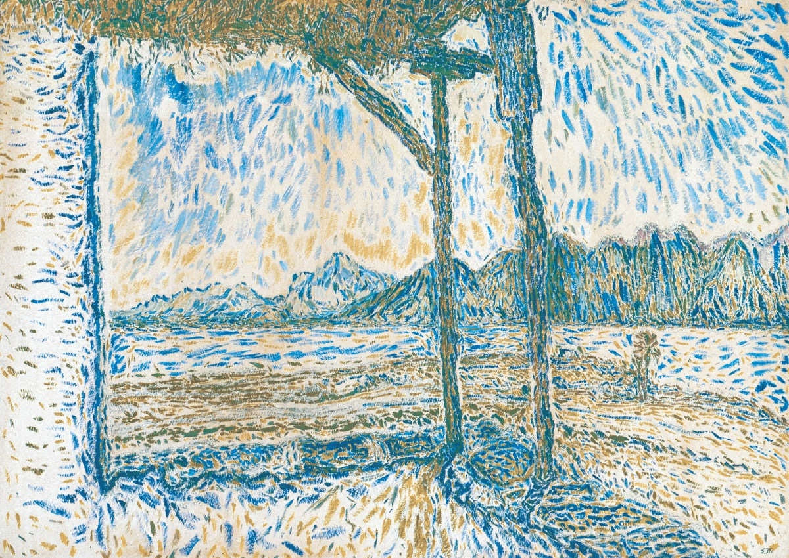
Landscape from Antiparos, 1948, Oil on cardboard, 44 x 64 cm, B&M Theocharakis Foundation, Greece https://www.searchculture.gr/aggregator/edm/theocharakis/000163-103109

Slide 12
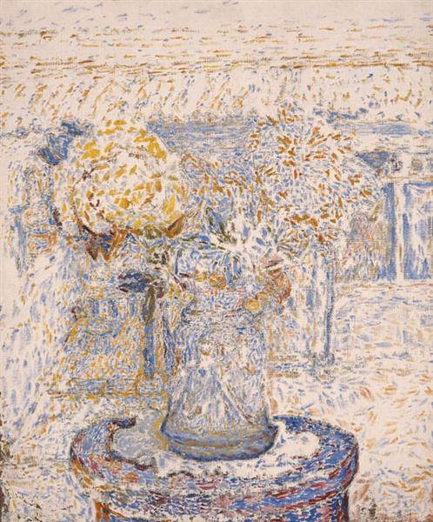
Vase of Flowers (dark colors), 1956, Oil on canvas, 51 x 40,5 cm, National Gallery, Athens, Greece https://www.nationalgallery.gr/en/artwork/vase-of-flowers-dark-colors-3691/

Slide 13
The End

