Slide 1
Luca della Robbia
1399/1400-1482

Slide 2
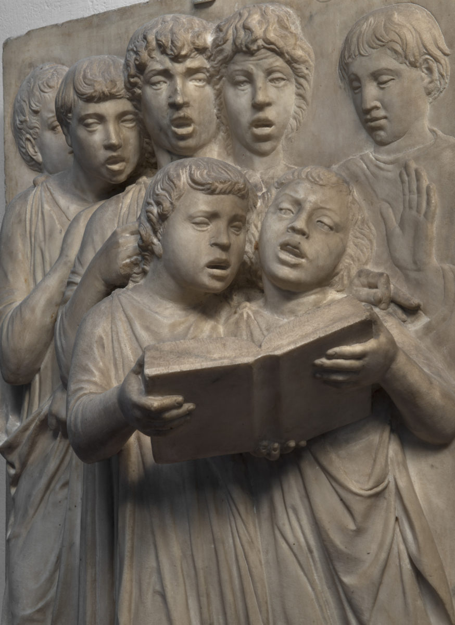
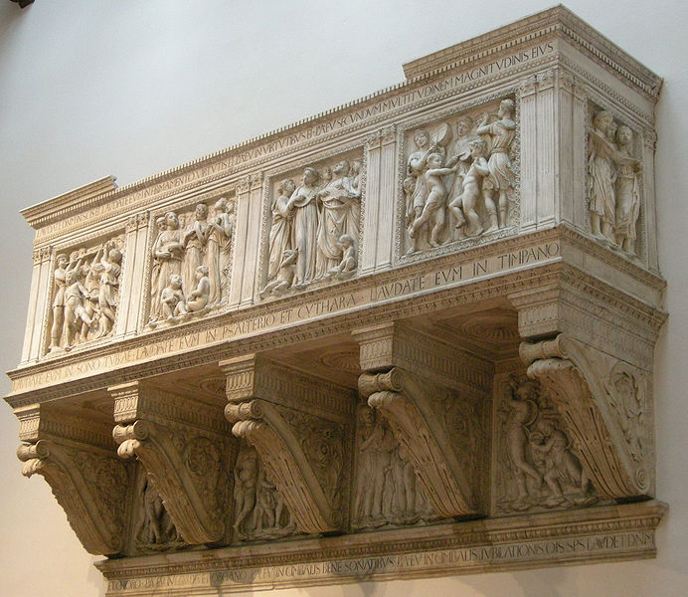
Cantoria, 1431-38, Marble,
328 x 560 cm,
Museo dell'Opera del Duomo, Florence, Italy https://en.m.wikipedia.org/wiki/File:Cantoria_di_luca_della_robbia_01.JPG and https://www.friendsofflorence.org/projects/the-cantoria-luca-della-robbia-museum-of-the-cathedral-opera-del-duomo/

Slide 3
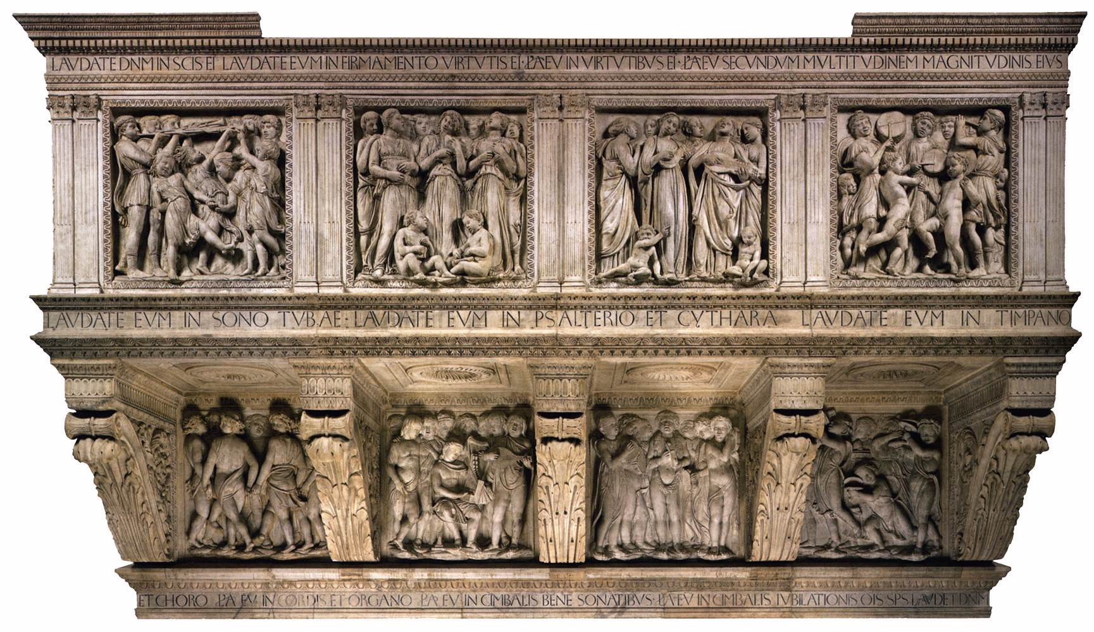
https://www.friendsofflorence.org/projects/the-cantoria-luca-della-robbia-museum-of-the-cathedral-opera-del-duomo/

Slide 4
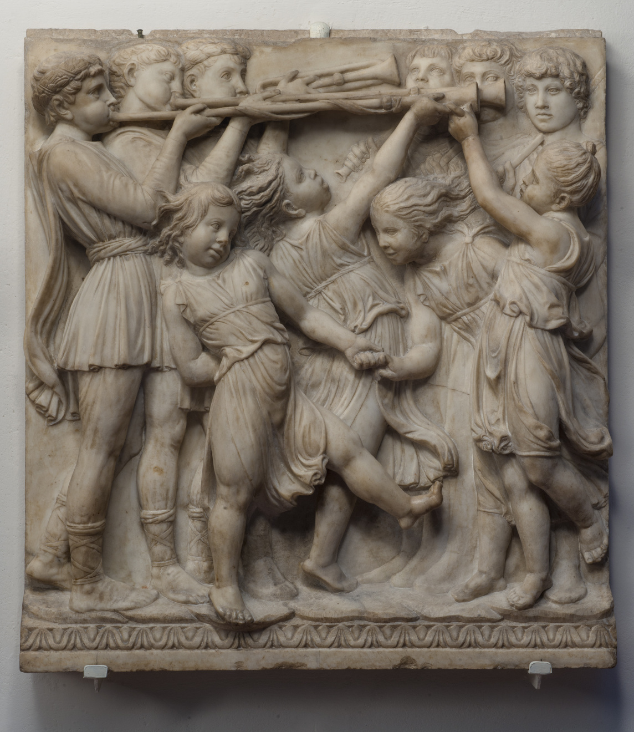
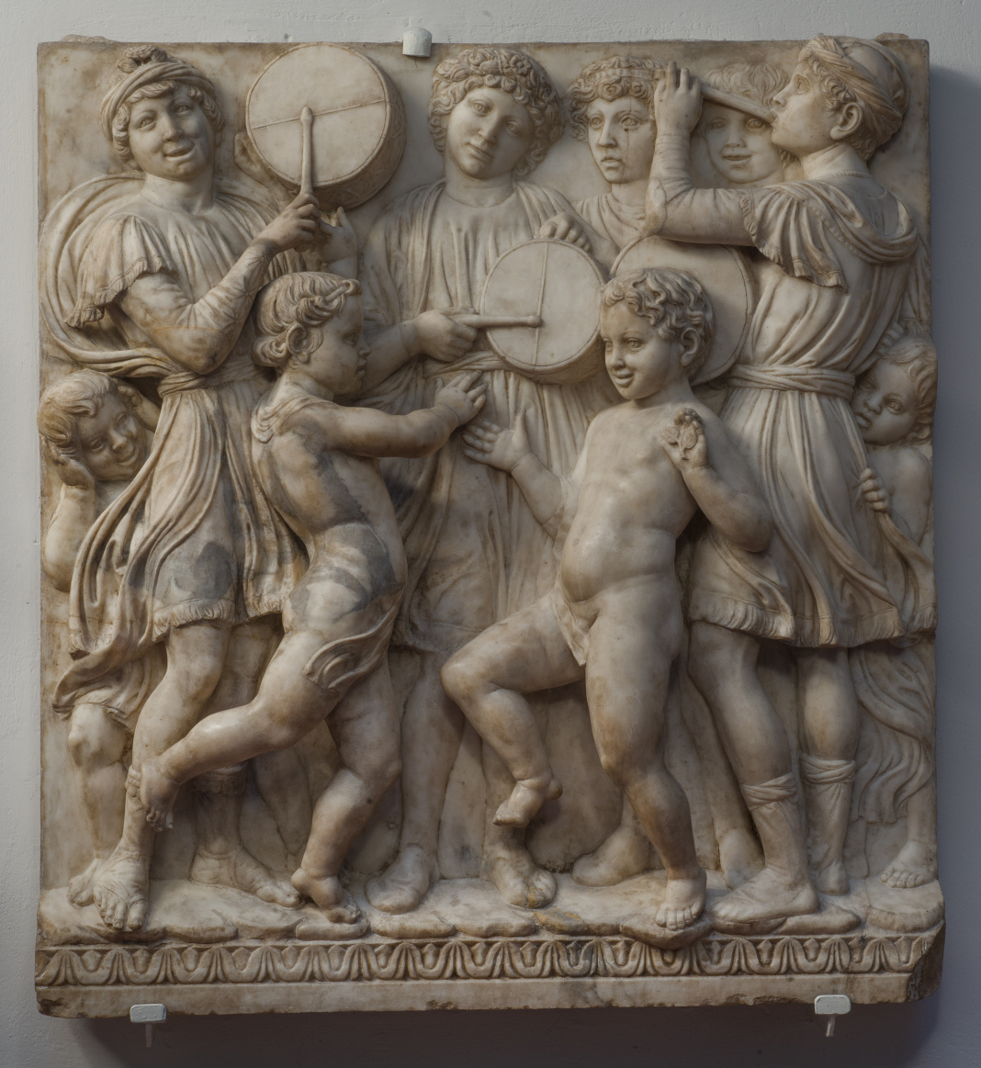
https://www.google.com/url?sa=i&url=https%3A%2F%2Fwww.friendsofflorence.org%2Fprojects%2Fthe-cantoria-luca-della-robbia-museum-of-the-cathedral-opera-del-duomo%2F&psig=AOvVaw2Oee6bLKEVEnhAE9FiHn0h&ust=1701596816915000&source=images&cd=vfe&opi=89978449&ved=0CBAQjRxqFwoTCIiKt-a_8IIDFQAAAAAdAAAAABAo

Slide 5
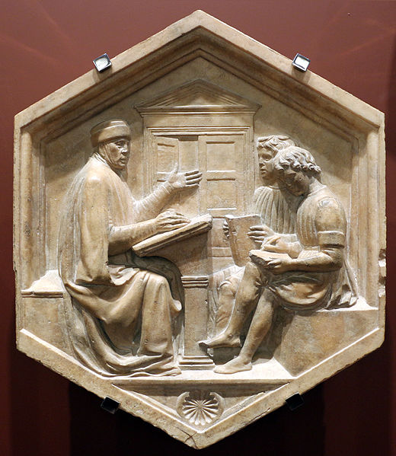
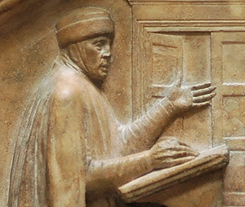
Grammar, c. 1437, Stone, 83 x 69 cm,
Museo dell'Opera del Duomo, Florence, Italy https://commons.wikimedia.org/wiki/File:Luca_della_robbia,_donato_o_prisciano_ovvero_la_grammatica,_1437-39,_dal_lato_nord_del_campanile.JPG and https://www.hs-augsburg.de/~harsch/Chronologia/Lspost06/Priscianus/pri_intr.html

Slide 6
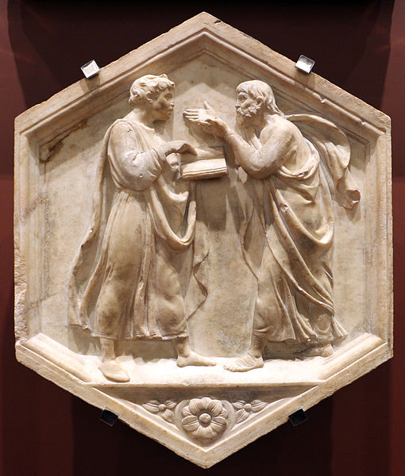
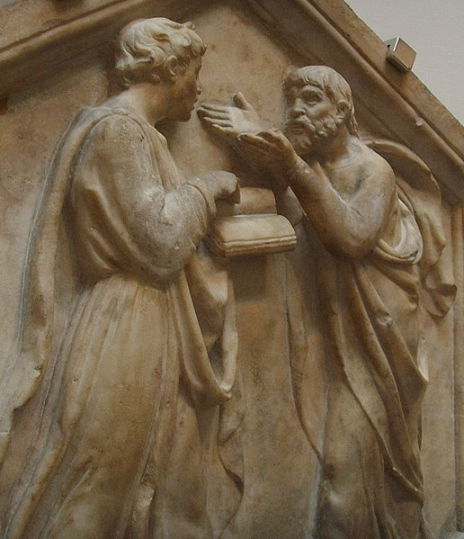
Logic (or Philosophy), c. 1437, Stone,
83 x 69 cm, Museo dell'Opera del Duomo, Florence, Italy https://commons.wikimedia.org/wiki/File:Luca_della_robbia,_platone_e_aristotele_ovvero_la_dialettica,_1437-39,_dal_lato_nord_del_campanile.JPG

Slide 7
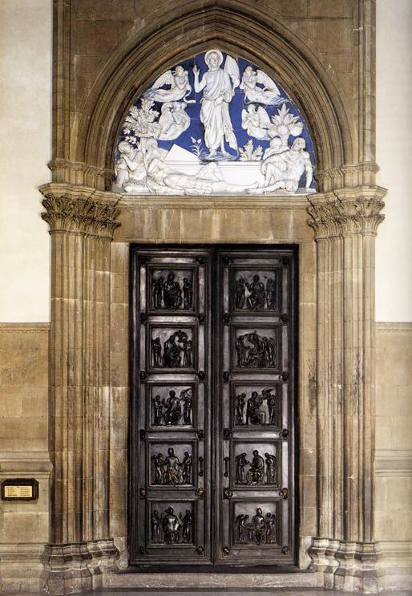
North Sacristy Doors with the Resurrection
1442-75, Enameled terracotta and bronze
Duomo, Florence, Italy https://www.flickr.com/photos/renzodionigi/3734319007

Slide 8
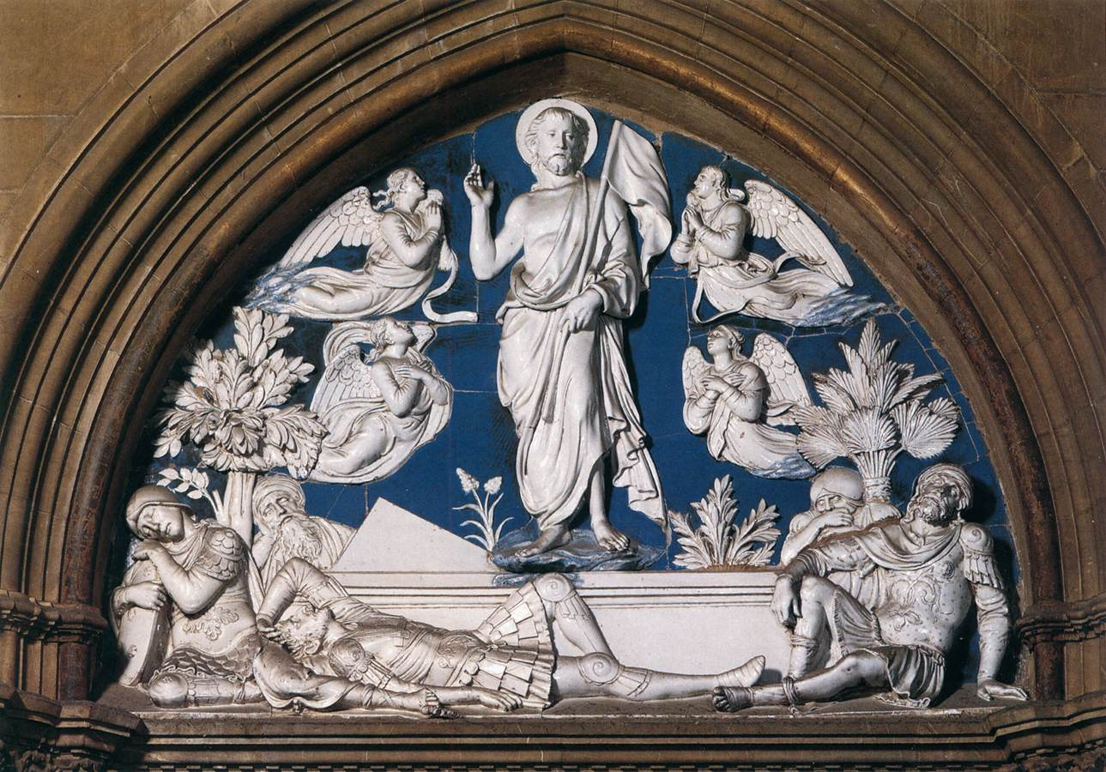
Resurrection,
1442-45,
Glazed and polychromed terracotta,
200 x 265 cm,
Duomo, Florence, Italy https://www.wga.hu/frames-e.html?/bio/r/robbia/luca/biograph.html

Slide 9
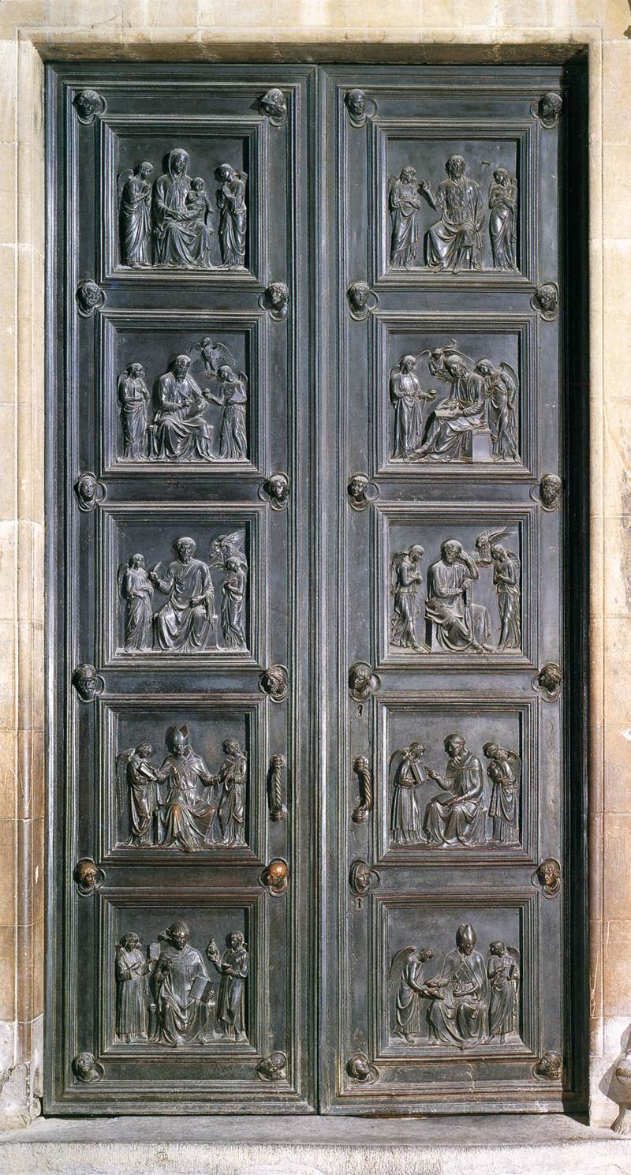
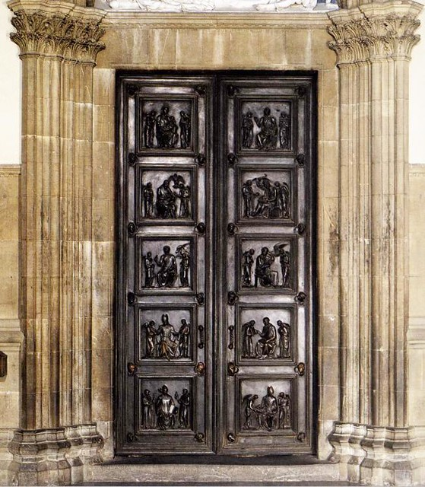
Bronze Doors of the New Sacristy, 1446-75, Bronze,
420 x 200 cm, Duomo, Florence, Italy https://www.wga.hu/frames-e.html?/bio/r/robbia/luca/biograph.html and https://www.flickr.com/photos/renzodionigi/3734316923

Slide 10
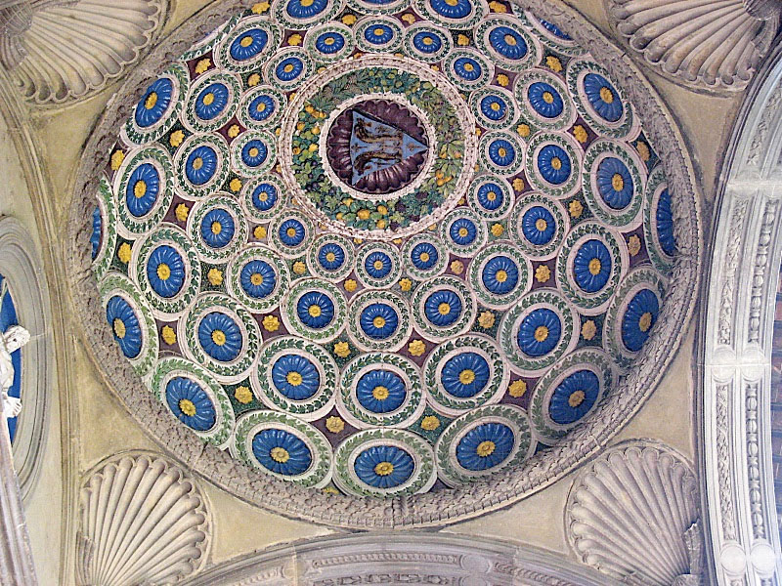
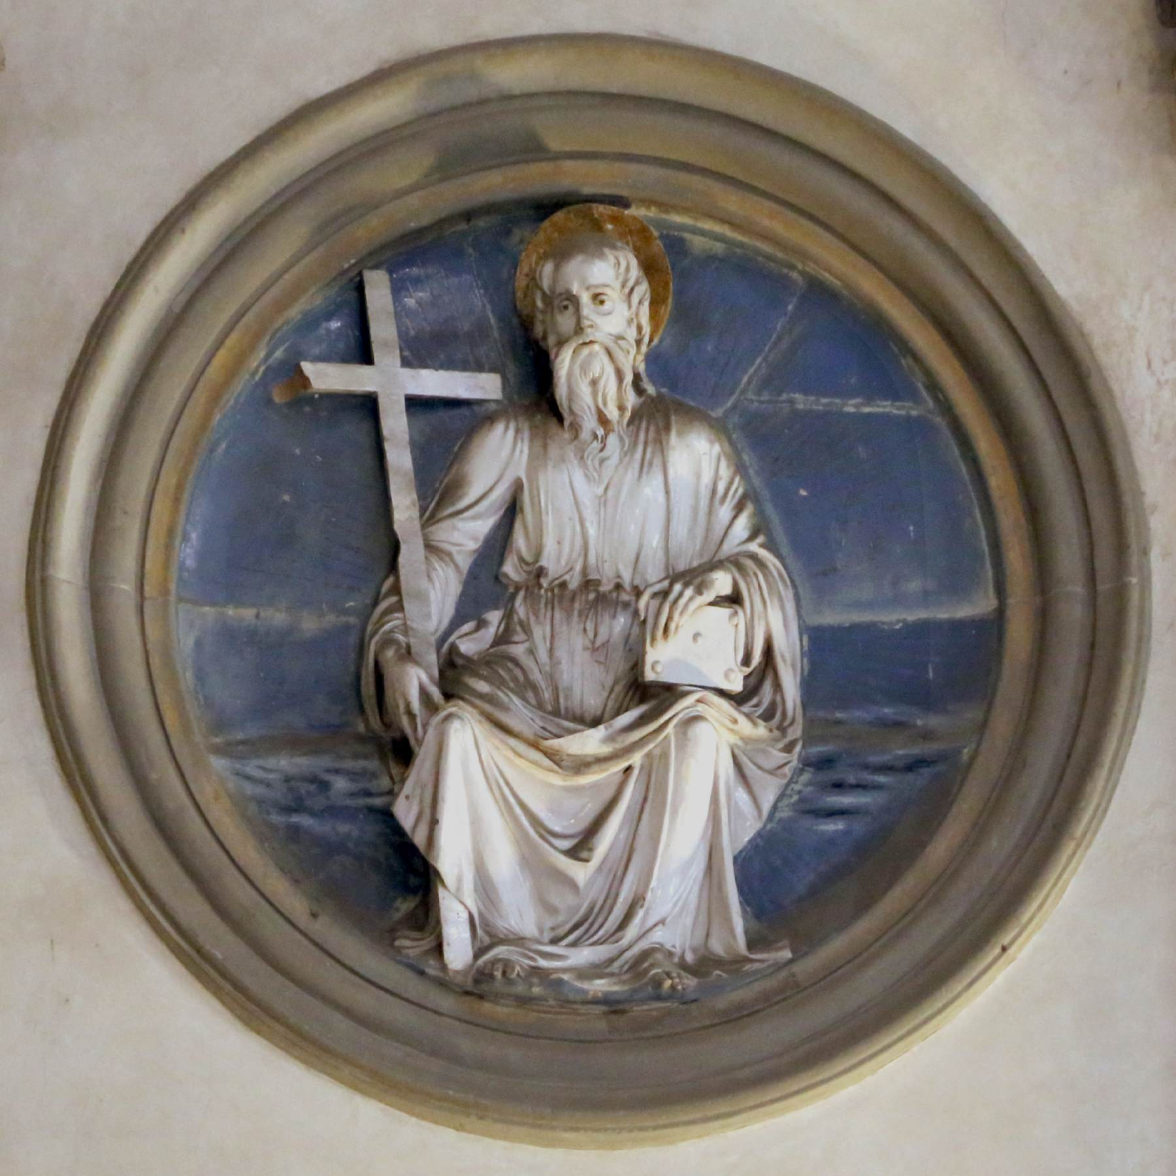
Pazzi Chapel Cupola of the Portico,
Saint Andrew, 1440s,
Glazed Terracotta,
Santa Croce, Florence, Italy https://www.museumsinflorence.com/musei/Pazzi_chapel.html and https://www.wga.hu/frames-e.html?/bio/r/robbia/luca/biograph.html

Slide 11
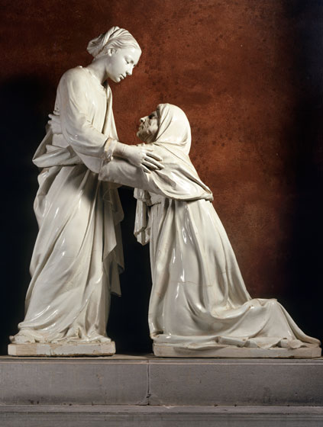
The Visitation, c. 1445, Glazed Terracotta, 184 x 153 cm, Church of San Giovanni Fuorcivitas, Pistoia, Italy https://www.nga.gov/features/slideshows/della-robbia-feature-1-slideshow.html#slide_3

Slide 12
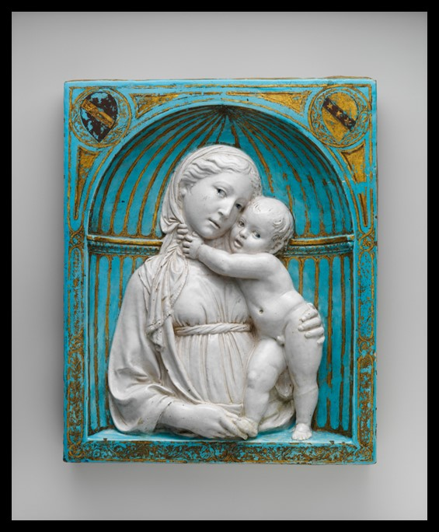
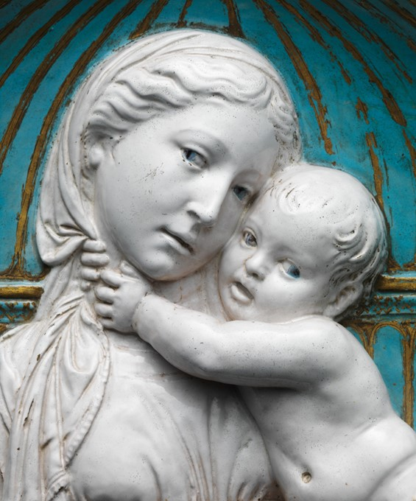
Virgin and Child in a niche, ca. 1460, Glazed Terracotta with gilt and painted details, 47.3 × 38.7 × 8.9 cm, the MET, NY, USA https://www.metmuseum.org/art/collection/search/204722

Slide 13
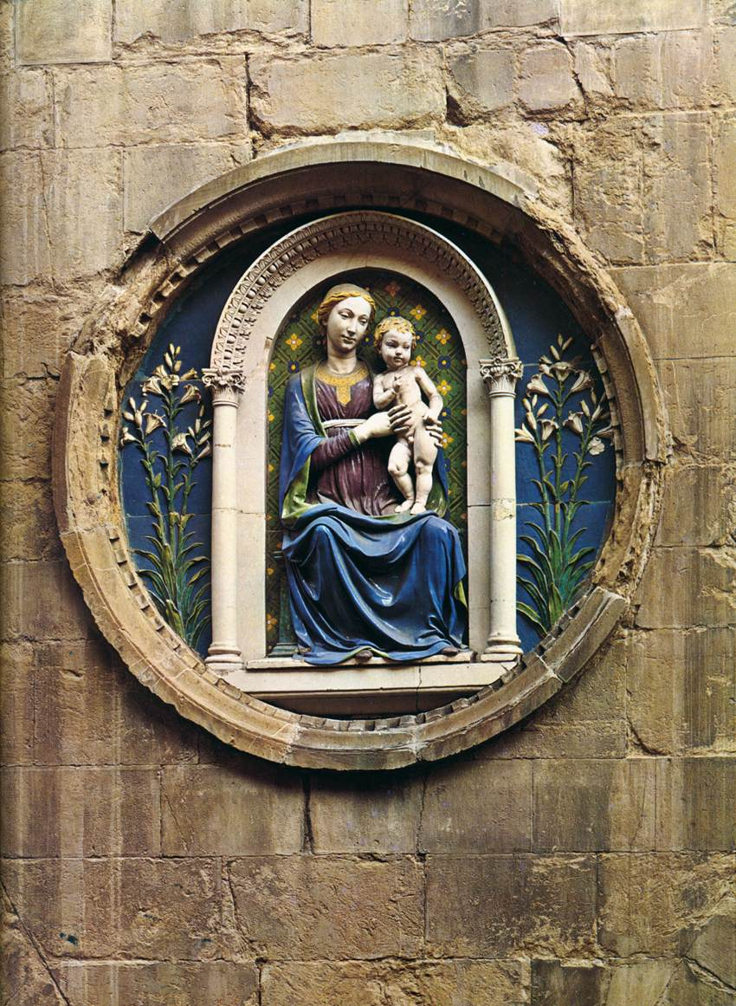
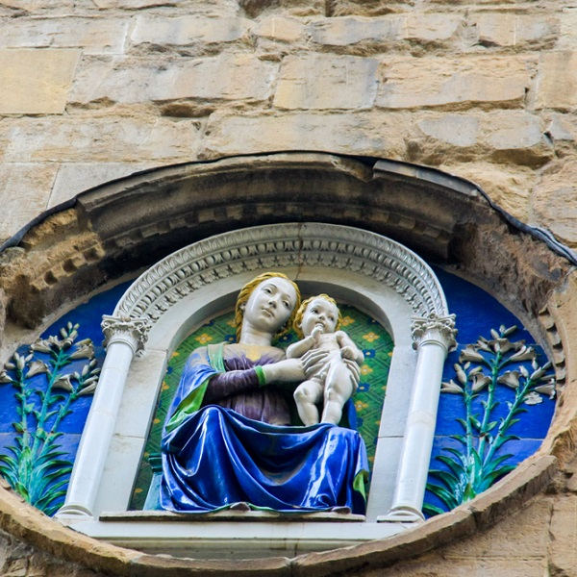
Madonna and Child, 1455-60, Glazed Terracotta, Diameter: 180 cm, Orsanmichele, Florence, Italy https://www.wga.hu/frames-e.html?/bio/r/robbia/luca/biograph.html and https://ciaotutti.nl/reizen-door-italie/toscane/majolica-familie-della-robbia-uit-florence/

Slide 14
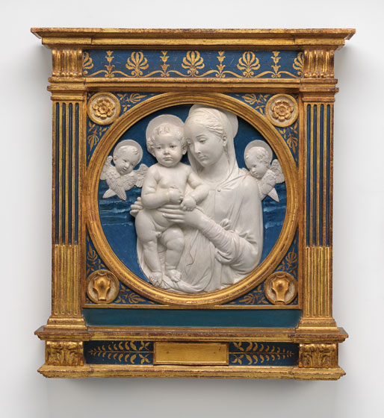
Madonna and Child with Cherubim, c. 1485, Glazed Terracotta,
Diameter: 54.7 cm, National Gallery of Art, Washington DC, USA https://www.nga.gov/features/slideshows/della-robbia-feature-1-slideshow.html

Slide 15
The End

