Slide 1
George Washington Lambert
Australian Artist
1873-1930
10 Paintings

Slide 2
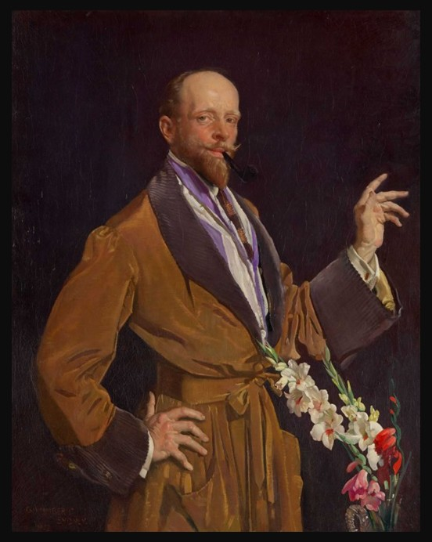
Self-portrait with Gladioli, before 1930, Oil on Canvas, 128.2x102.8 cm, National Portrait Gallery of Australia https://www.portrait.gov.au/portraits/2003.93/self-portrait-with-gladioli/

Slide 3
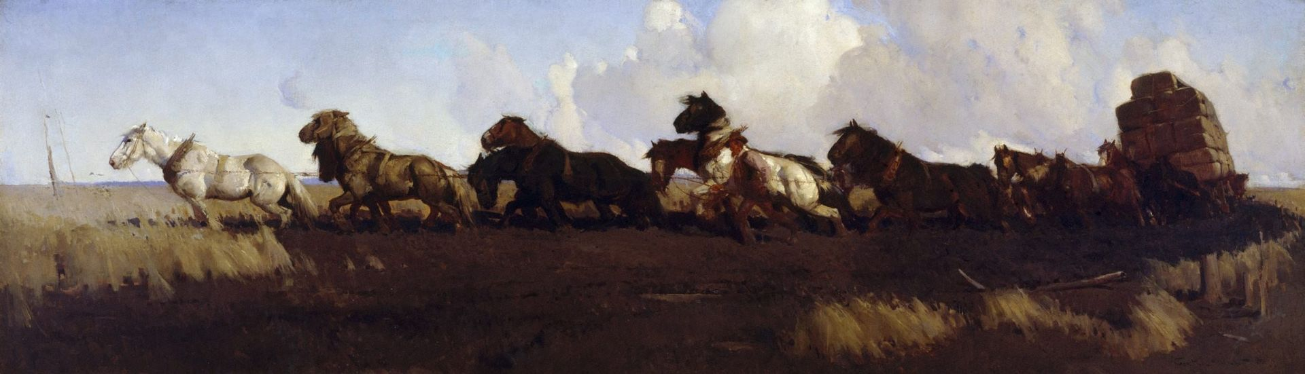
Across the black soil plains, 1899, Oil on Canvas, 91.6x305.5 cm, Art Gallery of the New South Wales, Australia https://commons.wikimedia.org/wiki/File:George_Lambert_-_Across_the_black_soil_plains.jpg

Slide 4
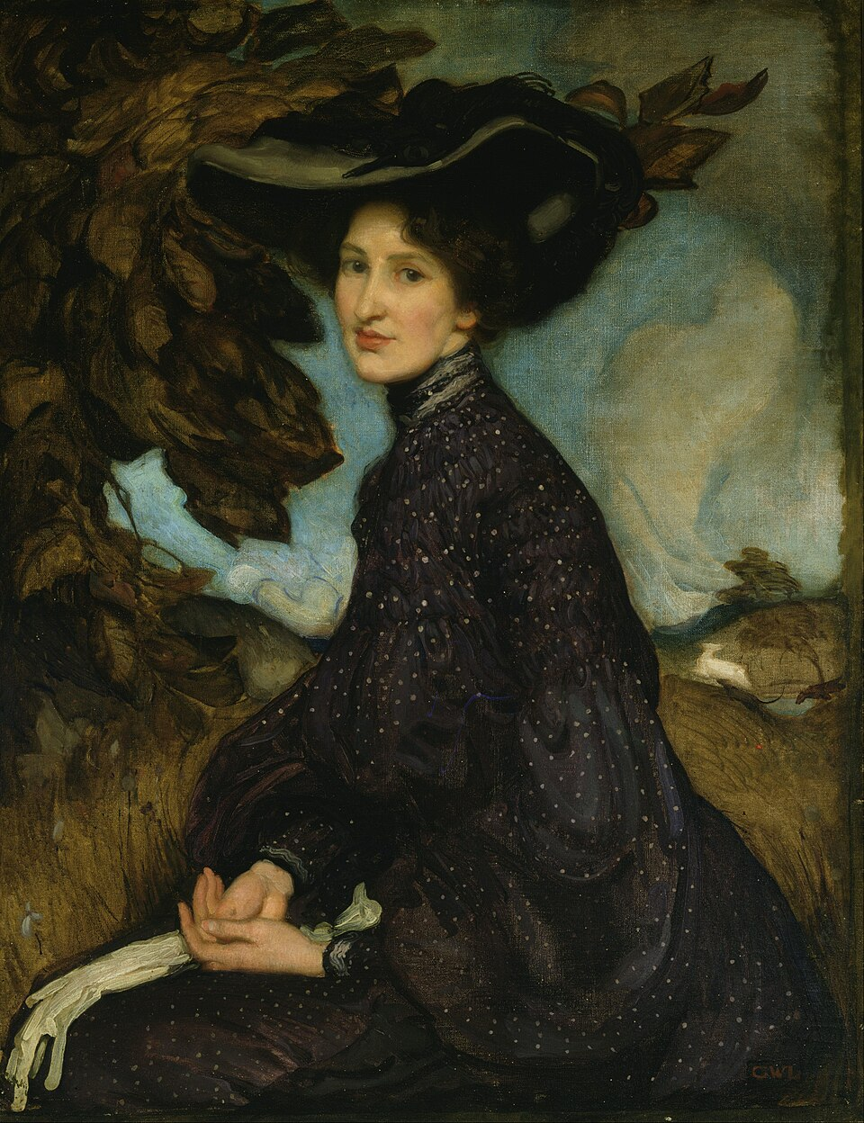
Miss Thea Proctor, 1903, Oil on Canvas, 90.0x69.8 cm, Art Gallery of the New South Wales, Australia https://en.wikipedia.org/wiki/George_Washington_Lambert#/media/File:George_W_Lambert_-_Miss_Thea_Proctor_-_Google_Art_Project.jpg

Slide 5
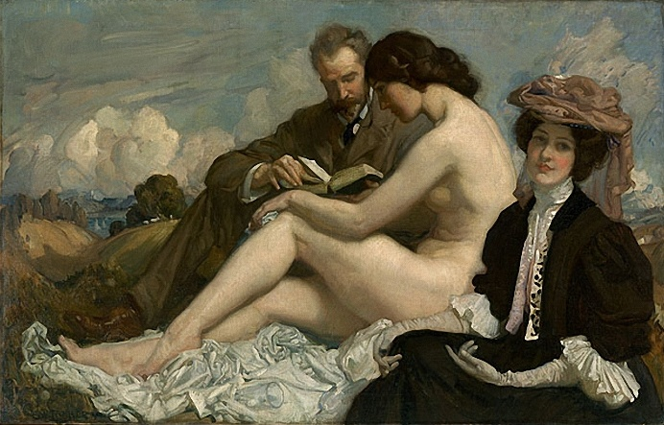
The Sonnet, 1907, Oil on Canvas, 113.3x177.4 cm, National Gallery of Australia, Australia https://en.wikipedia.org/wiki/The_Sonnet_(Lambert)#/media/File:George_Lambert_The_Sonnet_1907.jpg

Slide 6
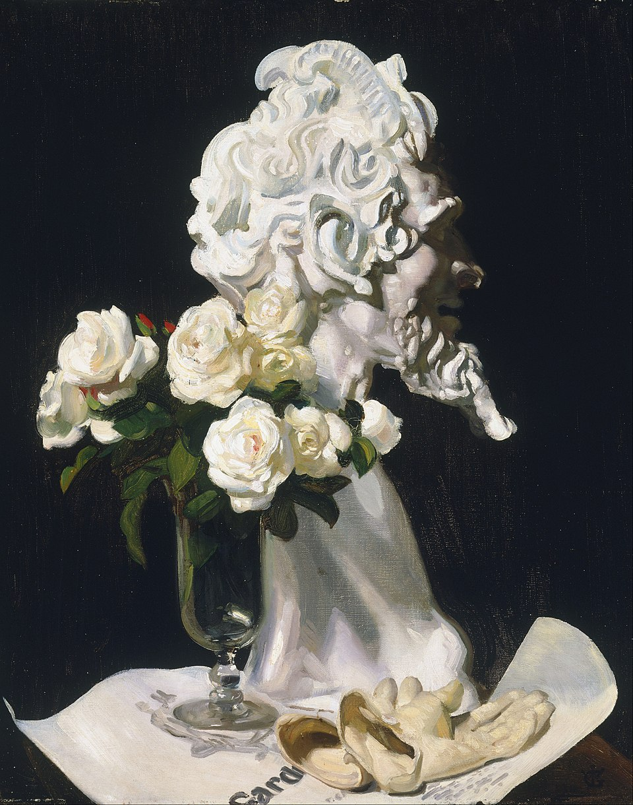
Pan is Dead (Still Life), 1911, Oil on Canvas, 76.5x63.5 cm, Art Gallery of the New South Wales, Australia https://commons.wikimedia.org/wiki/File:George_W_Lambert_-_Pan_is_dead_(still_life)_-_Google_Art_Project.jpg

Slide 7
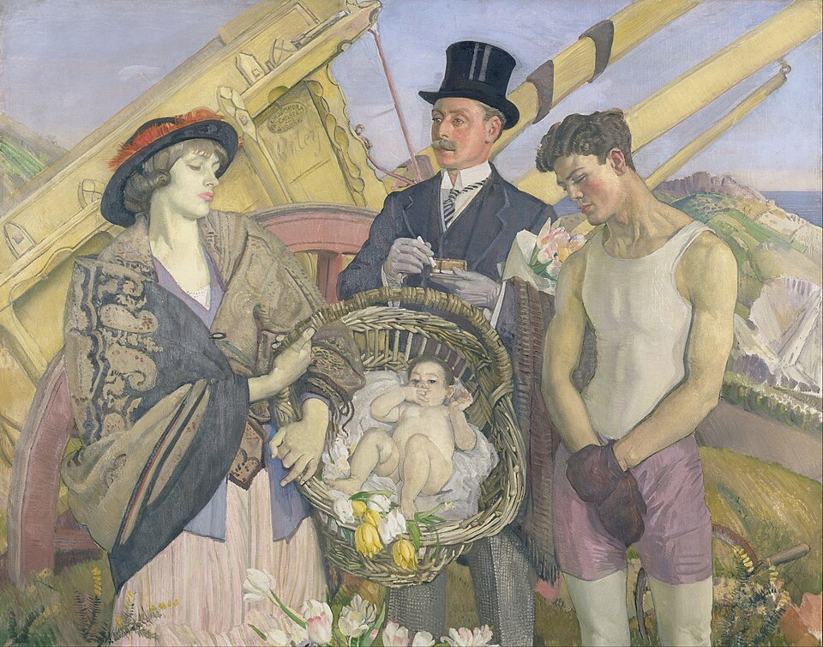
Important People, 1914-1921, Oil on Canvas, 134.7x171 cm, Art Gallery of the New South Wales, Australia https://commons.wikimedia.org/wiki/File:George_W_Lambert_-_Important_people_-_Google_Art_Project.jpg

Slide 8
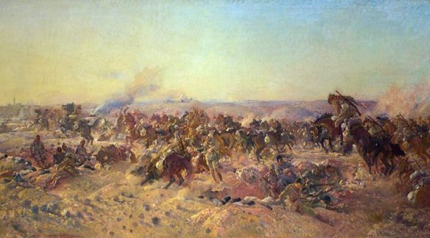
The Charge of the Australian Light Horse at Beersheba, 1917,
1920, Oil on Canvas, Australian War Memorial https://gurupig.com/2017/10/23/the-charge-of-the-australian-light-horse-at-beersheba-31-october-2017/

Slide 9
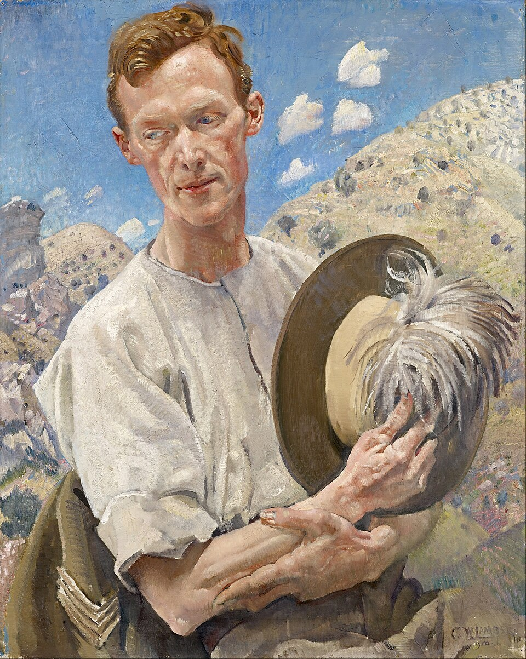
A Sergeant of Light Horse in Palestine, 1920, Oil on Canvas, 77x62 cm, National Gallery of Victoria, Australia https://commons.wikimedia.org/wiki/File:George_W._Lambert_-_A_sergeant_of_the_Light_Horse_-_Google_Art_Project.jpg

Slide 10
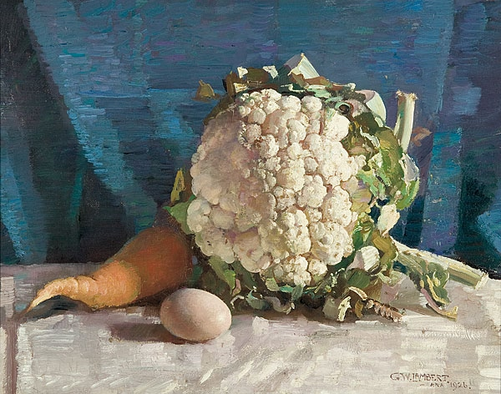
Egg and cauliflower still life, 1926, Oil on Canvas, 34.3x44.1 cm, Art Gallery of South Australia, Australia https://commons.wikimedia.org/wiki/File:George_Washington_Lambert_-_Egg_and_cauliflower_still_life.jpg

Slide 11
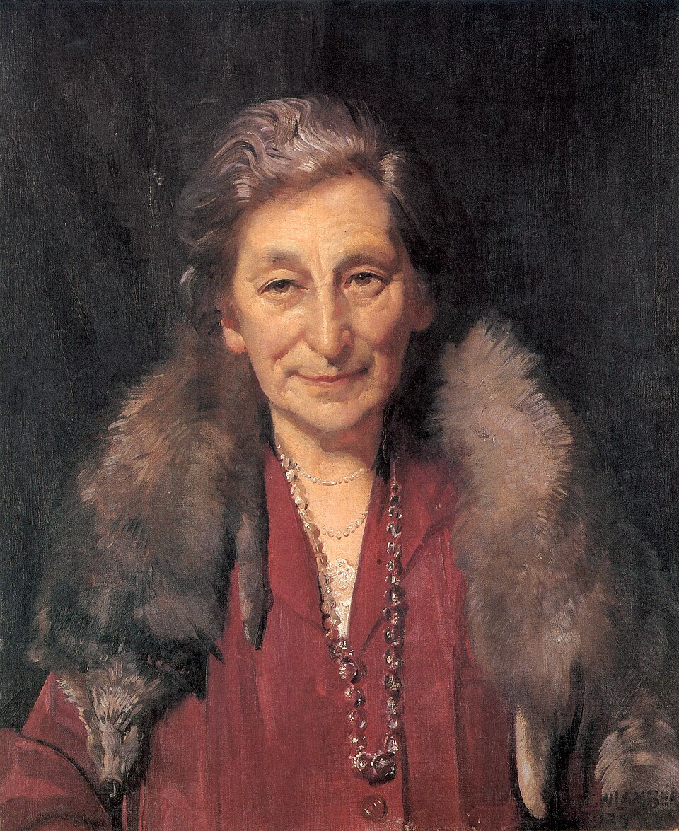
Portrait of Mrs Annie Murdoch, 1927, Oil on Canvas, 59.6 cm (23.4 in) Edit this at Wikidata; width: 49.5 cm, Private Collection https://commons.wikimedia.org/wiki/File:George_Washington_Lambert_-_Mrs_Annie_Murdoch.jpg

Slide 12
The End

