Slide 1
Henri Rousseau
1844 - 1910
10 Paintings

Slide 2
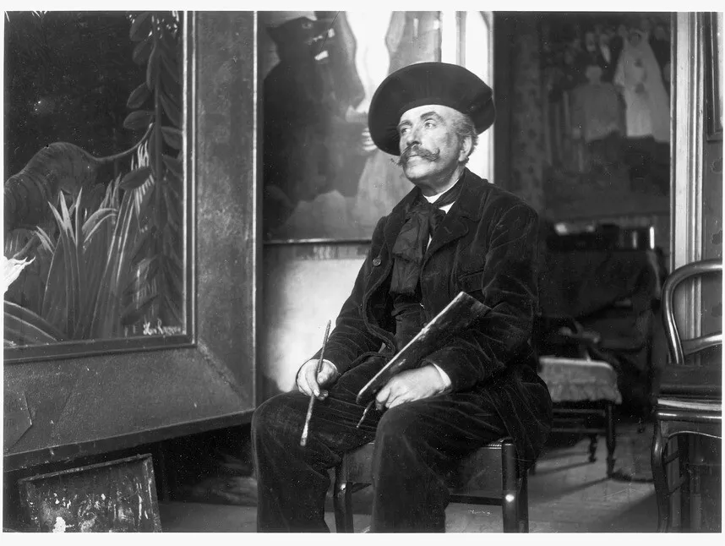
Henri Rousseau in his studio in 1907, Dornac (Paul François Arnold Cardon) / Archives Larousse / Bridgeman Images https://www.smithsonianmag.com/smart-news/meet-henri-rousseau-the-untrained-artist-who-wouldnt-quit-painting-despire-the-ridicule-he-received-from-critics-180987548/

Slide 3
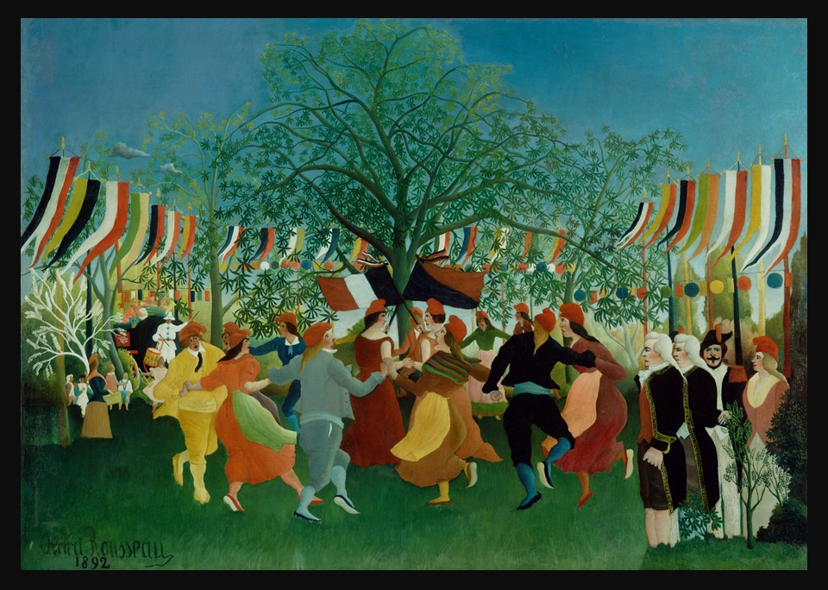
A Centennial of Independence, 1892, Oil on Canvas, 111.8 × 158.1 cm, the Getty Museum, CA, USA https://www.getty.edu/art/collection/object/103RJB

Slide 4
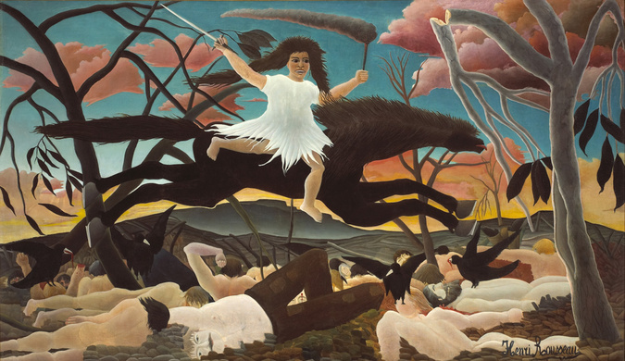
War, c. 1894, Oil on Canvas, 114,5x195 cm, Musée d'Orsay, Paris, France https://www.musee-orsay.fr/fr/collections/recherche?union_artist_names=21236&search_type=advanced_search

Slide 5
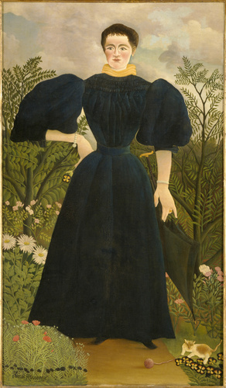
Portrait of Madame M., 1896, Oil on Canvas, 198,0x114,5 cm, Musée d'Orsay, Paris, France https://www.musee-orsay.fr/fr/collections/recherche?union_artist_names=21236&search_type=advanced_search

Slide 6
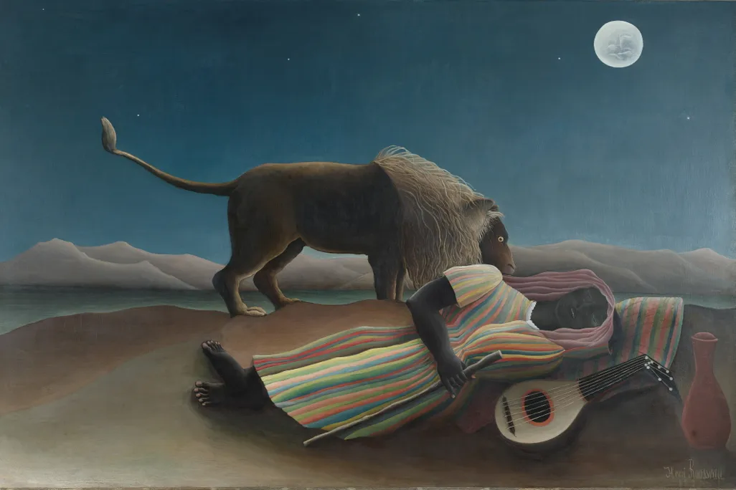
The Sleeping Girl, 1897, Oil on Canvas, 129.5x200.7 cm, MOMA, NY, USA https://www.smithsonianmag.com/smart-news/meet-henri-rousseau-the-untrained-artist-who-wouldnt-quit-painting-despire-the-ridicule-he-received-from-critics-180987548/

Slide 7
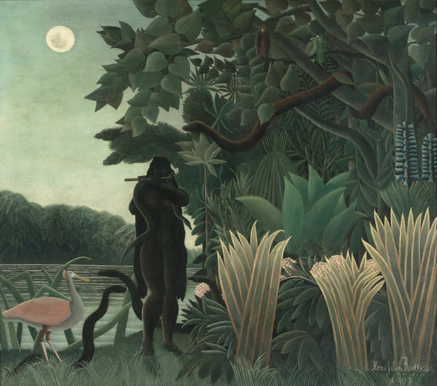
La Charmeuse de serpents, 1907, Oil on Canvas, 167x189,5 cm, Musée d'Orsay, Paris, France https://www.musee-orsay.fr/fr/collections/recherche?union_artist_names=21236&search_type=advanced_search

Slide 8
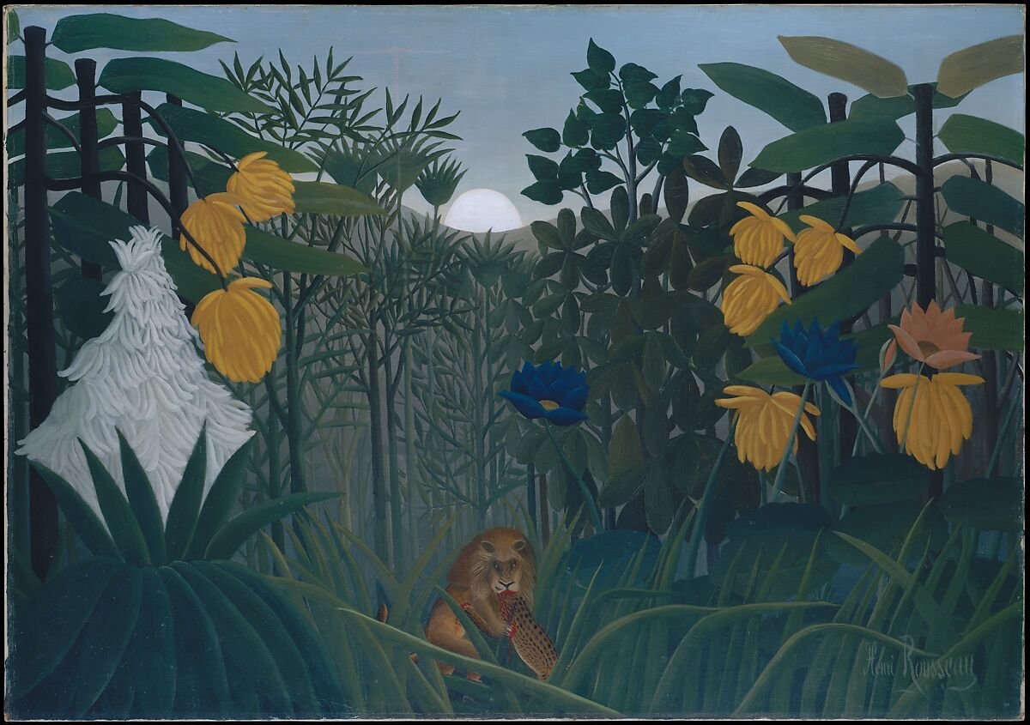
The Repast of the Lion, ca. 1907, Oil on Canvas, 113.7x160 cm, the MET, NY, USA https://www.metmuseum.org/art/collection/search/438822

Slide 9
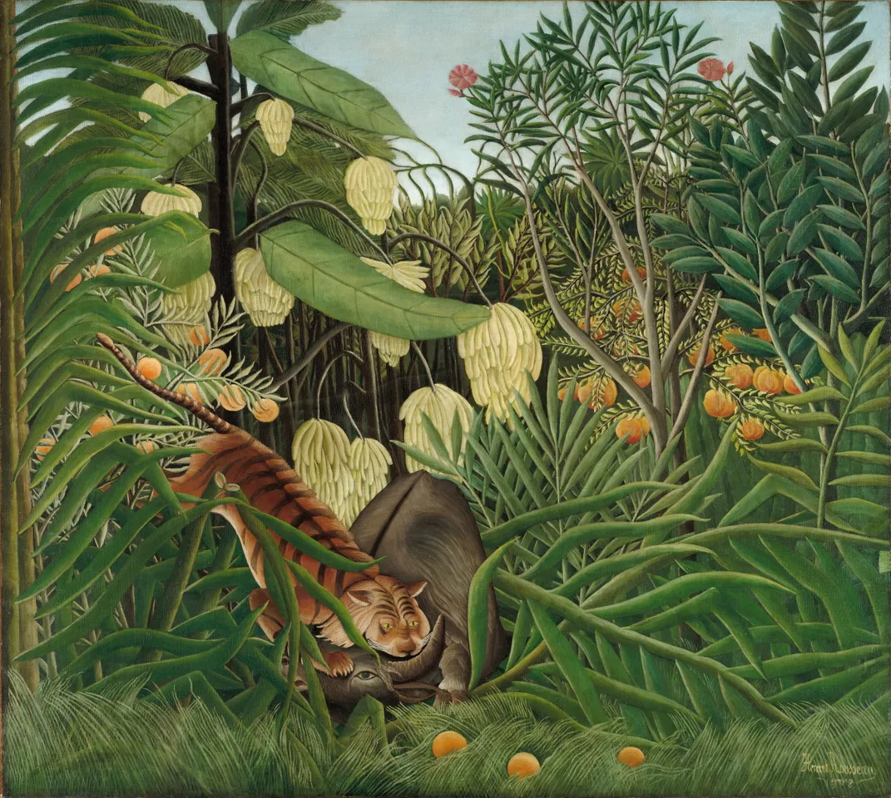
Fight Between a Tiger and a Buffalo, 1908, Oil on Canvas, 170x189.5 cm, The Cleveland Museum of Art https://www.smithsonianmag.com/smart-news/meet-henri-rousseau-the-untrained-artist-who-wouldnt-quit-painting-despire-the-ridicule-he-received-from-critics-180987548/

Slide 10
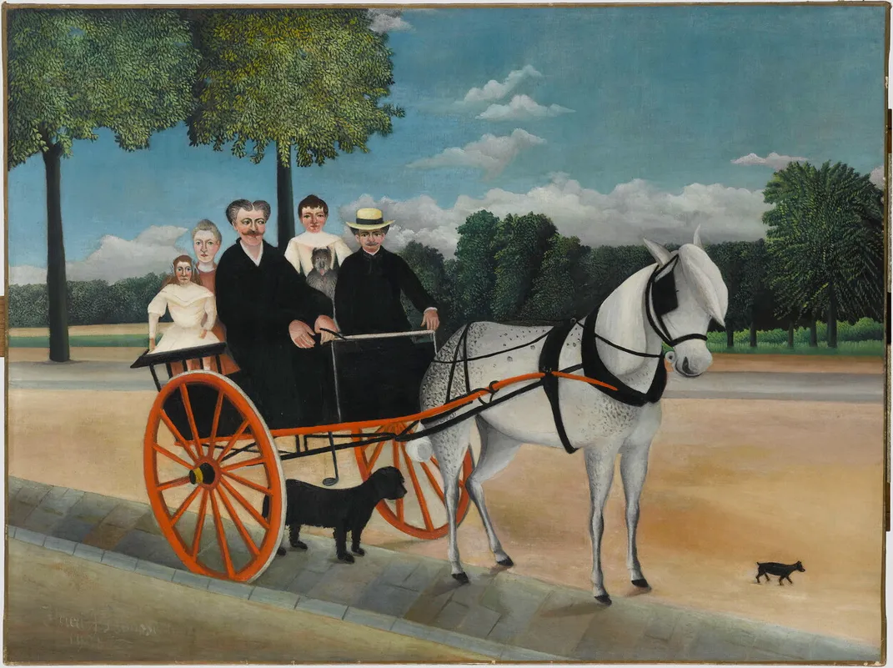
Père Junier’s Cart, 1908, Oil on Canvas, 97x129 cm, Musée de l’Orangerie, Paris, France https://www.smithsonianmag.com/smart-news/meet-henri-rousseau-the-untrained-artist-who-wouldnt-quit-painting-despire-the-ridicule-he-received-from-critics-180987548

Slide 11
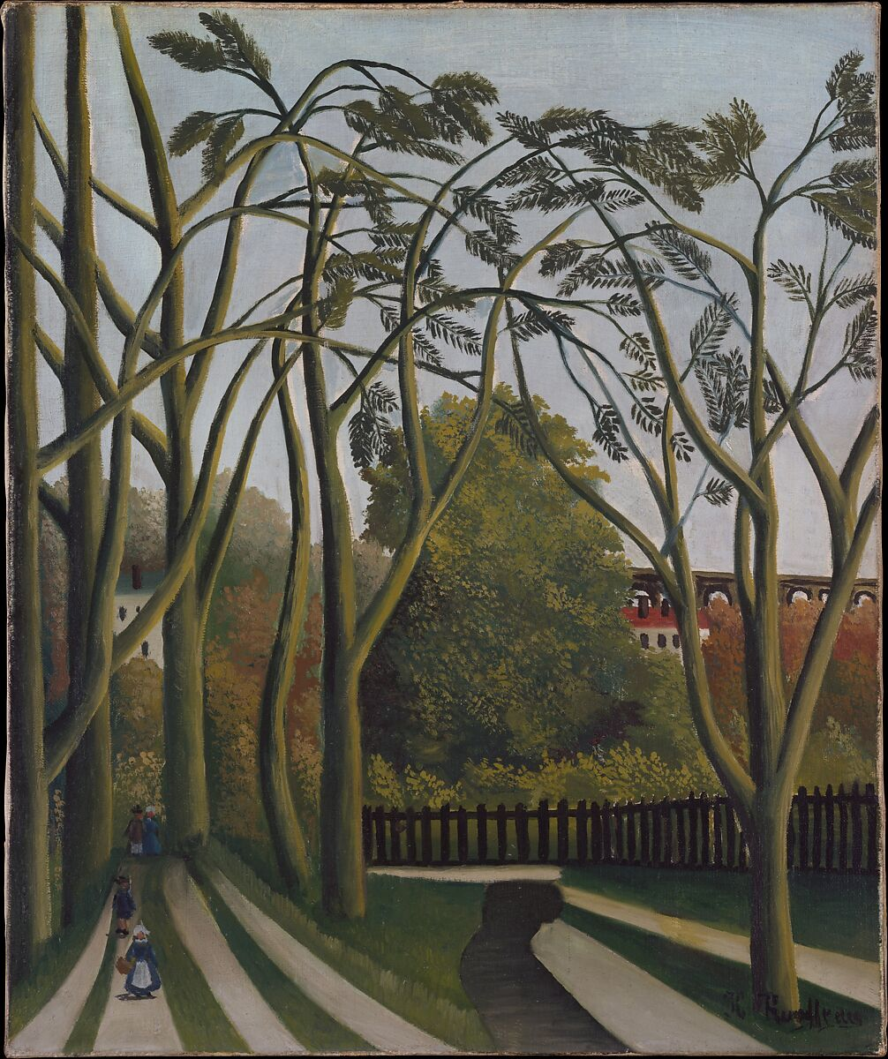
The Banks of the Bièvre near Bicêtre, ca. 1908–09, Oil on Canvas, 54.6 x 45.7 cm, the MET, NY, USA https://www.metmuseum.org/art/collection/search/437512

Slide 12
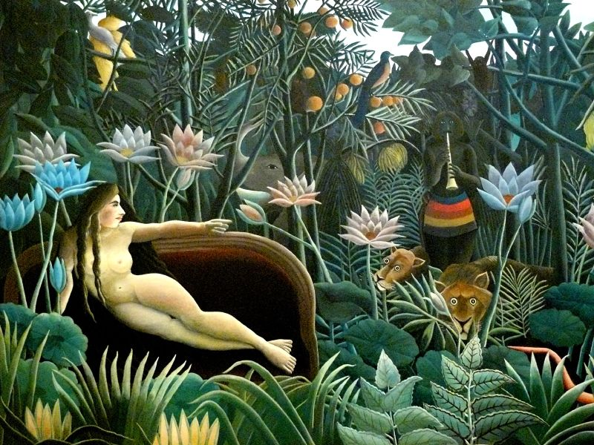
The Dream, 1910, Oil on Canvas, 204.5x298.5 cm, MOMA, NY, USA https://commons.wikimedia.org/wiki/File:WLA_moma_Henri_Rousseau_The_Dream.jpg

Slide 13
The End

