Slide 1
Childe Hassam, 1859-1935

Slide 2
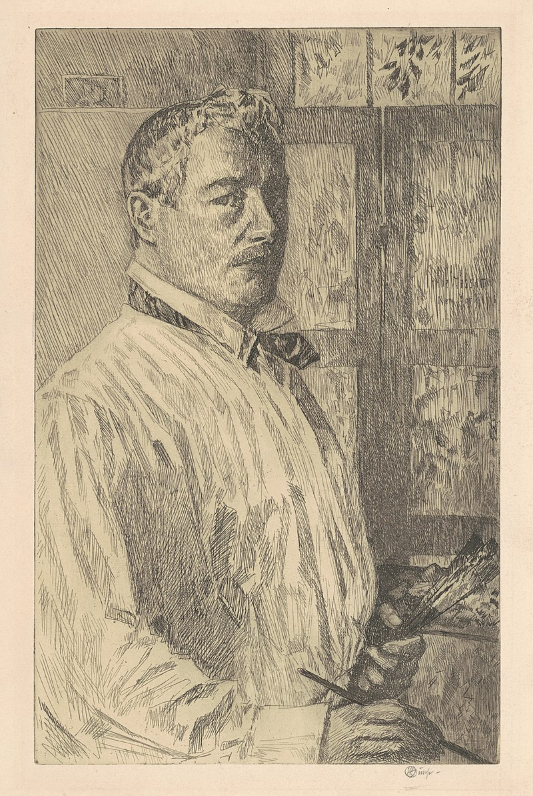
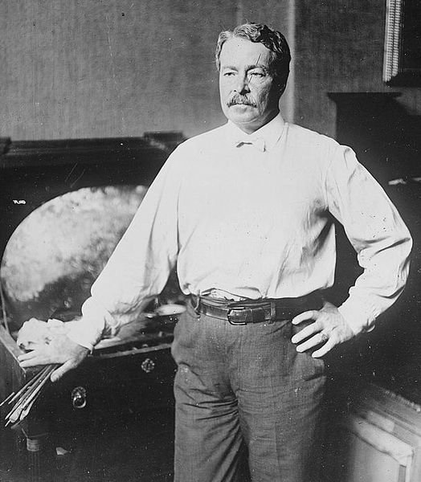
Childe Hassam, 1859-1935
Self-Portrait, 1916, etching in black on wove paper, 27.78 × 17.62 cm,
National Gallery of Art, Washington, DC, USA https://www.nga.gov/artworks/169562-self-portrait
Unknown Photo of Childe Hassam, early 20th century, Library of Congress, Washington, DC, USA

Slide 3
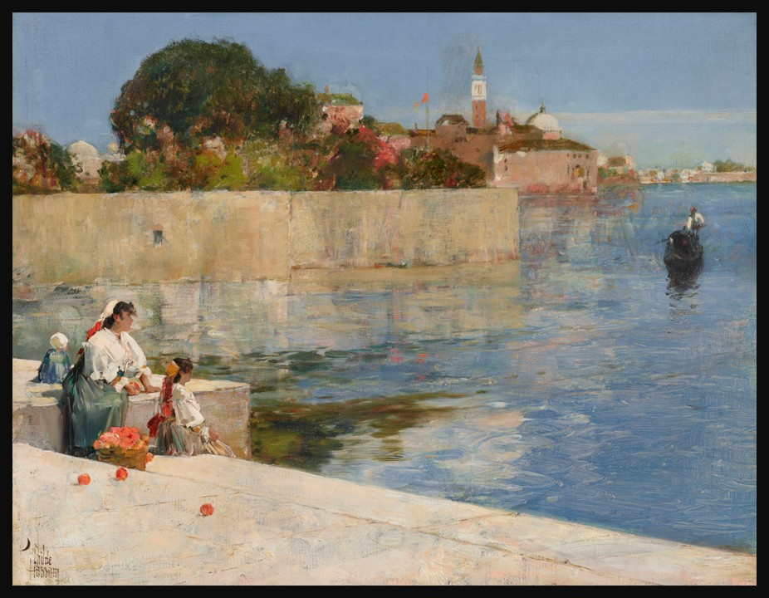
View of Venice, c. 1883, Oil on Canvas, 32.4 x 40.6 cm, Private Collection https://www.christies.com/en/lot/lot-6519611?ldp_breadcrumb=back

Slide 4
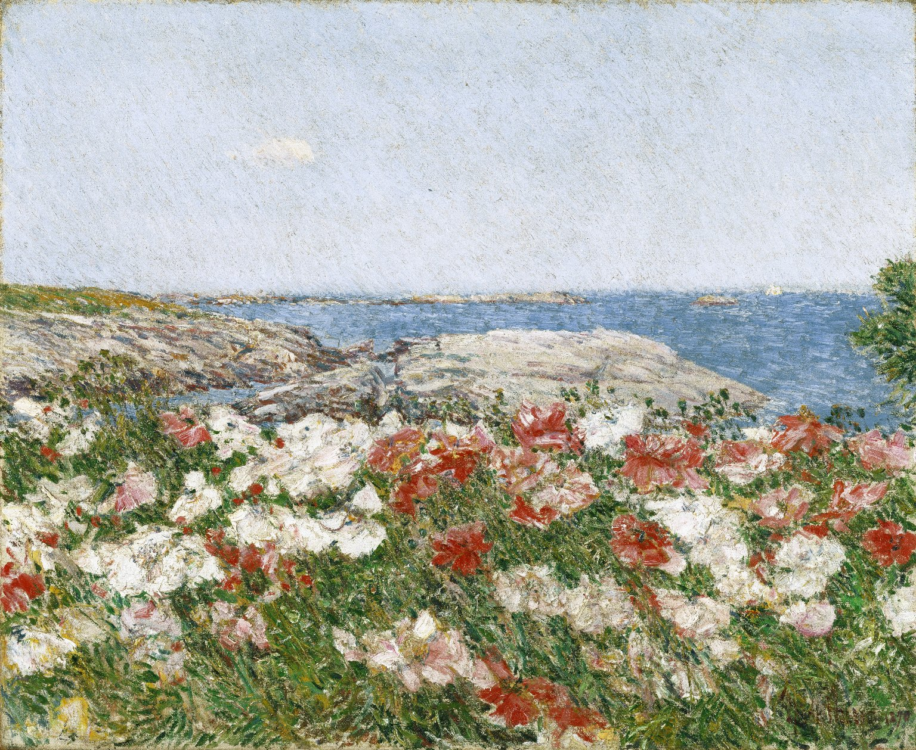
Poppies on the Isles of Shoals, 1890. Oil on Canvas, 45.7 x 55.7 cm, Brooklyn Museum, NY, USA https://commons.wikimedia.org/wiki/File:Poppies_on_the_Isles_of_Shoals,_Childe_Hassam.jpg

Slide 5
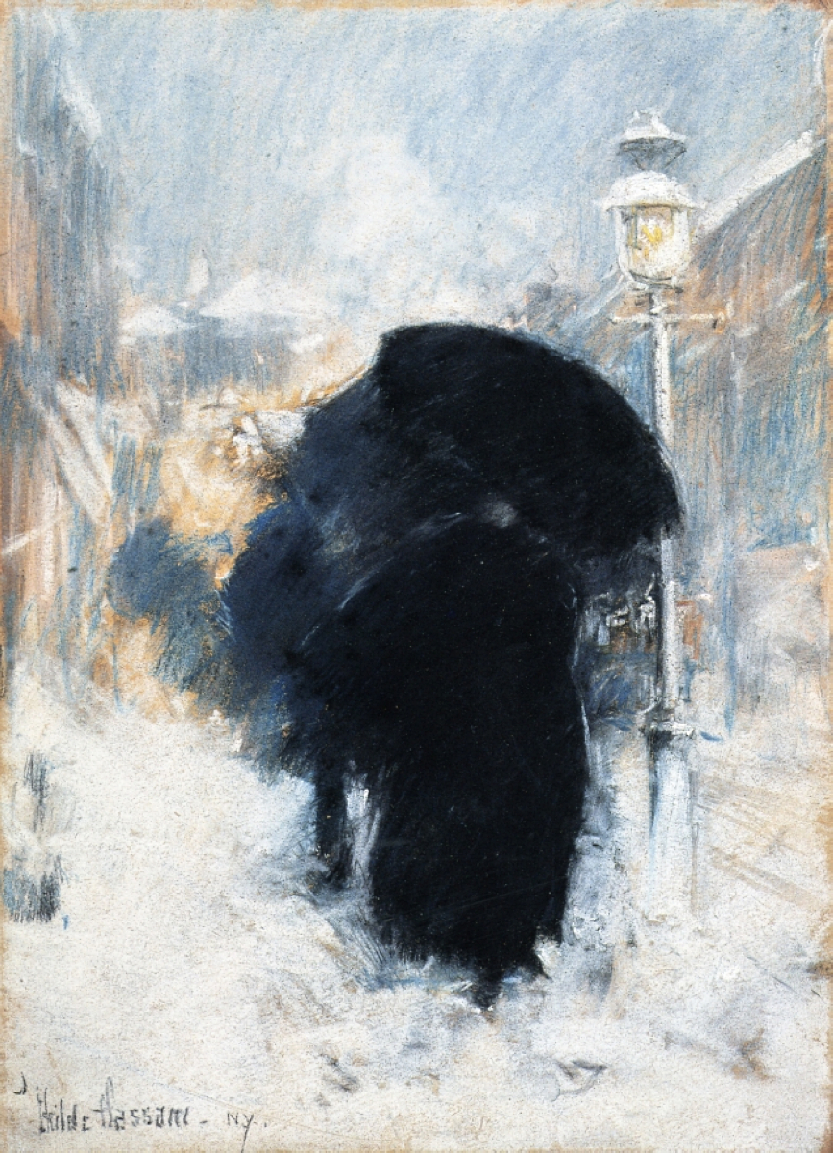
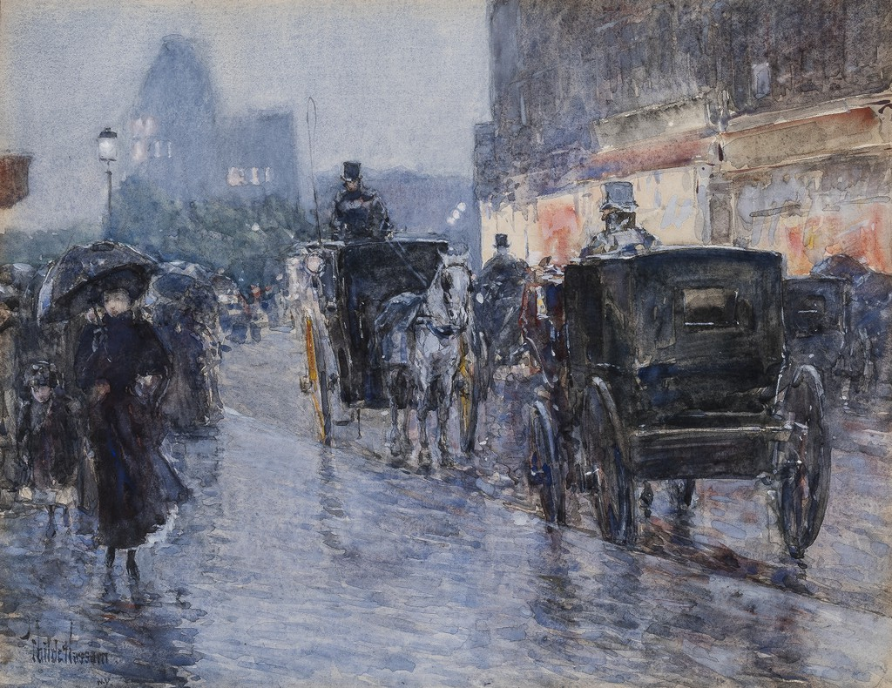
Horse Drawn Cabs at Evening, New York, c. 1890, Watercolor on paper, 35.6 x 45.1 cm, Terra Foundation for American Art https://conversations.terraamericanart.org/artworks/horse-drawn-cabs-at-evening-new-york/
A New York Blizzard, 1890, Pastel on grey paper, 35 x 24 cm, Isabella Steward Gardner Museum https://www.gardnermuseum.org/experience/collection/10824

Slide 6
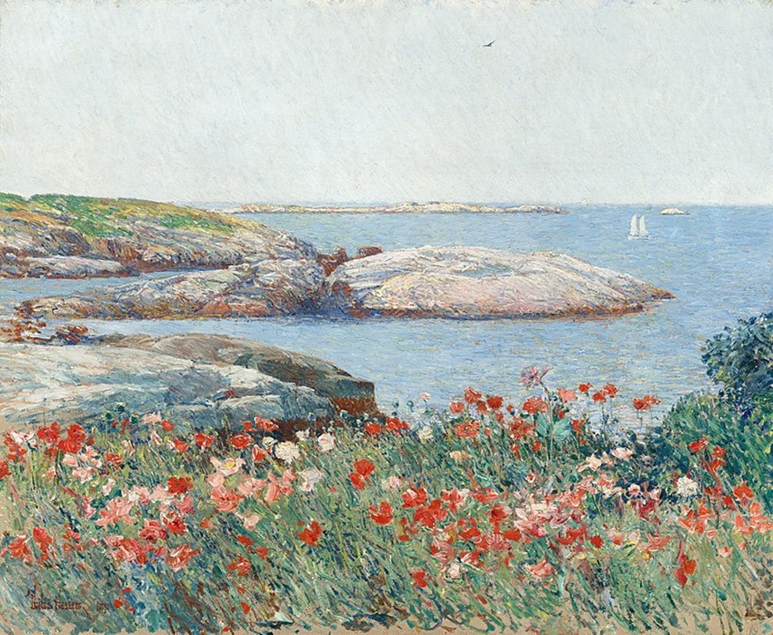
Poppies on the Isles of Shoals, 1891, 50.2x61 cm, National Gallery of Art, Washington DC, USA https://commons.wikimedia.org/wiki/File:Childe_Hassam,_Poppies,_Isles_of_Shoals,_1891.jpg

Slide 7
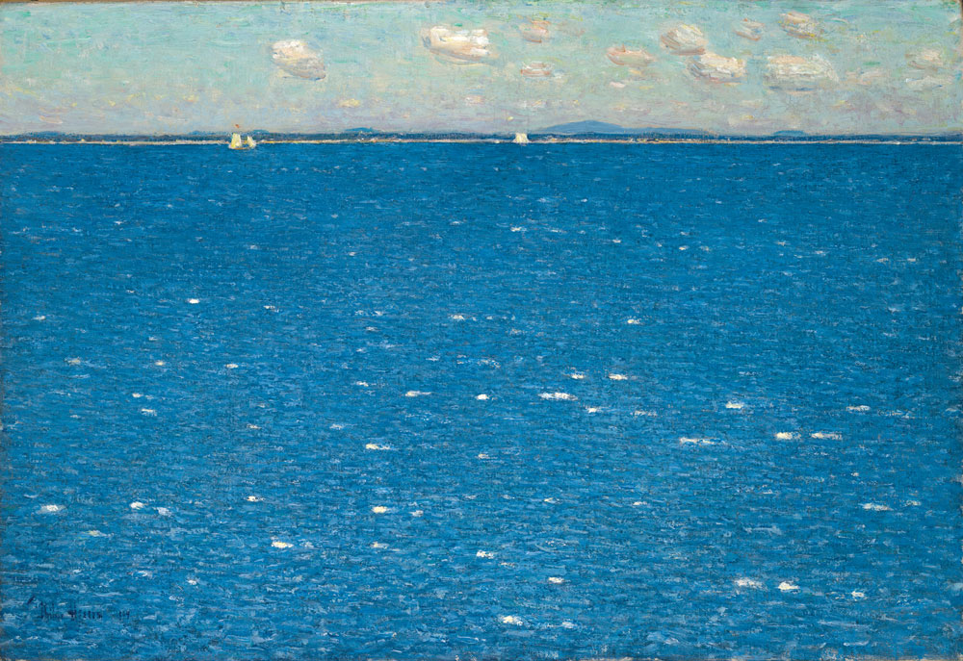
West Wind, Isles of Shoals, 1904, Oil on Canvas, 38.1x55.9 cm, Yale University Art Gallery, USA https://www.incollect.com/articles/american-impressionist-childe-hassam-and-the-isles-of-shoals

Slide 8
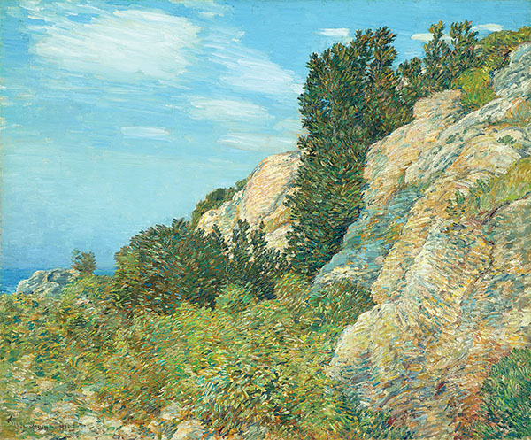
The Laurel in the Ledges, Appledore, 1905, Oil on Canvas, 63.5x76.2 cm, North Carolina Museum of Art, Raleigh, NC, USA https://www.historynet.com/childe-hassams-island-escape/

Slide 9
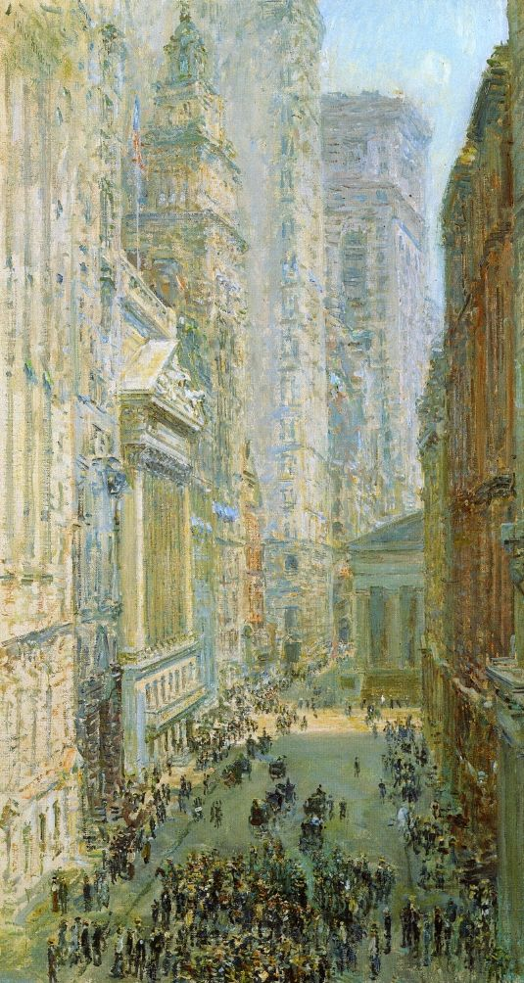
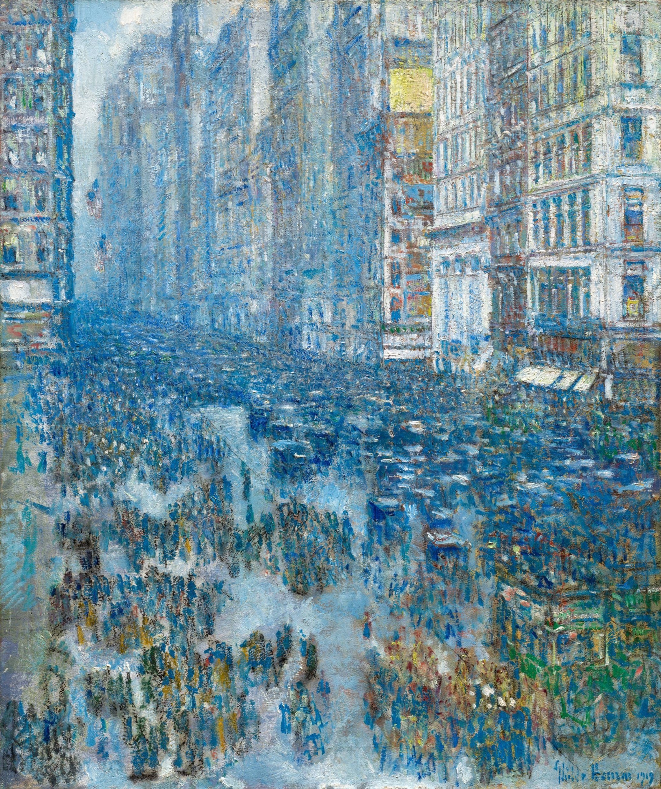
Lower Manhattan, 1907,oil on canvas,
78.7 x 42.5 cm,
Herbert F. Johnson Museum of Art https://visualelsewhere.wordpress.com/2012/08/06/childe-hassam-herbert-f-johnson-museum-of-art-loan-94-070-lower-manhattan-view-down-broad-street-1907/
Fifth Avenue, 1919, Oil on canvas, 61.3 x 51.5 cm, The Cleveland Museum of Art, USA https://www.clevelandart.org/art/1952.539

Slide 10
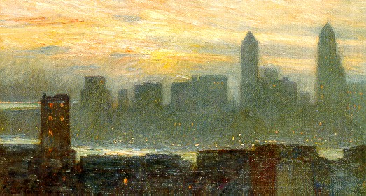
Manhattan's Misty Sunset, 1911, Oil on canvas, 45.72 x 81.28 cm, Butler Institute of Art http://americanartgallery.org/artist/details/view/sshow/id/131/pictureId/1254

Slide 11
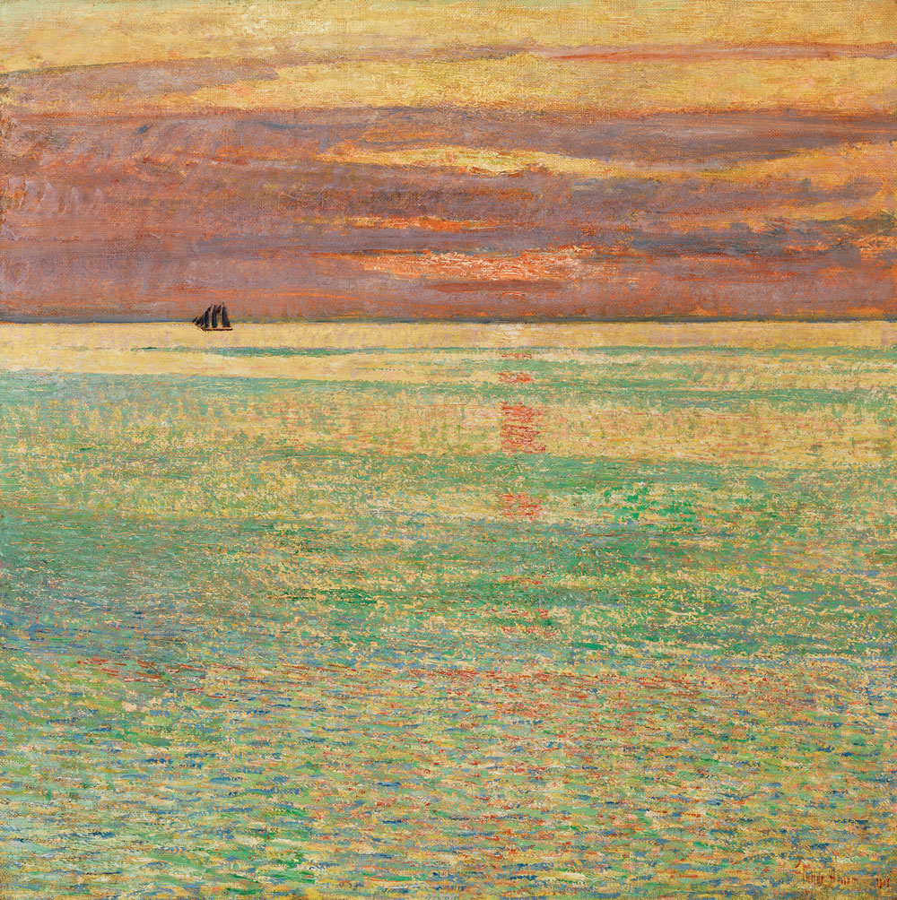
Sunset at Sea, 1911
Oil on canvas,
87.22x87.63 cm, Private collection https://www.incollect.com/articles/american-impressionist-childe-hassam-and-the-isles-of-shoals

Slide 12
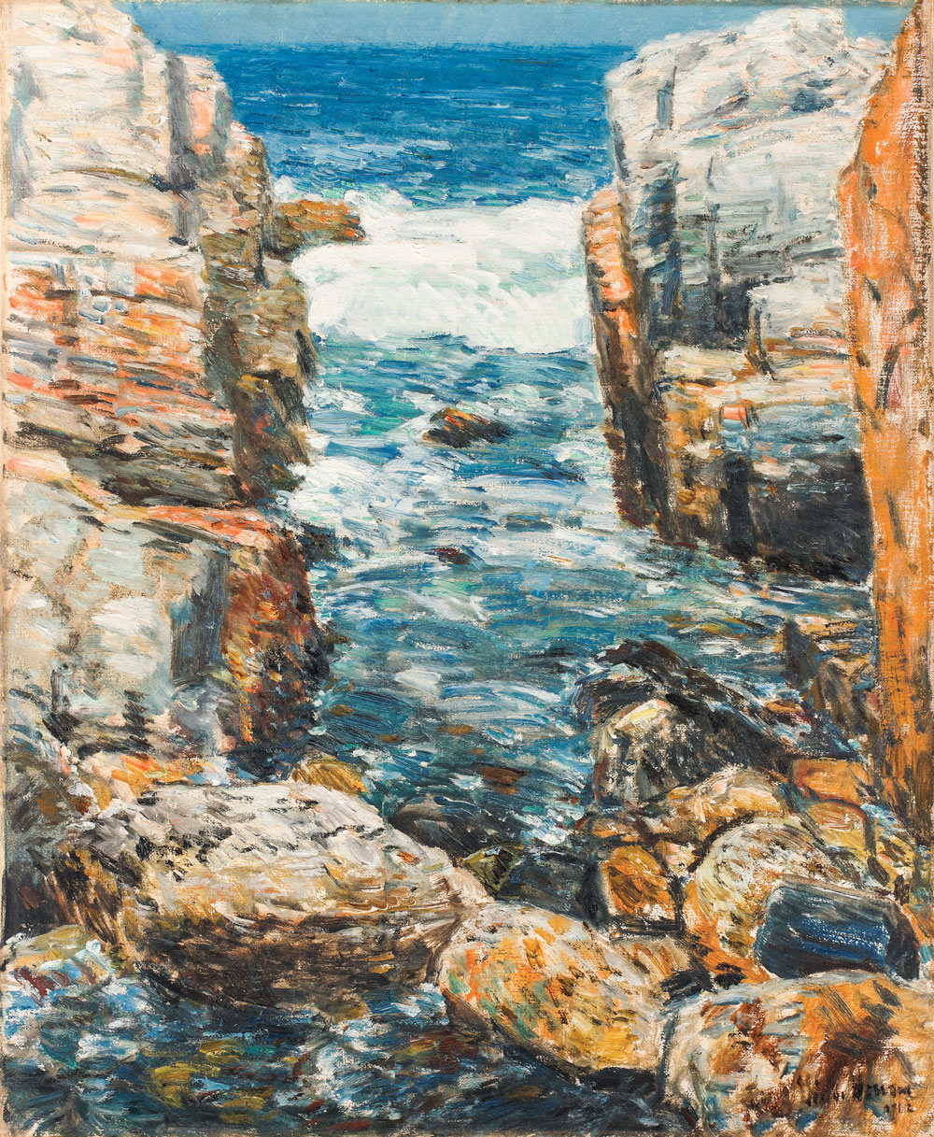
South Gorge, Appledore, Isles of Shoals, 1912
Oil on Canvas, 59.7 x 49.5 cm, Newark Museum, NJ, USA https://www.incollect.com/articles/american-impressionist-childe-hassam-and-the-isles-of-shoals

Slide 13
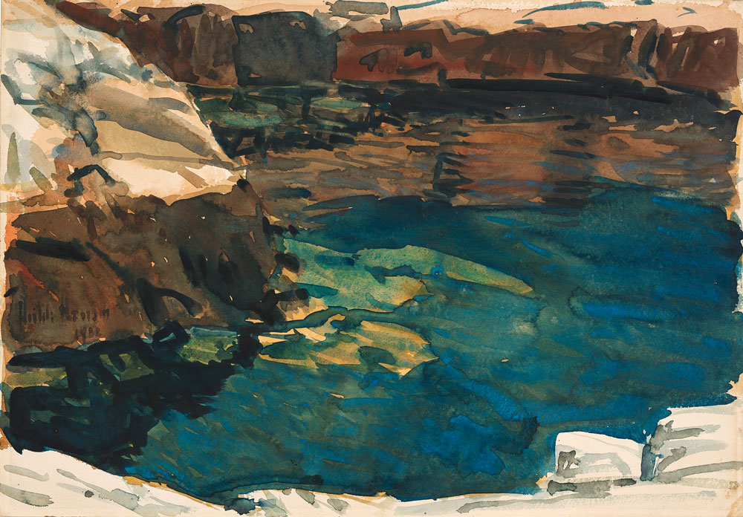
The Cove, 1912, Watercolor on Paper, 35.56x50.8 cm, Wichita Art Museum, Wichita, KS, USA https://www.incollect.com/articles/american-impressionist-childe-hassam-and-the-isles-of-shoals

Slide 14
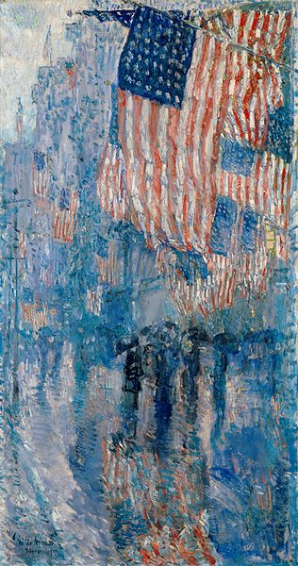
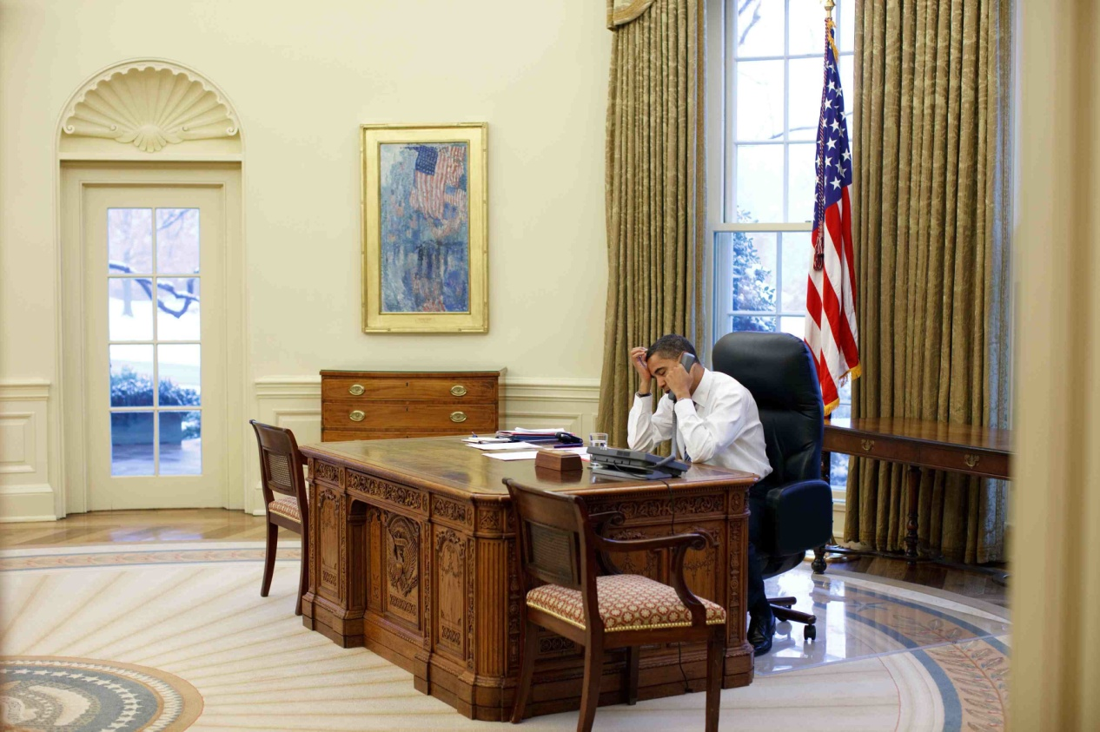
The Avenue of Rain, 1917, oil on canvas, The
White House, Washington, DC
". . . The avenue is Fifth Avenue, frequently decorated with American flags as American sentiment moved . . . from isolationism toward Intervention. The artist's most striking device here is the projection of flags into the picture from points of unseen anchor beyond the frame . . . . In one sense the flags become the surface of the painting . . . . https://www.whitehousehistory.org/photos/treasures-of-the-white-house-avenue-in-the-rain

Slide 15
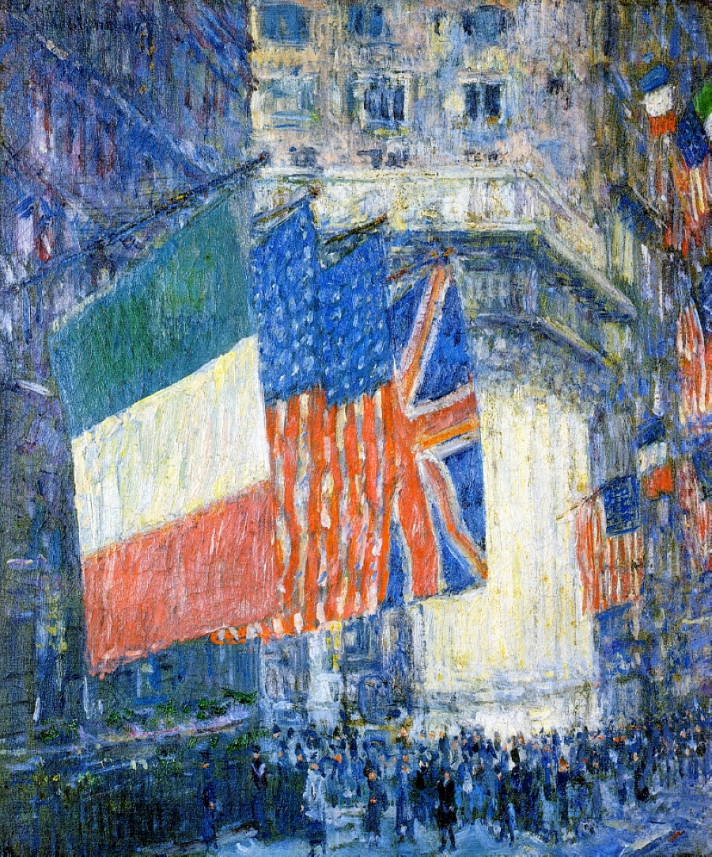
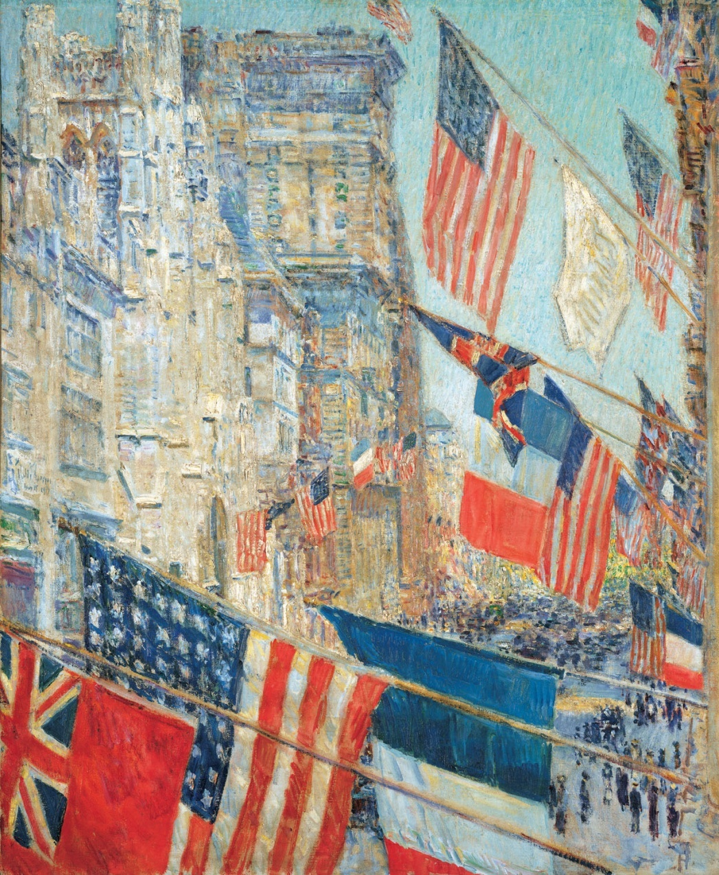
Avenue of the Allies, 1917, oil on canvas, Telfair Museum of Art, Savannah https://collections.telfair.org/objects/5335/avenue-of-the-allies
Allies Day, May 1917, 1917, oil on canvas, 92.7 x 76.8 cm, NGA https://www.nga.gov/artworks/30115-allies-day-may-1917

Slide 16
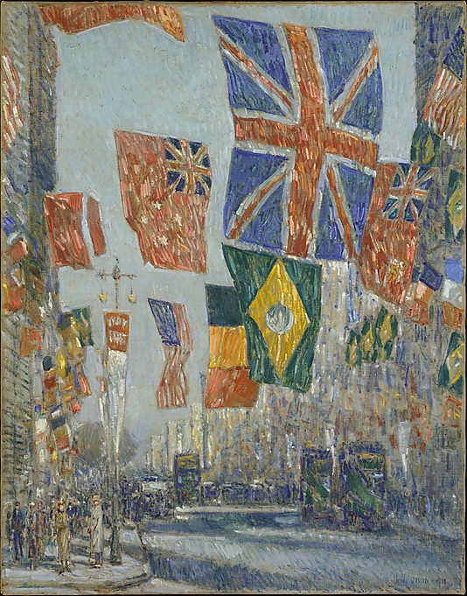
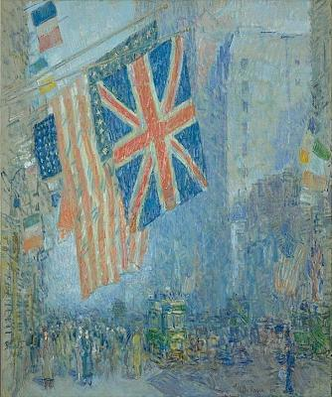
The Union Jack, New York, April Morning, 1918, Oil on canvas, 91.3 X 76.5 cm, Hirshhorn Museum https://www.si.edu/object/union-jack-new-york-april-morning%3Ahmsg_66.2402
Avenue of the Allies, Great Britain, 1918, oil on canvas, 91.4 x 72.1 cm, The MET https://www.metmuseum.org/art/collection/search/11028

Slide 17
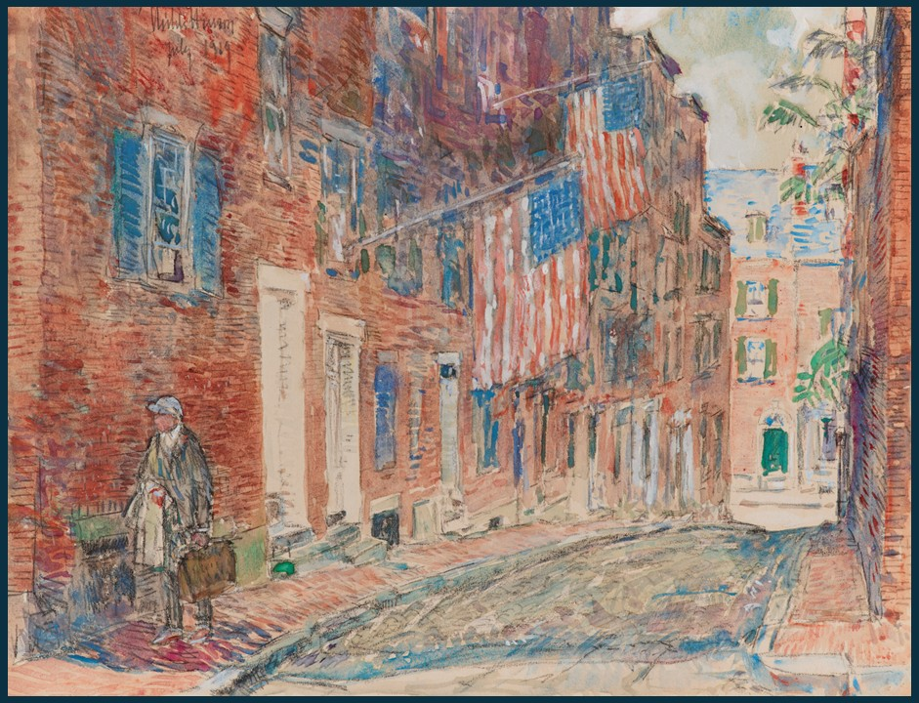
Acorn Street, Boston, July 1919, Mixed media on paper, 21 x 27.9 cm, Private Collection https://www.christies.com/en/lot/lot-6570341?ldp_breadcrumb=back

