Slide 1

Etruscan Art
Etruscan Funerary Art and Practices
Tomb of the Lionesses
circa 530-520 BC
Necropoli dei Monterozzi
Tarquinia, Italy

Slide 2
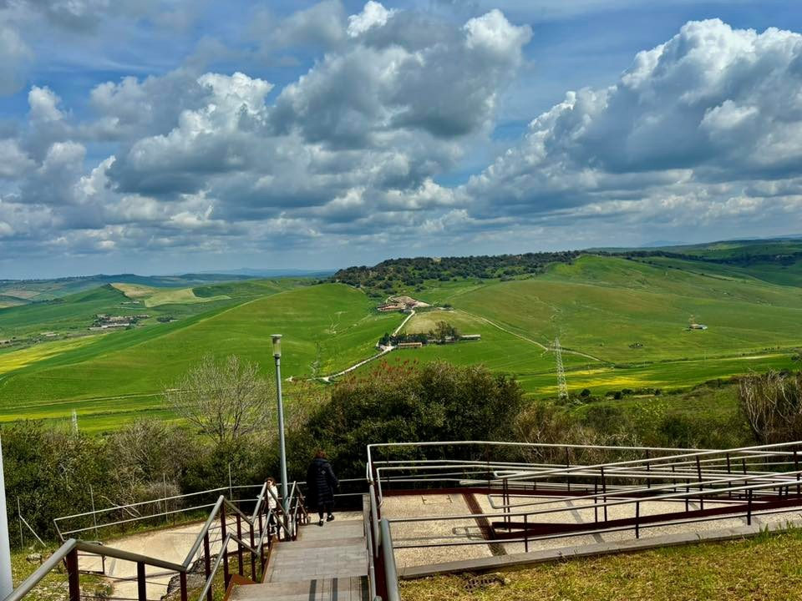
Etruscan Necropoli dei Monterozzi, Tarquinia, Italy
Photo Credit: Xanthippi Glavopoulou, April 2025

Slide 3
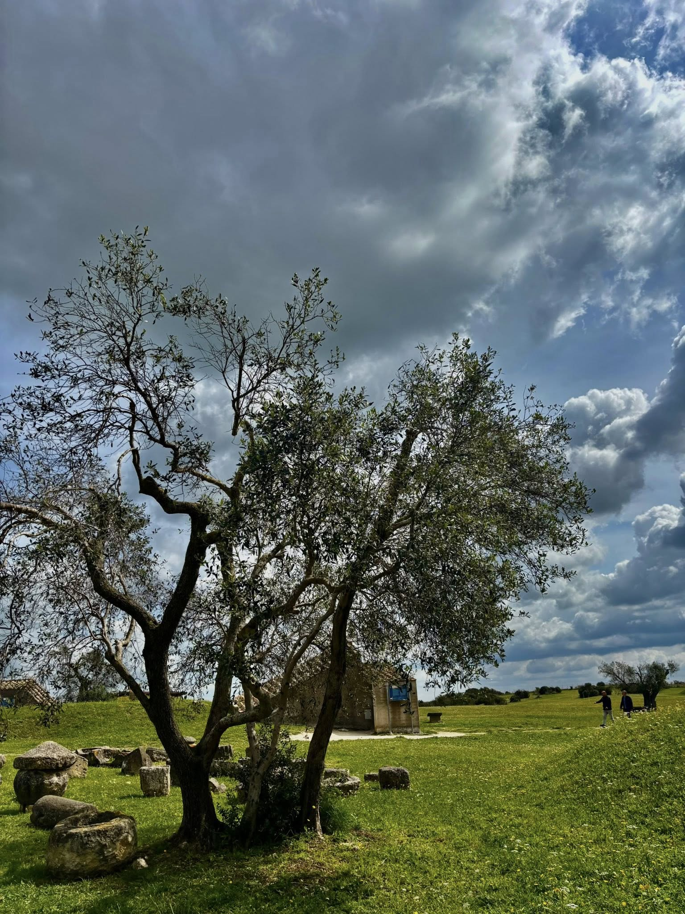
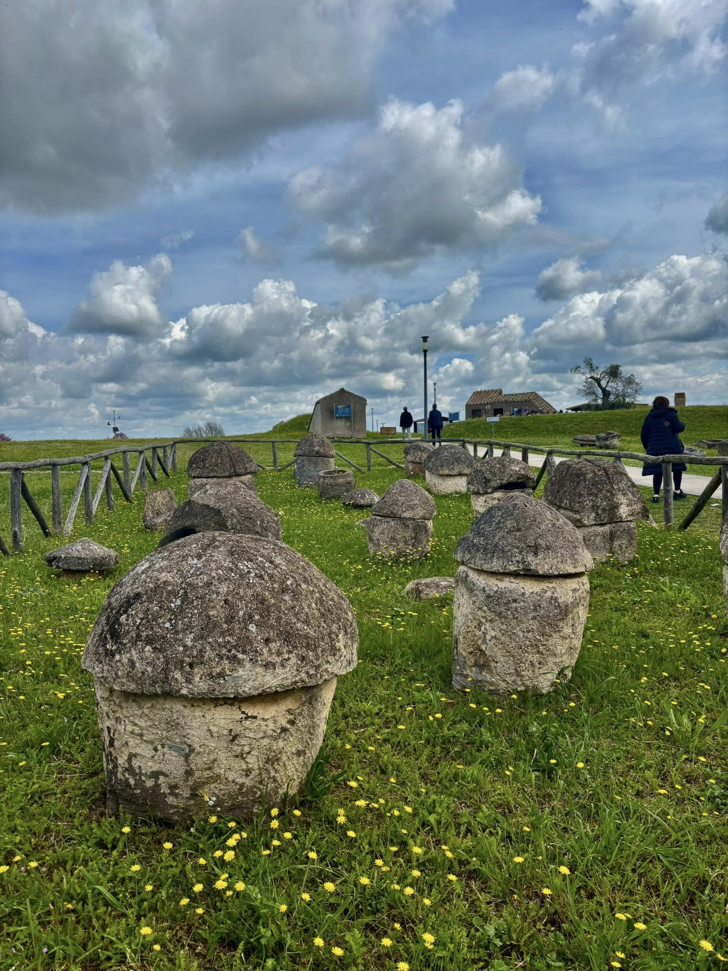
Etruscan Necropoli dei Monterozzi
Tarquinia, Italy
Photo Credit: Xanthippi Glavopoulou

Slide 4
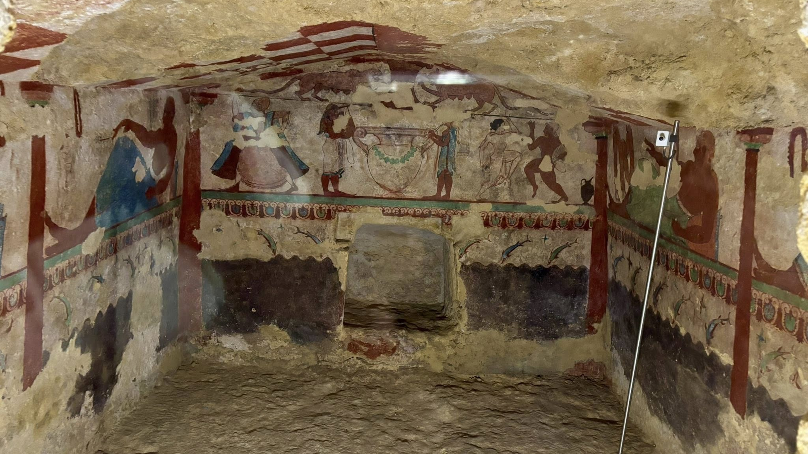
Photo Credit: Xanthippi Glavopoulou, April 2025

Slide 5
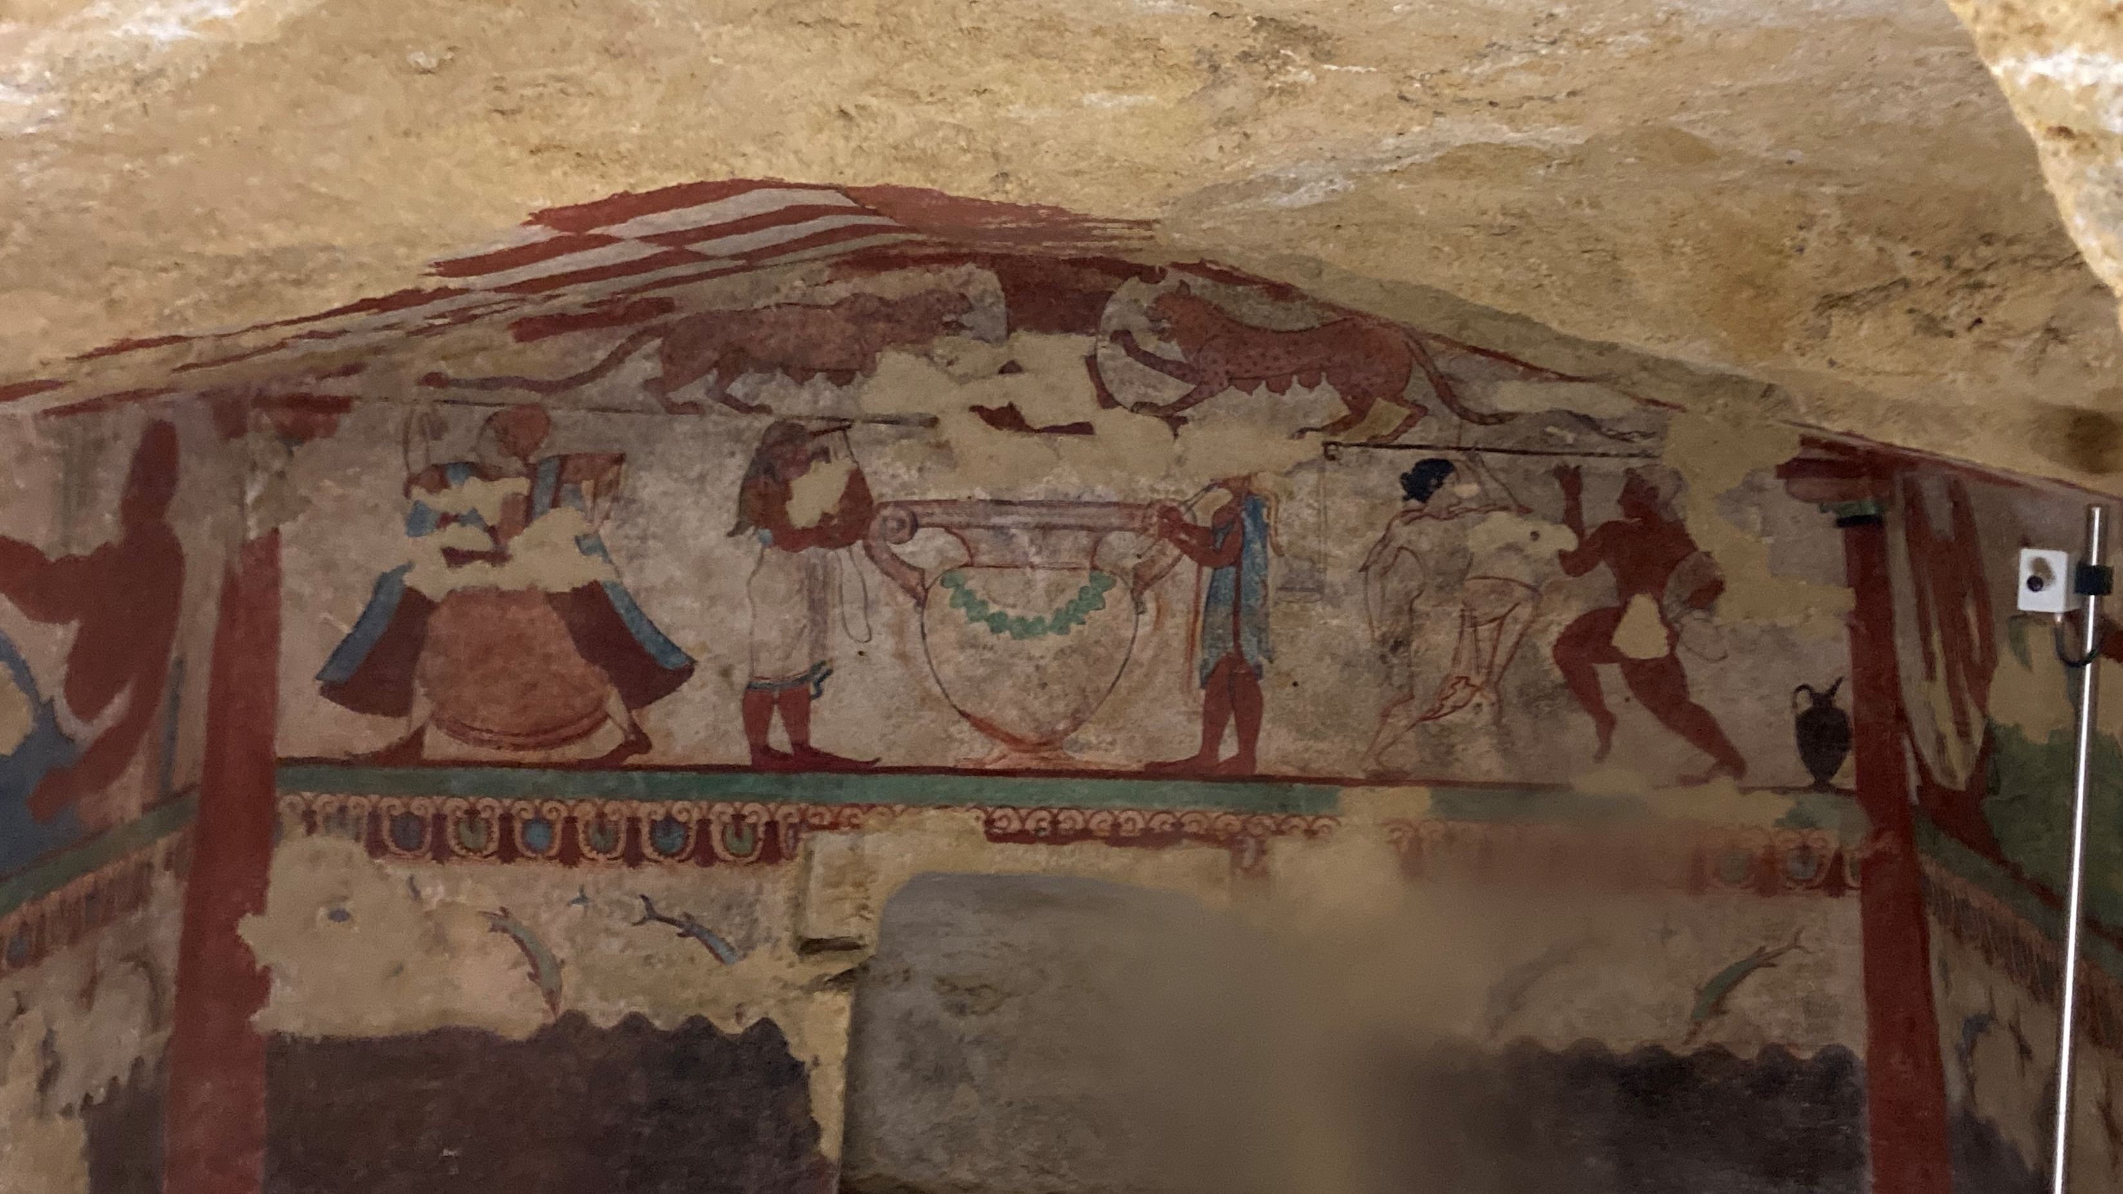
Rear Wall
Photo Credit: Amalia Spiliakou, April 2025

Slide 6
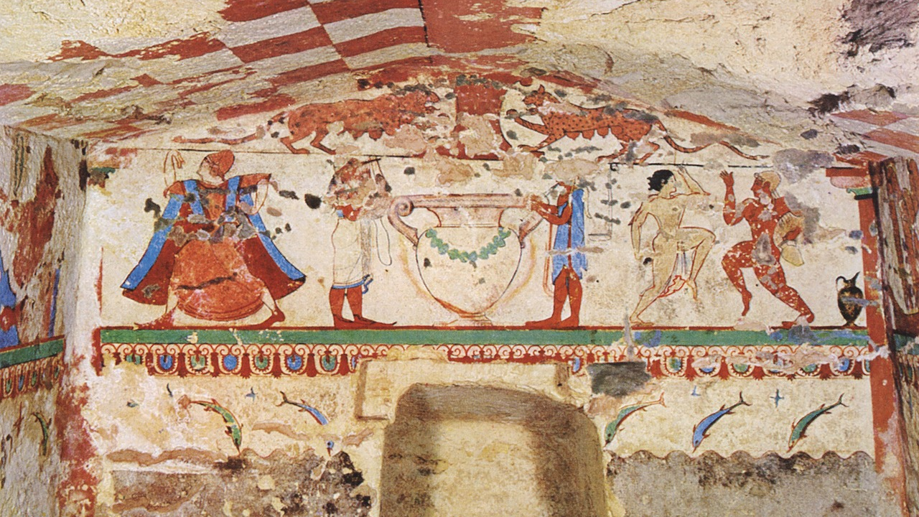
Rear Wall https://www.facebook.com/photo/?fbid=125778566707887&set=pcb.125779963374414

Slide 7
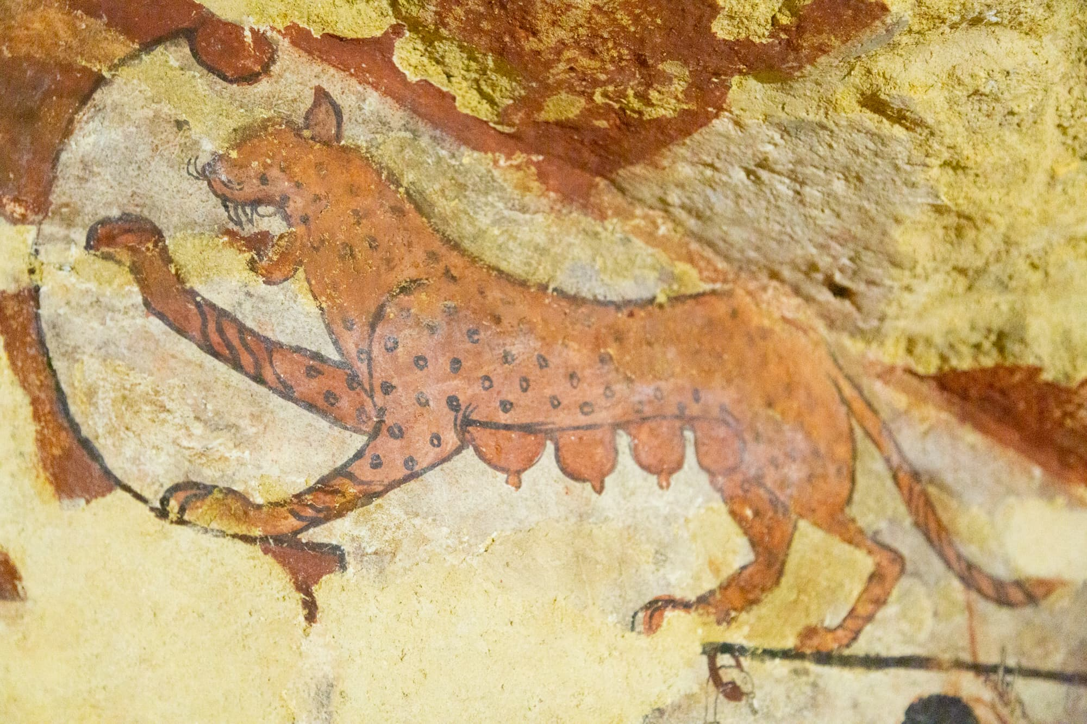
One of the two Lionesses, Rear Wall https://tarquiniaturismo.com/tomb-of-the-lionesses/?lang=en

Slide 8
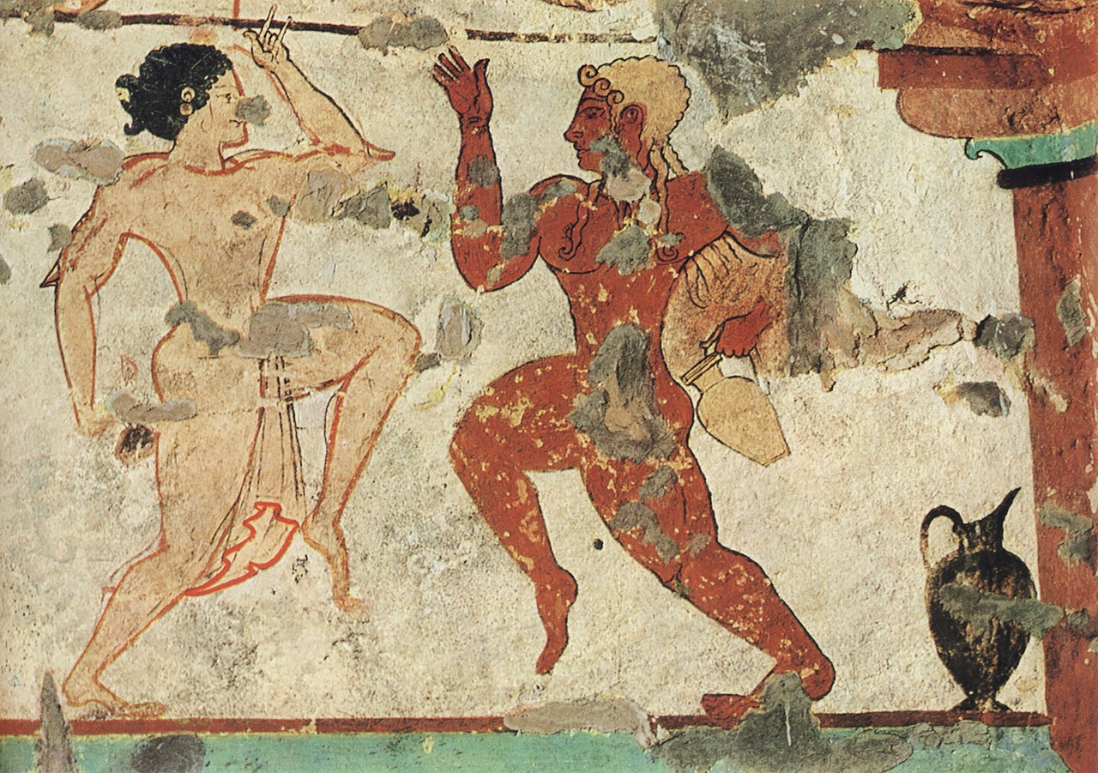
Ritual Dance, Rear Wall https://www.facebook.com/photo/?fbid=125778566707887&set=pcb.125779963374414

Slide 9
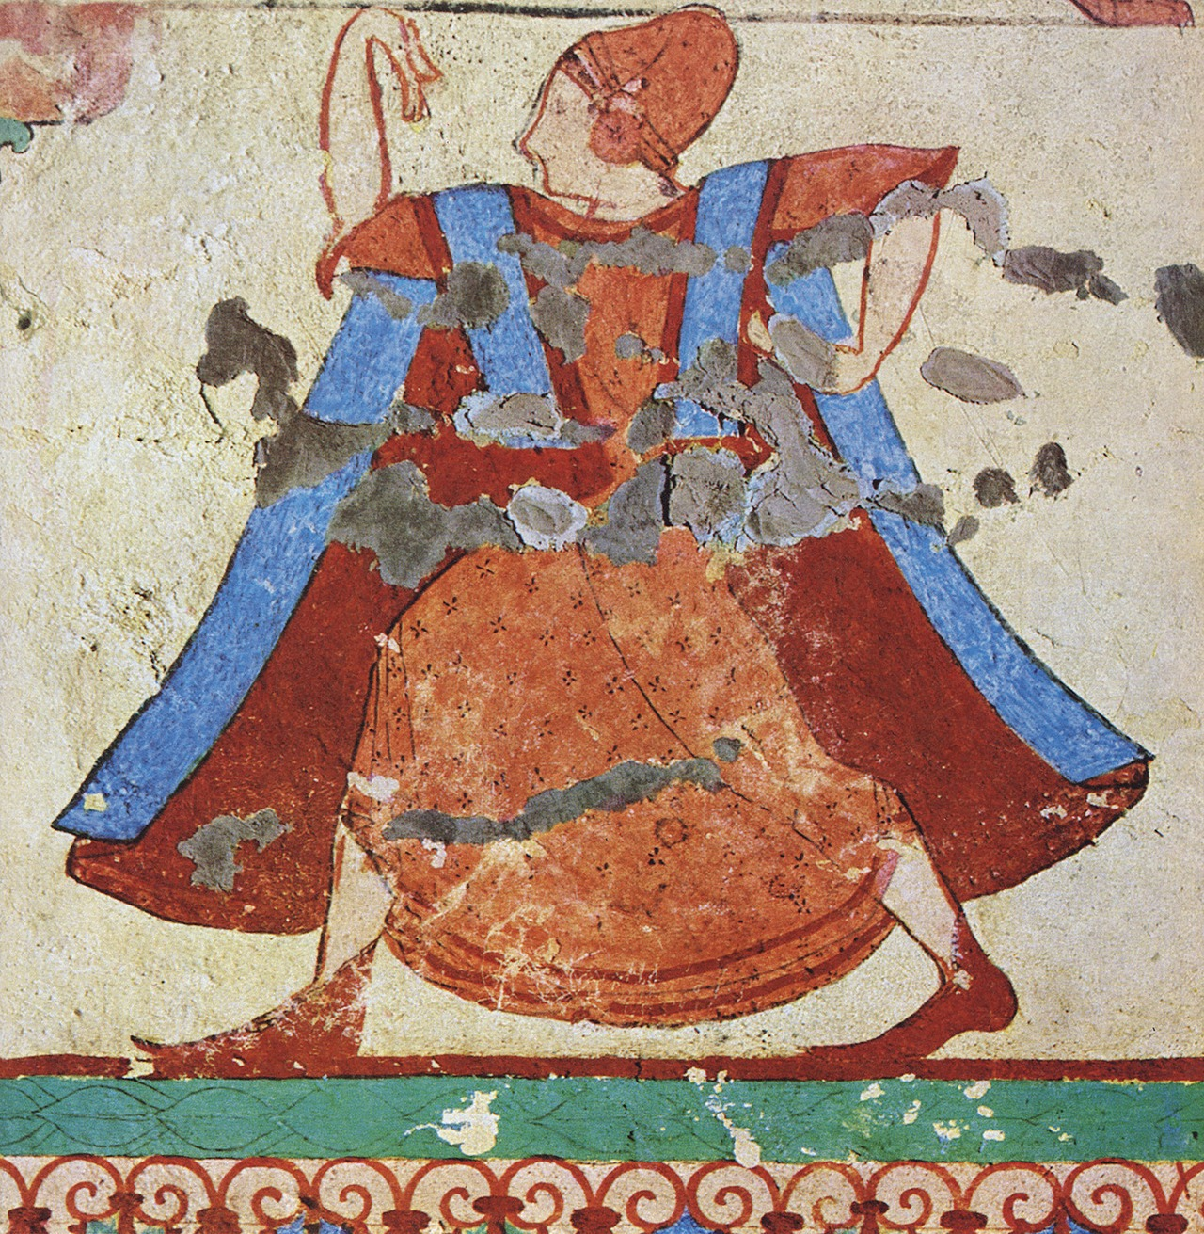
Ritual Dance, Rear Wall https://www.facebook.com/photo/?fbid=125778566707887&set=pcb.125779963374414

Slide 10
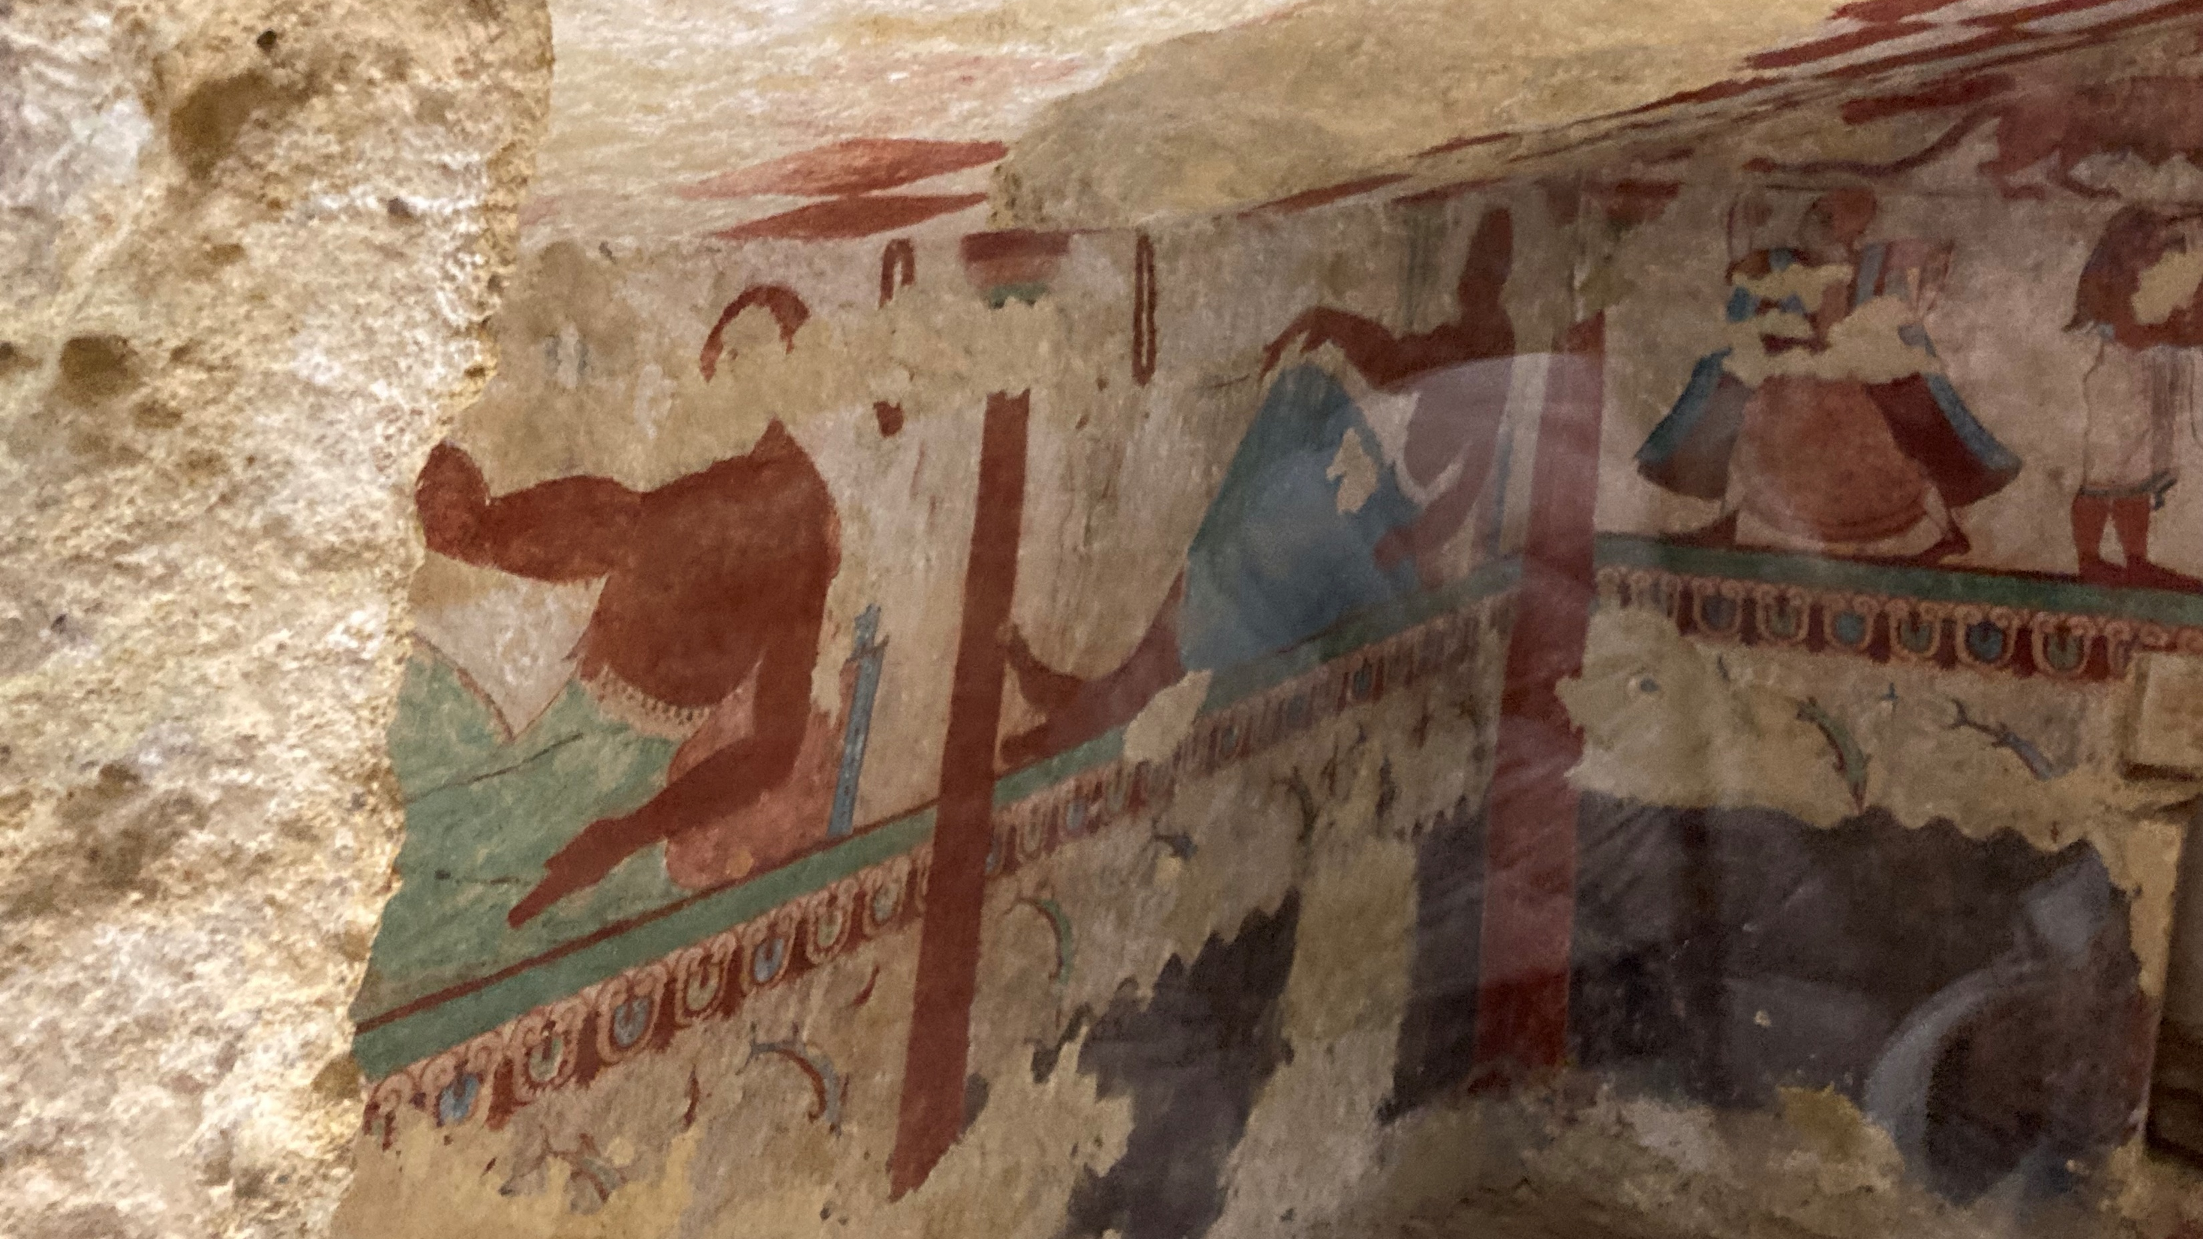
Left Wall
Photo Credit: Amalia Spiliakou, April 2025

Slide 11
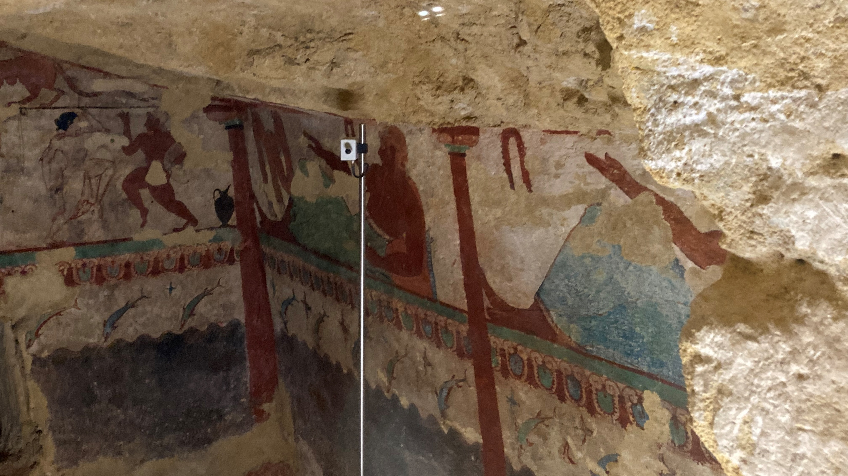
Photo Credit: Amalia Spiliakou, April 2025

Slide 12
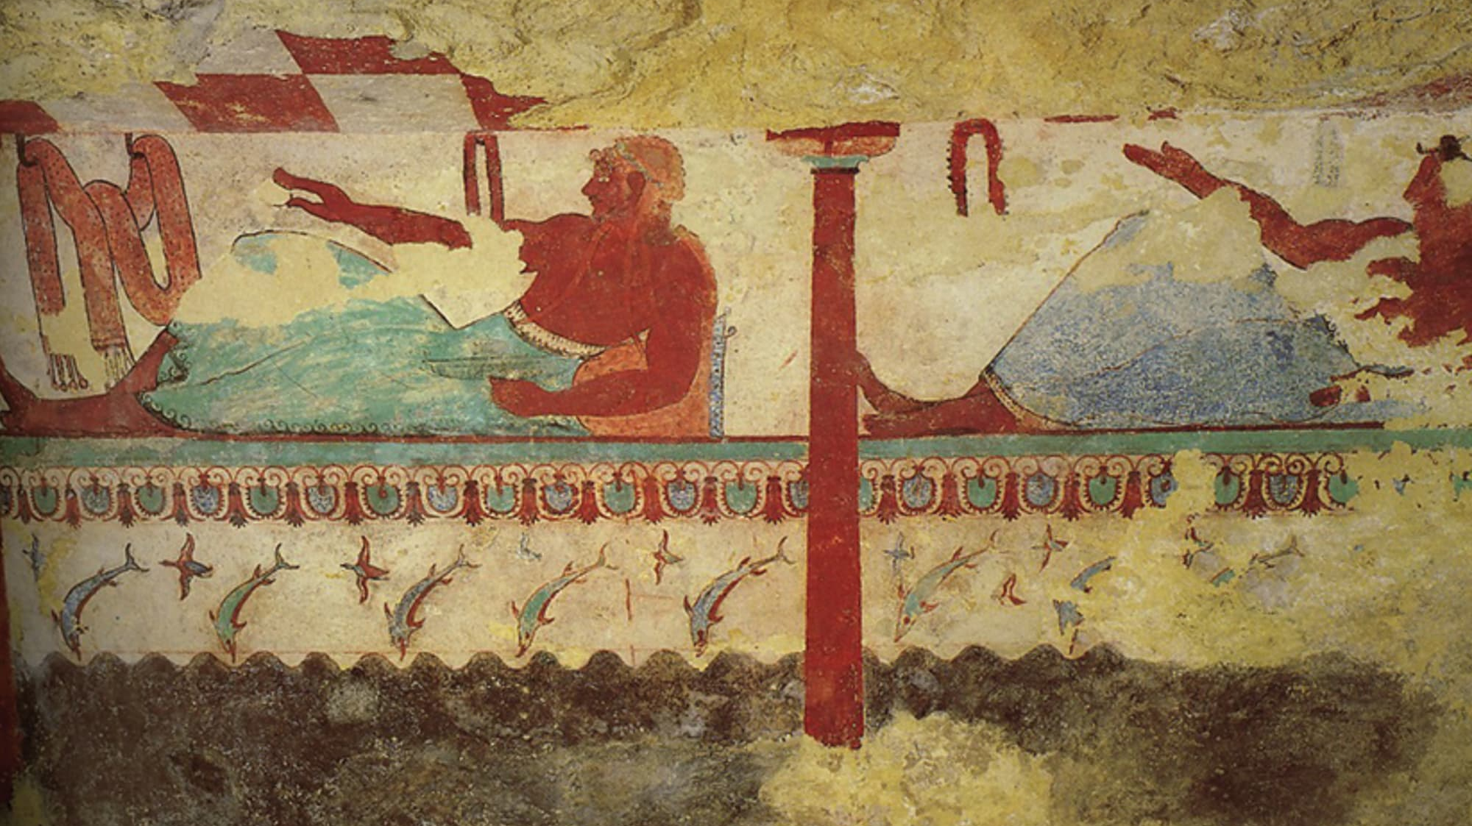
Right Wall https://tarquiniaturismo.com/tomb-of-the-lionesses/?lang=en

Slide 13
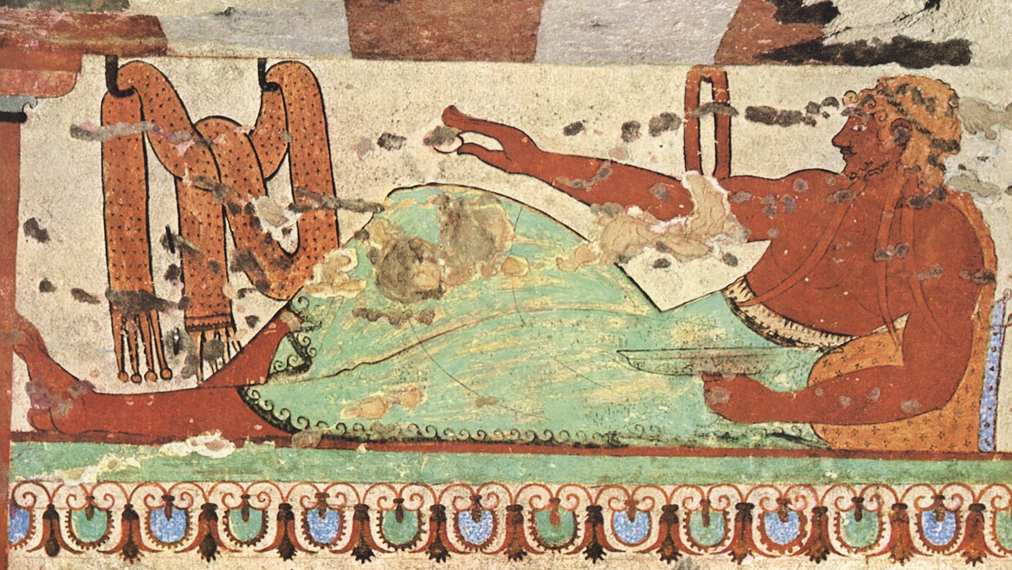
Right Wall https://www.facebook.com/photo?fbid=125778590041218&set=pcb.125779963374414

Slide 14
The End

