Slide 1
Orpheus

Slide 2
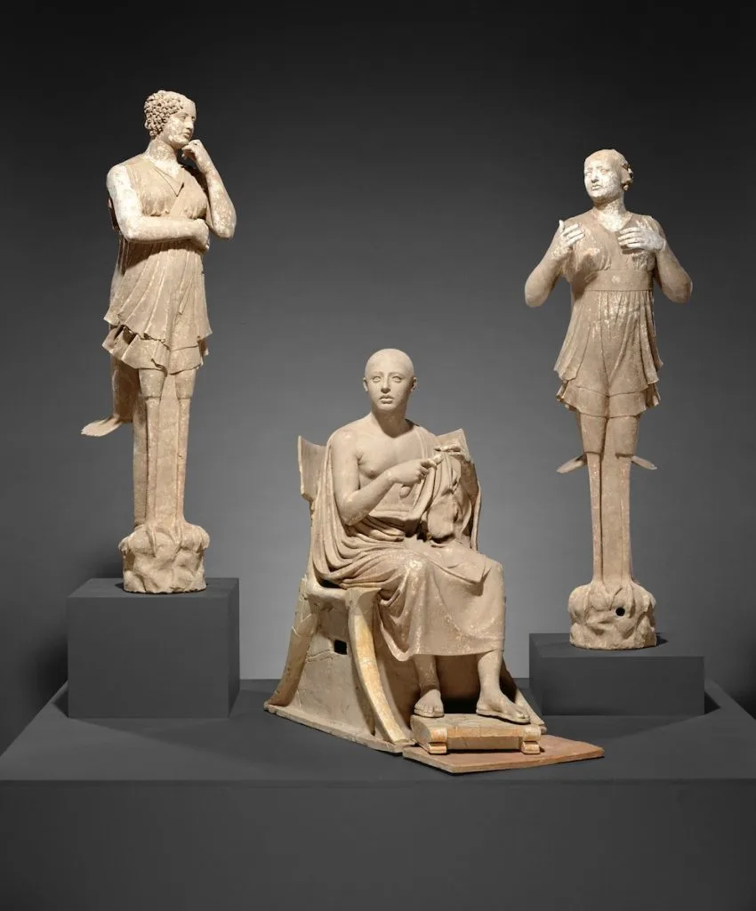
The poet Orpheus with a pair of Sirens, 350–300 BC, Terracotta, from Puglia, Italy https://news.artnet.com/art-world/getty-museum-returns-art-to-italy-2160059

Slide 3
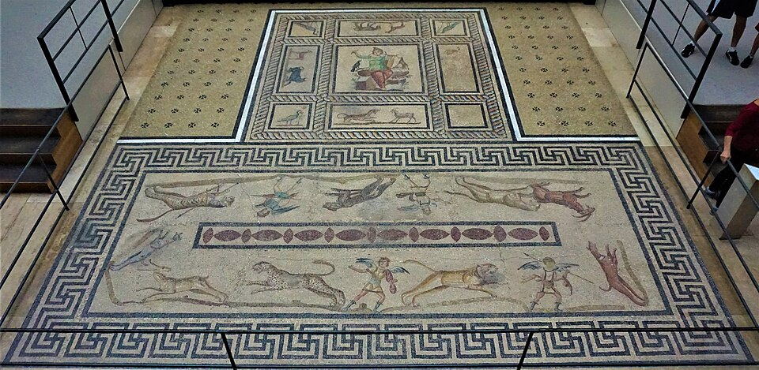
Orpheus from Miletus, 2nd century AD, Floor Mosaic, Pergamon Museum, Berlin, Germany https://commons.wikimedia.org/wiki/File:Orpheus_Mosaic_from_Miletus_-_Pergamon_Museum_-_Joy_of_Museums.jpg

Slide 4
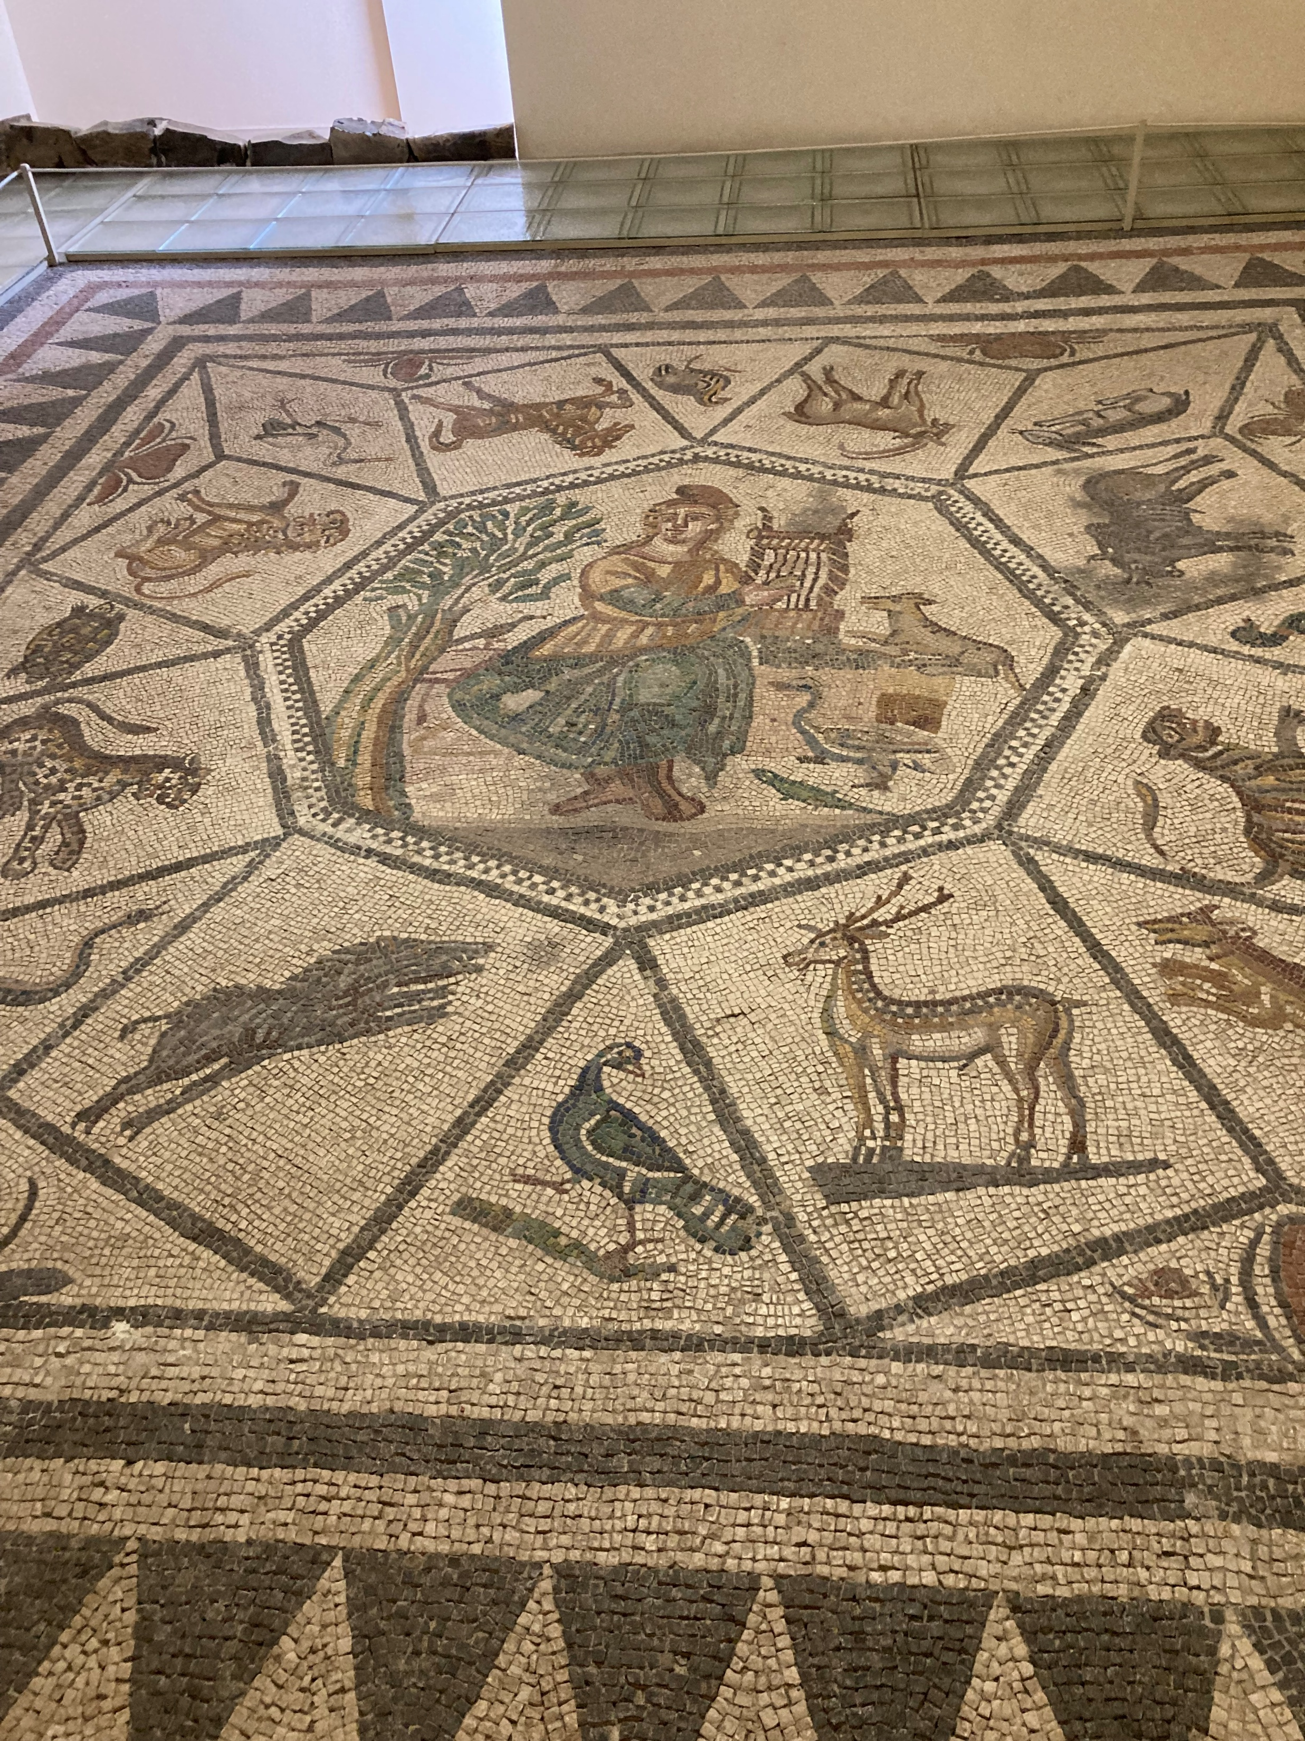
The House of Menander, Orpheus taming the animals, 2nd century AD, Archaeological Museum of Mytilene, Greece
Photo Credit for the mosaic of Menander: Amalia Spiliakou, Summer 2025

Slide 5
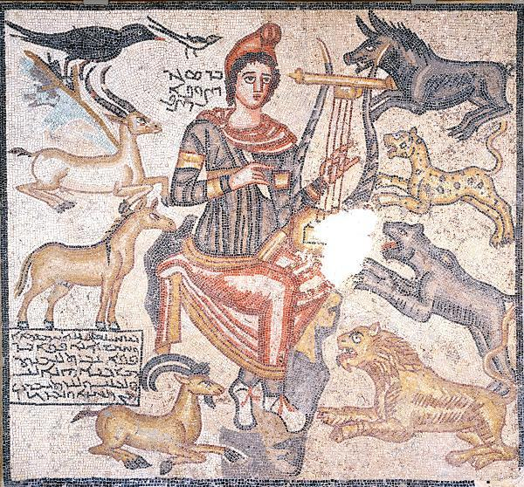
Orpheus Taming Wild Animals, 194 AD, Floor Mosaic, 164.4x152.4 cm, from the Eastern Roman Empire, near Edessa, currently in Turkey

Slide 6
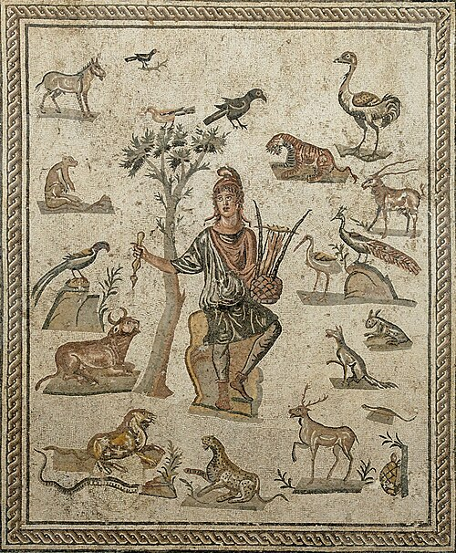
Orpheus and Eurydice
Orpheus surrounded by animals., ca. 200-250 AD, Floor Mosaic, Antonino Salinas Regional Archeological Museum, Palermo, Italy https://commons.wikimedia.org/wiki/File:Orpheus_Piazza_della_Vittoria_MAR_Palermo_NI2287.jpg

Slide 7
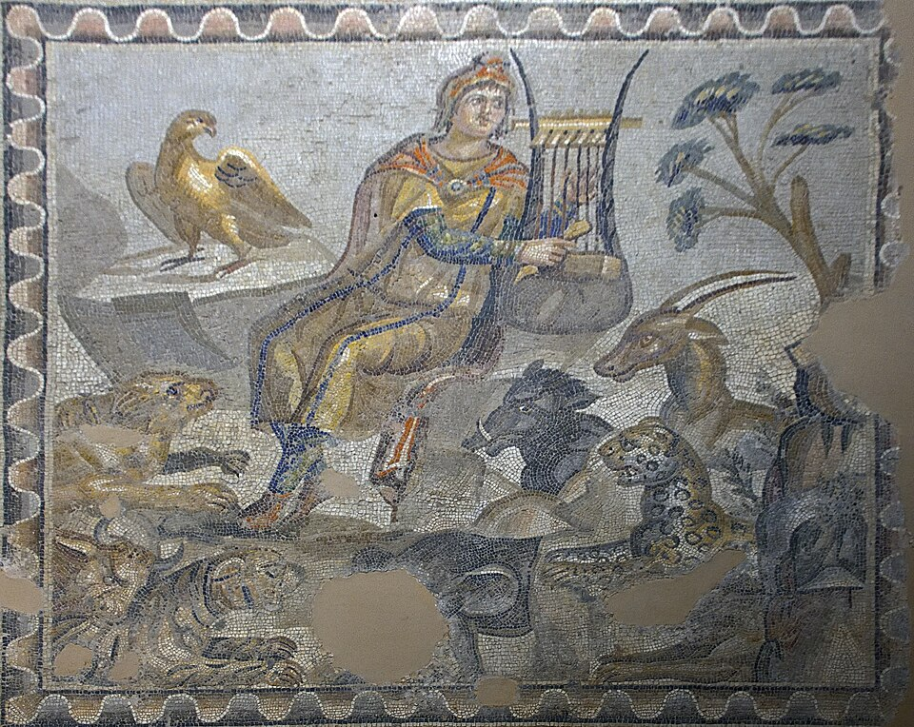
Orpheus playing his lyre, 3rd century AD, Floor Mosaic, Antakya Archaeological Museum, Turkey https://commons.wikimedia.org/wiki/File:Antakya_Archaeological_Museum_Orpheus_and_the_beasts_Detail_in_2008_23.jpg

Slide 8
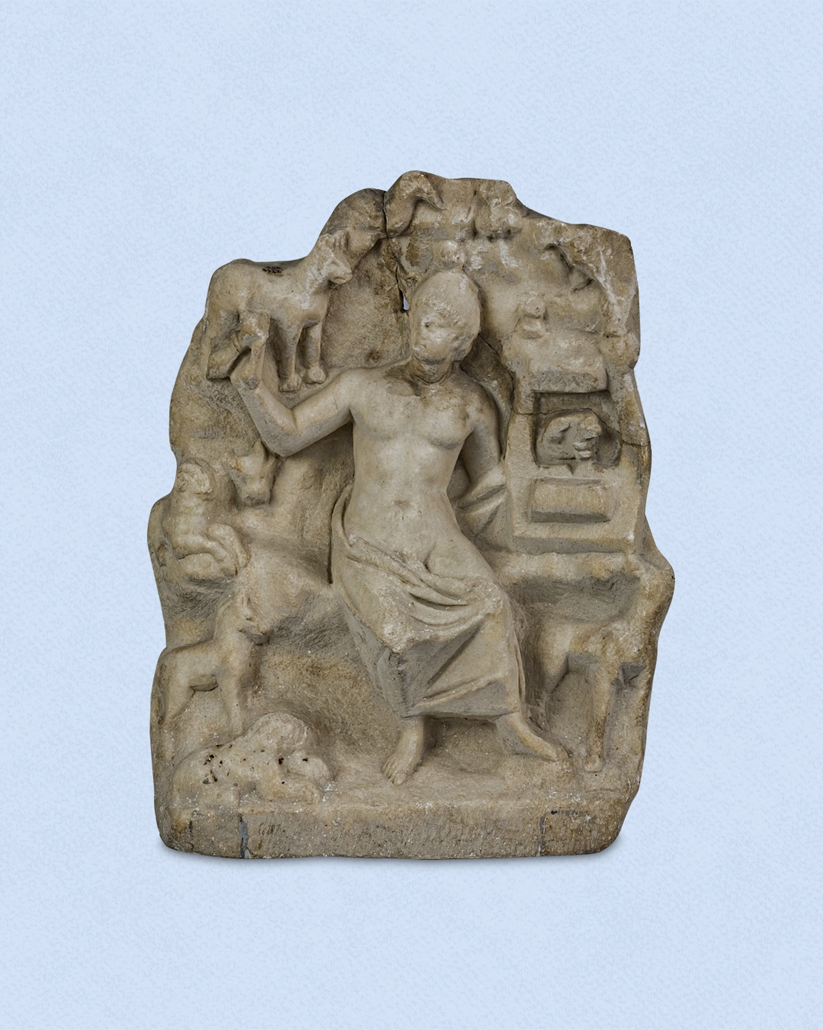
Orpheus, Roman, Archaeological and Ethnographic Museum, Edirne, Turkey https://www.facebook.com/photo.php?fbid=1031258745698230&id=100064423430674&set=a.249525467204899

Slide 9
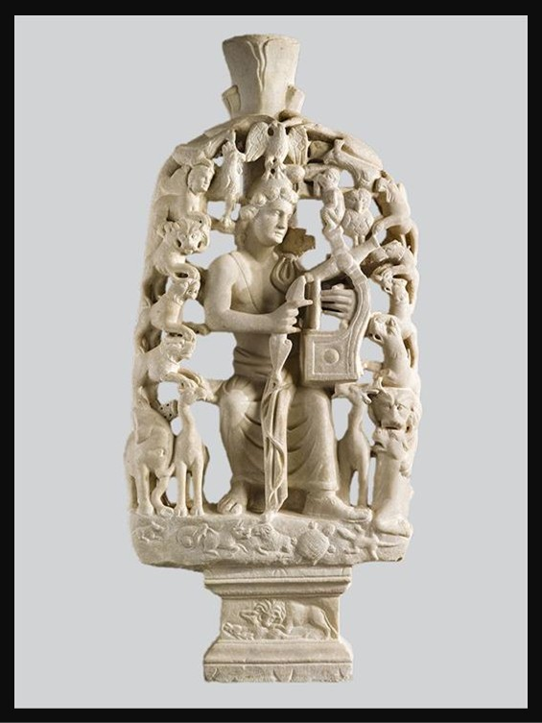
Table support with Orpheus, 4th c. AD, Marble, 110x50 cm, Byzantine and Christian Museum, Athens, Greece https://www.ebyzantinemuseum.gr/?i=bxm.en.exhibit&id=142

Slide 10
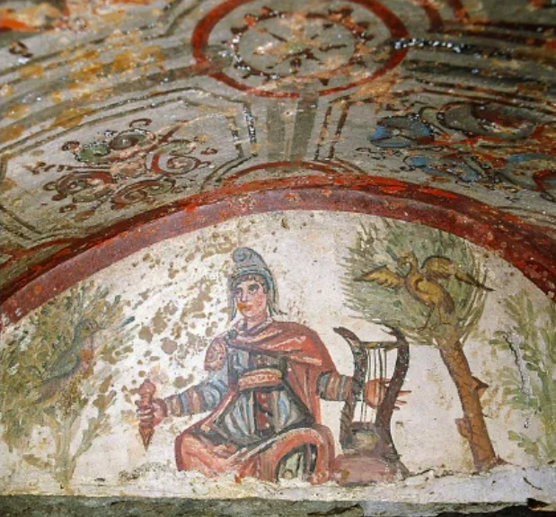
Arcosolium with the picture of Orpheus, Christian Catacomb of Saints Marcellinus and Peter,4th century AD, Fresco painting, Rome, Italy https://www.unaguidaturisticaroma.com/en/blog2/post/211620/christ-as-orpheus-in-the-roman-catacombs

Slide 11
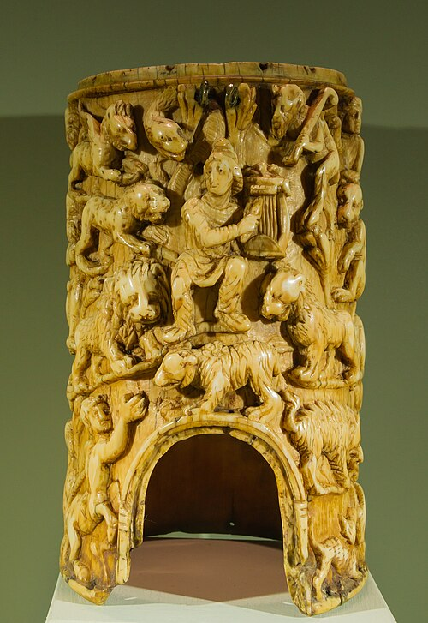
Cylindrical container with Orpheus enchanting the animals, late 4th century AD, Ivory and Silver, Museo Nazionale del Bargello, Florence, Italy https://commons.wikimedia.org/wiki/File:Orpheus_enchanting_the_animals_Colosseo_Rome_Italy.jpg

