Slide 1
Raphael, 1483–1520
Portraits of Women

Slide 2
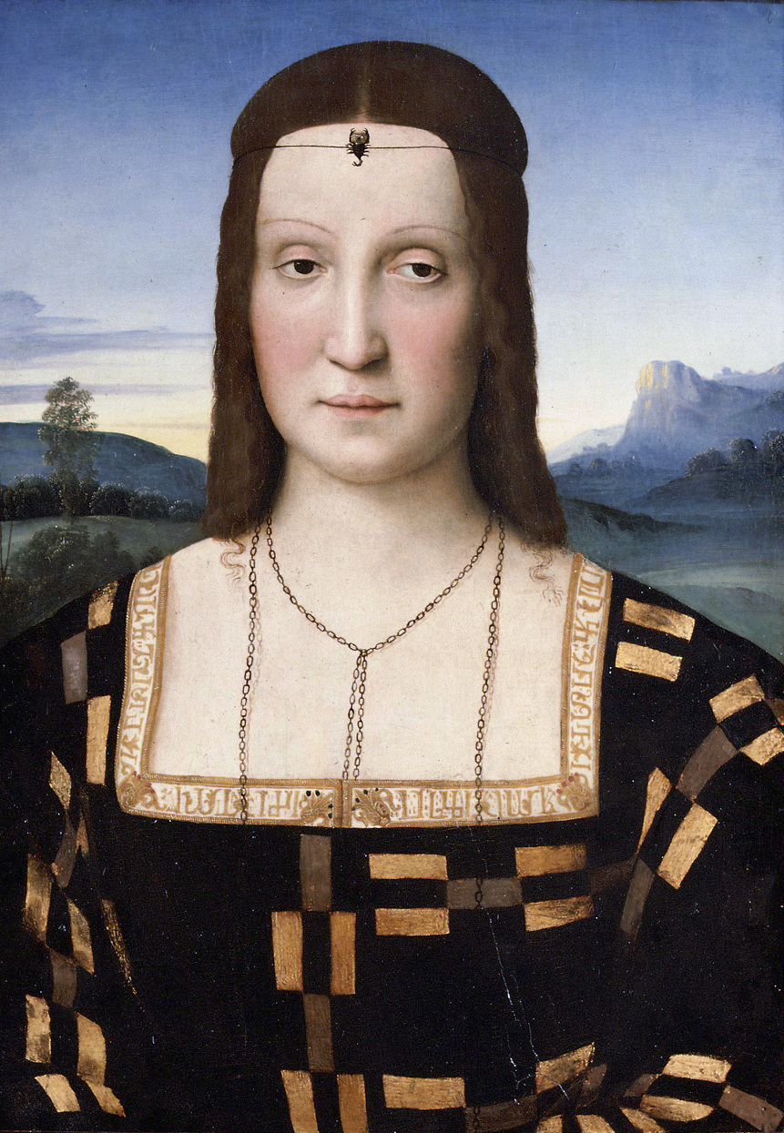
Elisabetta Gonzaga, c. 1503, Oil on wood,
53 x 37 cm,
Galleria degli Uffizi, Florence, Italy https://upload.wikimedia.org/wikipedia/commons/2/2a/Raffaello_-_ElisabettaGonzaga.jpg

Slide 3
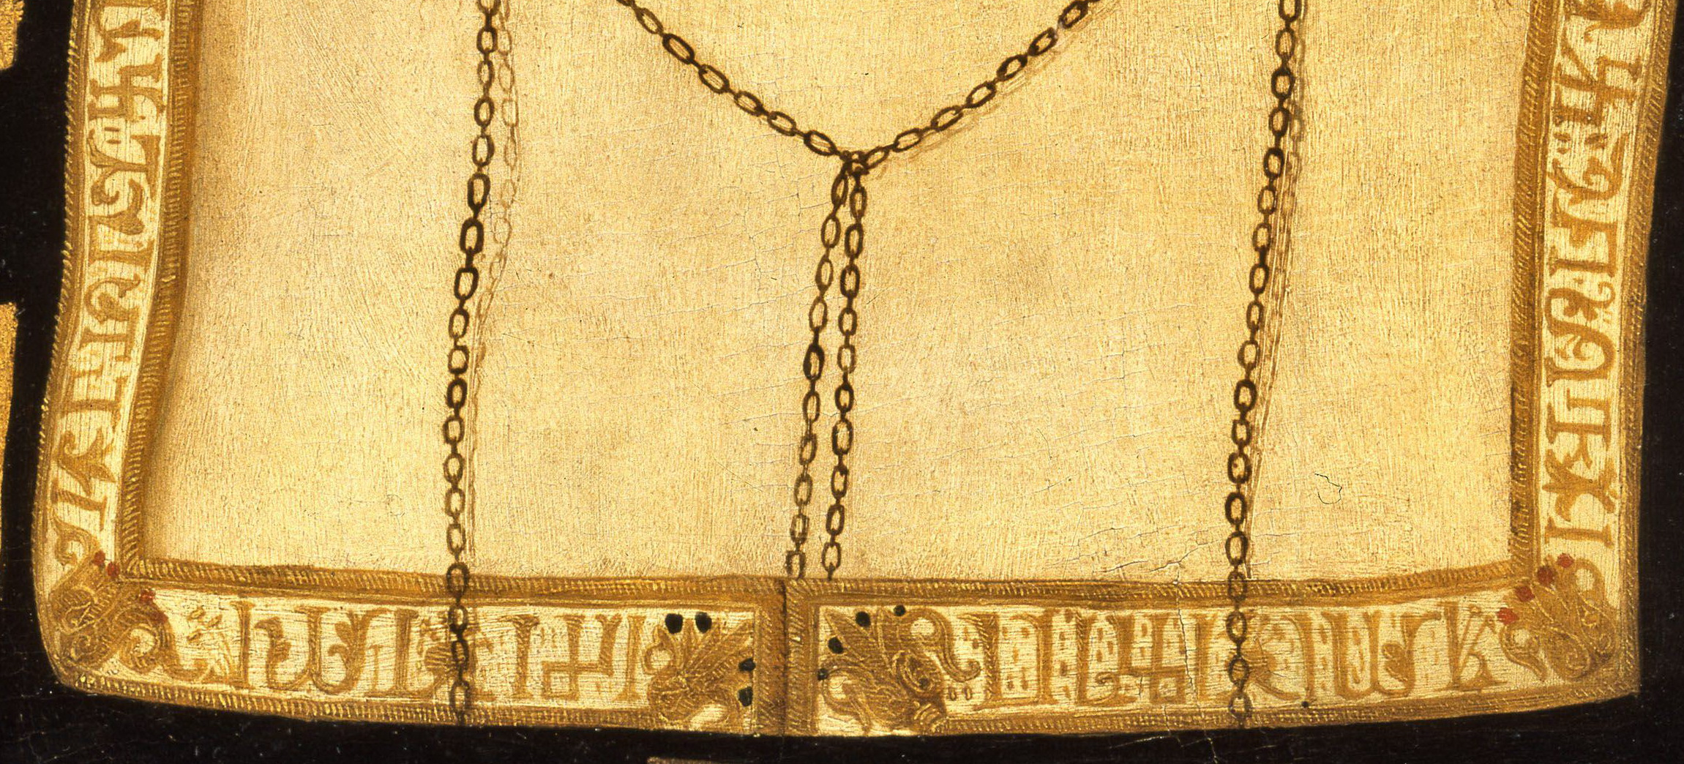
https://upload.wikimedia.org/wikipedia/commons/d/d7/Raffaello_Sanzio_-_Elisabetta_Gonzaga_-_WGA18618_%281%29.jpg

Slide 4
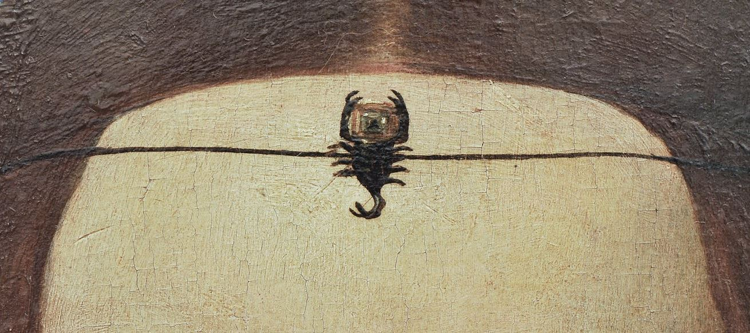
https://commons.wikimedia.org/wiki/Category:Elisabetta_Gonzaga_by_Raphael#/media/File:Elisabetta_Gonzaga_by_Raphael_-_crop.jpg

Slide 5
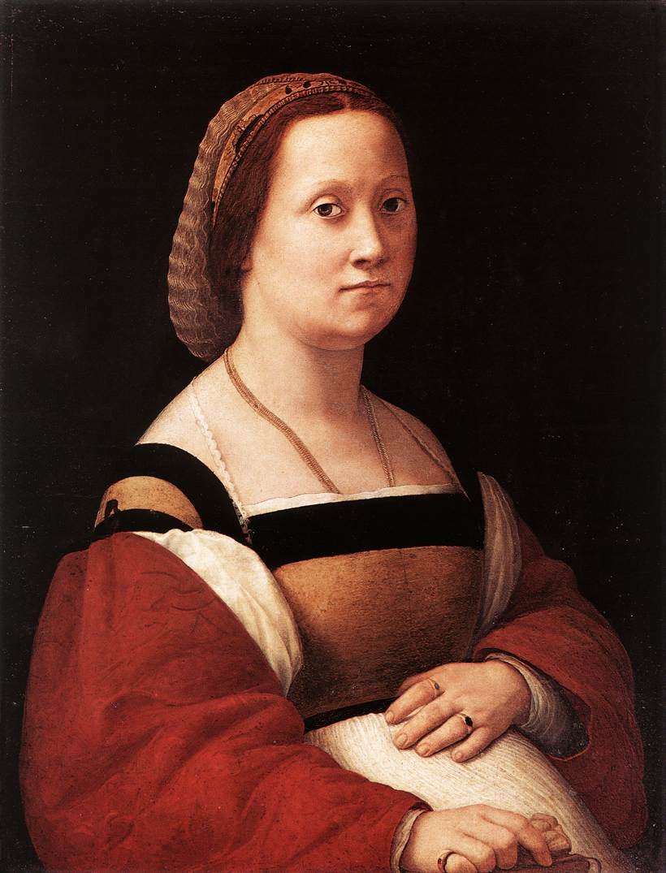
Portrait of a Woman (La Donna Gravida), 1505-06, Oil on panel, 66 x 52 cm, Galleria Palatina (Palazzo Pitti), Florence, Italy https://upload.wikimedia.org/wikipedia/commons/f/fe/Raphael-LaDonnaGravida%281505-1506%29.jpg

Slide 6
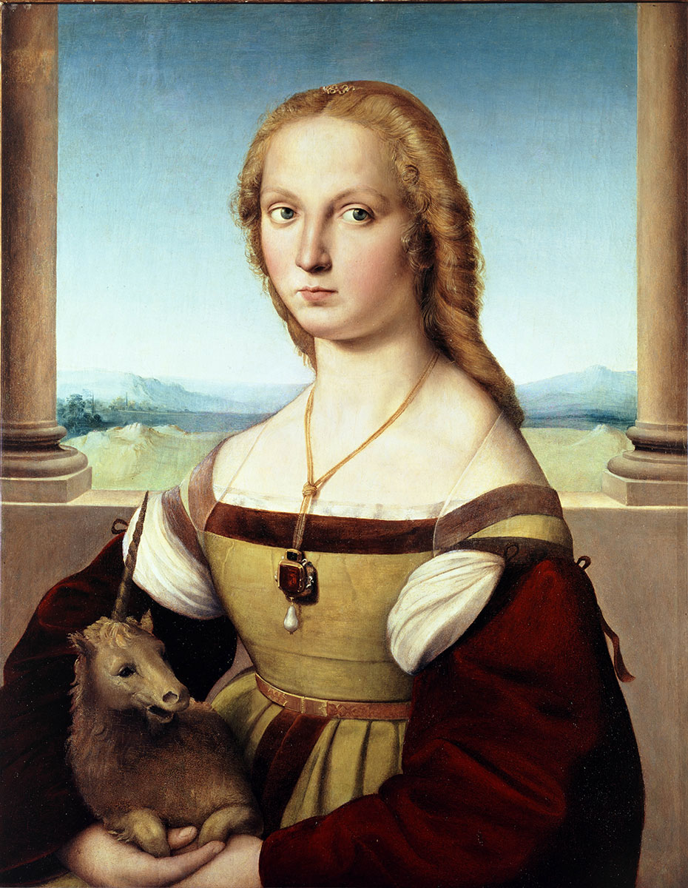
Lady with a Unicorn, c. 1505, Oil on wood, 65 x 51 cm, Galleria Borghese, Rome, Italy https://upload.wikimedia.org/wikipedia/commons/5/5a/Raffael_046.jpg

Slide 7
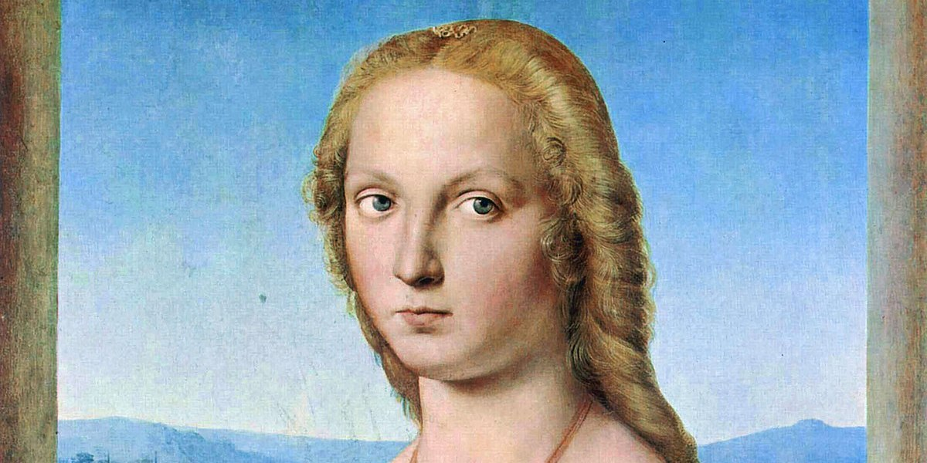
https://borghese.gallery/collection/paintings/portrait-of-young-woman-with-unicorn.html

Slide 8
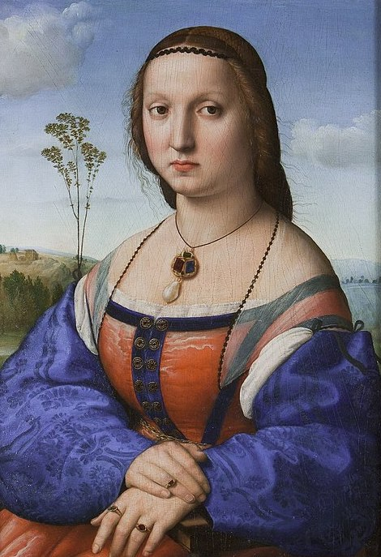
Portrait of Maddalena Doni, 1504-07, Oil on panel, 63 x 45 cm, Galleria degli Uffizi, Florence, Italy https://commons.m.wikimedia.org/wiki/Category:Magdalena_Strozzi%27s_portrait_paintings_by_Raffaello_Sanzio#/media/File%3AMaddalena_Strozzi.jpg

Slide 9
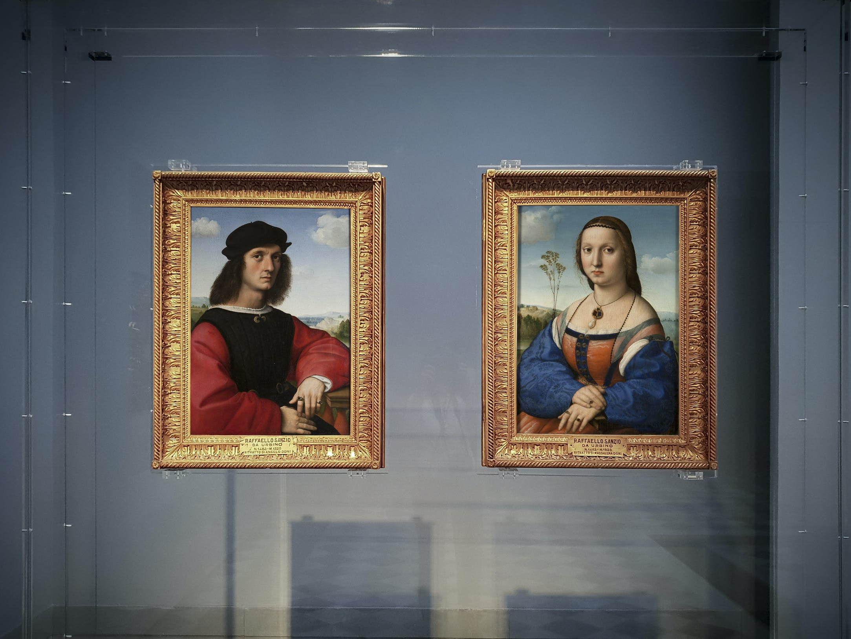
Portraits of Agnolo and Maddalena Doni, 1504-07, Oil on panel, 63 x 45 cm (each), Galleria degli Uffizi, Florence, Italy https://www.uffizi.it/en/artworks/portraits-doni-raffaello#&gid=1&pid=8

Slide 10
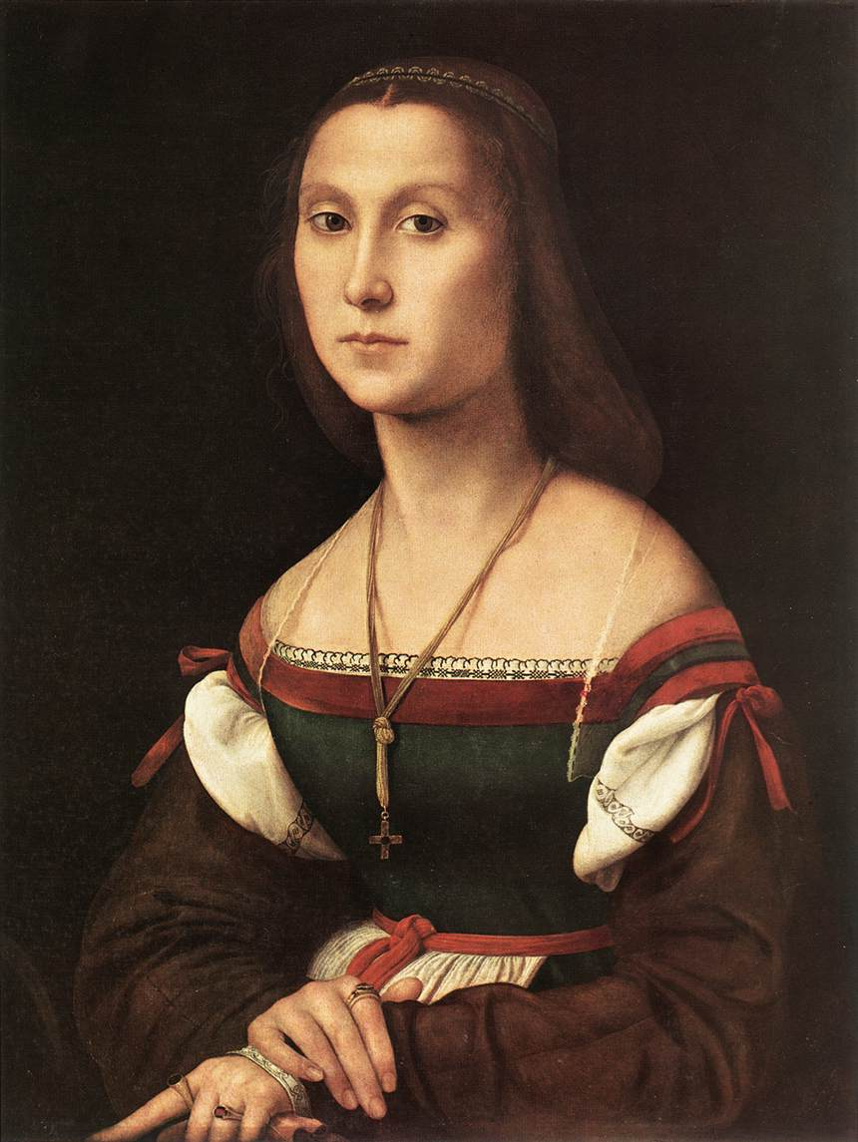
Portrait of a Woman (La Muta), 1507, Oil on wood, 64 x 48 cm, Galleria Nazionale delle Marche, Urbino, Italy https://upload.wikimedia.org/wikipedia/commons/d/d2/Raffaello%2C_la_muta.jpg

Slide 11
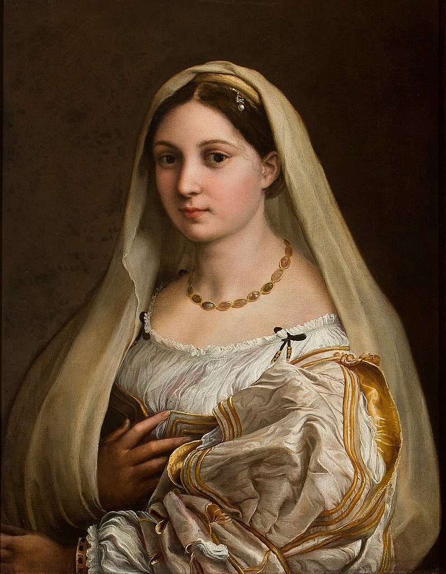
Woman with a Veil (La Donna Velata), 1516, Oil on canvas, 82 x 60 cm, Galleria Palatina (Palazzo Pitti), Florence, Italy https://en.wikipedia.org/wiki/La_velata#/media/File:La_velada,_por_Rafael.jpg

Slide 12
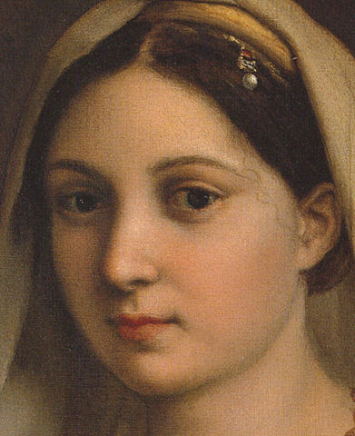
https://en.wikipedia.org/wiki/File:La_donna_velata_(detail).jpg

Slide 13
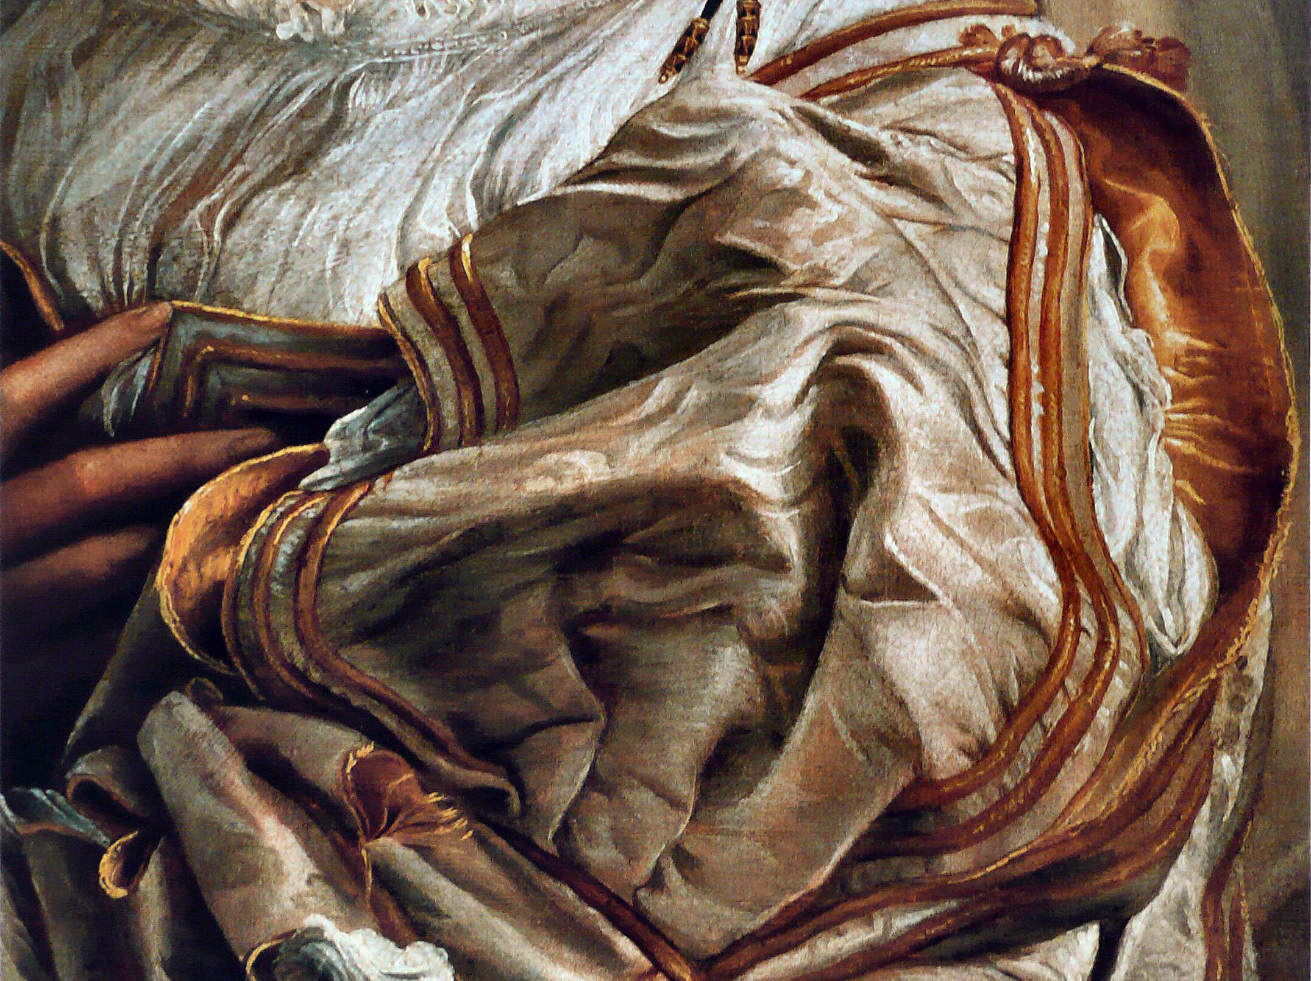
https://upload.wikimedia.org/wikipedia/commons/3/30/Rapha%C3%ABl_-_La_Velata.jpg

Slide 14
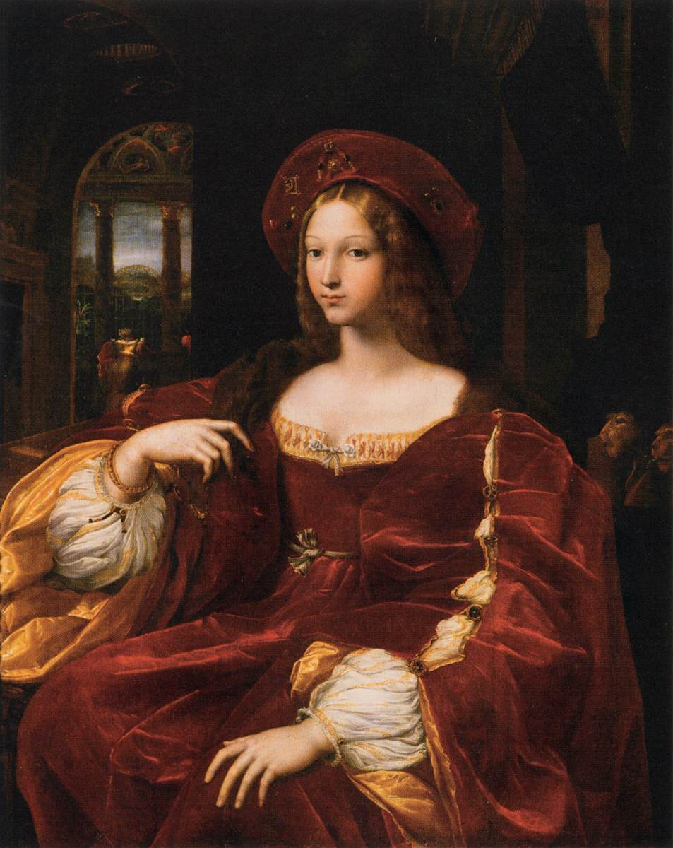
Portrait of Dona Isabel de Requesens, Vice-Queen of Naples, 1518, Oil on wood transferred to canvas, 120 x 95 cm,Musée du Louvre, Paris, France https://upload.wikimedia.org/wikipedia/commons/0/08/Rafael_-_Retrato_de_Isabel_de_Requesens.jpg

Slide 15
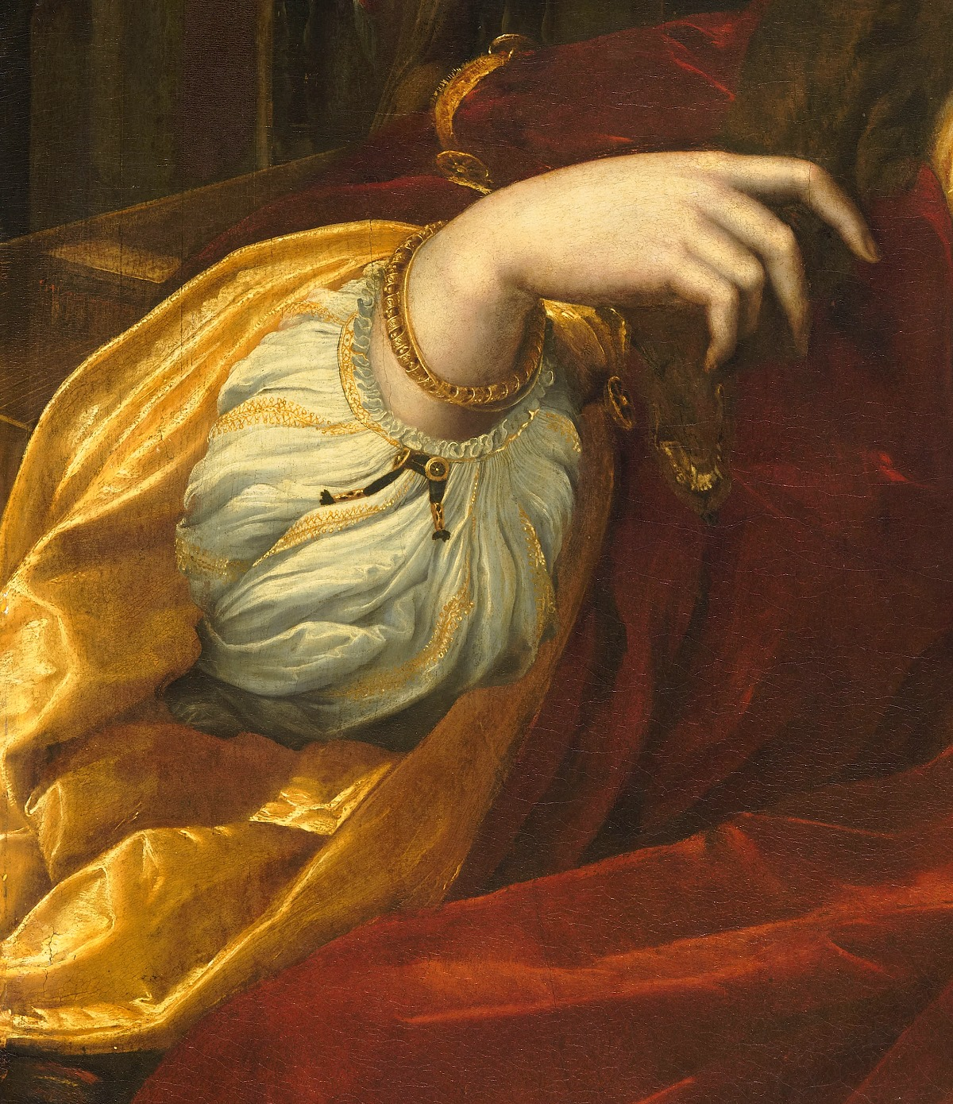
https://twitter.com/revizorsb/status/1298704313804627972

Slide 16
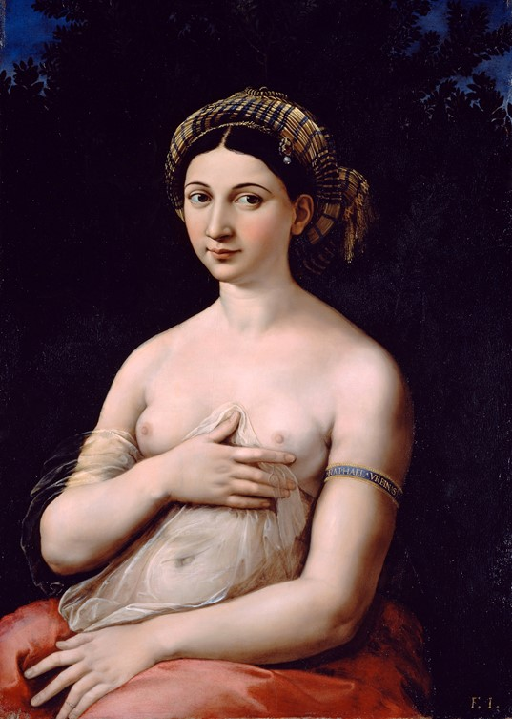
Portrait of a Woman - La Fornarina, about 1519–20, Oil on Panel, 85x60 cm, Galleria Nazionale di Arte Antica (GNAA), Palazzo Barberini, Rome, Italy https://commons.wikimedia.org/wiki/File:Fornarina.jpg

Slide 17
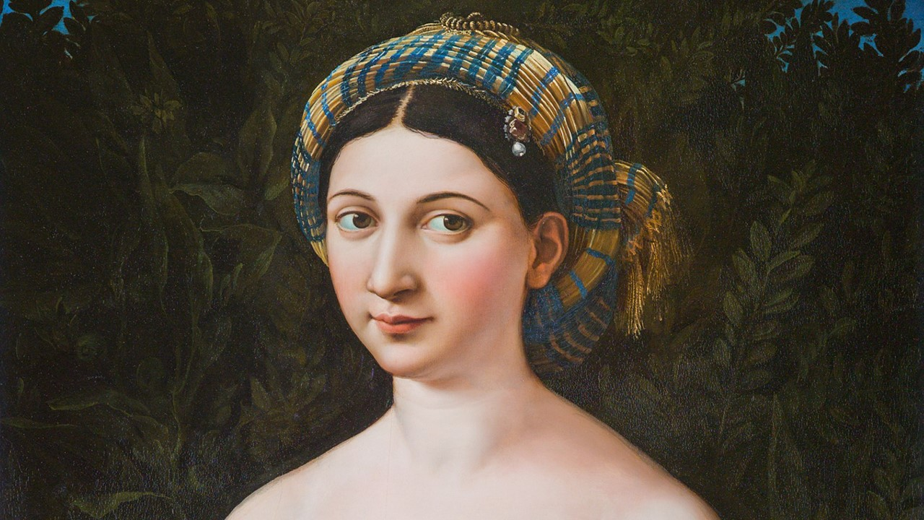
https://www.nationalgallery.org.uk/exhibitions/the-credit-suisse-exhibition-raphael/a-brief-introduction-to-raphaels-life-and-times

Slide 18
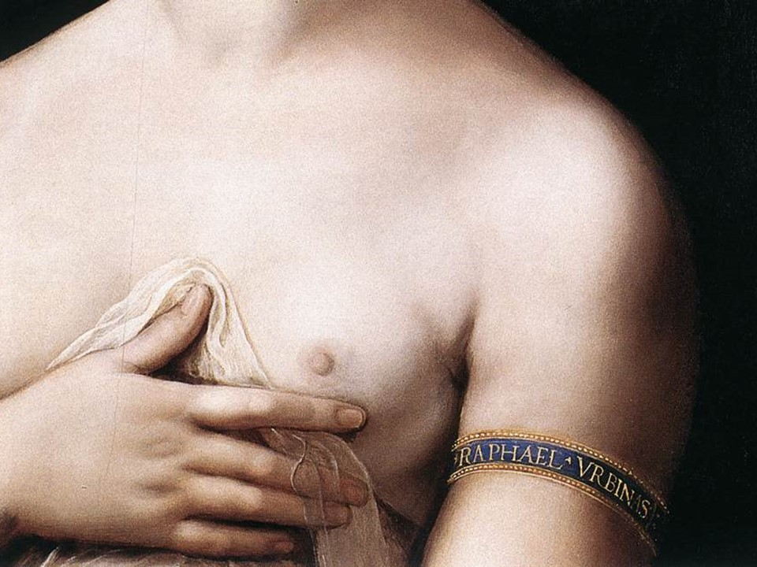
https://commons.wikimedia.org/wiki/File:Fornarina_03.jpg

Slide 19
The End

