Slide 1
Virgilio Costantini, 1882-1949
12 Paintings

Slide 2
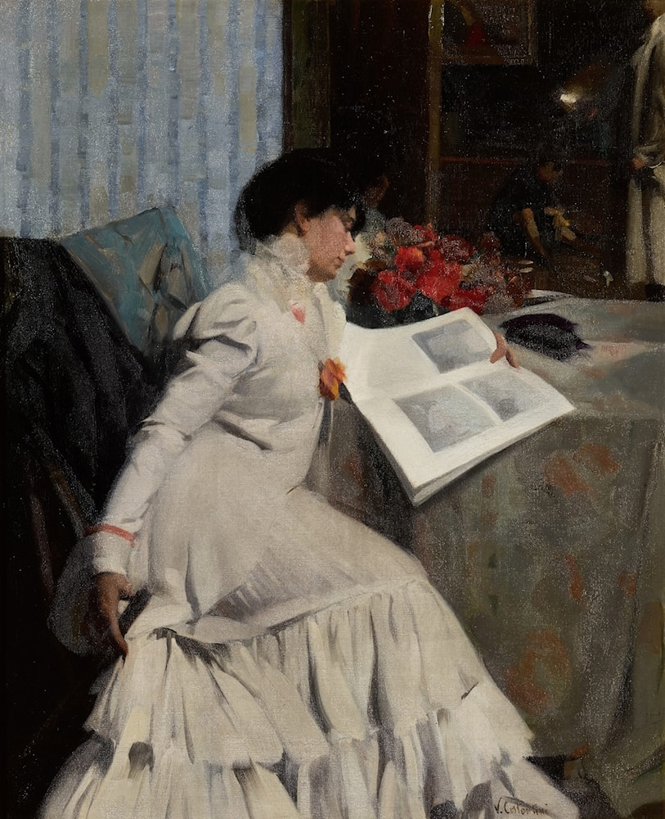
The Model's Repose, Date -, oil on canvas, 100.3 by 80.6 cm, Private Collection https://www.artrenewal.org/artworks/virgilio-costantini/the-models-repose/108162

Slide 3
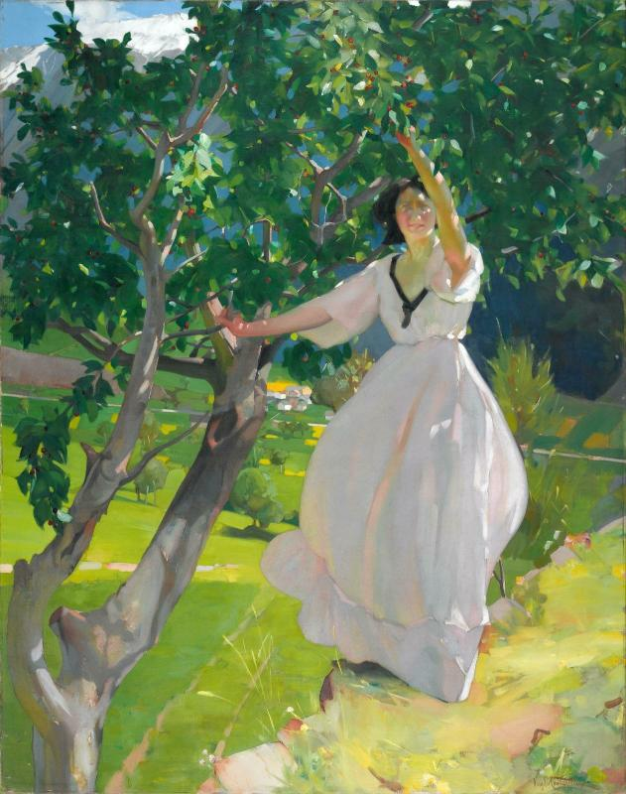
Le Cerisier, Date -,oil on canvas, 179 x 143 cm, Centre Pompidou, Paris, France https://www.centrepompidou.fr/en/ressources/oeuvre/cyjGx7

Slide 4
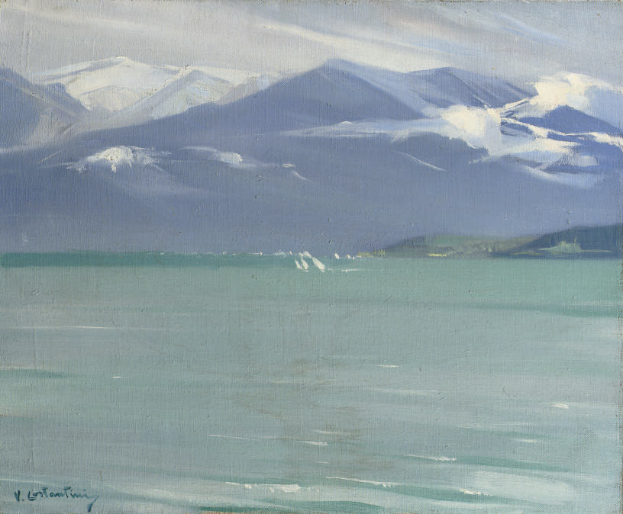
Wintersday at the lake Lac de Thune, Switzerland, Date -, oil on canvas, 38 x 46 cm, Private Collection https://www.christies.com/en/lot/lot-5227537

Slide 5
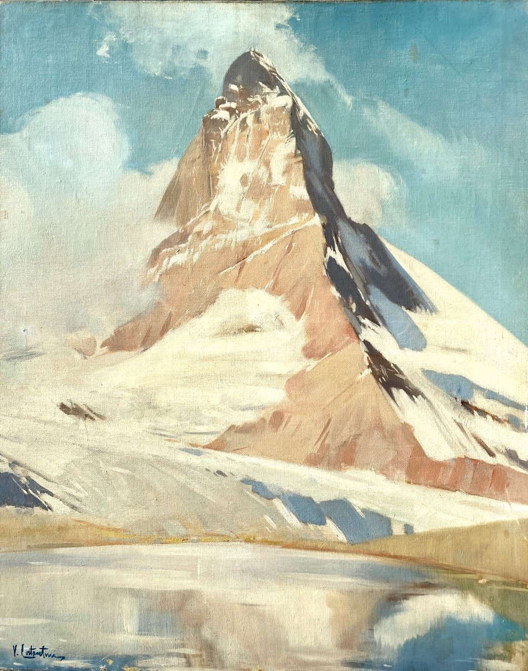
Le Cervin, Date -, oil on canvas, 92x73 cm, Private Collection https://www.proantic.com/1367828-le-cervin-huile-sur-toile-de-virgilio-costantini-peintre-ne-en-1882-dimensions-92-x-73-.html

Slide 6
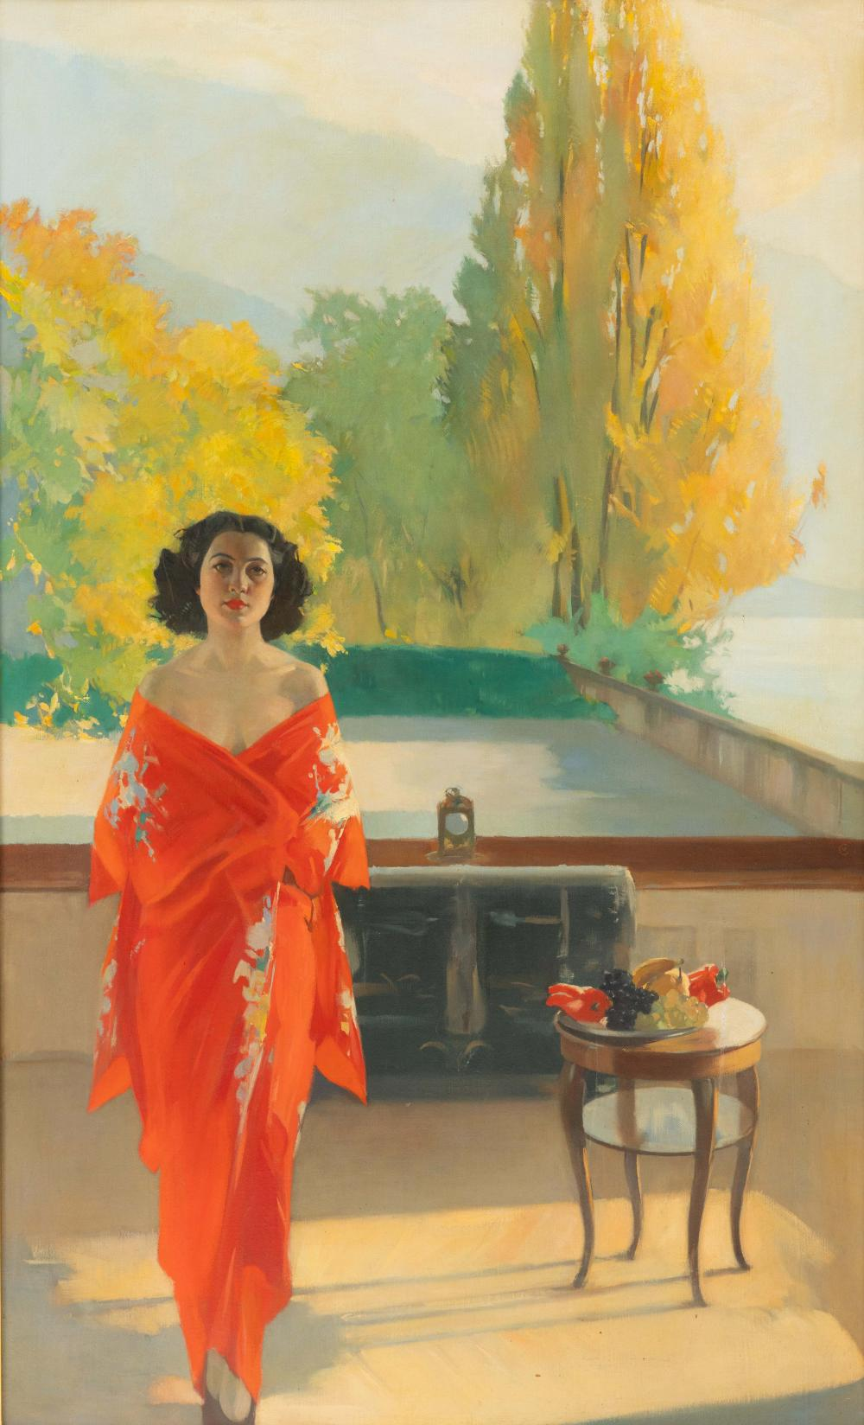
Lady in red on a balcony, Date -, oil on canvas, 144,5x87,5 cm, Private Collection https://www.invaluable.com/auction-lot/virgilio-constantini-italian-french-1882-1924-320-c-e0f405fa52

Slide 7
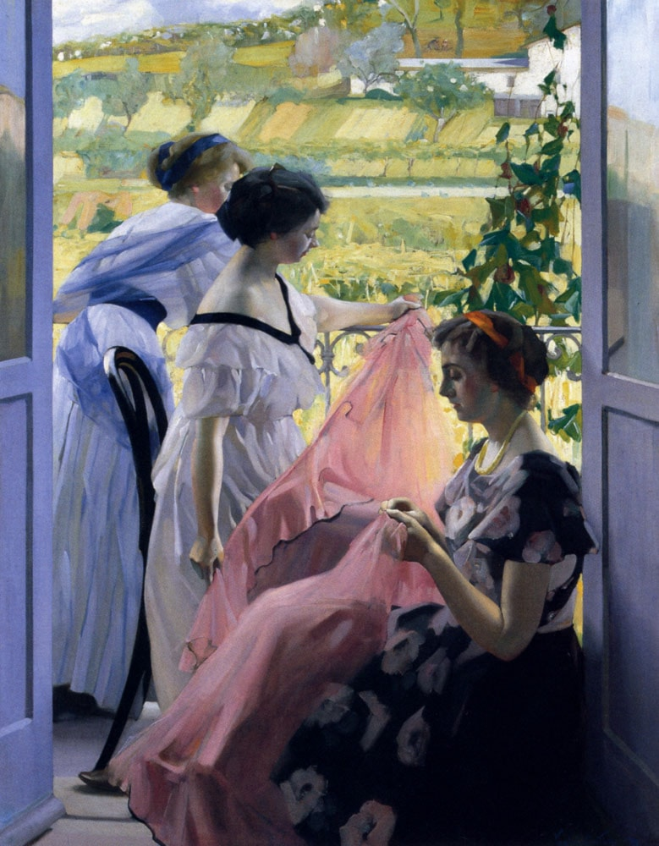
Le balcon, Date -, oil on canvas, 145 x 114 cm, Private Collection https://www.artrenewal.org/artworks/virgilio-costantini/le-bacon/29876

Slide 8
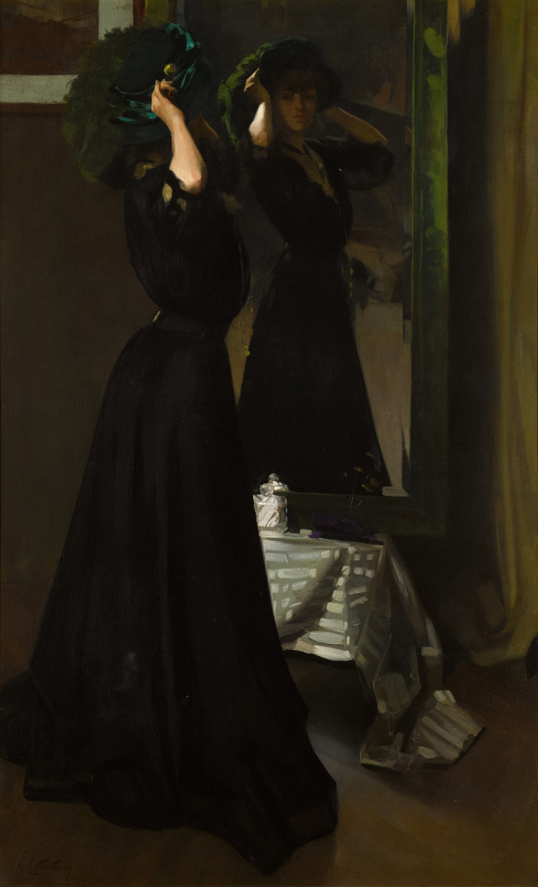
The Green Hat, 1908, oil on canvas, 130.5x81cm, Private Collection https://www.sothebys.com/en/buy/auction/2022/european-and-british-art-part-ii/the-green-hat-2

Slide 9
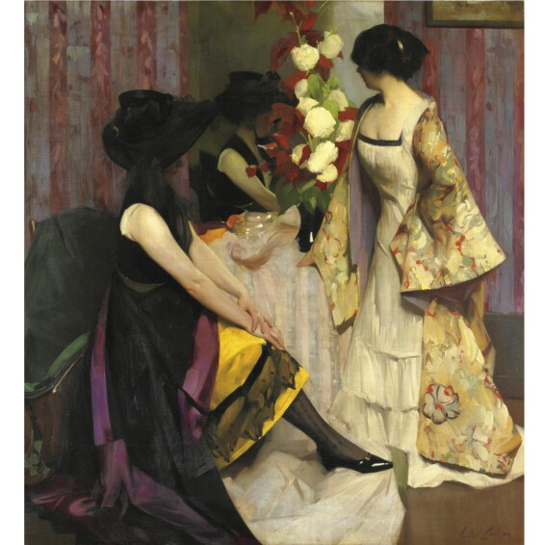
Déguisement, 1910, oil on canvas, 150 x 138 cm, Private Collection

Slide 10
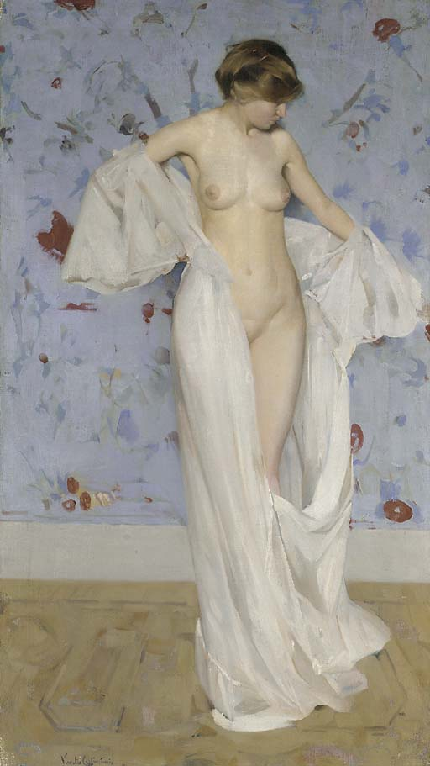
NU, 1911, oil on canvas, 120 x 68.3 cm, Private Collection https://www.christies.com/en/lot/lot-3993425

Slide 11
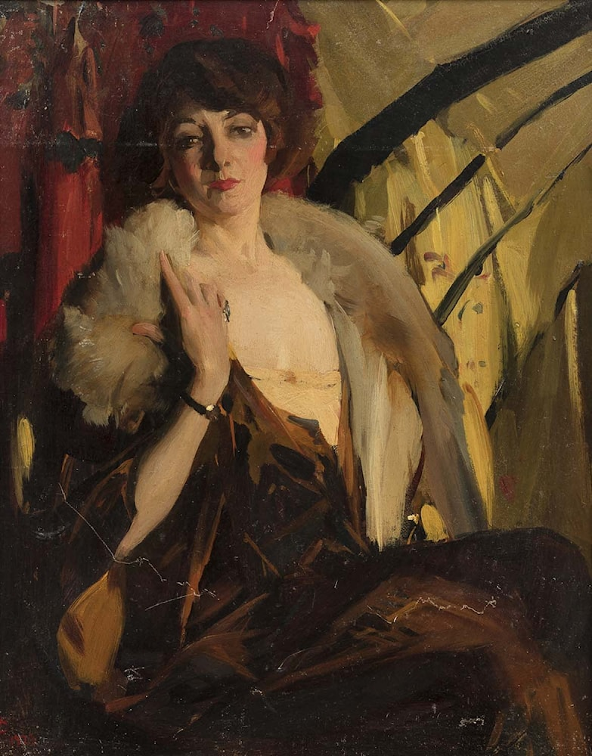
Enigme, 1925, oil on cardboard, 41 x 33 cm, Private Collection https://www.artrenewal.org/artworks/virgilio-costantini/portrait-delegante-au-theatre/108166

Slide 12
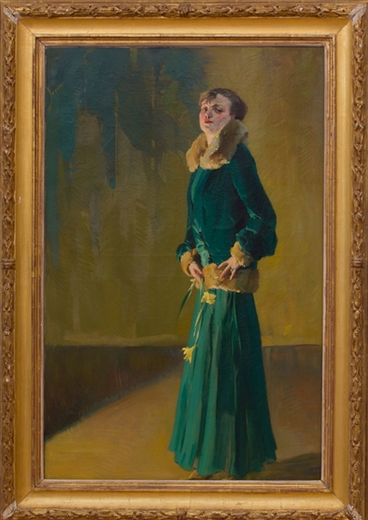
Woman in Green, 1931, oil on canvas, 101,6x66 cm, Private Collection https://www.mutualart.com/Artwork/Femme-en-Vert/1E33AFF8E2FDFF8E

Slide 13
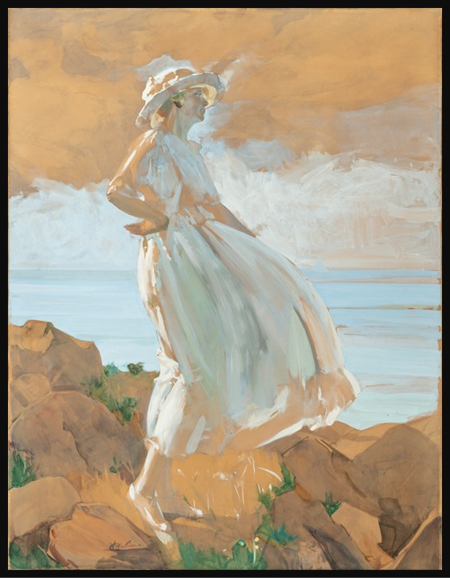
On the Cliff (Madame Costantini), 1936, Gouache on paper laid down on canvas, 138,7 x 106,2 cm, Private Collection https://www.christies.com/en/lot/lot-3993425

Slide 14
The End

