Slide 1
James Holland
1799-1870
Flowers

Slide 2
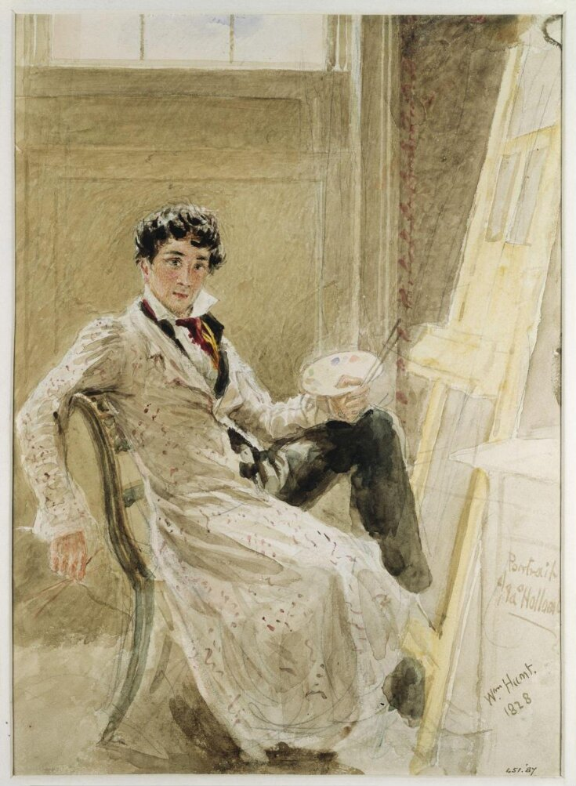
William Henry Hunt, 1790-1864
James Holland, Painter, 1828, Wotercolour on Paper, 31.11x22.22 cm, V&A Museum, London, UK https://collections.vam.ac.uk/item/O1295814/james-holland-painter-watercolour-hunt-william-henry/

Slide 3
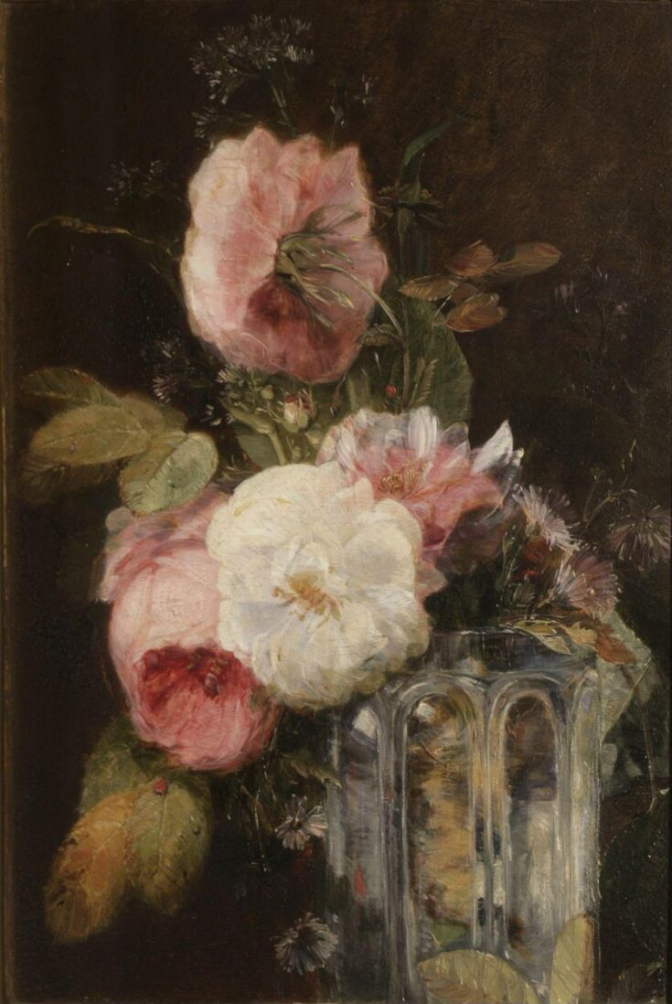
Flowers, 19th century, Oil on Panel, 34.60x24.44 cm, V&A Museum, London, UK https://collections.vam.ac.uk/item/O134516/flowers-oil-painting-holland-james/

Slide 4
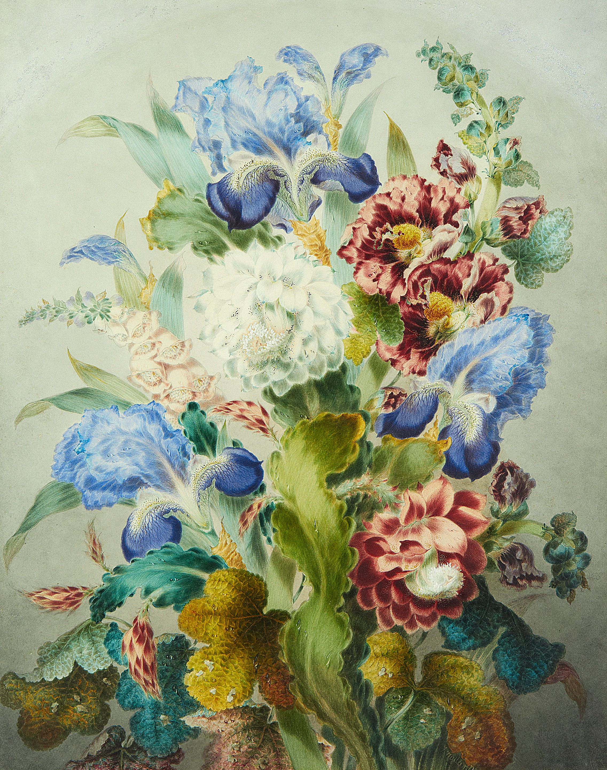
Still Life of Flowers, 19th century, Watercolour over traces of pencil on Paper, 54 x 42.5cm, Private Collection https://www.bonhams.com/auction/20785/lot/23/james-holland-rws-british-1799-1870-still-life-of-flowers/

Slide 5
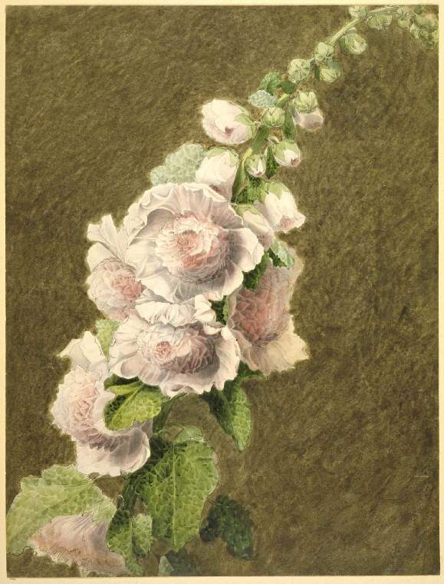
Stem with flowers in bud and bloom, 19th century, Drawing, 386x293 mm, Fitzwilliam Museum, Cambridge, UK https://data.fitzmuseum.cam.ac.uk/id/object/23576

Slide 6
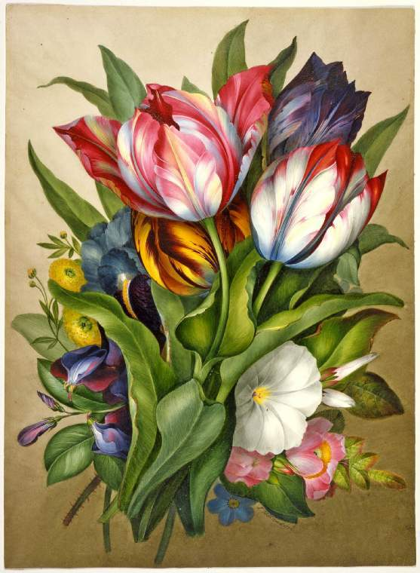
Spray of tulips, everlasting pea, mild rose and hibiscus, 1820’, Drawing, Fitzwilliam Museum, Cambridge, UK https://data.fitzmuseum.cam.ac.uk/id/object/23603

Slide 7
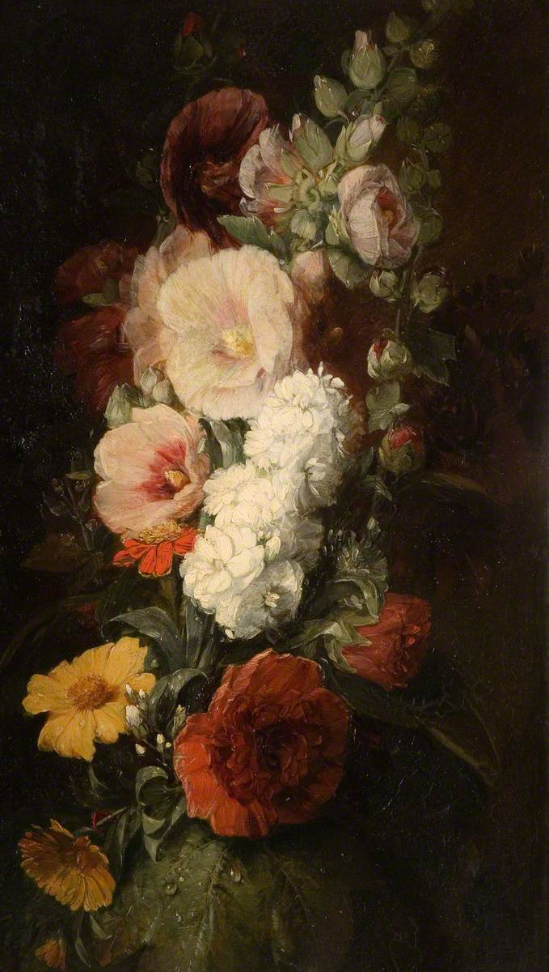
Flowers from Nature, 1828, Oil on Panel, 47.5x27.5 cm, The Potteries Museum & Art Gallery https://artuk.org/discover/stories/james-holland-the-potteries-painter-of-light

Slide 8
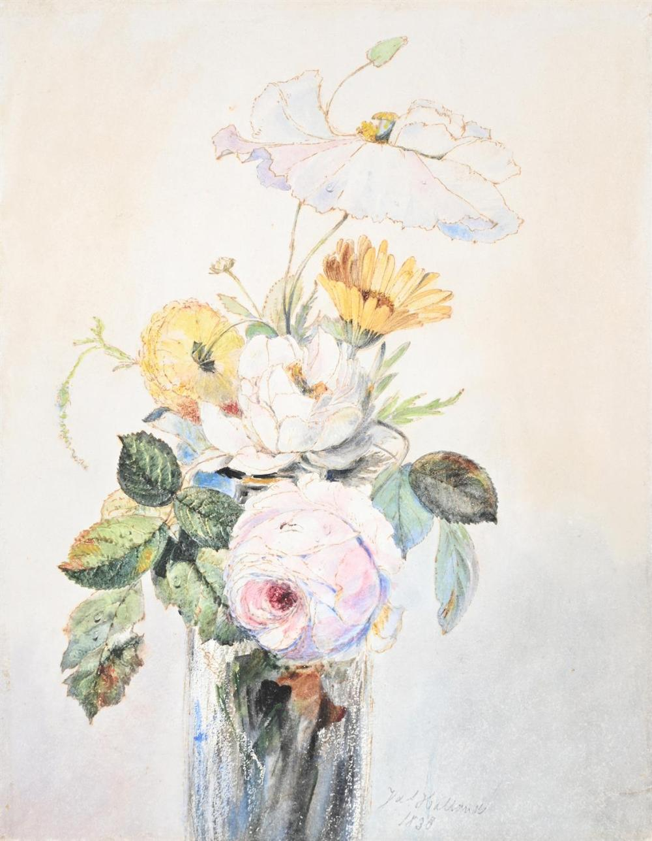
Still Life of Peonies, Poppies and Marigolds, 1830, Ink and Watercolour on Paper, 29 x 22cm, Private Collection https://www.invaluable.com/auction-lot/james-holland-british-1799-1870-still-life-of-peo-304-c-9d6ad4a14d

Slide 9
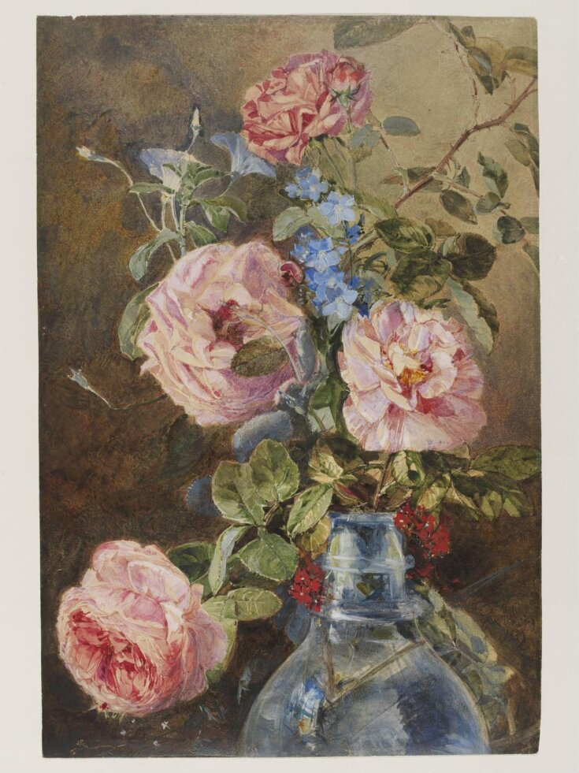
Roses, Convolvulus and Delphiniums in a Glass Vase, 1839, Watercolour on Paper, 42.70x2881 cm, V&A Museum, London, UK https://collections.vam.ac.uk/item/O1070494/roses-convolvulus-and-delphiniums-in-watercolour-james-holland/

Slide 10
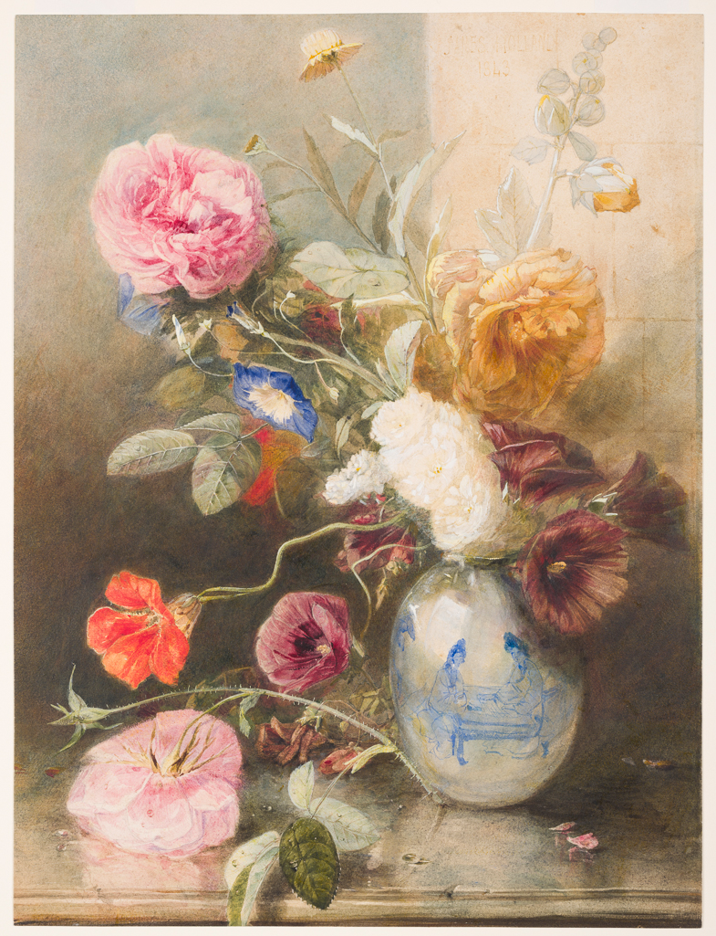
Flowers in a vase which stands on a ledge, 1843, Watercolour on Card, 450x341 mm, Fitzwilliam Museum, Cambridge, UK https://data.fitzmuseum.cam.ac.uk/id/image/media-209096

Slide 11
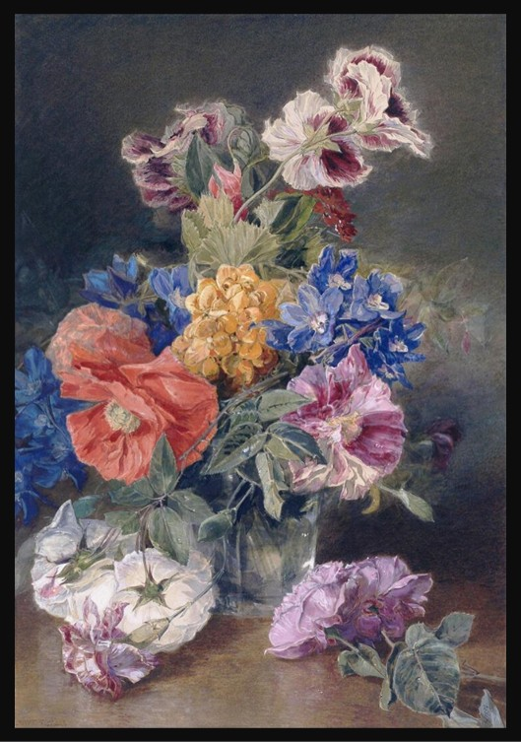
Roses, Poppy, Pelargonia, Delphinium and Calceolarias in a Glass Vase, 1859, Watercolour, 43.18x37.30 cm, Victoria and Albert Museum, London, UK https://collections.vam.ac.uk/item/O1070493/roses-poppy-pelargonia-delphinium-and-watercolour-james-holland/

Slide 12
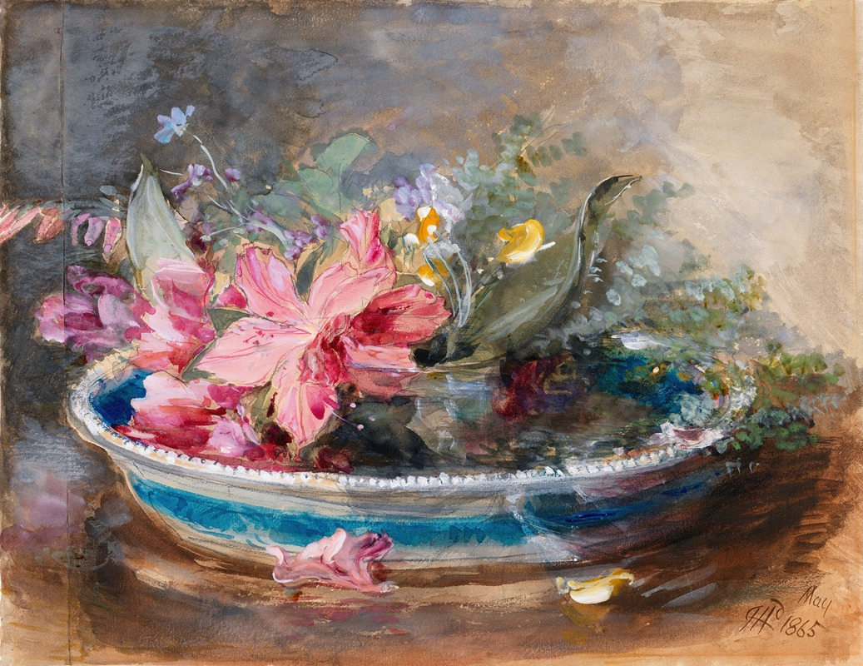
Flowers in a Bowl, 1865, Watercolour on Card, Fitzwilliam Museum, Cambridge, UK https://artvee.com/dl/flowers-in-a-bowl/

