Slide 1

Charles Auguste Émile Durand dit Carolus-Duran, 1837-1917
12 Paintings

Slide 2
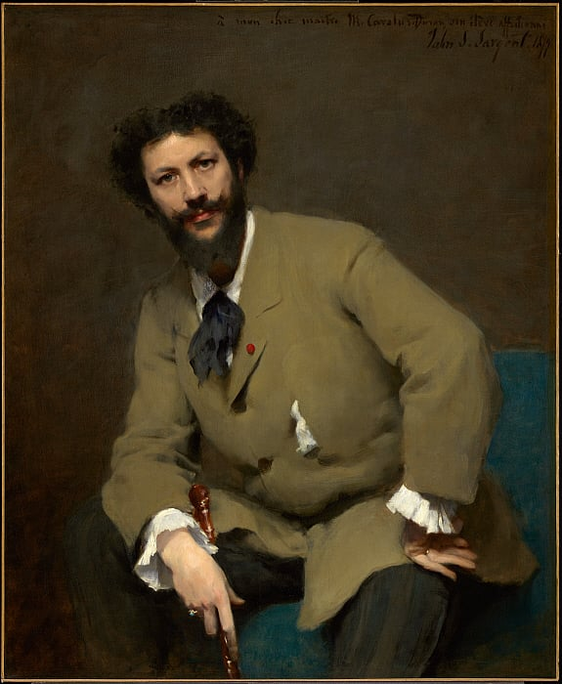
John Singer Sargent, 1856–1925 Portrait of Carolus-Duran, 1879, Oil on canvas, 116.8 x 96 cm, The Clark, MA, USA https://www.clarkart.edu/artpiece/detail/carolus-duran

Slide 3
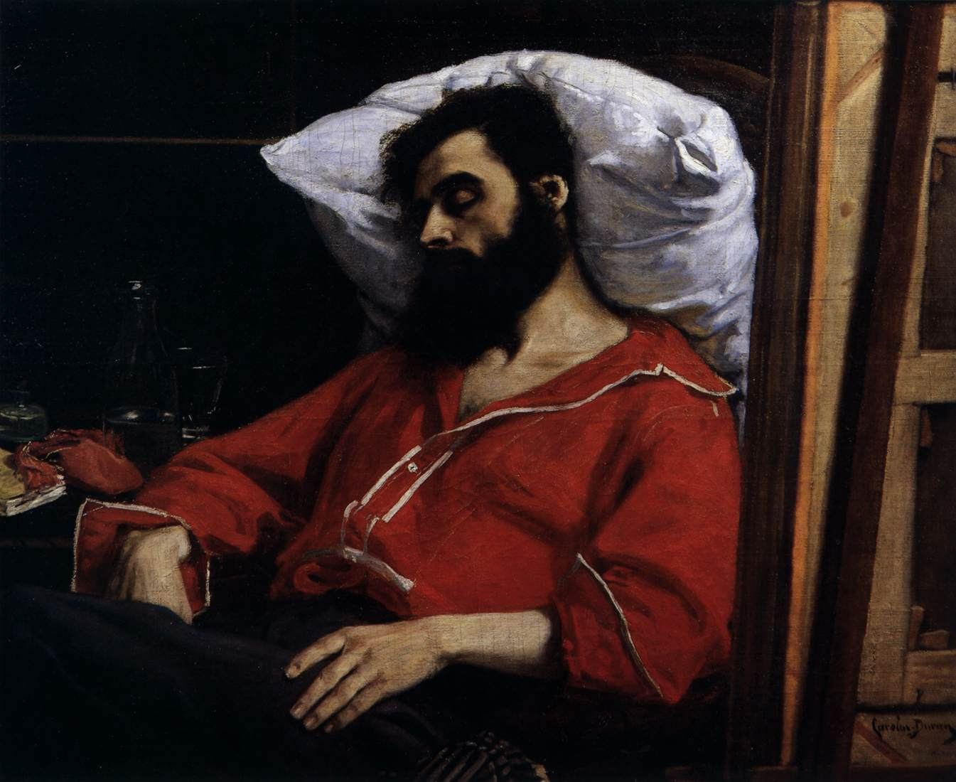
The Convalescent or The Casualty, 1860, Oil on canvas, 99 x 125 cm, Musée d'Orsay, Paris, France https://www.wga.hu/frames-e.html?/html/c/carolus/index.html

Slide 4
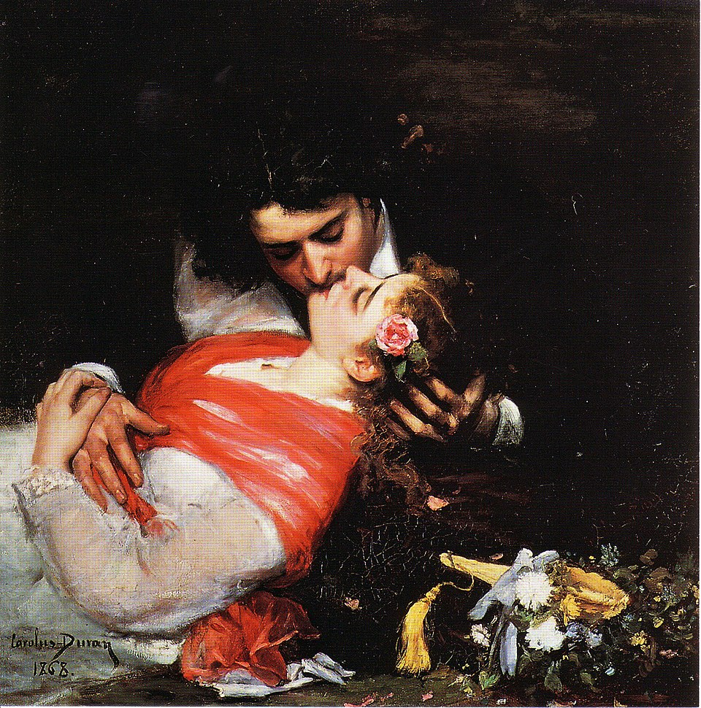
The Kiss, 1868, Oil on canvas, 92x91,5, cm, Palais des Beaux-Arts de Lille, France https://commons.wikimedia.org/wiki/File:Carolus-Duran,_1868_-_Le_baiser.jpg

Slide 5
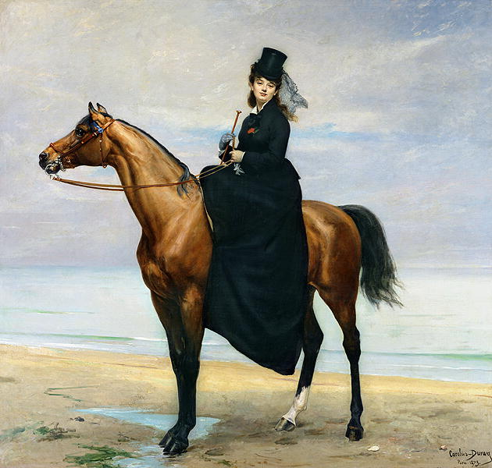
Equestrian Portrait of Mademoiselle Croizette, 1873, Oil on canvas, 340x312 cm, MUba Eugène-Leroy, France https://commons.wikimedia.org/wiki/File:Carolus-Duran_-_Equestrian_Portrait_of_Mademoiselle_Croizette.JPG

Slide 6
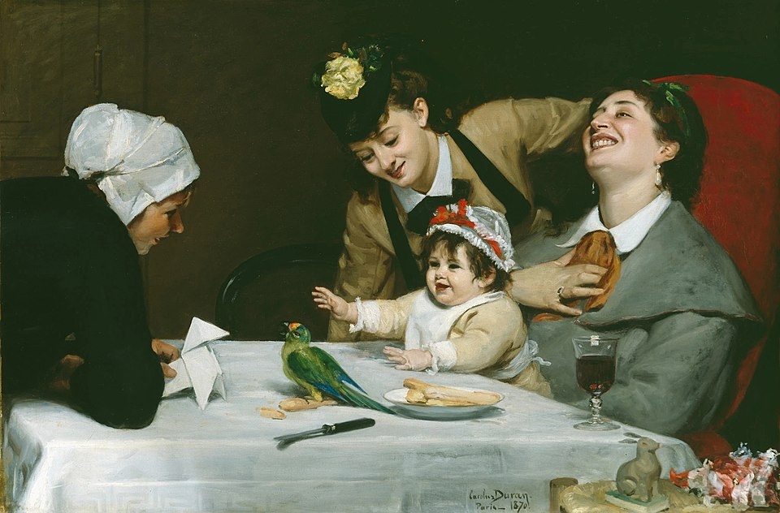
Merrymakers, 1870, oil on canvas, 90,2x139,7 cm, Detroit Institute of Arts, USA https://commons.wikimedia.org/wiki/File:Carolus-Duran_-_Merrymakers_(1870).jpg

Slide 7
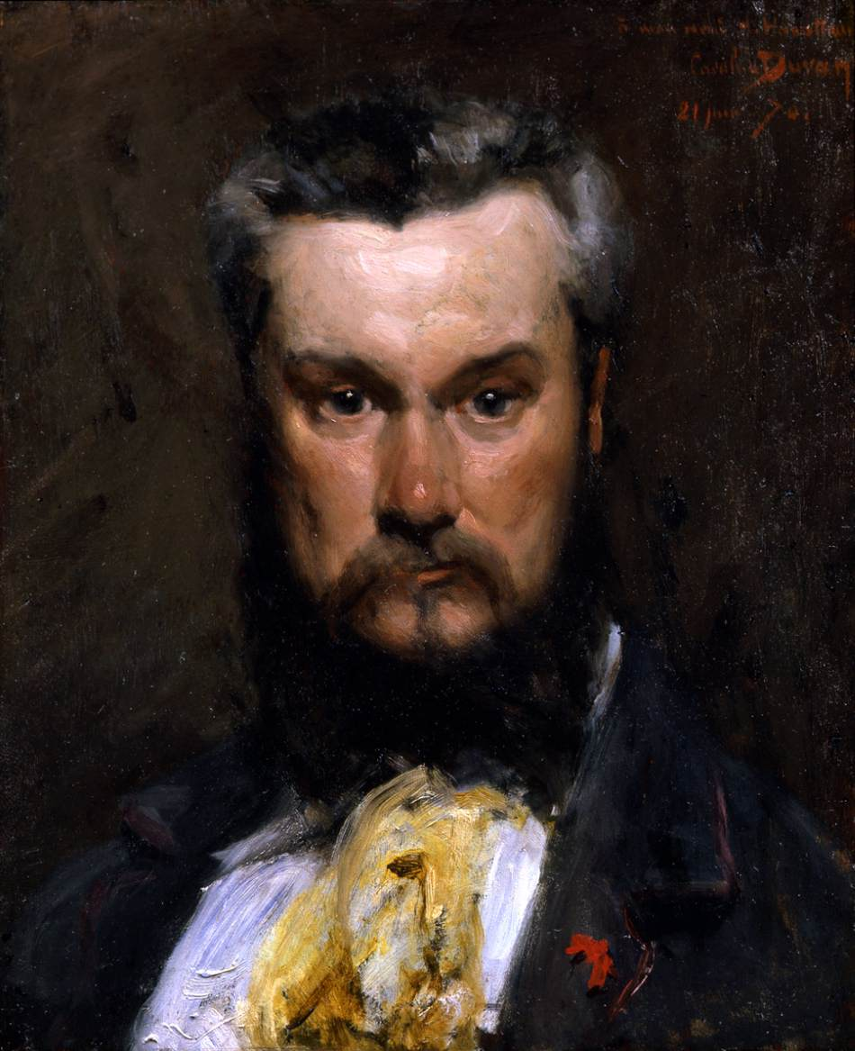
Portrait of Hector Hanoteau, 1870, Oil on canvas, 46 x 37 cm, Private Collection https://www.wga.hu/frames-e.html?/html/c/carolus/index.html

Slide 8
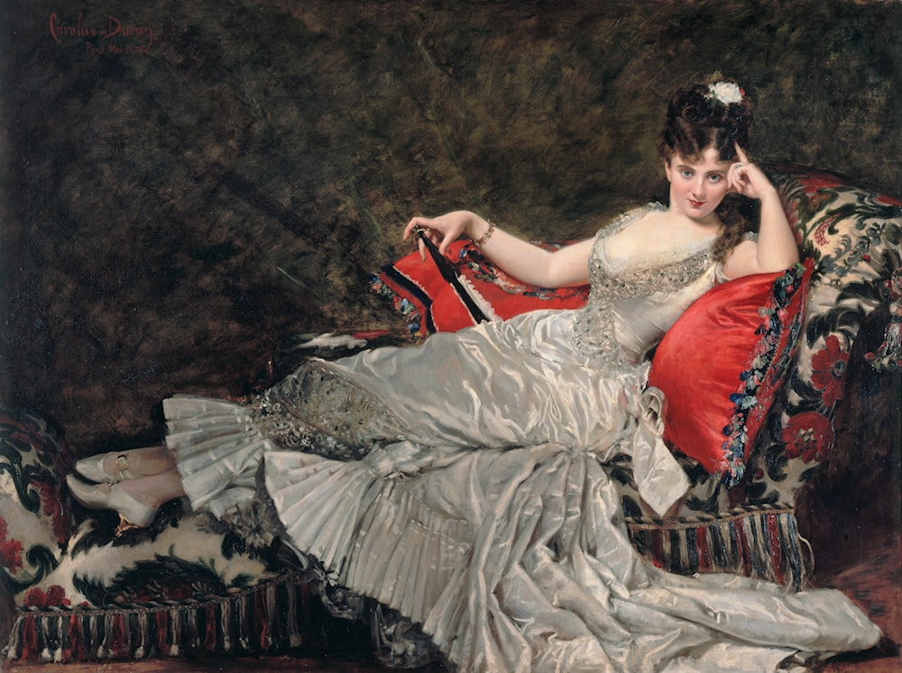
Portrait of Mademoiselle de Lancey, 1876, Oil on canvas, 152.5 x 211 cm, Petit Palais, Paris, France https://www.petitpalais.paris.fr/en/le-petit-palais

Slide 9
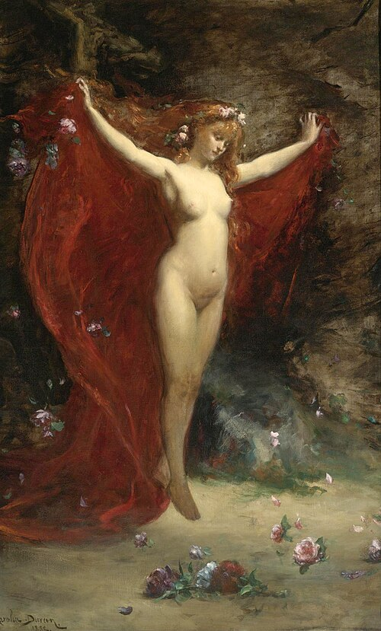
Vision, 1883, Oil on Canvas, 205.7x125.7 cm, Private Collection

Slide 10
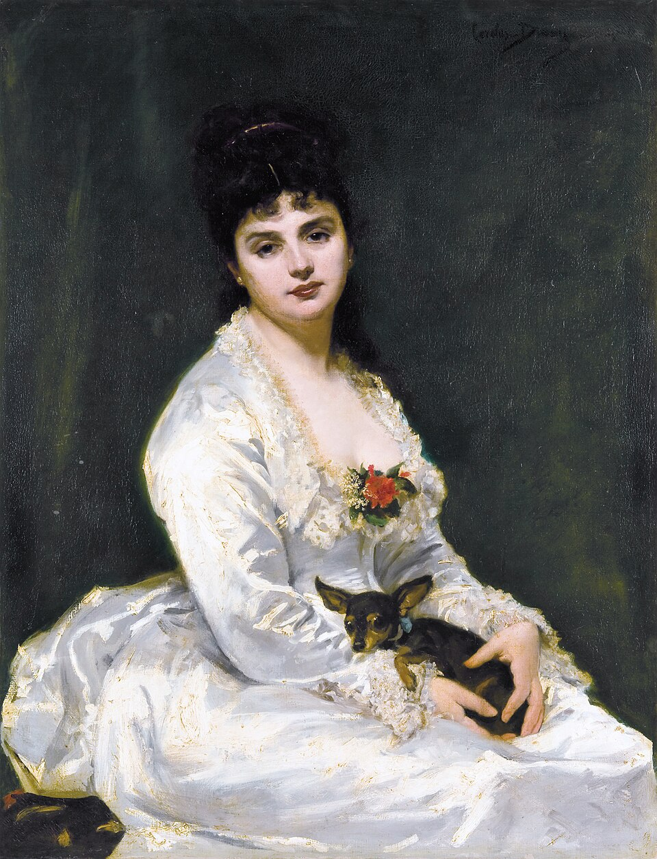
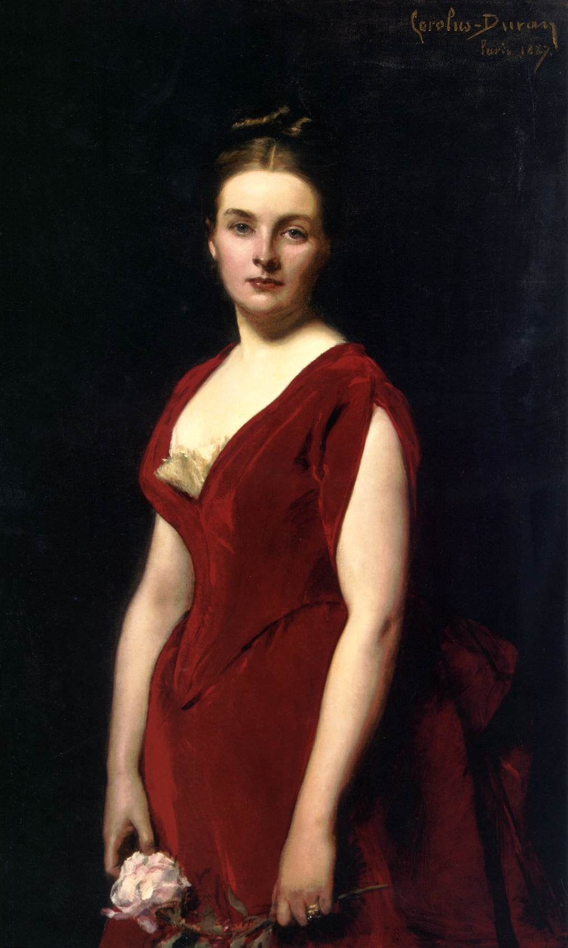
Madame Henry Fouquier, 1876, Oil on canvas, 113.5x86.5 cm, Private Collection https://commons.wikimedia.org/wiki/File:Madame_Henry_Fouquier,_by_Carolus_Duran.jpg Portrait of Anna Alexandrovna Obolenskaya, 1887, Oil on canvas, 120 x 78 cm, The Hermitage, St. Petersburg, Russia https://www.wga.hu/frames-e.html?/html/c/carolus/index.html

Slide 11
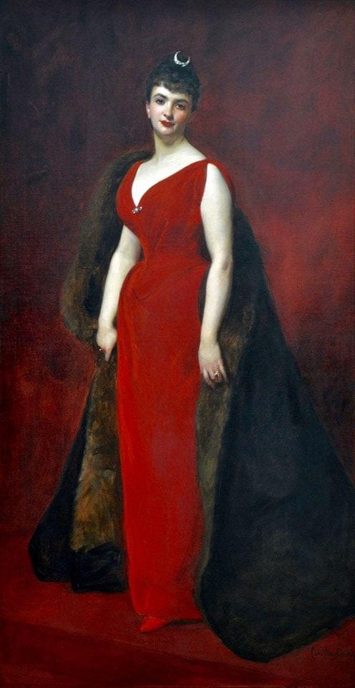
Marguerite Stern, 1889, Oil on canvas, 247,6x148 cm, Petit Palais, Paris, France https://www.petitpalais.paris.fr/en/le-petit-palais

Slide 12
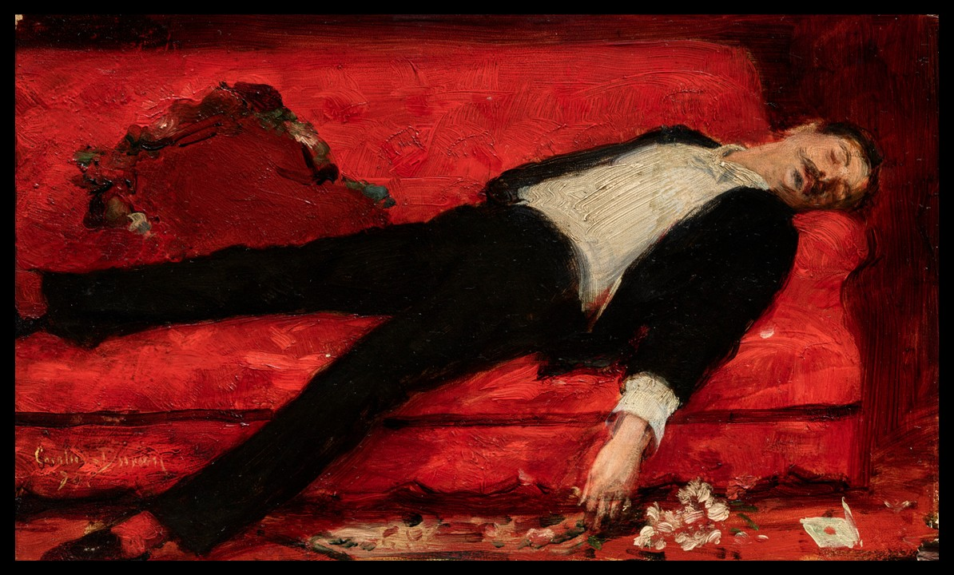
The Letter, 1889 (?), Oil on canvas, 18x30 cm, Private Collection https://www.christies.com/en/lot/lot-6554862?ldp_breadcrumb=back

Slide 13
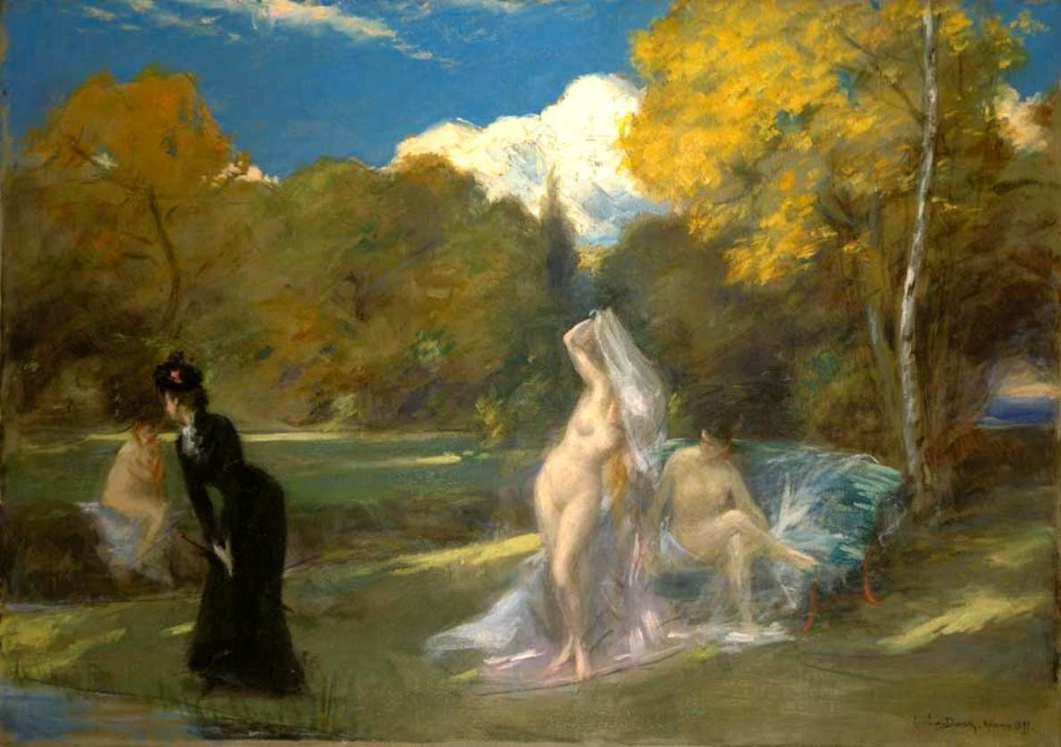
After the Swimming, 1899, Oil on canvas, 72 x 99 cm, Private Collection https://www.wga.hu/frames-e.html?/html/c/carolus/index.html

