Slide 1
John Singer Sargent
1856-1925

Slide 2
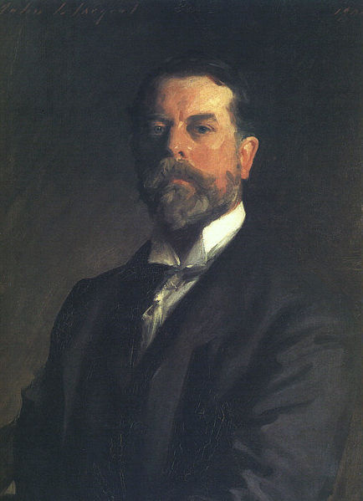
John Singer Sargent, 1856-1925 Self Portrait, 1906, oil on canvas, 70 × 53 cm, Uffizi Gallery, Florence, Italy https://commons.wikimedia.org/wiki/File:Sargent,_John_SInger_(1856-1925)_-_Self-Portrait_1907_b.jpg

Slide 3
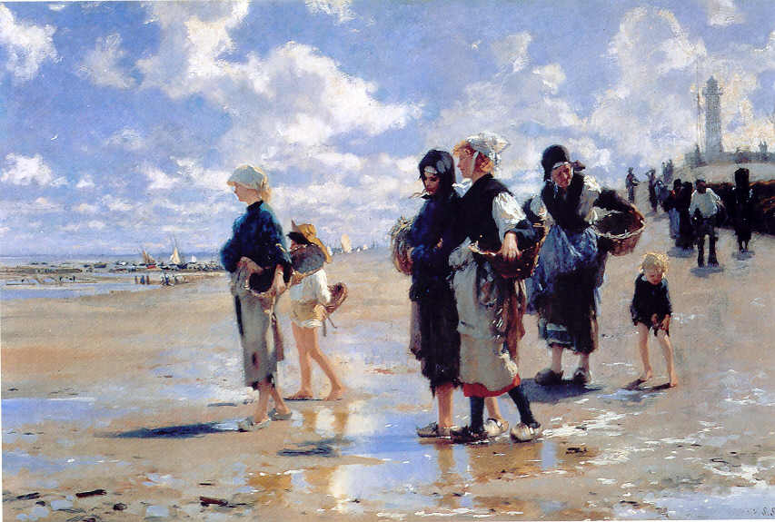
Oyster Gatherers of Cancale, 1878, oil on canvas, 96.8 x 123.2 cm, Corcoran Gallery of Art, Washington DC, USA https://www.jssgallery.org/Paintings/10076.html

Slide 4
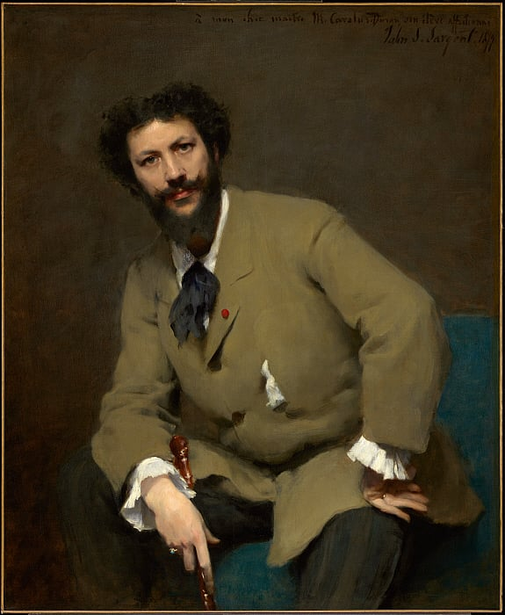
Portrait of Carolus-Duran, 1879, oil on canvas, Sterling and Francine Clark Art Institute at Williamstown, MA, USA https://www.clarkart.edu/artpiece/detail/carolus-duran

Slide 5
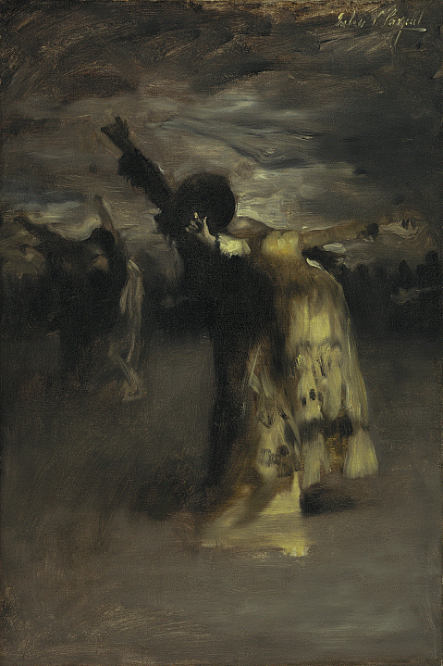
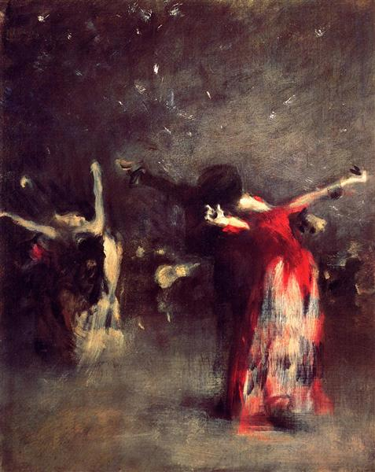
Study for Spanish Dance, 1879-1880, oil on canvas, 72.39 x 48.26 cm, Nelson-Atkins Museum of Art MS, USA https://art.nelson-atkins.org/objects/5539/study-for-spanish-dance Study for The Spanish Dance, c.1879, oil, canvas, 48.26 x 38.74 cm, Private Collection https://www.wikiart.org/en/john-singer-sargent/study-for-the-spanish-dance

Slide 6
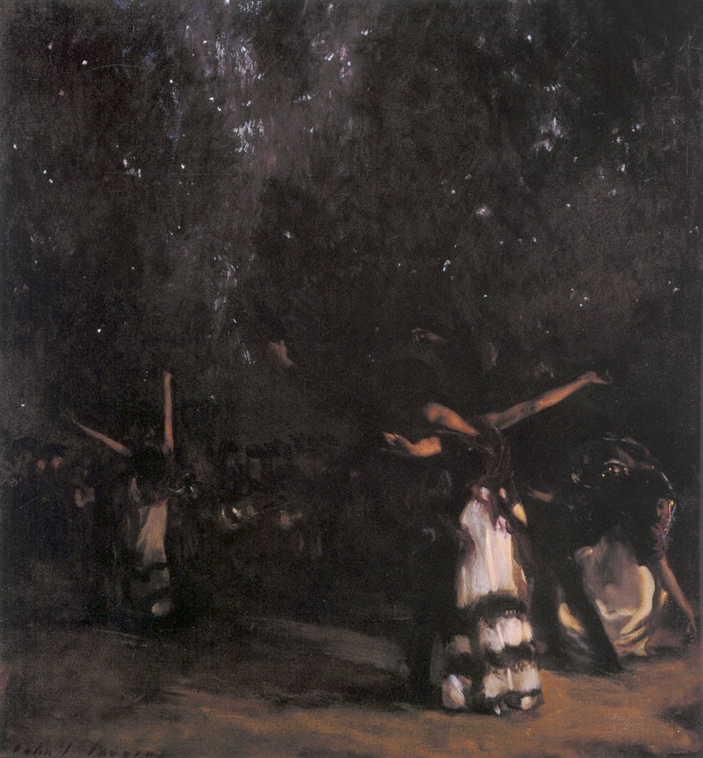
Spanish Dance, 1879-80, oil on canvas, 89.5 x 84.5 cm, The Hispanic Society of America, NY, USA https://instareyog.blogspot.com/2014/03/john-singer-sargent-part-3.html

Slide 7
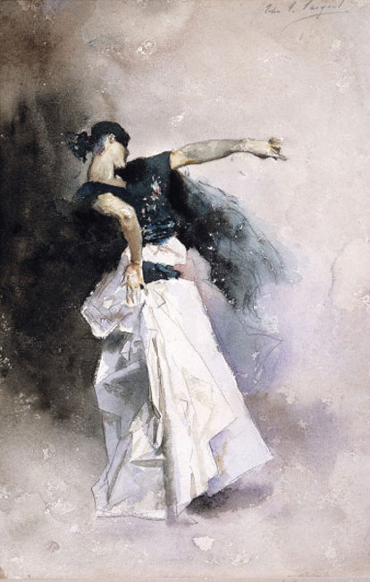
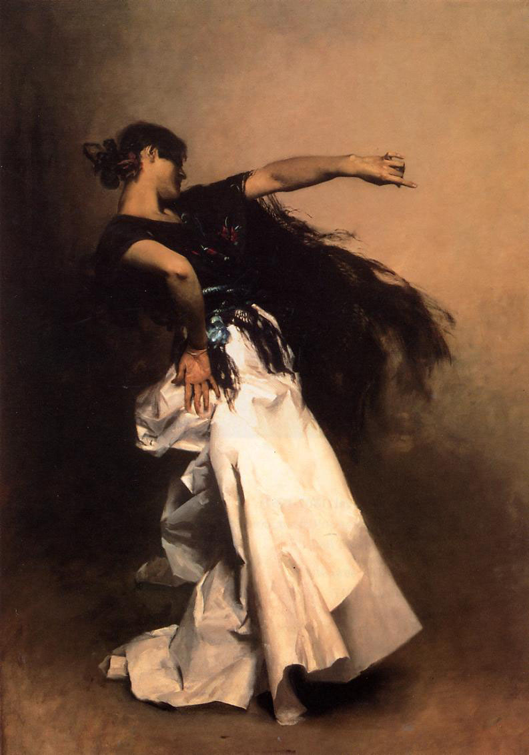
Study for Spanish Dancer, c. 1880–1881, watercolor over graphite on paper, 30.16 × 20 cm, 52.07 × 41.28 × 4.13 cm, Dallas Museum of Art, TX, USA https://www.jssgallery.org/Paintings/Sketches/Study_for_El_Jaleo/10286.html Spanish Dancer, c. 1879-82, oil on canvas, 222.75x1511.3 cm, Private collection https://upload.wikimedia.org/wikipedia/commons/7/7b/Sargent_John_Singer_Spanish_Dancer.jpg

Slide 8
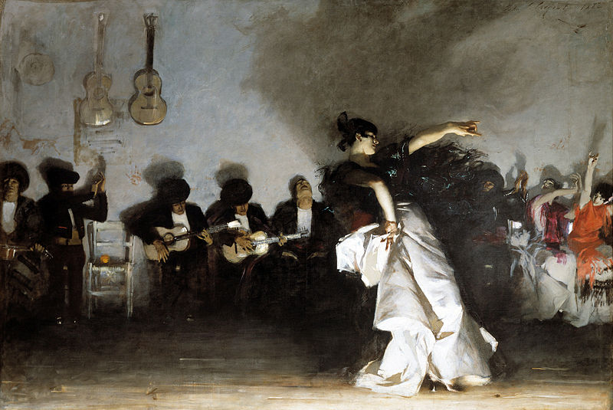
El Jaleo, 1882. oil on canvas, 237 × 352 cm, Isabella Stewart Gardner Museum, Boston, USA https://en.wikipedia.org/wiki/El_Jaleo#/media/File:EL_JALEO-SINGER.jpg

Slide 9
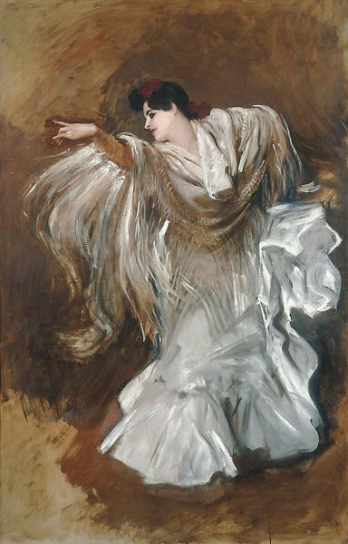
La Carmencita Dancing, 1890, oil on canvas, 137.16 x 88.9 cm, Private Collection https://www.metmuseum.org/art/collection/search/21358

Slide 10
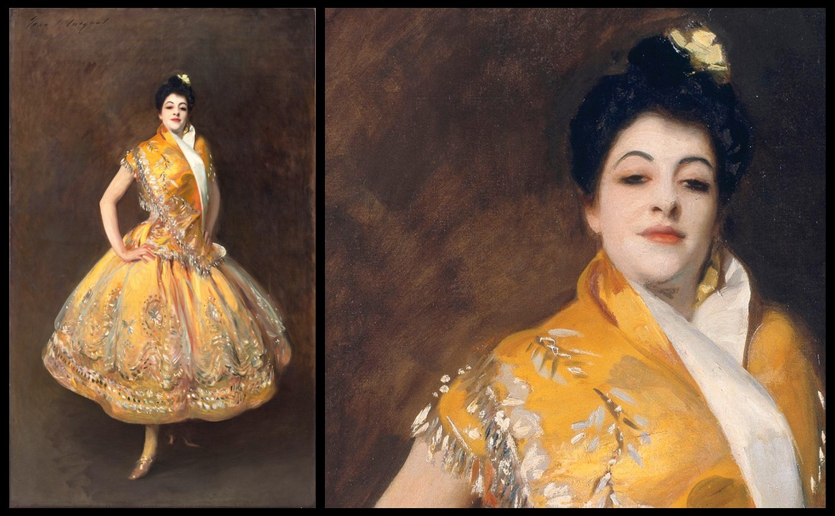
La Carmencita (and detail), c. 1890, oil on Canvas, 229,0 x 140,0 cm, Musée d’Orsay, Paris, France https://www.musee-orsay.fr/en/artworks/la-carmencita-9161 and https://www.facebook.com/artic/photos/pcb.10156398108568150/10156398121923150/?type=3&eid=ARAJqnf0ffscPXNE5DuZvOr1KSTg38J0yvdUPccBTitulGvhVU0Wpt-1YLwxNsNS_whsdRXHa7EE0-w9

Slide 11
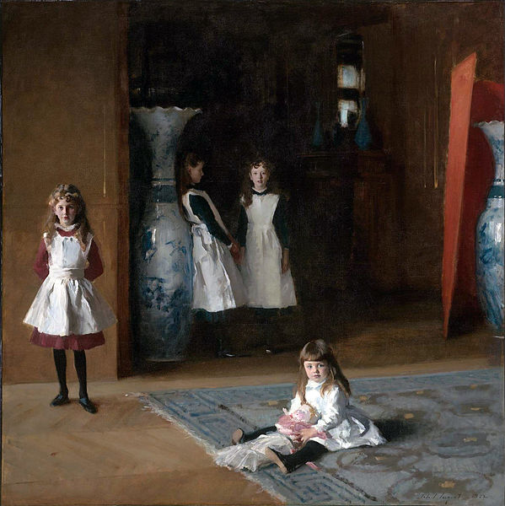
The Daughters of Edward Darley Boit, 1882, oil on canvas, 222.5 cm × 222.5 cm, MFA, Boston, USA https://en.wikipedia.org/wiki/The_Daughters_of_Edward_Darley_Boit

Slide 12
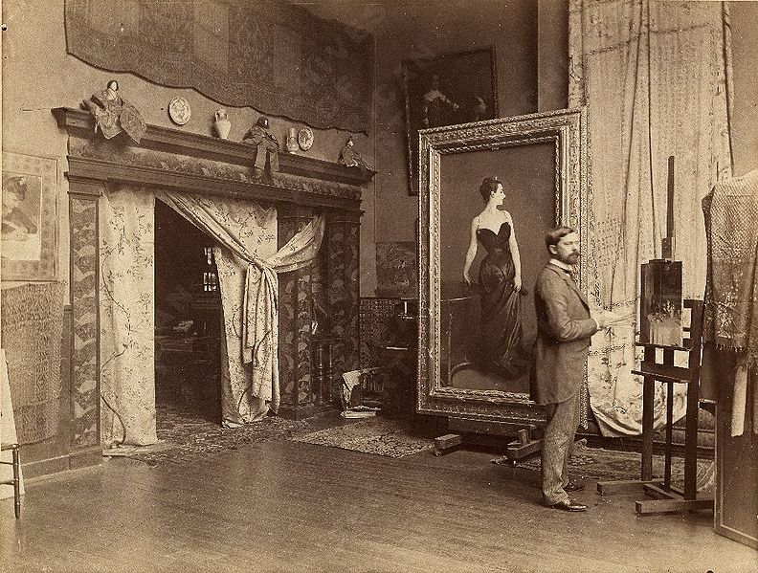
John Singer Sargent in his Studio with the Portrait of Madame X, 1884, Archives of American Art, Smithsonian, Washington DC, USA https://www.youtube.com/watch?v=RCSx3zw0eGY

Slide 13
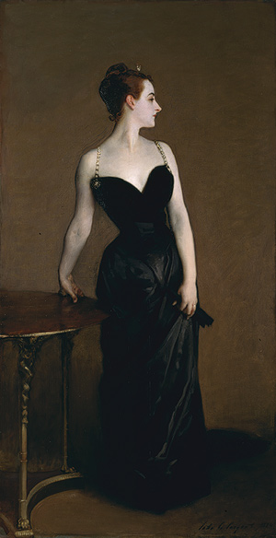
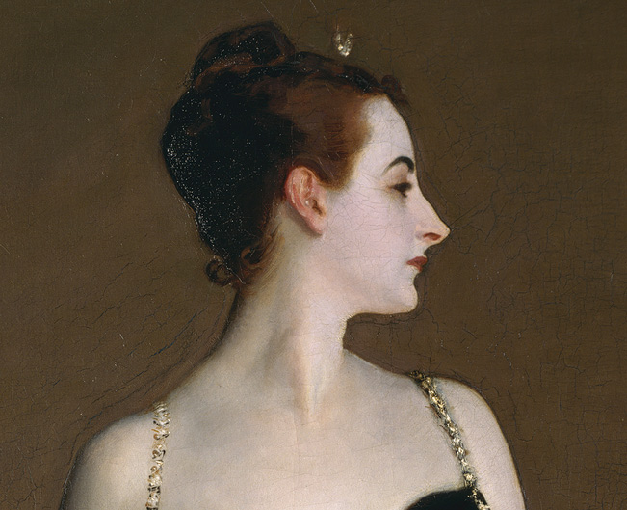
Madame X (Madame Pierre Gautreau), 1883–84, oil on canvas, 208.6 x 109.9 cm, the MET, NY, USA https://en.wikipedia.org/wiki/Portrait_of_Madame_X

Slide 14
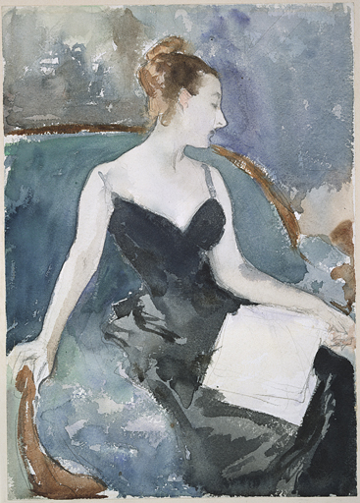
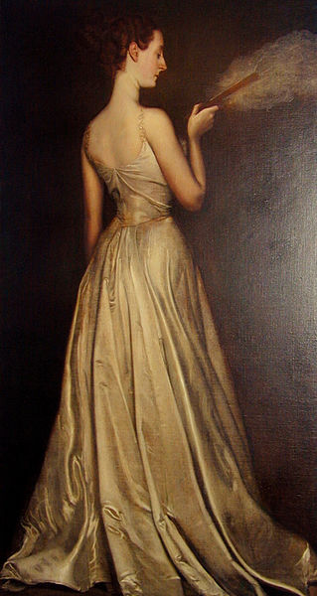
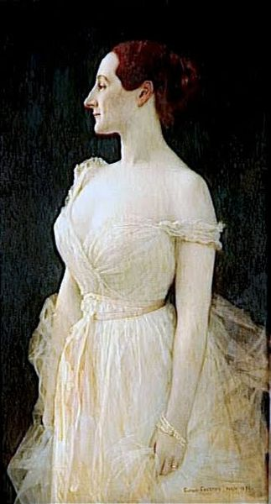
Madame Gautreau (Madame X), 1883, drawing, watercolor and graphite on white wove paper, Harvard Art Museum/Fogg Museum Antonio de La Gandara, Portrait of Mme Pierre Gautreau, 1898, Gibbes Museum of Art, GA Gustave Courtois, Portrait of Mme Pierre Gautreau, 1891, unknown owner https://en.wikipedia.org/wiki/Portrait_of_Madame_X

Slide 15
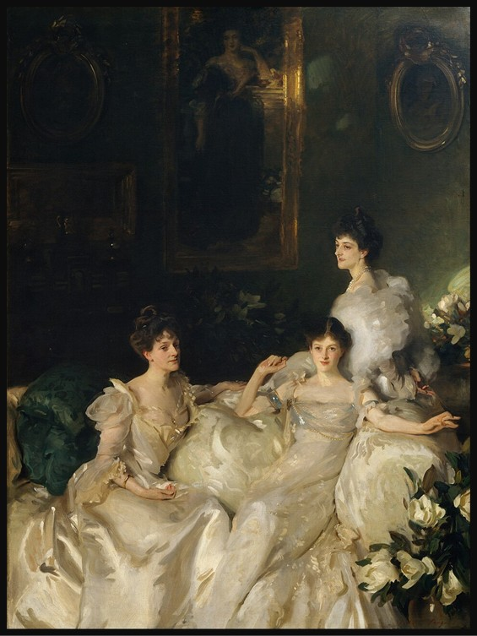
The Wyndham Sisters - Lady Elcho, Mrs. Adeane, and Mrs. Tennant, 1899, oil on Canvas, 292.1 x 213.7 cm, Metropolitan Museum of Art, NY, USA https://commons.wikimedia.org/wiki/File:The_Wyndham_Sisters_-_Lady_Elcho,_Mrs._Adeane,_and_Mrs._Tenant.jpg

Slide 16
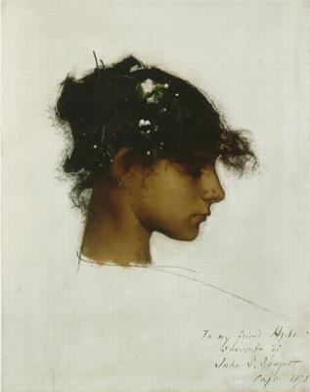
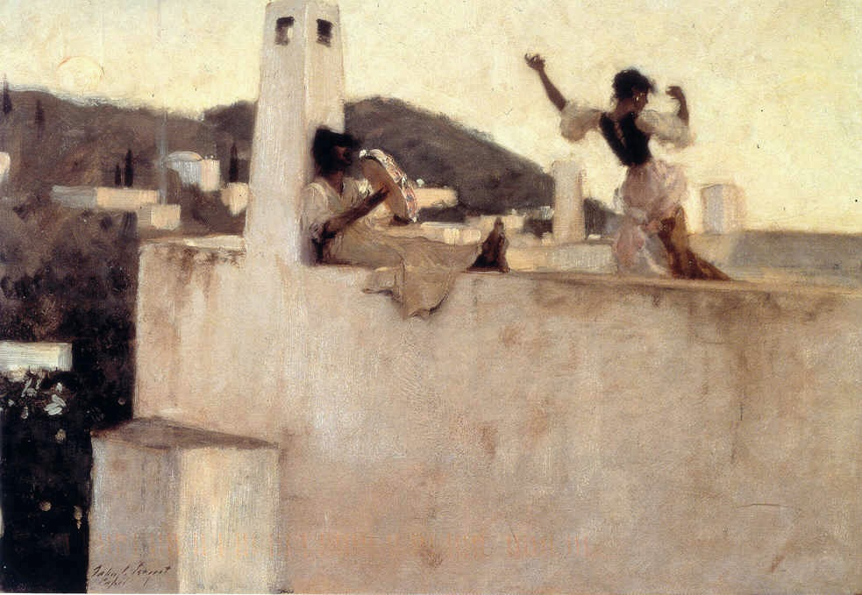
Rosina-Capri , 1878, oil on canvas, 19.7 x 25.5 in, Private collection Rosina Ferrara, Head of a Capri Girl, about 1878, oil paint on canvas, Denver Art Museum https://commons.wikimedia.org/wiki/File:John_Singer_Sargent_-_Rosina-Capri_(1878).jpg and https://www.facebook.com/groups/Italian.liberty/posts/4543818962336822/

Slide 17
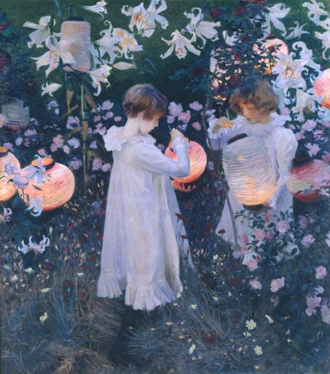
Carnation, Lily, Lily, Rose, 1885-6, oil on canvas, 1740 x 1537 mm, TATE Gallery, London, UK https://www.tate.org.uk/art/artworks/sargent-carnation-lily-lily-rose-n01615

Slide 18
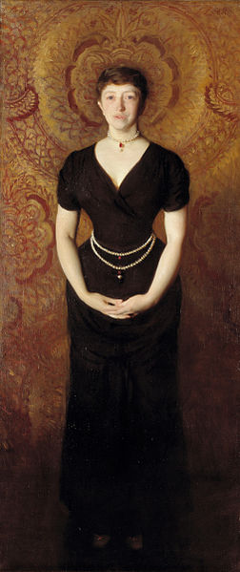
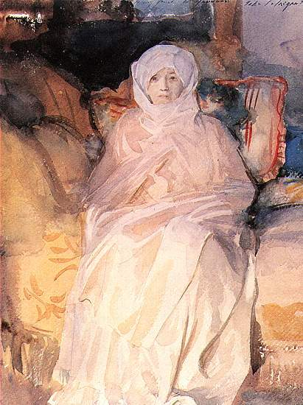
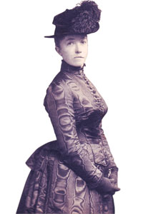
Isabella Stewart Gardner, 1888, oil on canvas, 190 x 81.2 cm, Isabella Stewart Gardner Museum, Boston, USA https://www.gardnermuseum.org/experience/collection/10867 Mrs Gardner in White, 1920, watercolor, Isabella Stewart Gardner Museum, Boston https://www.gardnermuseum.org/experience/collection/10883

Slide 19
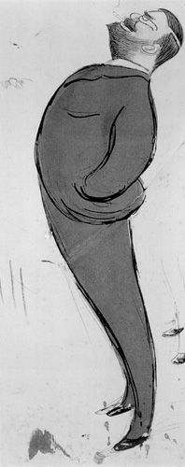
John S. Sargent by Max Beerbohm, 1872-1956, Tate Gallery, London Graphite and pen with wash, Friend of the JSS Gallery https://www.jssgallery.org/Other_Artists/Max_Beerbohm/John_S_Sargent.htm . . .I have been making friends, in a modest way, with Sargent whom I like particularly. He is incredibly unspoilt, simple and natural and outgoing. I spent a morning in his studio the other day - he wanted me to see a portrait he was painting. I liked the portrait very much and the painter still more. . . The truth is that when he is at his best no one can touch him, and he generally is perfectly aware himself when he is not. . .

Slide 20
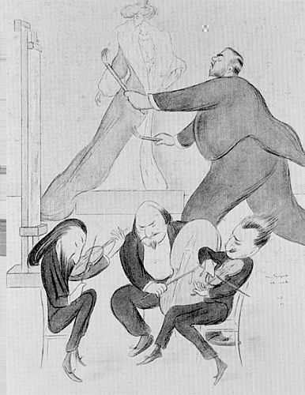
Mr. Sargent at Work by Max Beerbohm, 1872-1956, frontispiece from "The Book of Caricatures, London, UK https://www.jssgallery.org/Other_Artists/Max_Beerbohm/Mr_Sargent_at_Work.htm In a letter to his future wife Beerbohm wrote: 'I have just done a rather good "Mr Sargent at Work"-more or less suggested by a musical party he gave some nights ago. Two fiddlers and a cellist in the foreground, and a duchess on a flatform in the background, and he in between, dashing at a canvas, with a big and swilling brush in either hand. I wish I could make my living by drawing.'

Slide 21
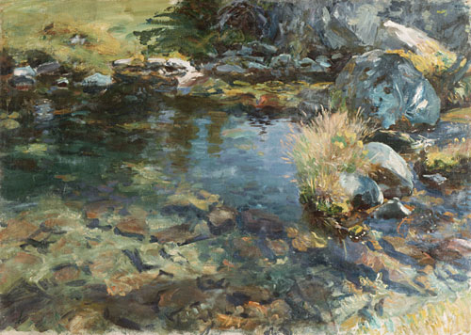
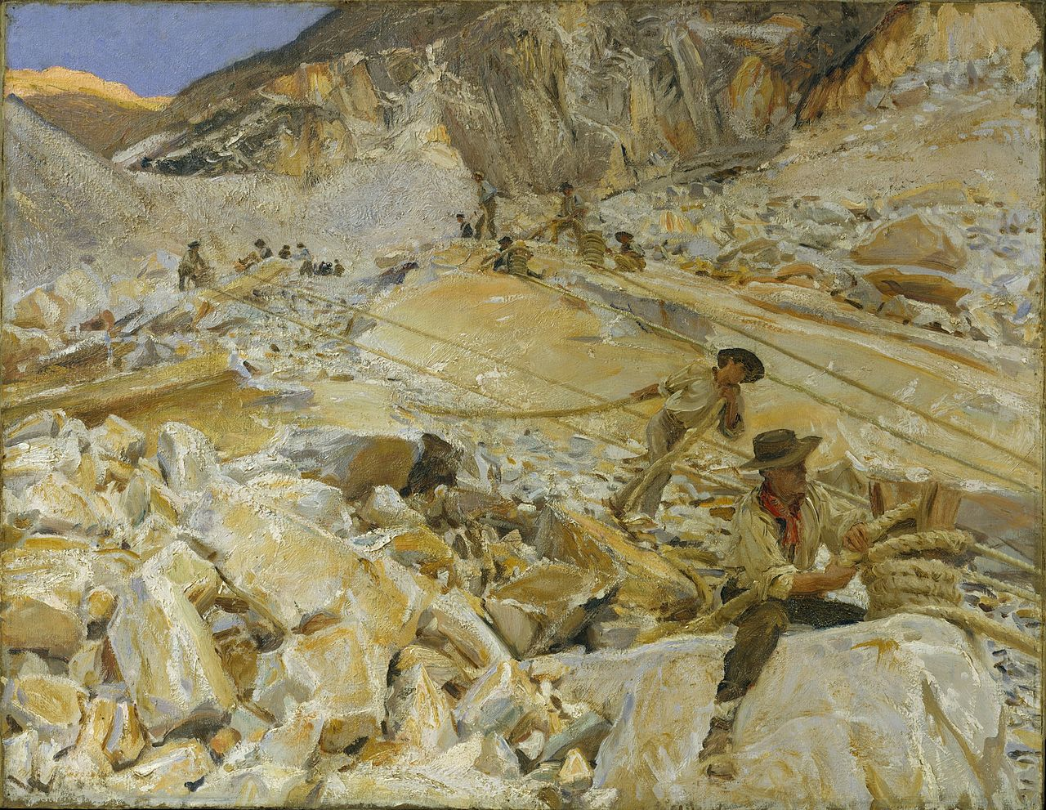
Alpine Pool, 1907, oil on canvas, 69.9 x 96.5 cm, The MET, NY, USA https://www.jssgallery.org/Paintings/10026.html Bringing down Marble from the Quarries to Carrara, 1911, oil on canvas, 71.4 x 91.8 cm, The MET, NY, USA https://en.wikipedia.org/wiki/Bringing_Down_Marble_from_the_Quarries_to_Carrara

Slide 22
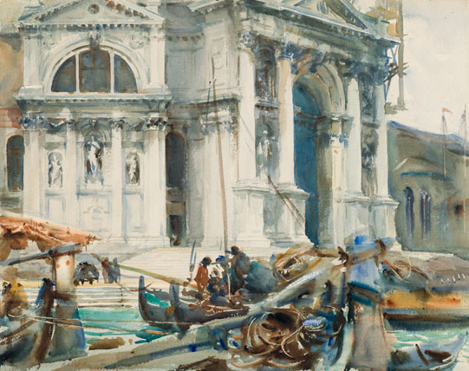
Santa Maria della Salute, 1904, translucent and opaque watercolor and graphite with graphite underdrawing, 46.2 x 58.4 cm, Brooklyn Museum https://habituallychic.luxury/2013/04/john-singer-sargent-watercolors/

Slide 23
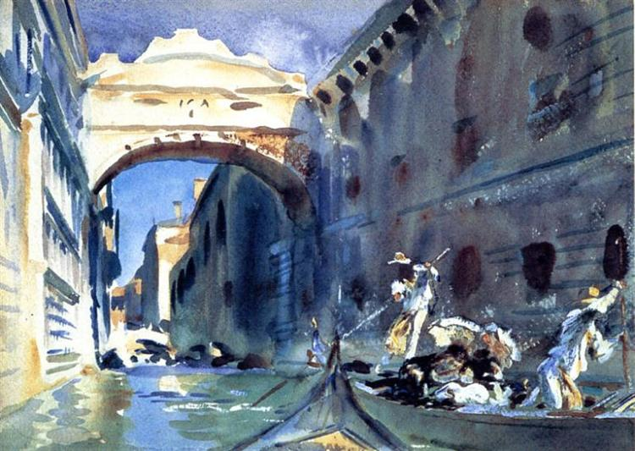
Bridge of Sights, 1903-04, translucent and opaque watercolor with graphite and red-pigmented underdrawing, 25.4 x 35.6 cm, Brooklyn Museum https://www.wikiart.org/en/john-singer-sargent/the-bridge-of-sighs

Slide 24
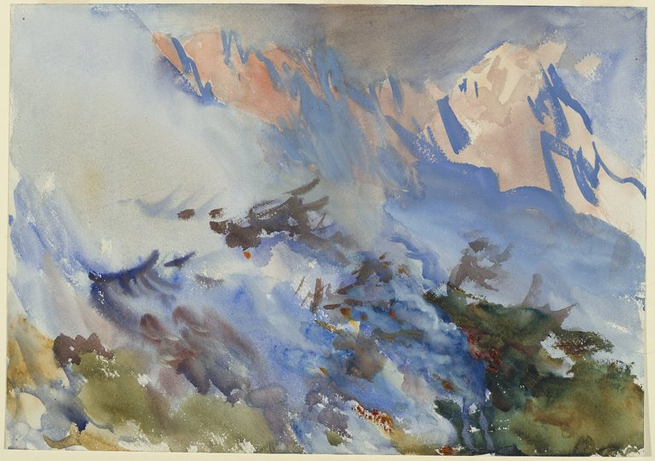
Mountain Fire, 1906-07, opaque and translucent watercolour, 60.6 x 75.7 x 3.5 cm, Brooklyn Museum https://www.brooklynmuseum.org/opencollection/objects/20383

Slide 25
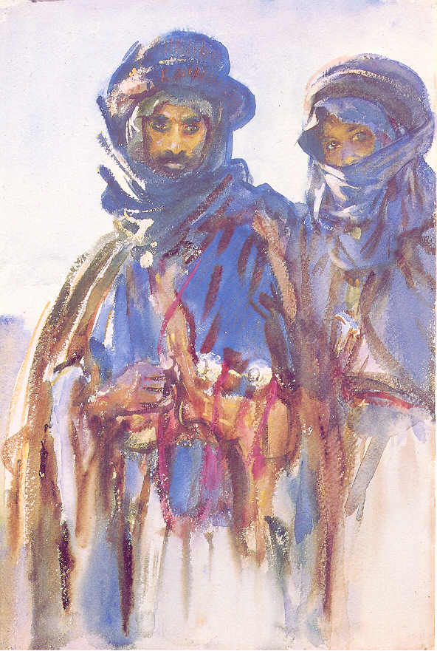

Bedouins, 1905, transparent watercolor with touches of opaque watercolor on off-white, thick, rough-textured wove paper, 45.7 x 30.5 cm, The Brooklyn Museum, New York https://www.jssgallery.org/Paintings/Bedouins.htm and http://www.eurocles.com/arpoma/arpoma-musees2.php?action=rech4&rep=../data/peinture/&filename=sargent

Slide 26
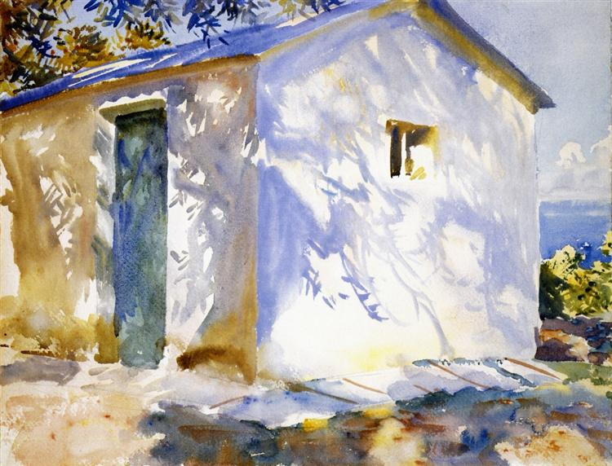
Corfu: Lights and Shadows, 1909. translucent and opaque watercolor with graphite underdrawing, 40.3 x 53 cm, MFA, Boston https://www.wikiart.org/en/john-singer-sargent/corfu-lights-and-shadows-1909

Slide 27
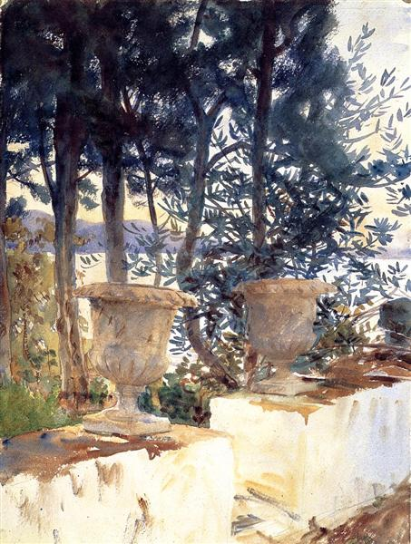
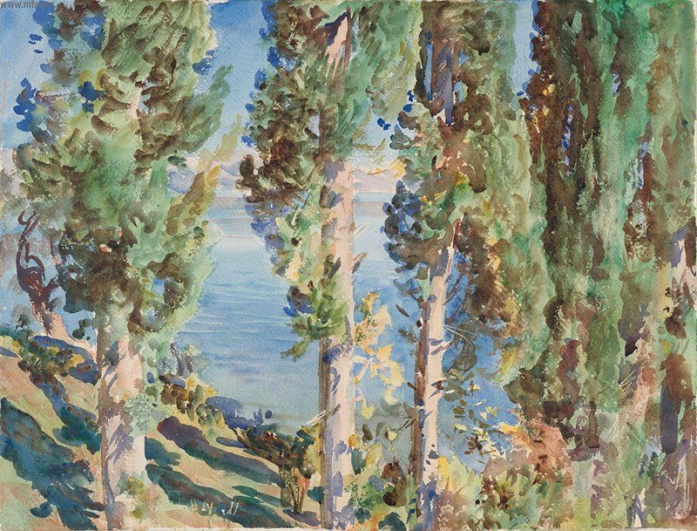
Corfu: The Terrace, 1909, watercolor over graphite pencil on paper, 52 x 40 cm, MFA, Boston https://www.wikiart.org/en/john-singer-sargent/corfu-the-terrace-1909 Corfu: Cypresses, 1909, watercolor over graphite pencil on paper, 40 x 52.1 cm, MFA, Boston https://commons.wikimedia.org/wiki/File:John_Singer_Sargent_-_Corfu-_Cypresses_-_Google_Art_Project.jpg

Slide 28
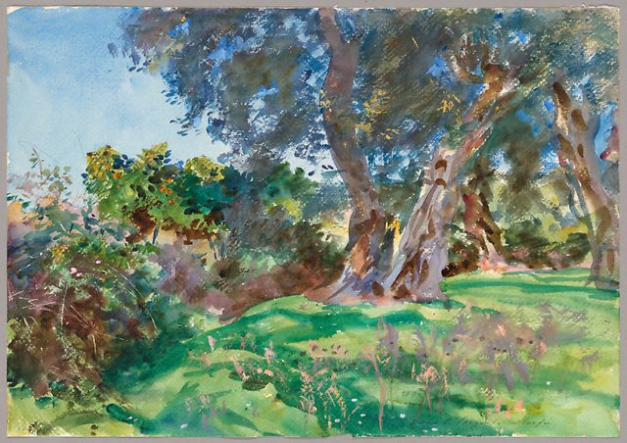
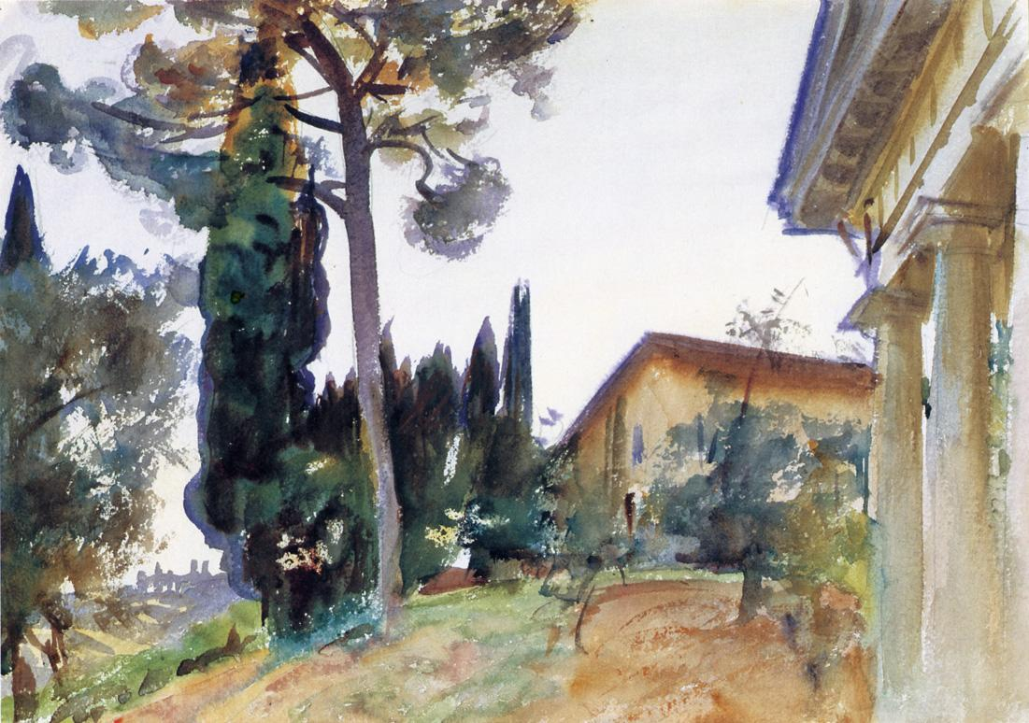
Olive Trees, Corfu, 1909, watercolor and opaque watercolor with scraping and wax resist over graphite on ivory wove paper, 356 × 508 mm, The Art Institute of Chicago, USA https://www.thepassivevoice.com/olive-trees-corfu/ Corfu, 1909, watercolour, 34.93 x 49.53 cm, Pennsylvania Academy of Fine Arts, USA http://www.hellenicaworld.com/Art/Paintings/en/PartJSSargent0172.html

Slide 29
THE END

