Slide 1

Temple A
Early Archaic period: 650-600 BC,
Prinias, possibly ancient city of Rizinia,
Island of Crete, Greece

Slide 2
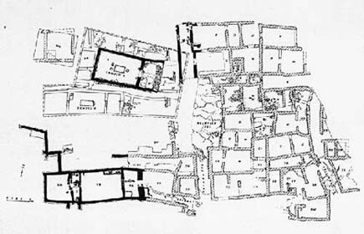
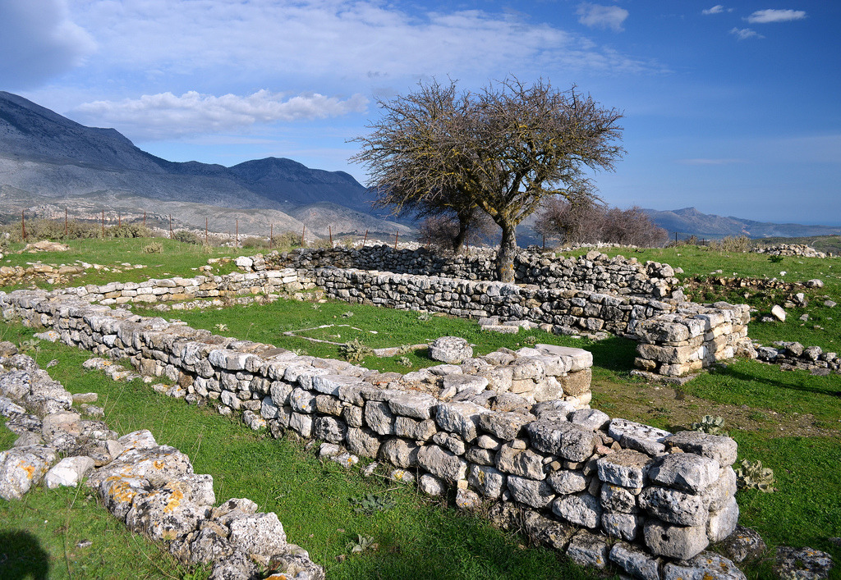
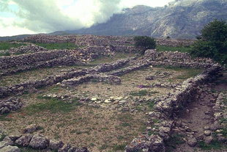
Possibly ancient city of Rizinia, modern Prinias The ancient settlement of Prinias, a unique example of continuity and development during the Geometric and the Archaic Periods is located on a plateau (the Patela) at the confluence of two valleys in central Crete, in a strategic position between the northern and southern areas of the island. https://web.archive.org/web/20081229062101/http://www.ibam.cnr.it/IBAM_files/attivita/wp1/wp1.htm and https://archaicwonder.tumblr.com/post/67432631115/temple-a-in-prinias-crete-occupation-of

Slide 3
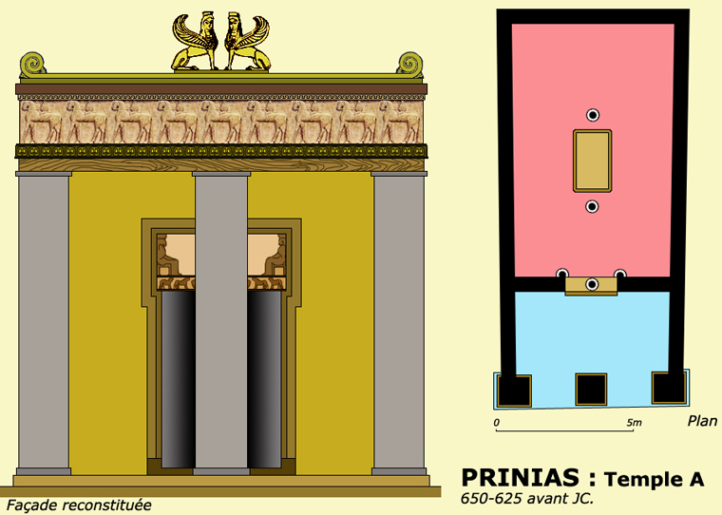
The founding of Naukratis before 630 BCE exposed the Greeks to Egyptian monumental stone architecture, inspiring the construction of early stone buildings in Greece, such as Temple A at Prinias (c. 625 BCE). This temple is the earliest known Greek example with sculptural decoration, featuring a limestone lintel carved with a frieze of stylized panthers in the Orientalizing style. https://quizlet.com/198667170/greek-lecture-81-flash-cards/

Slide 4
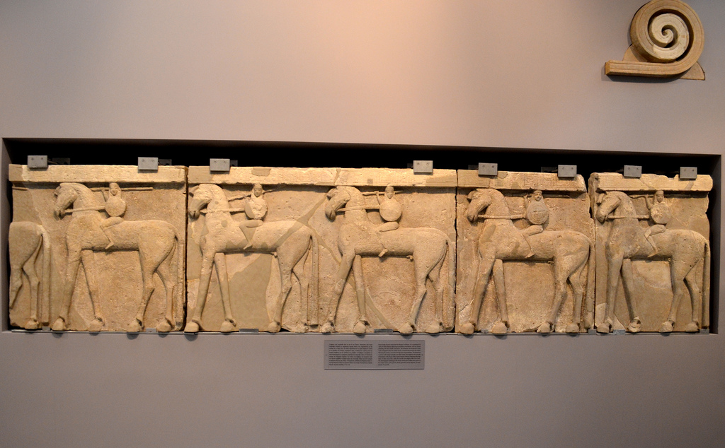
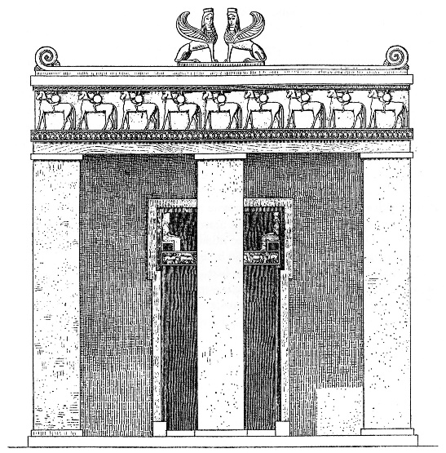
Frieze of Temple A at Prinias, Early Archaic period, 650-600 BC, Stone (Poros stone), 84x362 cm, Heraklion Archaeological Museum, Crete, Greece https://ca.heraklionmuseum.gr/ca/pawtucket/index.php/Detail/objects/489 https://airial.travel/attractions/greece/iraklio/natural-history-museum-of-crete-mRMKRa_R

Slide 5
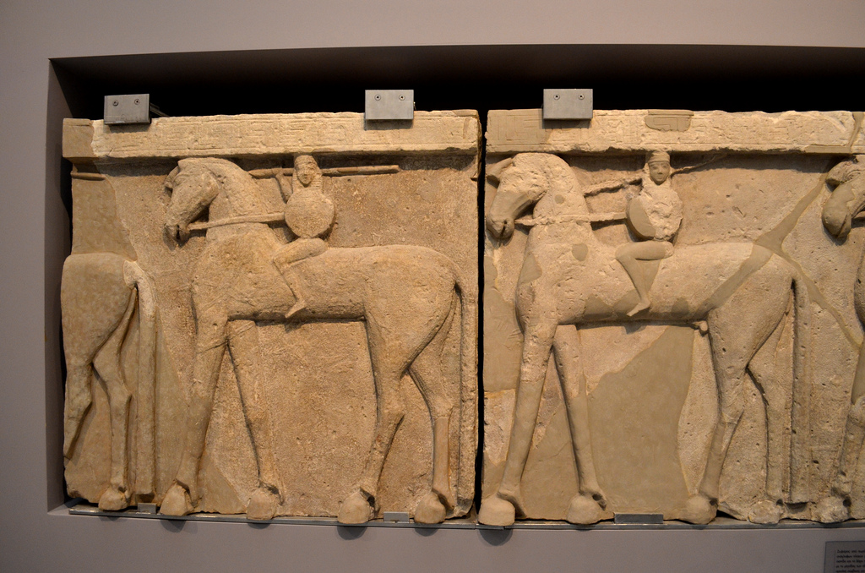
https://www.flickr.com/photos/dandiffendale/9456687452

Slide 6
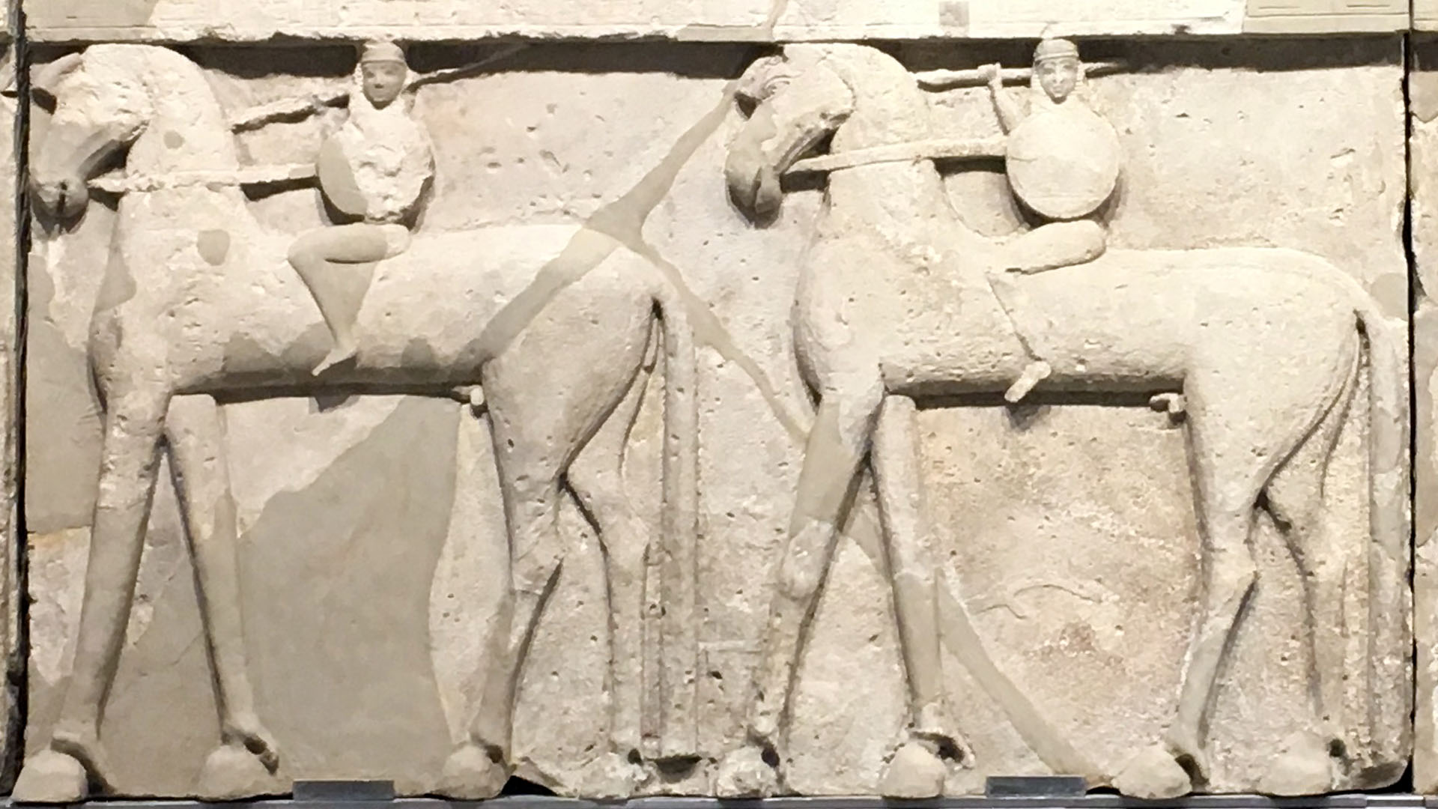
https://www.ancientworldmagazine.com/articles/armed-riders-crete-reliefs-temple-prinias/

Slide 7
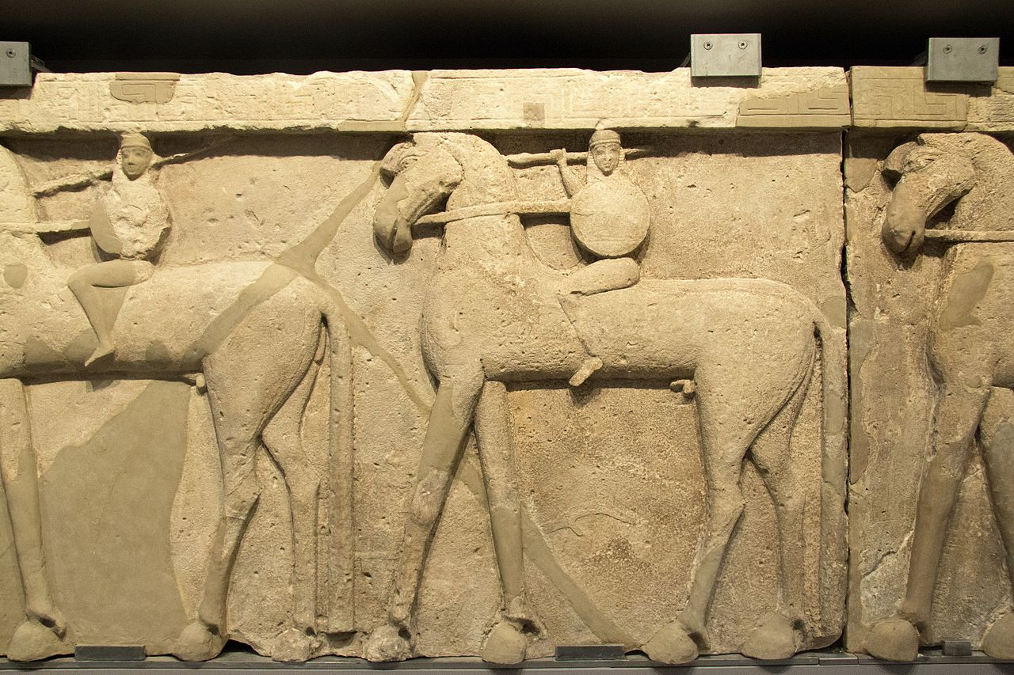

Slide 8
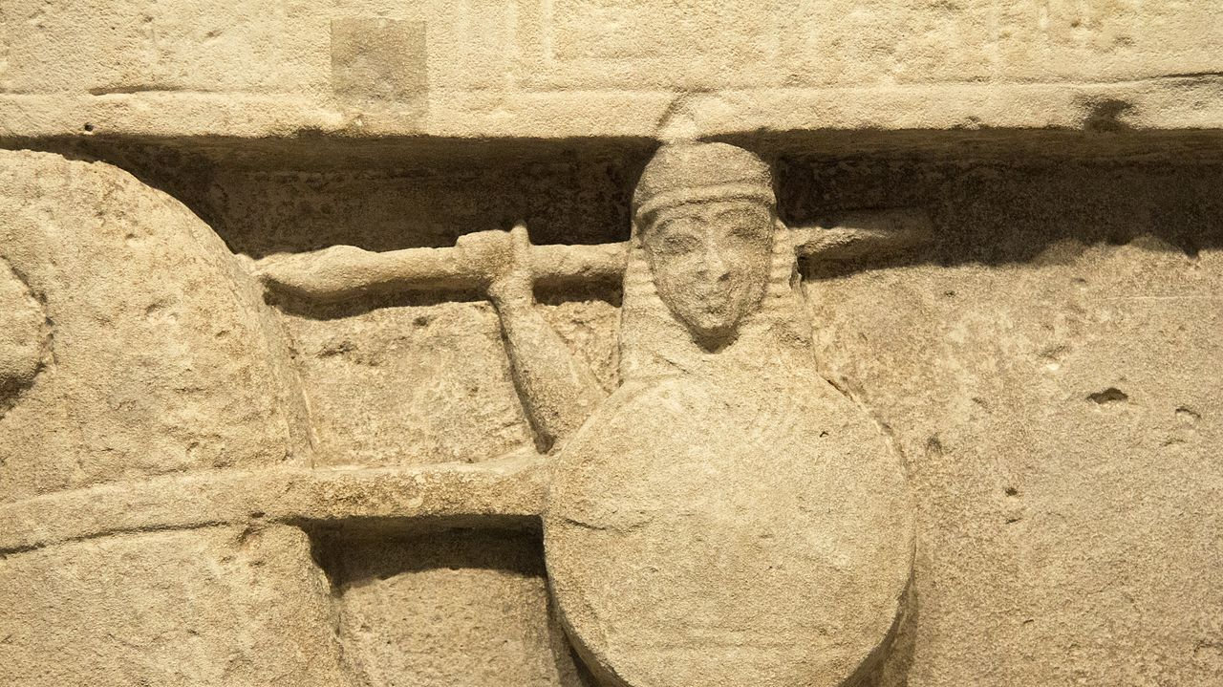
https://www.facebook.com/photo/?fbid=10225102604500955&set=pcb.1081135783088319

Slide 9
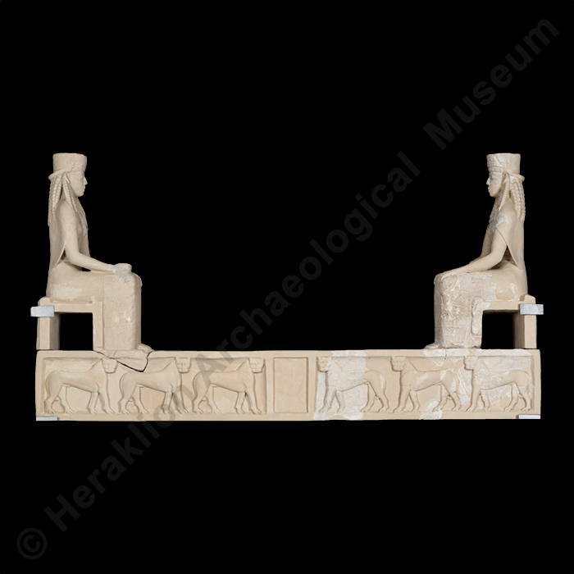
Lintel of Temple A at Prinias, Early Archaic period, 650-600 BC, Stone (Poros stone), Heraklion Archaeological Museum, Crete, Greece At the top, two identical enthroned goddesses, seated facing each other with their hands on their knees. Under the goddesses, the epistyle of the doorway is decorated with six panthers in relief. On the lower part of the epistyle, the two goddesses appear again, this time standing. https://heraklionmuseum.gr/en/exhibit/lintel-of-prinias-temple/

Slide 10
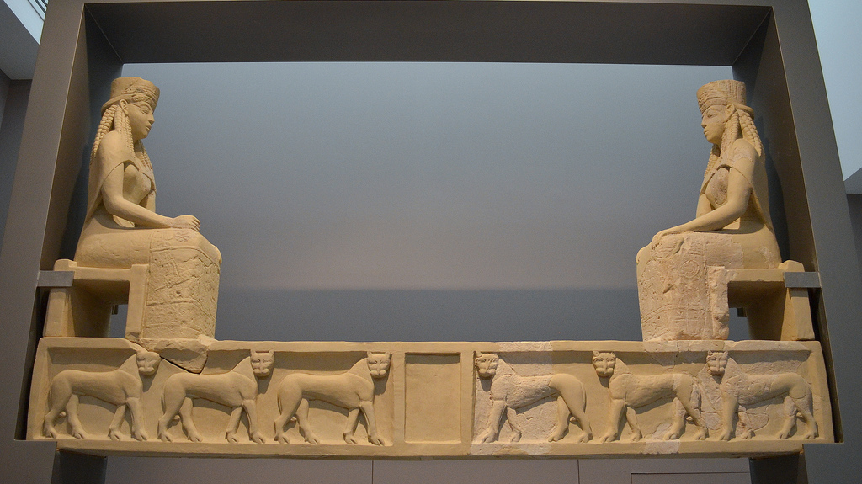
https://www.flickr.com/photos/dandiffendale/9456678798

Slide 11
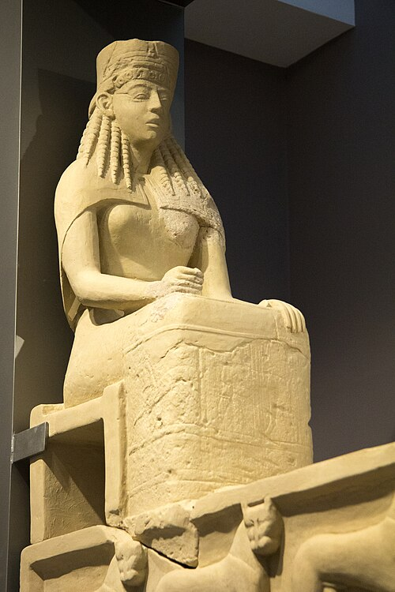
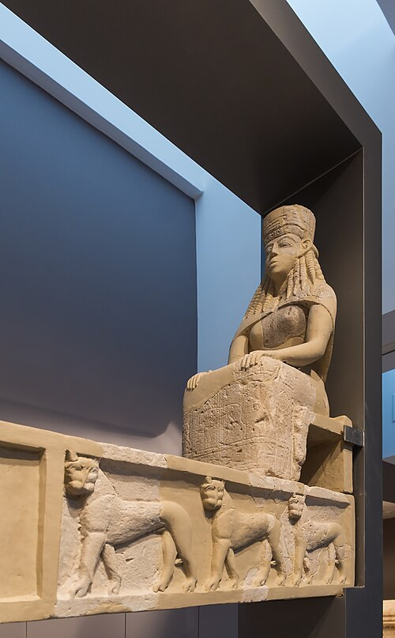
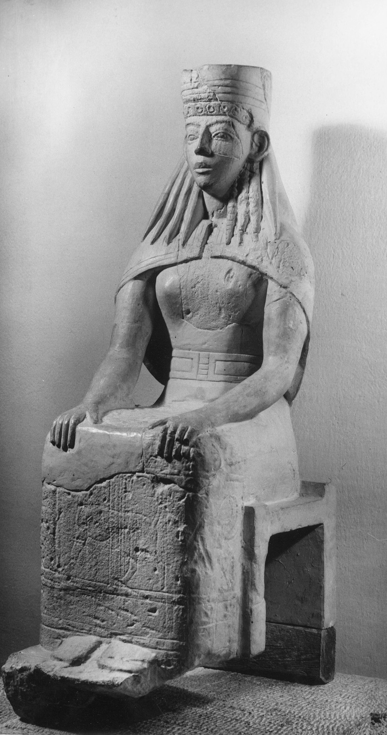
https://commons.wikimedia.org/wiki/File:Daedalic_lintel_from_Prinias,_650-600_BC,_AMH,_NM_231,_145382.jpg https://www3.ascsa.edu.gr/archives/afc/new_list-afc.php?IDfield=Site&IDfind=Prinias https://commons.wikimedia.org/wiki/File:Linteau_d%C3%A9dalique_heraklion_museum_NM231_Greece.jpg

Slide 12
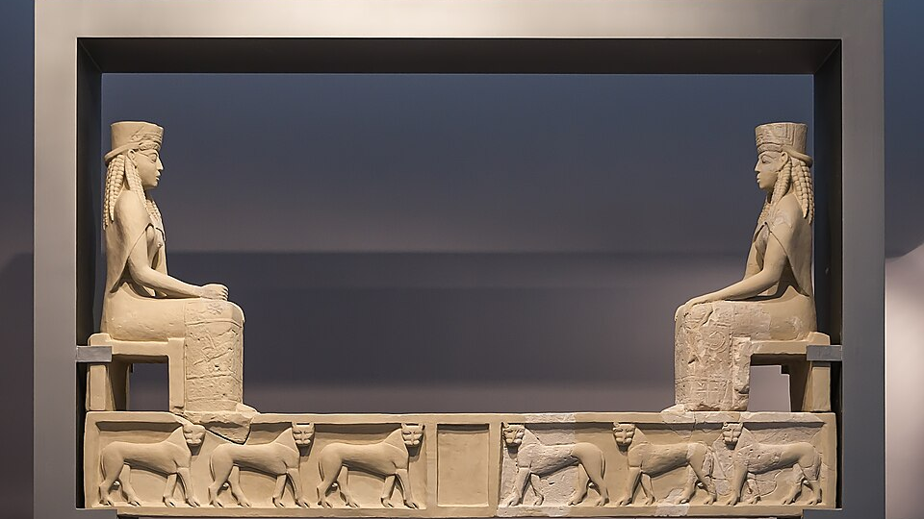
https://commons.wikimedia.org/wiki/File:Daedalic_Lintel_complete_Heraklion_museum_NM231_Greece.jpg

Slide 13
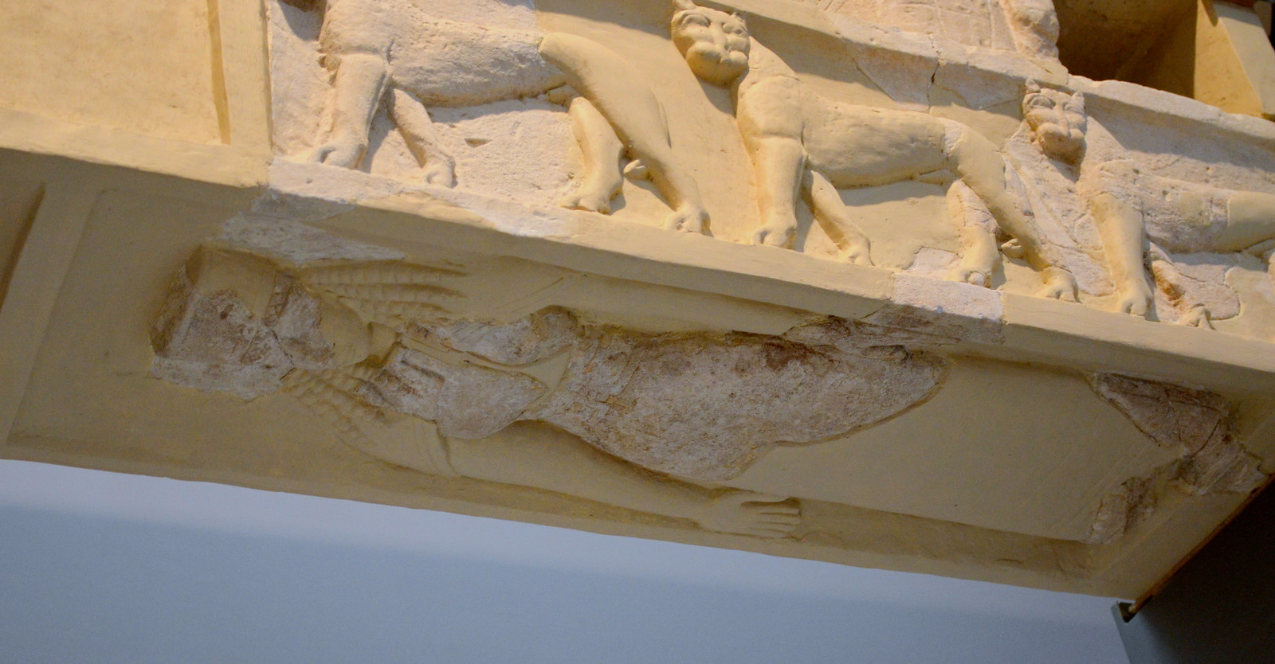
https://www.flickr.com/photos/dandiffendale/9453901899

Slide 14
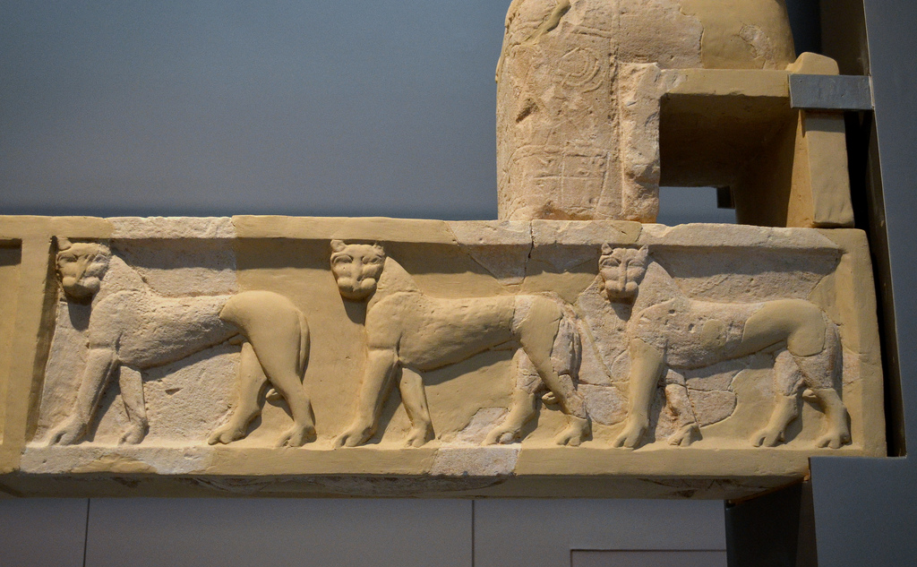
https://www.flickr.com/photos/dandiffendale/9456680238

