Slide 1
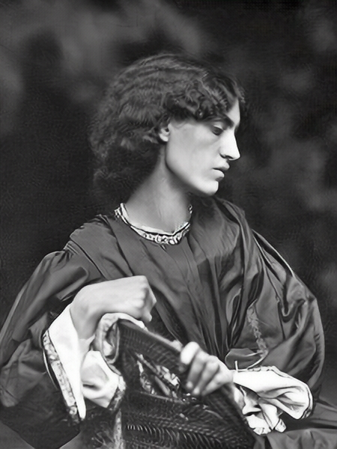
Dante Gabriel Rossetti and Jane Morris Jane Morris (née Jane Burden; 1839–1914), photographed by John Robert Parsons, 7 June 1865, posed by Dante Gabriel Rossetti, printed by Emery Walker Ltd https://en.wikipedia.org/wiki/Jane_Morris

Slide 2
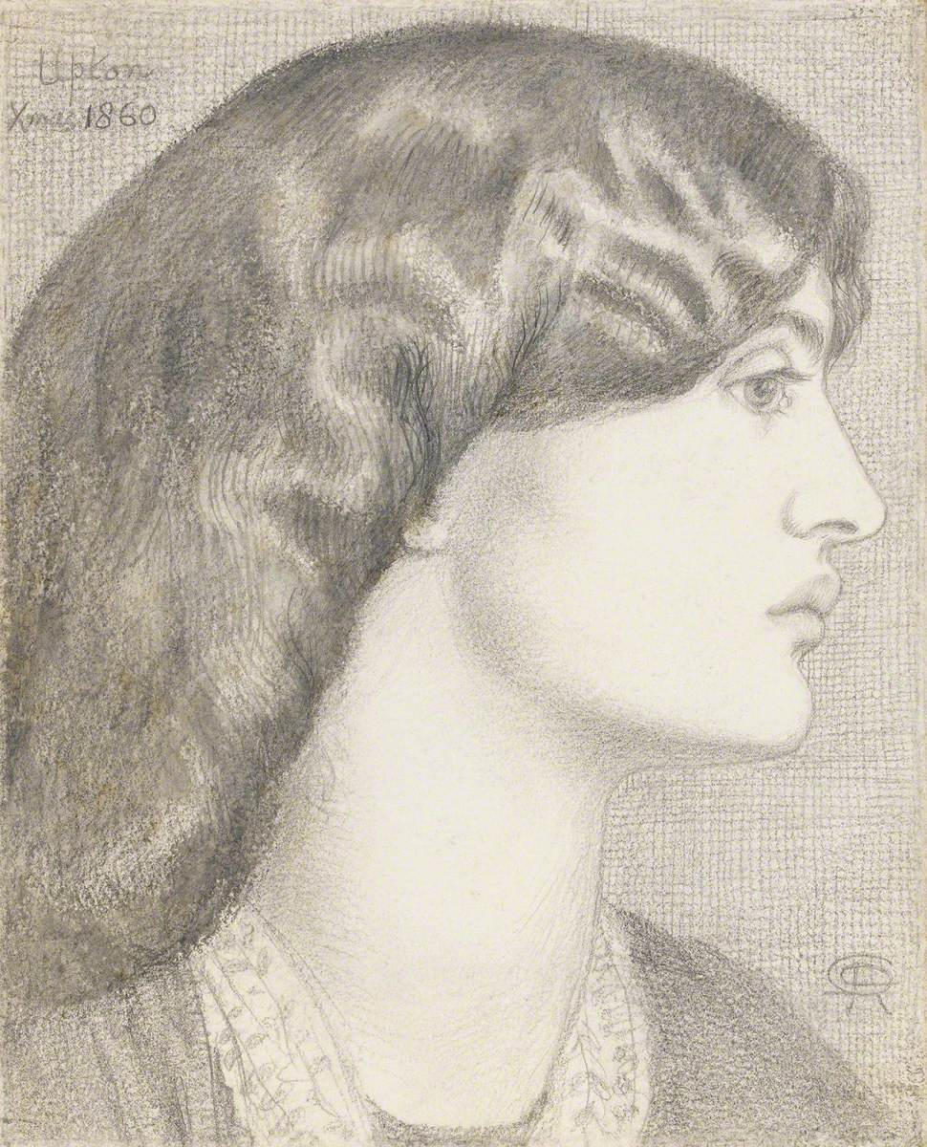
Portrait of Jane Morris, née Burden (1839–1914), 1860, graphite on paper, 21.9x17.8 cm, The Fitzwilliam Museum, University of Cambridge, UK https://artuk.org/discover/artworks/jane-morris-nee-burden-18391914-266476/search/actor:rossetti-dante-gabriel-18281882/page/4/view_as/grid

Slide 3
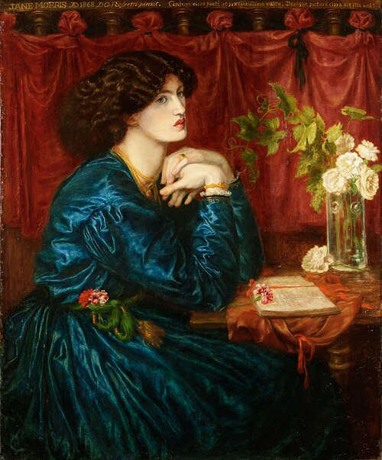
Jane Morris (The Blue Silk Dress), 1868, oil on canvas, 101.5x90.2 cm, Society of Antiquaries of London, UK https://en.wikipedia.org/wiki/File:Jane-morris-blue-silk.jpg

Slide 4
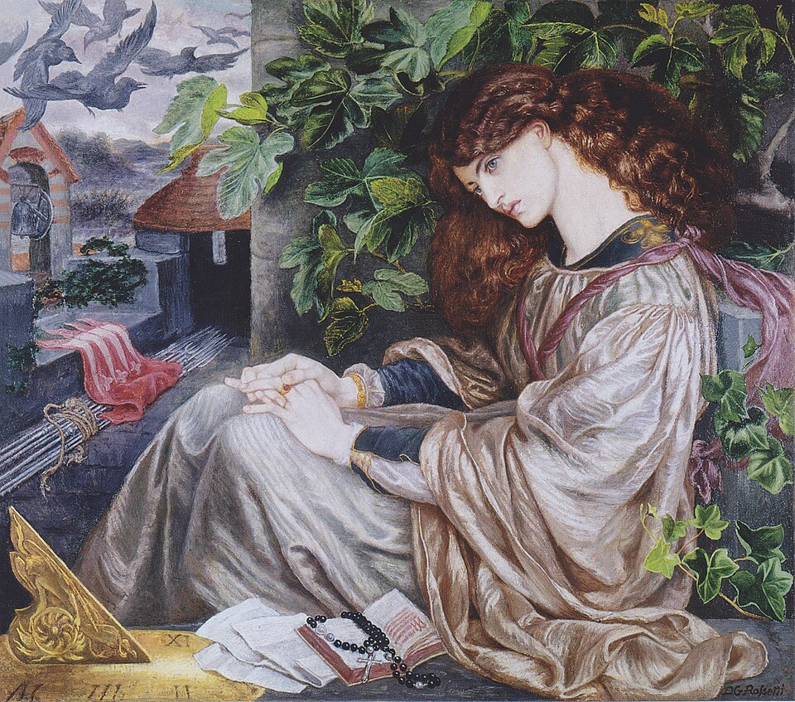
La Pia de' Tolomei, between 1868 and 1880, oil on canvas, 104.7x120.6 cm, Spencer Museum of Art, Kansas, USA https://en.wikipedia.org/wiki/Jane_Morris

Slide 5
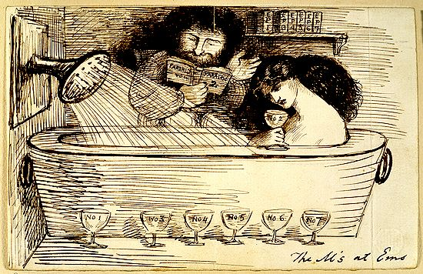
The M's at Ems, 21 July 1869, pen and brown ink on paper, 11.3x17.9 cm, British Museum, London, UK https://en.wikipedia.org/wiki/Jane_Morris

Slide 6
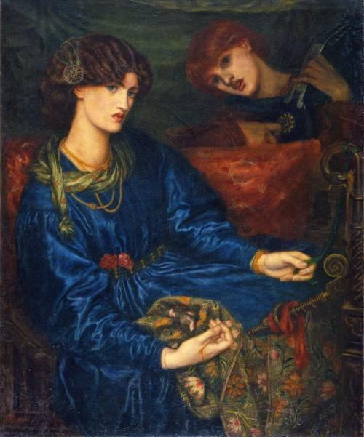
Mariana, 1870, oil on canvas, 109.8x90.5 cm, Aberdeen Art Gallery, Scotland https://en.wikipedia.org/wiki/Jane_Morris

Slide 7
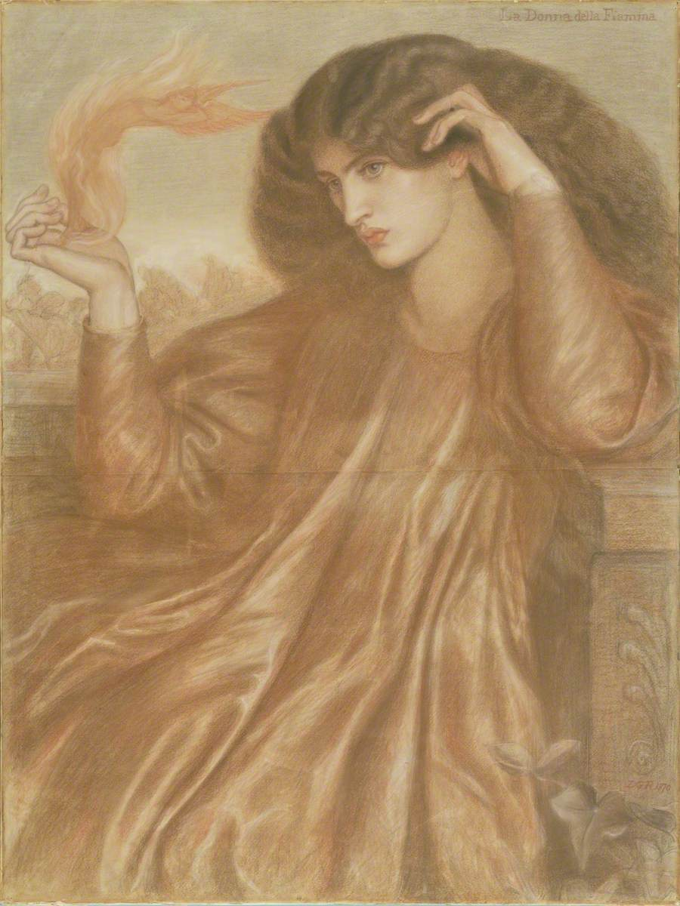
La Donna della Fiamma, 1870-1871, pastel & pencil on paper, 101.8x76.1 cm, Manchester Art Gallery, UK https://artuk.org/discover/artworks/la-donna-della-fiamma-243949/search/actor:rossetti-dante-gabriel-18281882/page/5/view_as/grid

Slide 8
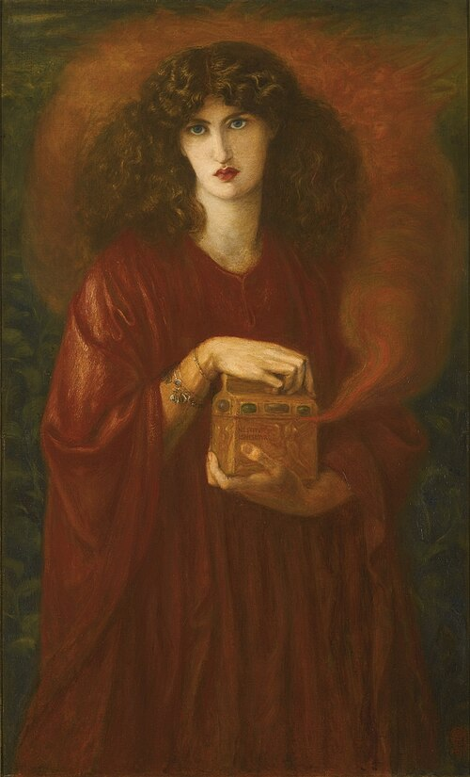
Pandora, 1871, oil on canvas, 131x79, Private Collection https://commons.wikimedia.org/wiki/File:Dante_Gabriel_Rossetti_-_Pandora.jpg

Slide 9
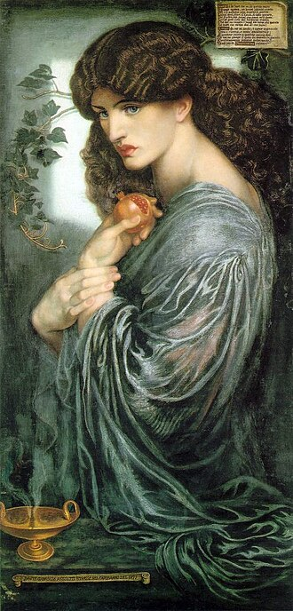
Proserpine, 1874, oil on canvas, 1251x610 mm, Tate, London, UK https://en.wikipedia.org/wiki/Jane_Morris

Slide 10
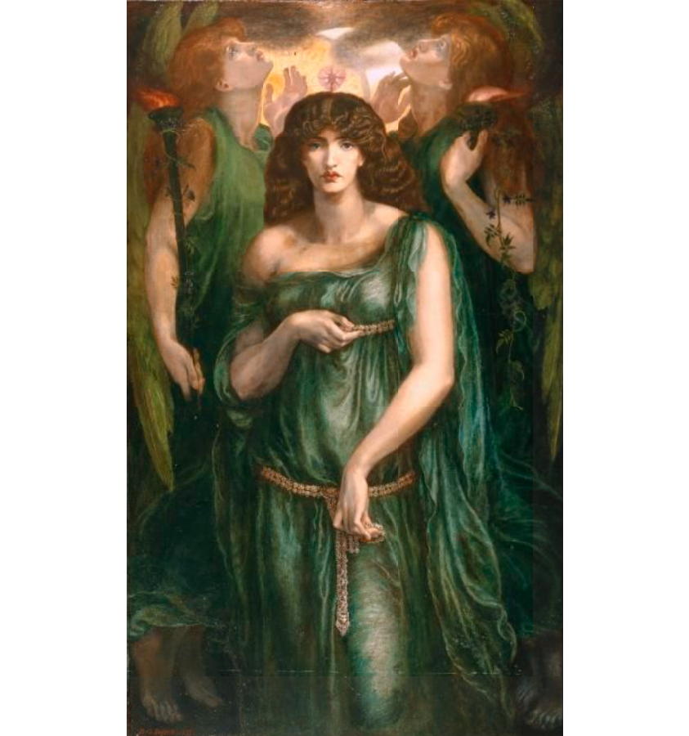
Astarte Syriaca, 1877, oil on canvas, 185x109 cm, Manchester Art Gallery, UK https://collections.manchesterartgallery.org/collections/narrative/5a2bb3b4-940c-396b-b21d-eb7b258738e4/

Slide 11
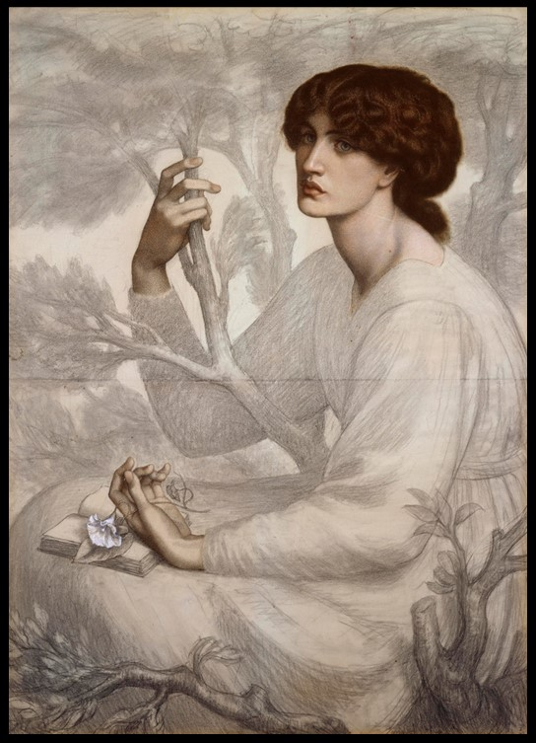
The Day Dream, 1872-8, Pastel and black chalk on tinted paper, 104.8 × 76.8 cm, Ashmolean Museum, Oxford, UK https://www.dropbox.com/sh/uf2hslku4m1ekmv/AADeYM9gsbAVhyxdpXIGQcA5a?dl=0&preview=1+CAPTIONS.pdf

Slide 12
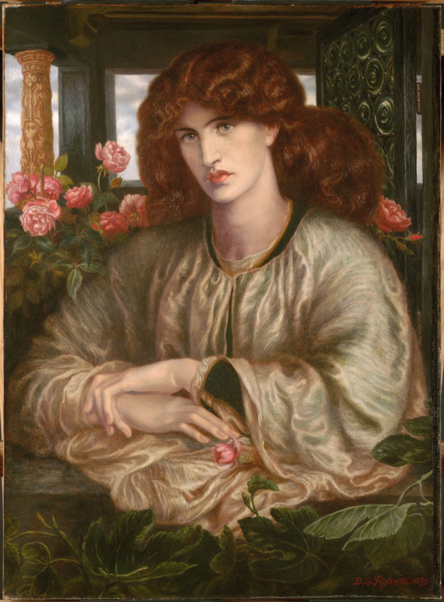
La Donna della Finestra, 1879, oil on canvas, 100.7x74 cm, Fogg Museum of Art, Harvard University, Cambridge, USA https://harvardartmuseums.org/collections/object/230158

Slide 13
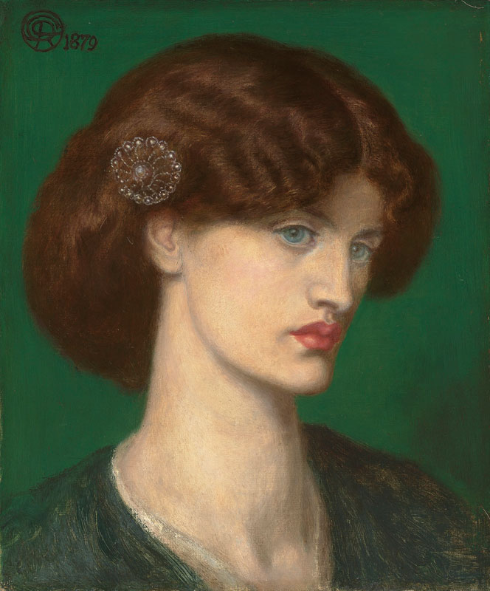
Beatrice, 1879, oil on canvas, 34.30x28.00 cm, Private Collection https://commons.wikimedia.org/wiki/File:Dante_Gabriel_Rossetti_-_Beatrice_(1879).jpg

Slide 14
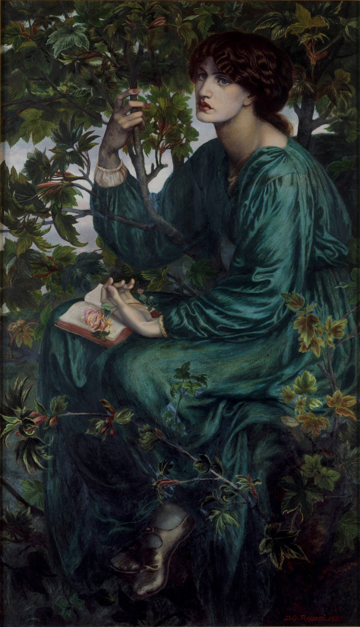
The Daydream, 1880, Oil on Canvas, 158.7x92.7 cm, Victoria and Albert Museum, London, UK https://collections.vam.ac.uk/item/O14962/the-day-dream-oil-painting-rossetti-dante-gabriel/

Slide 15
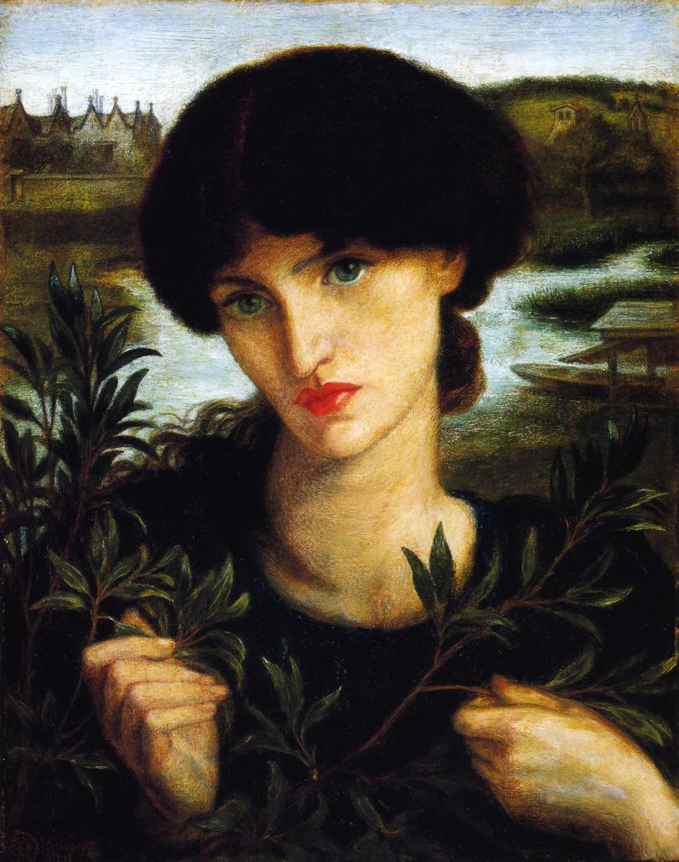
Water Willow, 1871, oil on canvas mounted on panel, 33x26.6 cm, Delaware Art Museum, USA https://en.wikipedia.org/wiki/Delaware_Art_Museum

Slide 16
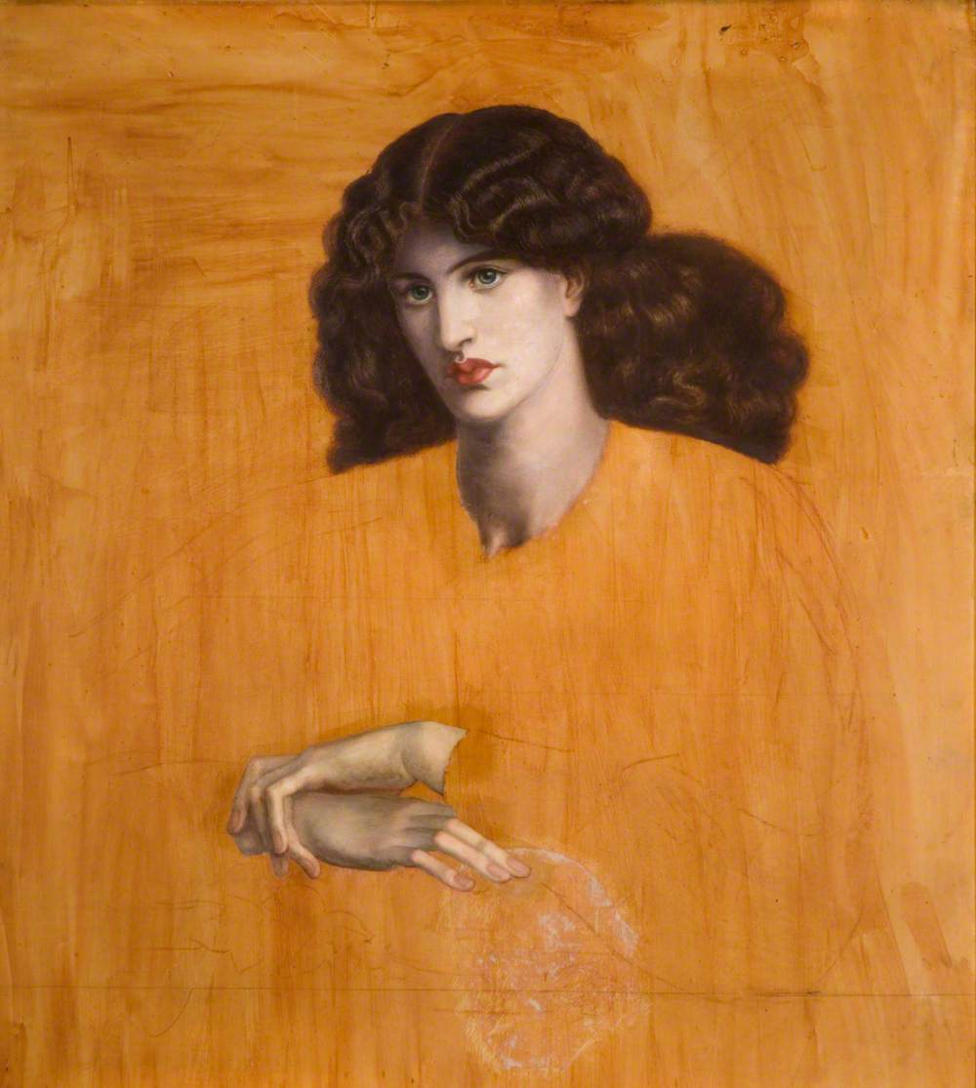
La donna della finestra (unfinished), 1881, oil on canvas over pencil, 97x87 cm, Birmingham Museums Trust, UK https://artuk.org/discover/artworks/la-donna-della-finestra-33650/search/actor:rossetti-dante-gabriel-18281882/page/5/view_as/grid

