Slide 1

Tsukioka Yoshitoshi
1839–1892

Slide 2
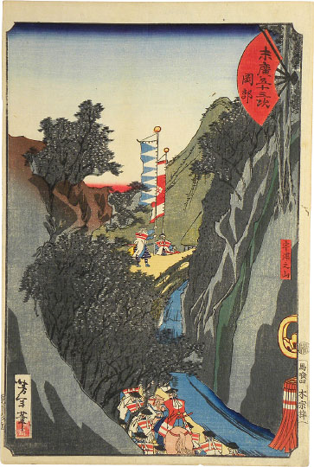
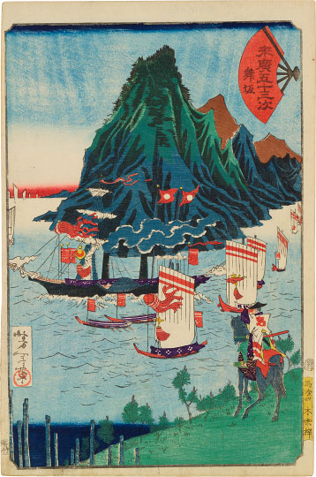
Fifty-Three Stations with a Folding Fan: Okabe
Fifty-Three Stations with a Folding Fan: Maisaka
Prints from Famous Sites on the Tokaido Road (Tōkaidō meisho zue), 1864-1865,
Color woodcut, 37.5 x 26 cm, Private Collections https://www.scholten-japanese-art.com/yoshitoshi_13.php

Slide 3
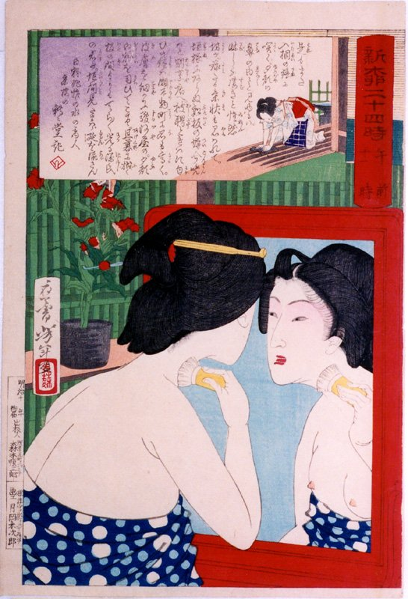
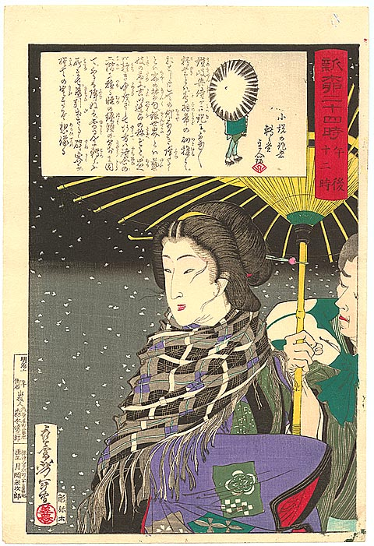
Geisha powdering neck at mirror
12 midnight - Geisha walking with attendant in snow
Twenty-Four Hours at Shinbashi and Yanagibashi, 1880, Private Collections https://yoshitoshi.net/series/24hours.html

Slide 4
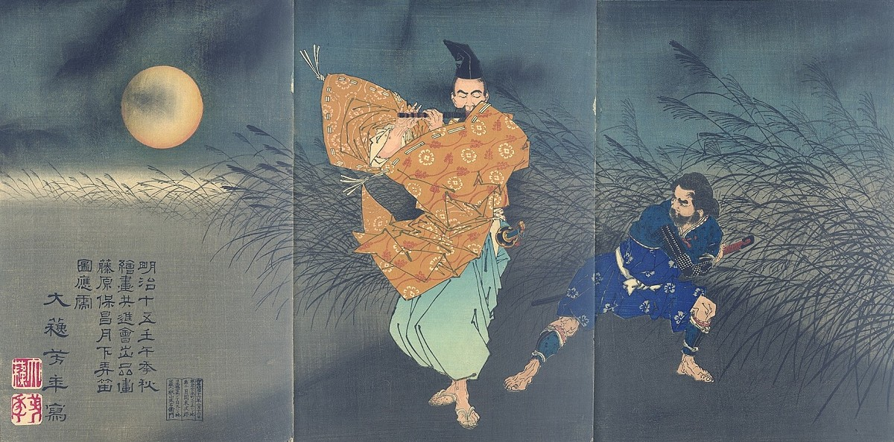
Tsukioka Yoshitoshi, Japanese artist, 1839-1892
Fujiwara Yasumasa plays the flute by moonlight, Meiji period, late 19th century, woodblock print, triptych, left sheet signed zu oju Taiso Yoshitoshi sha, with artist’s seals Taiso and Yoshitoshi, published by Akiyama Buemon (Kokkeido), 12th February 1883, Vertical oban triptych: each sheet approx. 36 x 23.6 cm, Private Collection https://fineartamerica.com/featured/fujiwara-no-yasumasa-playing-the-flute-by-moonlight-1882-tsukioka-yoshitoshi.html

Slide 5
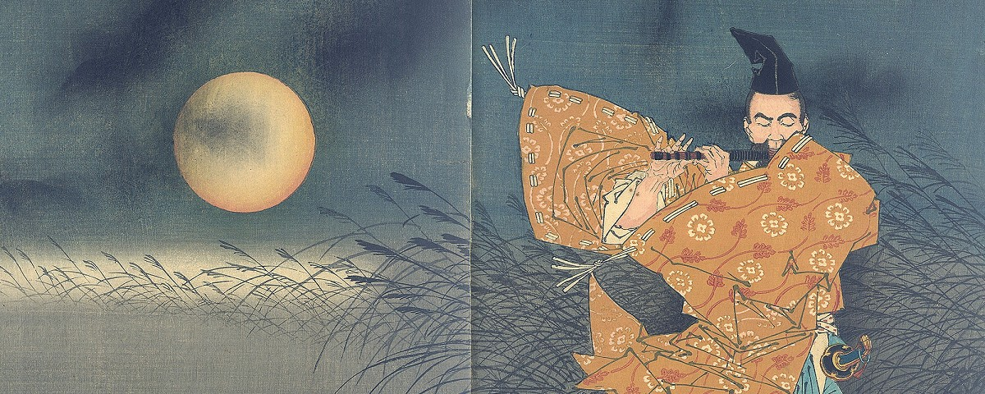

Slide 6
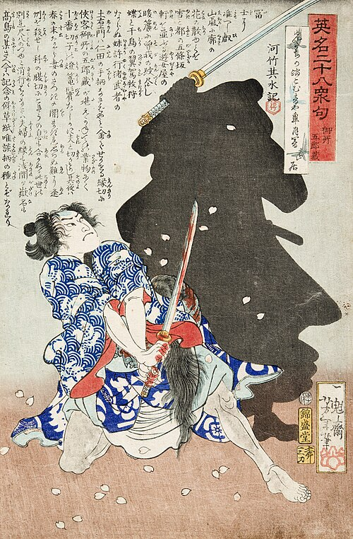
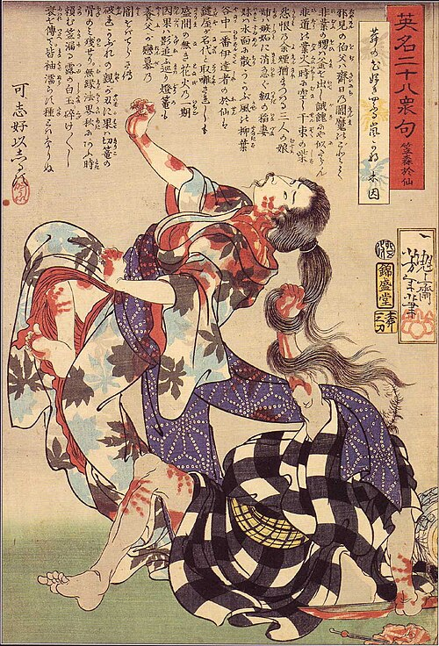
Twenty-eight famous murders with verse, published from 1866 to 1867, coloured woodblock prints, 35x24 cm
Gosho Gorozo Battling a Shadow, LACMA, USA https://en.wikipedia.org/wiki/Twenty-Eight_Famous_Murders_with_Verse#/media/File:Gosho_Gorozo_Battling_a_Shadow_LACMA_M.84.31.220.jpg
The murder of Kasamori Osen, Private Collection https://commons.wikimedia.org/wiki/File:The_murder_of_Kasamori_Osen.jpg

Slide 7
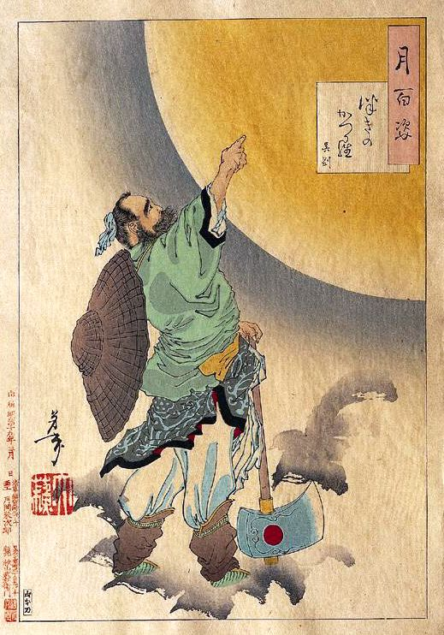
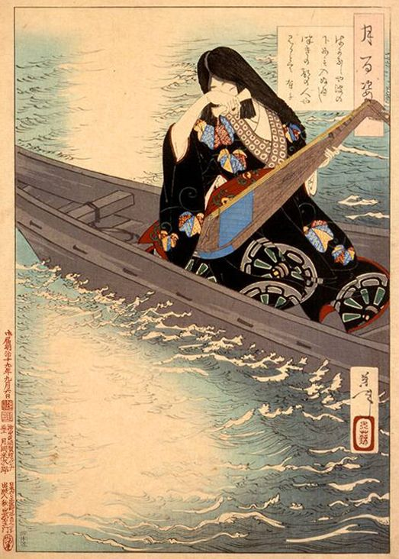
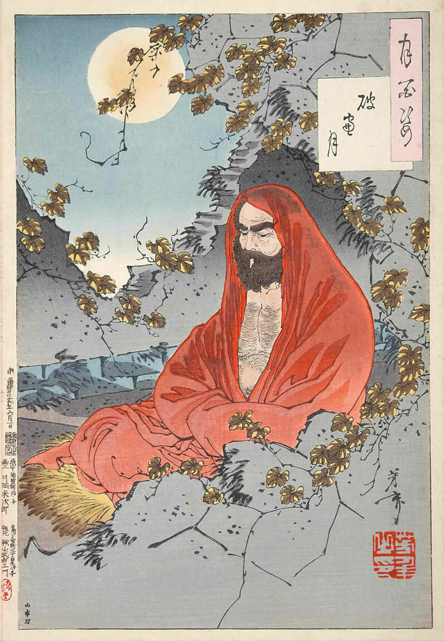
Yoshitoshi's 100 Aspects of the Moon… a collection of 100 ōban size ukiyo-e woodblock prints by Japanese artist Tsukioka Yoshitoshi printed in batches, starting in 1885 until 1892 https://en.wikipedia.org/wiki/One_Hundred_Aspects_of_the_Moon

Slide 8
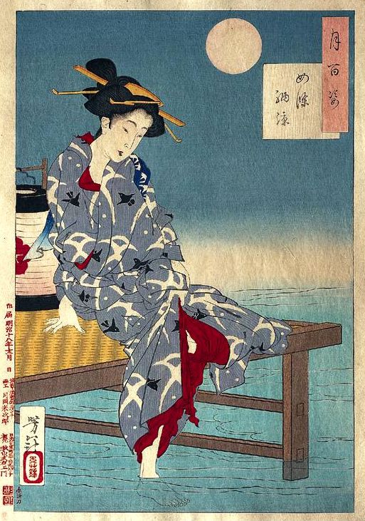
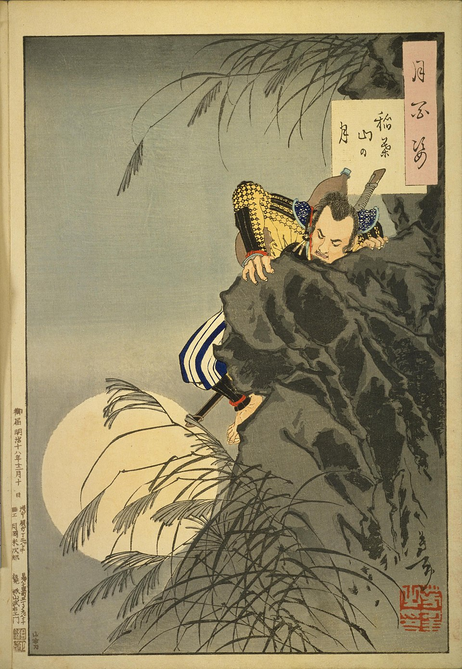
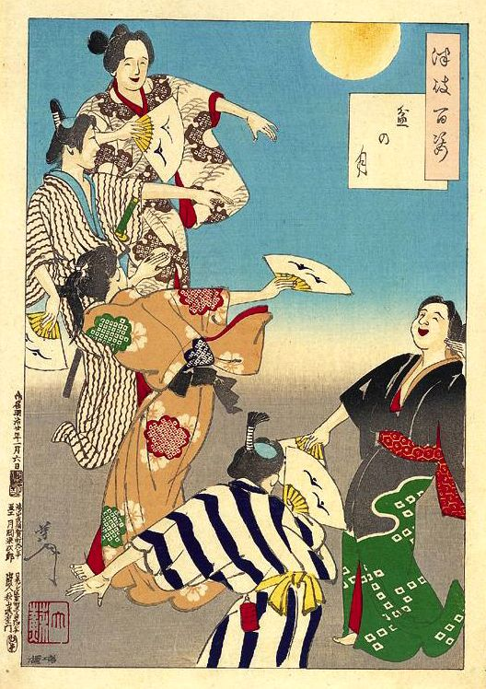
Cooling off at Shijo
The young Toyotomi Bon Festival Moon
Hideyoshi leads a small group assaulting the castle on Inaba https://en.wikipedia.org/wiki/One_Hundred_Aspects_of_the_Moon

Slide 9
The End

