Slide 1
Constantinos Maleas
1879-1928

Slide 2
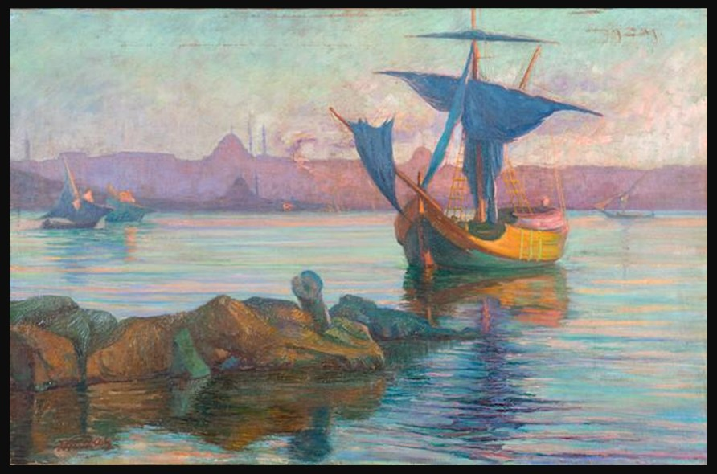
Coucher de soleil à Constantinople, 1904-1905, oil on canvas, 60 x 90 cm, Private Collection https://www.bonhams.com/auction/29818/lot/11/constantinos-maleas-1879-1928-coucher-de-soleil-a-constantinople/

Slide 3
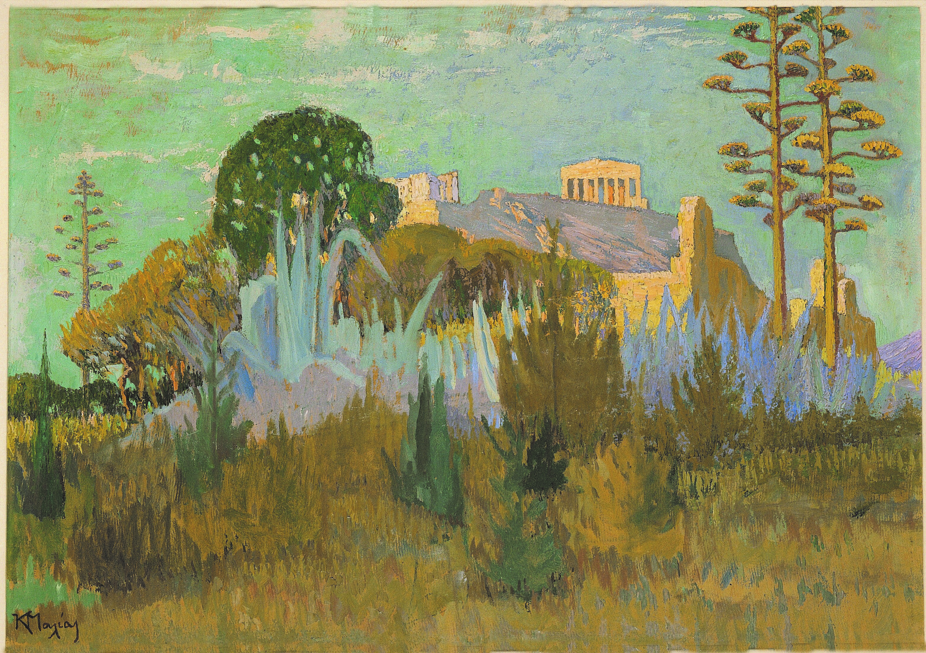
Acropolis, 1918-1920, Oil on cardboard, 63 x 90 cm, Alpha Bank Politismos, Greece https://www.alphapolitismos.gr/en/art-collection/our-works-of-art/konstantinos-maleas-acropolis/

Slide 4
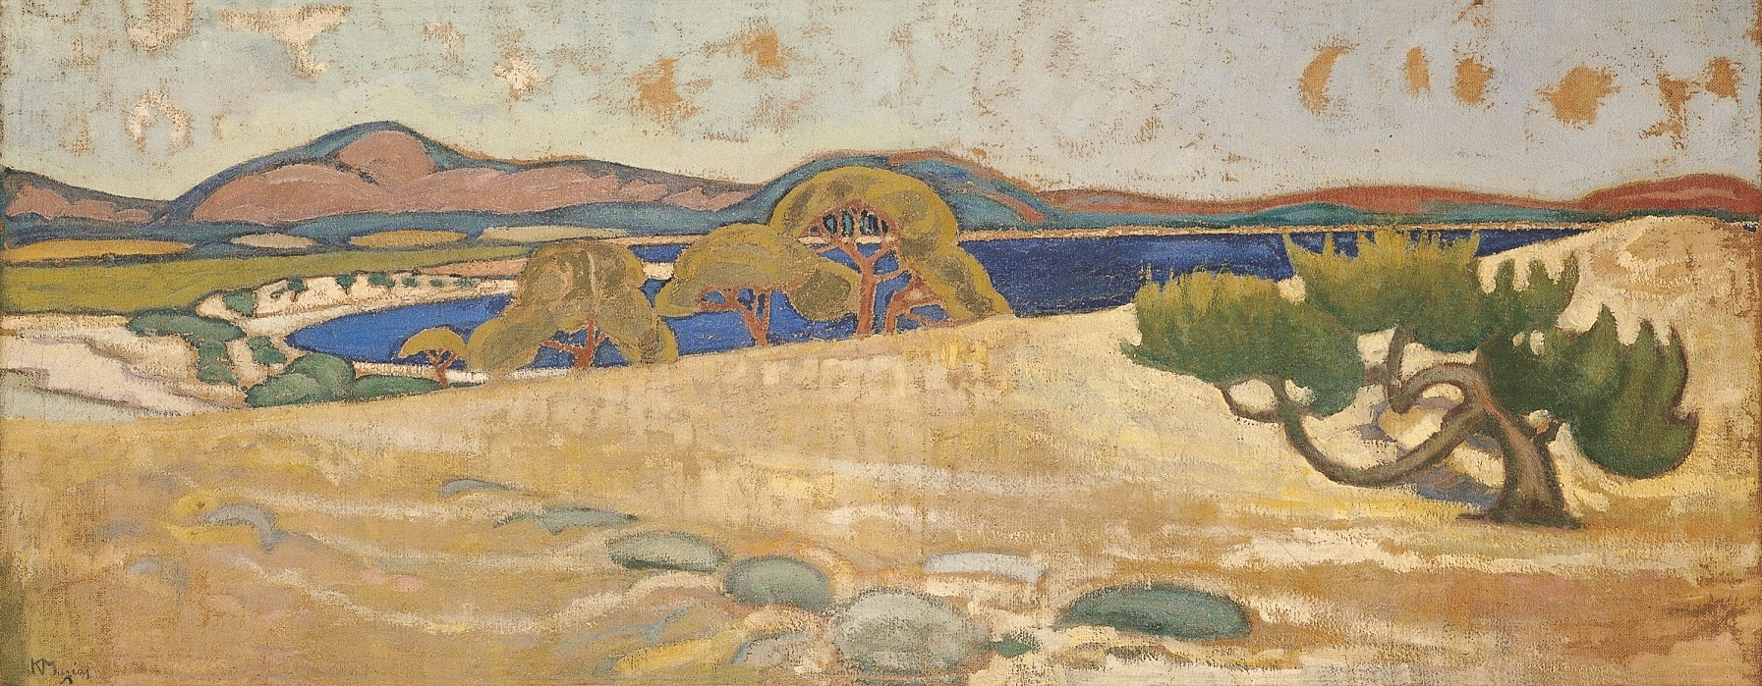
Lavrio, 1918-1920, Oil on linen, 69 x 174 cm. Alpha Bank Politismos, Greece https://www.alphapolitismos.gr/en/art-collection/our-works-of-art/konstantinos-maleas-lavrio/

Slide 5
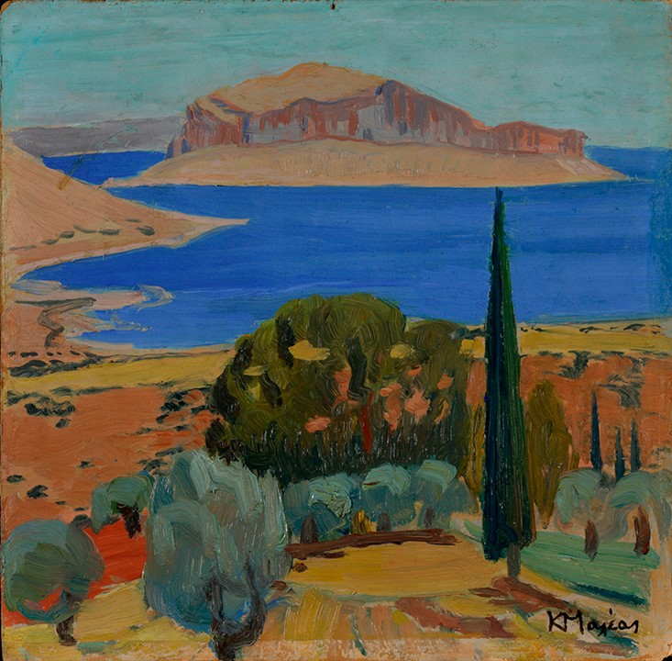
Monemvasia (Houses at Monemvasia), 1920-28, oil on cardboard, 50 x 57.5 cm, National Bank of Greece, Greece https://museum.bankofgreece.gr/topoianaforas/modern_greek_art/504_Maleas_en.html

Slide 6
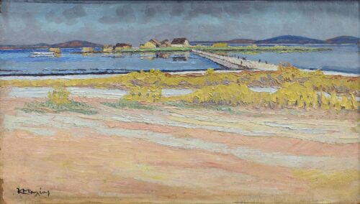
Messolonghi Lagoon, 1921, Oil on hardboard, 29 x 49 cm, National Gallery – Alexandros Soutsos Museum, Athens, Greece https://www.nationalgallery.gr/en/artwork/messolonghi-lagoon/

Slide 7
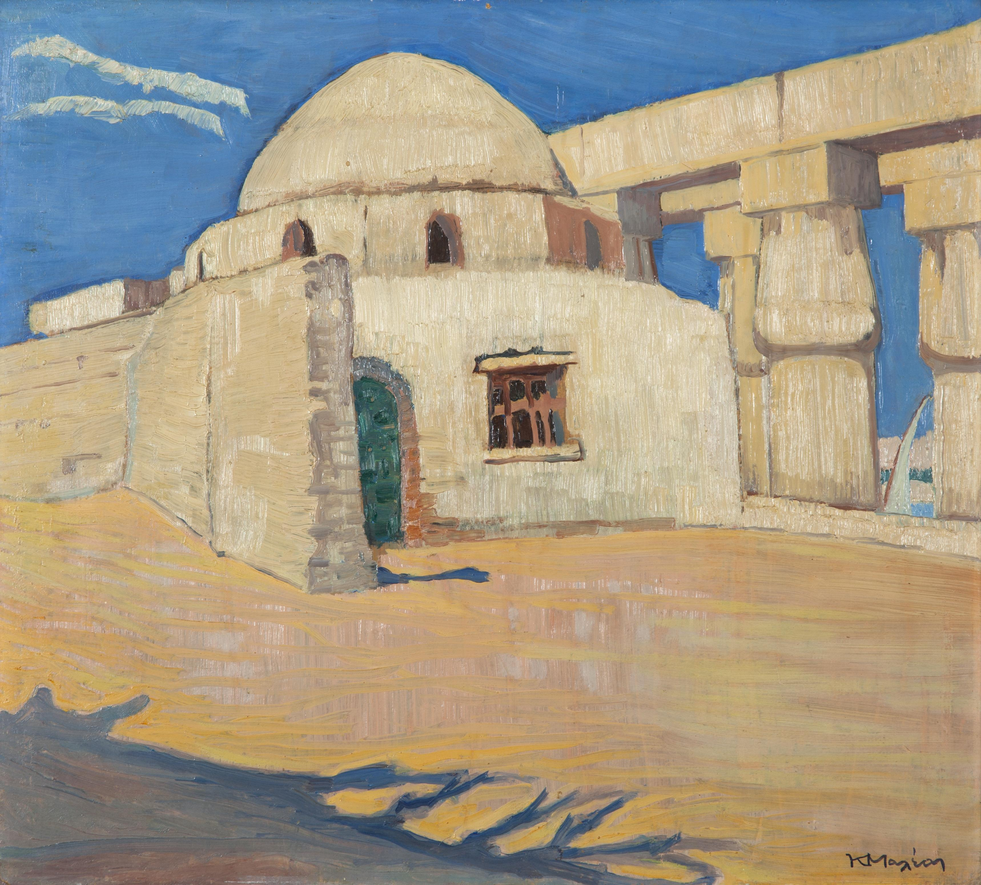
Luxor, 1923, Oil on cardboard, 48.5 x 54.5 cm, Private Collection https://www.invaluable.com/auction-lot/constantinos-maleas-greek-1879-1928-luxor-48-5-x--29-c-eb241e69dd?srsltid=AfmBOoqSnM2DT_TJa3kMquM2DdoT5PX5ca_VlAuLLeVeRElKBY8d_GKf

Slide 8
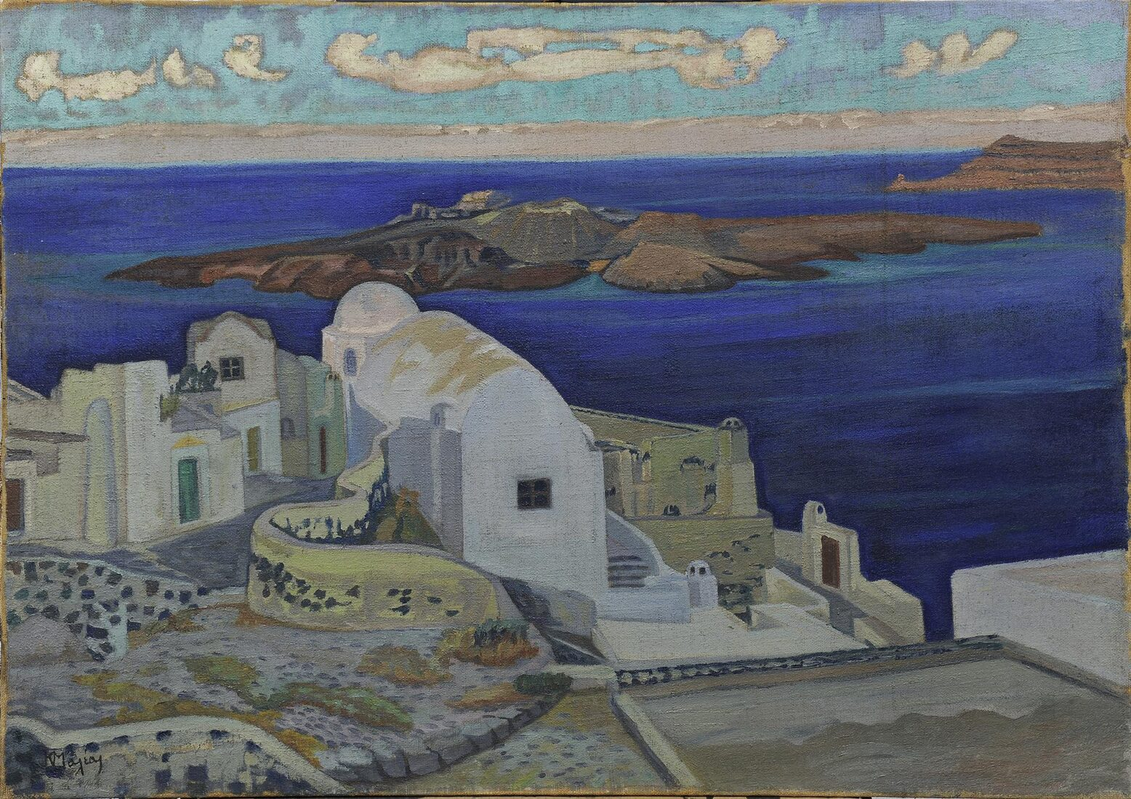
Santorini, 1924 – 1928, Oil on canvas, 75 x 107 cm, National Gallery – Alexandros Soutsos Museum, Athens, Greece https://www.nationalgallery.gr/en/artwork/santorini/

Slide 9
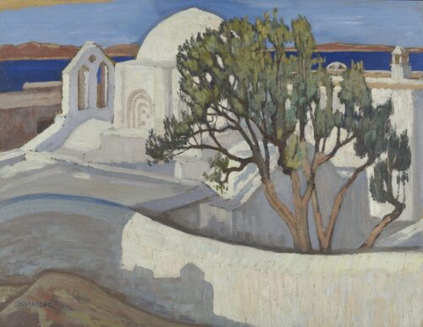
The Church of the Pantanassa, Naxos, ca 1924 – 1928, Oil on Pasteboard, 53 x 69 cm, National Gallery – Alexandros Soutsos Museum, Athens, Greece https://www.nationalgallery.gr/en/artist/maleas-konstantinos/

Slide 10
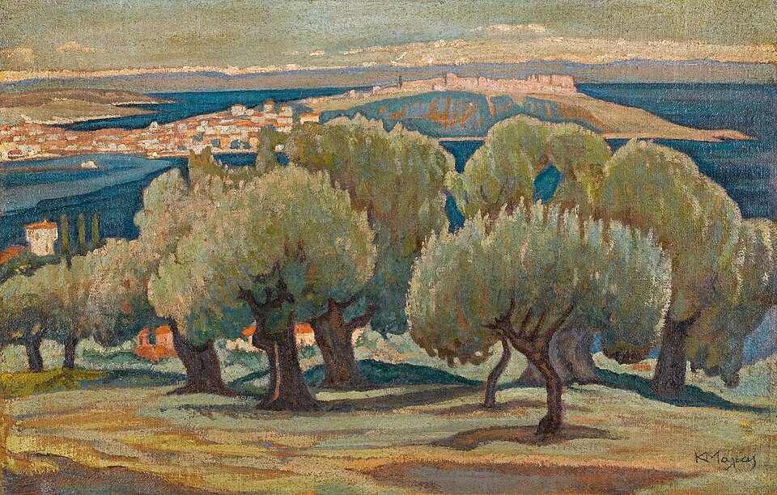
Olive trees in Mytilene, before 1928, Oil on canvas, 53 cm x 83 cm, Private Collection https://commons.wikimedia.org/wiki/File:Konstantinos_Maleas_Olive_trees_in_Mytilene.jpg

Slide 11
The End

