Slide 1
Winslow Homer
1836-1910

Slide 2
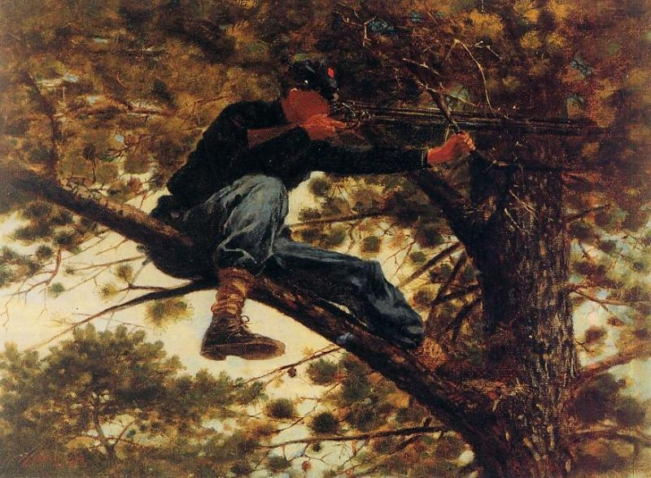
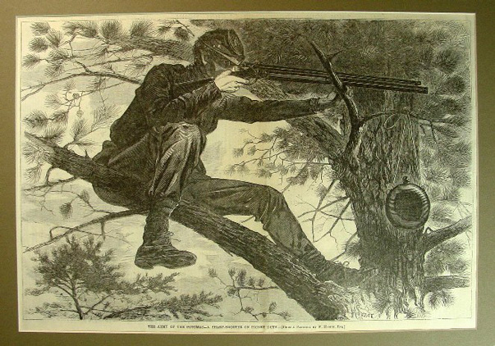
Sharpshooter on Picket Duty, 1863, Oil on canvas, Portland Museum of Art Wood engraving for the Harper's Weekly, Volume VI, 15 November 1862, p. 724 https://commons.wikimedia.org/wiki/File:Winslow_Homer_-_Sharpshooter.jpg https://commons.wikimedia.org/wiki/File:Winslow_Homer_-_Sharpshooter.jpg#/media/File:The_Army_of_the_Potomac_--_A_sharp-shooter_on_picket_duty_(Boston_Public_Library).jpg

Slide 3
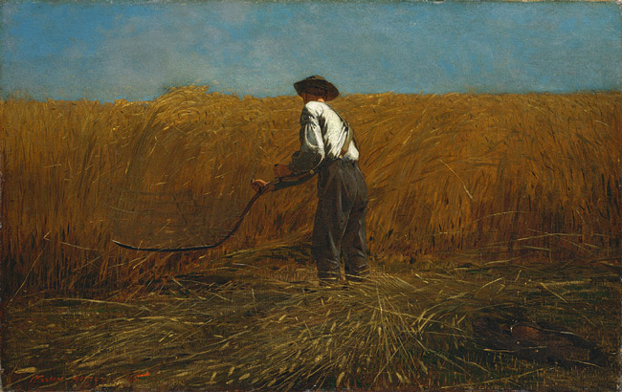
The Veteran in a New Field, 1865, Oil on canvas, 61.3 x 96.8 cm, The MET https://commons.wikimedia.org/wiki/File:The_Veteran_in_a_New_Field_1865_Winslow_Homer.jpg

Slide 4
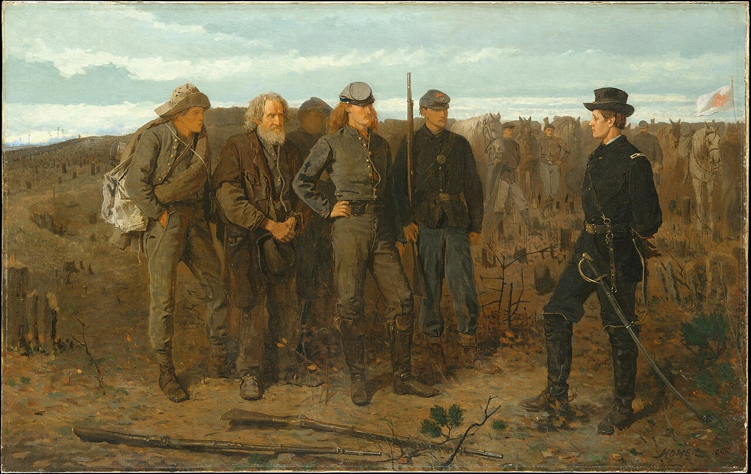
Prisoners from the Front, 1866, Oil on canvas, 61 x 96.5 cm, The MET https://commons.wikimedia.org/wiki/File:Winslow_Homer_-_Prisoners_from_the_Front_-_The_Metropolitan_Museum_of_Art.jpg

Slide 5
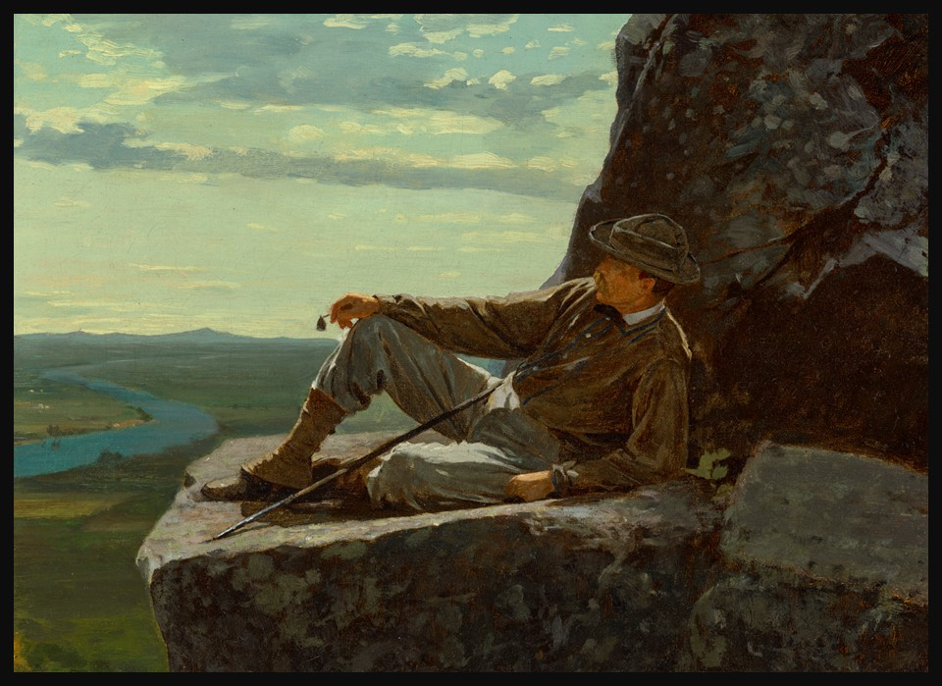
Winslow Homer, American, 1836-1910 A Mountain Climber Resting, 1869, Oil on canvas, 26.7 x 36.8 cm, Private Collection https://www.christies.com/en/lot/lot-6569220?ldp_breadcrumb=back

Slide 6
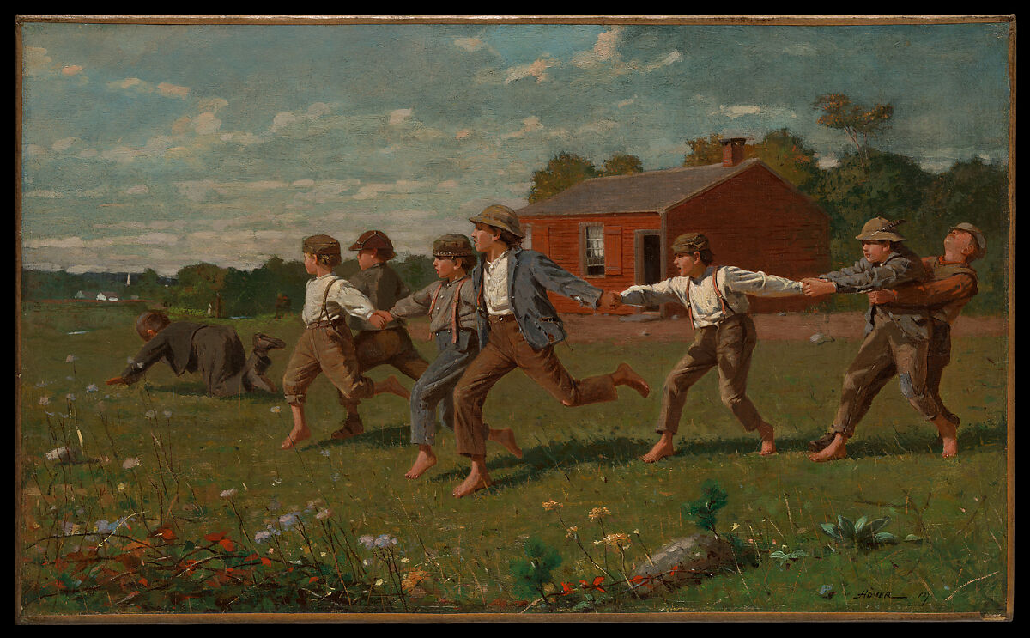
Snap the Whip, 1872, Oil on canvas, 30.5 x 50.8 cm, the MET, NY, USA https://www.metmuseum.org/art/collection/search/11140

Slide 7

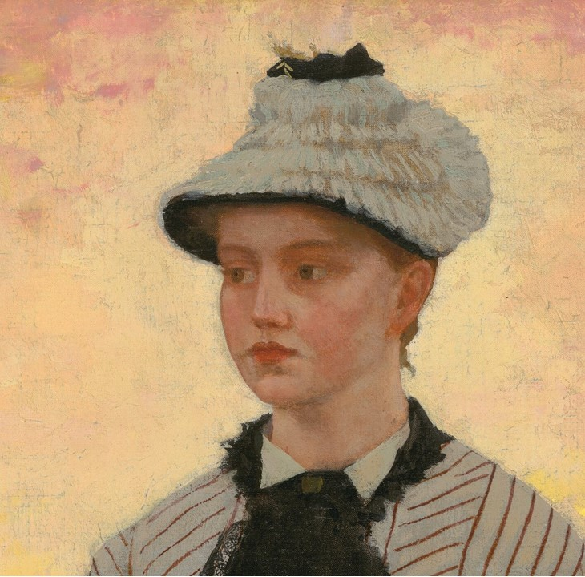
Winslow Homer, American, 1836 - 1910 The Red School House, 1873, Oil on canvas, 55.5 x 39.5 cm, NGA, Washington DC, USA https://www.nga.gov/collection/art-object-page.66419.html

Slide 8
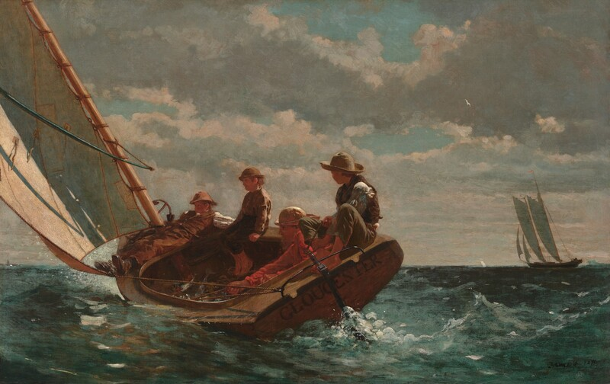
Breezing up, 1876, Oil on canvas, 61.5 × 97 cm, NGA, Washington DC, USA https://www.nga.gov/artworks/30228-breezing-fair-wind

Slide 9
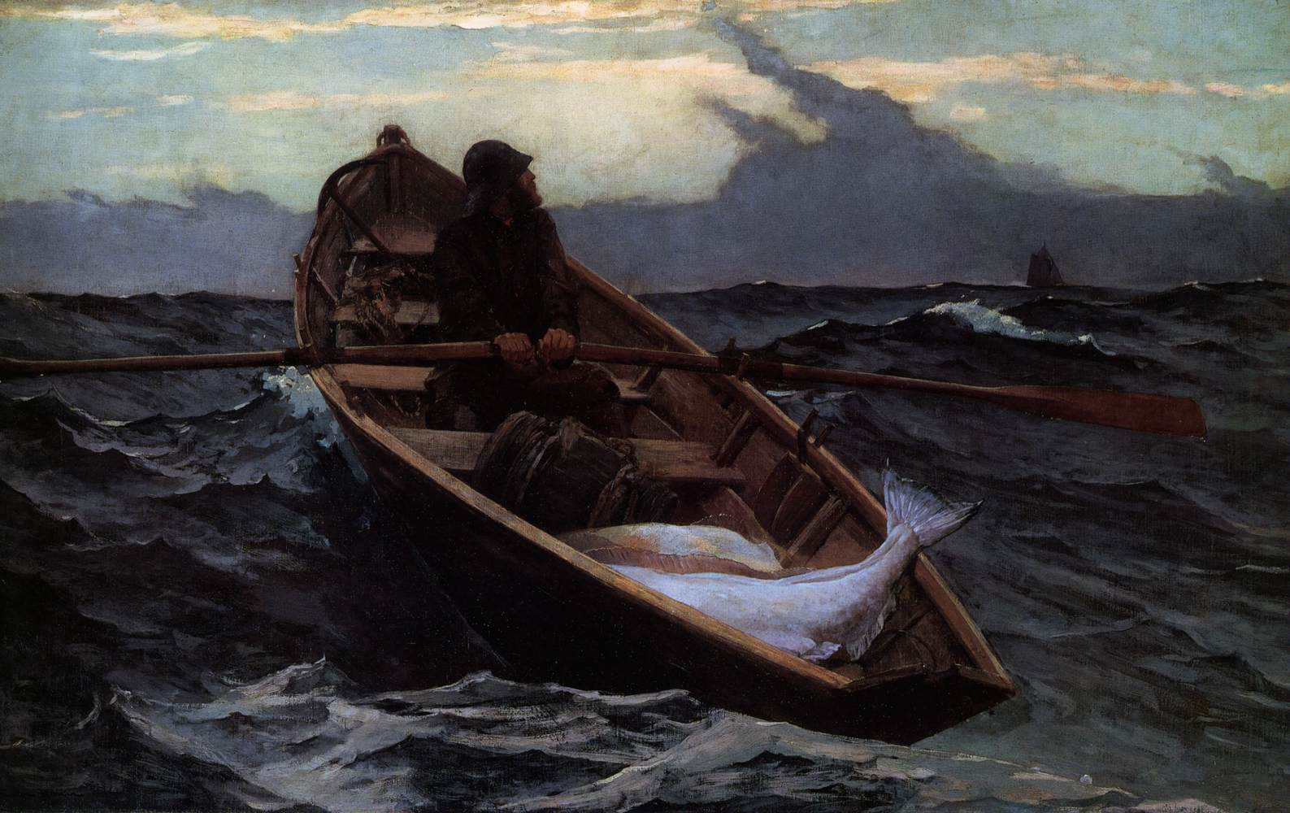
Fog Warning, 1885, Oil on canvas, 76 x 122 cm, Museum of Fine Arts, Boston, USA https://www.wga.hu/frames-e.html?/bio/h/homer/biograph.html

Slide 10
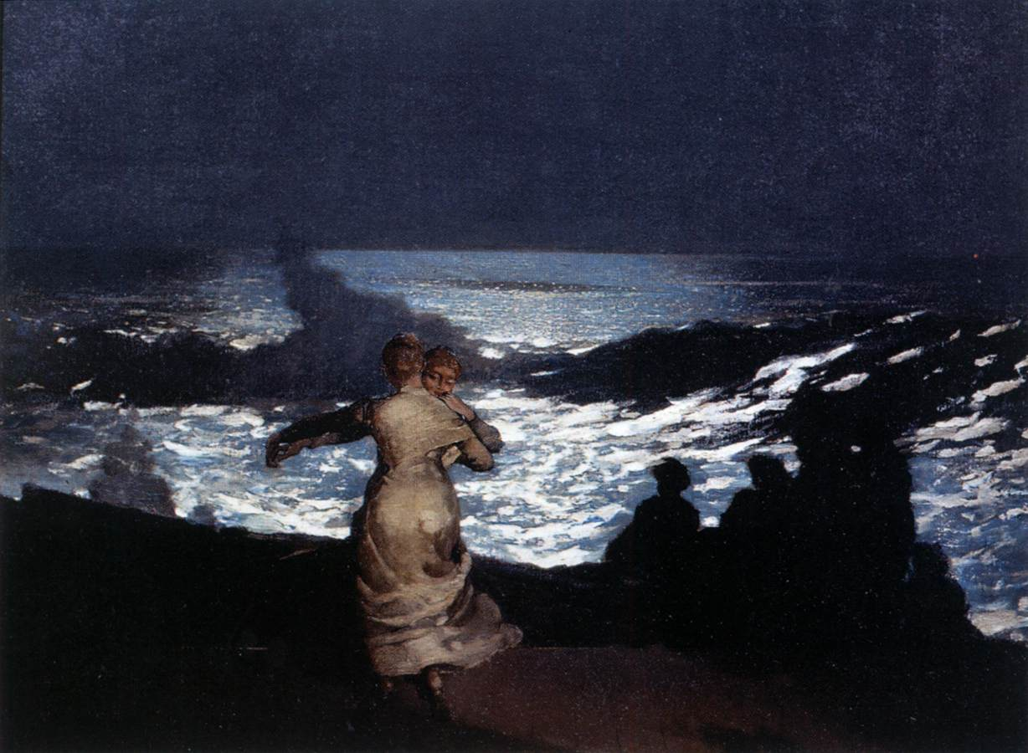
Summer Night, 1890, Oil on canvas, 77 x 102 cm, Musée d'Orsay, Paris, France https://www.wga.hu/frames-e.html?/bio/h/homer/biograph.html

Slide 11
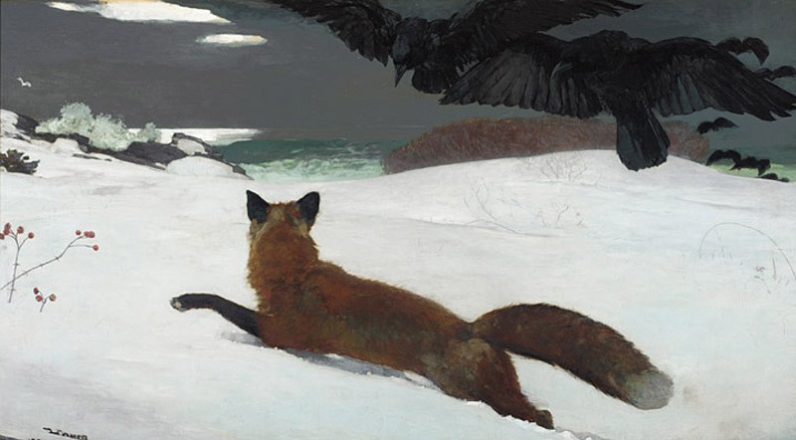
The Fox Hunt, 1893, Oil on canvas, 96.5 × 174 cm, Pennsylvania Academy of Fine Arts, USA https://www.pafa.org/museum/collection/item/fox-hunt

Slide 12
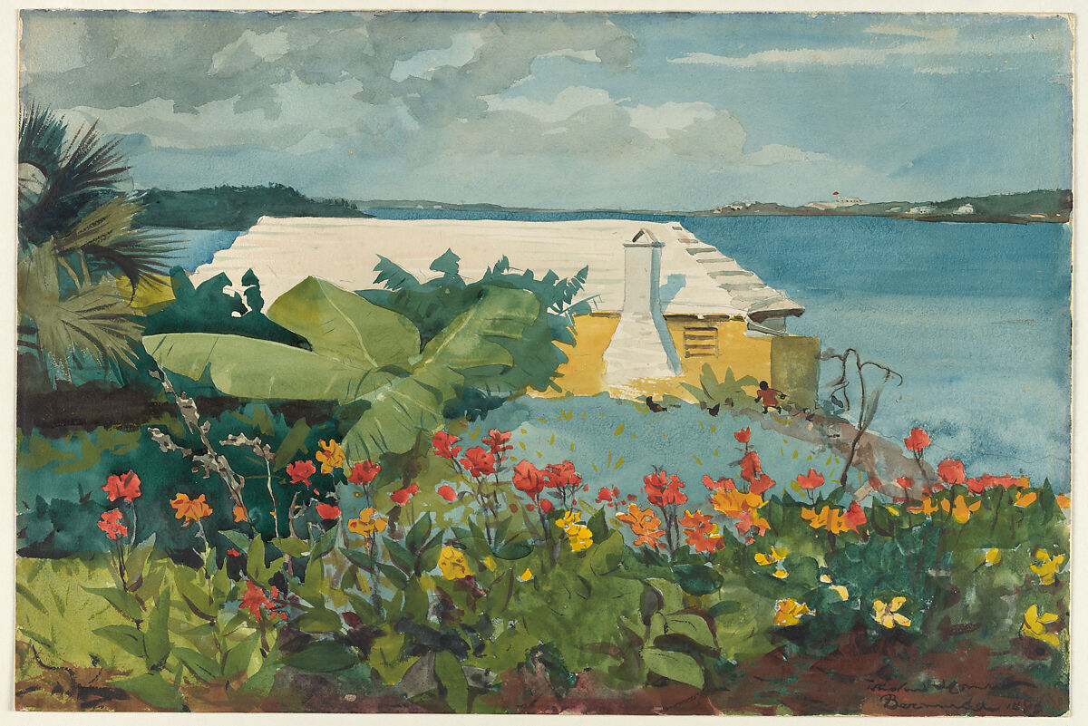
Flower Garden and Bungalow, Bermuda, 1899, Watercolor and graphite on off-white wove paper, 35.4 x 53.2 cm, the MET, NY, USA https://www.metmuseum.org/art/collection/search/11121

Slide 13
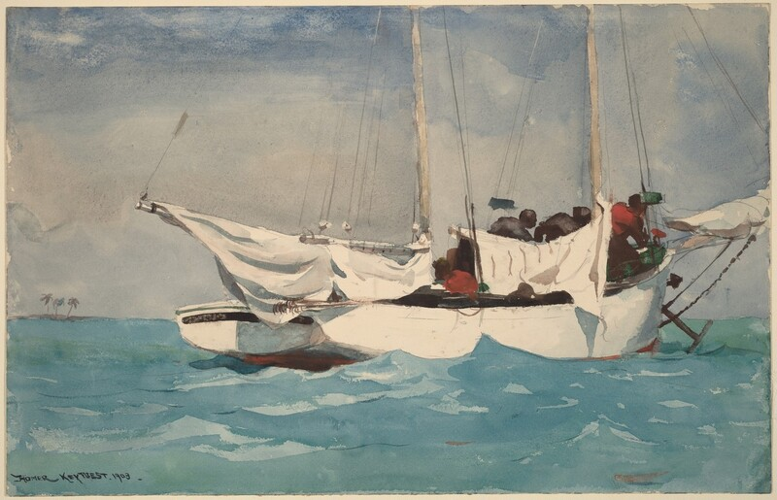
Key West, Hauling Anchor, 1903, Watercolor over graphite on paper, NGA, Washington DC https://www.nga.gov/artworks/55584-key-west-hauling-anchor

Slide 14
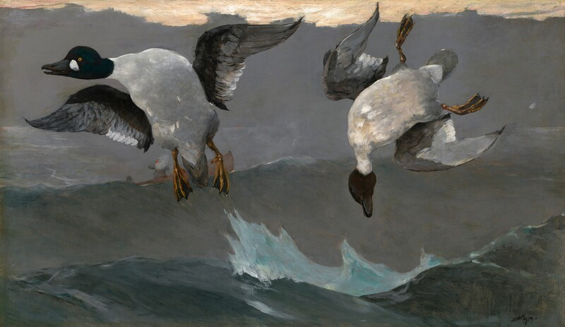
Right and Left, 1909, Oil on canvas, NGA, Washington DC, USA https://www.nga.gov/artworks/39763-right-and-left

Slide 15
The End

