Slide 1

Ennion: Master Glassmaker
1st century AD

Slide 2
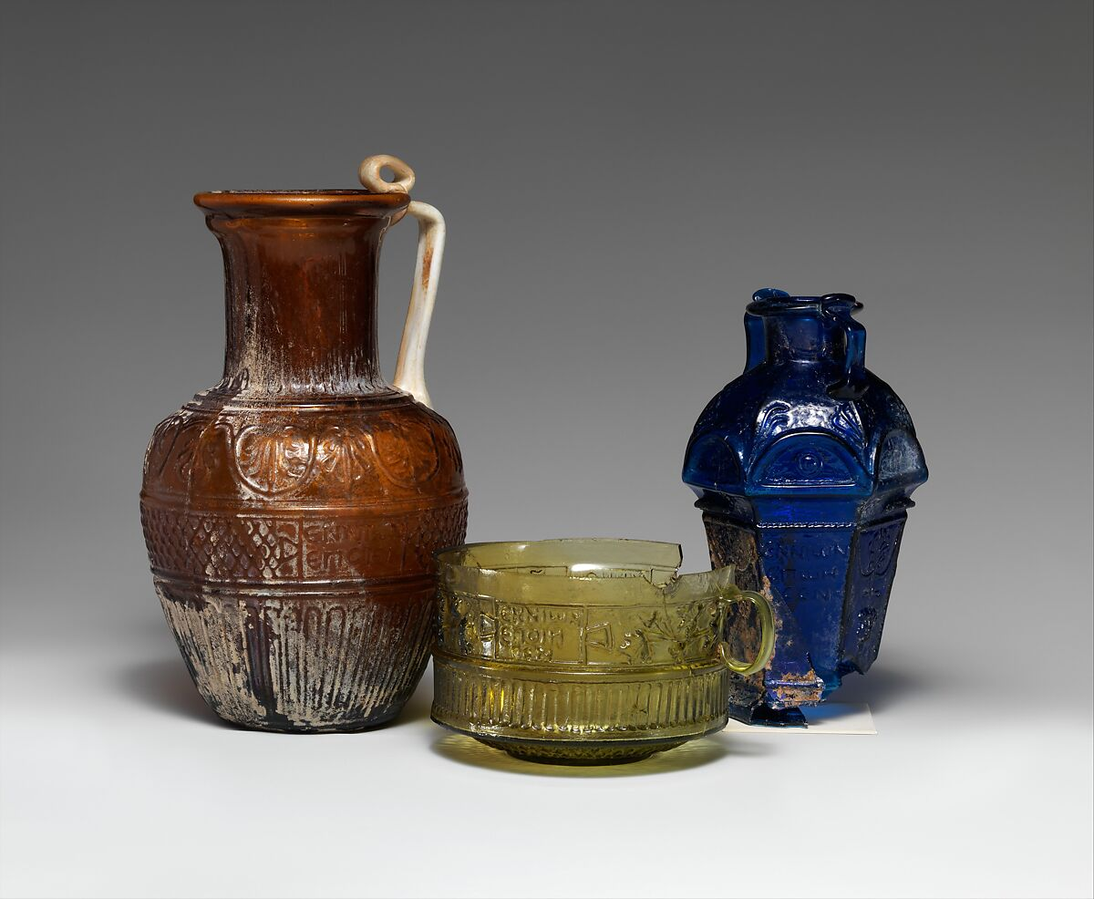
The Metropolitan Museum of Art Collection of Glassware by Ennion, New York, USA

Slide 3
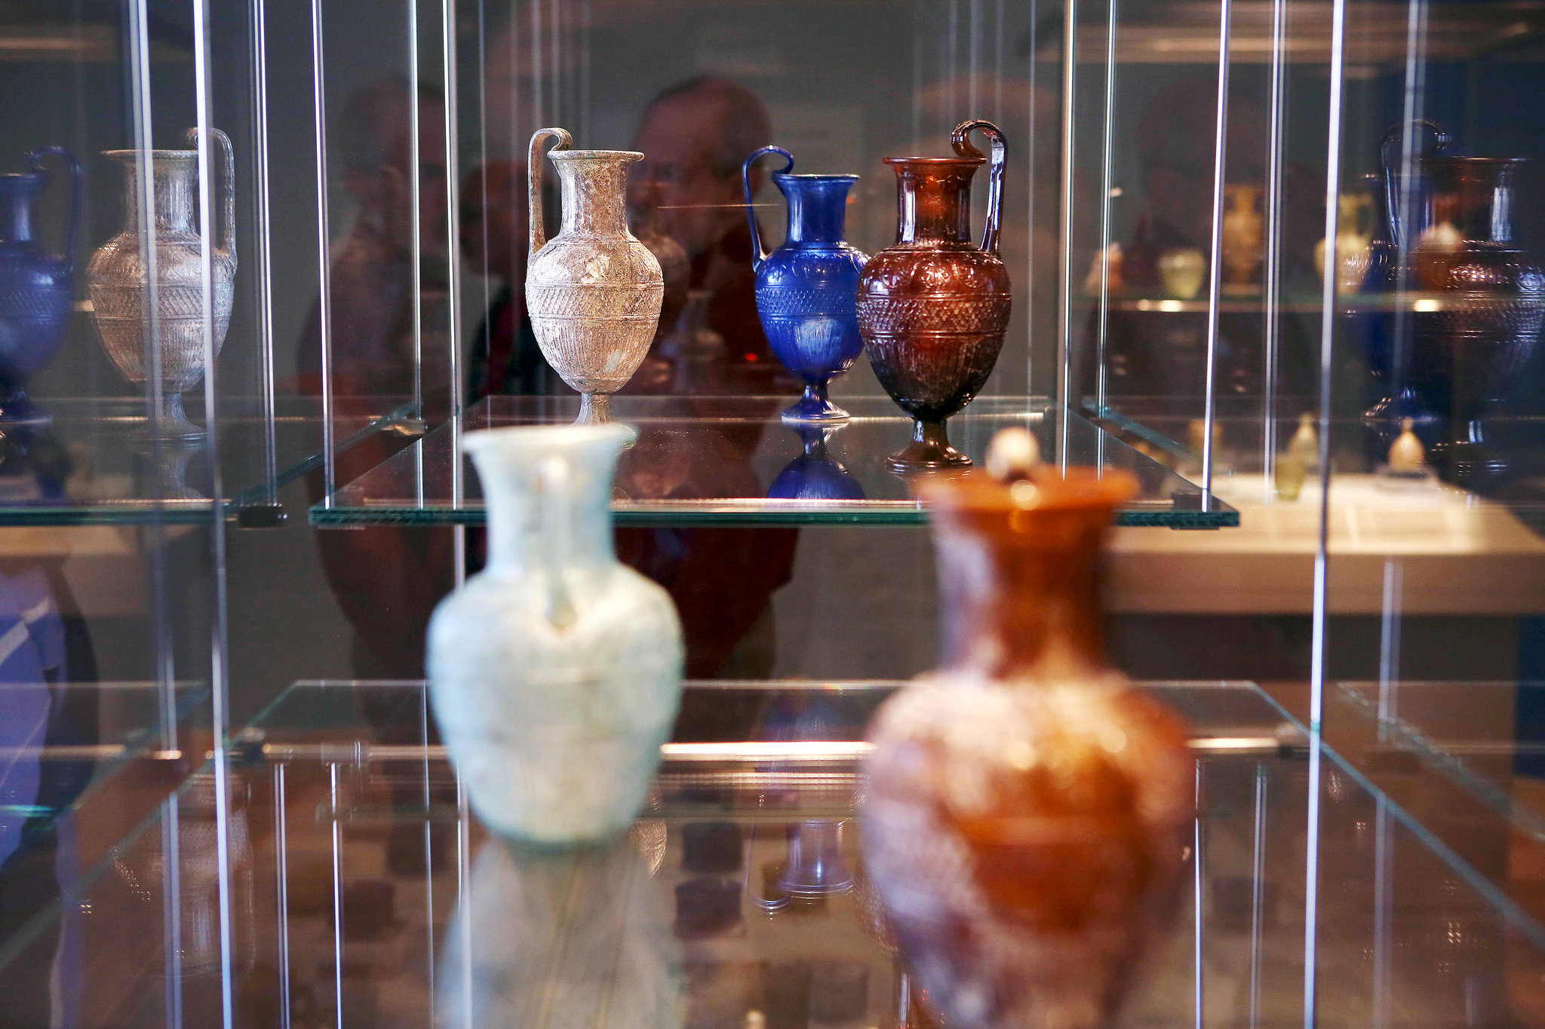
New York Times Review Photo of the 2015 Exhibition Ennion: Master of Roman Glass at the Metropolitan Museum of Art, New York https://www.nytimes.com/2015/03/06/arts/design/review-ennion-at-the-met-profiles-an-ancient-glassmaker.html

Slide 4
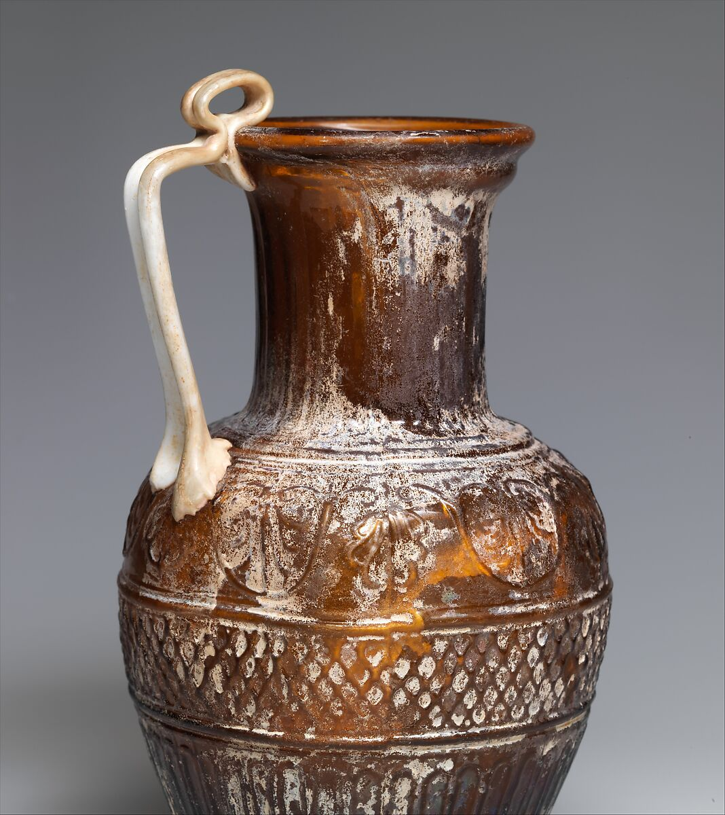
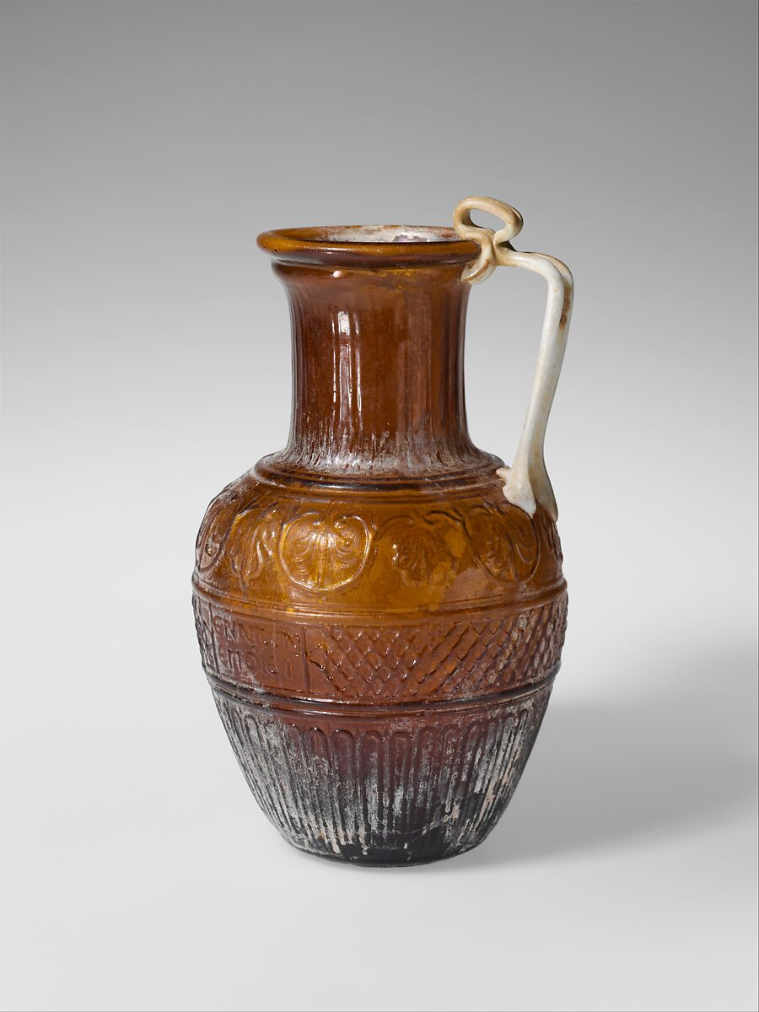
Glass jug, 1st half of 1st century AD, Glass, 18.4 × 10.6 cm, the MET, NY, USA https://www.metmuseum.org/met-publications/lightfoot-metropolitan-museum-journal-v-50-2015

Slide 5
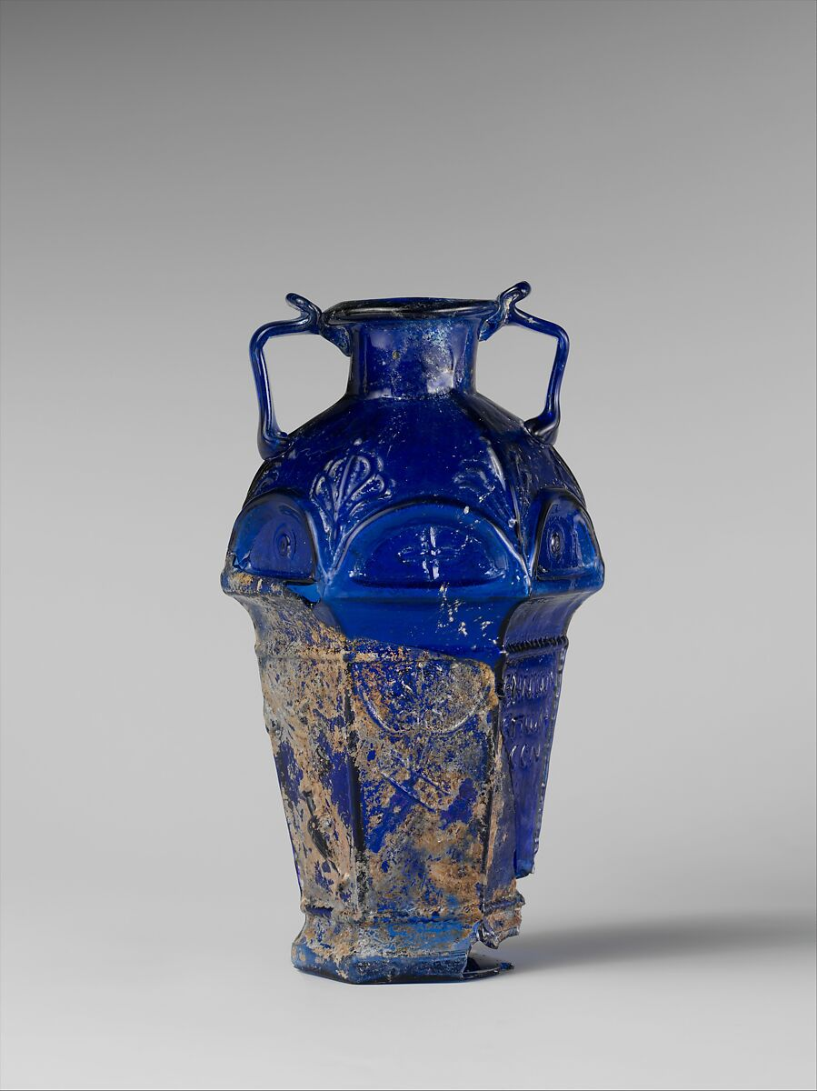
Glass hexagonal amphoriskos, 1st half of 1st century AD, Glass, 14.2 × 8 × 7.2 cm, the MET NY, USA https://www.metmuseum.org/art/collection/search/245376

Slide 6
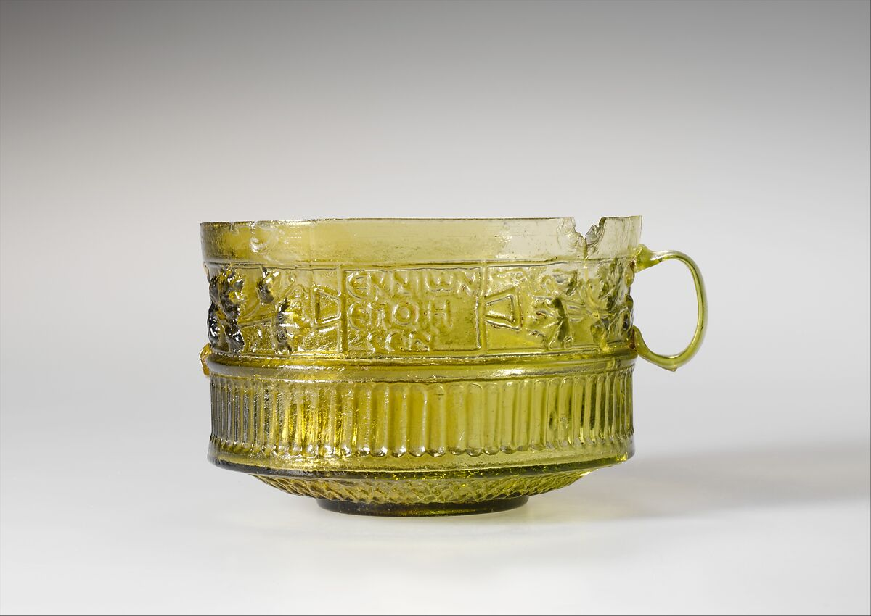
Glass cup, 1st half of 1st century AD, Glass, 6.2 × 11.1 cm, the MET, NY, USA https://www.metmuseum.org/art/collection/search/249469

Slide 7
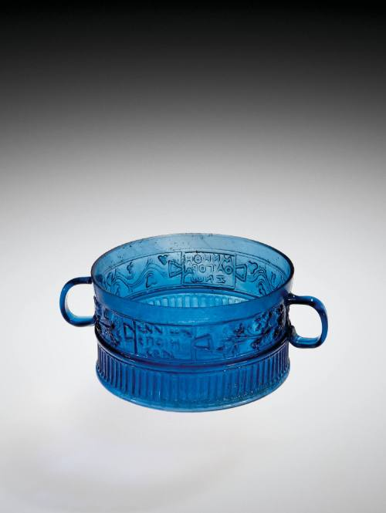
Cup, 30-70, Glass, H: 6 cm - Diam: 9.7 cm, Corning Museum of Art, USA https://glasscollection.cmog.org/objects/6137/cup

Slide 8
cup, 1st century AD, Glass, Height: 6 cm, Shlomo Moussaieff Collection https://www.metmuseum.org/met-publications/ennion-master-of-roman-glass

Slide 9
Globular bowl, 1st century AD, Glass, Height: 6.5 cm Chrysler Museum of Art, Norfolk, Virginia, USA https://www.metmuseum.org/met-publications/ennion-master-of-roman-glass

Slide 10
One-handled jug, 1st century AD, Glass, 22 cm, Glass pavilion collection, Eretz Israel Museum, Tel Aviv, Israel https://www.metmuseum.org/met-publications/ennion-master-of-roman-glass

Slide 11
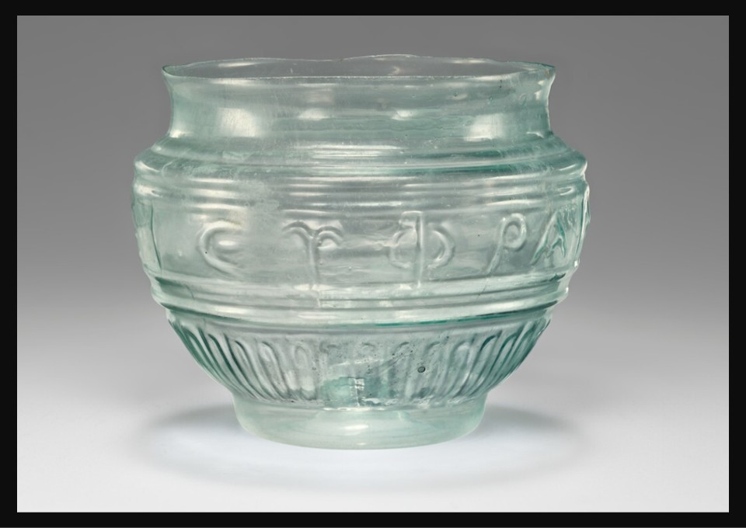
Possibly from the Workshop of Ennion, Greek,?, active about 1 – 50 AD Mold-blown cup, first half of 1st century AD, Glass, Hight: 6.9 cm, Getty Villa, CA, USA https://www.getty.edu/art/collection/object/10400N

Slide 12
The End

