Slide 1
Codex Purpureus Rossanensis
6th century AD
Diocesan Museum, Rossano, Italy
Photo Credits: https://www.artesacrarossano.it/eng/details_works.php?IDo=34

Slide 2
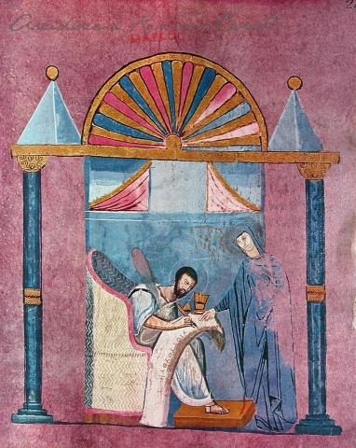
The Portrait of Saint Mark

Slide 3
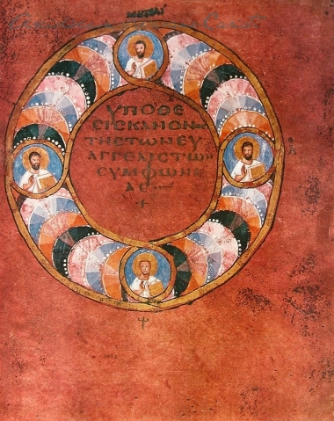
Canons Title Page

Slide 4
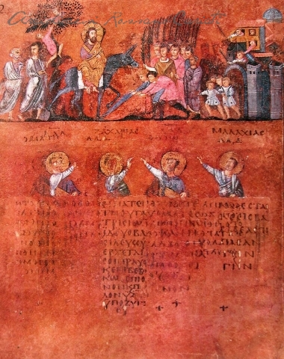
The entry of Jesus into Jerusalem

Slide 5
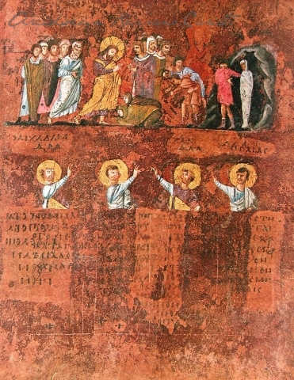
The Resurrection of Lazarus

Slide 6
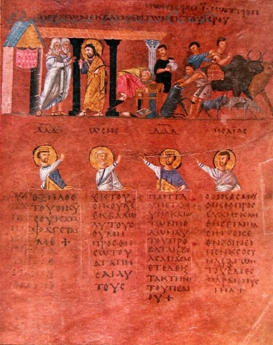
Talking with the Priests in the TEMPLE

Slide 7
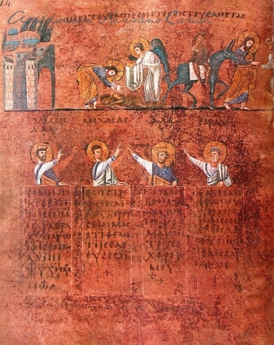
Parable of the good Samaritan

Slide 8
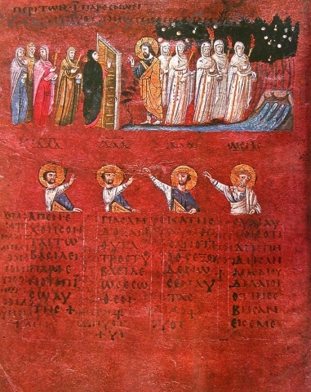
Parable of the 10 Virgins

Slide 9
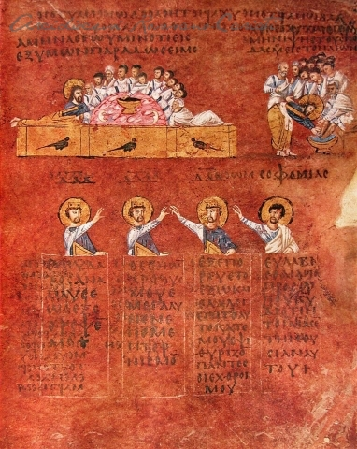
The Last Supper

Slide 10
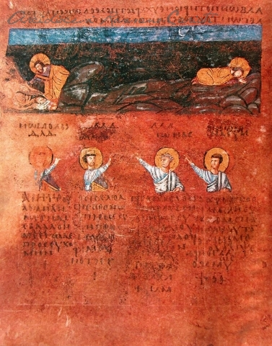
In the Garden of Gesthemane

Slide 11
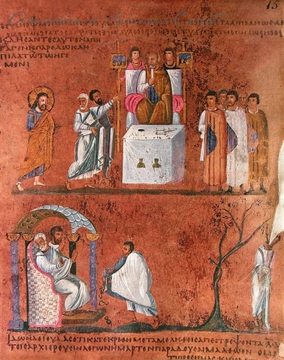
Christ’s Trial in front of Ponzius Pilate

Slide 12
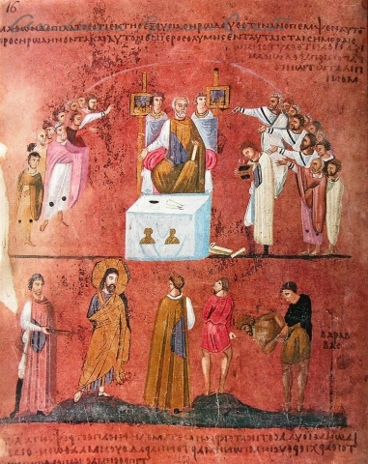
The choice between Jesus and Barabbas

