Slide 1

The House of Euripos
2nd-3rd century AD, Archaeological Museum of Mytilene, Greece
Photo credit: Amalia Spiliakou, Summer 2025

Slide 2
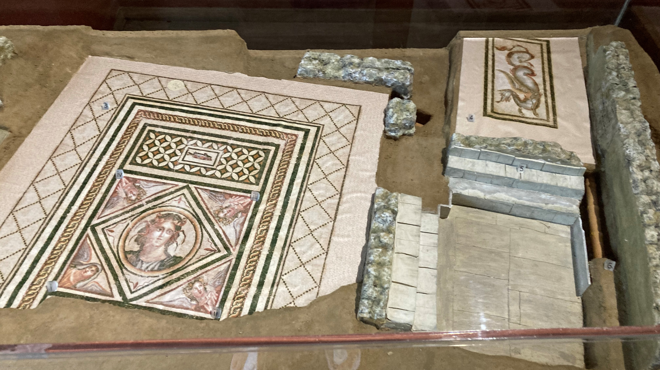

Slide 3
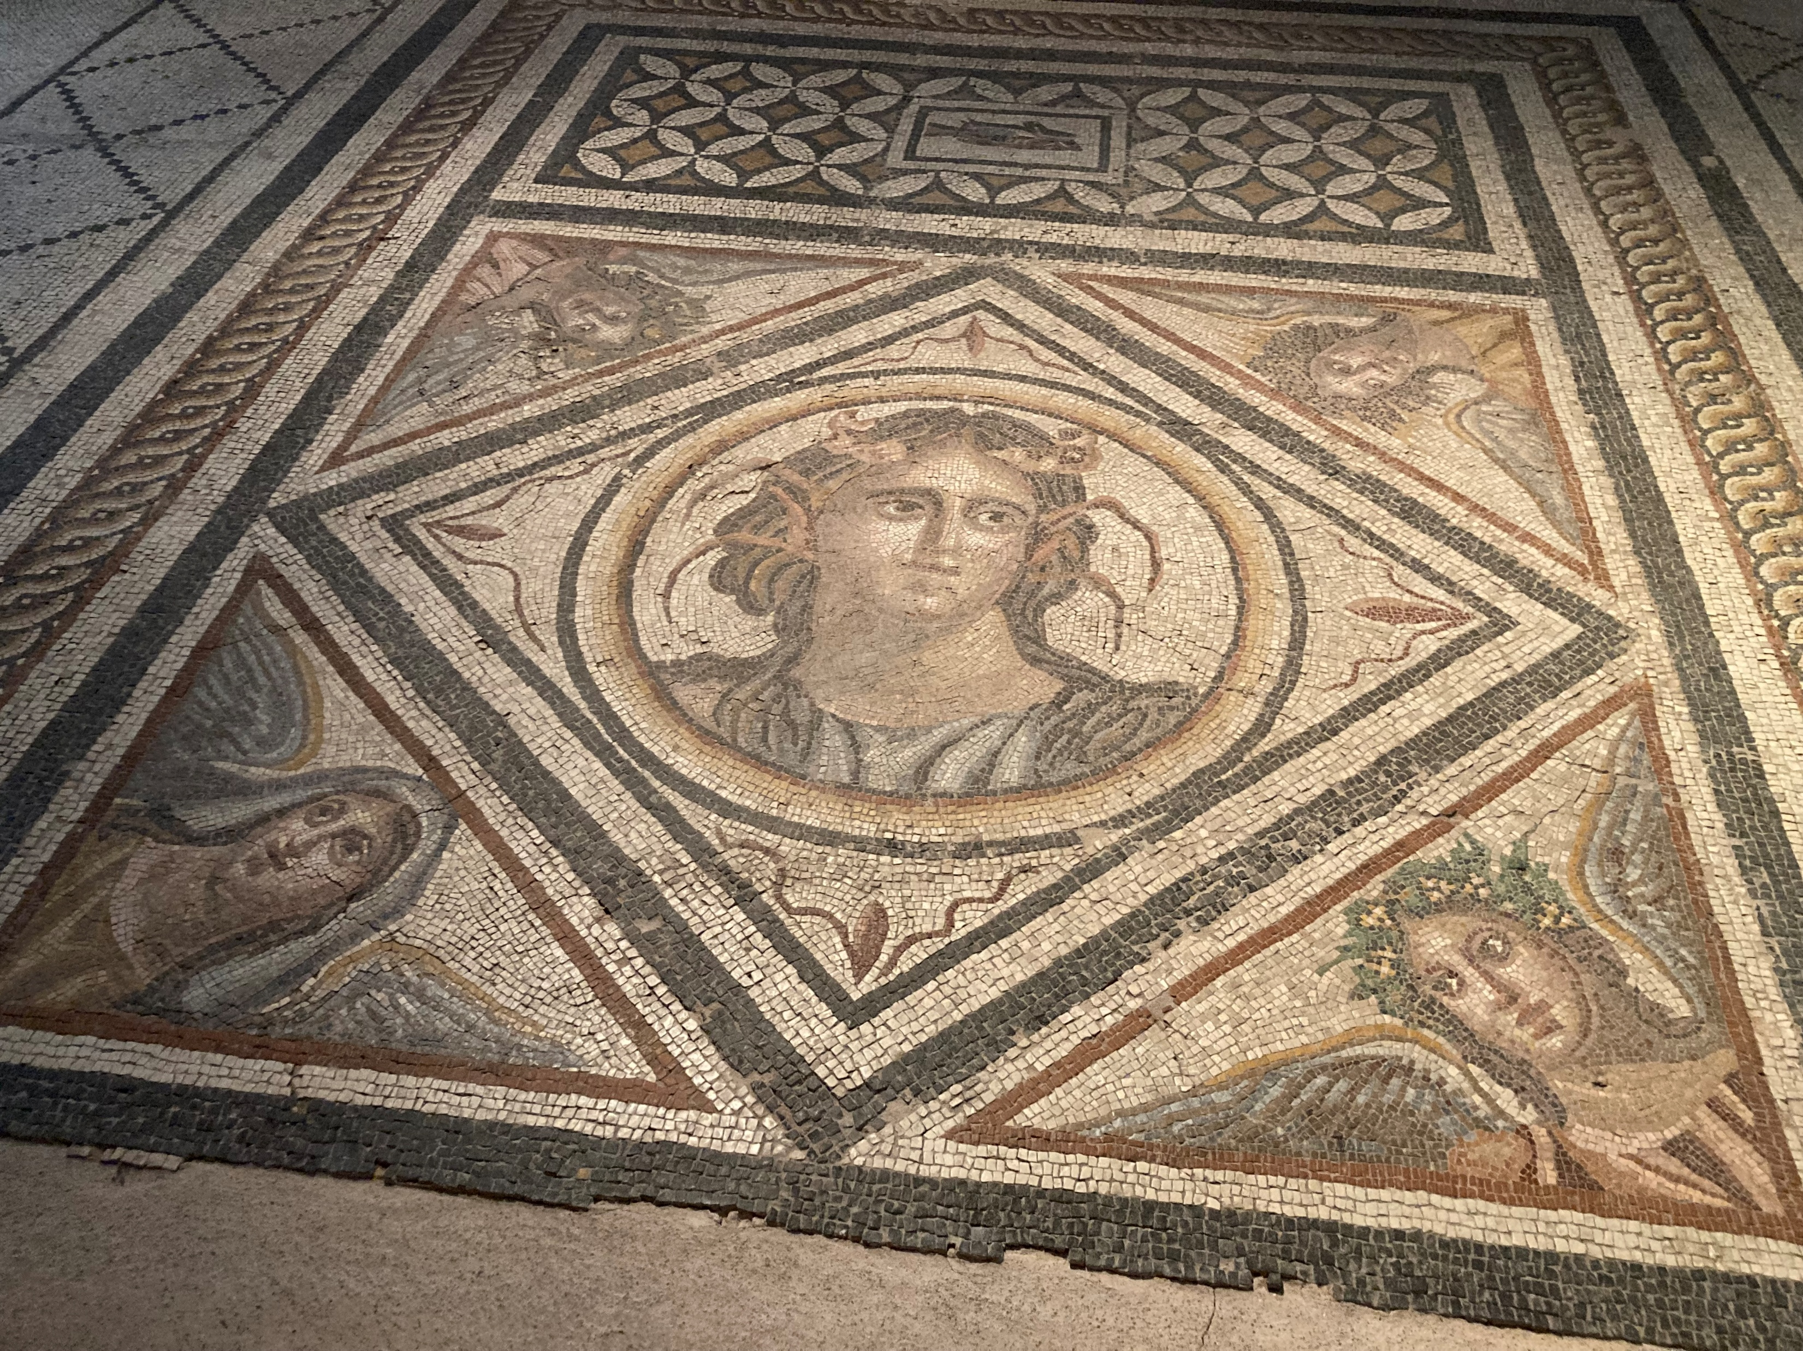

Slide 4
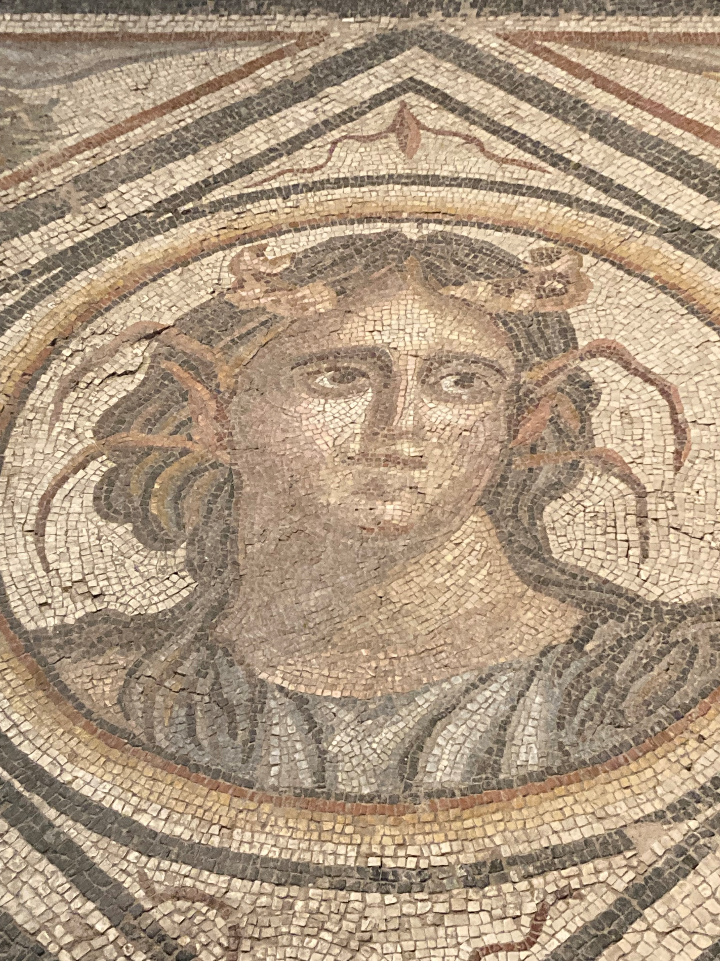

Slide 5
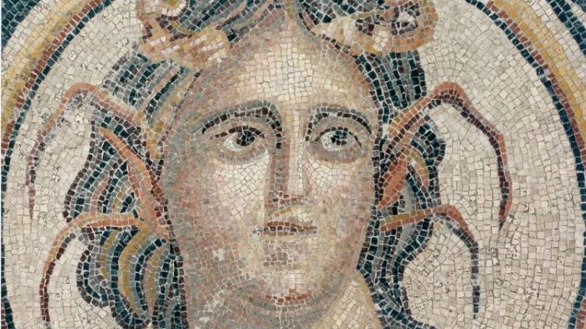
https://www.politikalesvos.gr/%CF%84%CE%B9-%CE%BD%CE%B1-%CE%B4%CF%89-%CF%83%CF%84%CE%BF-%CE%B1%CF%81%CF%87%CE%B1%CE%B9%CE%BF%CE%BB%CE%BF%CE%B3%CE%B9%CE%BA%CF%8C-%CE%BC%CE%BF%CF%85%CF%83%CE%B5%CE%AF%CE%BF-%CE%BC%CF%85%CF%84%CE%B9/

Slide 6
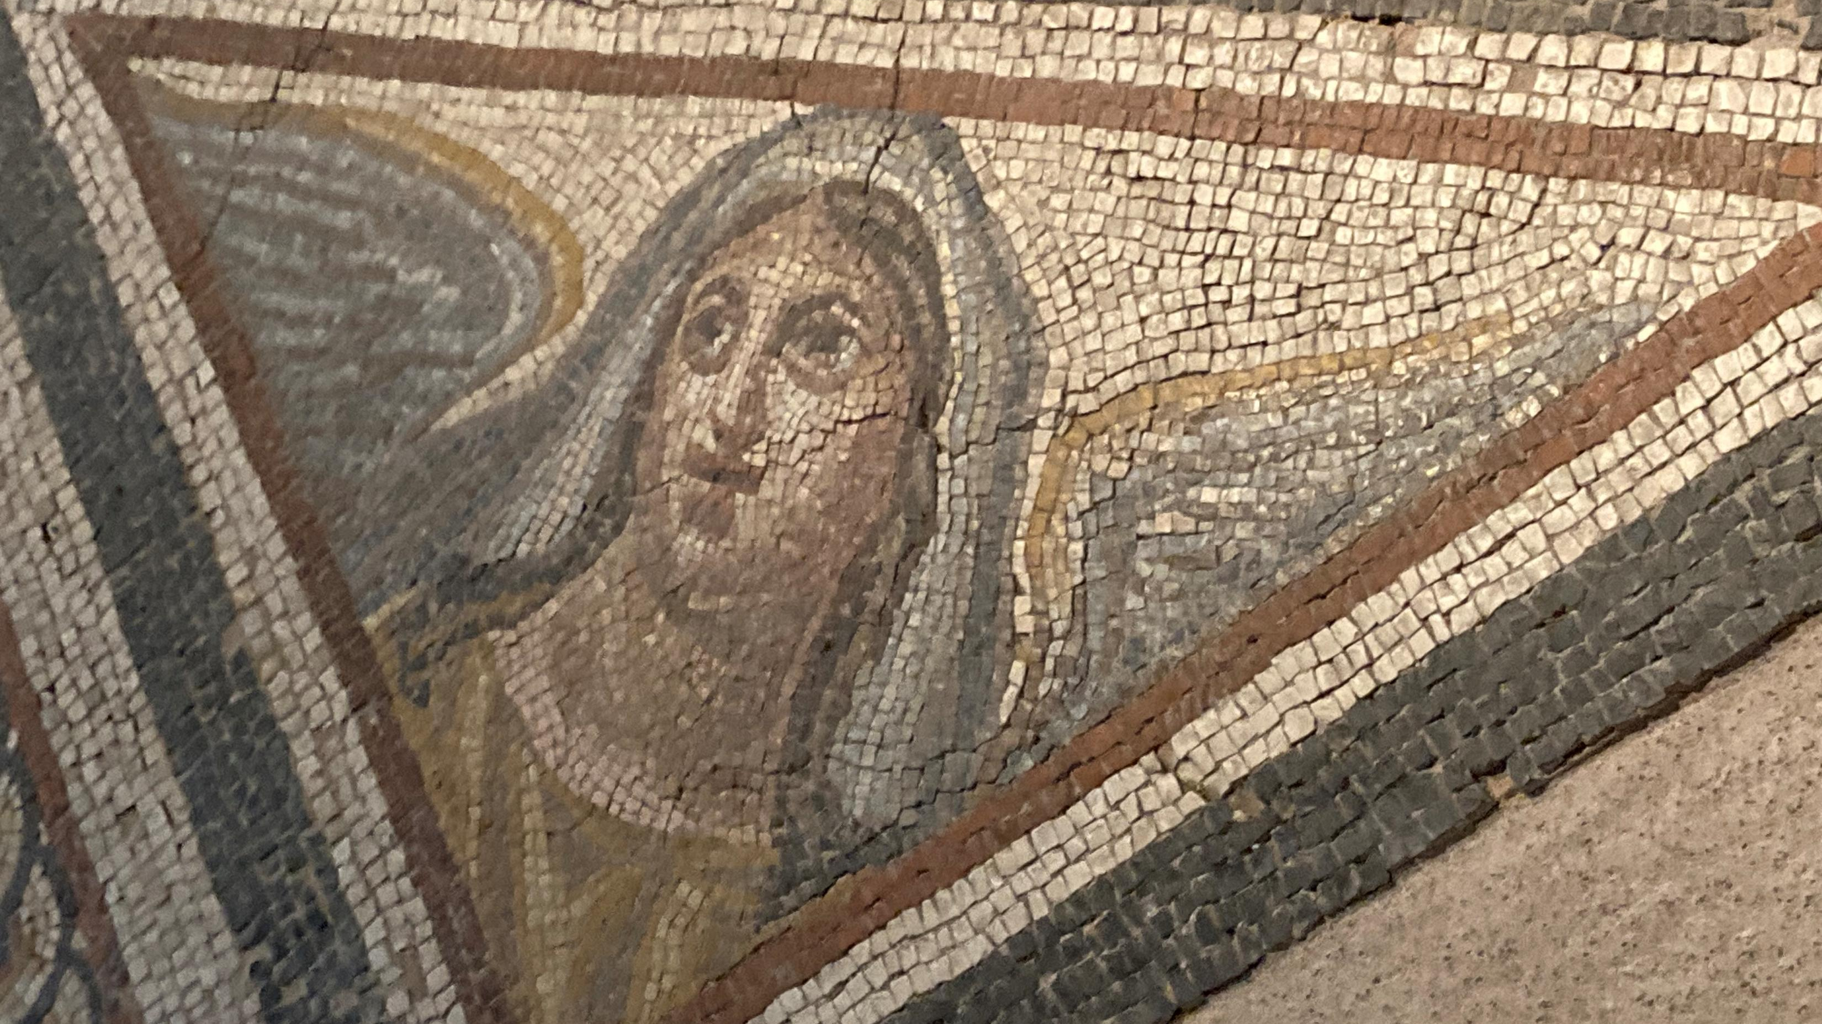

Slide 7
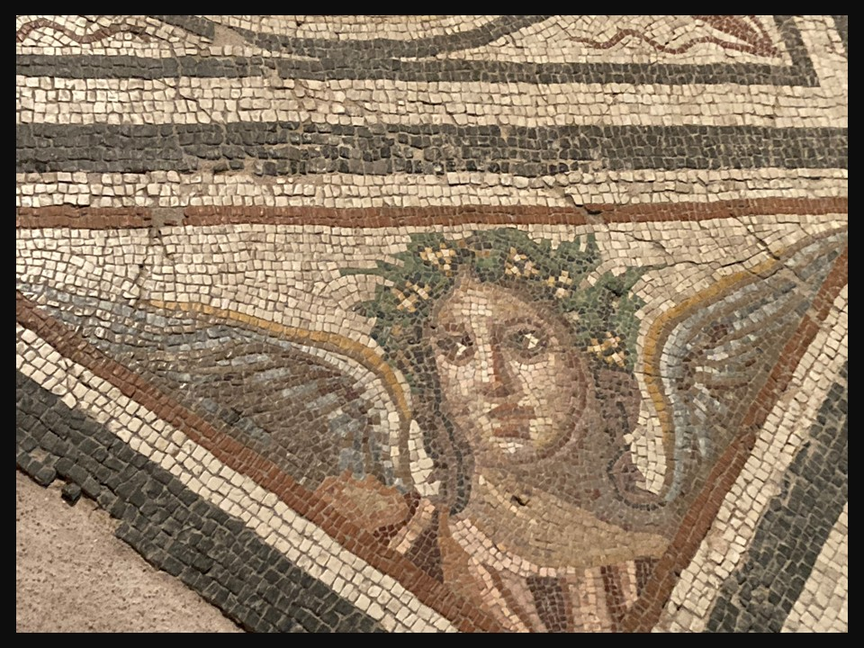

Slide 8
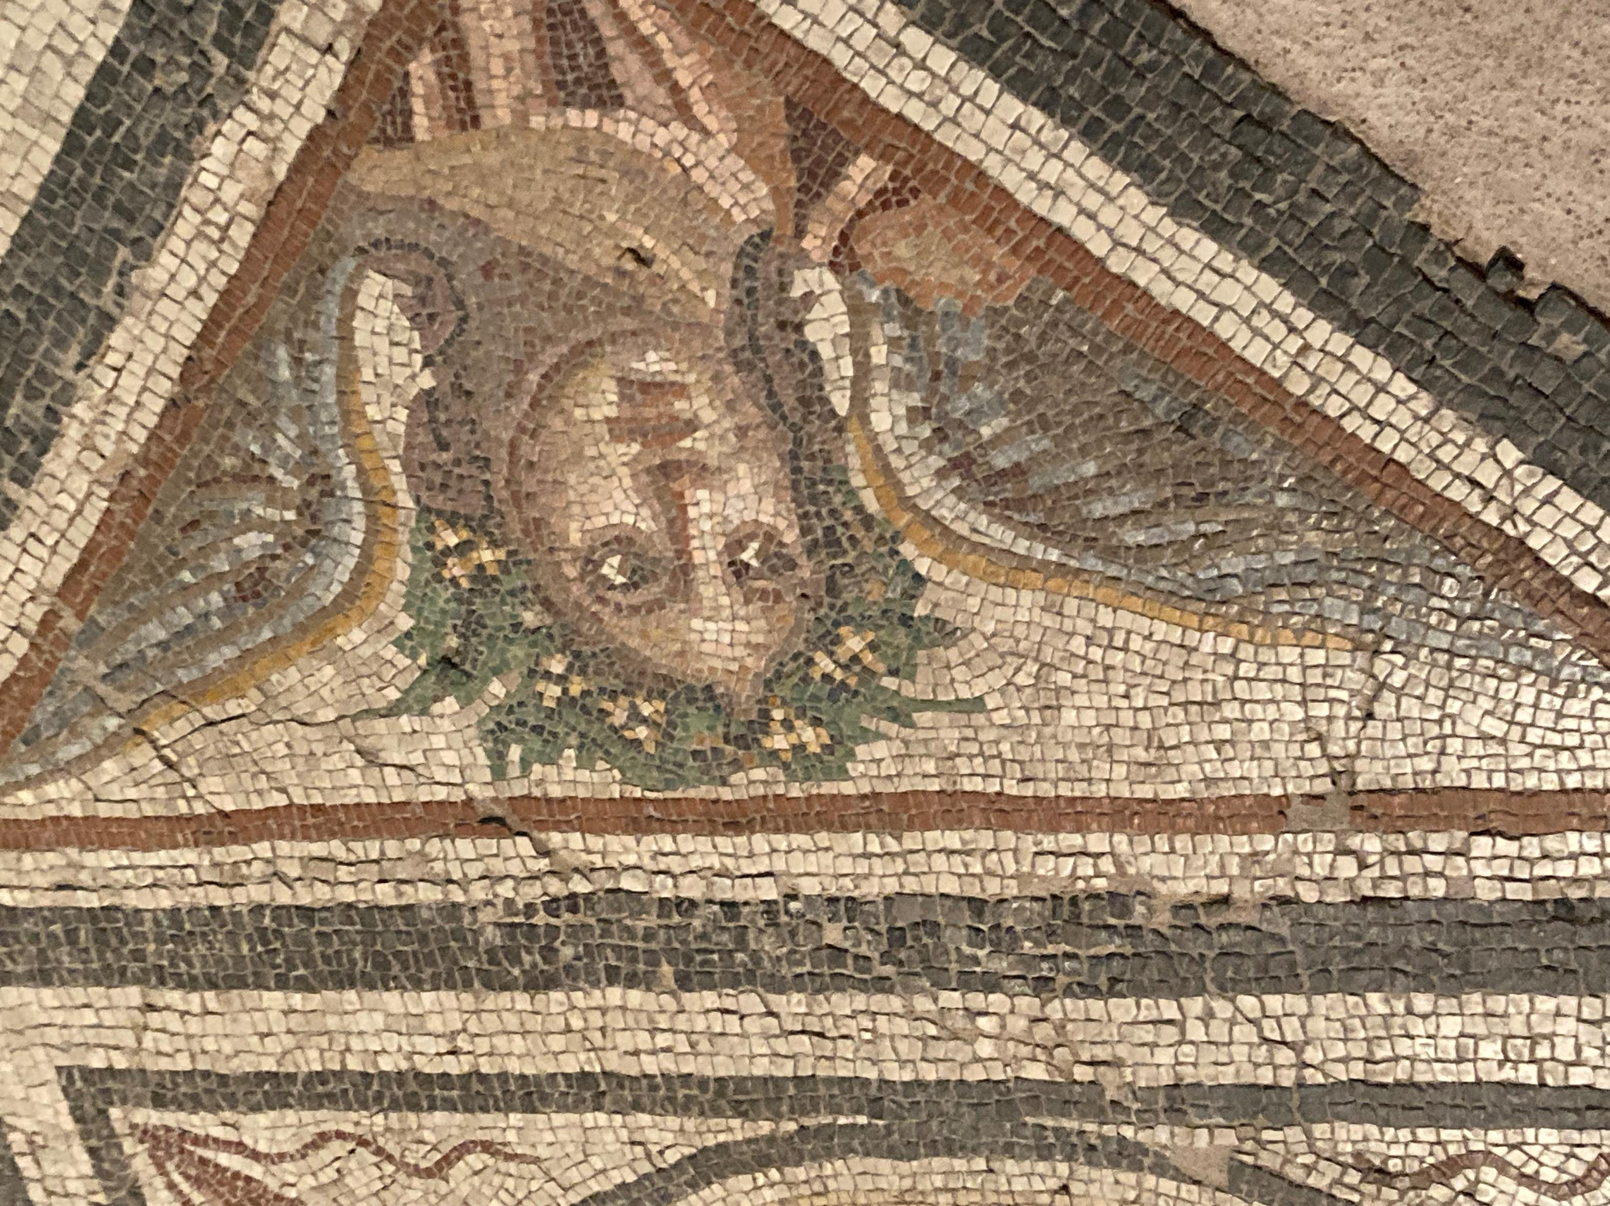

Slide 9
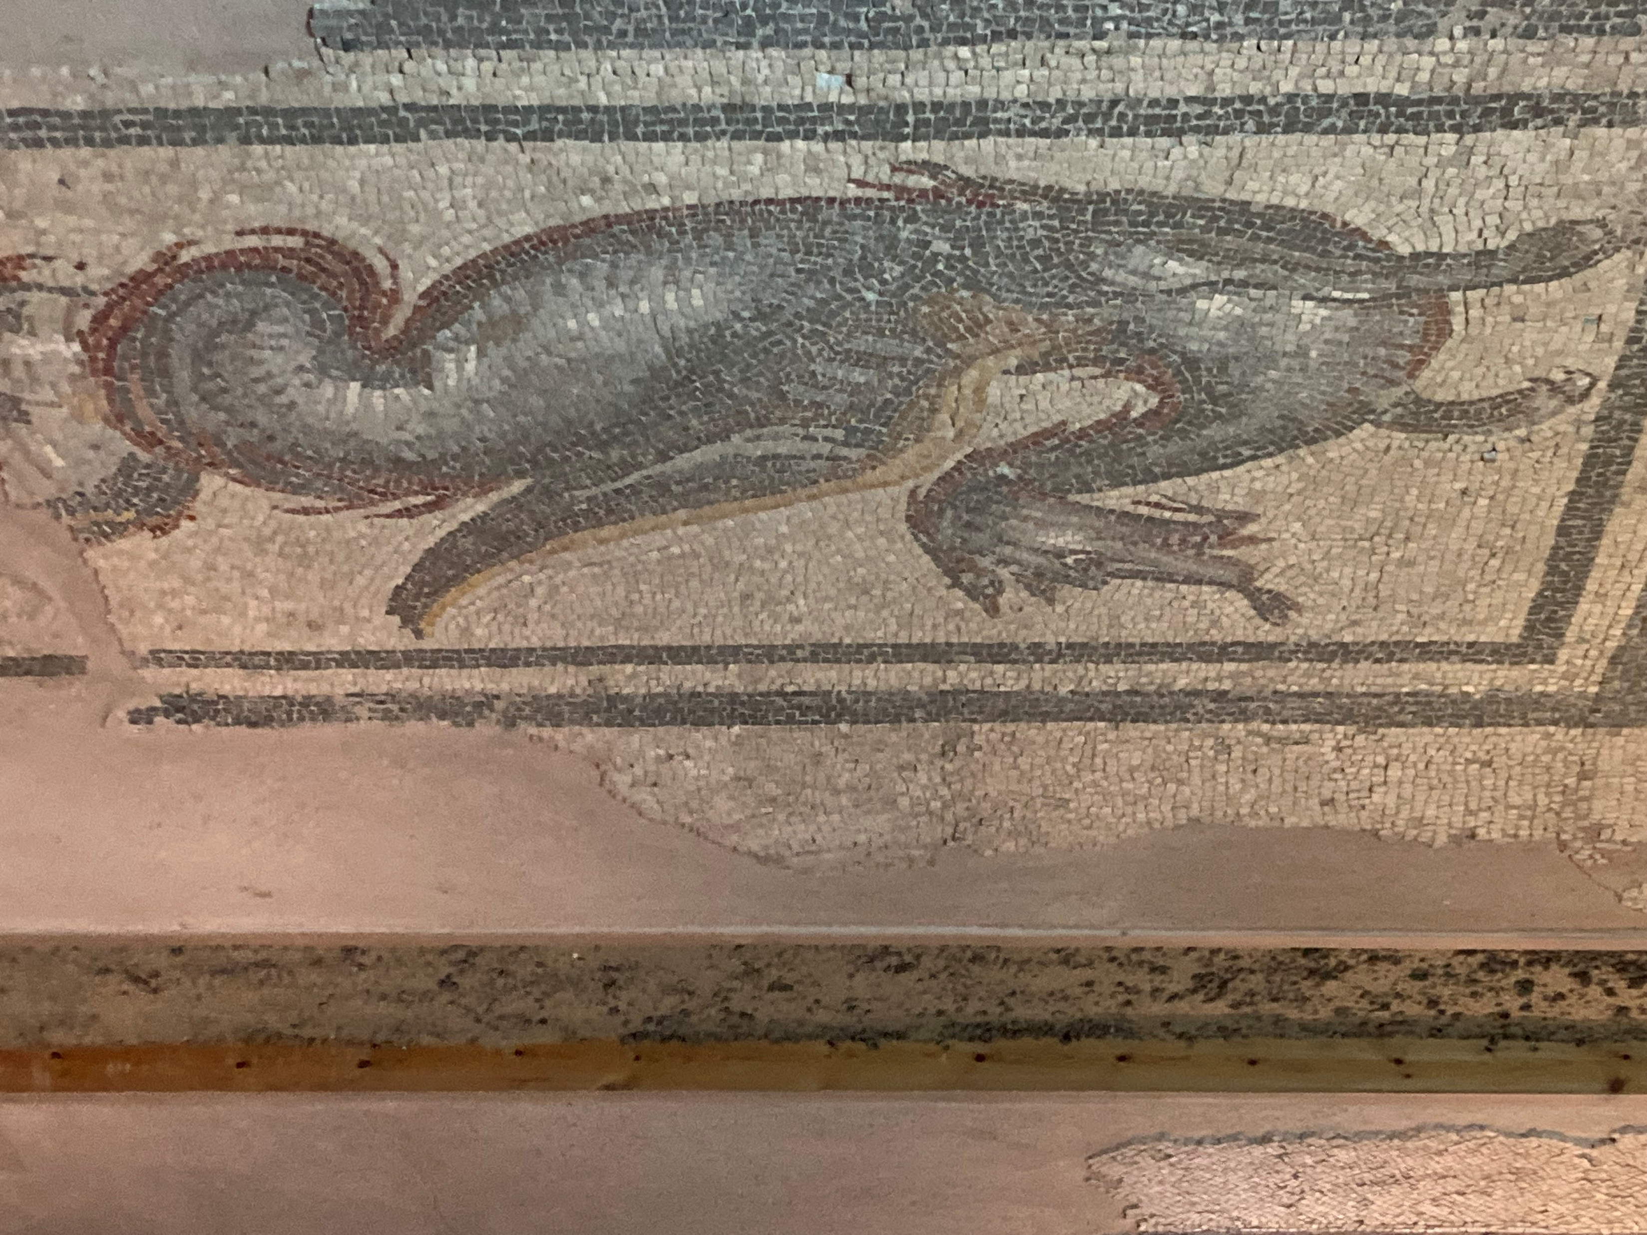

Slide 10
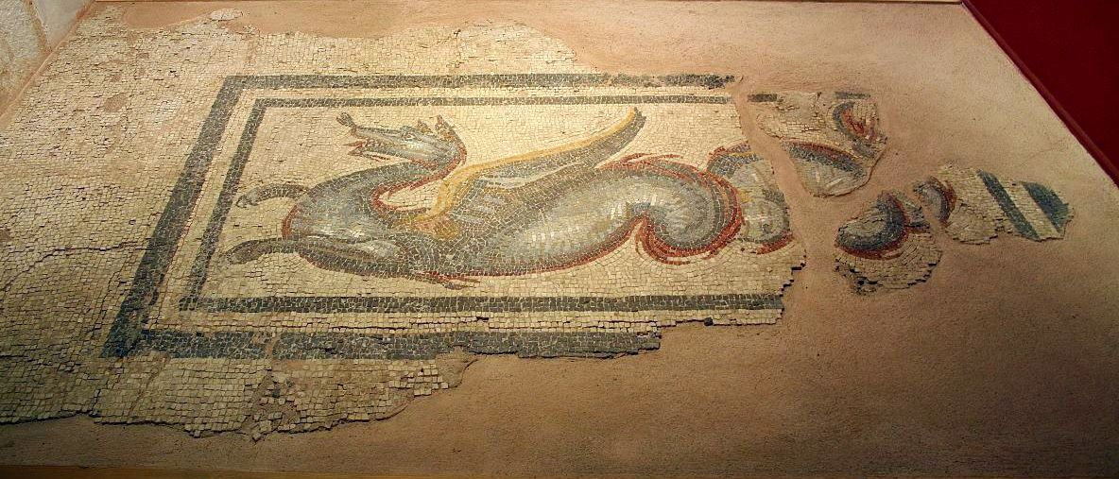
https://www.politikalesvos.gr/%CF%84%CE%B9-%CE%BD%CE%B1-%CE%B4%CF%89-%CF%83%CF%84%CE%BF-%CE%B1%CF%81%CF%87%CE%B1%CE%B9%CE%BF%CE%BB%CE%BF%CE%B3%CE%B9%CE%BA%CF%8C-%CE%BC%CE%BF%CF%85%CF%83%CE%B5%CE%AF%CE%BF-%CE%BC%CF%85%CF%84%CE%B9/

Slide 11
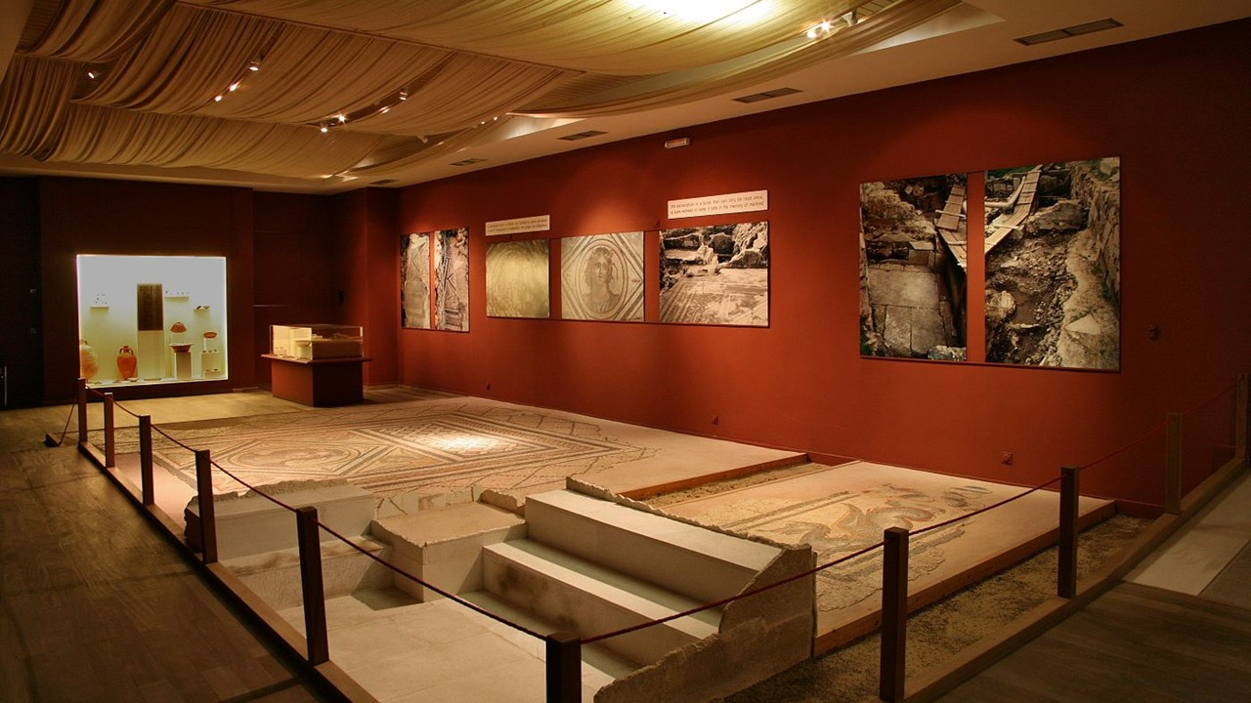
https://www.politikalesvos.gr/%CF%84%CE%B9-%CE%BD%CE%B1-%CE%B4%CF%89-%CF%83%CF%84%CE%BF-%CE%B1%CF%81%CF%87%CE%B1%CE%B9%CE%BF%CE%BB%CE%BF%CE%B3%CE%B9%CE%BA%CF%8C-%CE%BC%CE%BF%CF%85%CF%83%CE%B5%CE%AF%CE%BF-%CE%BC%CF%85%CF%84%CE%B9/

