Slide 1

10 Ivory Pyxides
Greco-Roman World
15th cent BC – 15th cent AD

Slide 2
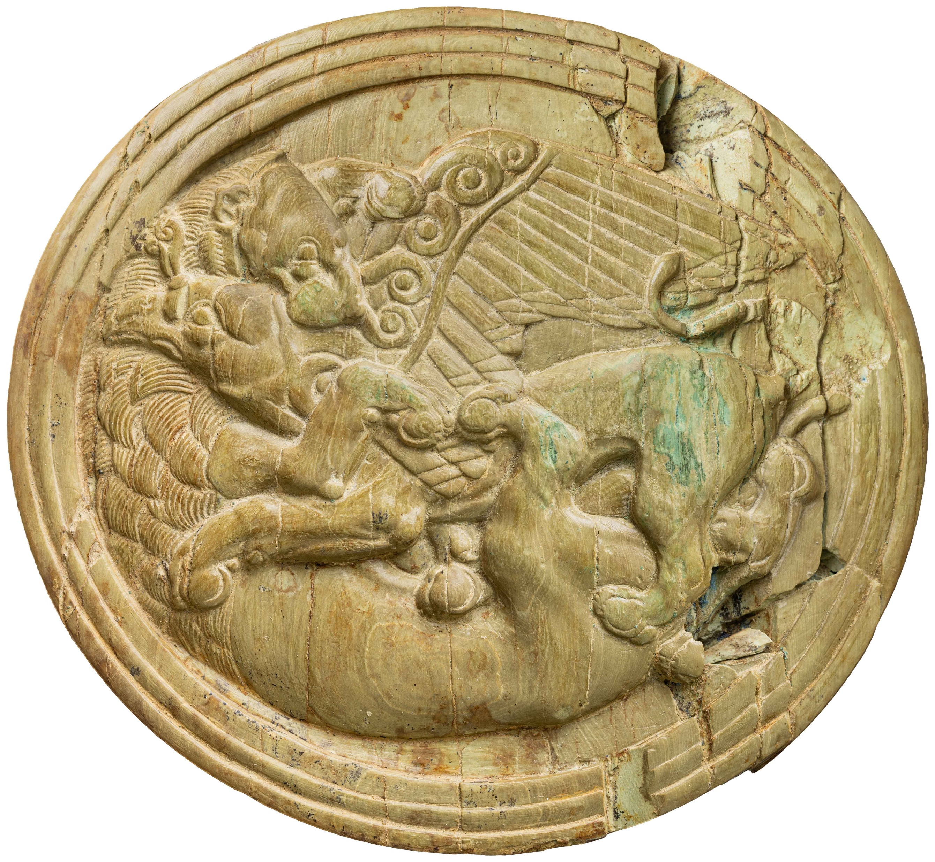
Pyxis Lid with a Lion attacking a Griffin, 1630-1440 BC, from the Tomb of the Griffin Warrior in Pylos, southwestern Greece https://www.thehistoryblog.com/archives/73314

Slide 3
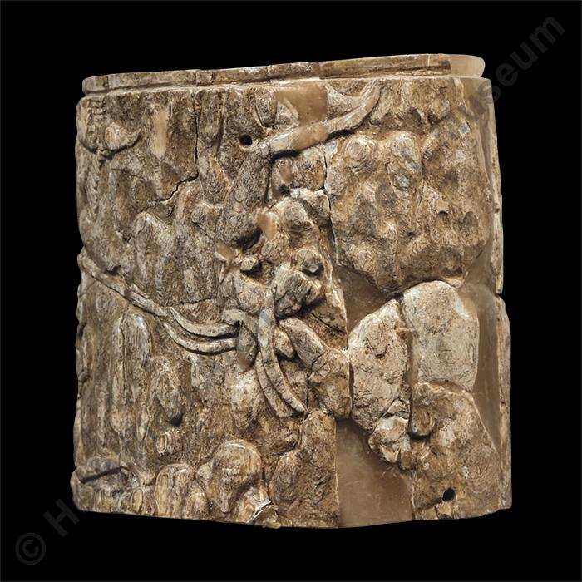
Ivory pyxis with relief scene of bull hunt and capture, Late Minoan ΙI period, 1500-1450 BC, Tomb Η, Katsambas, Ivory, Height: 9.2 cm, Diameter: 8.5 cm, Heraklion Archaeological Museum, Crete, Greece https://ca.heraklionmuseum.gr/ca/pawtucket/index.php/Detail/objects/86

Slide 4
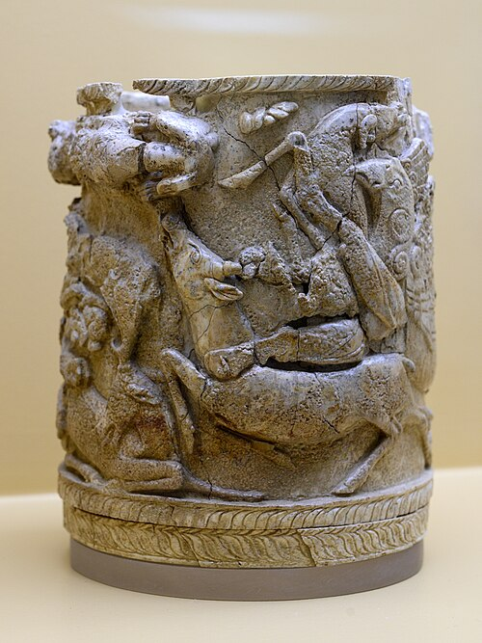
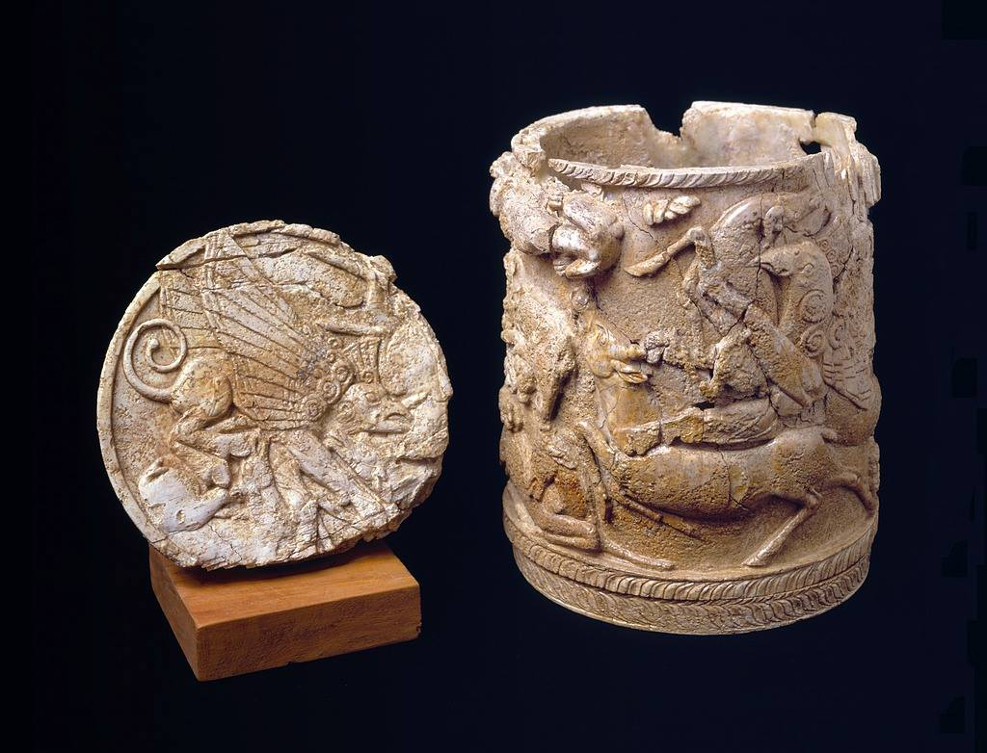
Pyxis of Griffin attacking a deer, late 15th century BC, Ivory, Height: 16 cm, Museum of the Ancient Agora in Athens, Greece

Slide 5
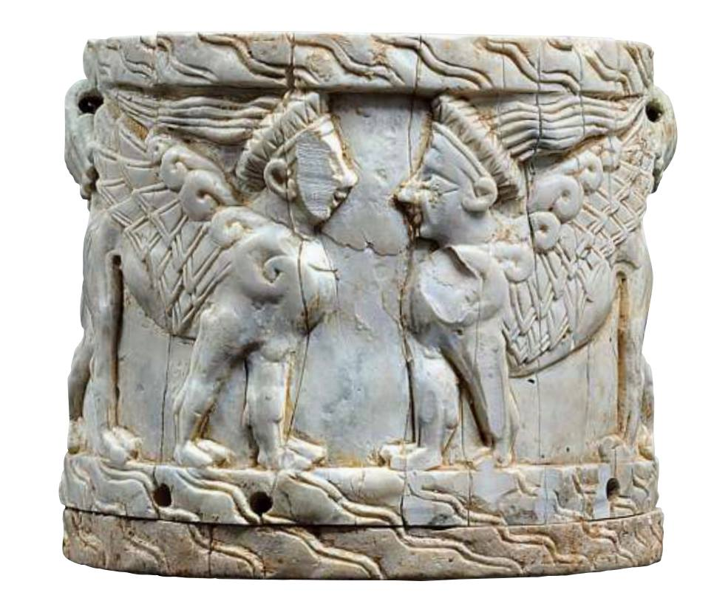
Ivory pyxis with heraldic Sphinxes from a chamber grave in Megalo Kastelli, Thebes, 13th c. BC, Archaeological Museum of Thebes, Greece https://www.facebook.com/photo.php?fbid=3710790215702934&id=259681654147158&set=a.311546025627387&locale=th_TH

Slide 6
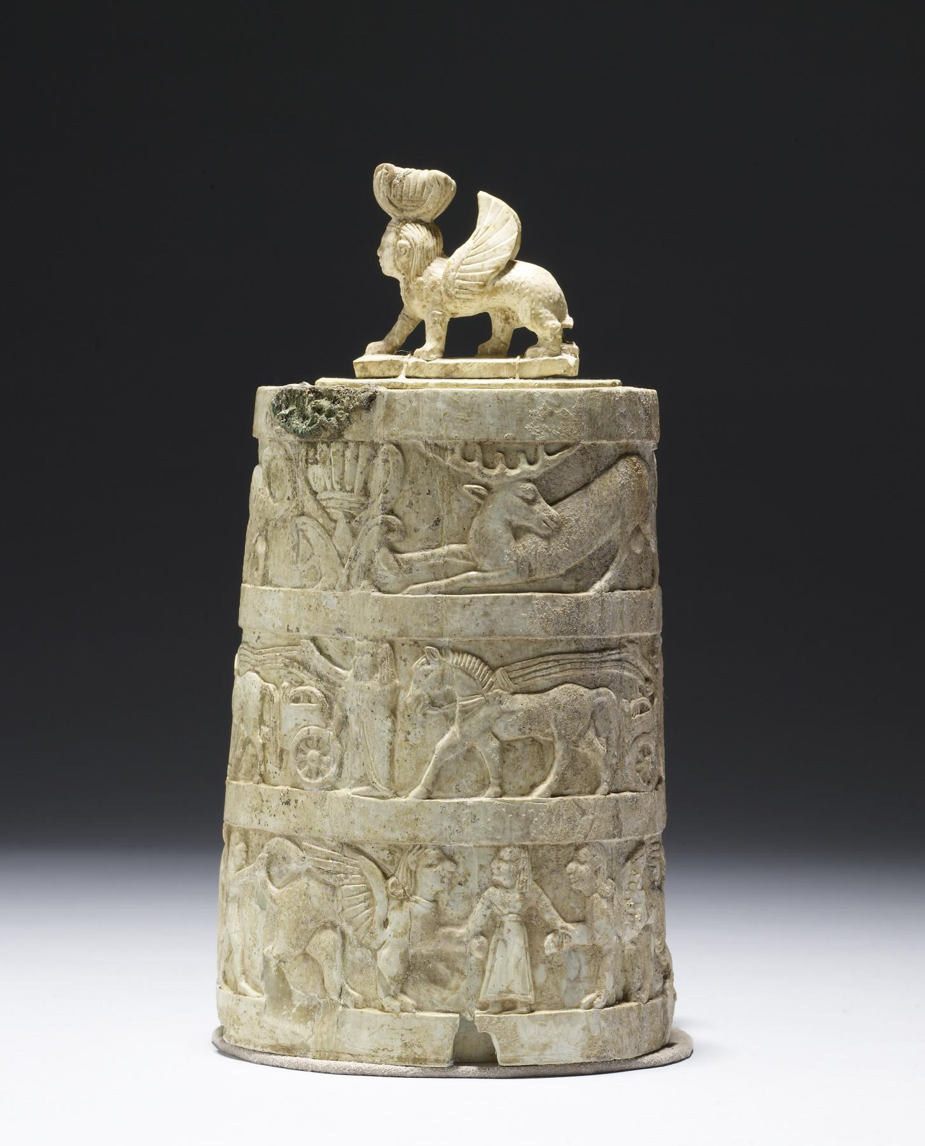
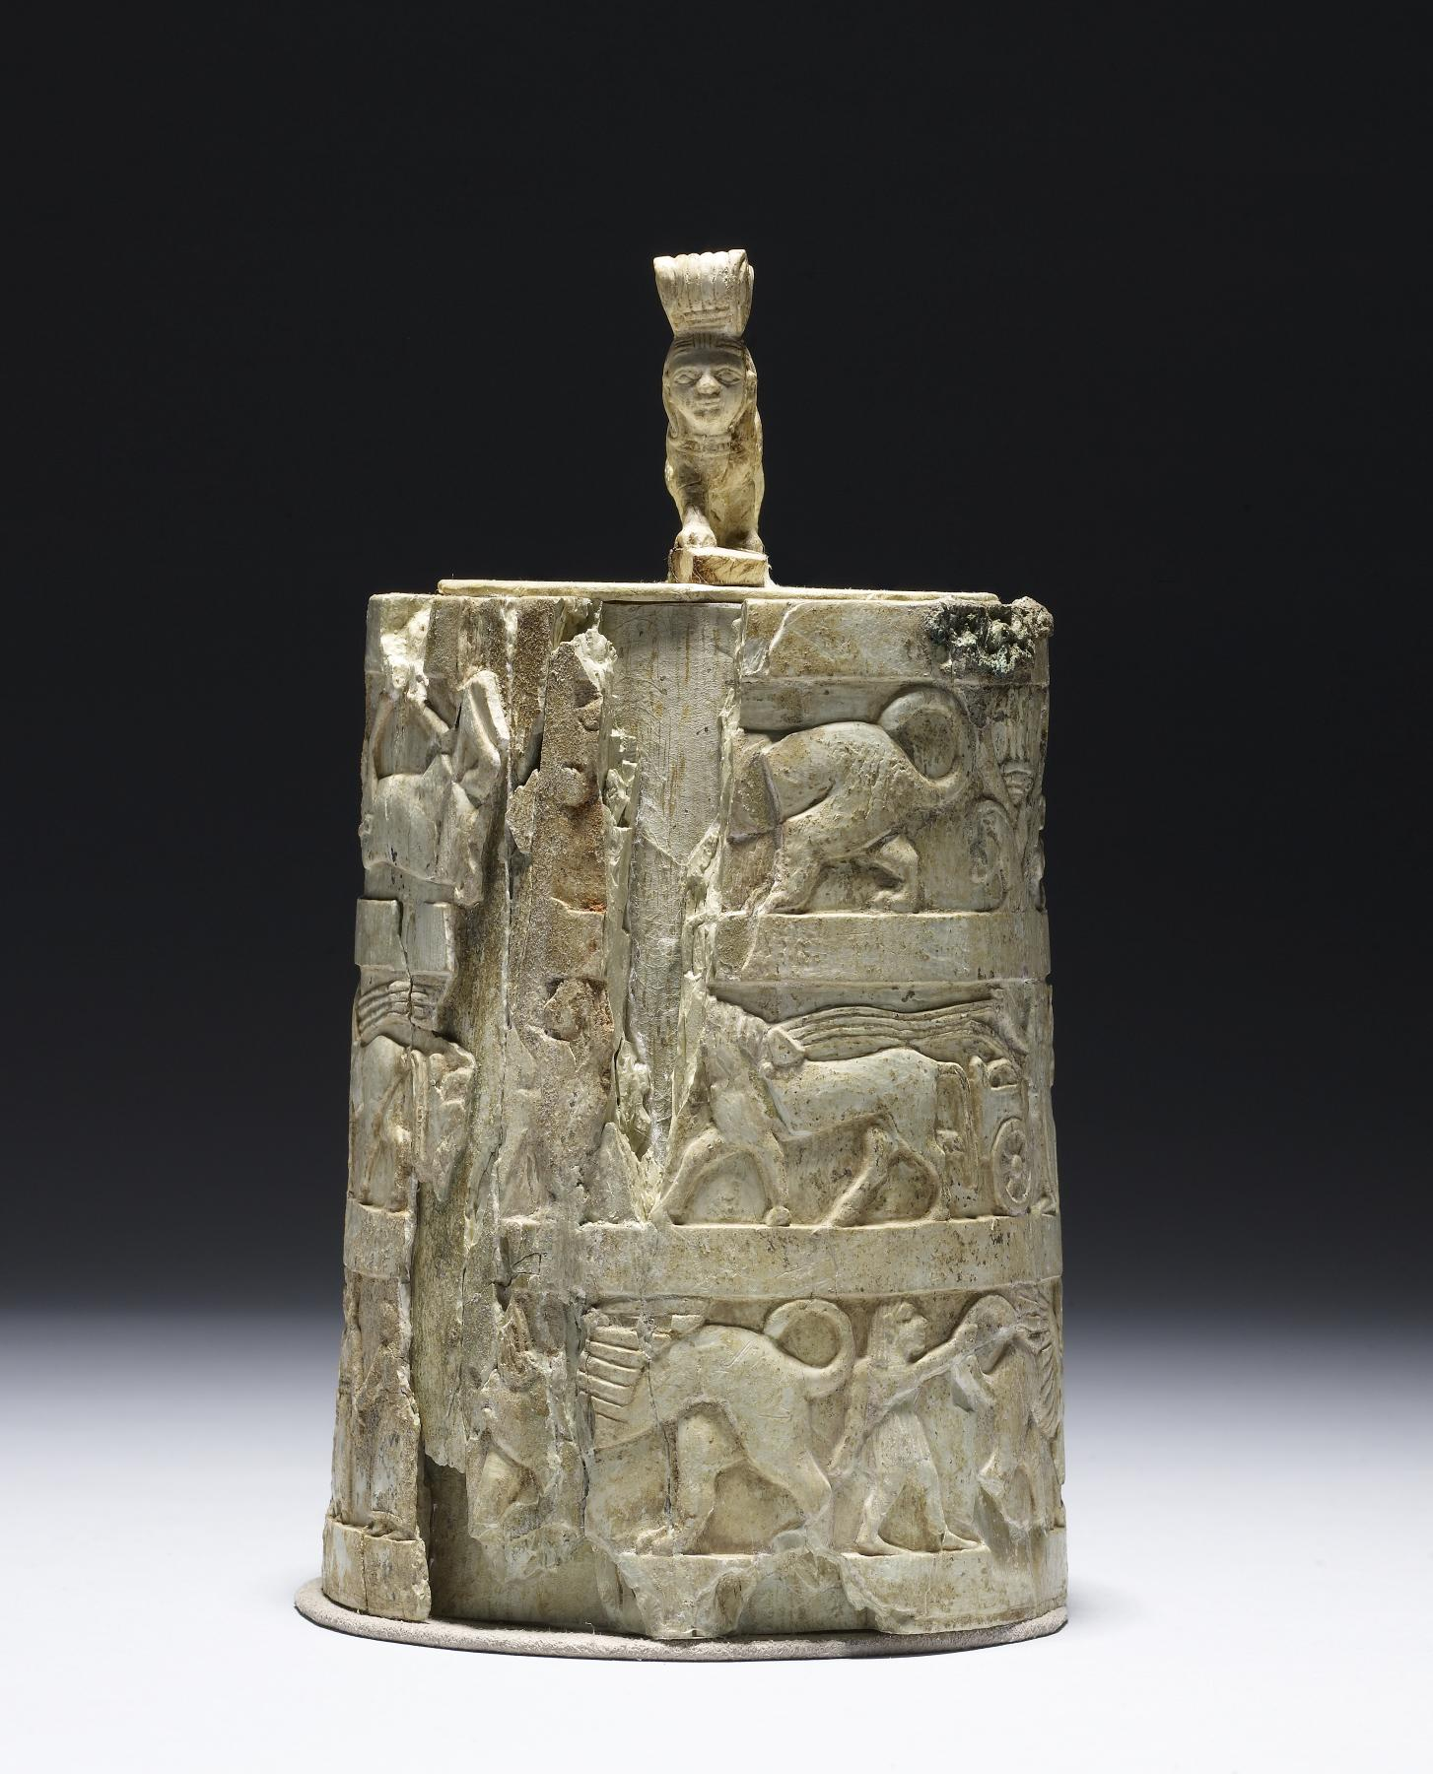
Pyxis and Lid with Sphinx-Shaped Handle by an Etruscan Artist, 650-625 BC, Ivory, 14.1 x 10.5 x 10.4 cm, The Walters Art Museum, MD, USA

Slide 7
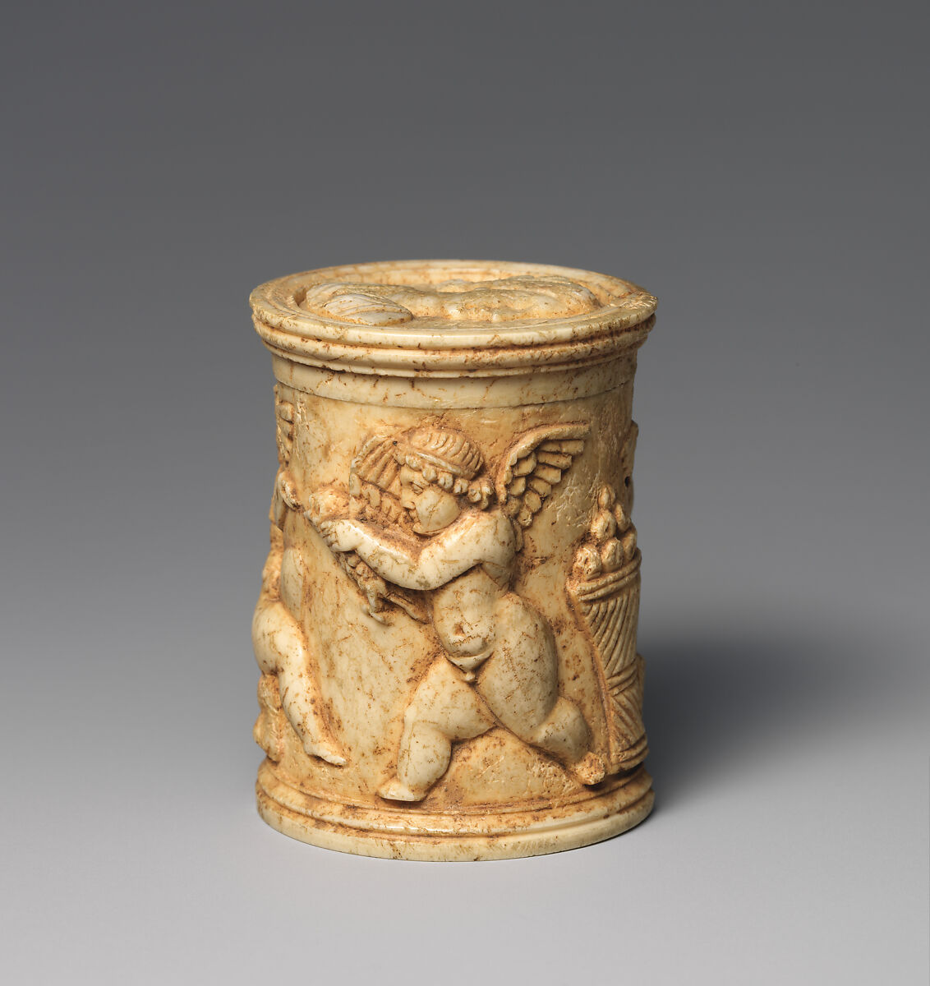
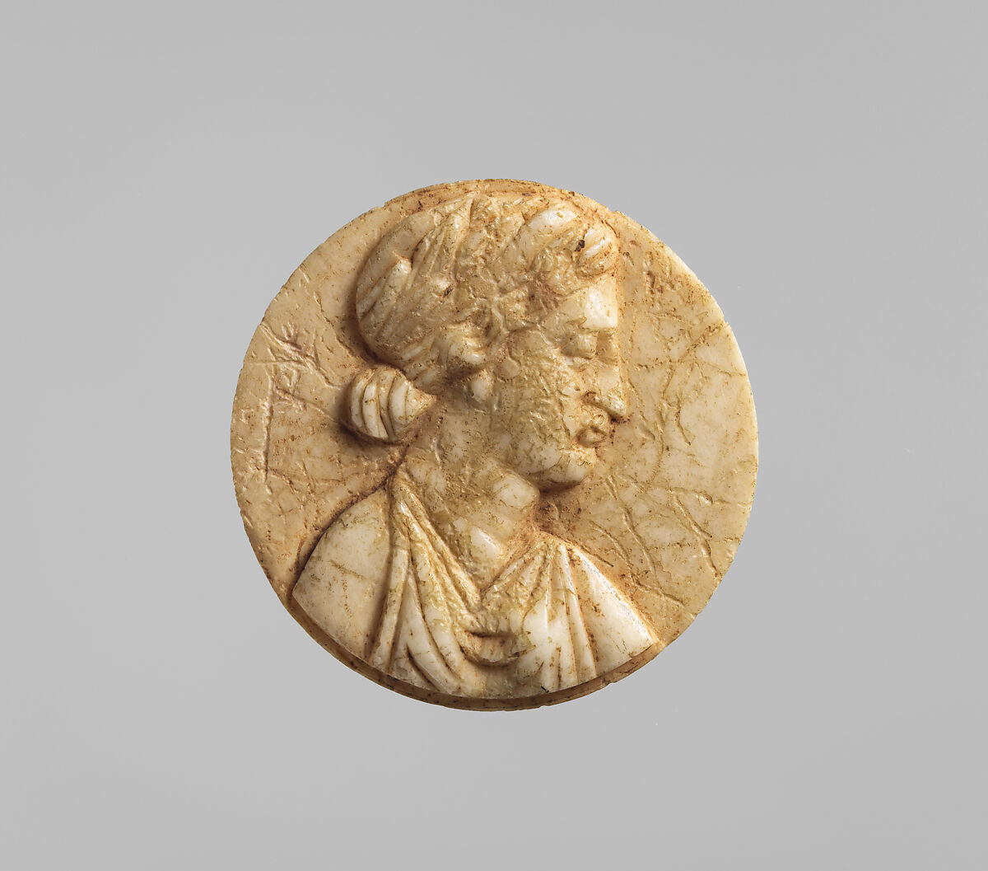
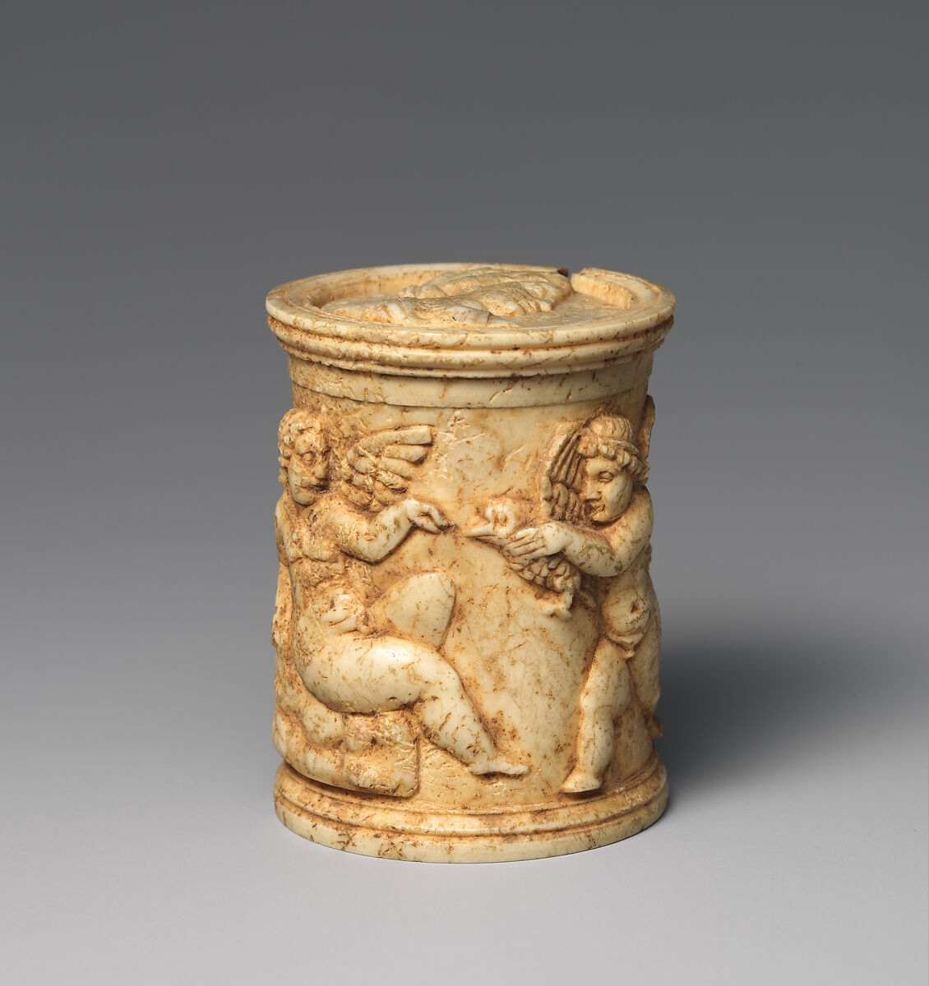
Ivory pyxis (box with lid), Early Imperial, 1st century AD, Ivory, Height: 5.1 cm, Diam.: 4 cm, the MET, NY, USA https://www.metmuseum.org/art/collection/search/251403

Slide 8
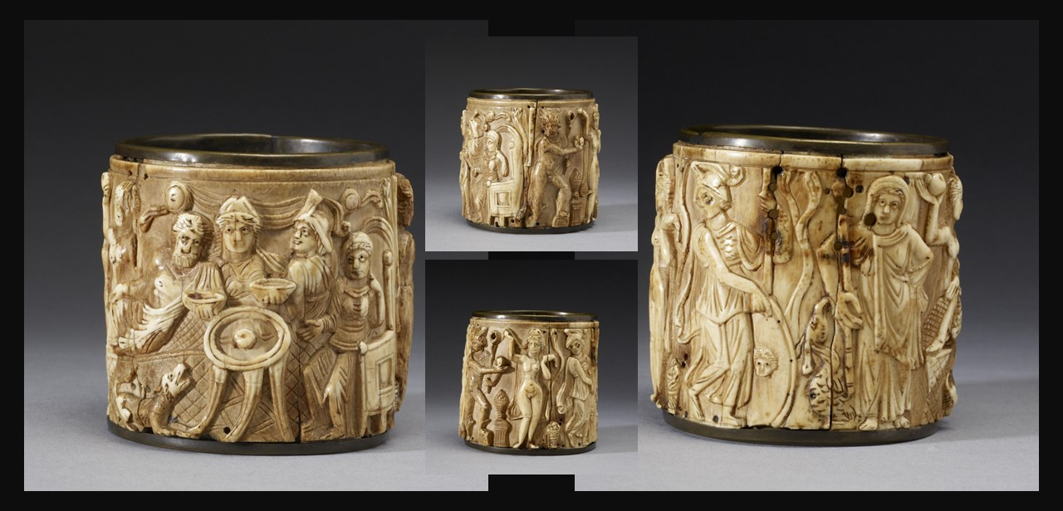
Circular Pyxis with Mythological scenes, 5th-6th century, from Egypt, Ivory, 8.5 x 9.1 cm, The Walters Art Gallery, Baltimore, USA https://art.thewalters.org/object/71.64/

Slide 9
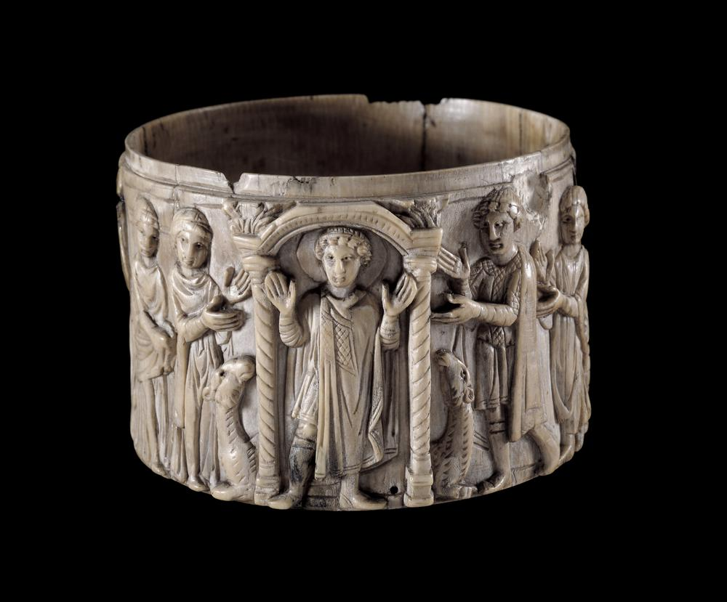
Pyxis with Saint Menas and Camels, Byzantine period, 6th century AD, Ivory, Height: 79 mm, British Museum, London, UK

Slide 10
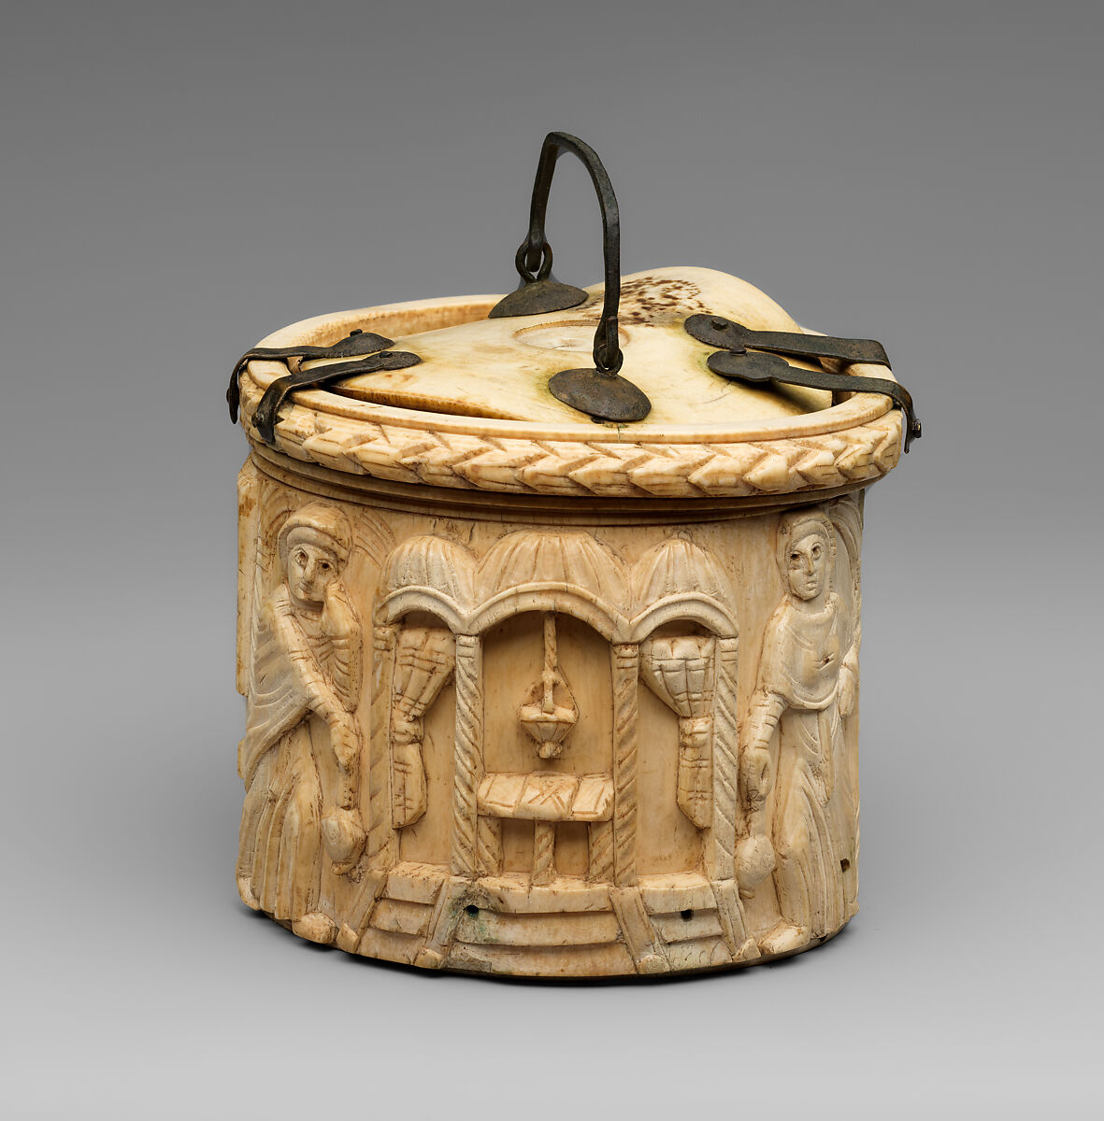
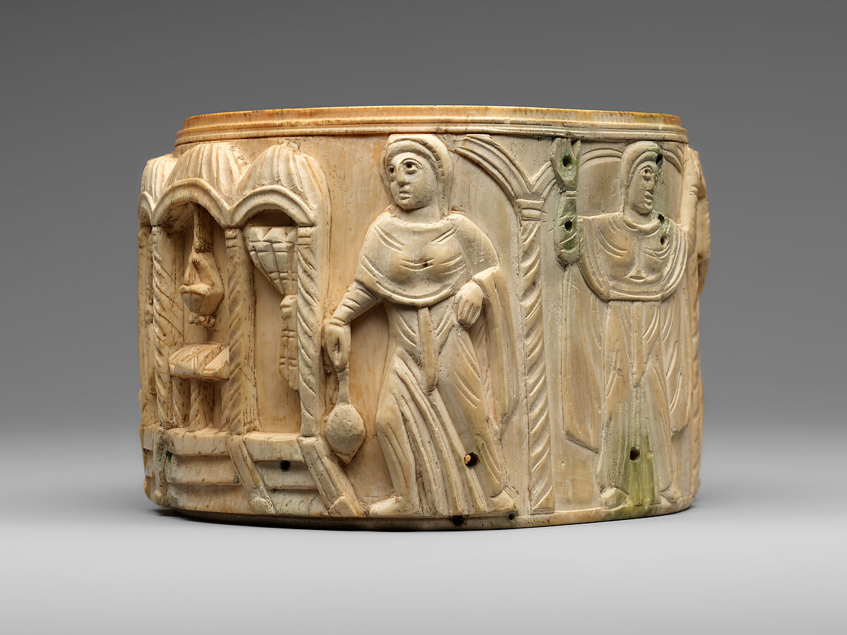
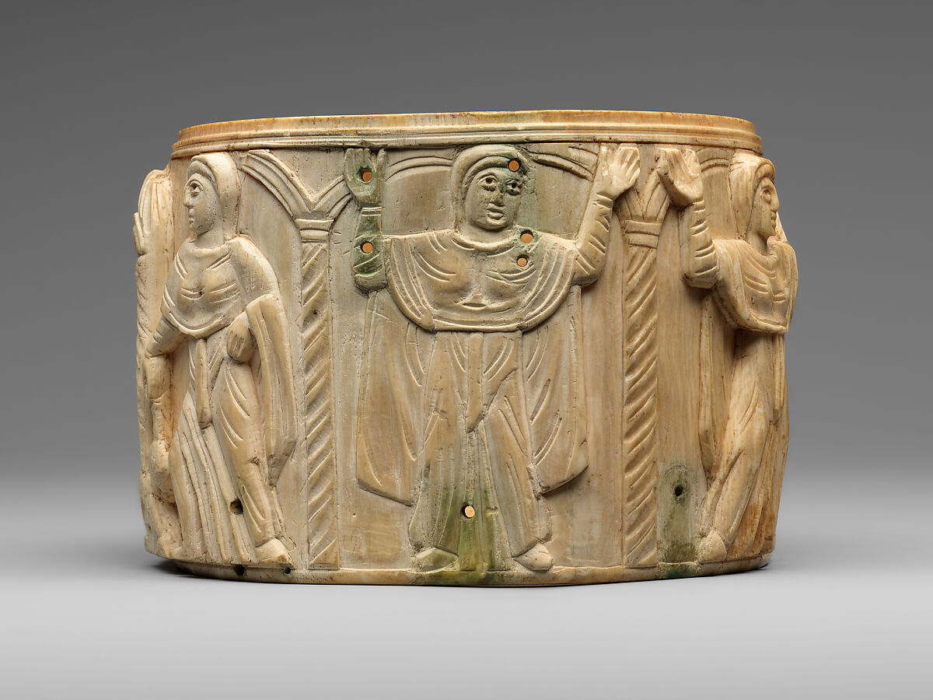
Circular Box (Pyxis) with the Women at Jesus' Tomb, 500s, Byzantine period, Ivory, Overall (with lid): 10.8 x 12.7 x 12.1 cm, the MET, NY, USA https://www.metmuseum.org/art/collection/search/464499

Slide 11
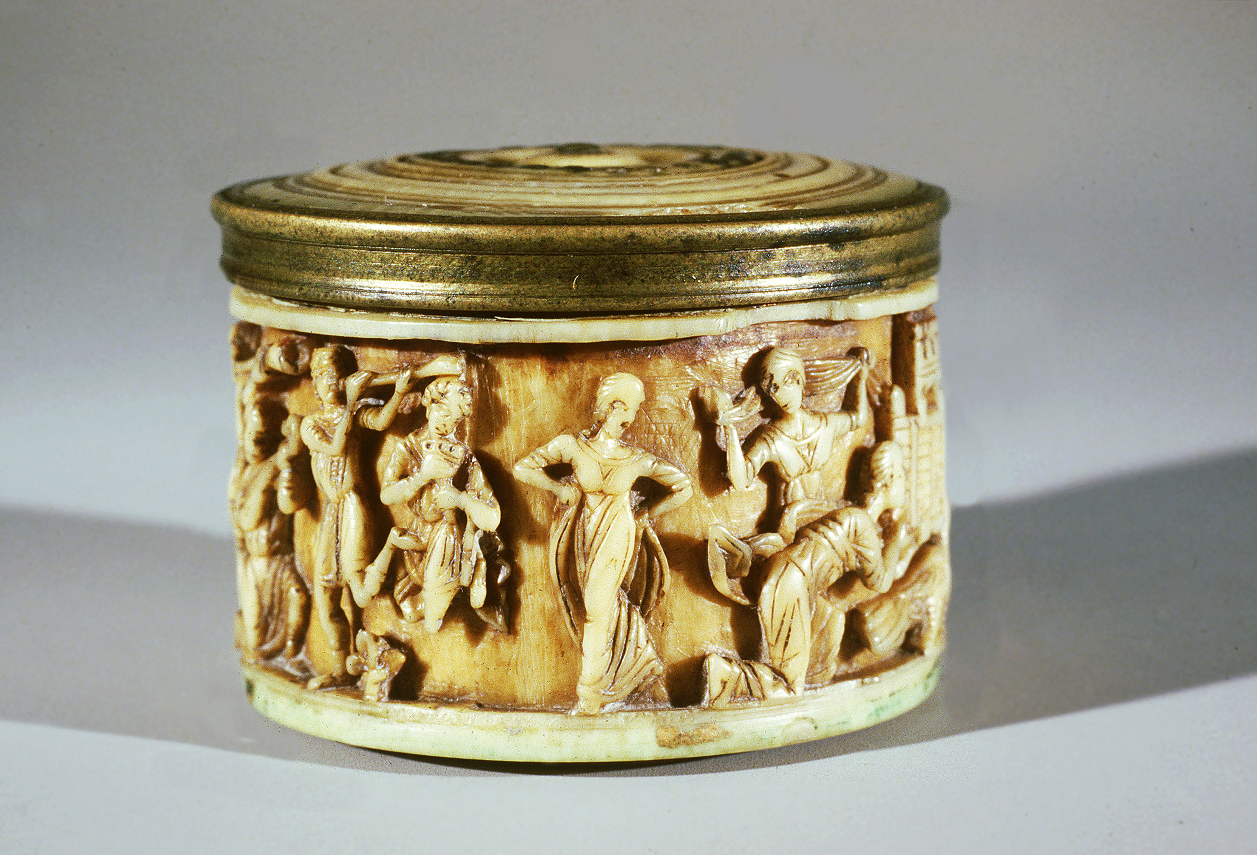
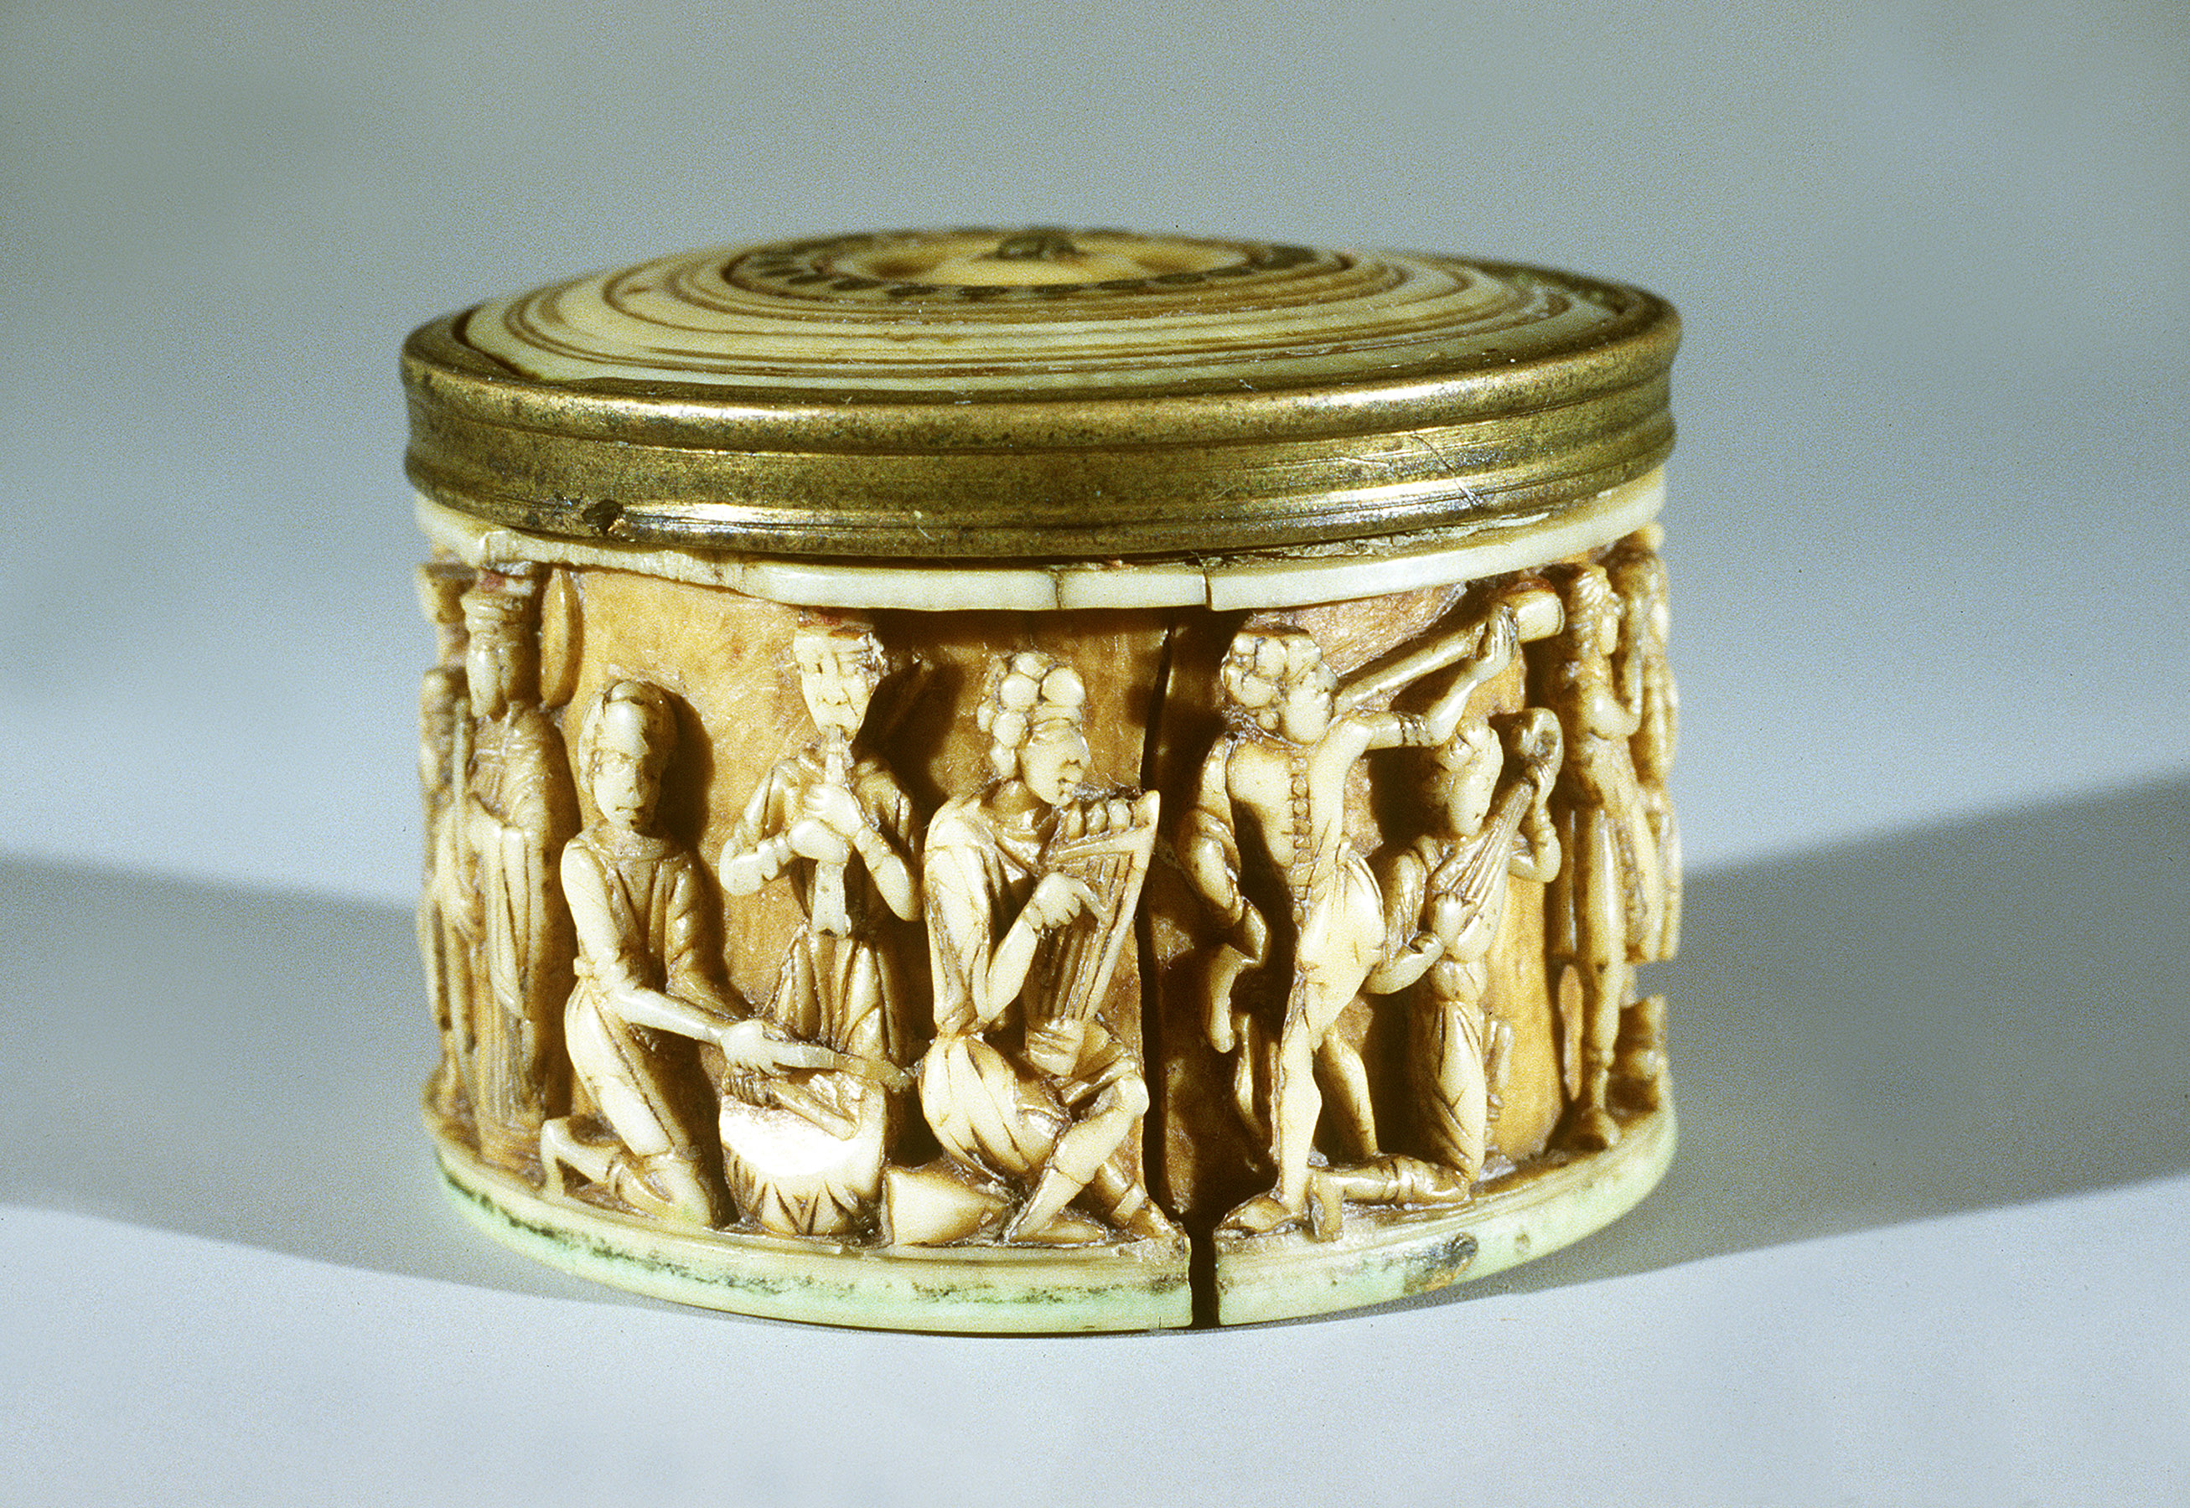
Pyxis with Imperial Families and Ceremonial Scenes, Late Byzantine, 1403 – 1404, Ivory, 2.95x4.3 cm, Dumbarton Oaks, Washington DC, USA

