Slide 1
Aristophanes
Staging Ornithes (The Birds): Art, Costume, and Performance from Antiquity to Today

Slide 2
The Birds (Ornithes), first performed by Aristophanes in 414 BC at the Festival of Dionysus, is a comedy that departs from the playwright’s usual direct political satire while still reflecting the deep civic unease of late fifth-century Athens.
Against the backdrop of war and public disillusionment, the play imagines escape from human society through the fantastical creation of a city in the sky, Nephelokokkygia (“Cloudcuckooland”). Two Athenians, Pisthetairos and Euelpides, persuade the birds to build this new realm, but the dream of an egalitarian utopia quickly gives way to authoritarian control as Pisthetairos consolidates power. A series of intruders, poets, legal officials, and even divine envoys, are expelled, while the gods themselves are forced to negotiate when human worship is diverted. Pisthetairos ultimately marries Basileia, the embodiment of Zeus’ authority, symbolically assuming sovereignty over both mortals and immortals. What begins as comic fantasy thus becomes a sharp meditation on ambition, hubris, and the inescapability of human corruption, themes reinforced by the play’s parabasis, in which the chorus directly addresses the audience with satirical commentary on human behavior.

Slide 3
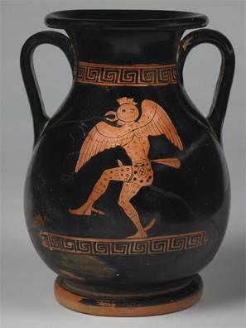
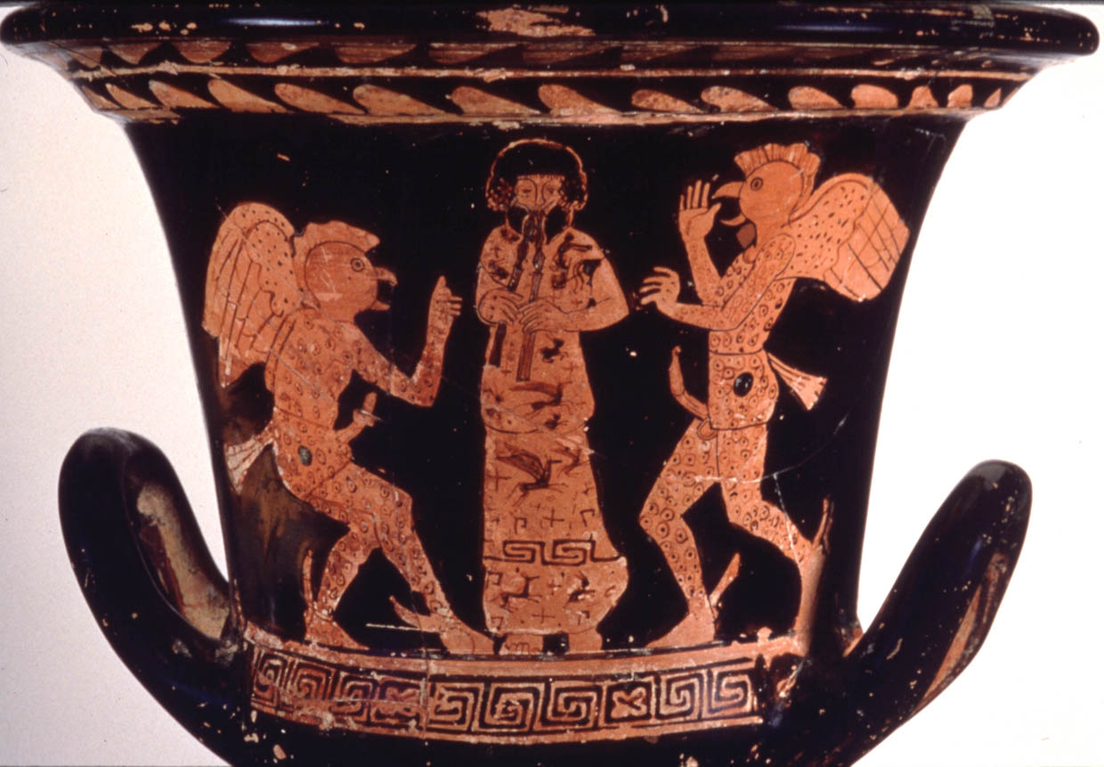
Red Figure Calyx Krater, ca 414 400 BC, probably inspired by Aristophanes the “Birds,” Getty Museum
Attic red-figured Pelike, c.425 BC, Michael C. Carlos Museum of Emory University

Slide 4
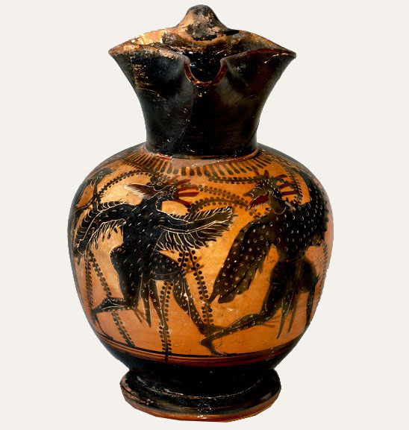
Black Figure Wine jug (oinochoe), ca. 480 BC, a chorus of men disguised as birds, London, British Museum

Slide 5
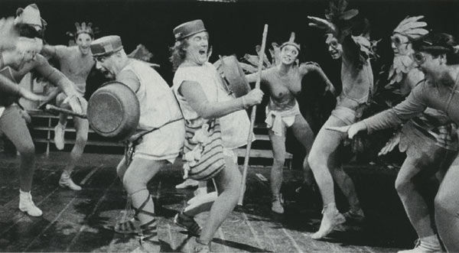
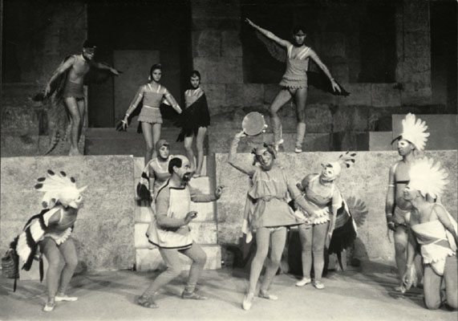
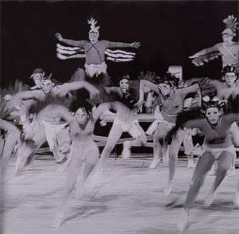
In 1959, a landmark modern interpretation of Aristophanes’ The Birds was presented at the Epidaurus Festival through the collaboration of four leading figures of twentieth-century Greek art. The production was directed by Karolos Koun, whose innovative approach reshaped the reception of ancient drama for contemporary audiences. The musical score was composed by Manos Hatzidakis, whose work brought a distinctive modern sensibility to the classical text. Visual identity was entrusted to Yannis Tsarouhis, who designed both the scenery and the costumes, while choreography was developed by Rallou Manou, integrating movement as a central expressive element. Together, these artists created a performance that has since assumed near-legendary status in the history of modern Greek theater.

Slide 6
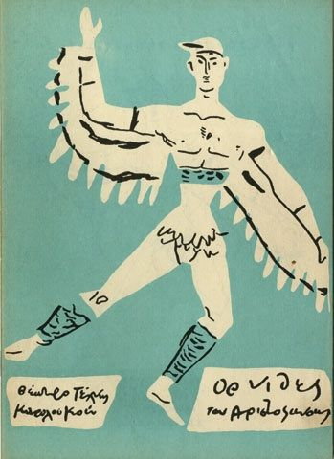
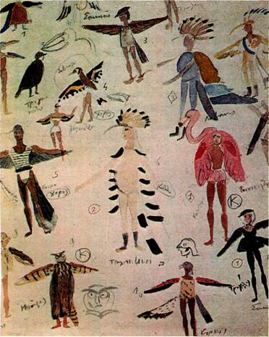
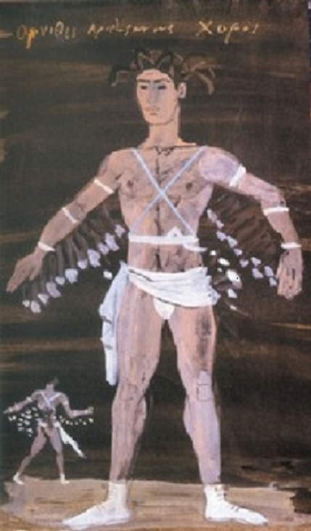
Yannis Tsarouhis Costume Designs for Aristophanes “Birds,” Festival of Epidaurus, 1959

Slide 7
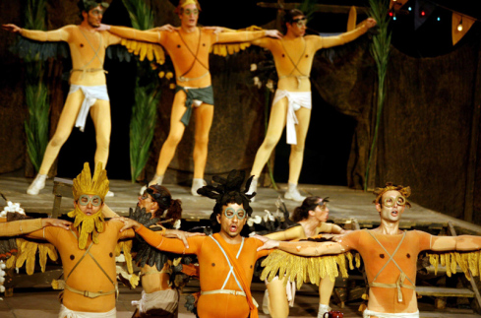

Slide 8
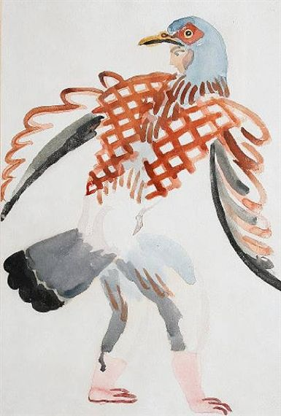
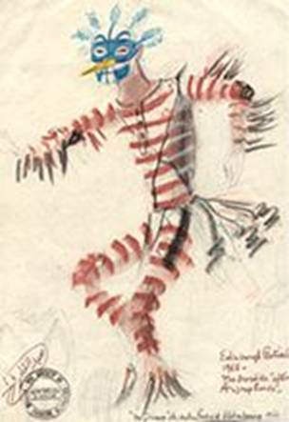
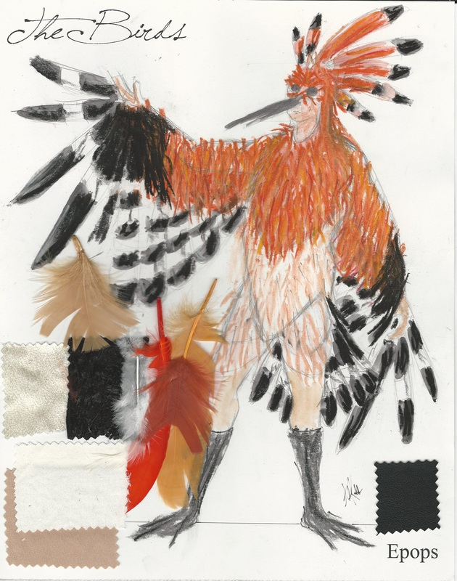
Costume Design from the Cambridge Production of Aristopanes 'THE BIRDS,' by Duncan Grant, 1923
Design by Abd' Elkader Farrah for the Birds, 1966, Edinburgh Festival
Costume Design for Hoopoe by Alex Kosbad http://akosbab.weebly.com/the-birds---aristophanes.html

Slide 9
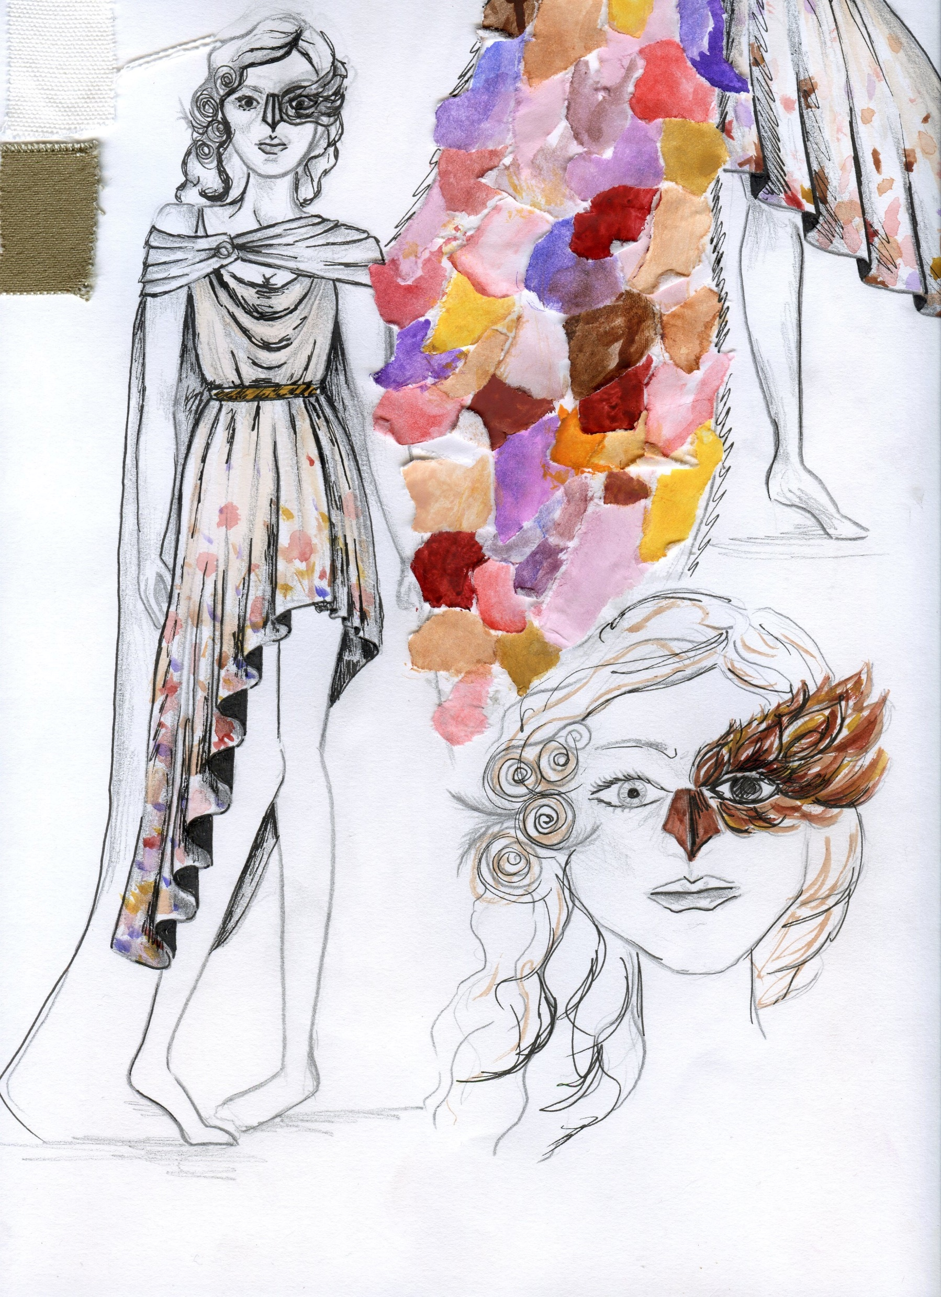
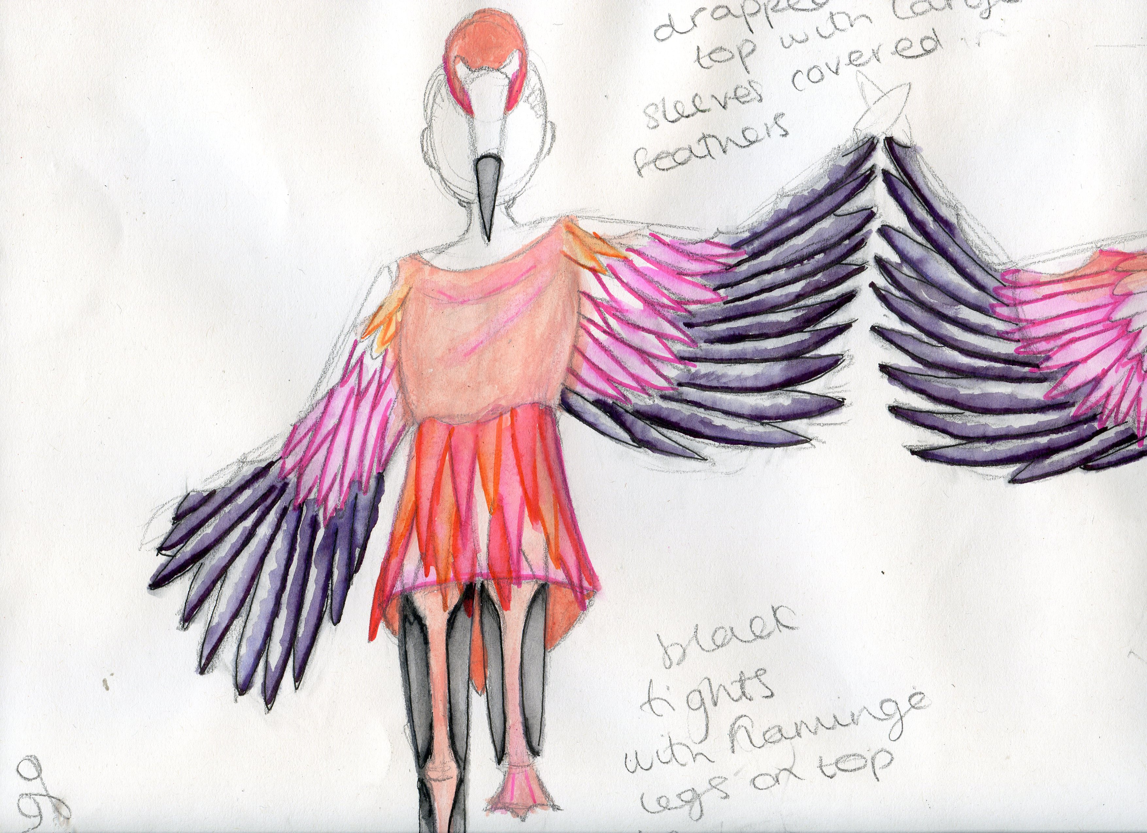
Costumes for the “Birds” by Jasmine Middleton

Slide 10
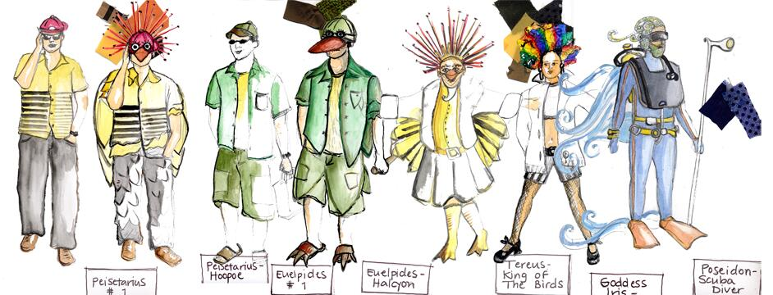
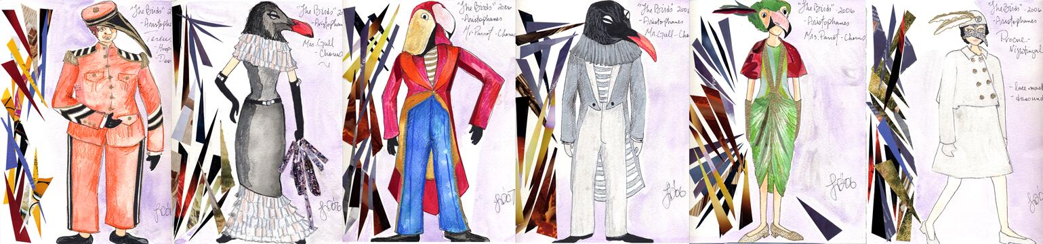
University of British
Columbia
The “Birds” was used as the basis of a term design project for senior Costume Design students. The group was asked to collect images of avian and human subjects that reflected both sides of the Birds cast of characters. Research was carried out about the birds that would have inhabited Greece in Aristophanes time.

Slide 11
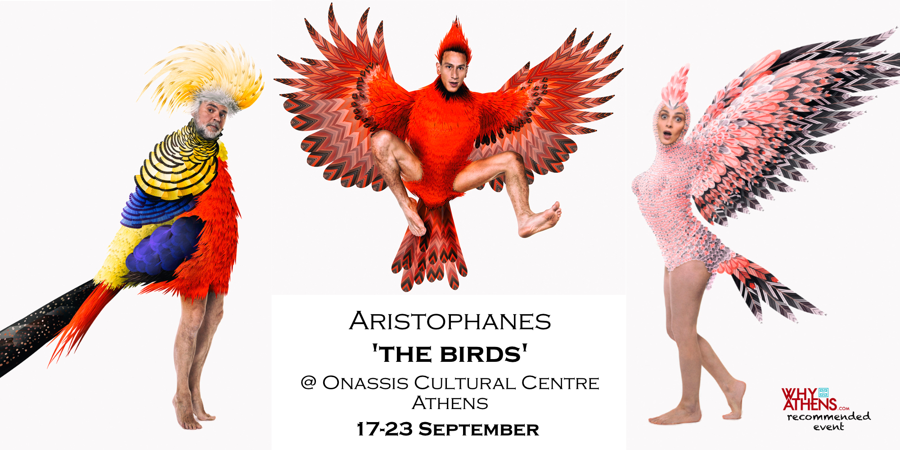
Nikos Karathanos, Aristophanes, the “Birds” https://www.onassis.org/

Slide 12
