Slide 1
Philip Wilson Steer
1860-1942

Slide 2
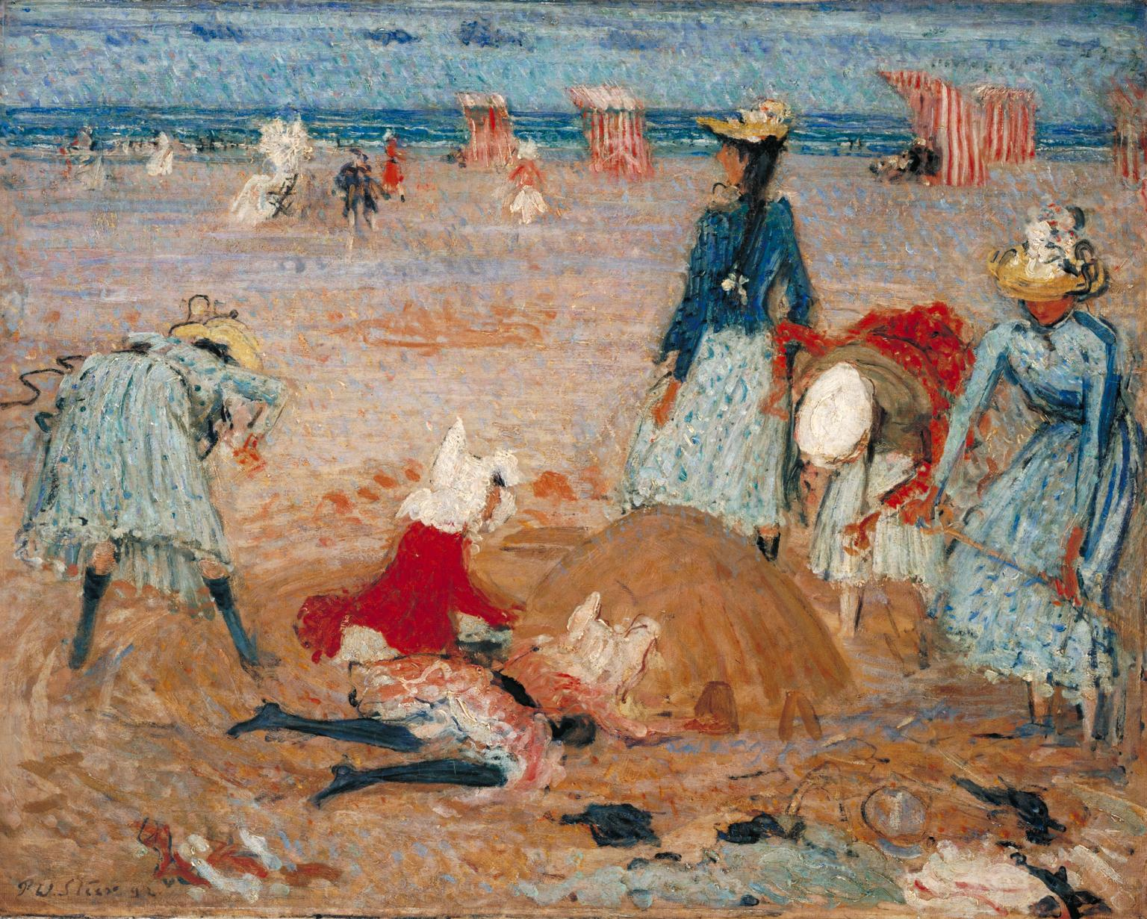
Boulogne Sands, 1888-90, Oil paint on canvas, 610 x 765 mm

Slide 3
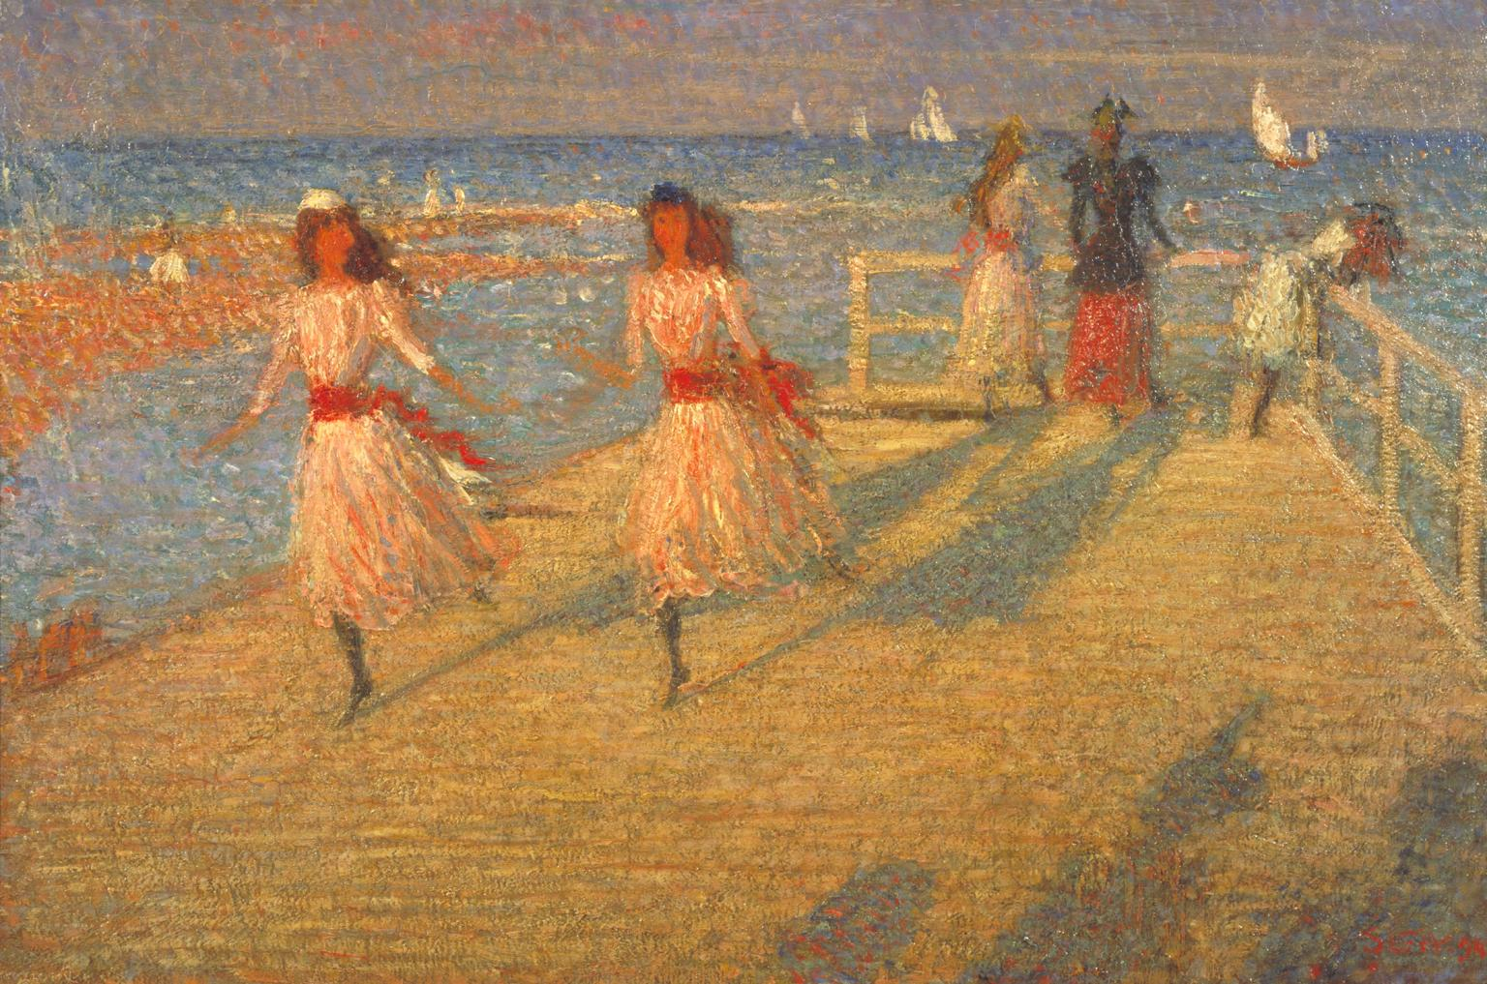
Girls Running, Walberswick Pier,
1888–94,
Oil paint on canvas,
629 x 927 mm

Slide 4
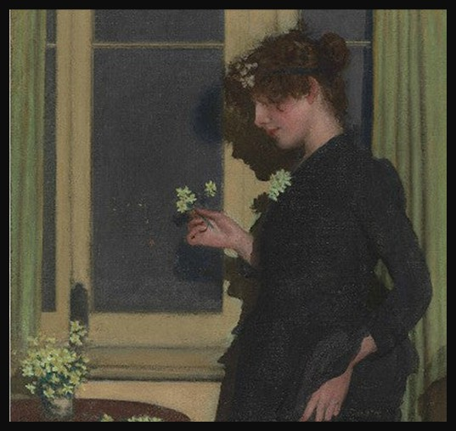
Jonquil, 1890, Oil on Canvas, 91.5x91.5cm, Private Collection

Slide 5
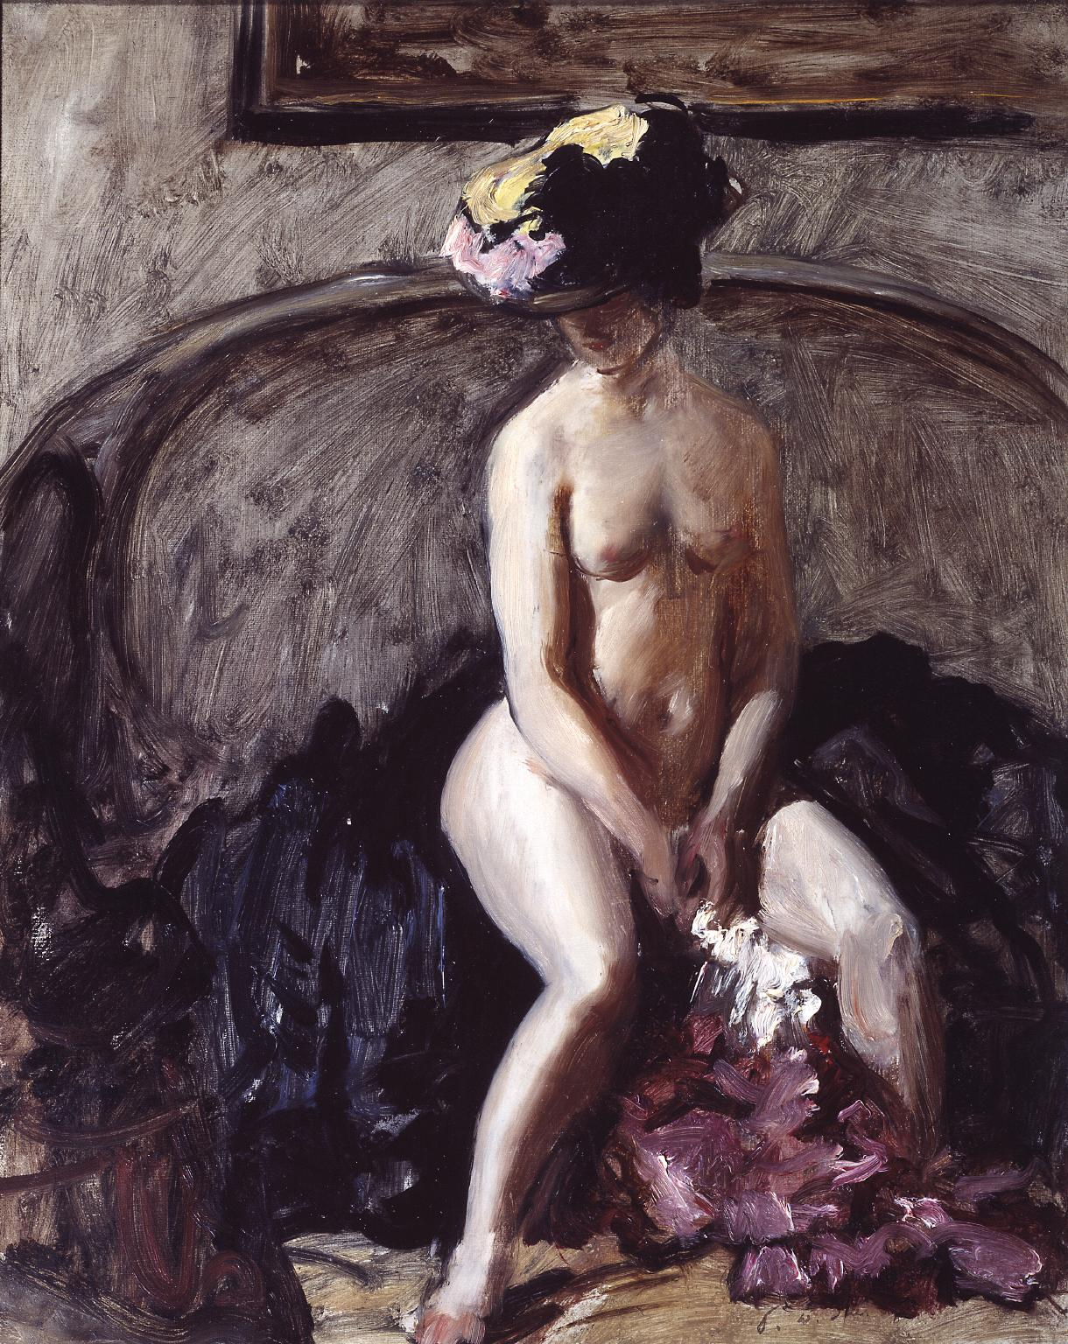
Seated Nude: The Black Hat, c.1900, Oil paint on canvas,
508 x 406 mm

Slide 6
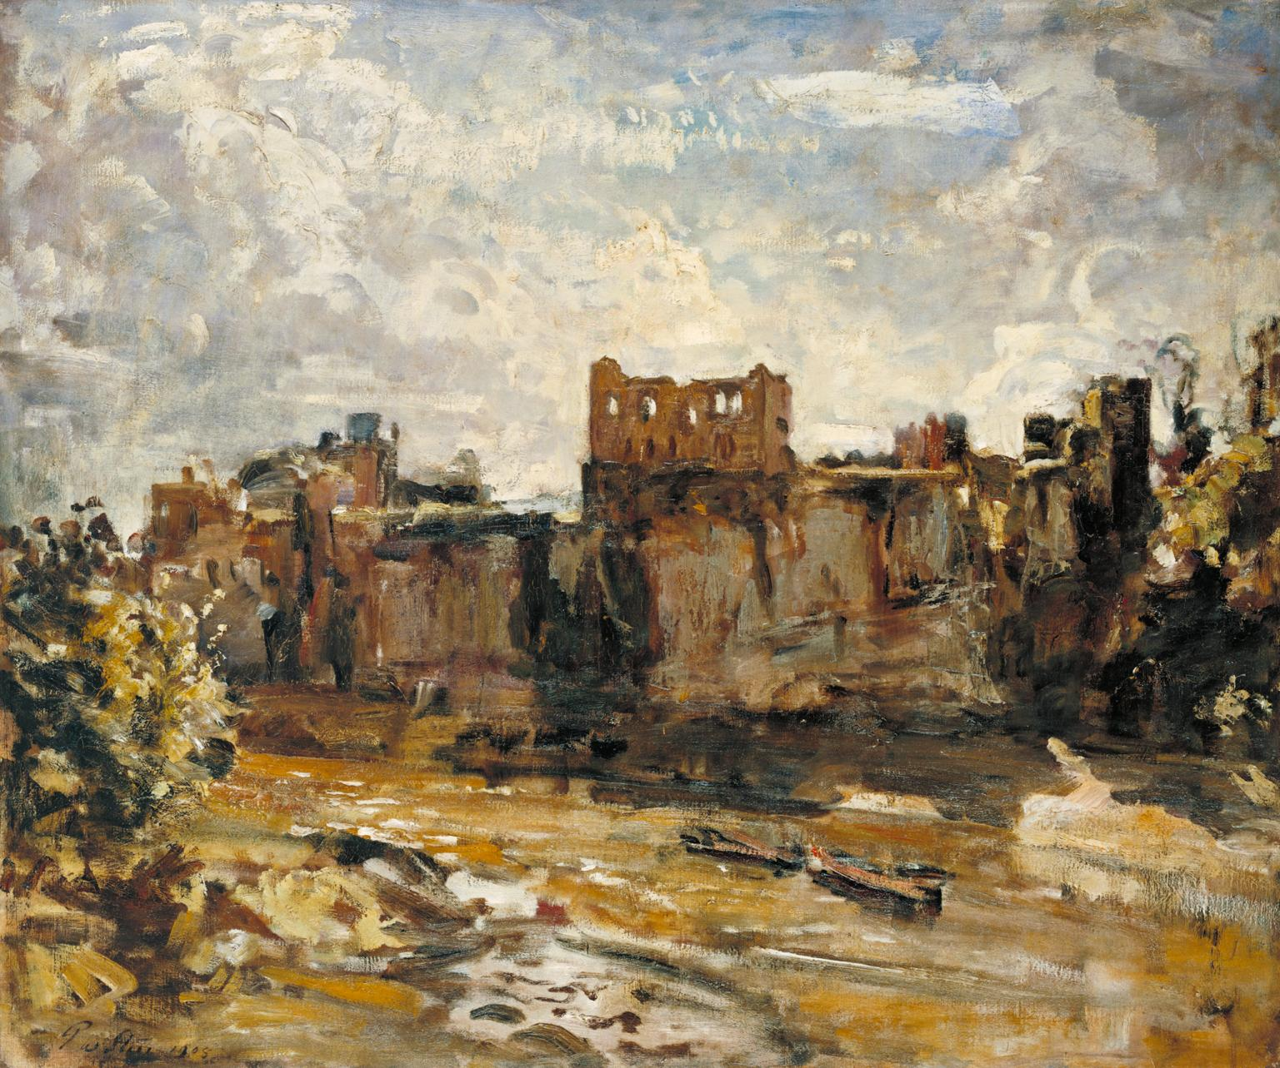
Chepstow Castle, 1905,
Oil paint on canvas,
765 x 918 mm

Slide 7
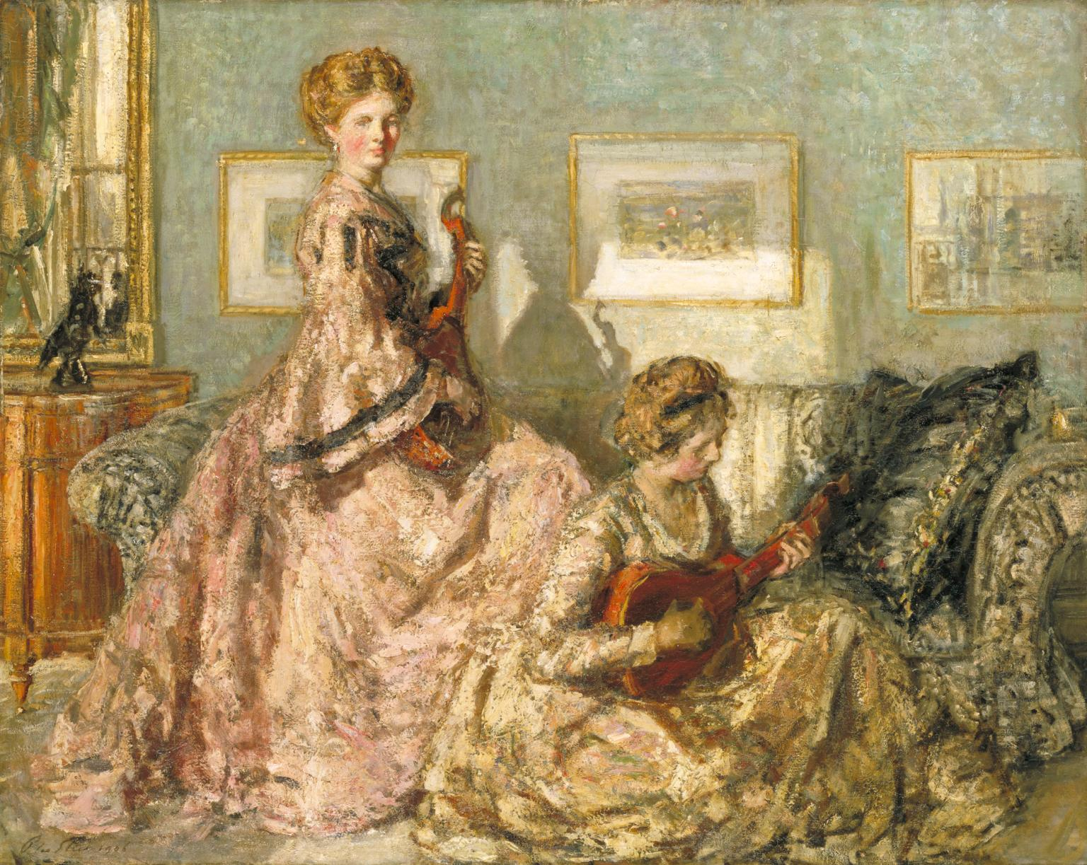
The Music Room, 1905–6, Oil paint on canvas, 1022 x 1270 mm

Slide 8
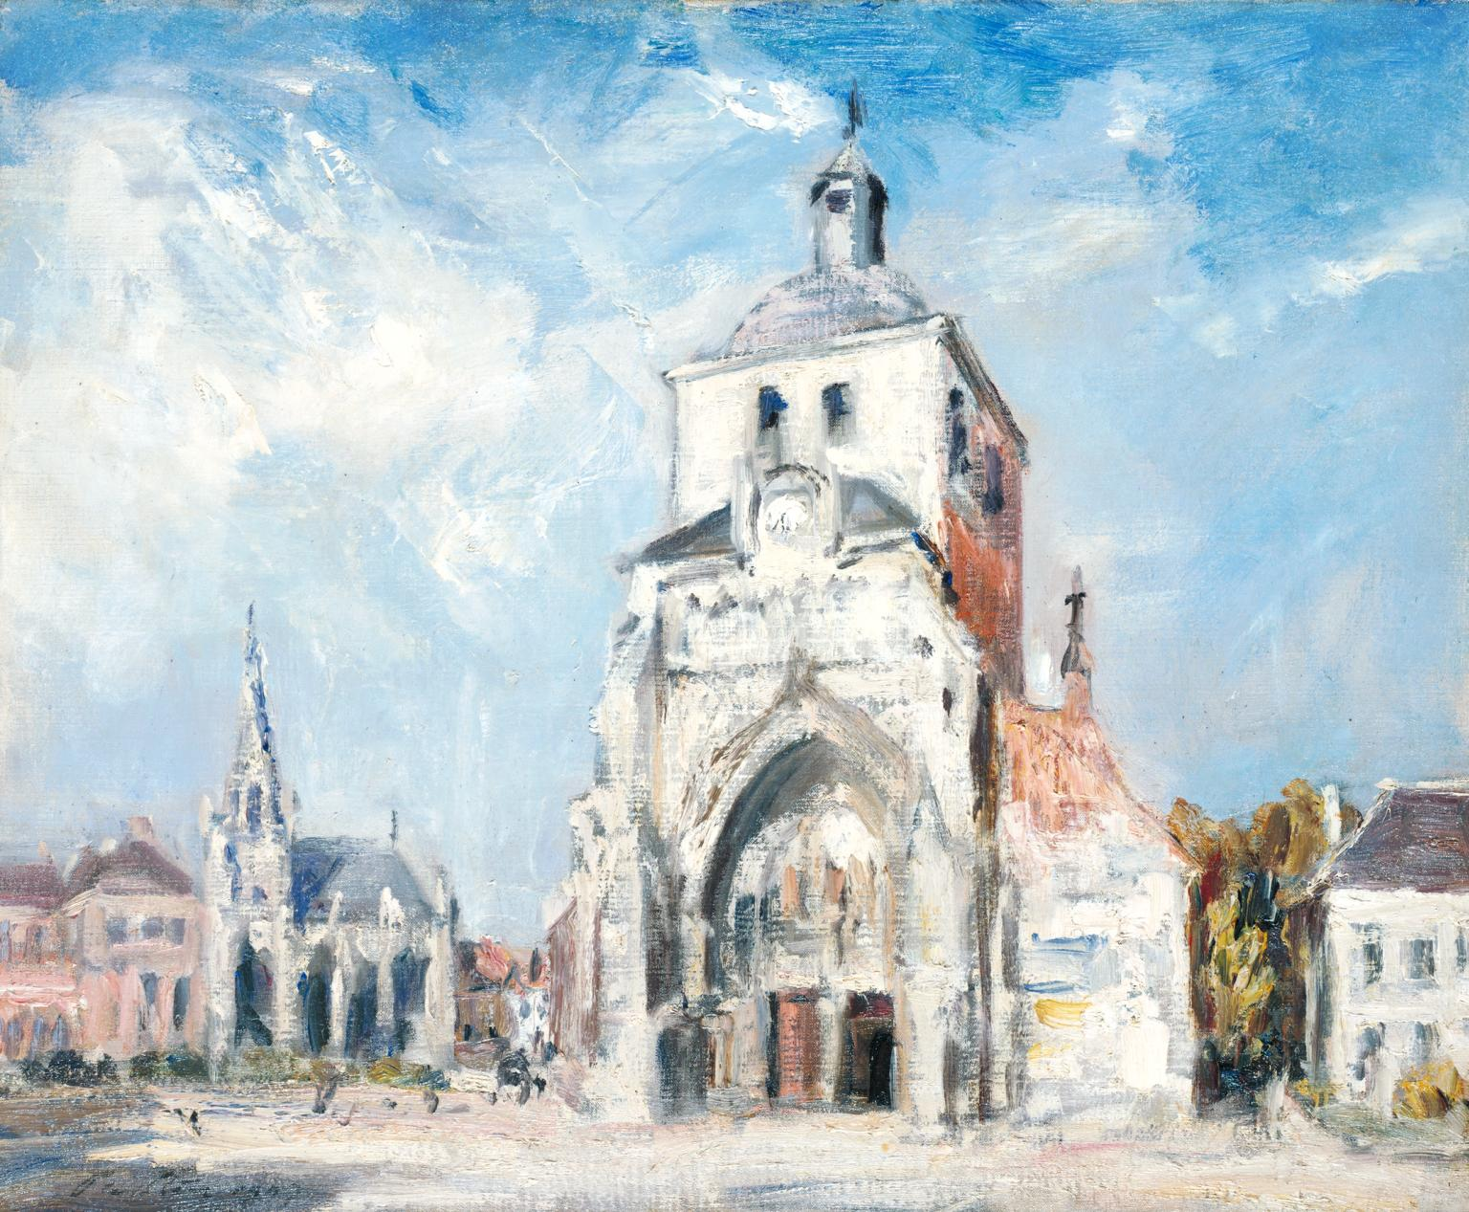
The Church at Montreuil, 1907, Oil paint on canvas, 502 x 610 mm

Slide 9
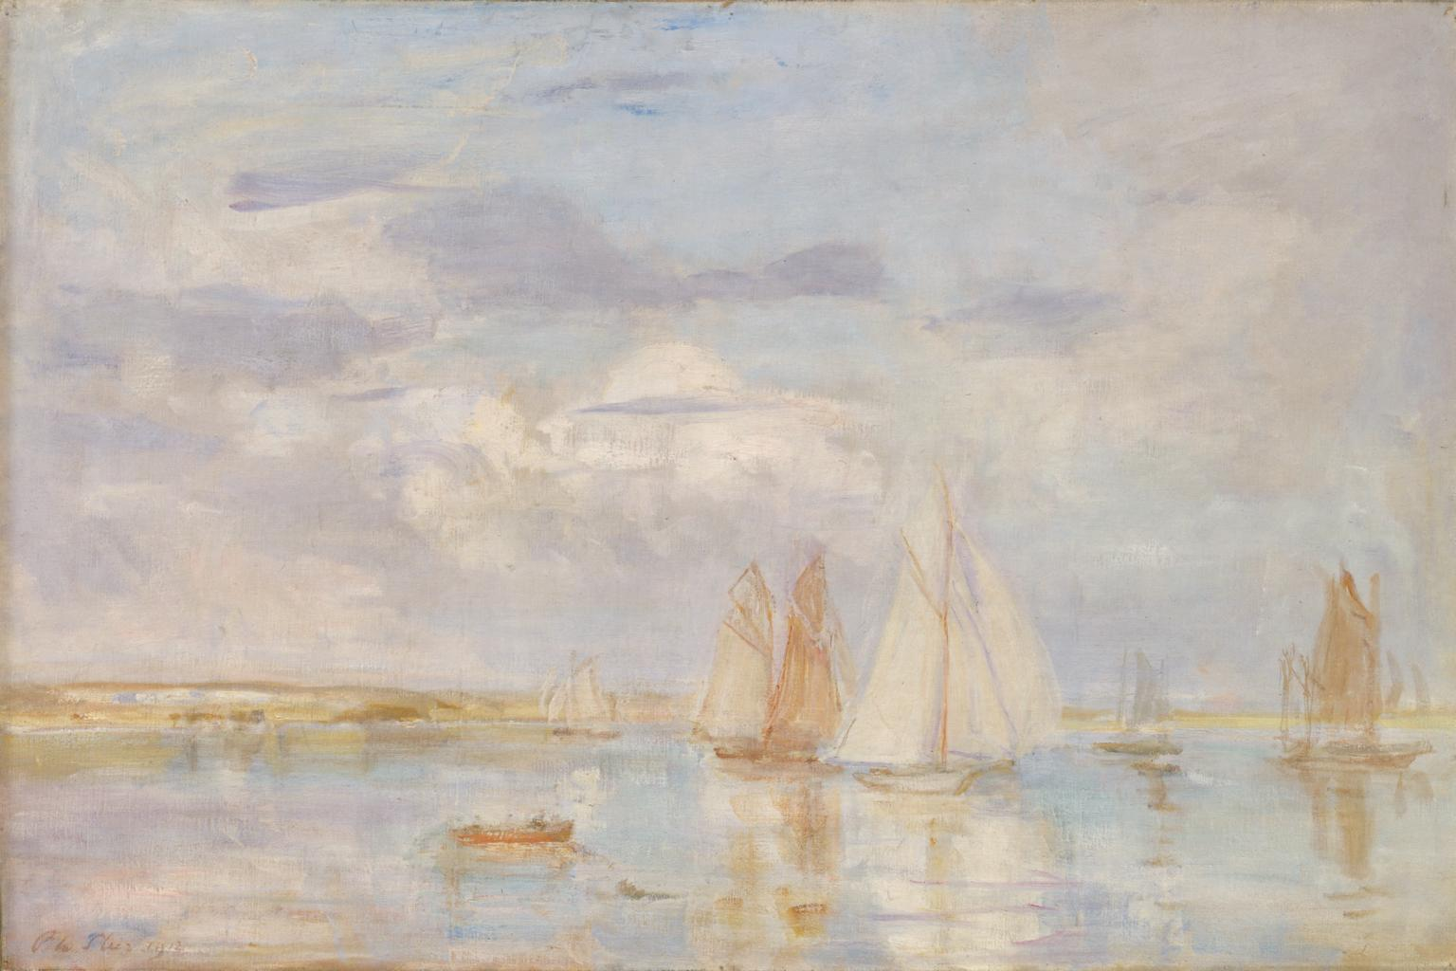
The White Ship, 1912, Canvas, 61×92

Slide 10
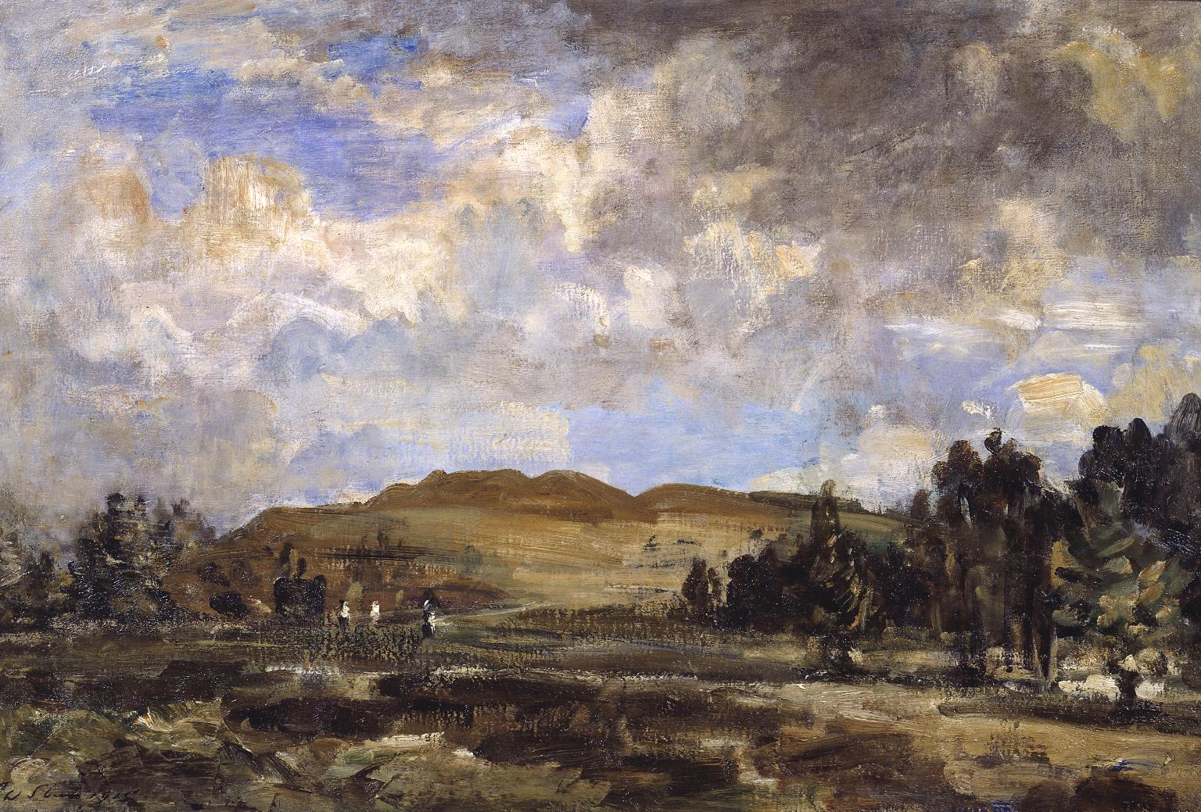
Painswick Beacon, 1915, Oil paint on canvas,
610 x 914 mm

Slide 11
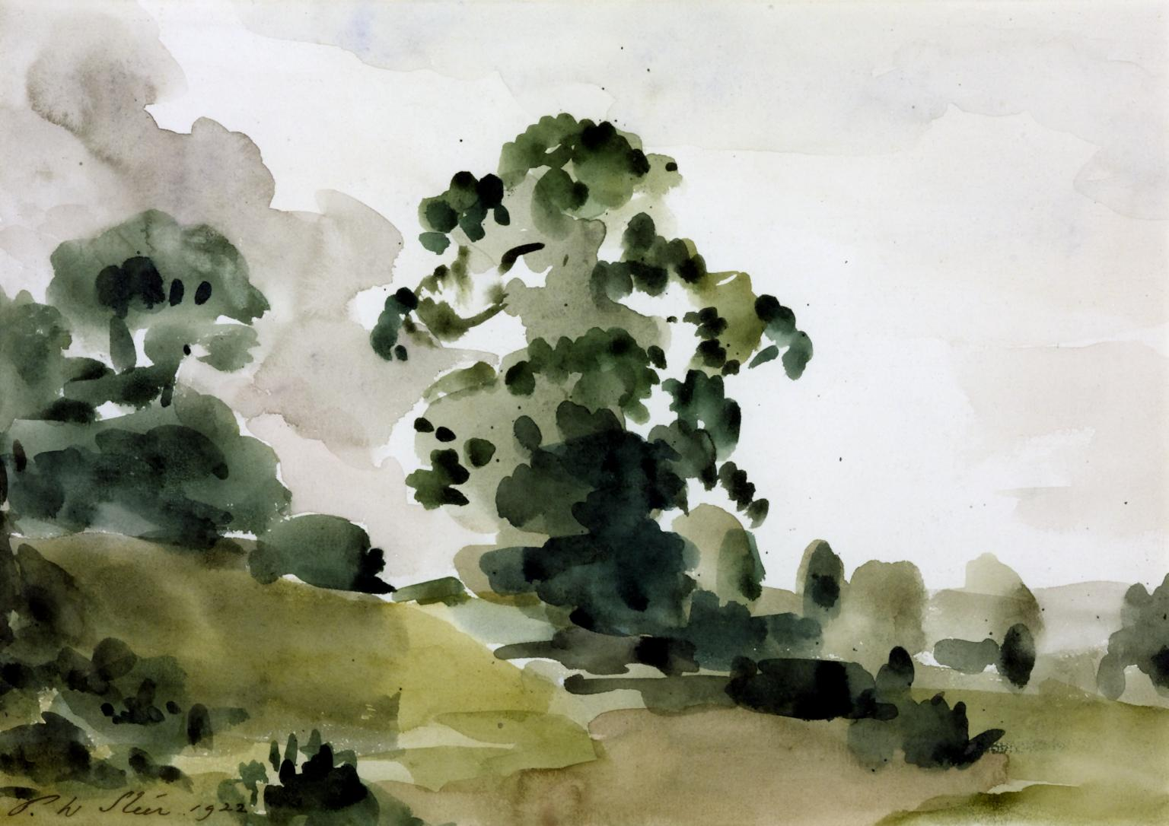
Elm Trees, 1922, Watercolour on paper, 232 x 327 mm

Slide 12
9 artworks featured are from the Tate Collection
Photo Credits: https://www.tate.org.uk/collection?aid=1990
Jonquil, 1890, Oil on Canvas, 91.5x91.5cm, Private Collection
Photo Credit: https://www.paulfrasercollectibles.com/blogs/art-photography/philip-wilson-steers-jonquil-will-lead-british-impressionist-art-sale?srsltid=AfmBOooN3TM25j_xhU_nVNGhK4y5qROs7_af7yFZ_Dpx-3wx8w8h2N41

