Slide 1
Mesopotamia’s Women Who Wrote History
All works shown in the Morgan Library & Museum exhibition “She Who Wrote: Enheduanna and Women of Mesopotamia, ca. 3400–2000 BC.”

Slide 2
‘The exhibition She Who Wrote: Enheduanna and Women of Mesopotamia, ca. 3400–2000 BC, was on view at the Morgan Library & Museum in New York from October 14, 2022, through February 19, 2023. Co-curated by Sidney Babcock, Jeannette and Jonathan Rosen Curator and Department Head, Ancient Western Asian Seals & Tablets, and Erhan Tamur, the exhibition brought together for the first time a comprehensive selection of artworks from the British Museum, the Louvre, the Staatliche Museen zu Berlin, Vorderasiatisches Museum, and the Penn Museum, among others, that capture rich and shifting expressions of women’s lives in ancient Mesopotamia during the 3rd millennium BC.’ https://www.penn.museum/sites/expedition/goddesses-mothers-rulers/

Slide 3
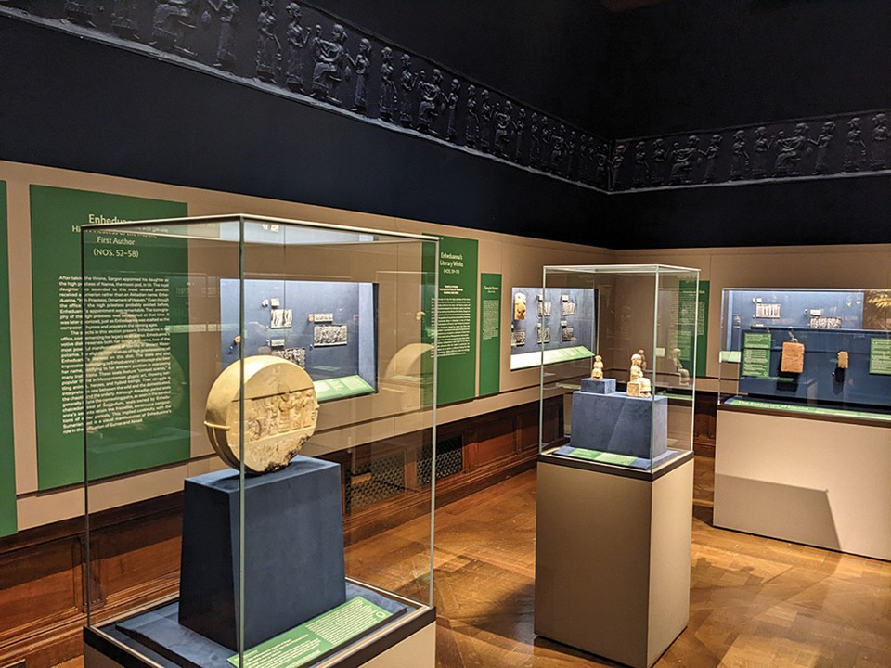
She Who Wrote: Enheduanna and Women of Mesopotamia, ca. 3400–2000 BC
View of the Morgan Library and Museum Exhibition at New York, USA https://ajaonline.org/museum-review/4785/

Slide 4
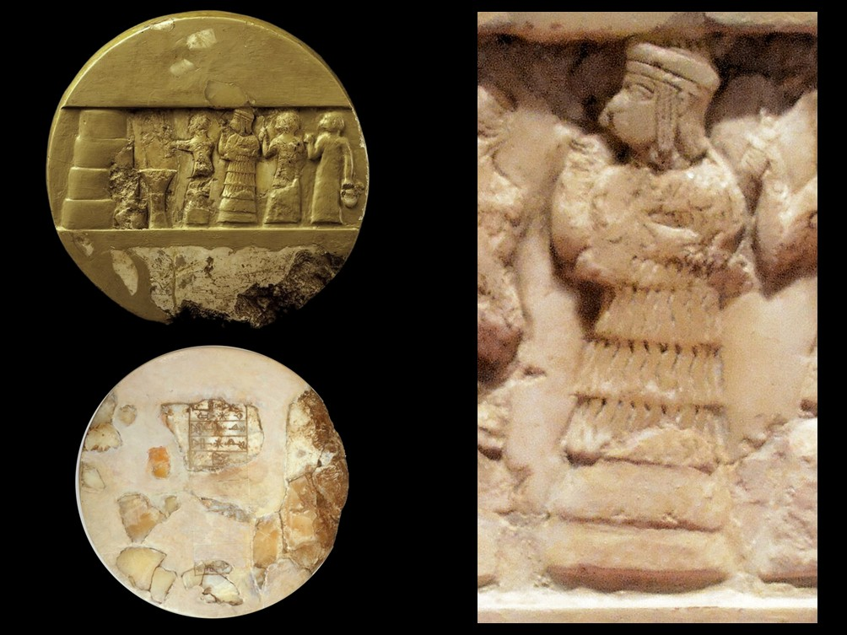
Disk of Enheduanna, daughter of Sargon, on one side is a panel wherein is carved in relief a scene of sacrifice, on the other an inscription of Enheduanna, Akkadian period, ca. 2300 BC, Alabaster, Diameter 25 cm, Depth: 7 cm, University of Pennsylvania Museum of Archaeology and Anthropology, Philadelphia, USA https://www.penn.museum/collections/object_images.php?irn=293415#image2 and https://en.wikipedia.org/wiki/Enheduanna

Slide 5
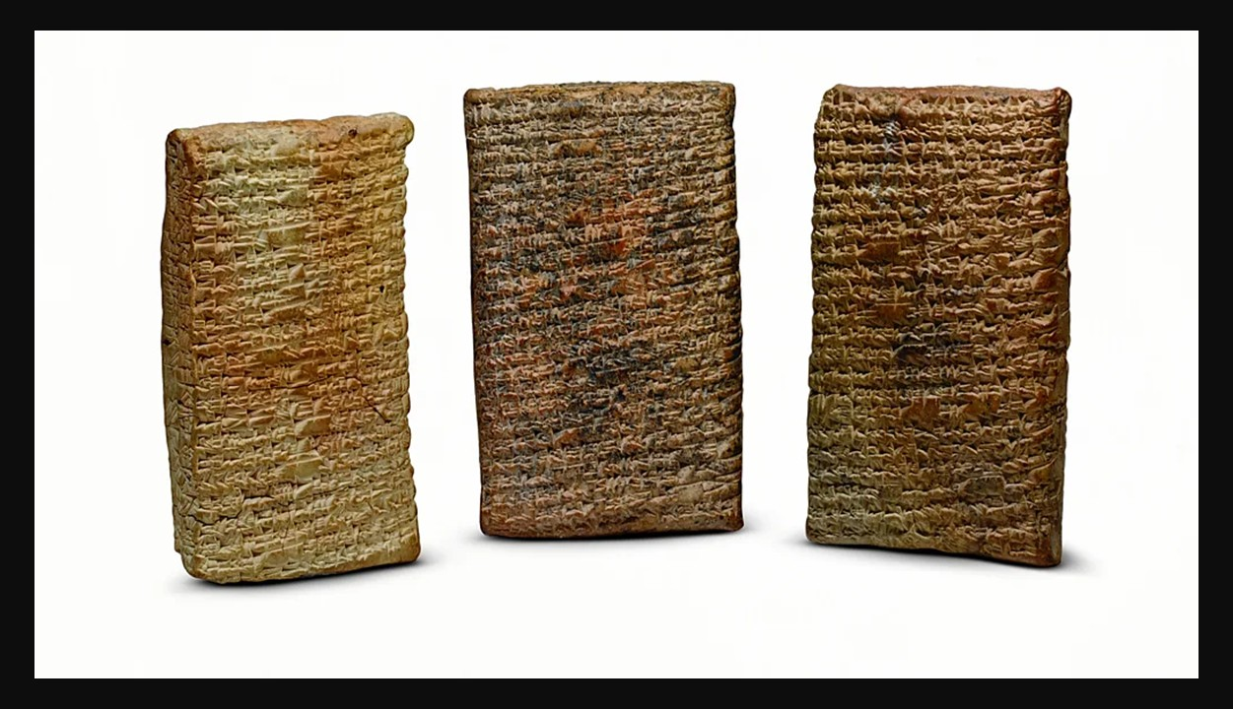
Tablets inscribed with "The Exaltation of Inanna" in three parts, Mesopotamia, possibly Larsa (modern Tell Senkereh), Old Babylonian period, ca. 1750 BC, Clay, Yale Babylonian Collection, Princeton University, USA https://www.themorgan.org/exhibitions/online/she-who-wrote/three-tablets

Slide 6
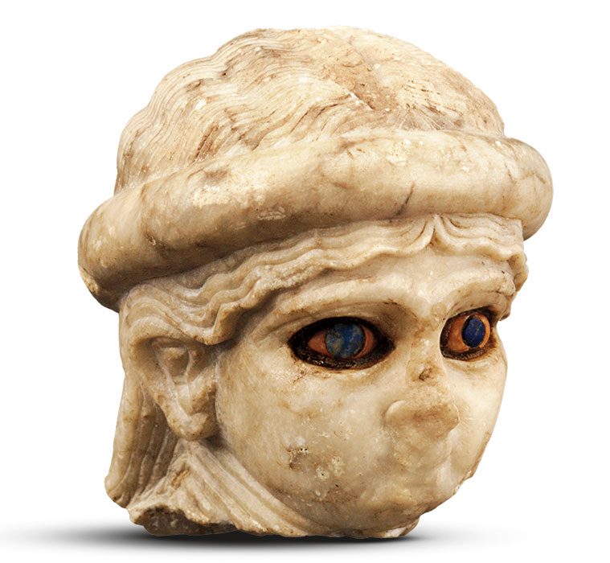
Head of a high priestess (?) with inlaid eyes, Mesopotamia, Akkadian, Ur, Akkadian period (ca. 2334–2154 BC), Alabaster, shell, lapis lazuli, and bitumen, University of Pennsylvania Museum of Archaeology and Anthropology, Philadelphia, USA https://www.themorgan.org/exhibitions/online/she-who-wrote/high-priestess

Slide 7
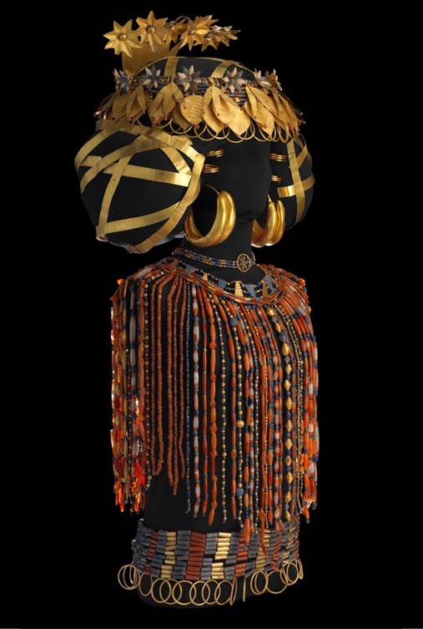
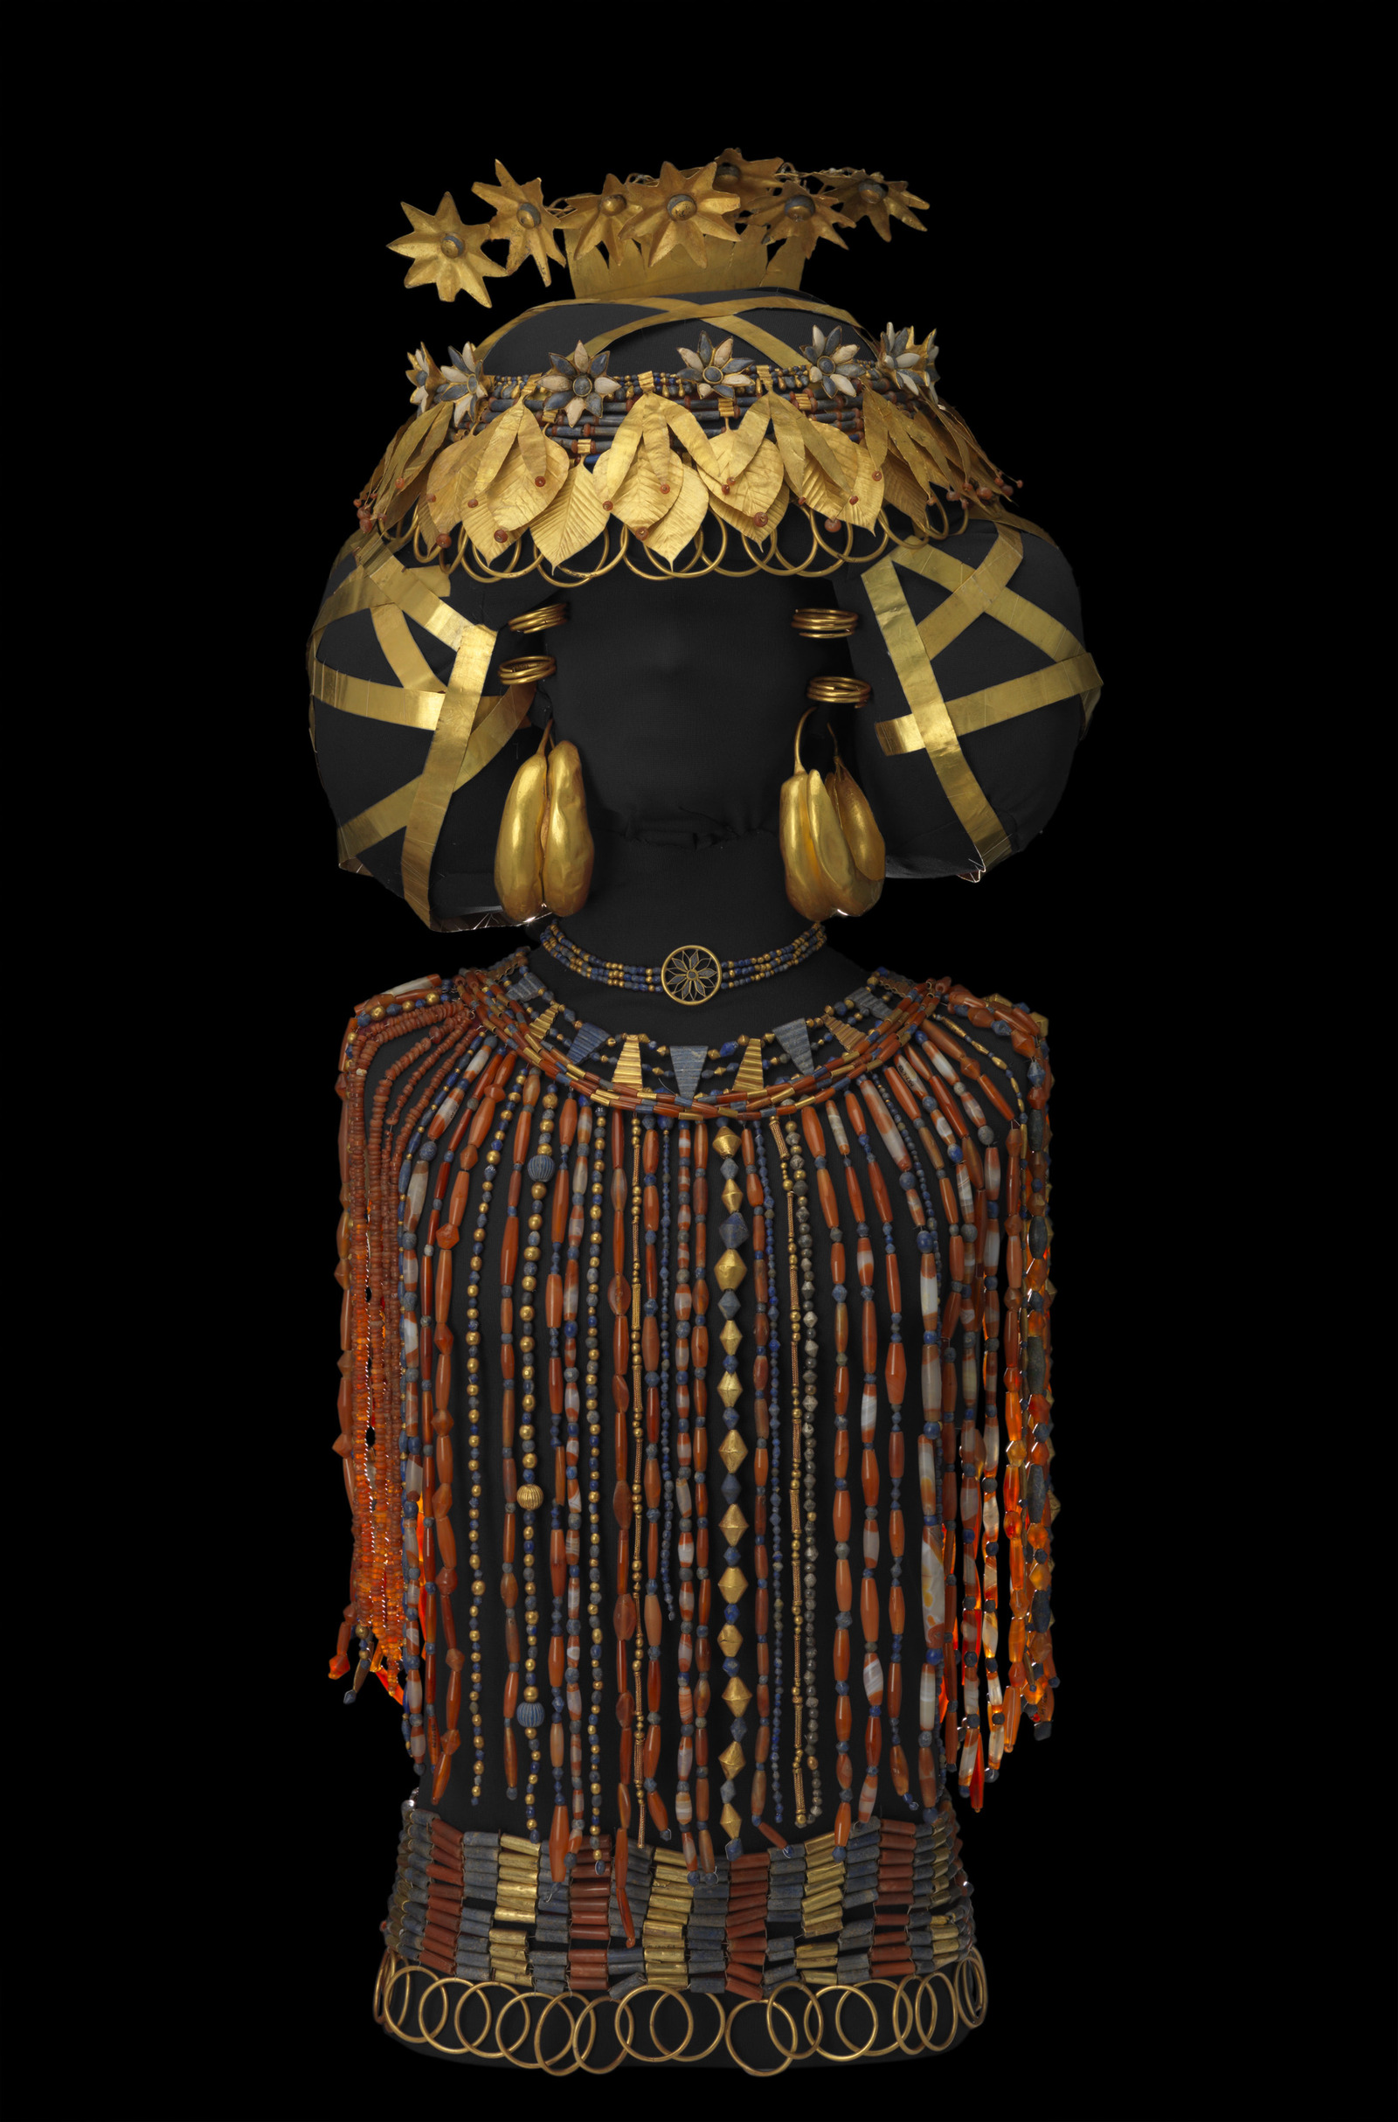
Queen Puabi’s funerary ensemble, Mesopotamia, Sumerian, Ur , Early Dynastic IIIa period, ca. 2500 BC, Gold, lapis lazuli, carnelian, silver, and agate, University of Pennsylvania Museum of Archaeology and Anthropology, Philadelphia, USA https://www.penn.museum/collections/highlights/neareast/puabi.php

Slide 8
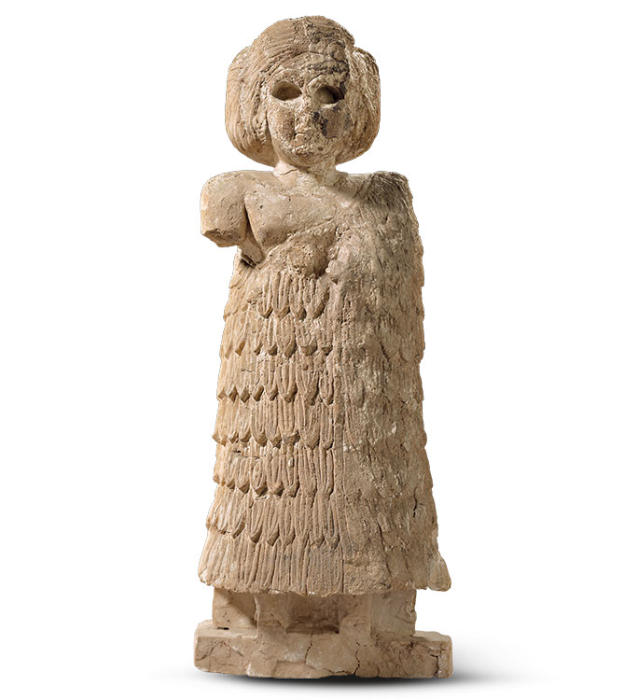
Standing female figure, Mesopotamia, Assur, Early Dynastic IIIb period, ca. 2400 BC, Alabaster, Staatliche Museen Zu Berlin, Vorderasiatisches Museum https://www.themorgan.org/exhibitions/online/she-who-wrote/standing-female-figure-234

Slide 9
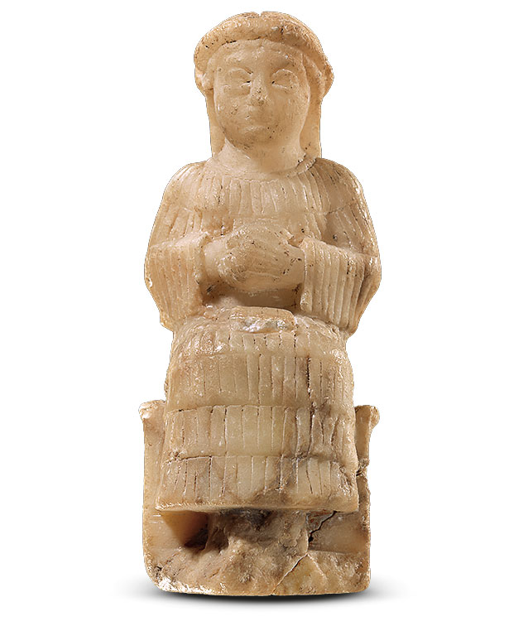
Seated female figure with tablet on lap, Mesopotamia, Neo-Sumerian
Ur III period (ca. 2112–2004 BC), Alabaster, Staatliche Museen Zu Berlin, Vorderasiatisches Museum, Germany https://www.themorgan.org/exhibitions/online/she-who-wrote/seated-female-figure-tablet

Slide 10
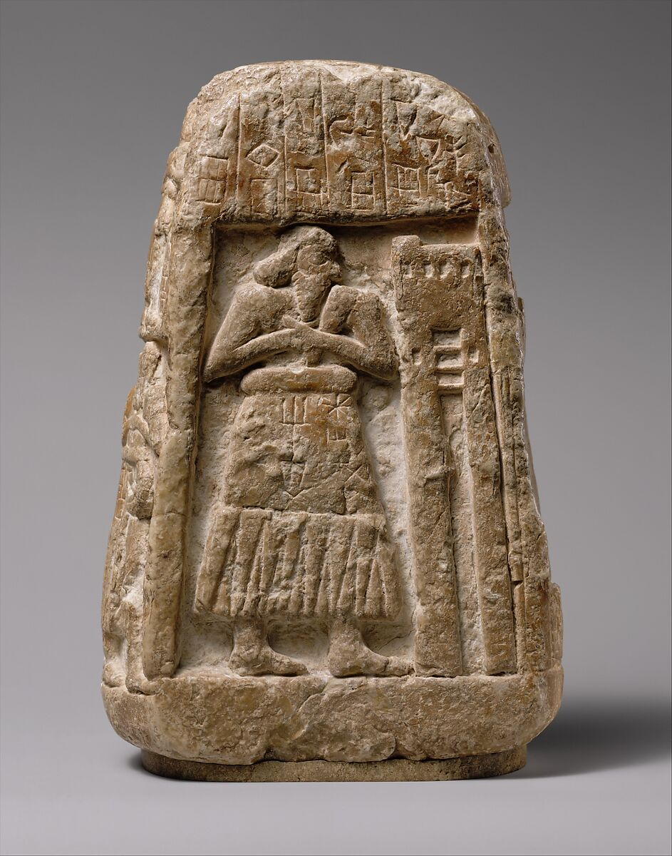
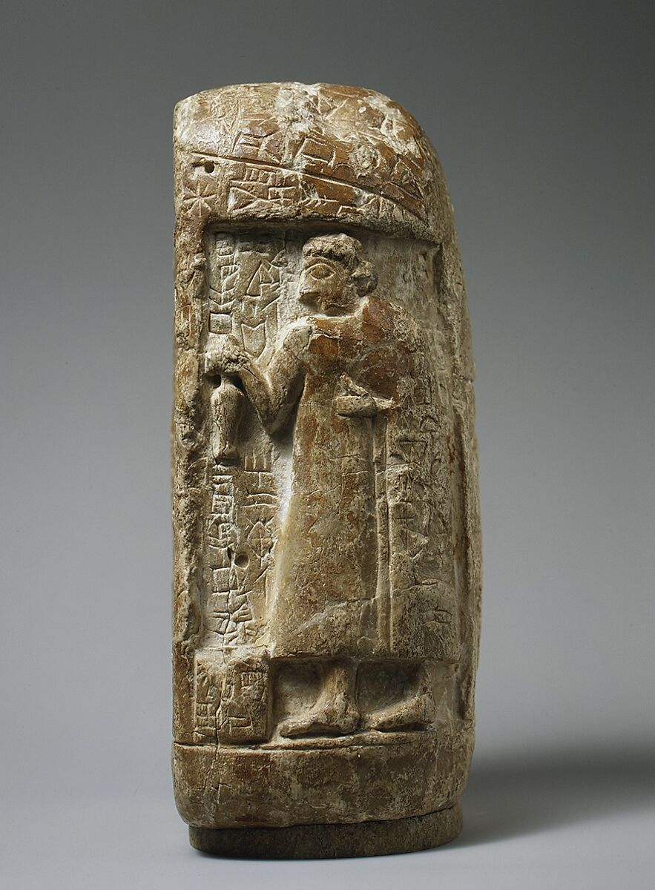
Stele of Shara-igizi-Abzu, The two principal figures—Ushumgal, a priest of the god Shara, and his daughter Shara-igizi-Abzu—face one another on two sides, Mesopotamia, Sumerian, possibly Umma, Early Dynastic I–II period, ca. 2900–2600 BC, Gypsum alabaster, the MET, NY, USA https://www.metmuseum.org/art/collection/search/329079

Slide 11
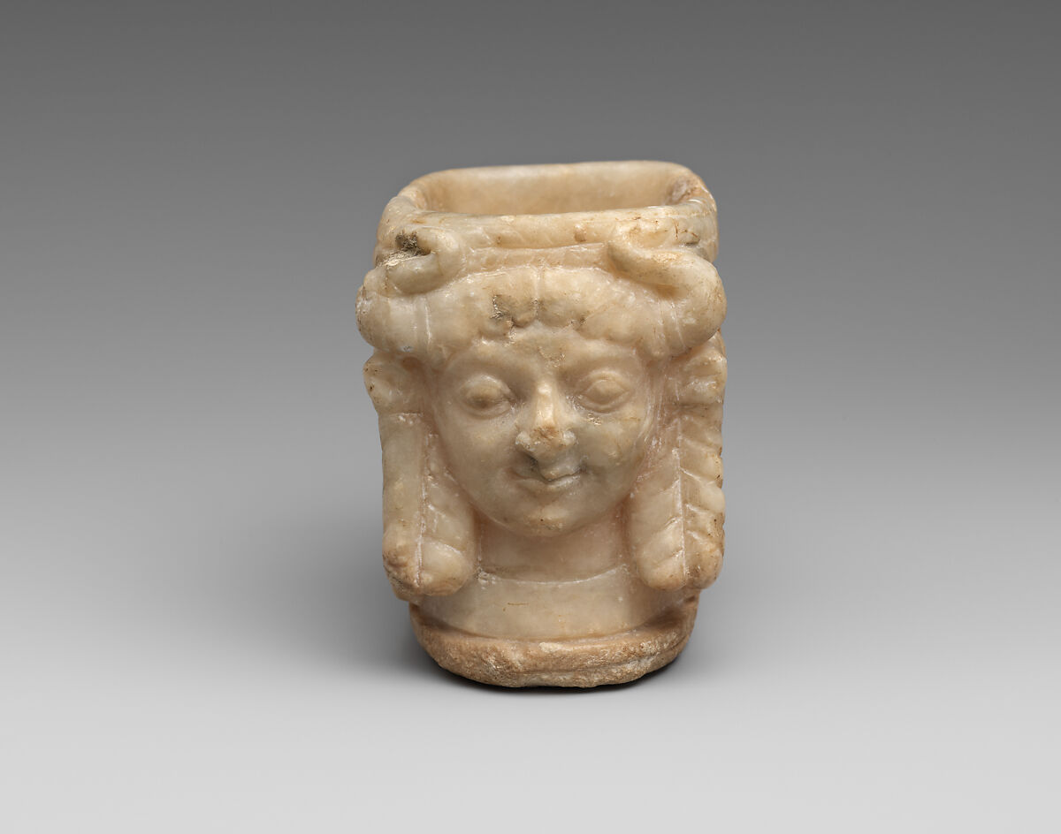
Vessel with faces of female deities, Mesopotamia, Sumerian, Early Dynastic IIIa period, ca. 2500 BC, Inscription largely abraded in antiquity, Gypsum alabaster, the MET, NY, USA https://www.themorgan.org/exhibitions/online/she-who-wrote/vessel-female-deities

Slide 12
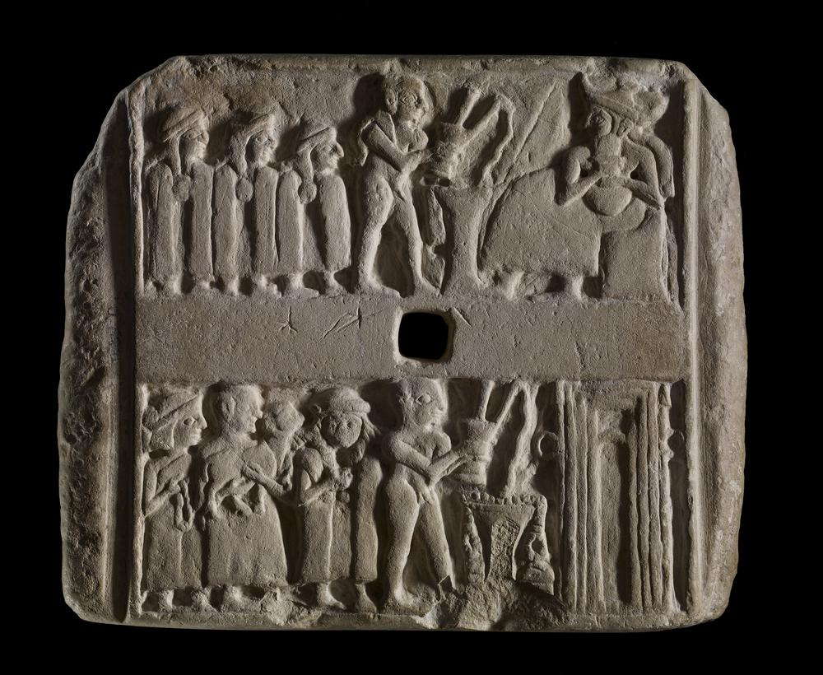
Wall plaque with libation scenes, Mesopotamia, Sumerian, Ur, Early Dynastic IIIa period, ca. 2500 BC, Limestone, The British Museum, London, UK https://www.britishmuseum.org/collection/object/W_1927-0527-34

Slide 13
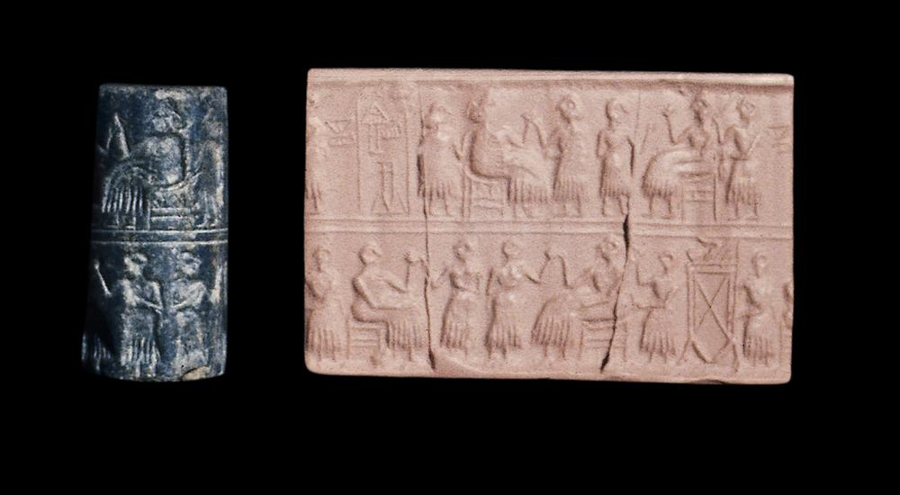
Cylinder seal (and modern impression) of Queen Puabi, Mesopotamia, Sumerian, Ur, Early Dynastic IIIa period, ca. 2500 BC, Cuneiform inscription in Sumerian: Queen Pu-abi, Lapis lazuli, The British Museum, London, UK https://www.britishmuseum.org/collection/object/W_1928-1010-235

Slide 14
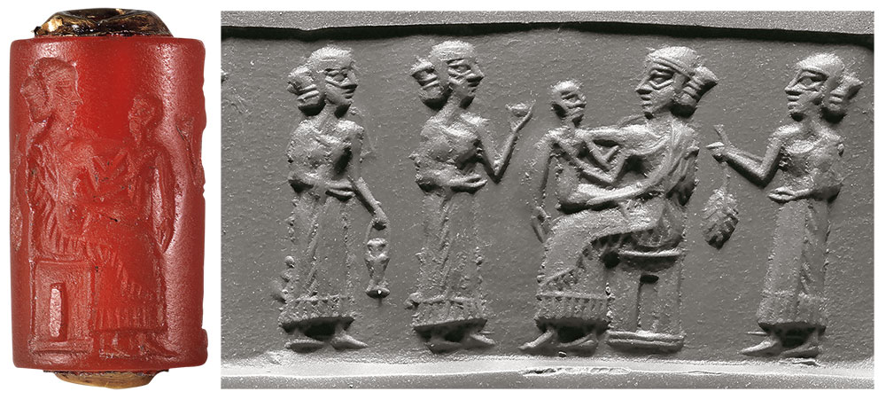
Cylinder seal (and modern impression) with mother and child attended by women, Mesopotamia, Akkadian, Ur, Akkadian period (ca. 2334–2154 BC), Carnelian and gold, University of Pennsylvania Museum of Archaeology and Anthropology, Philadelphia, USA https://www.themorgan.org/exhibitions/online/she-who-wrote/cylinder-seal-mother-child

