Slide 1
2026
12 Months
12 Flowers

Slide 2
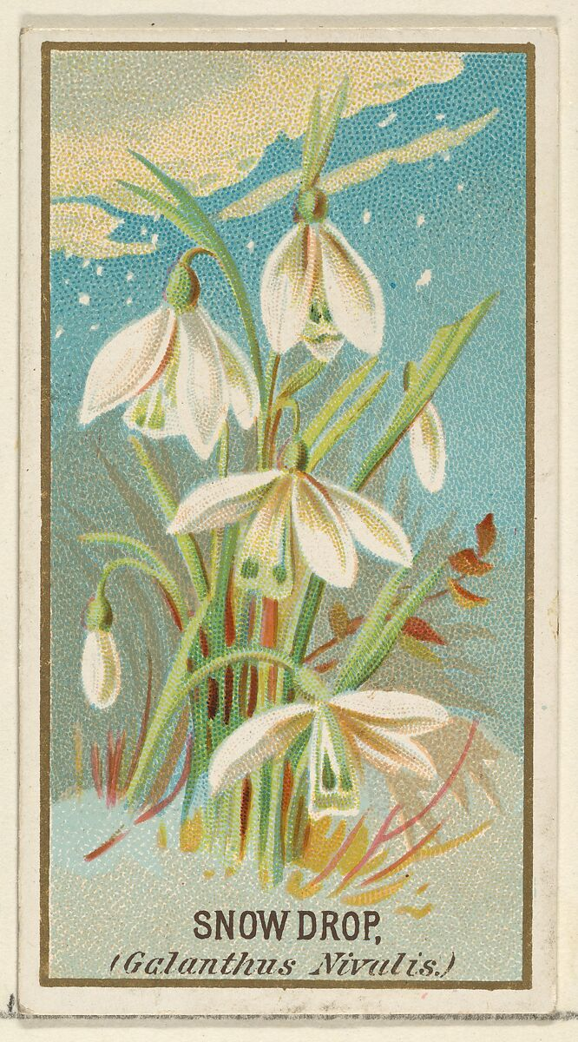
January: Carnation or Snowdrop
Publisher: Issued by Goodwin & Company
Printer: George S. Harris & Sons (American, Philadelphia)
Snowdrop (Galanthus Nivalis), from the Flowers series for Old Judge Cigarettes, 1890, Commercial color lithograph, 7 x 3.8 cm, the MET, NY, USA https://www.metmuseum.org/art/collection/search/400559

Slide 3
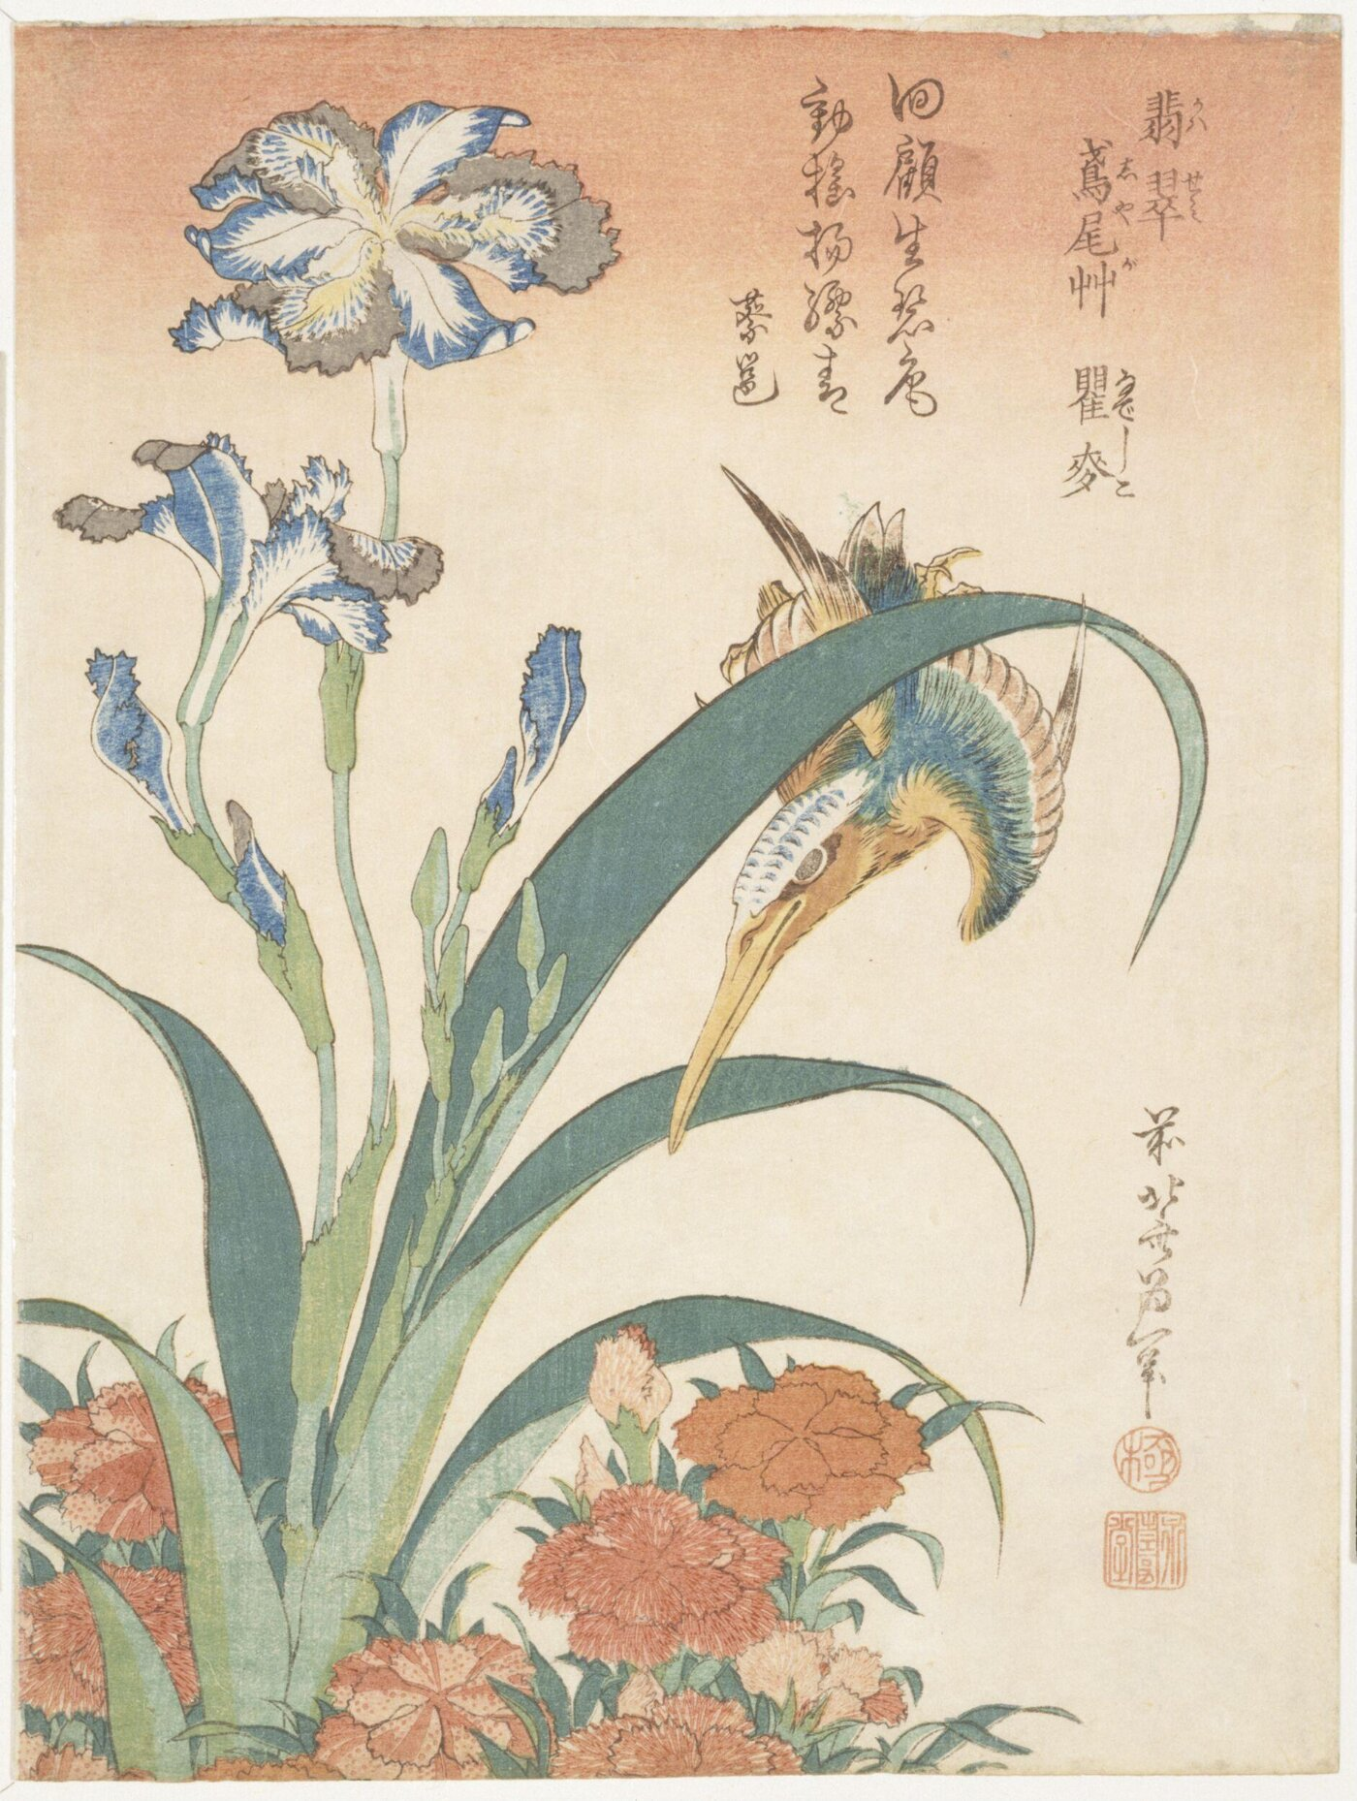
February: Violet or Iris
Katsushika Hokusai, 1760-1849
Kingfisher, Irises and Wild Pinks, ca. 1834, Woodblock Print, 22.9x16.5cm, Victoria&Albert Museum, London, UK https://framemark.vam.ac.uk/collections/2006AU7280/full/1400,/0/default.jpg

Slide 4
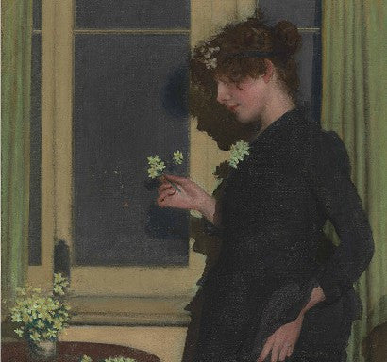
March: Daffodil or Jonquil
Philip Wilson Steer, English, 1860-1942
Jonquil, 1890, Oil on Canvas, 91.5x91.5cm, Private Collection https://www.paulfrasercollectibles.com/blogs/art-photography/philip-wilson-steers-jonquil-will-lead-british-impressionist-art-sale?srsltid=AfmBOooN3TM25j_xhU_nVNGhK4y5qROs7_af7yFZ_Dpx-3wx8w8h2N41

Slide 5
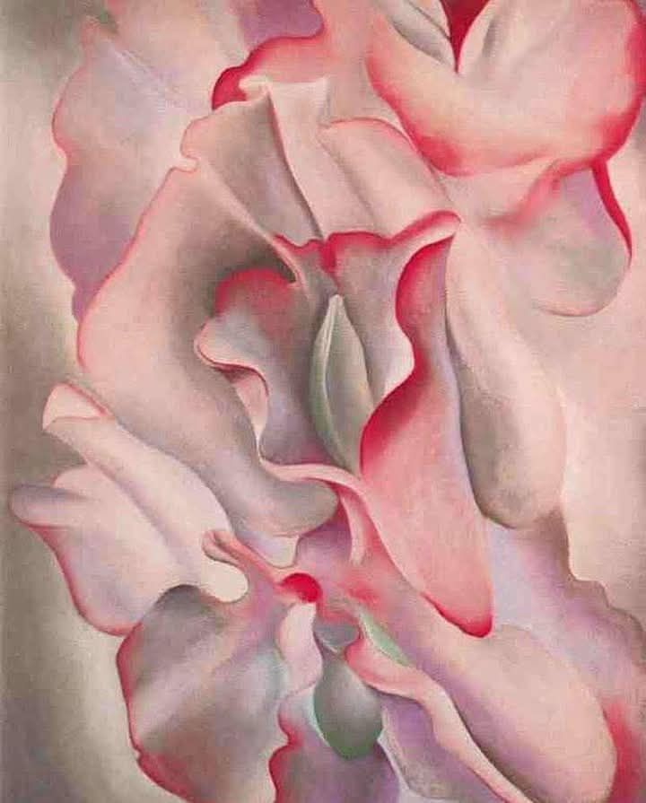
April: Daisy or Sweet Pea
Georgia O'Keeffe, American, 1887-1986
Pink sweet peas II, 1940, Oil on Canvas; 101.6×76.3 cm, Private collection https://www.facebook.com/photo/?fbid=10162953797243474&set=g.5907271979

Slide 6
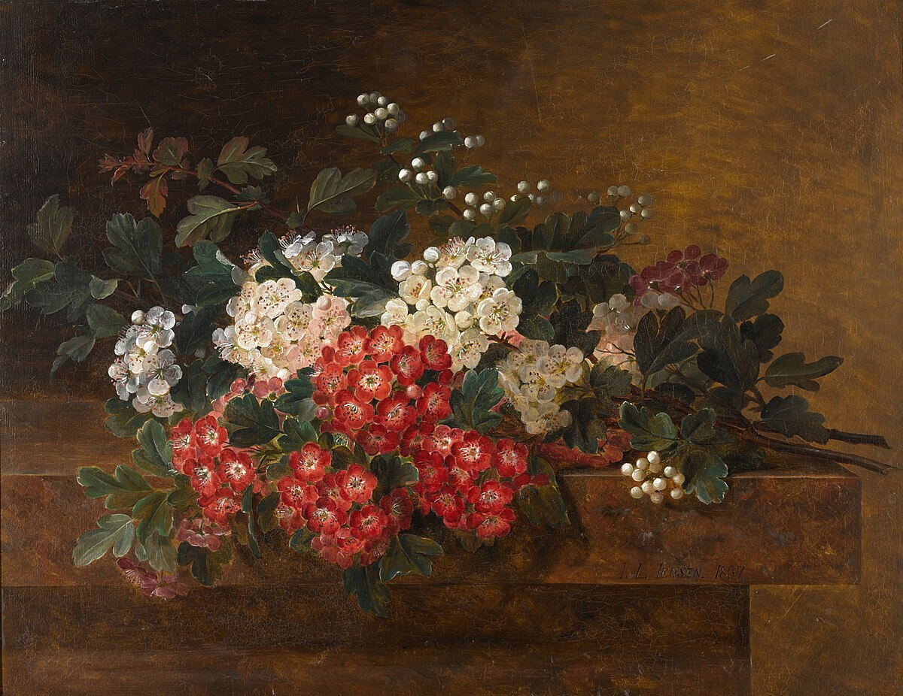
May: Lily of the Valley or Hawthorn
Johan Laurentz Jensen, Danish, 1800 – 1856
Still Life With Hawthorn Blossom, 1837, Oil on Panel, 29x37cm, Private Collection https://www.sothebys.com/en/buy/auction/2020/european-british-art/still-life-with-hawthorn-blossom

Slide 7
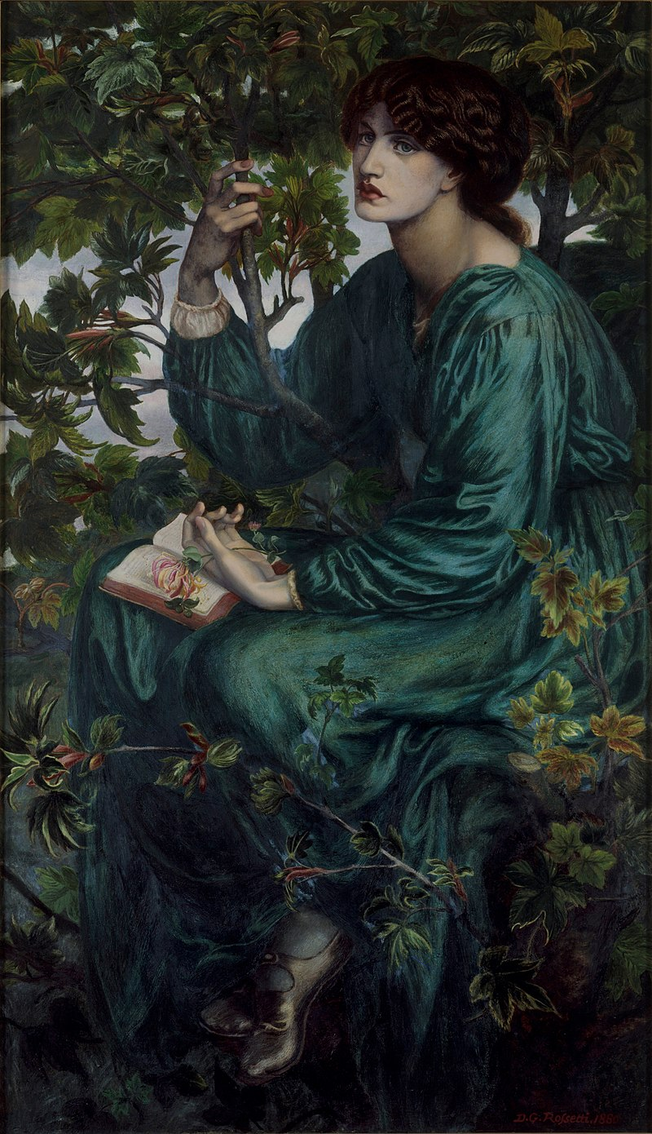
June: Rose or Honeysuckle
Dante Gabriel Rossetti, UK artist, 1828-1882
The Day Dream, 1880, Oil on Canvas, 158.7x 92.7 cm, Victoria and Albert Museum, London, UK https://en.wikipedia.org/wiki/The_Day_Dream_(Rossetti)

Slide 8
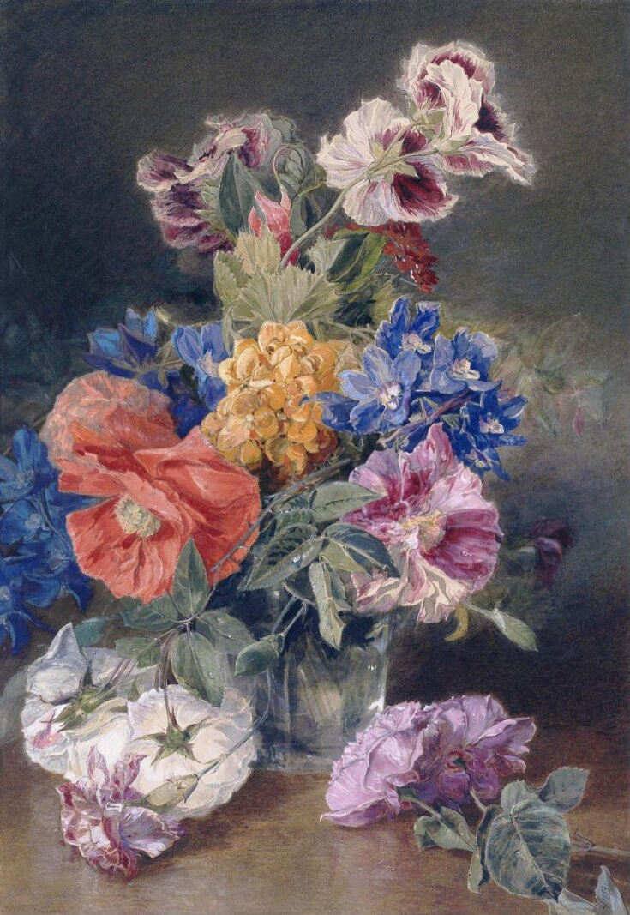
July: Larkspur or Delphinium
James Holland, 1799-1870
Roses, Poppy, Pelargonia, Delphinium and Calceolarias in a Glass Vase, 1859, Watercolour, 43.18x37.28 cm, Victoria and Albert Museum, London, UK https://collections.vam.ac.uk/item/O1070493/roses-poppy-pelargonia-delphinium-and-watercolour-james-holland/

Slide 9
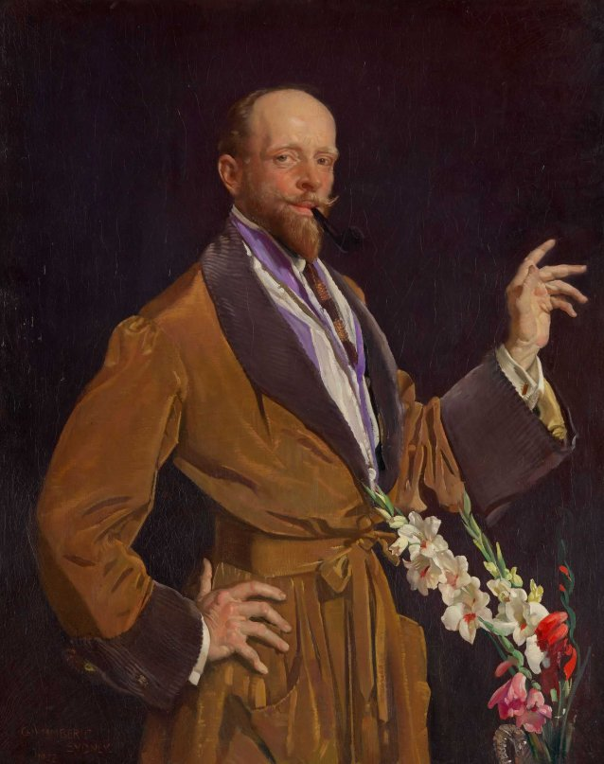
August: Gladiolus or Poppy
George Washington Lambert, 1873-1930
Self-portrait with Gladioli, before 1930, Oil on Canvas, 128.2x102.8 cm, National Portrait Gallery of Australia https://www.portrait.gov.au/portraits/2003.93/self-portrait-with-gladioli/

Slide 10
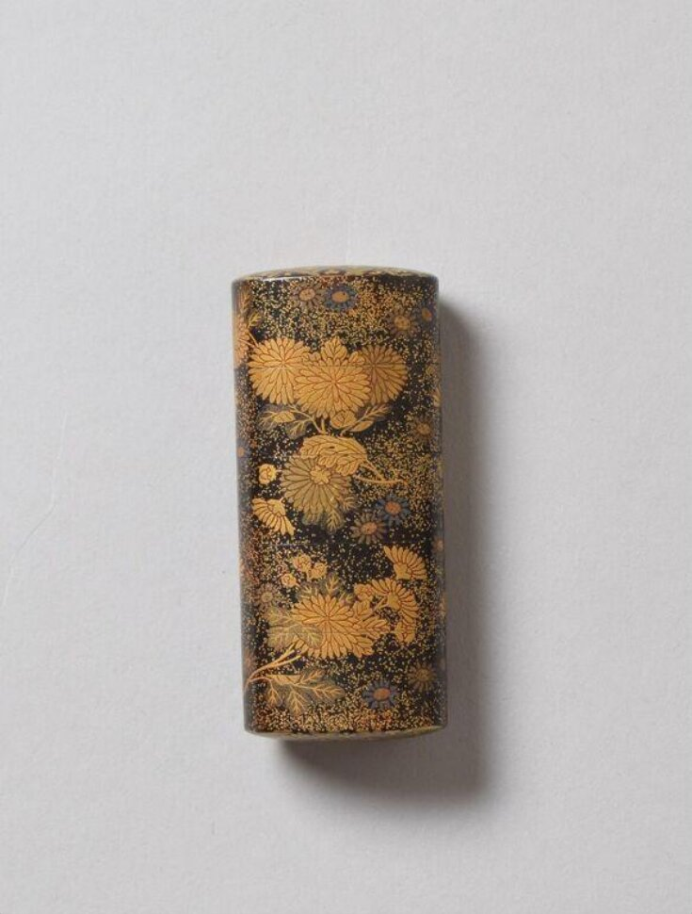
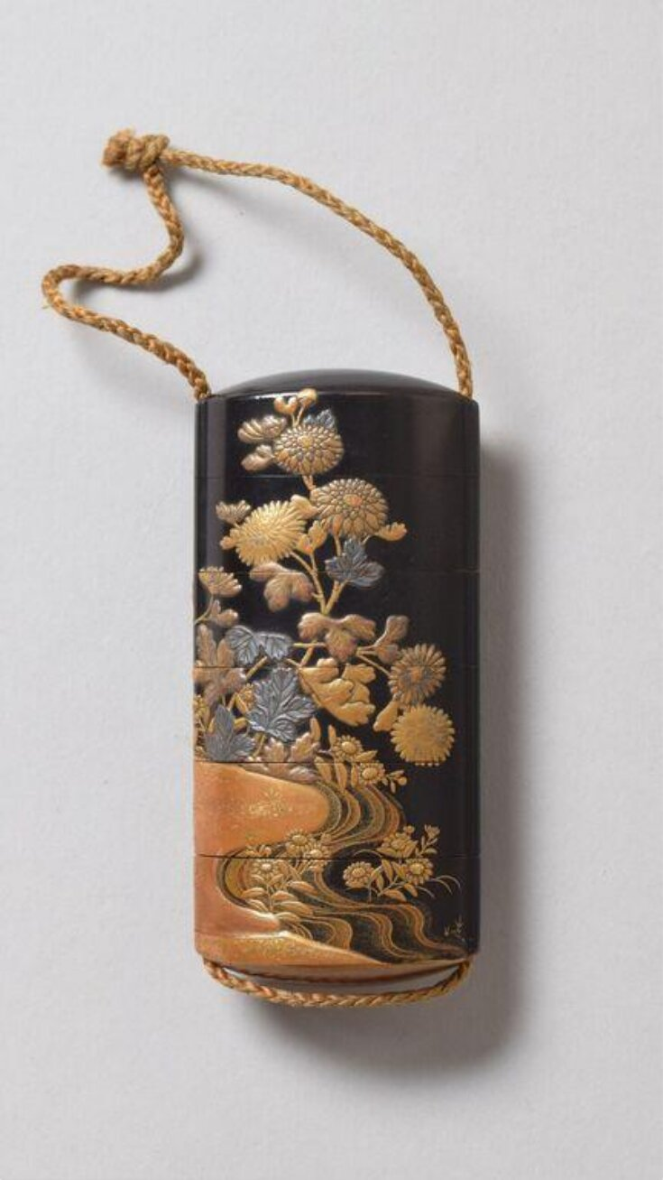
September: Aster or Morning Glory
Inrō with flowering chrysanthemums and asters, 18th century - 19th century,Laquer, Height: 7.1cm, Victoria and Albert Museum, London, UK https://collections.vam.ac.uk/item/O458070/inr%C5%8D-unknown/
Inrō with flowering chrysanthemums and asters, 18th century - 19th century, Lacquer, Height: 9.2cm, Victoria and Albert Museum, London, UK https://collections.vam.ac.uk/item/O458198/inr%C5%8D-unknown/inr%C5%8D-unknown/

Slide 11
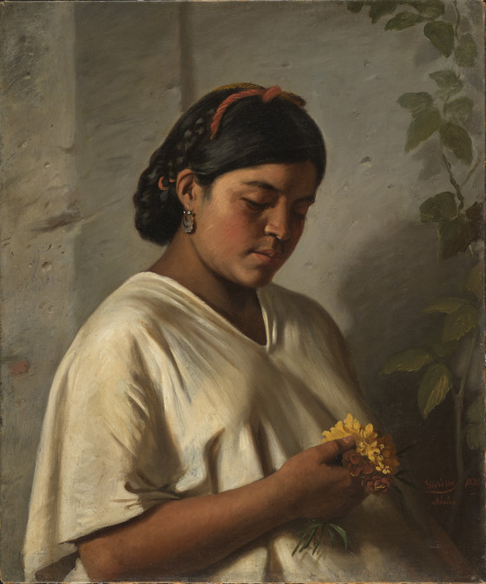
October: Marigold or Cosmos
Felipe Santiago Gutiérrez, Mexican Artist, 1824-1904
Indian Woman with Marigold (Mujer indígena con cempasúchil), 1876, Oil on Canvas, 67.95x56.52 cm, Los Angeles, County Museum of Art, USA https://collections.lacma.org/node/1035000

Slide 12
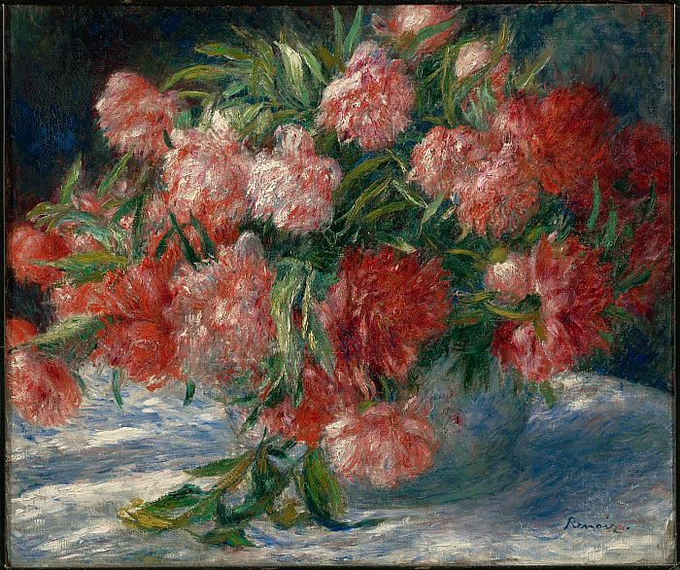
November: Peony or Chrysanthemum
Pierre-Auguste Renoir, French, 1841–1919,
Peonies, c. 1880, Oil on Canvas, 55.3 x 65.7 cm, The Clark Art Institute, MA,USA https://www.clarkart.edu/ArtPiece/Detail/Peonies?utm_source=chatgpt.com

Slide 13
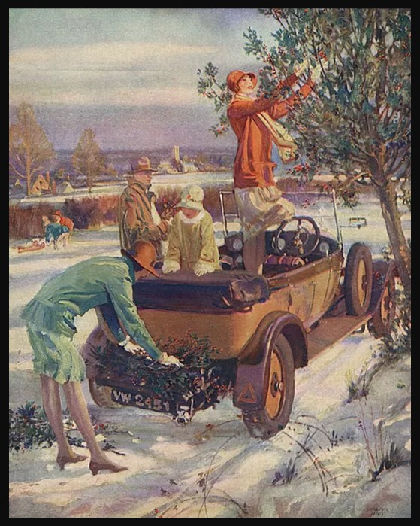
December: Holly or Narcissus or Poinsettia
Millar Watt, British, 1895-1975
The Day before Christmas: Gathering the Holly, 25th November 1929, The Sphere Christmas Number s://www.mediastorehouse.com/mary-evans-prints-online/day-christmas-gathering-holly-millar-watt-14114371.html

