Slide 1
Jean- François de Troy
1679-1752

Slide 2
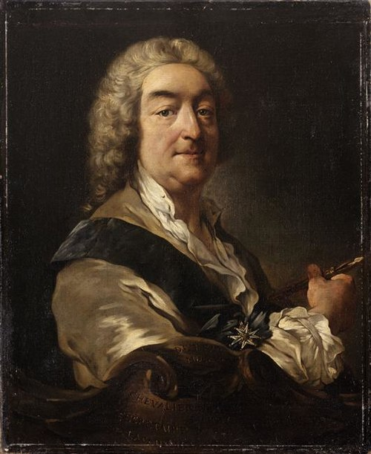
Self Portrait, 1734, Oil on Canvas, 75x61.5 cm , Palace of Versailles , France

Slide 3
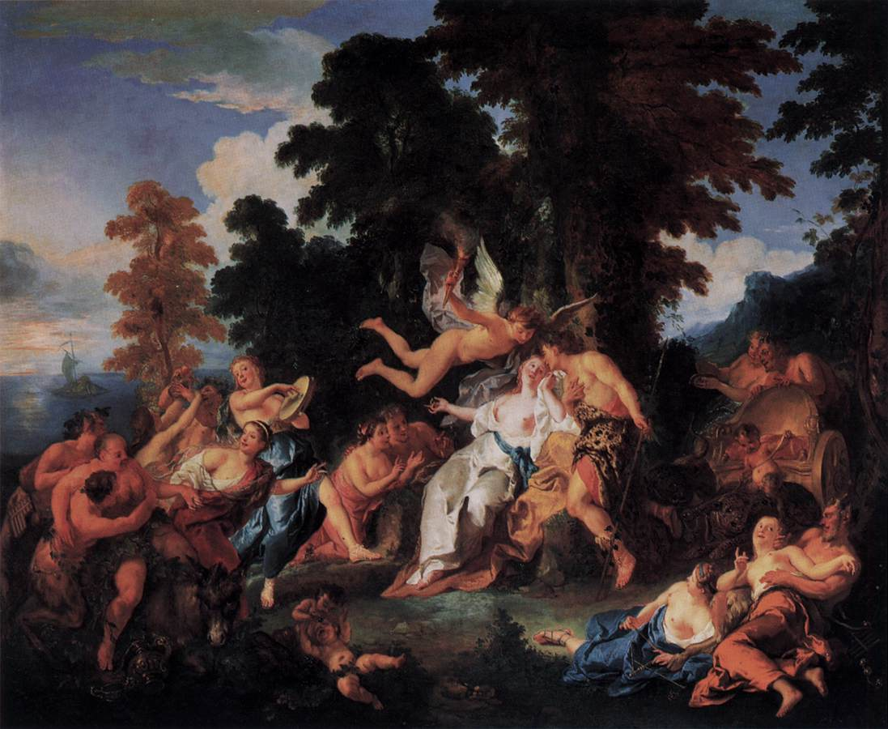
Bacchus and Ariadne, c. 1717, Oil on canvas, 140 x 165 cm
Staatliche Museen, Berlin, Germany https://www.wga.hu/frames-e.html?/html/t/troy/jeanfran/index.html

Slide 4
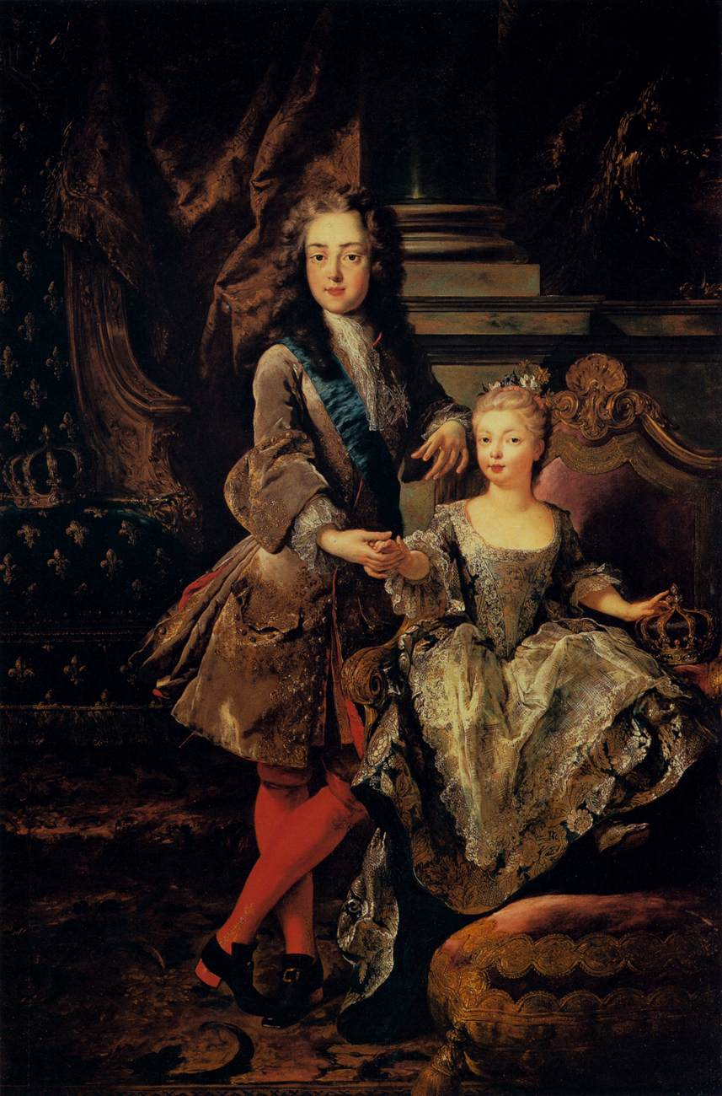
Portrait of Louis XV of France and Maria Anna Victoria of Spain, 1723, Oil on canvas, 195 x 129 cm, Galleria Palatina (Palazzo Pitti), Florence, Italy https://www.wga.hu/frames-e.html?/html/t/troy/jeanfran/index.html

Slide 5
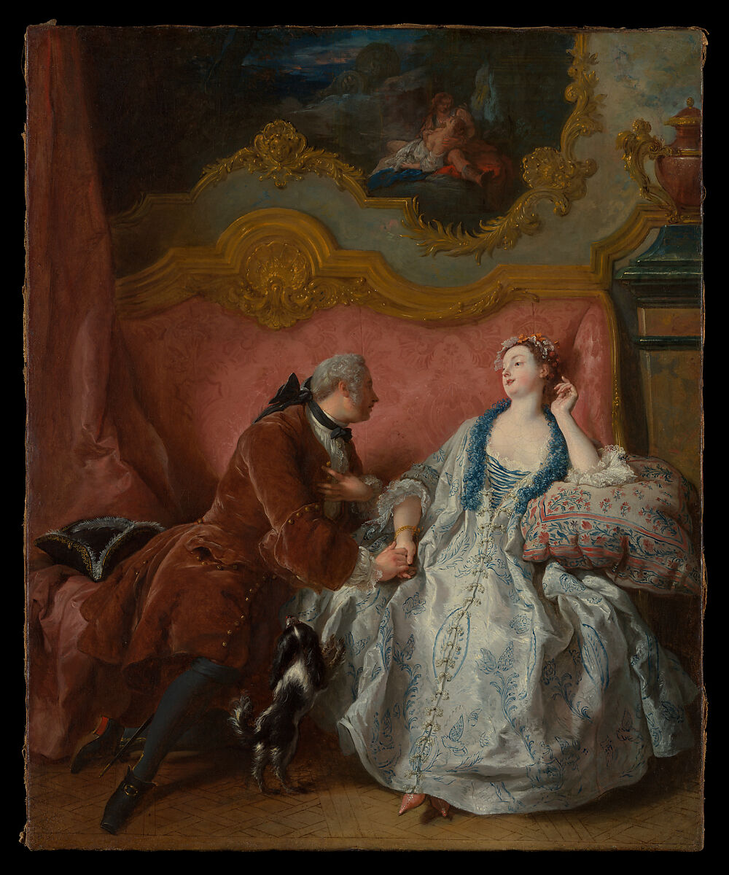
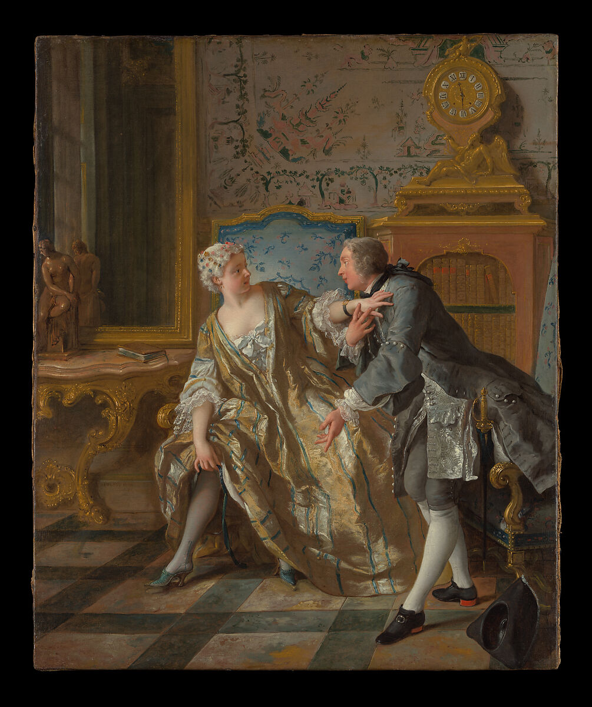
The Declaration of Love, ca. 1724, Oil on canvas, 65.1 × 53.3 cm,
The Garter, 1724, Oil on canvas, 64.8 × 53.7 cm, the MET, NY, USA https://www.metmuseum.org/art/collection/search/438127 and https://www.metmuseum.org/art/collection/search/438126

Slide 6
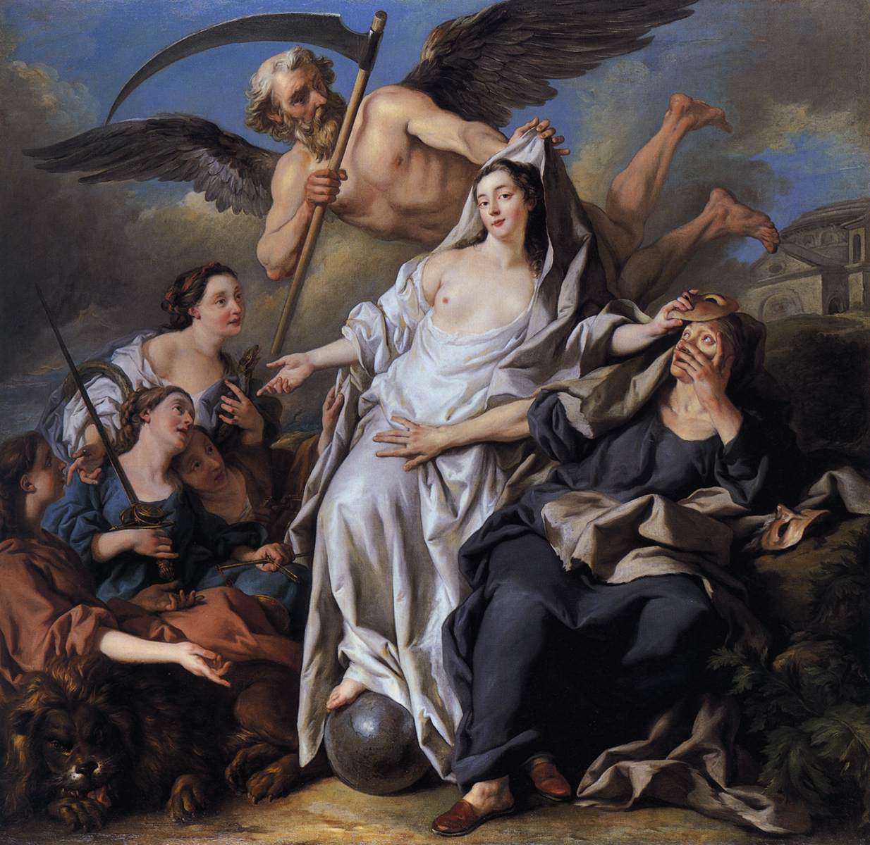
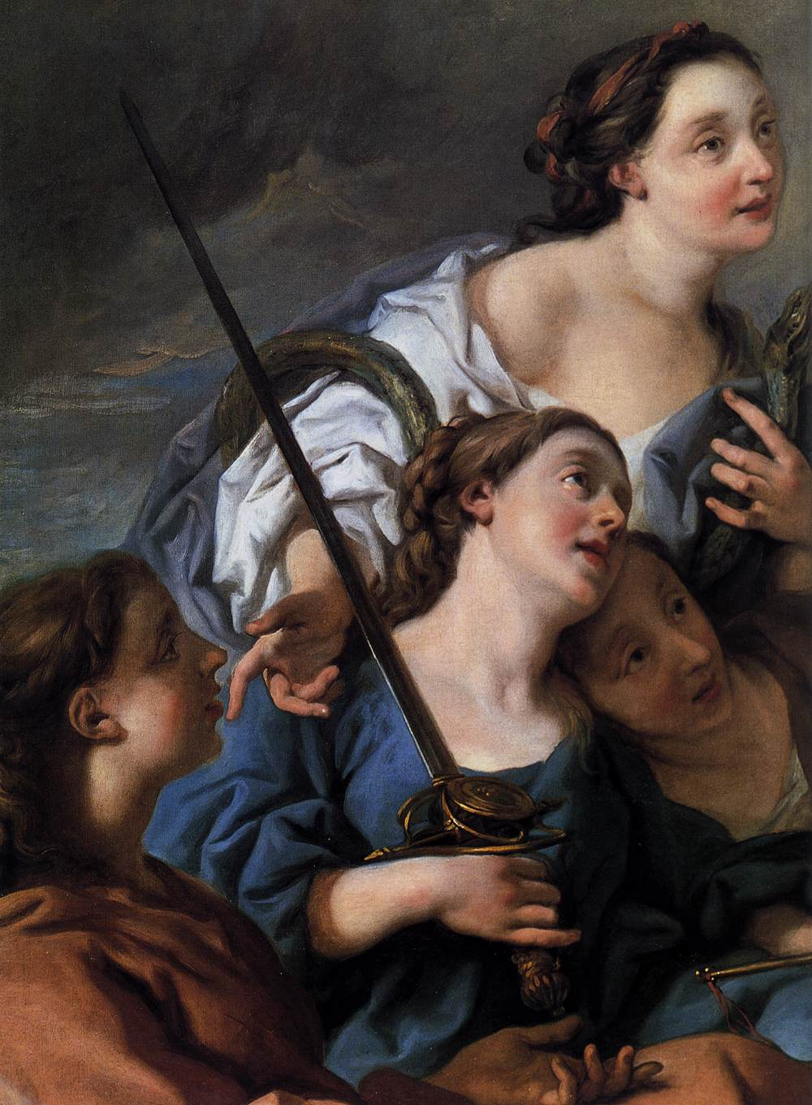
An Allegory of Time Unveiling Truth, 1733, Oil on canvas,
National Gallery, London, UK https://www.wga.hu/frames-e.html?/html/t/troy/jeanfran/index.html

Slide 7
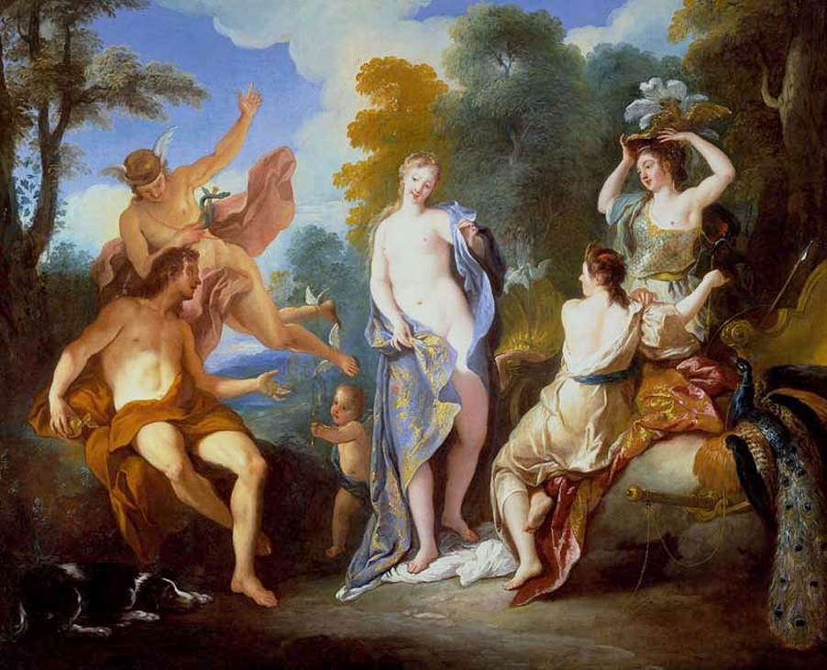
The Judgment of Paris,
1734, Oil on canvas, 78 x 99 cm, Private collection https://www.wga.hu/frames-e.html?/html/t/troy/jeanfran/index.html

Slide 8
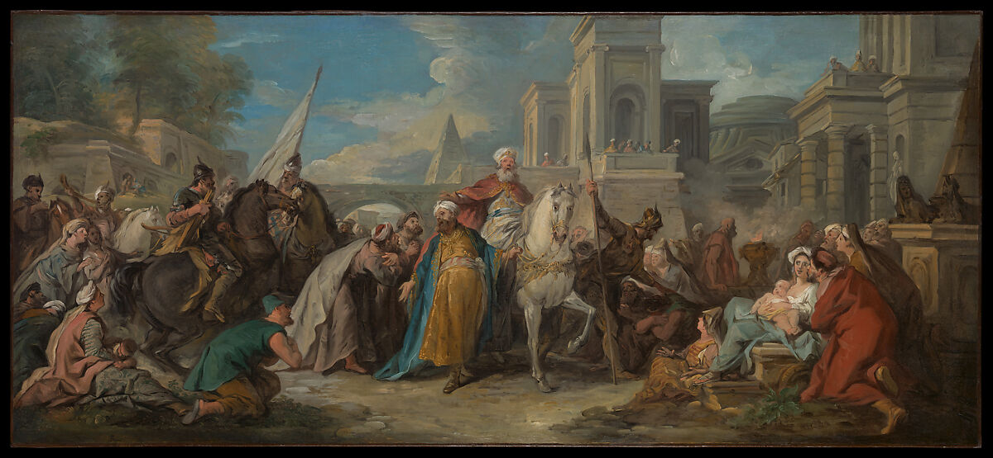
The Triumph of Mordecai, ca. 1736, Oil on canvas, 86 x 150.2 cm, the MET, NY, USA https://www.metmuseum.org/art/collection/search/437845

Slide 9
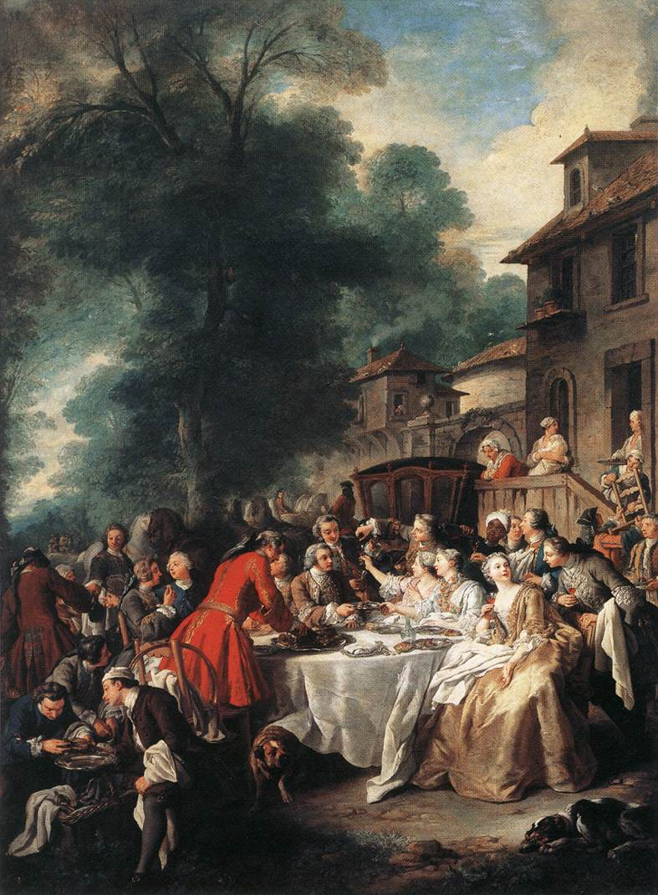
A Hunting Meal, 1737, Oil on canvas, 241 x 170 cm, the Louvre, Paris, France https://www.wga.hu/frames-e.html?/html/t/troy/jeanfran/index.html

Slide 10
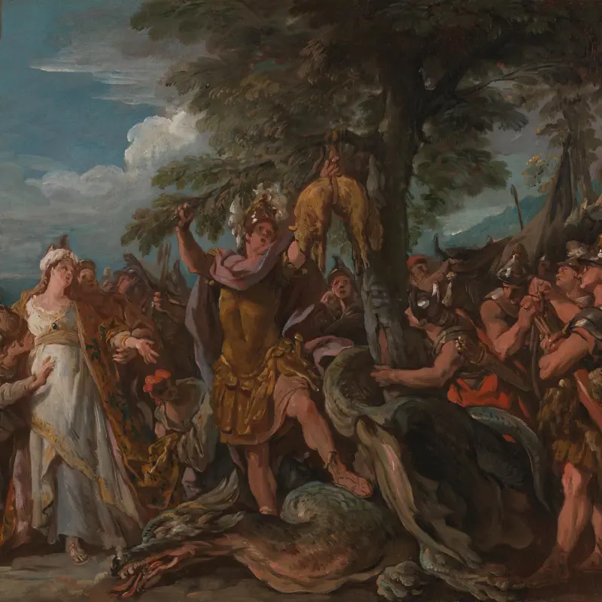
The Capture of the Golden Fleece, Sketches for the Story of Jason, 1742-3, Oil on canvas, 55.6 × 81 cm, the National Gallery, London, UK https://www.nationalgallery.org.uk/paintings/jean-francois-de-troy-the-capture-of-the-golden-fleece

Slide 11
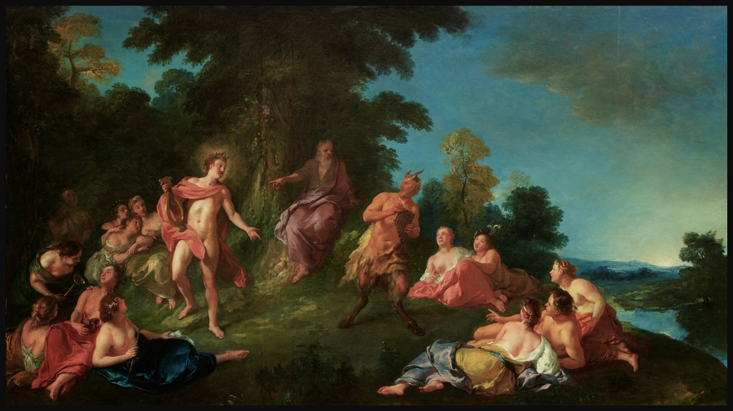
Apollo and Pan, or The Judgment of Tmolus, Date unknown, Oil on Panel, originally a harpsichord lid painting cut into a rectangle,
87.5 × 154 cm, Private Collection https://onlineonly.christies.com/s/collections-provenant-des-familles-cosse-brissac-dormesson-la-bedoyere/jean-francois-de-troy-paris-1679-1752-rome-65/273871?ldp_breadcrumb=back

