Slide 1
Ancient Greek Pottery
The François Vase

Slide 2
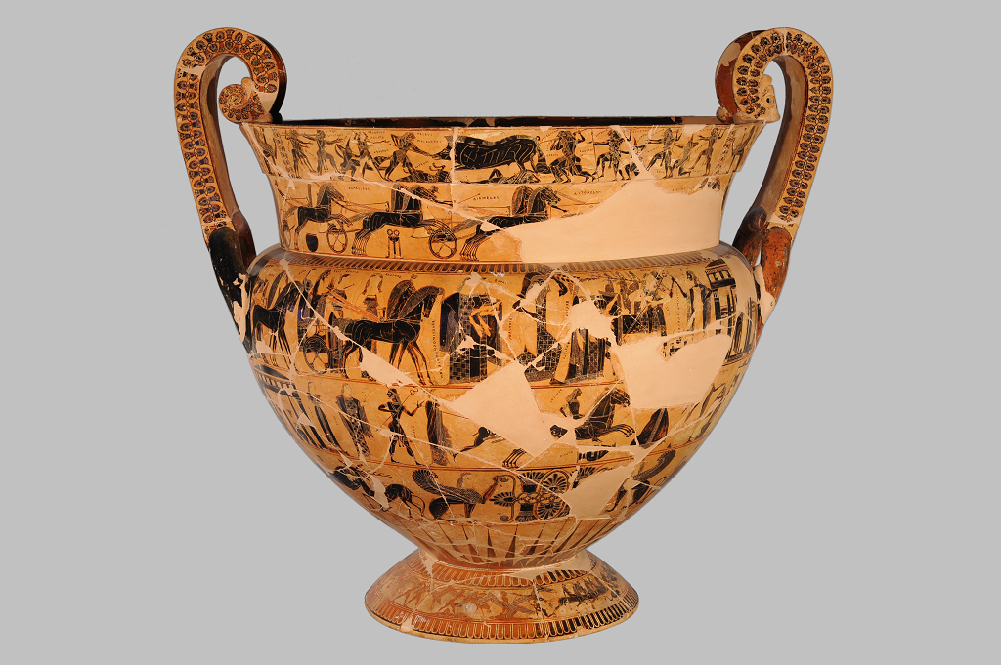
François Vase, Volute Krater, black figure, 570-560 BC, painter Kleitias and potter Ergotimos, Florence Archaeological Museum https://www.florenceinferno.com/the-francois-vase/

Slide 3
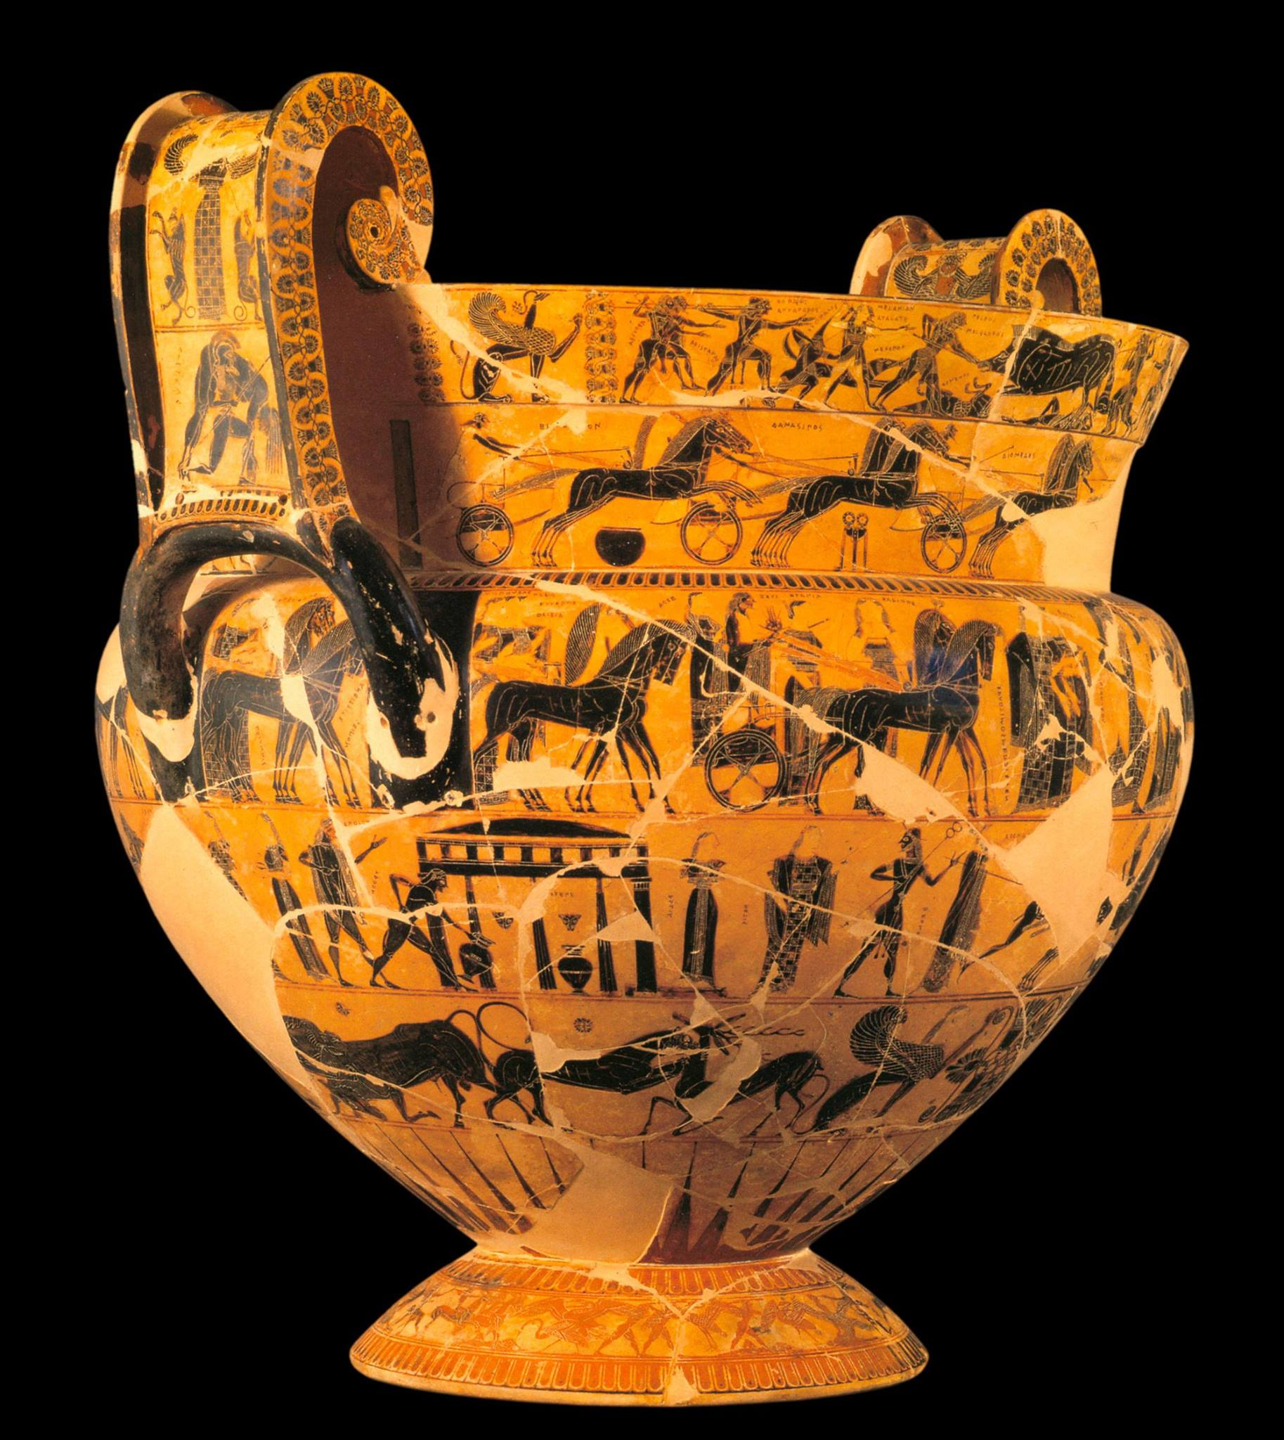
The François Vase
Identification Data
Painter: Kleitias
Potter: Ergotimos
Date: c.570 B.C.E. (archaic period)
Shape: volute krater
Technique: Black-Figure
Function: mixing bowl for wine and water.
Size: 66cm in Height
Location: Museo Archeologico, Florence, Italy
https://www.facebook.com/471707109534948/photos/the-%27fran%C3%A7ois-vase%27-or-an/1020034548035532/

Slide 4
Basic Characteristics
1. Shape and decoration revolutionary for time
3. Surface divided into seven horizontal registers or friezes or bands
4. 270 human figures (plus animals); 121 accompanied by inscriptions
5. Boustrophedon writing, alternating left-to-right and right-to-left
6. Orientalizing motifs, including griffins, sphinxes, and vegetal forms such as lotus and palmette.

Slide 5
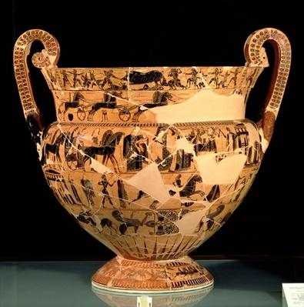
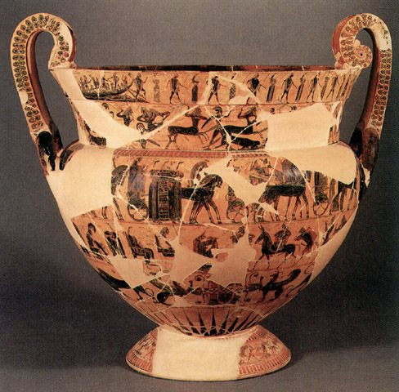
Side A (top) – Side B (bottom)
Neck Registers 1 and 2: Upper: the Hunt for the Calydonian Boar (A) and the dance of Theseus with the Athenian youths during their escape from Crete (B).Lower: a chariot race at the funeral games for Patroklos (A) and the battle between Lapiths and Centaurs (B).
Body Register 3: A frieze encircling the vase depicting the wedding of Peleus and Thetis, with a procession of deities.
Body Register 4: Achilles pursuing Troilos (A) and the return of Hephaistos to Olympus (B).
Body Register 5: Sphinxes, animals, palmette decoration.
Body Register 6: Decorative Rays
Foot Register 7: The battle between pygmies and cranes.
Handles: Ajax carrying the dead Achilles, and Artemis (or the Mistress of Beasts).
https://en.wikipedia.org/wiki/Fran%C3%A7ois_Vase

Slide 6
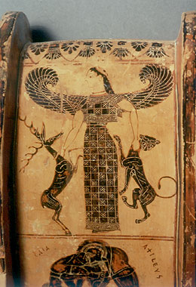
Conventions of Black Figure Style Pottery
1. Figures are rendered as silhouettes filled in with black slip.
2. Added color, white and purplr, is used to distinguish elements such as female flesh, drapery, and certain animals.
3. Incisions are used to indicate hair, internal anatomical details, and decorative patterns on clothing.
https://www.fhw.gr/chronos/03/en/gallery/cph22.html

Slide 7
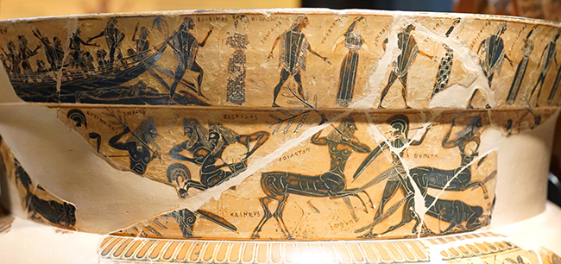
Stylistic Characteristics of Black-Figure Figure Drawing
Small-scale figures rendered as silhouettes.
Figures shown with the head in profile, frontal eye, a frontal torso, legs and feet in profile.
Incised anatomical details are delicate and precise, demonstrating an accurate understanding of major muscle groups.
Texture is suggested through contrast, such as smooth human hair versus the spiky bristles of the boar.
Movement is conveyed by devices such as
one foot placed in front of the other; raised
or outstretched legs to indicate running;
and joined hands to represent dancing.
Movement and gesture are generally lively
and energetic, but dignified in the wedding.
Emotions are suggested through gestures,
including raised hands.
https://www.khanacademy.org/humanities/ancient-art-civilizations/
greek-art/greek-pottery/a/the-francois-vase-story-book-of-greek-mythology

Slide 8
The François Vase
Photos: smarthistory
https://smarthistory.org/francois-vase/

Slide 9
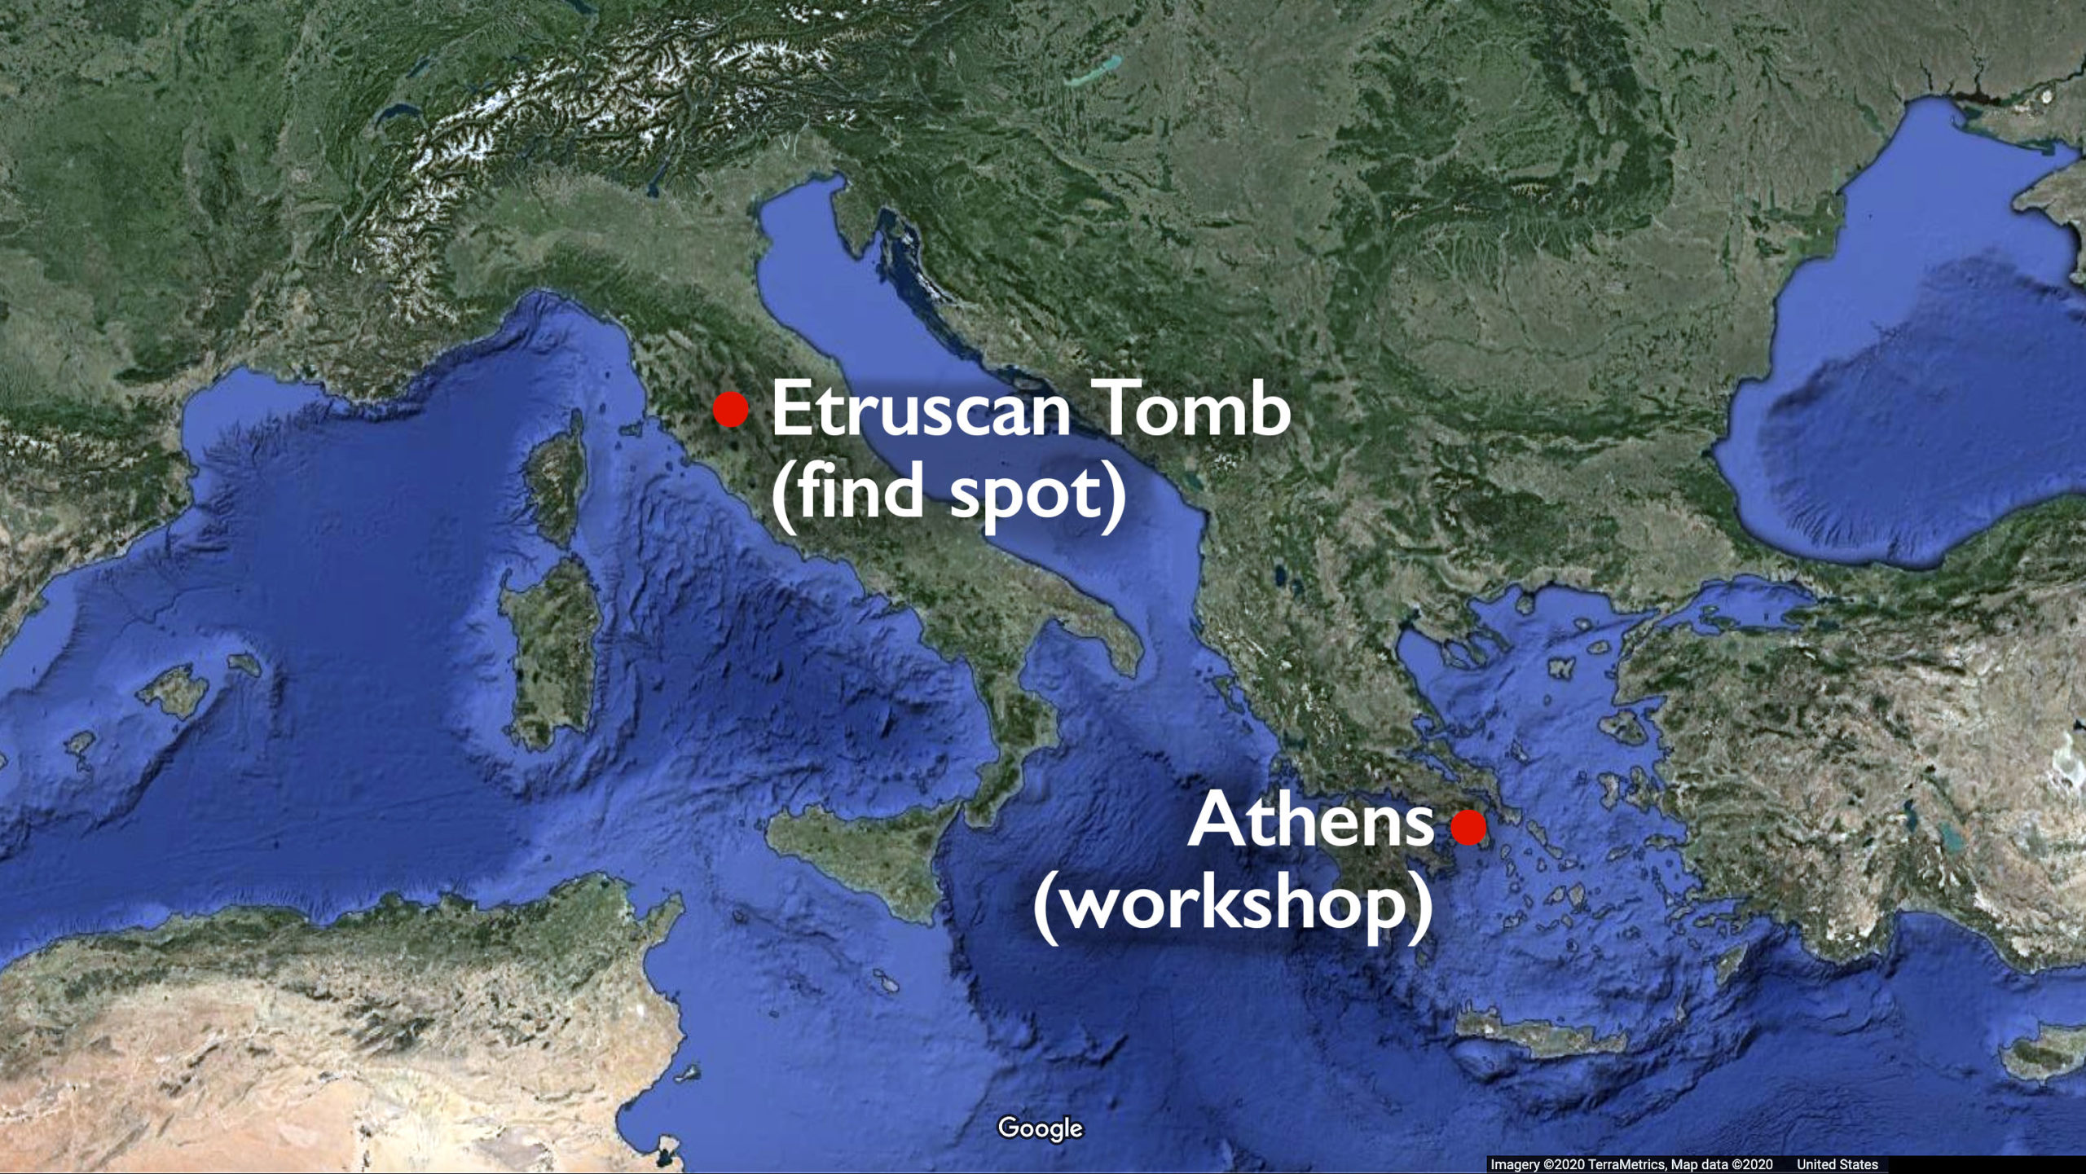
From Athens, Greece, to Chiusi, Italy, where in 1844, Alessandro François found fragments of it in an Etruscan tomb. Subsequent excavations led to the discovery of additional fragments.

Slide 10
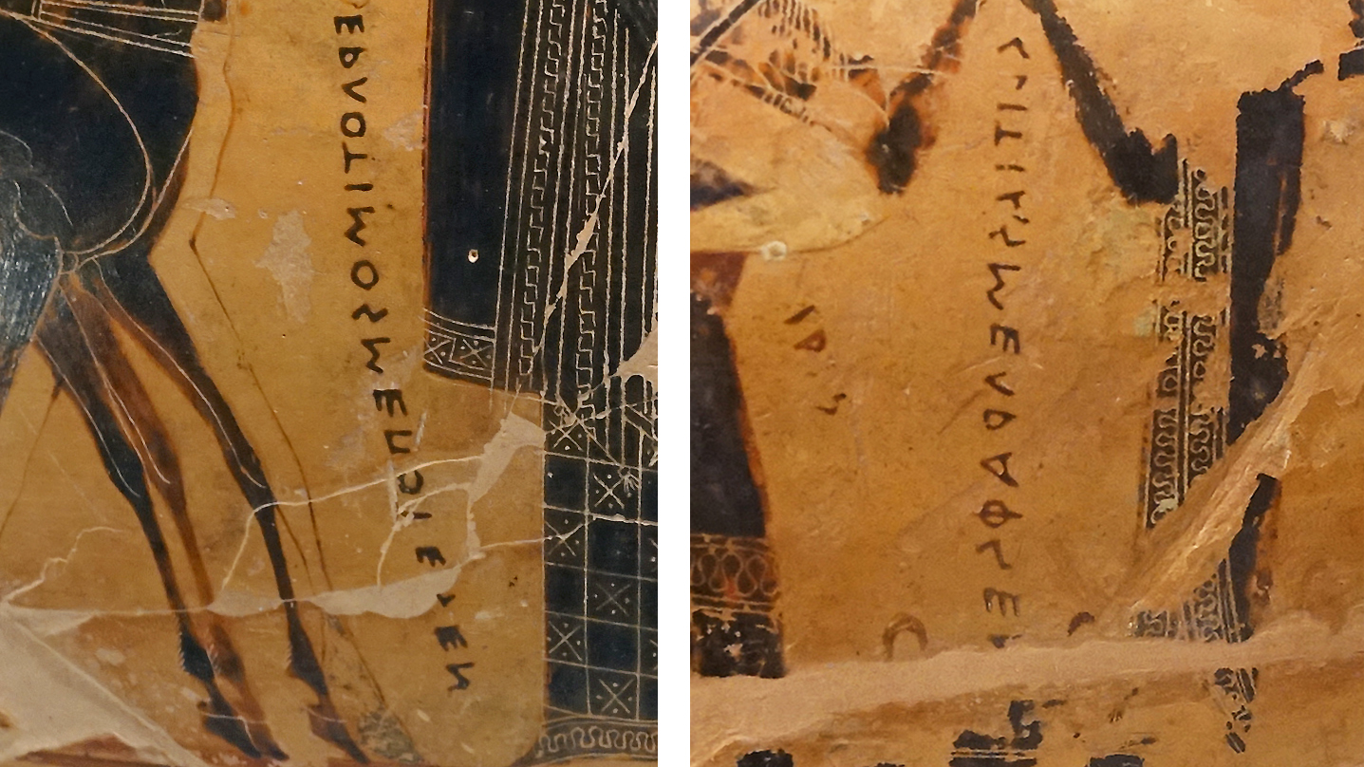
Detail with painted label (left) identifies Ergotimos as the potter; painted label (right) identifies Kleitias as the painter

Slide 11
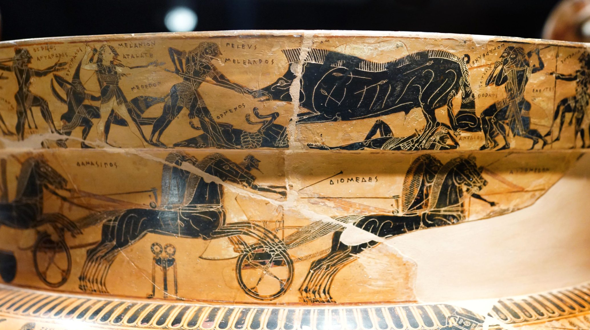
Detail with Calydonian Boar Hunt (top register) and chariot race (below)

Slide 12

Detail with Athenian youth, freed from the Minotaur’s labyrinth by Theseus, disembarking from a boat; below the battle between the Lapiths and the centaurs

Slide 13
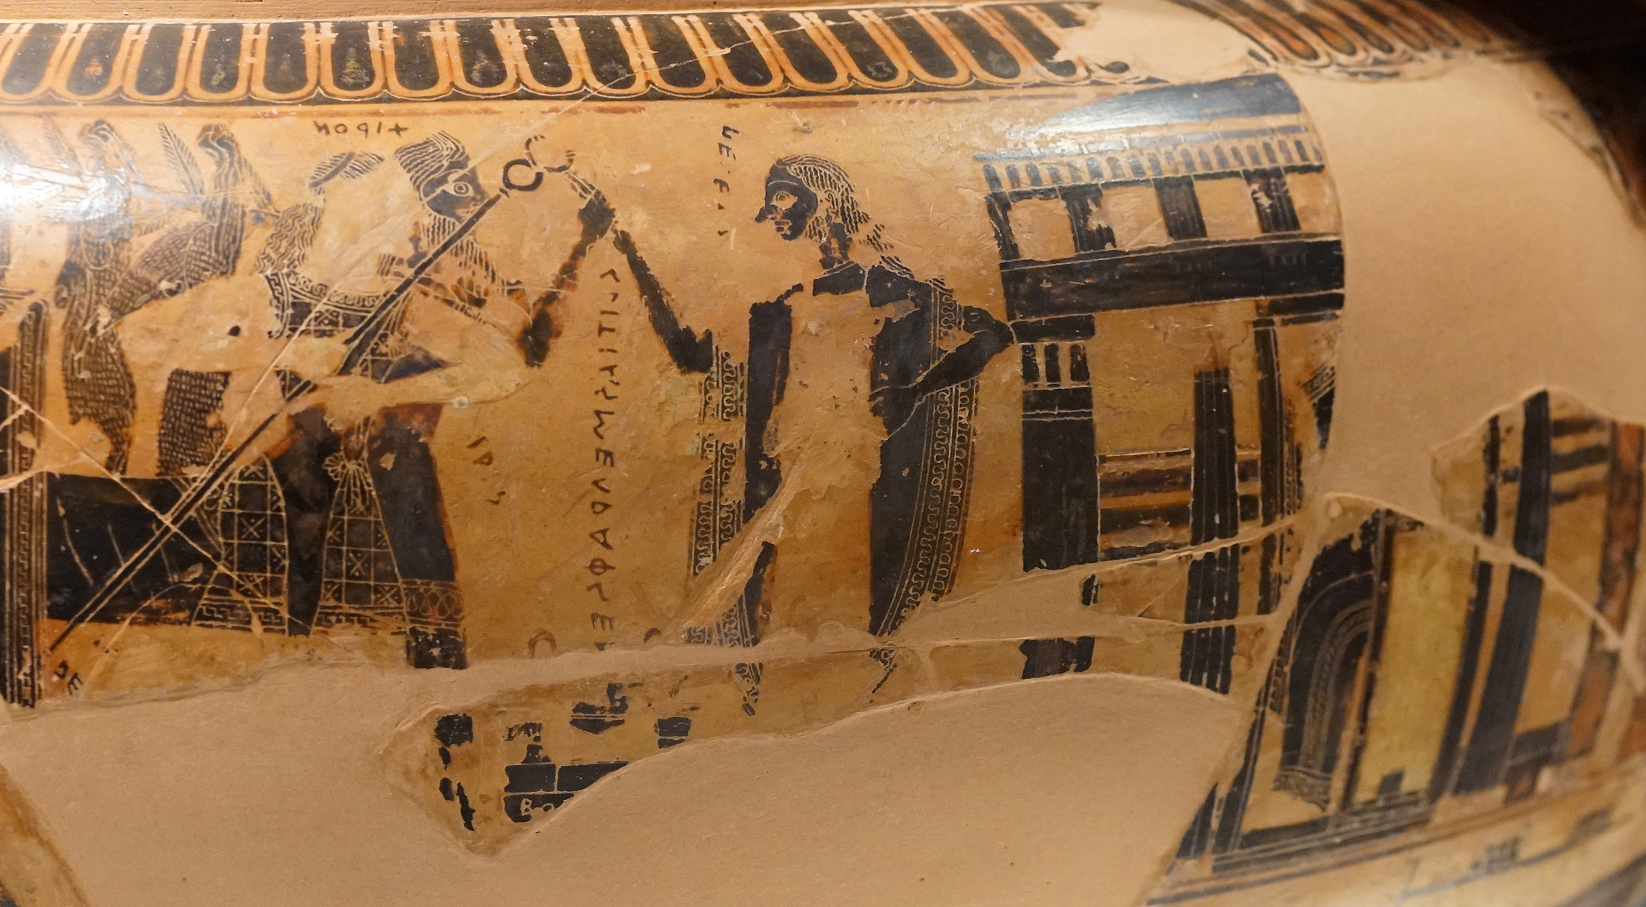
Detail with Peleus (center) who stands before his house greeting the centaur Chiron seen beside the goddess Iris (left) at the head of the wedding procession (the inscription identifying the painter can be read under their clasped hands). The seated Thetis (fragmented), can be seen within the house.

Slide 14
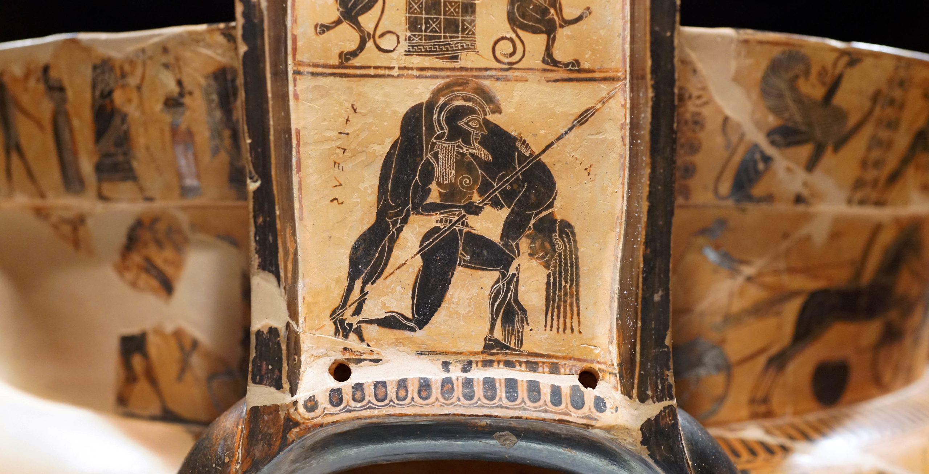
Detail with Ajax carrying the body of Achilles on the handle of the vase

Slide 15
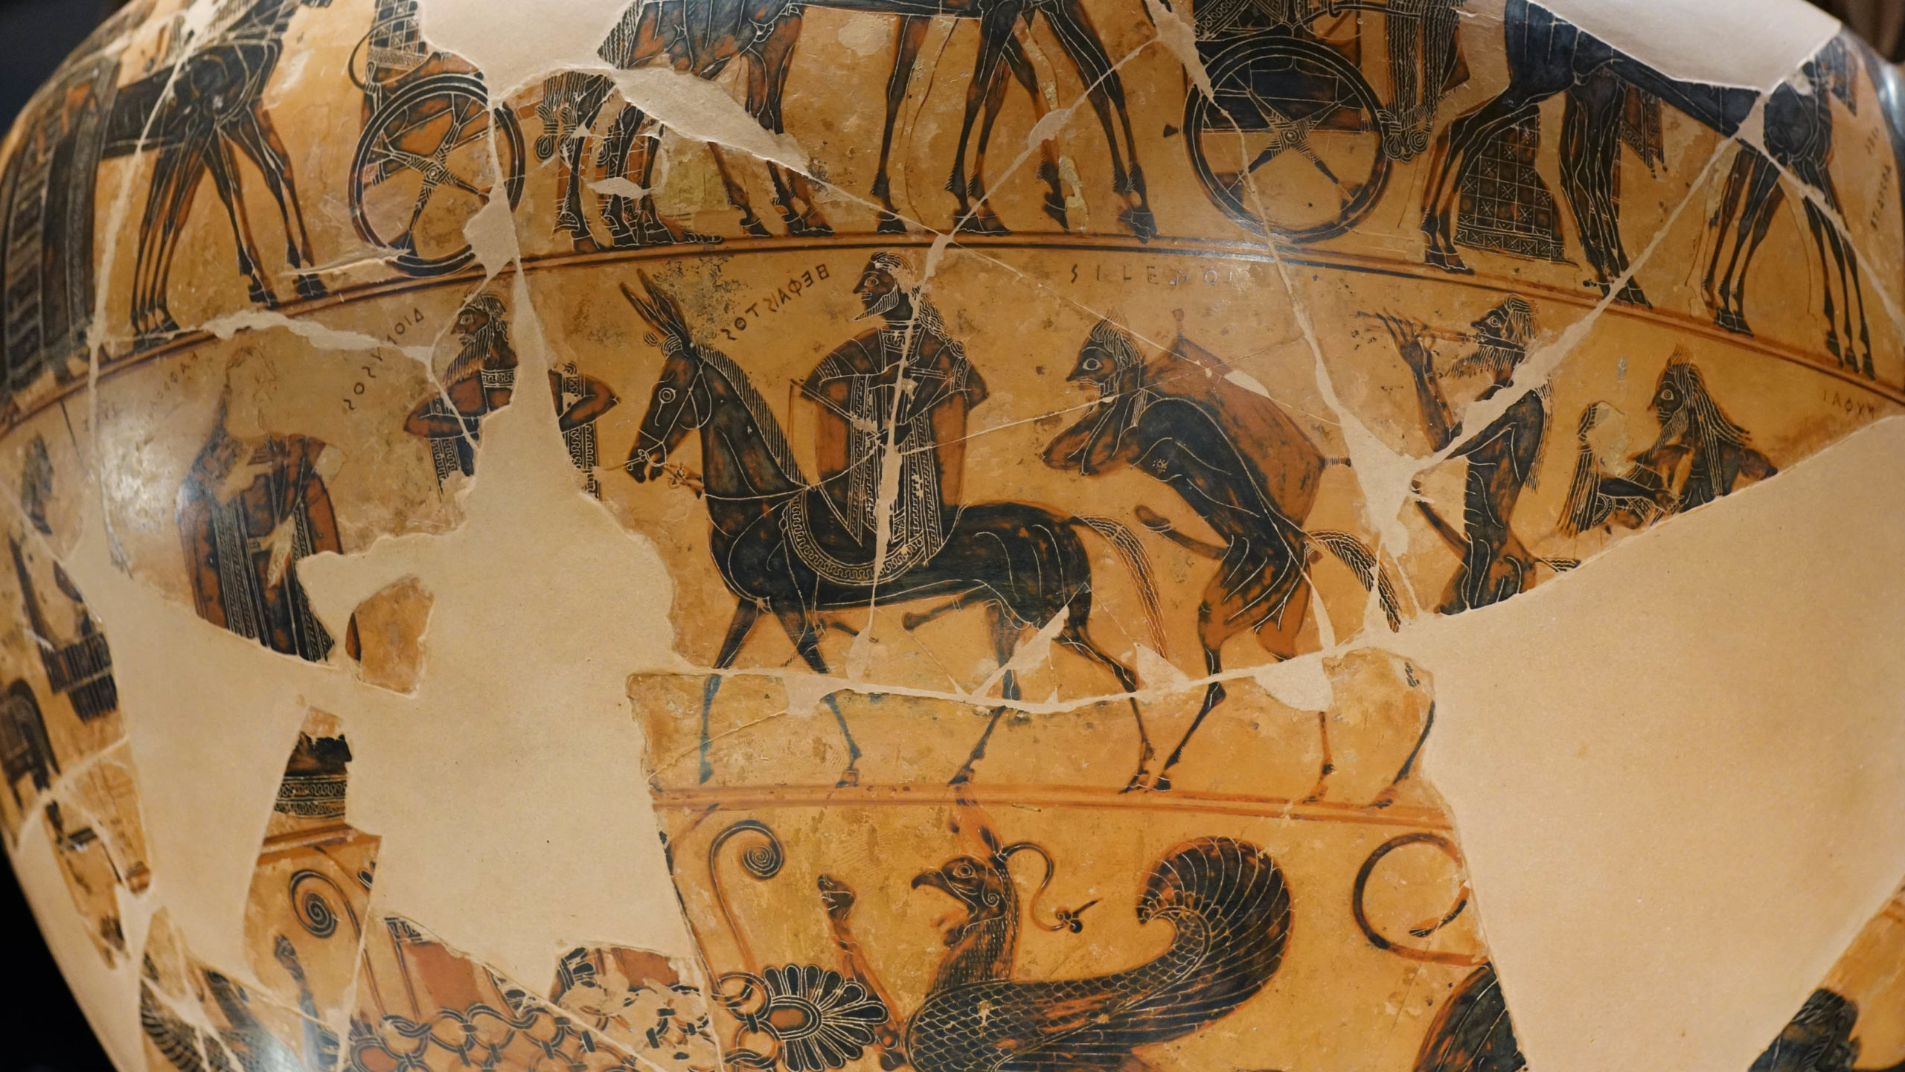
Detail with the return of Hephaistos to Mount Olympus, with Dionysos ahead, and the satyr Silenus behind

Slide 16
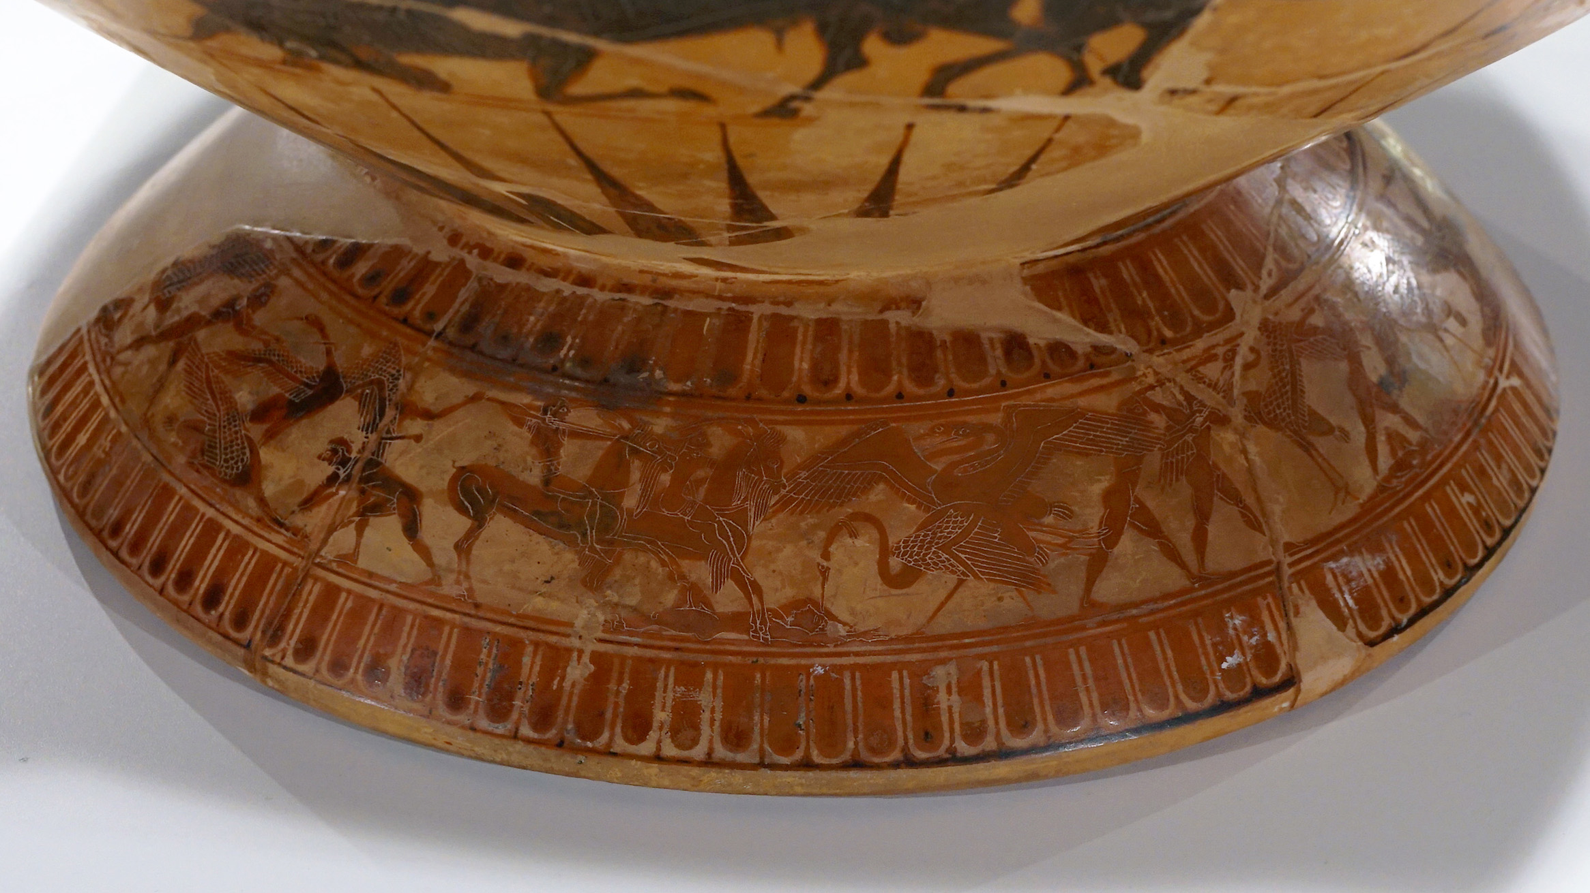
Detail of foot with the battle of the cranes and pygmies

Slide 17
The François Vase
Photos by
Amalia Spiliakou, April 2025

Slide 18
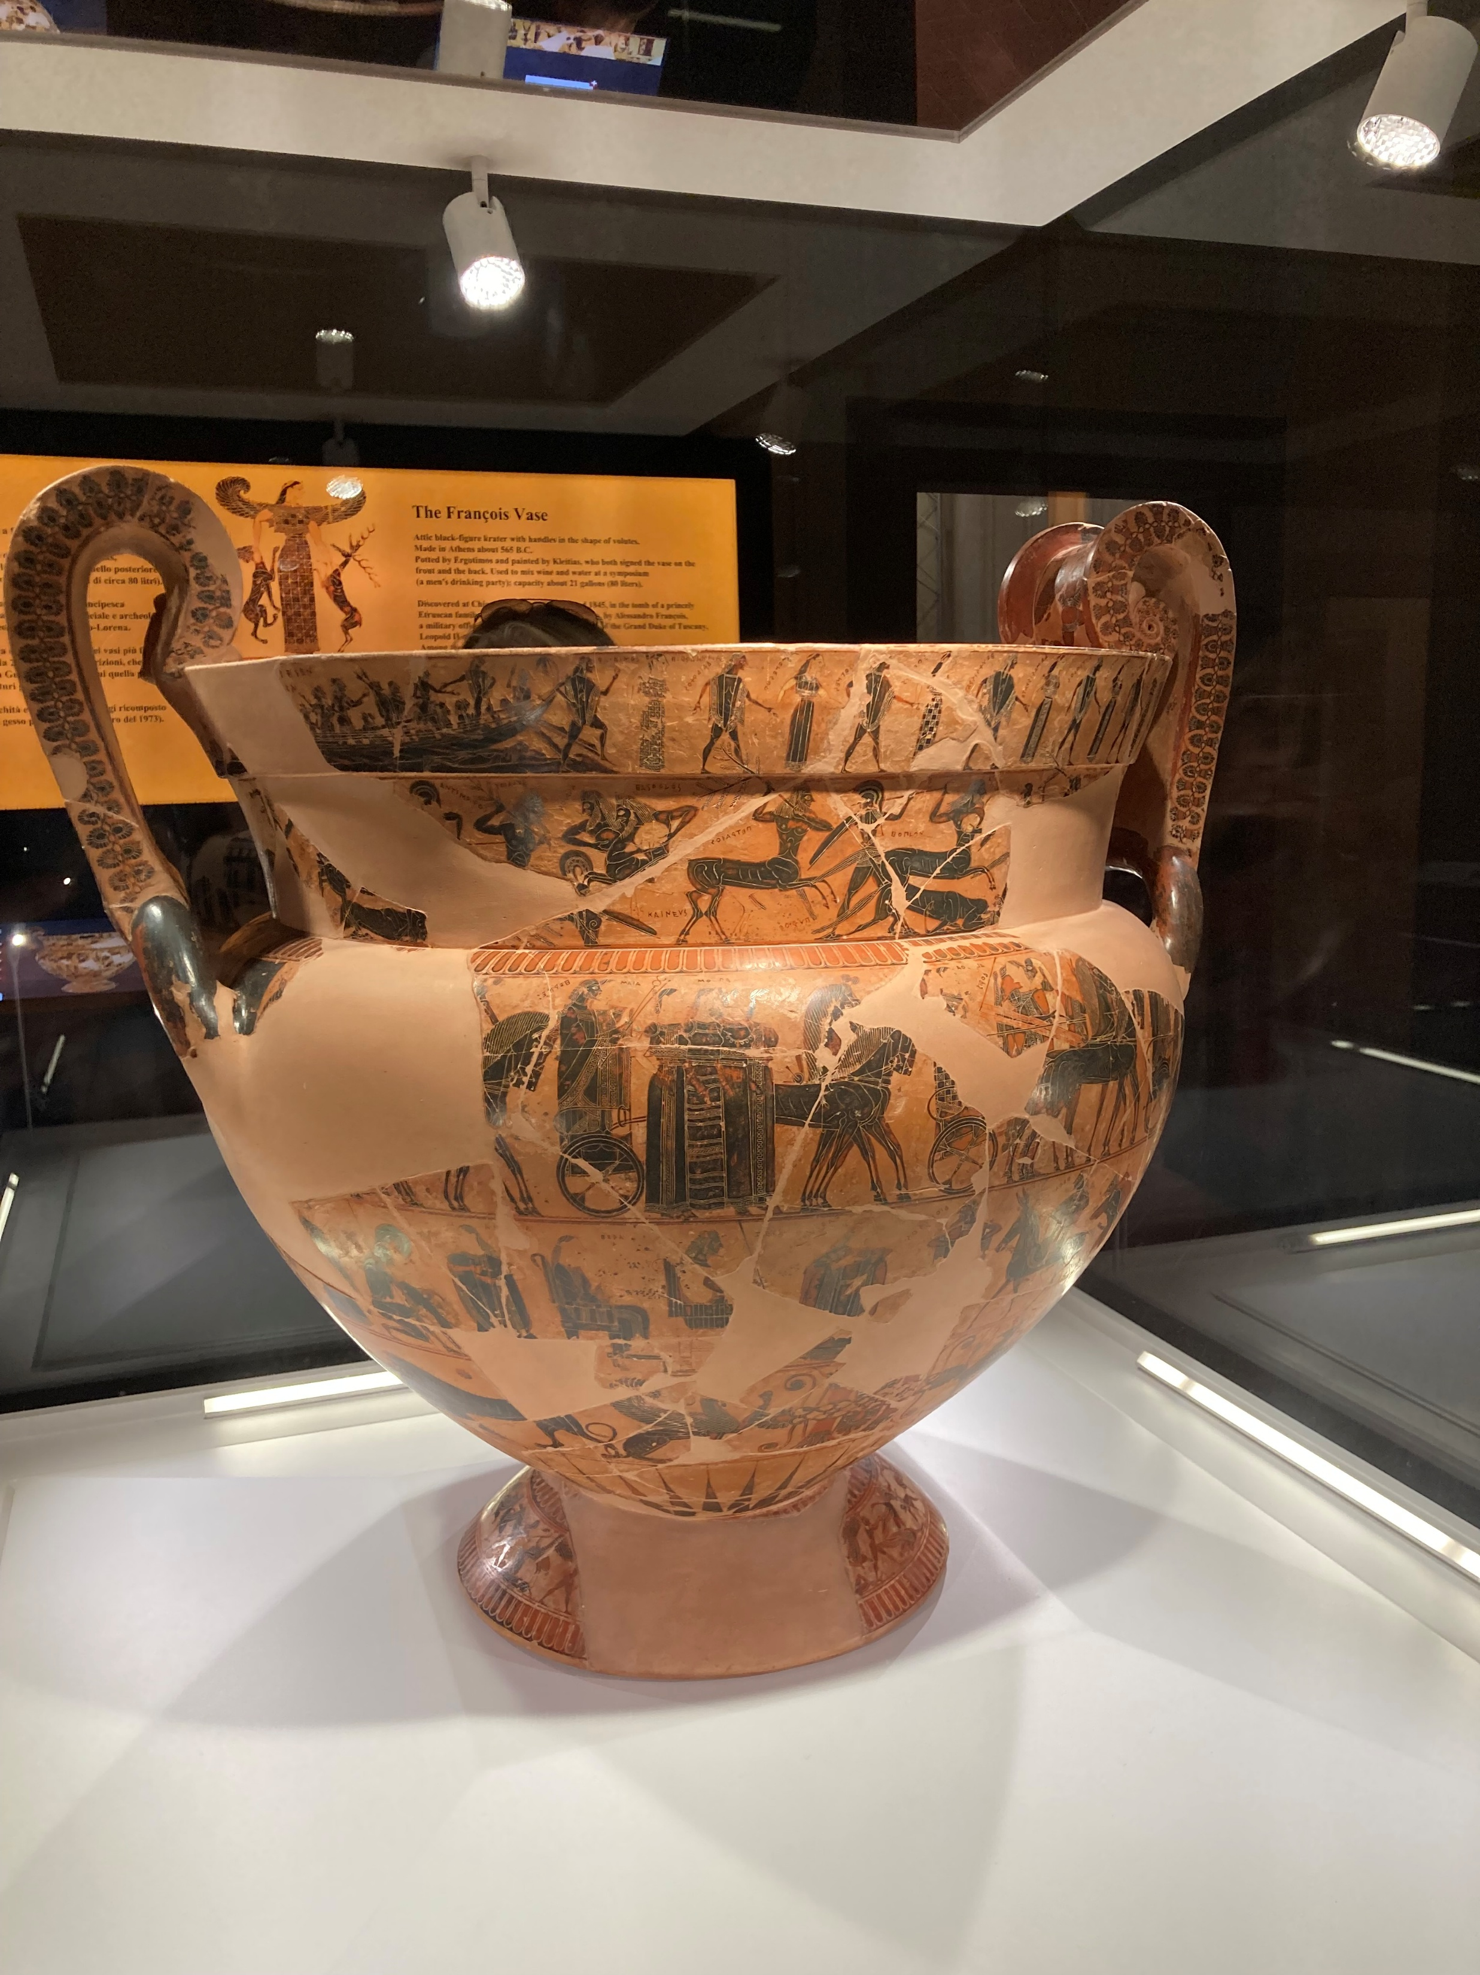
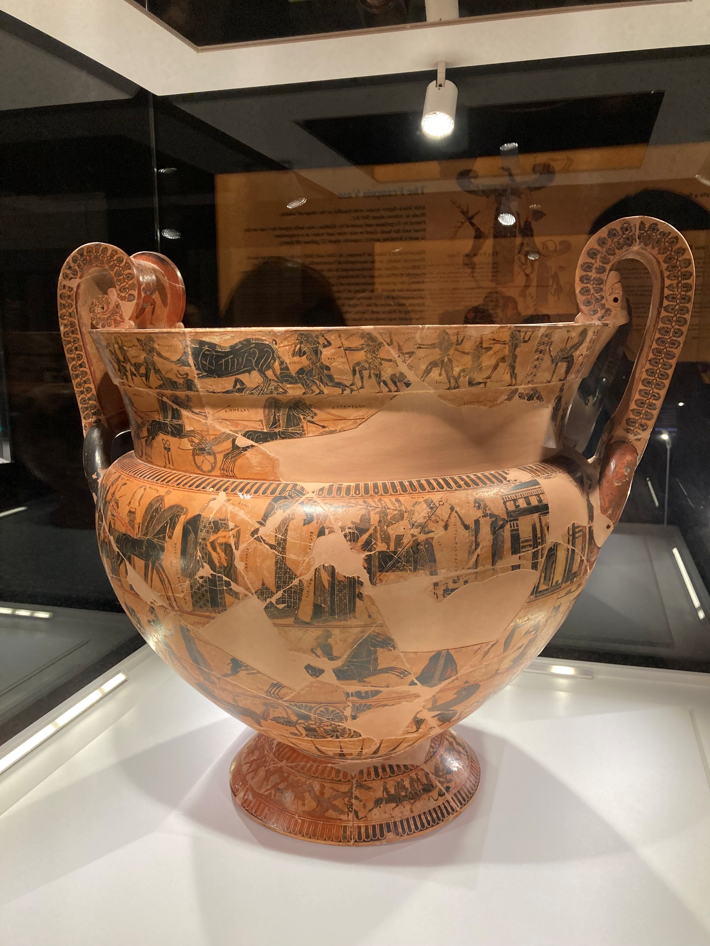

Slide 19
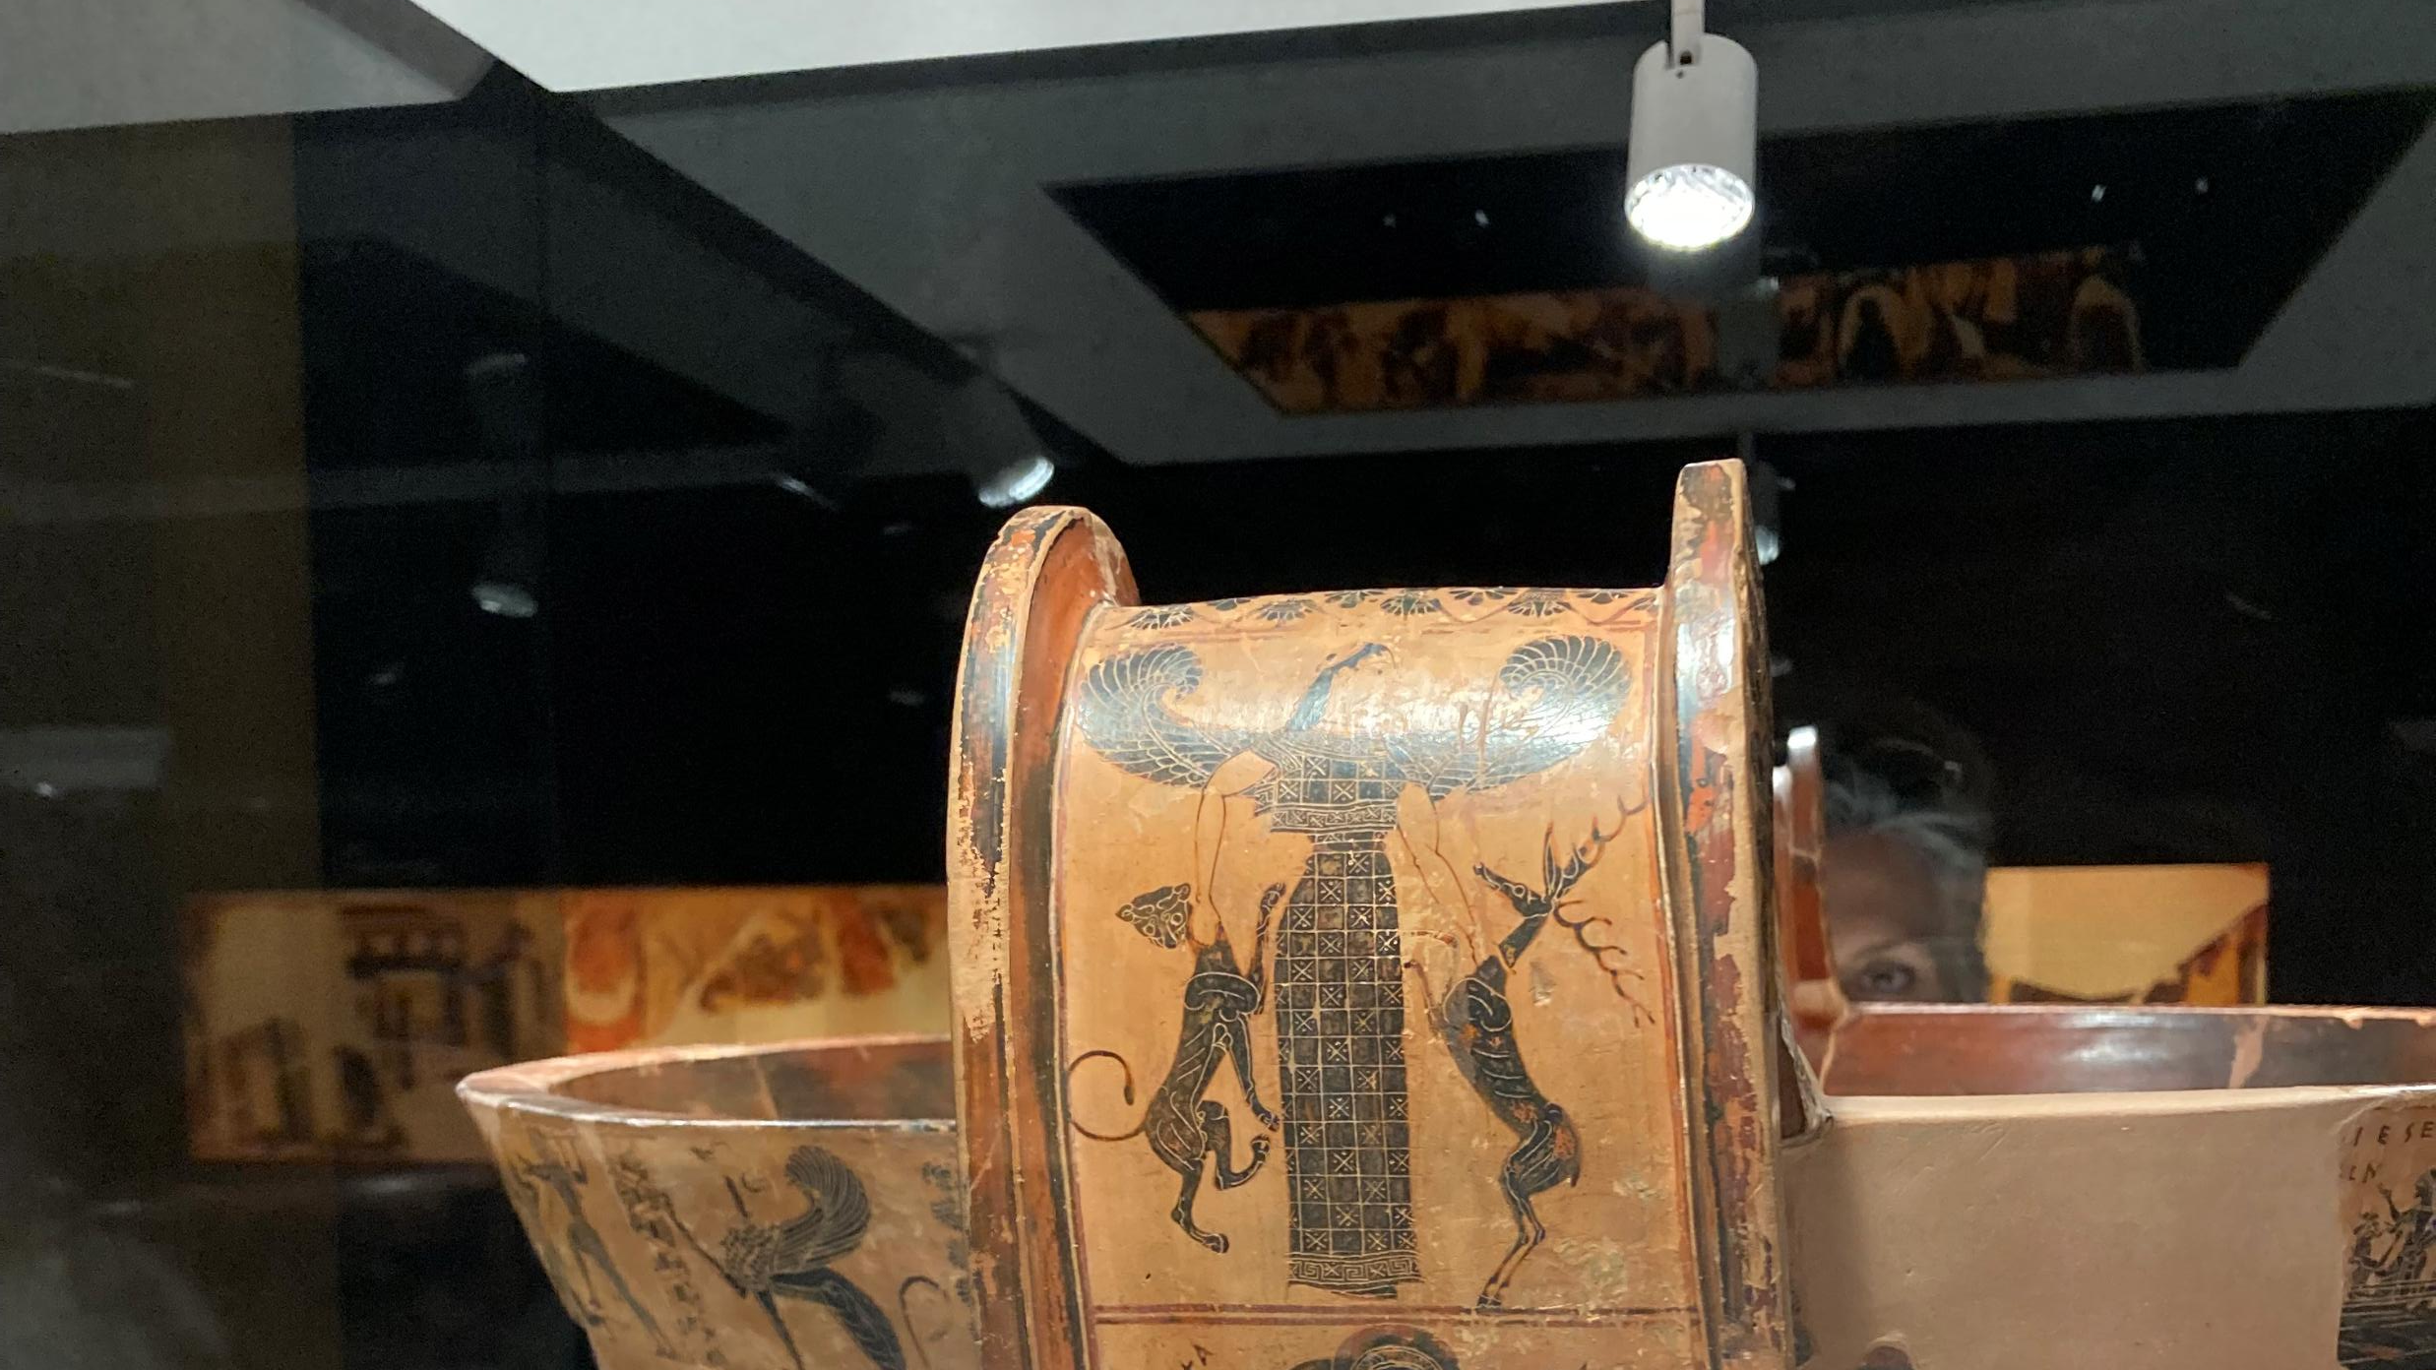

Slide 20
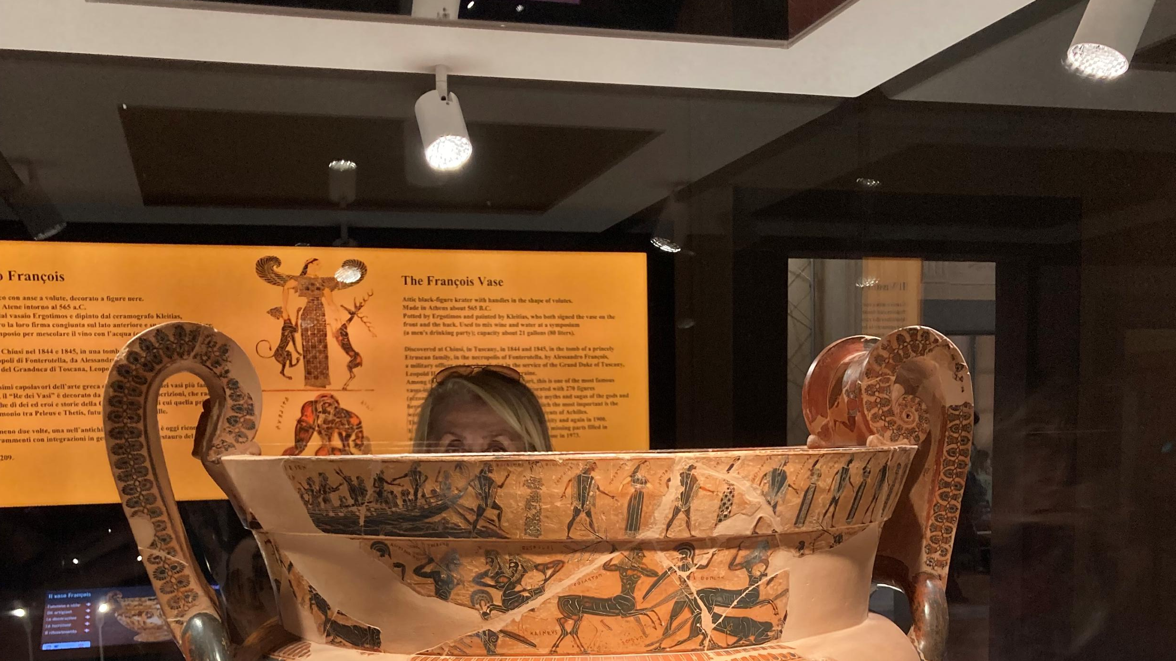

Slide 21
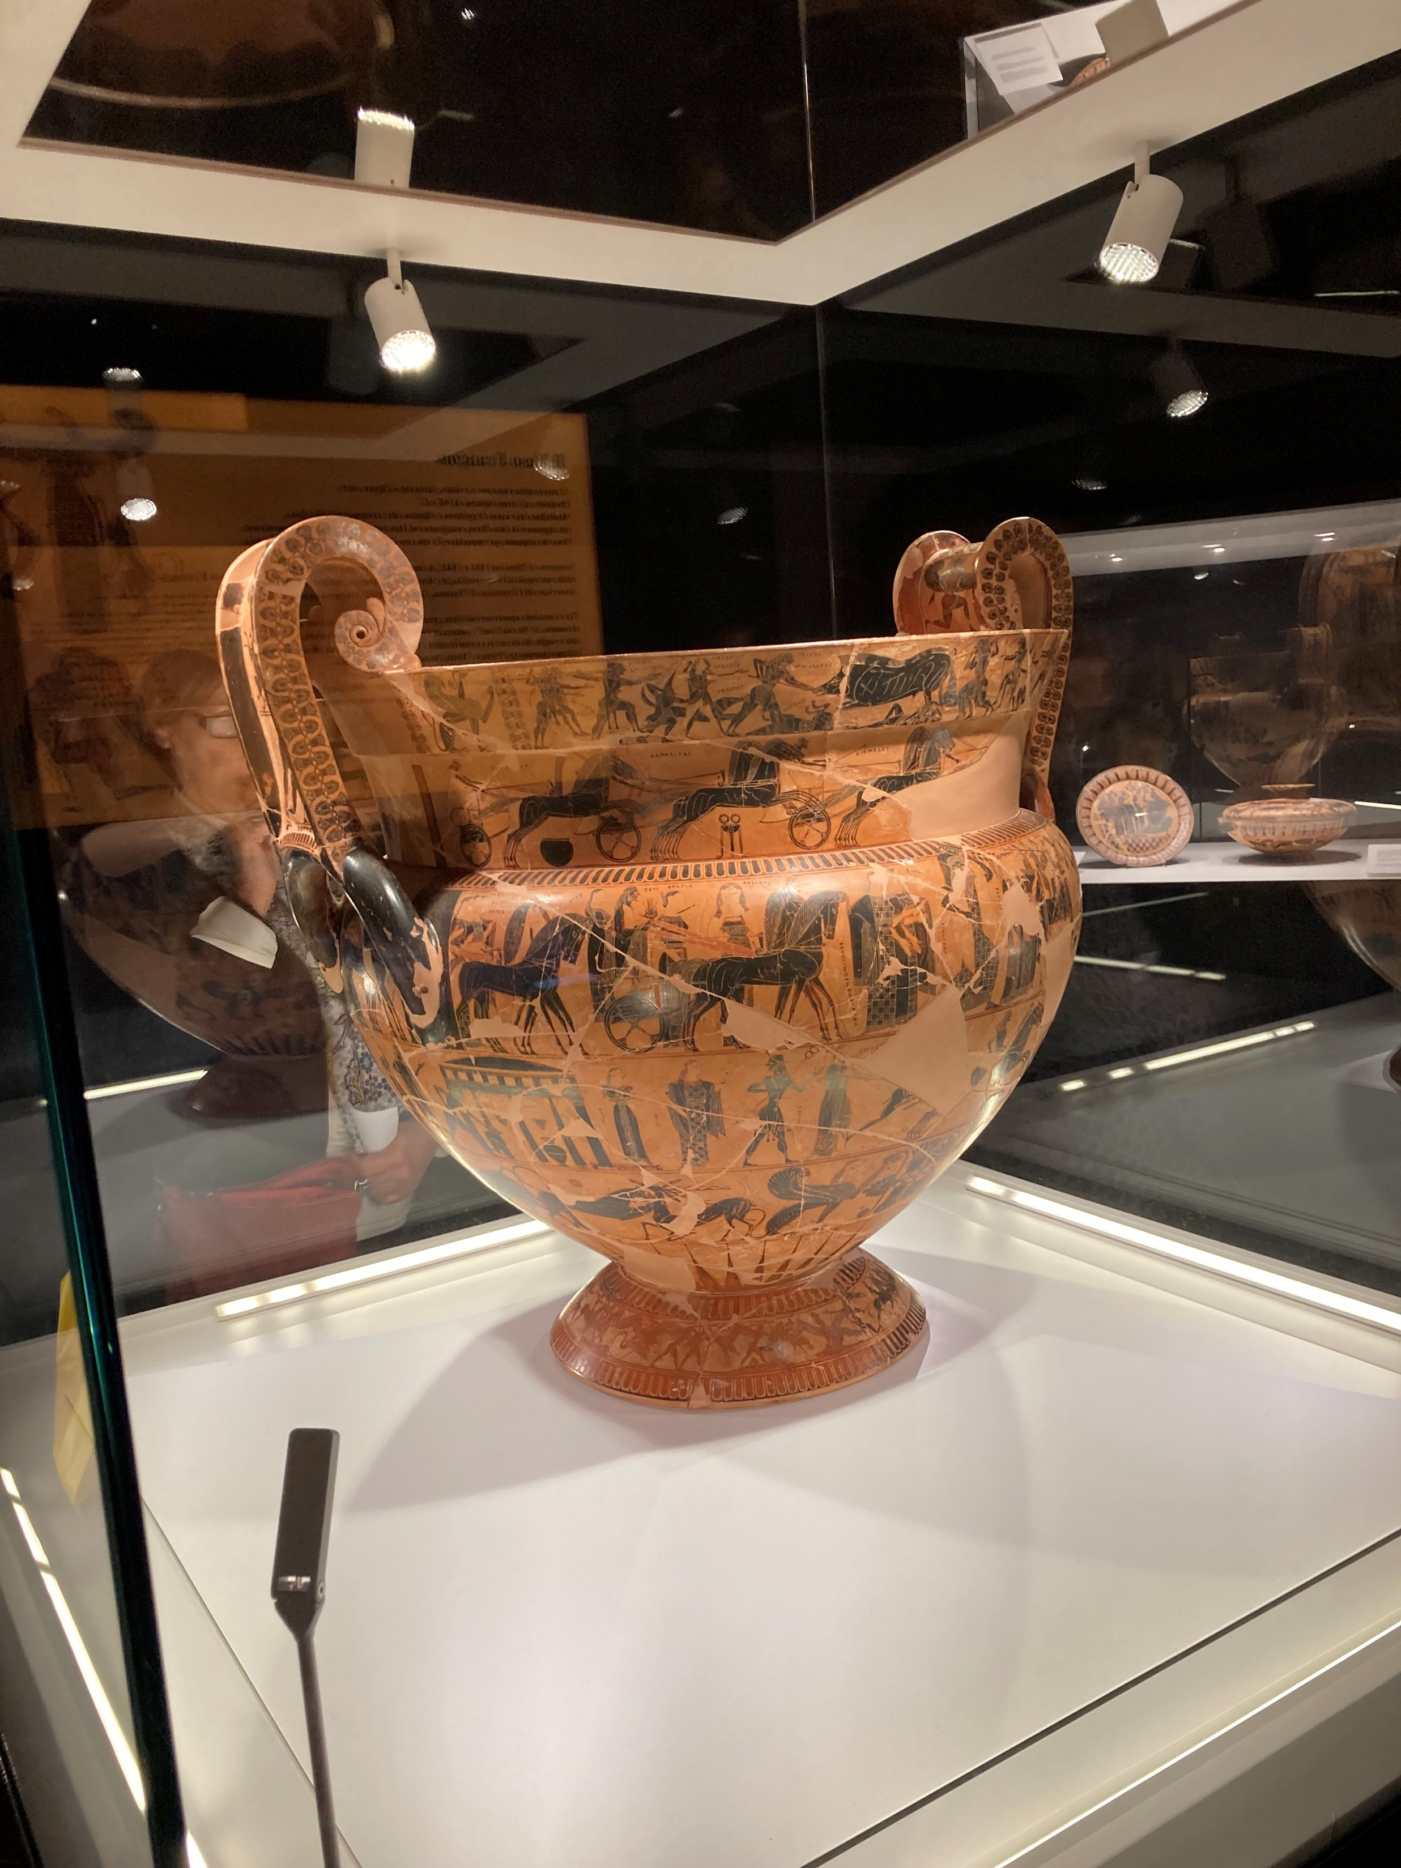
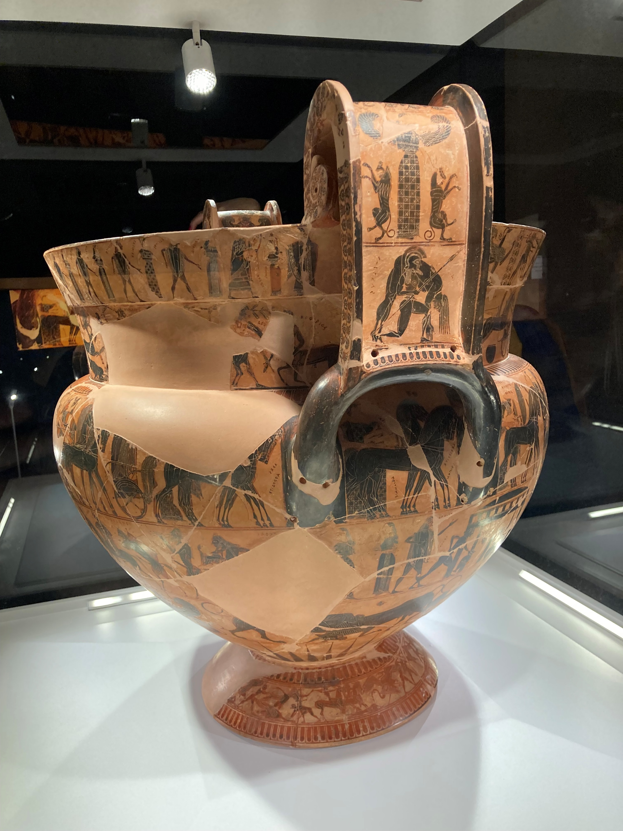

Slide 22
