Slide 1

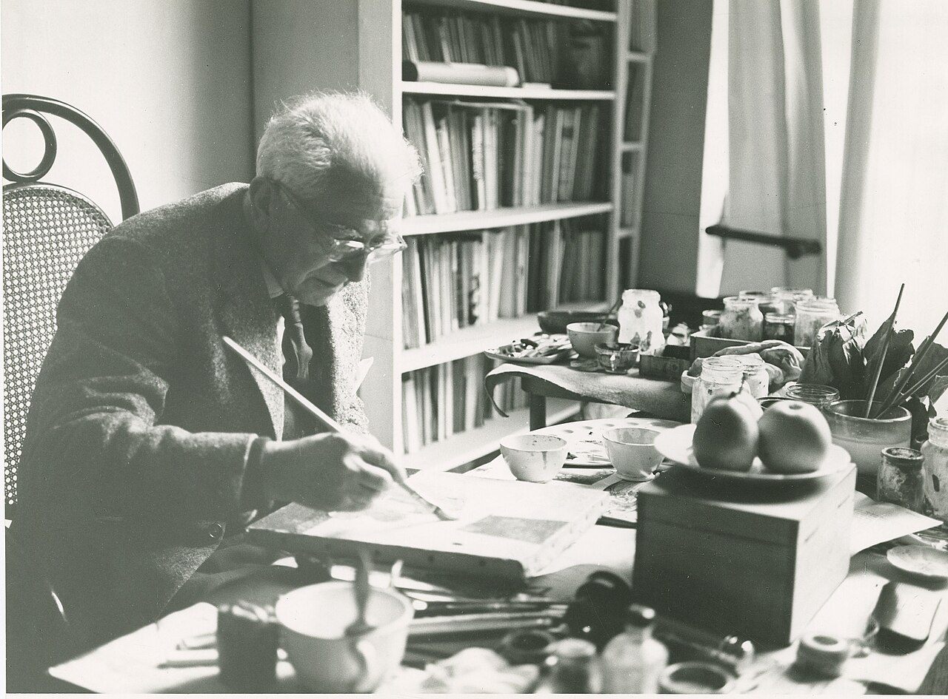
Felice Casorati
1883-1963

Slide 2
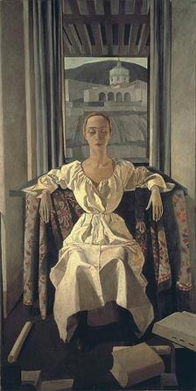
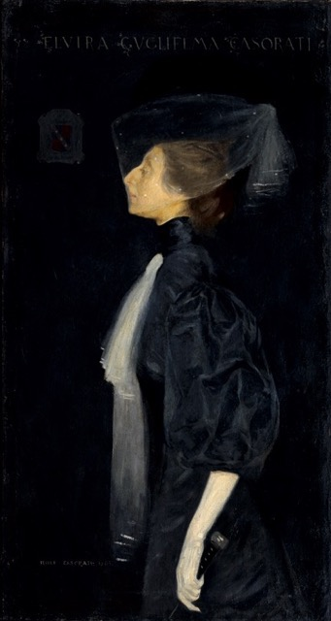
Silvana Cenni by Felice Casorati, 1922, tempera on canvas, 205 x 105 cm, Private Collection https://en.wikipedia.org/wiki/Felice_Casorati#/media/File:CasoratiSilvanaCenni.jpg
Portrait of a Lady or Portrait of Sister Elvira, 1907, Oil on Canvas, 135 x 72 cm, Private Collection http://www.miaminiche.com/felice-casoratis-search-for-balance-between-academic-painting-neoclassicism-and-anti-classicism/

Slide 3
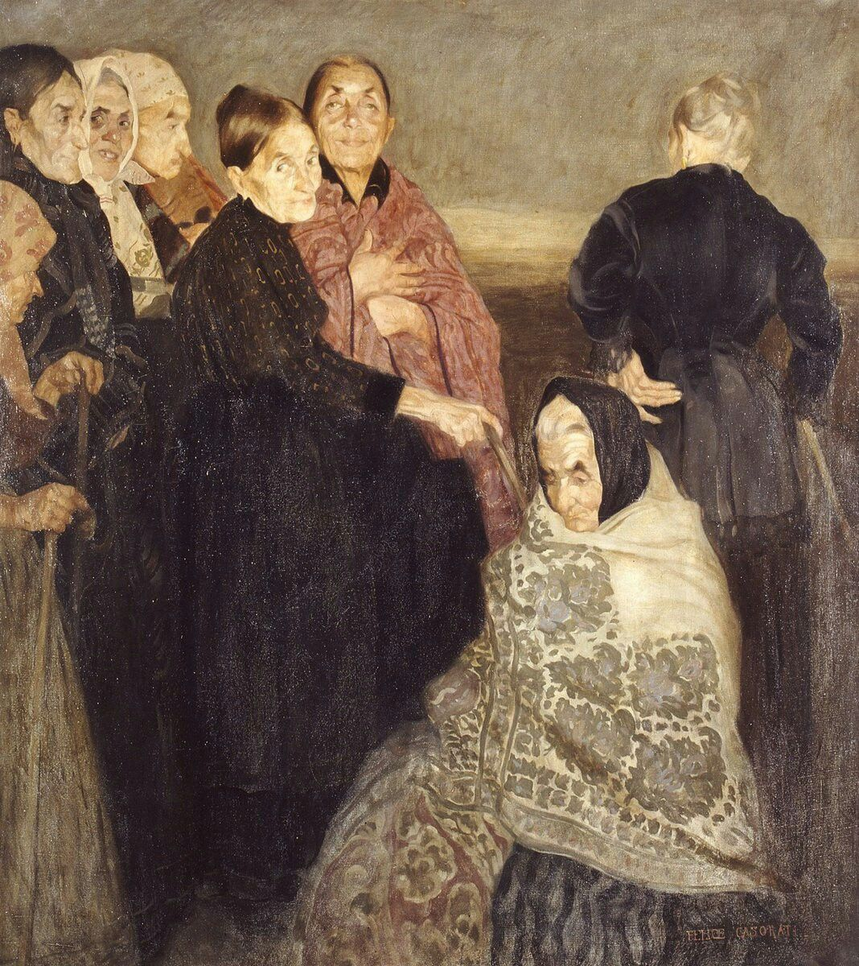
The Old Comrades (Le Vecchie Comari), 1908, Oil on Canvas, 131×116 cm, Galleria d’Arte Moderna di Verona, Italy

Slide 4
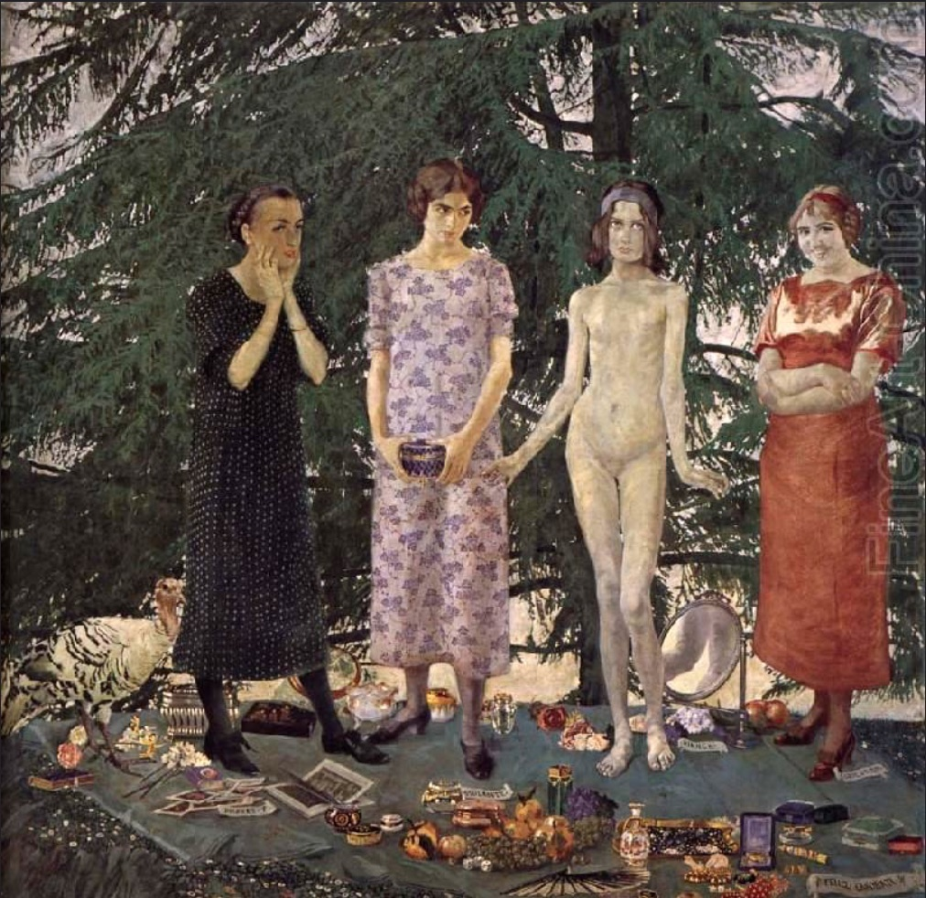
The Young Ladies (Le Signorine), 1912, Oil on Canvas, 197 x 190 cm, Galleria Internazionale d’Arte Moderna, Venezia, Italy http://www.miaminiche.com/felice-casoratis-search-for-balance-between-academic-painting-neoclassicism-and-anti-classicism/

Slide 5
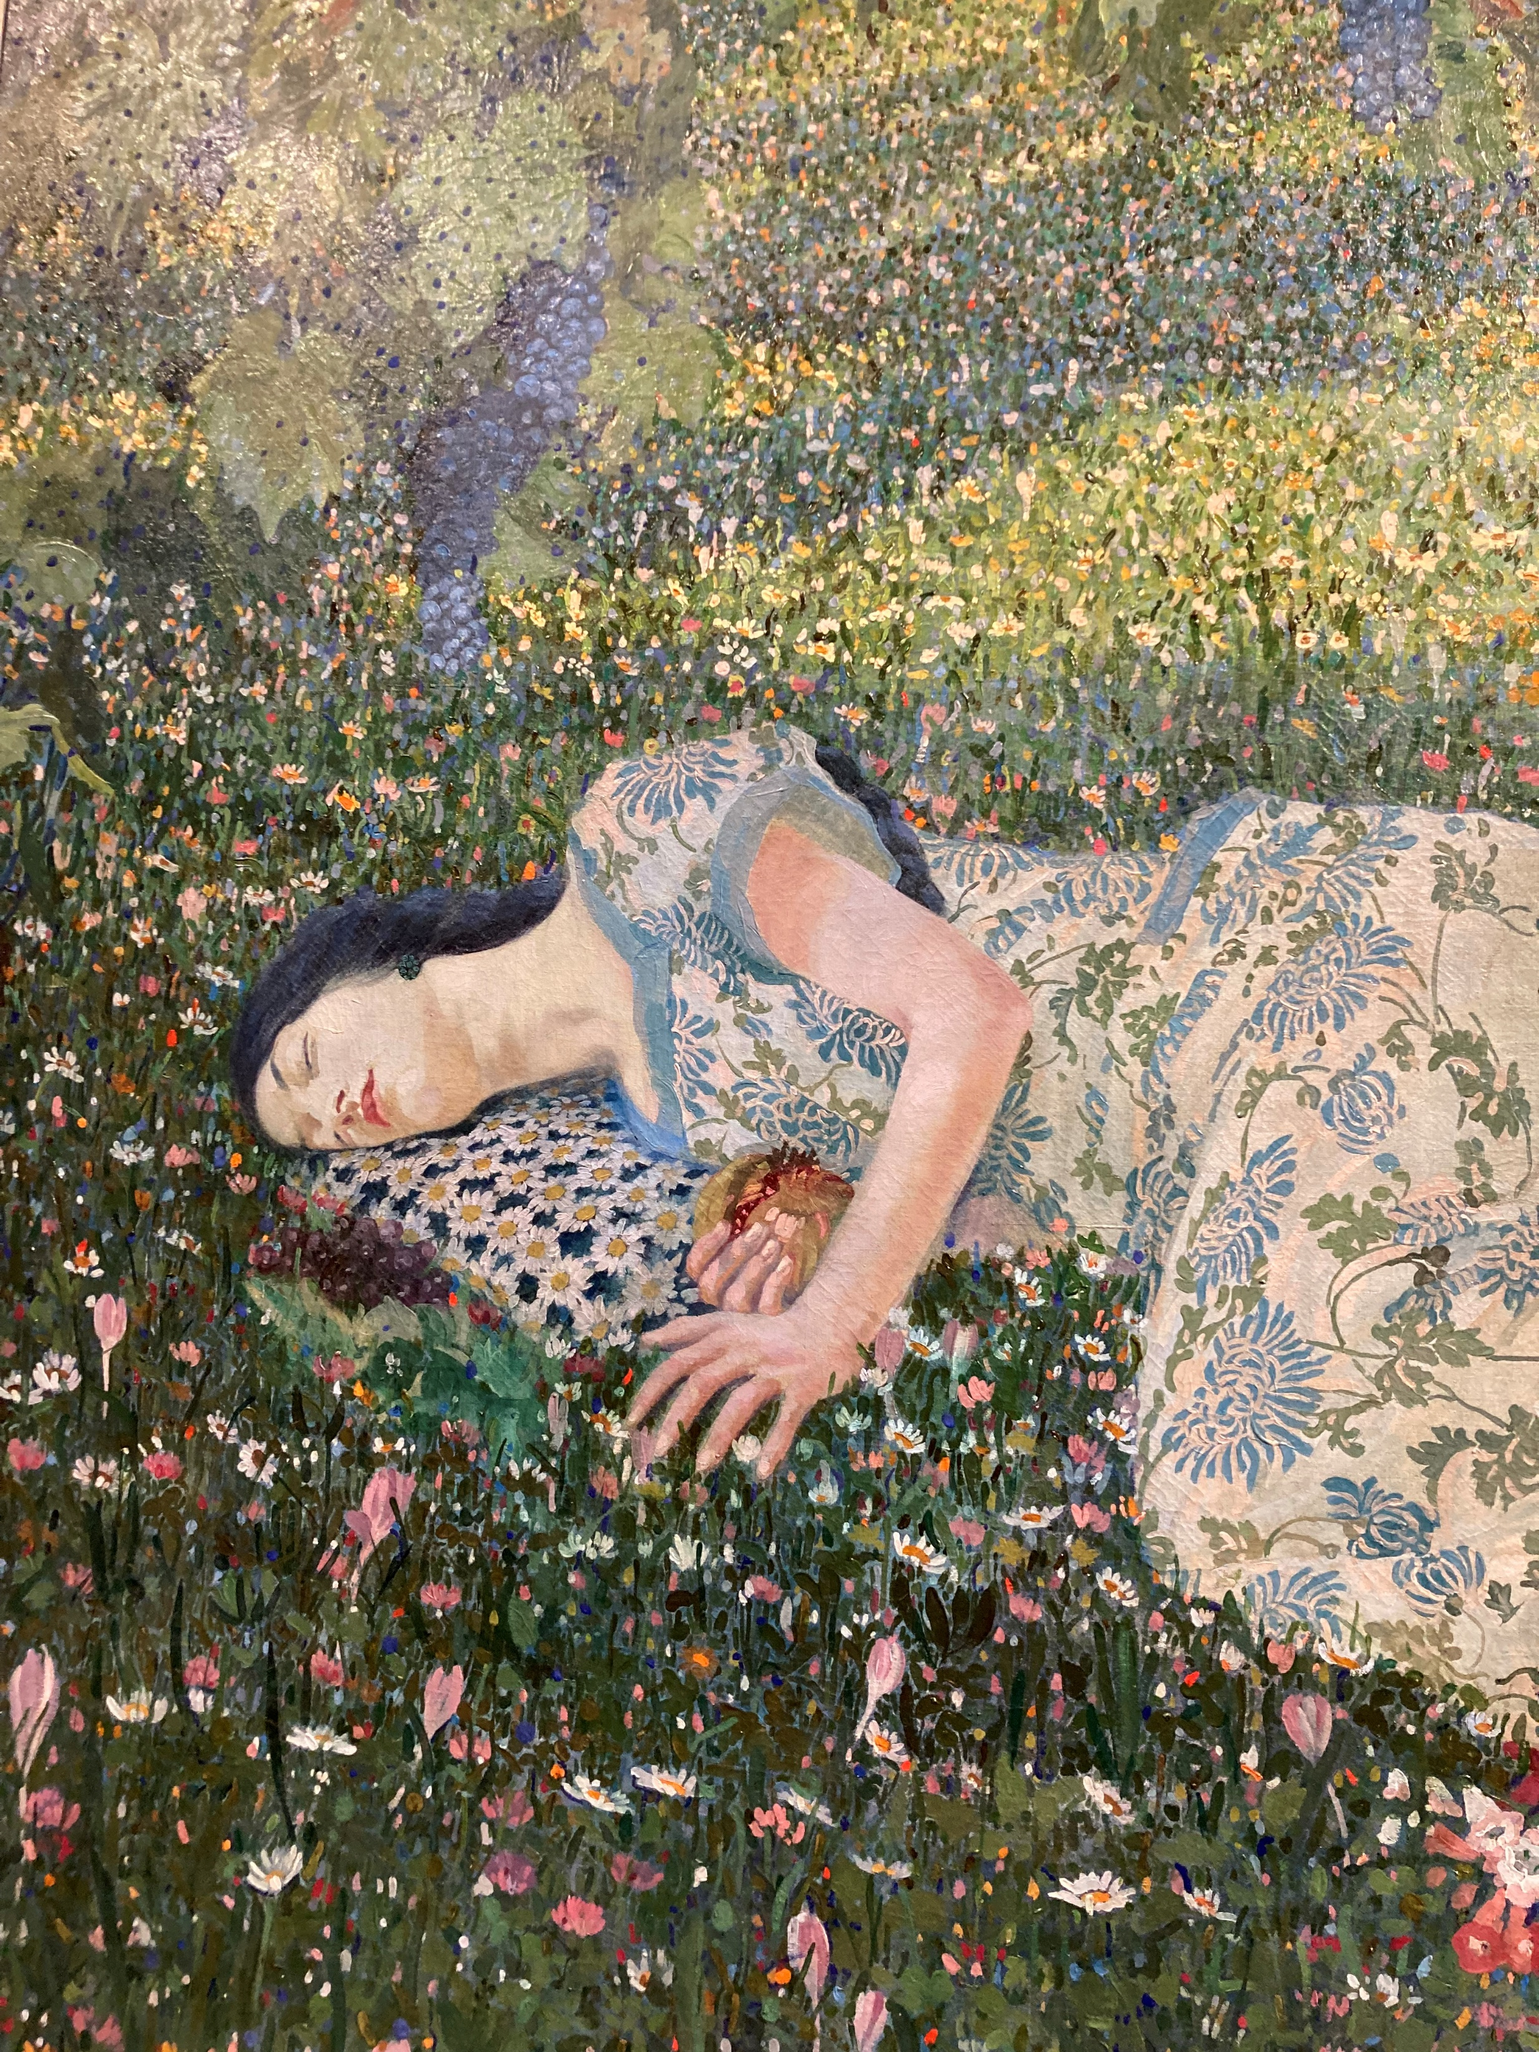
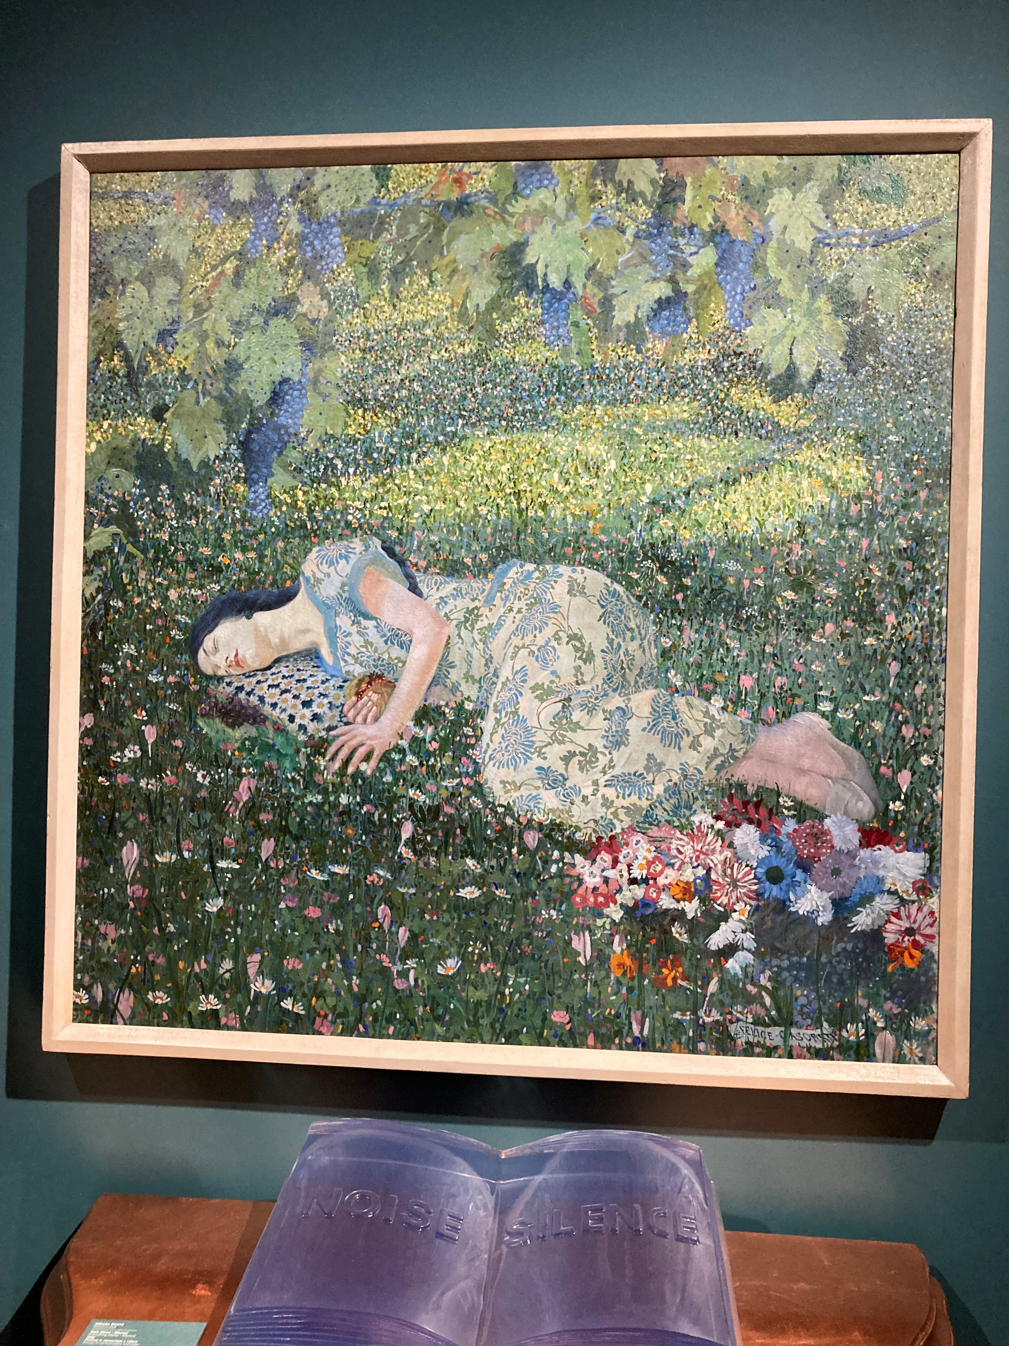
The Dream of the Pomegranate, 1913, Oil on Canvas, Palazzo Maffei, Verona Italy – Photo Credit: Amalia Spiliakou, September 2025

Slide 6
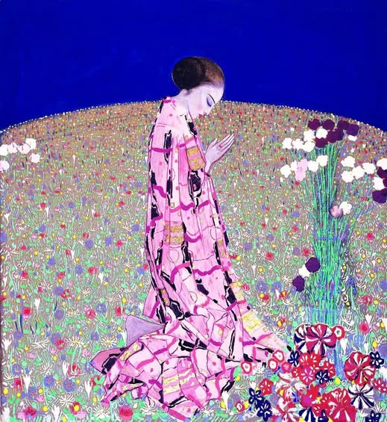
The Prayer, The Prayer, 1914, Tempera on Moleskin, 130x120 cm, Galleria d'Arte Moderna Achille Forti, Verona, Italy

Slide 7
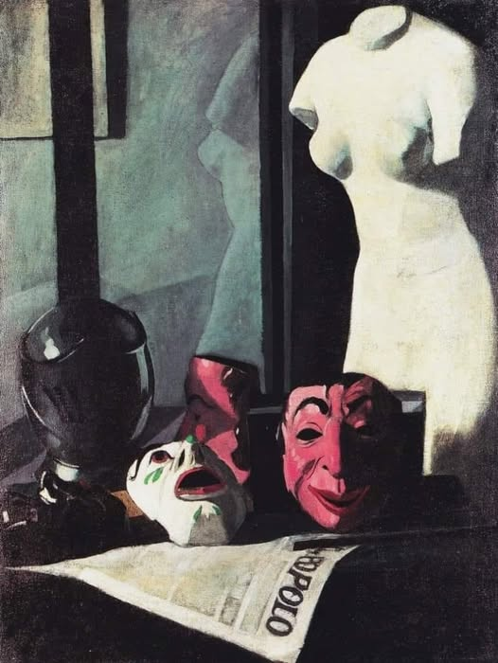
Masks, 1921, Oil on Canvas, 100 x 75.5 cm, Alessandria,
Civic Museum and Art Gallery, Italy

Slide 8
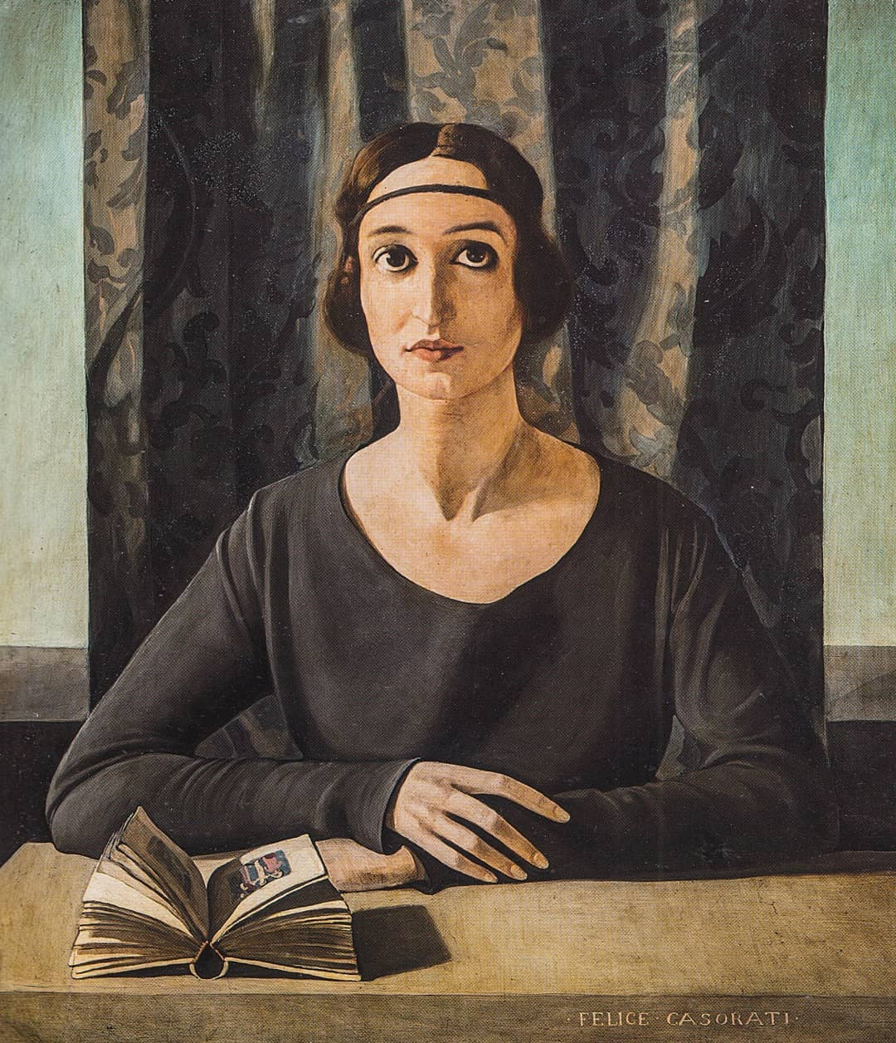
Portrait of Cesarina Gurgo Salice or Portrait of a Lady, 1922, Oil on Panel, 72 x 60 cm, Private collection https://www.facebook.com/museirealitorino/photos/felice-casoraticesarina-gualino-gurgo-salice1922-olio-su-telacollezione-privata/2633643183313636/?_rdr

Slide 9
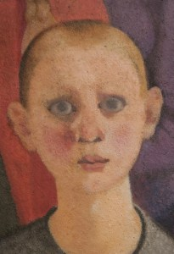
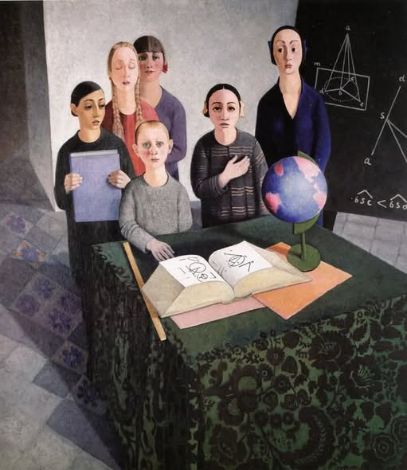
Gli scolari (Pupils), 1927-28, Oil on panel, 169 x 151 cm, Galleria d'Arte Moderna Empedocle Restivo, Palermo, Italy https://www.facebook.com/100083181165978/posts/felice-casorati-gli-scolari-pupils-1927-28-oil-on-panel-169-x-151-cm-galleria-da/620808580701842/

Slide 10
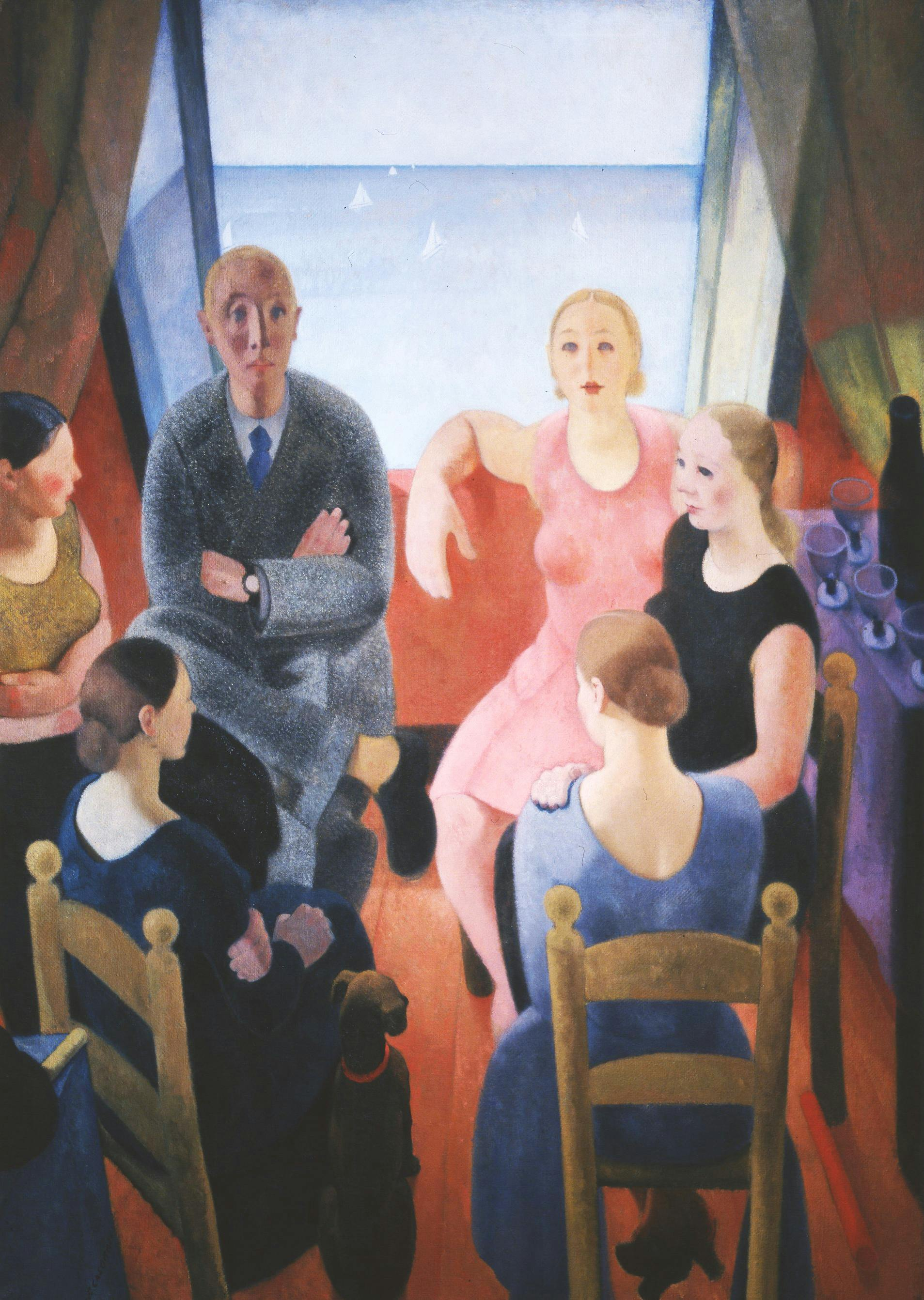
The Stranger, 1930, Oil on Canvas, 170 x 120 cm, Pitti Palace-Gallery of Modern Art, Florence, Italy https://www.uffizi.it/en/artworks/the-stranger-felice-casorati

Slide 11
The End

