Slide 1
Raffaello Sanzio
1483-1520
The Florentine
Madonnas
155-1508

Slide 2
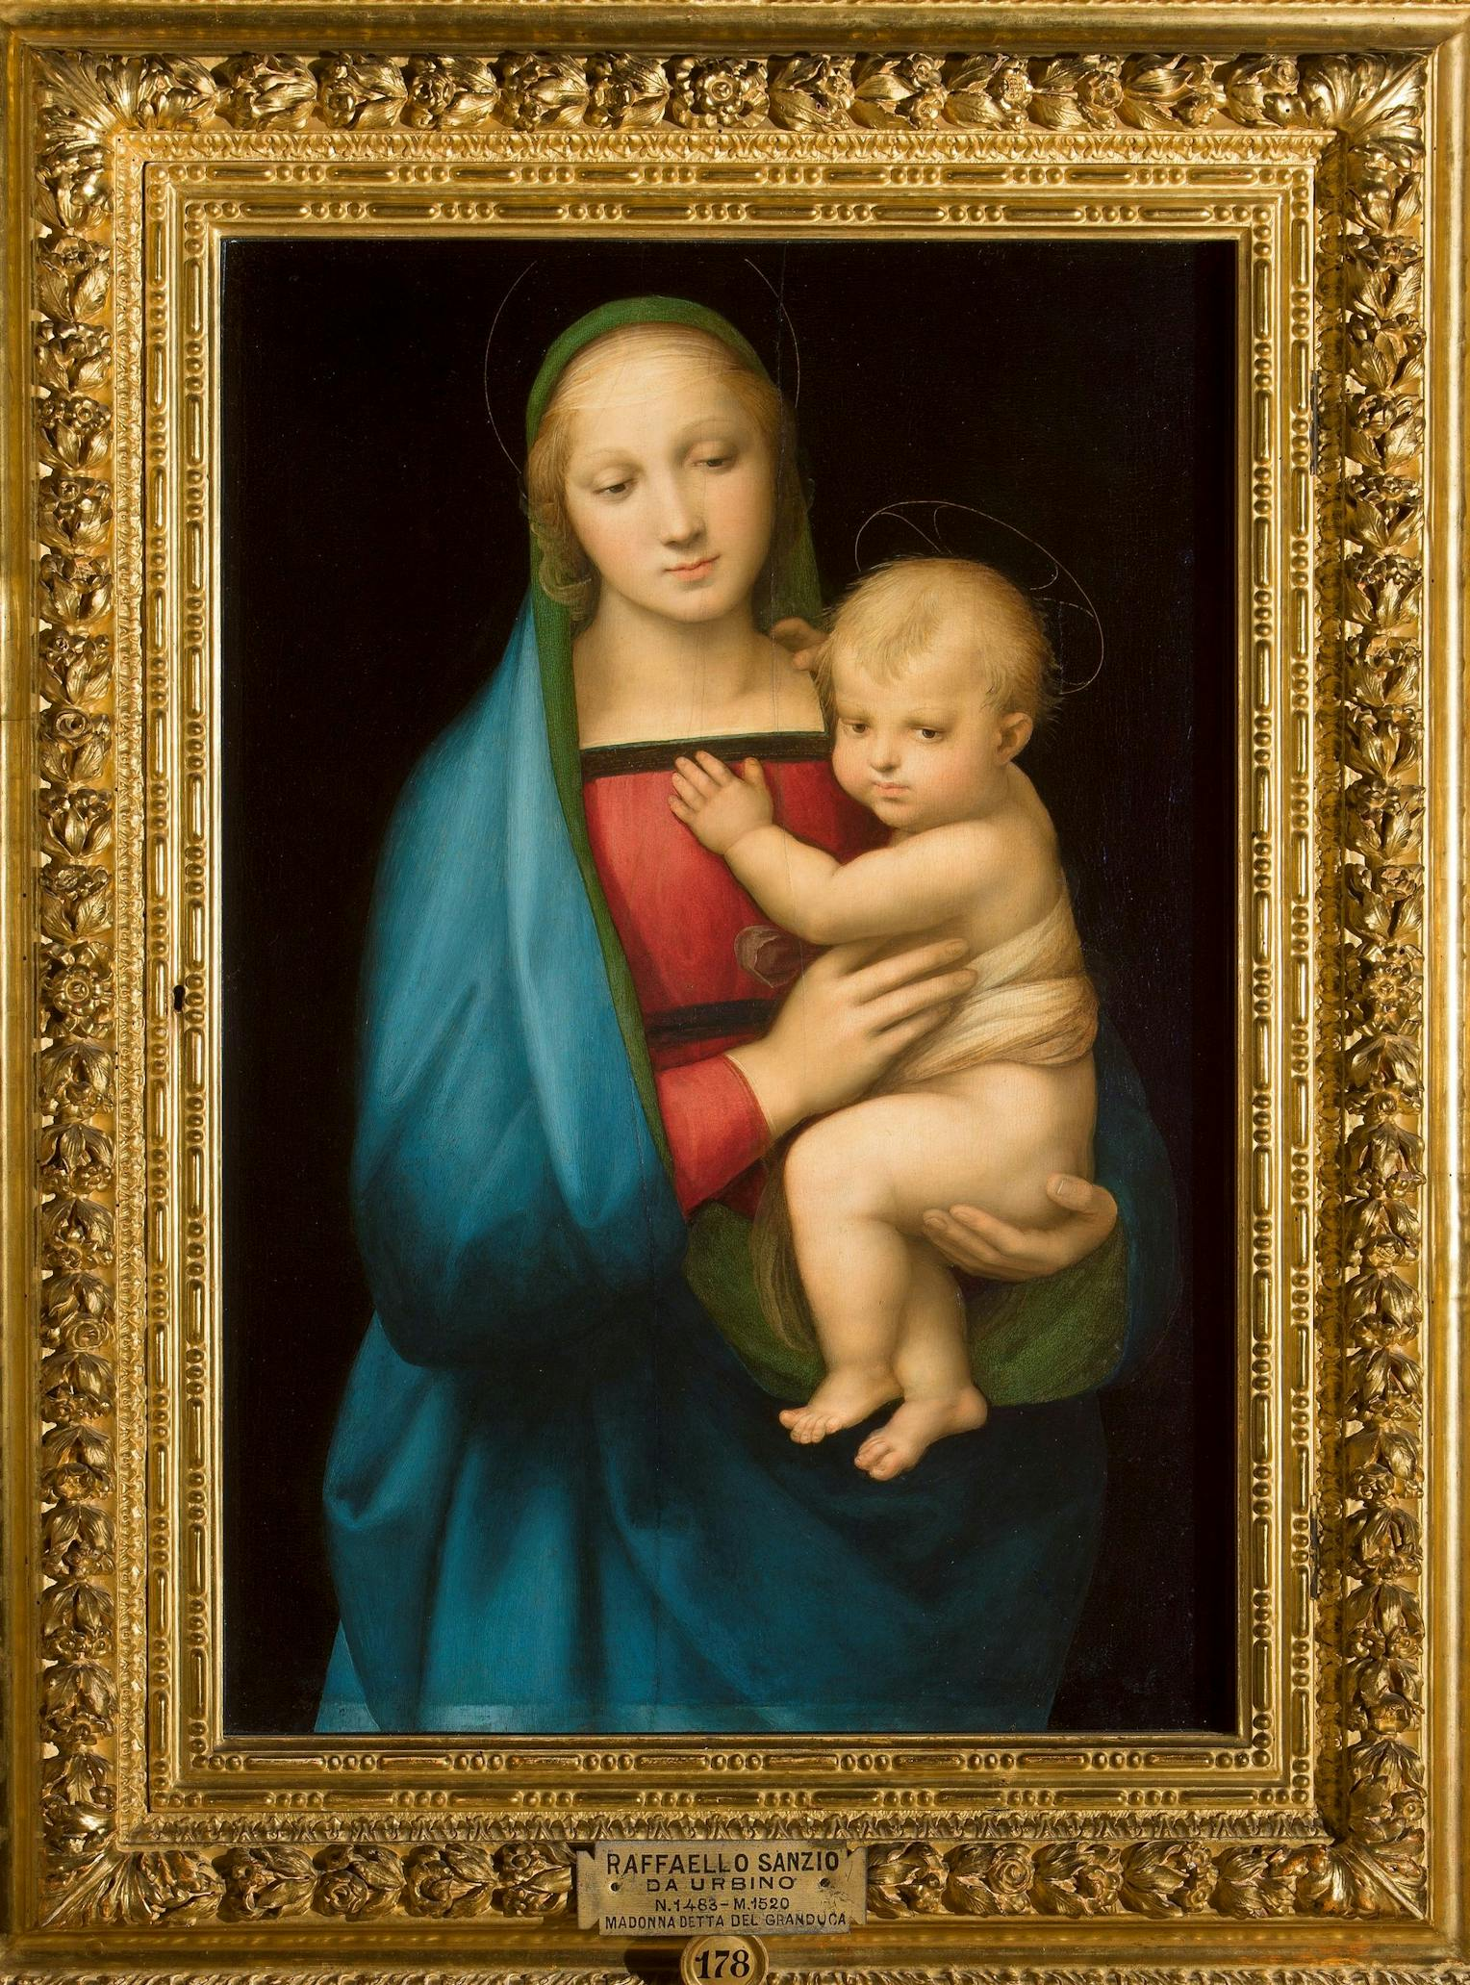
The Granduca Madonna, 1506, Oil on wood,
84 x 56 cm, Galleria Palatina (Palazzo Pitti), Florence, Italy https://www.uffizi.it/en/artworks/madonna-del-granduca#gallery

Slide 3
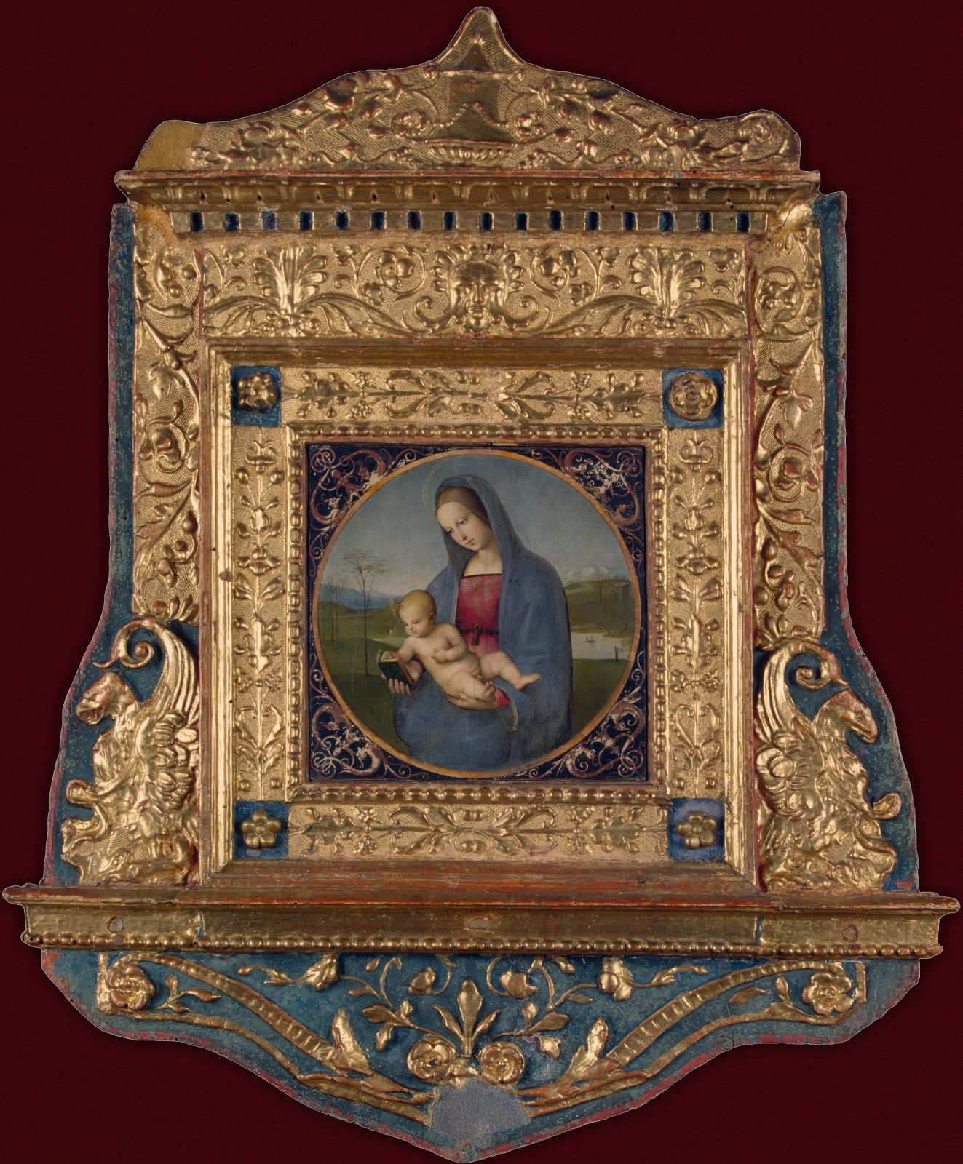
Madonna with the Book (Conestabile Madonna), 1504, Tempera on canvas transferred from wood, diameter 17,9 cm, The Hermitage, St. Petersburg, Russia https://www.hermitagemuseum.org/digital-collection/29672?lng=en

Slide 4
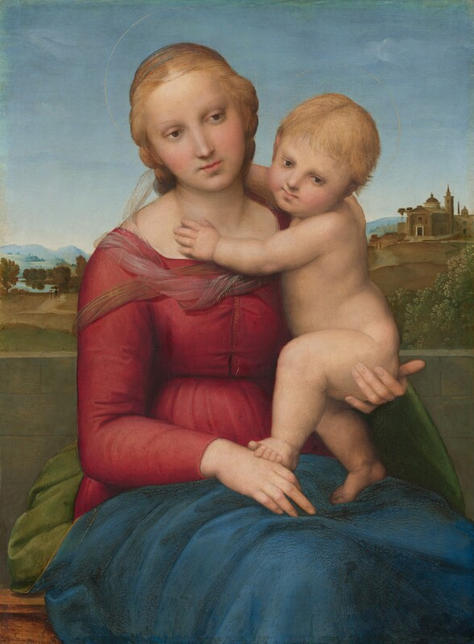
Madonna and Child (The Small Cowper Madonna), 1504-05, Oil on wood, 58 x 43 cm, National Gallery of Art, Washington DC, USA https://www.nga.gov/artworks/1196-small-cowper-madonna

Slide 5
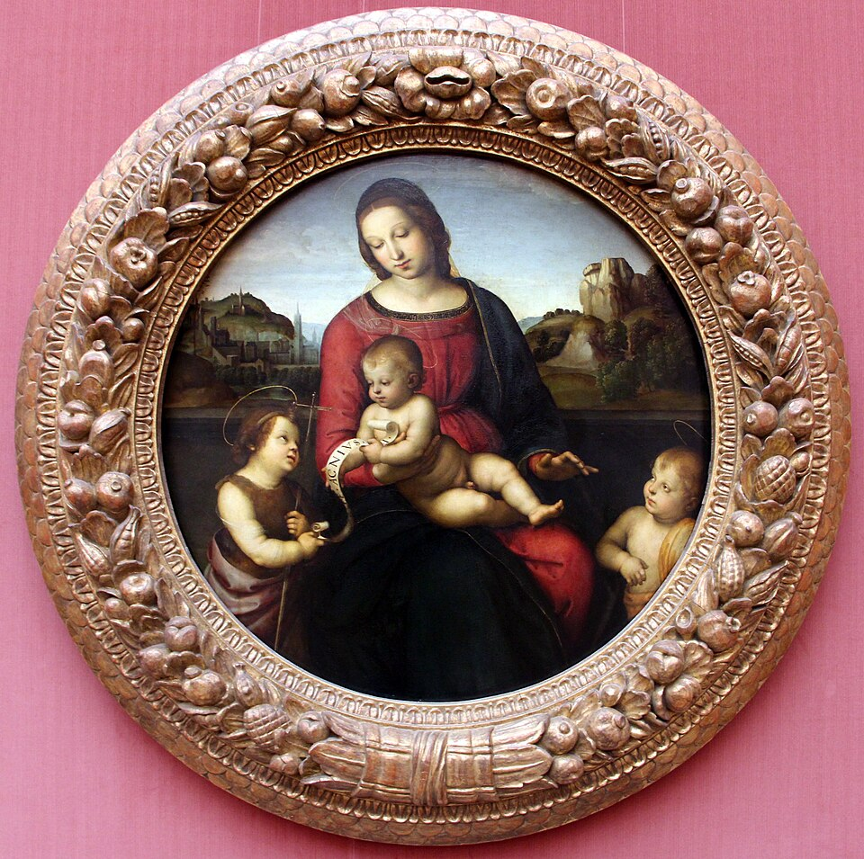
Terranuova Madonna, c. 1505, Oil on wood, Diameter: 86 cm, Staatliche Museen, Berlin, Germany https://commons.wikimedia.org/wiki/File:Raffaello,_madonna_terranuova,_1505_ca.JPG

Slide 6
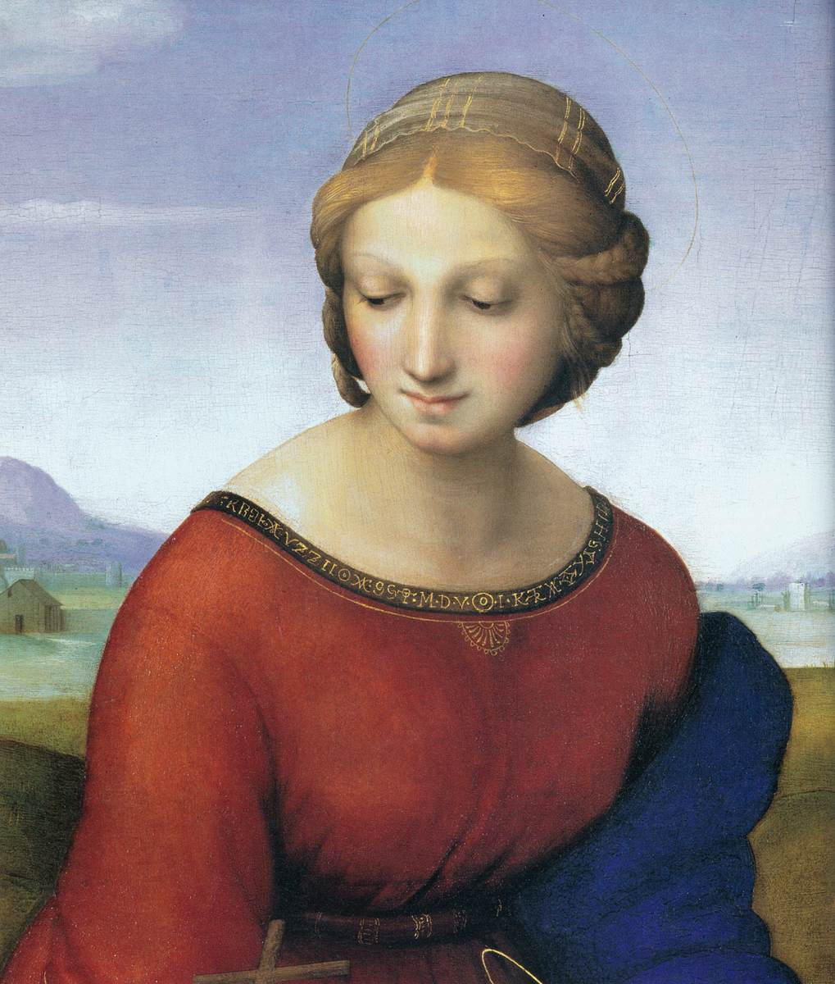
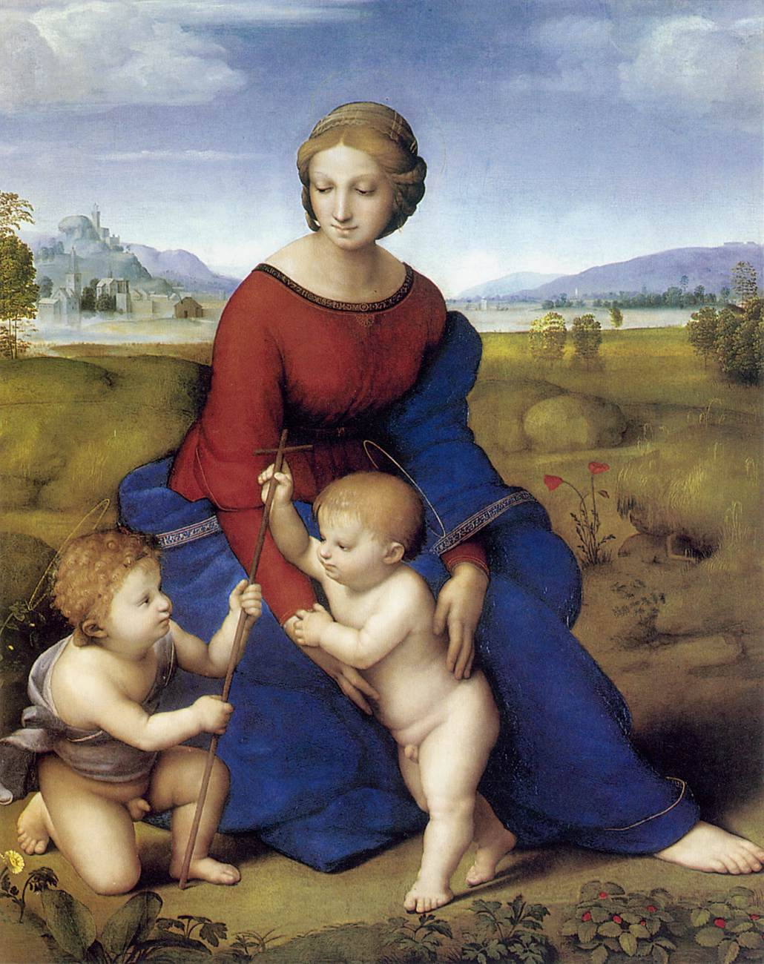
Madonna of Belvedere (Madonna del Prato), 1506, Oil on wood,
113 x 88 cm, Kunsthistorisches Museum, Vienna, Austria https://www.wga.hu/frames-e.html?/html/r/raphael/index.html

Slide 7
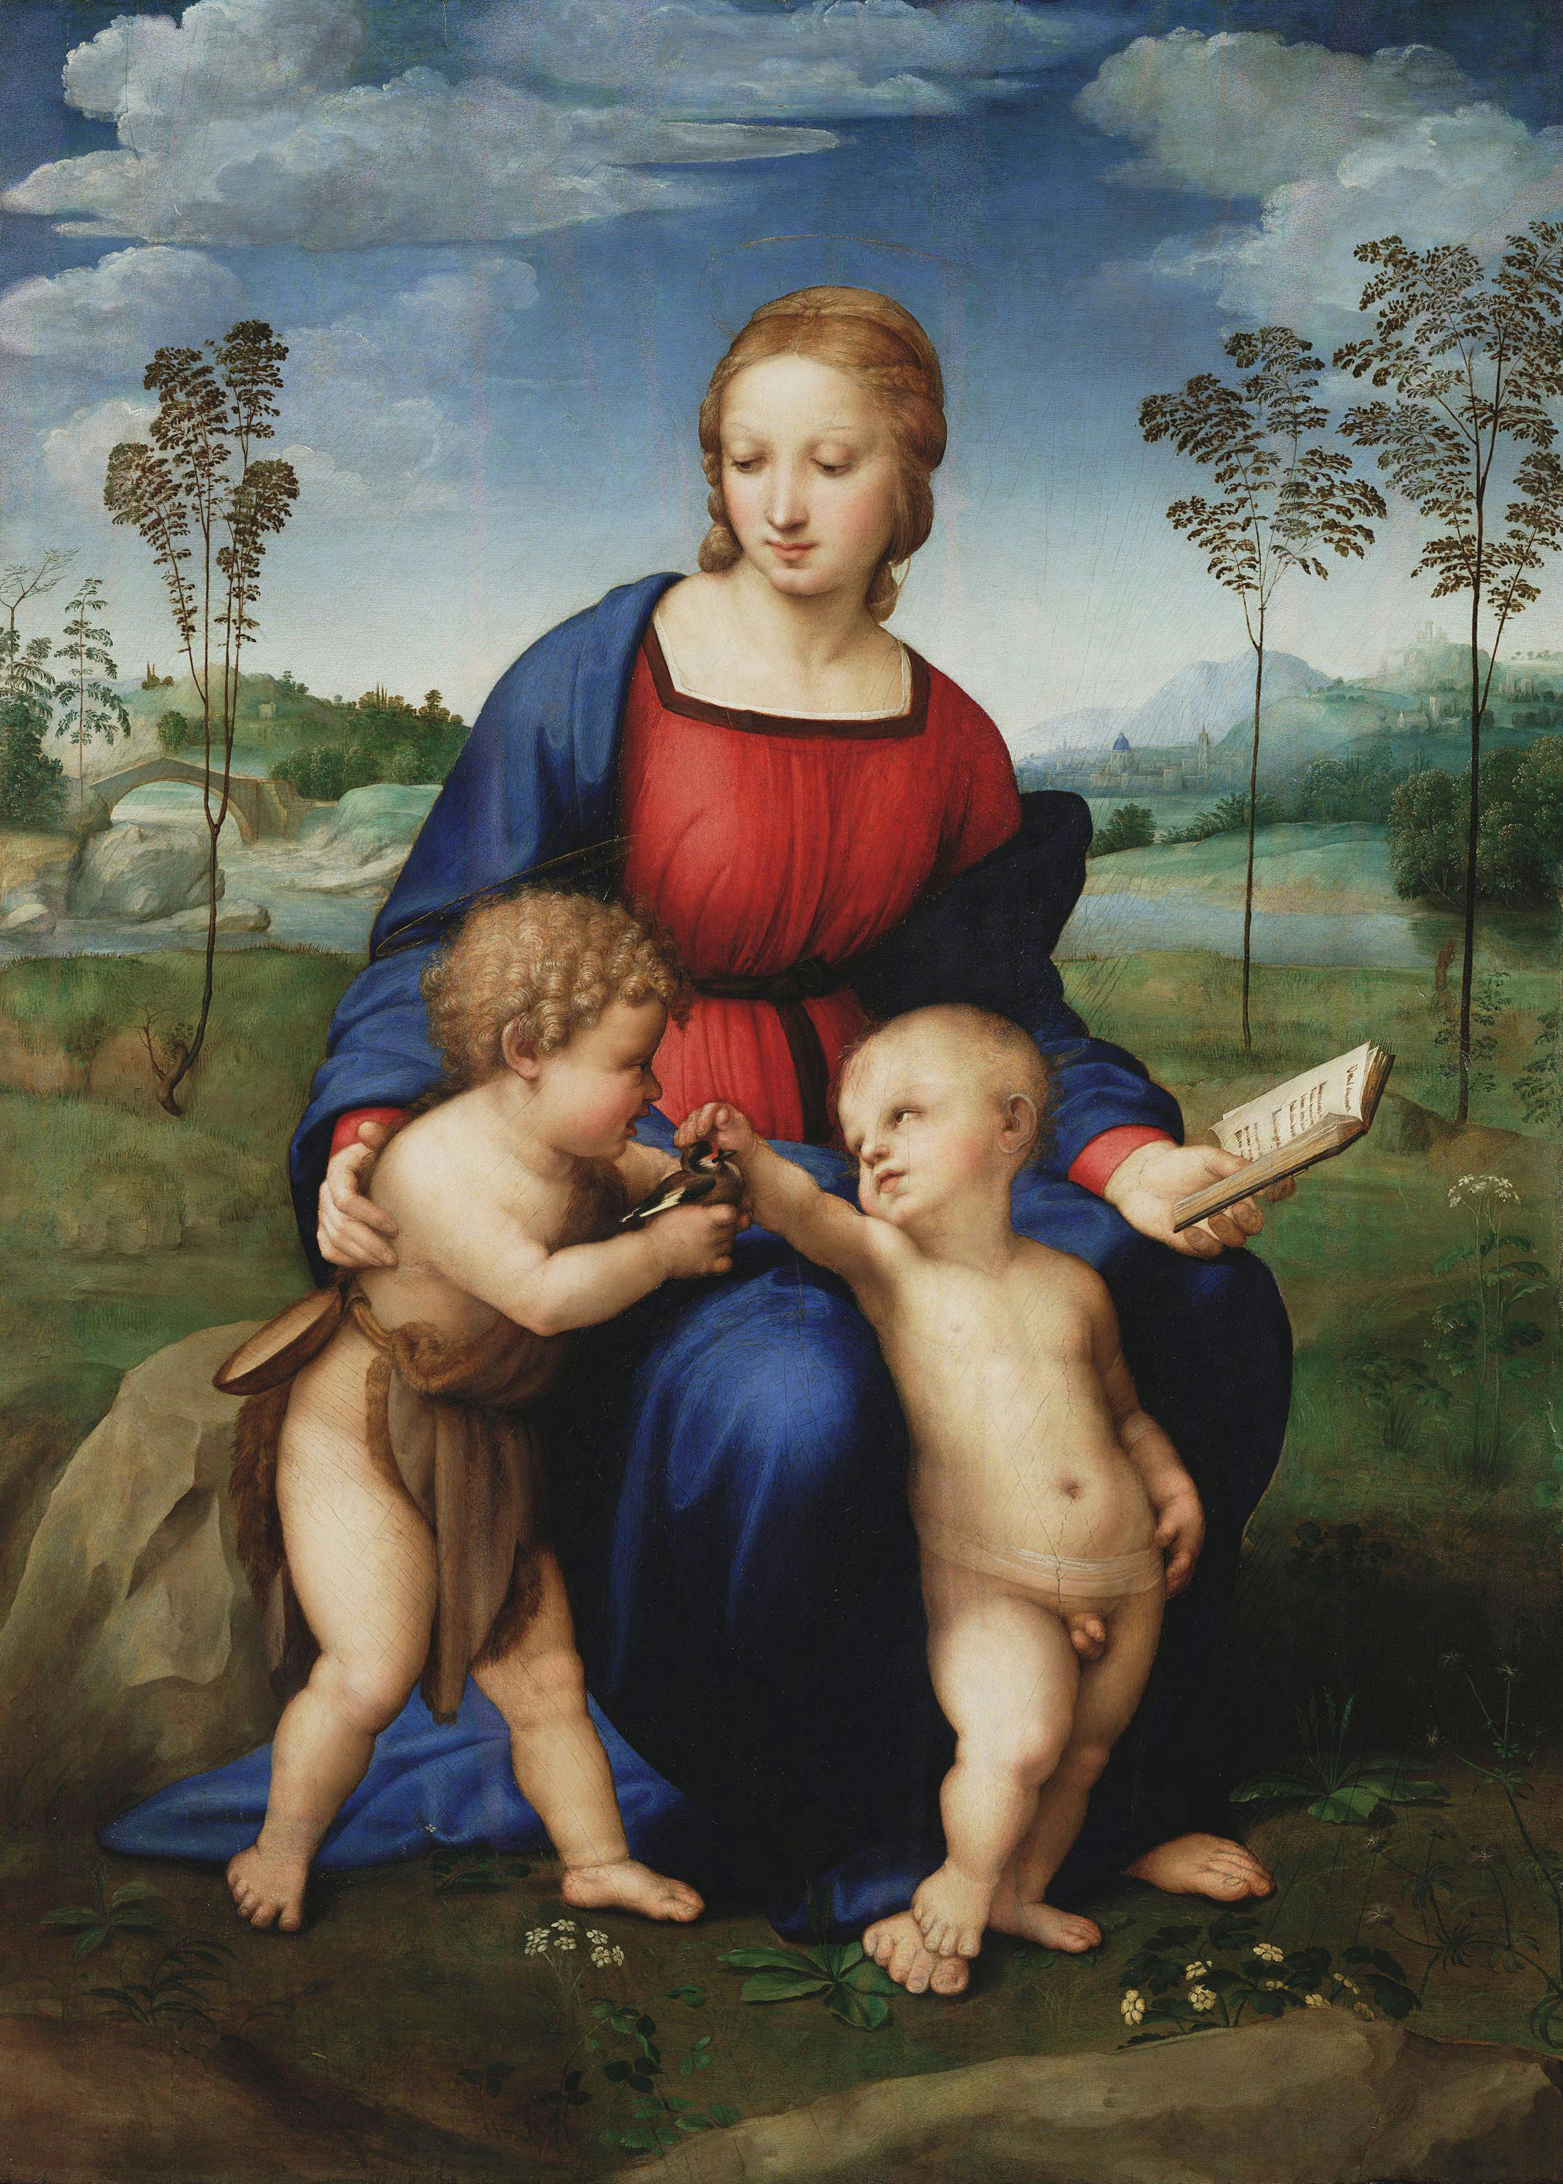
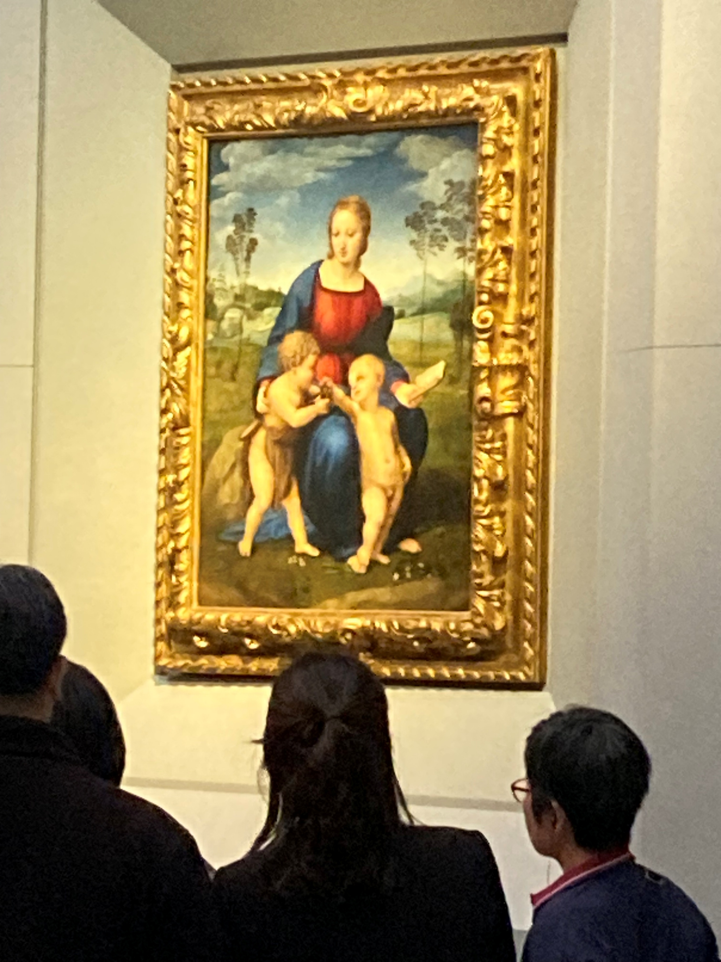
Madonna of the Goldfinch, before February 1506, Oil on wood, 107 x 77 cm, Galleria degli Uffizi, Florence, Italy
Left: https://www.uffizi.it/en/artworks/mary-christ-and-the-young-john-the-baptist-known-as-the-madonna-of-the-goldfinch - Right: Amalia Spiliakou, Galleria degli Uffizi, April 2025

Slide 8
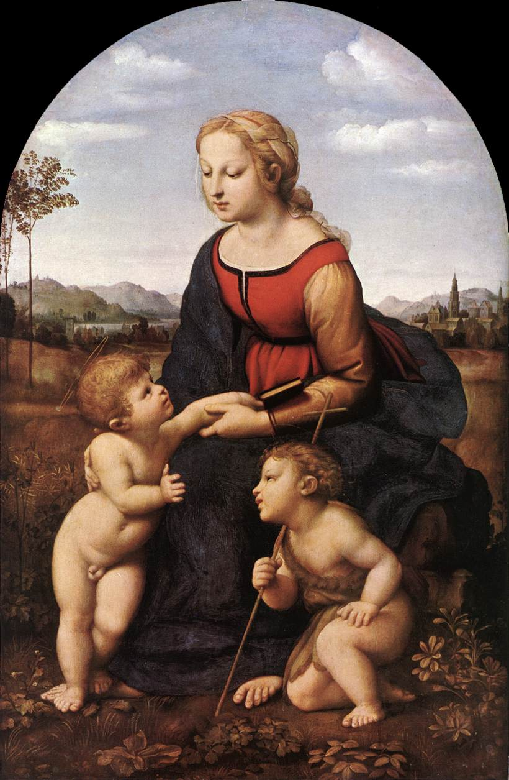
The Virgin and Child with Saint John the Baptist (La Belle Jardinière), 1507, Oil on wood, 122 x 80 cm, Musée du Louvre, Paris, France https://www.wga.hu/frames-e.html?/html/r/raphael/index.html

Slide 9
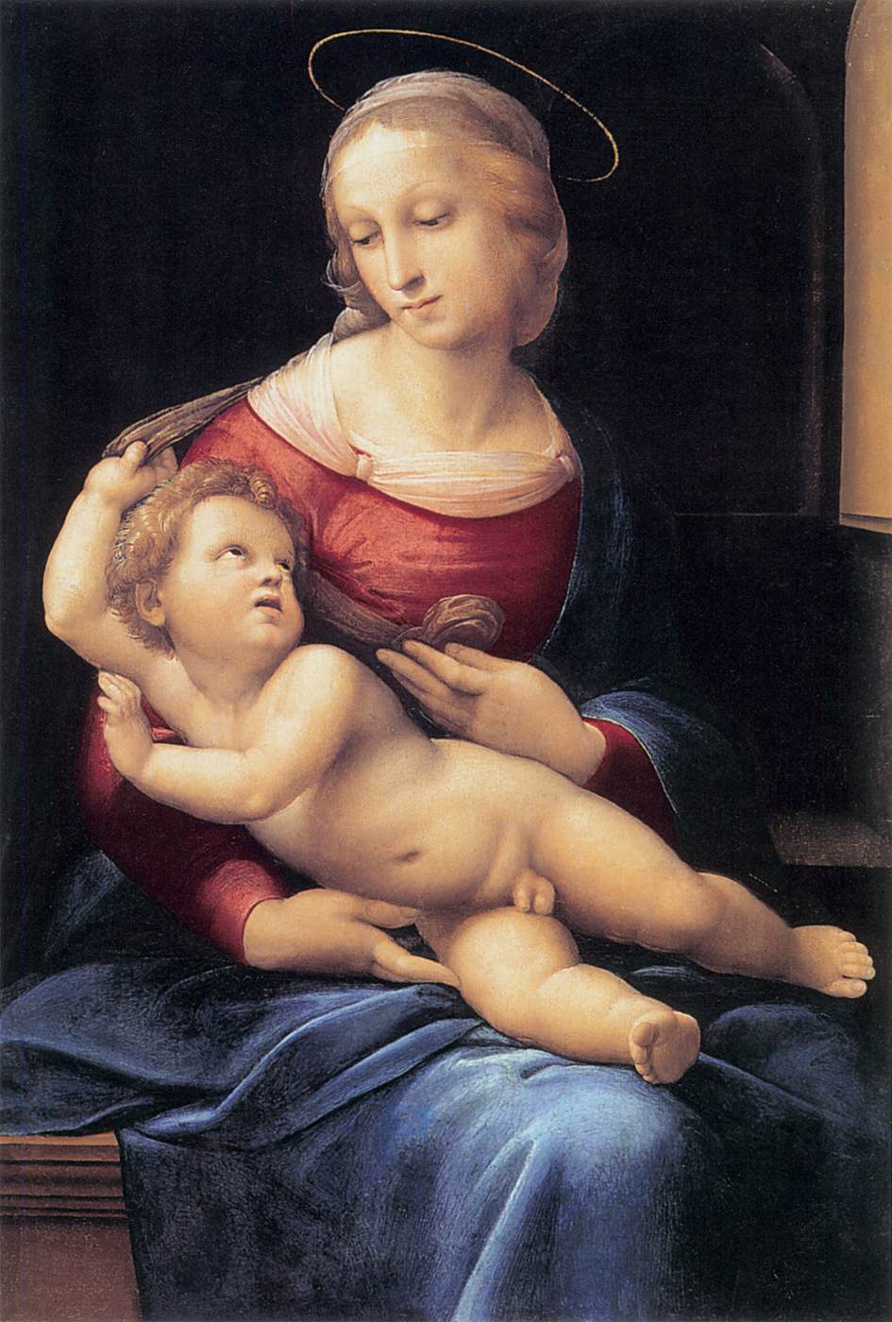
Bridgewater Madonna, c. 1507, Oil on canvas transferred from panel, 81 x 56 cm, National Gallery of Scotland, Edinburgh, Scotland https://www.wga.hu/frames-e.html?/html/r/raphael/index.html

Slide 10
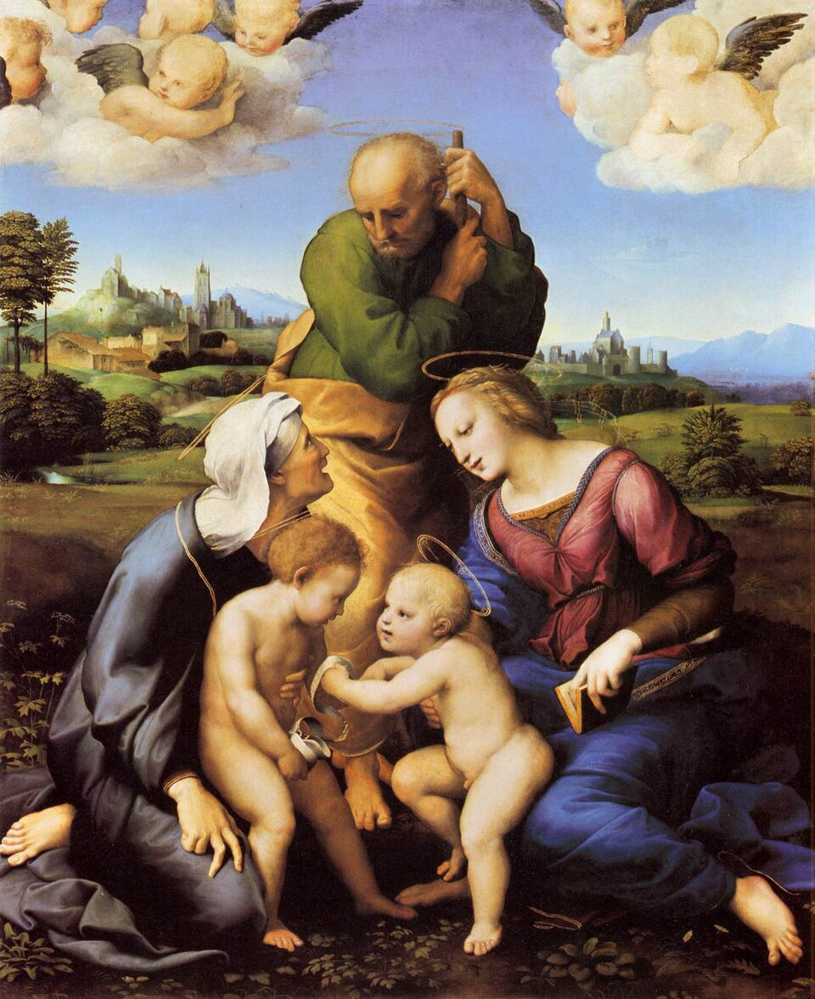
The Canigiani Madonna, 1507, Oil on wood, 131 x 107 cm, Alte Pinakothek, Munich, Germany https://en.wikipedia.org/wiki/Canigiani_Holy_Family#/media/File:Rafael_-_Sagrada_Fam%C3%ADlia_Canigiani.jpg

Slide 11
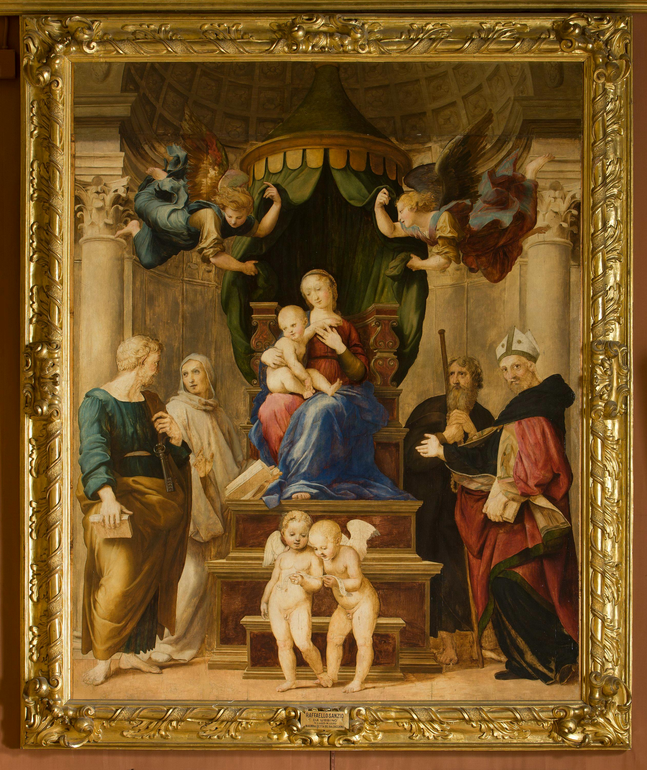
Madonna del Baldacchino, 1507-08, Oil on canvas, 276 x 224 cm, Galleria Palatina (Palazzo Pitti), Florence, Italy https://www.wga.hu/frames-e.html?/html/r/raphael/index.html

Slide 12
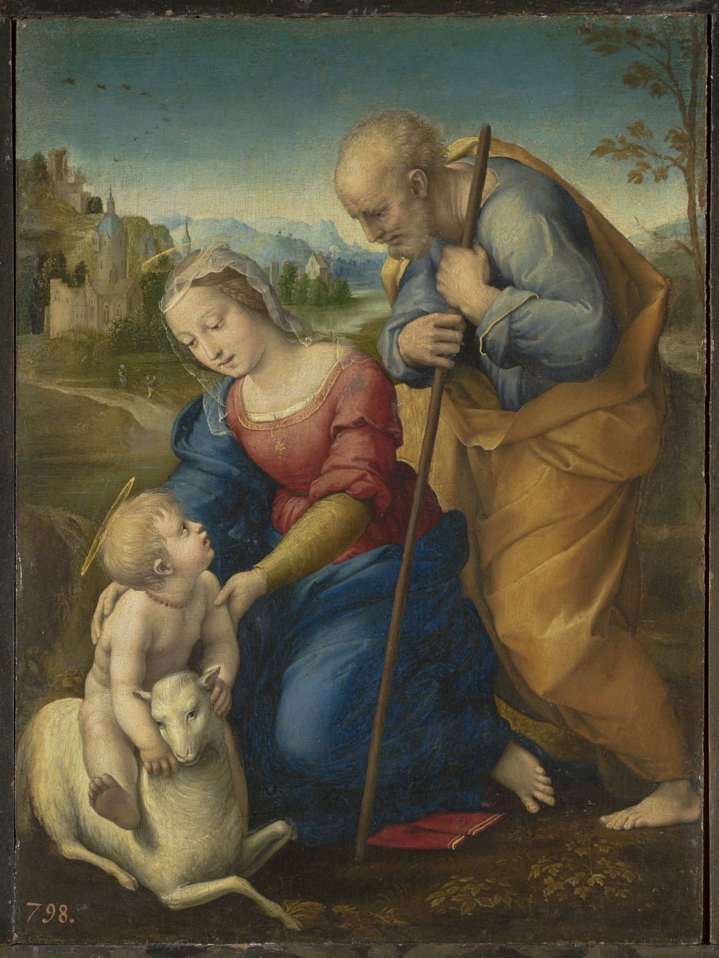
The Holy Family with a Lamb, 1507, Oil on wood, 29 x 21 cm, Museo del Prado, Madrid, Spain https://www.museodelprado.es/en/the-collection/art-work/the-holy-family-with-a-lamb/828f13e3-5a4e-4107-b0a4-5607d17dfd66

Slide 13
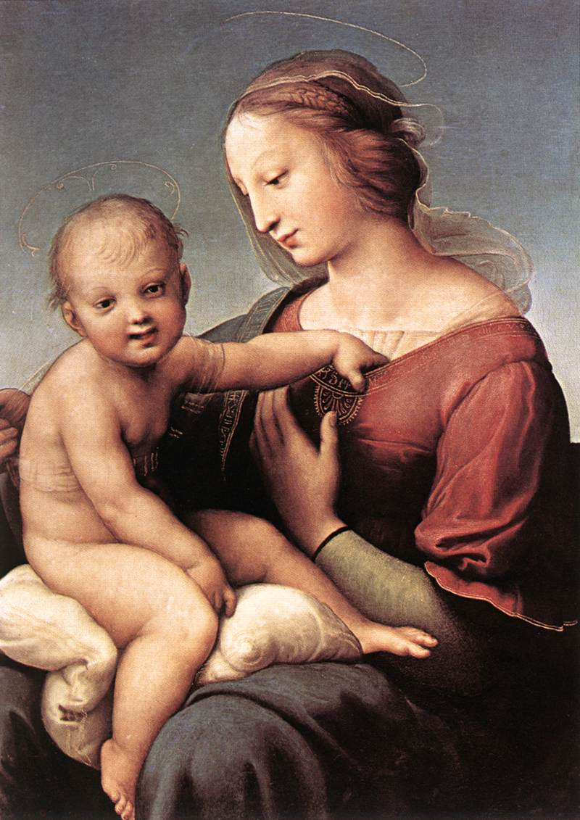
Madonna and Child (The Large Cowper Madonna), 1508, Oil on wood, 81 x 57 cm, National Gallery of Art, Washington DC, USA https://www.wga.hu/html_m/r/raphael/2firenze/2/39cowper.html

Slide 14
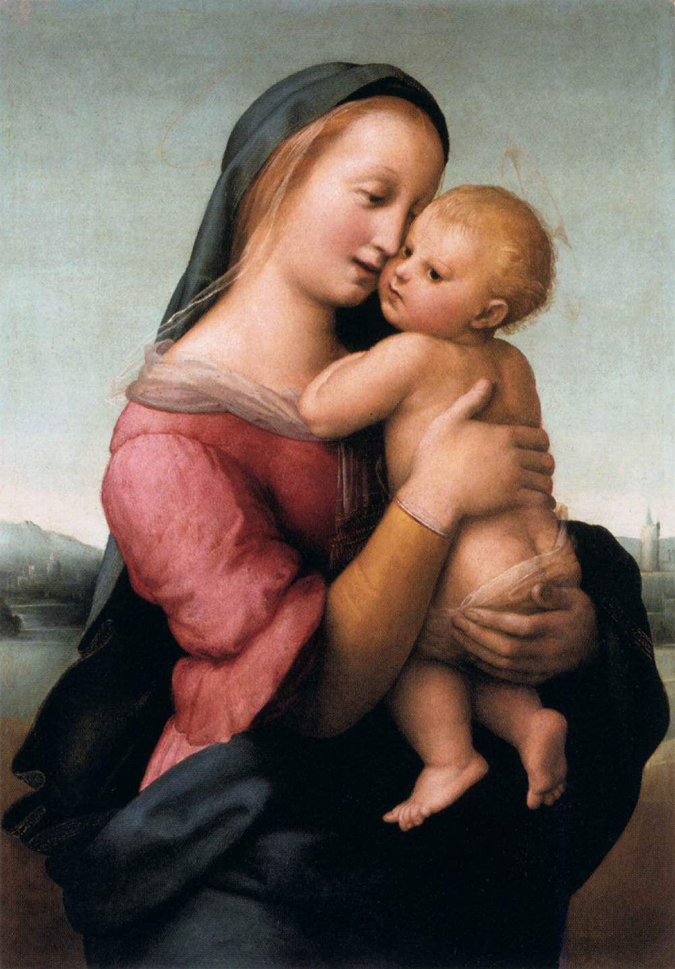
Madonna and Child (The Tempi Madonna), 1508, Oil on wood, 75 x 51 cm, Alte Pinakothek, Munich, Germany https://www.wga.hu/frames-e.html?/html/r/raphael/index.html

Slide 15
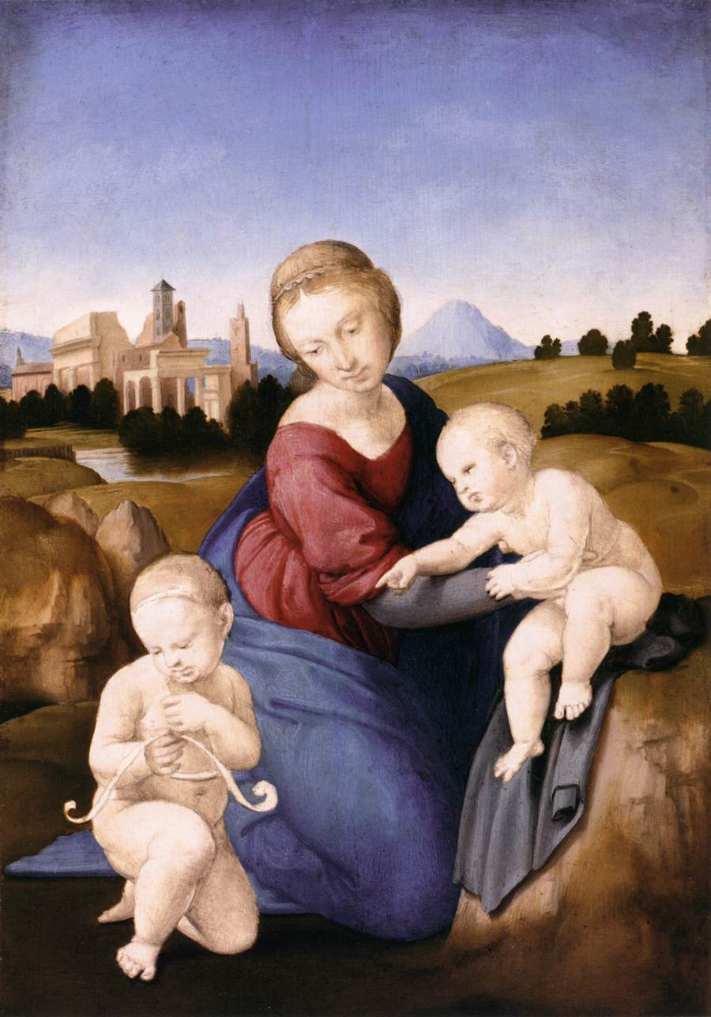
Madonna and Child with the Infant St John, c. 1508, Tempera and oil on wood, 29 x 22 cm, Szépmûvészeti Múzeum, Budapest, Hungary https://www.wga.hu/frames-e.html?/html/r/raphael/index.html

Slide 16
The End

