Slide 1

The House of Menander built after the 2nd century AD, on earlier remains of the Hellenistic period
Mytilene, Greece

Slide 2
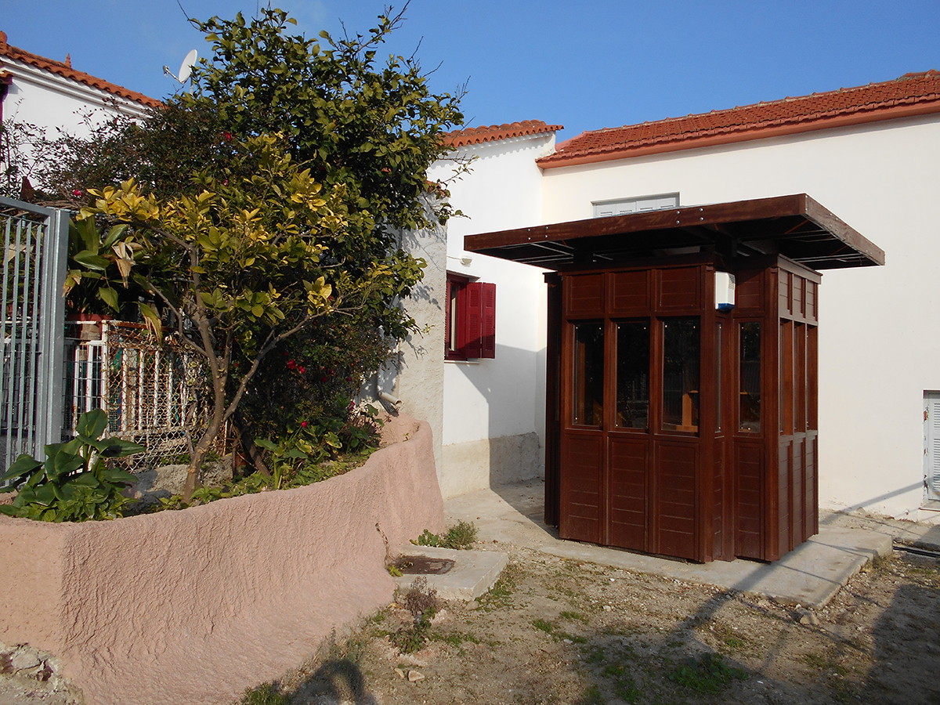
The House of Menander
Infokiosk at the entrance of the archaeological site https://www.efales-ar.gr/en/ancient_site/the-house-of-menander-in-mytilene/#gallery-3190-3

Slide 3
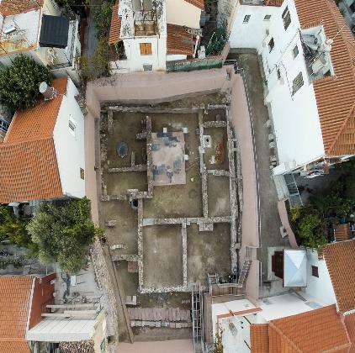
The House of Menander
Areal View of the archaeological site http://odysseus.culture.gr/h/2/gh2560.jsp?obj_id=19976

Slide 4
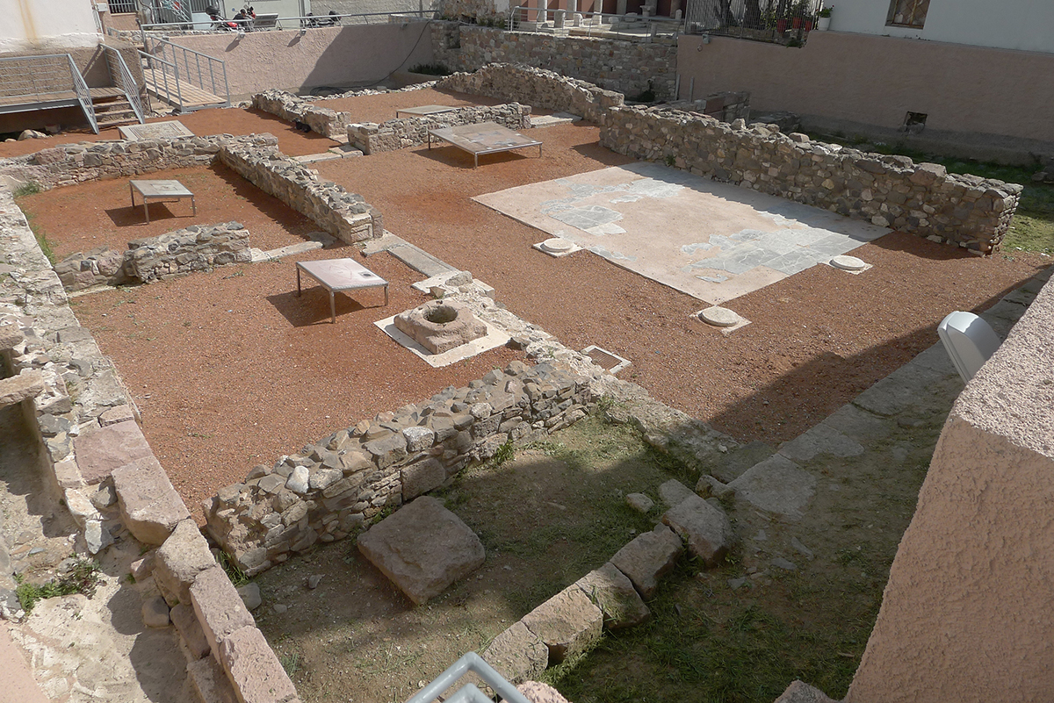
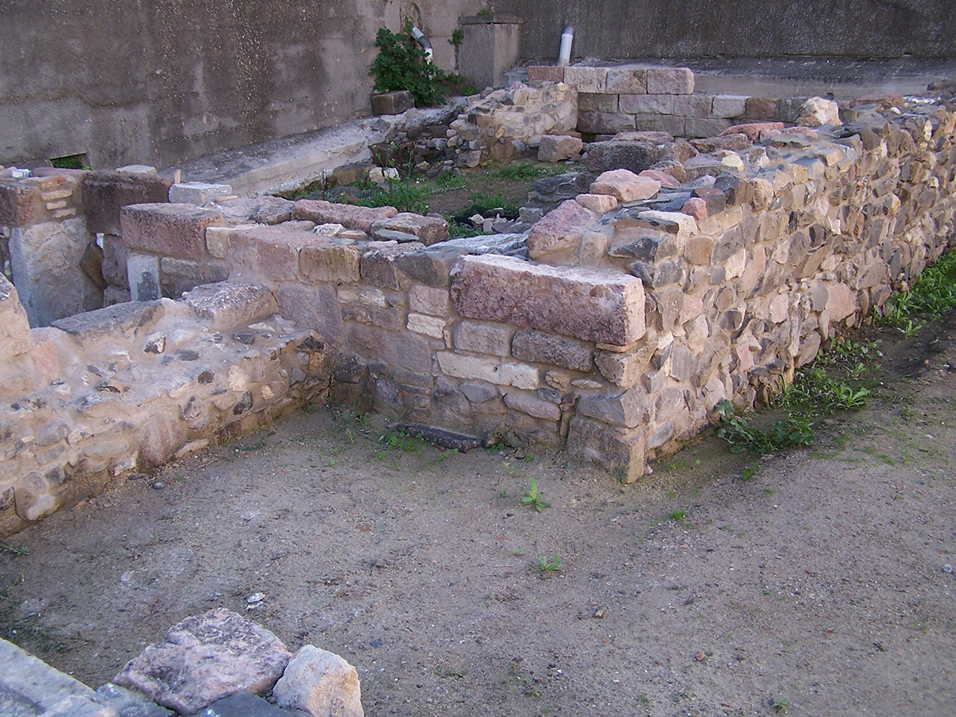
The House of Menandrer in Mytilene's Krinagora Street https://www.efales-ar.gr/en/ancient_site/the-house-of-menander-in-mytilene/#gallery-3190-1

Slide 5
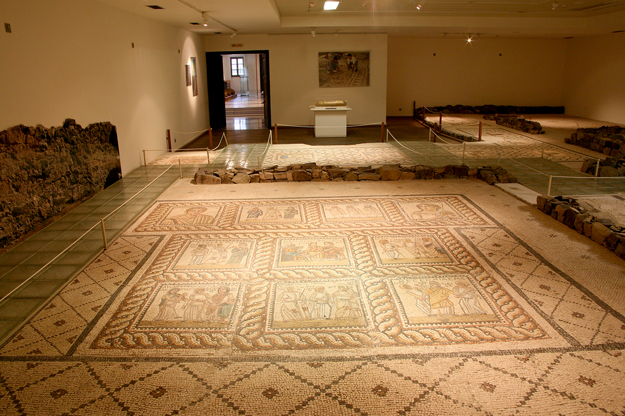
Mosaic floor from the Triclinium from the House of Menander as exhibited at the Archaeological Museum of Mytilene https://www.efales-ar.gr/en/ancient_site/the-house-of-menander-in-mytilene/#gallery-3190-4

Slide 6
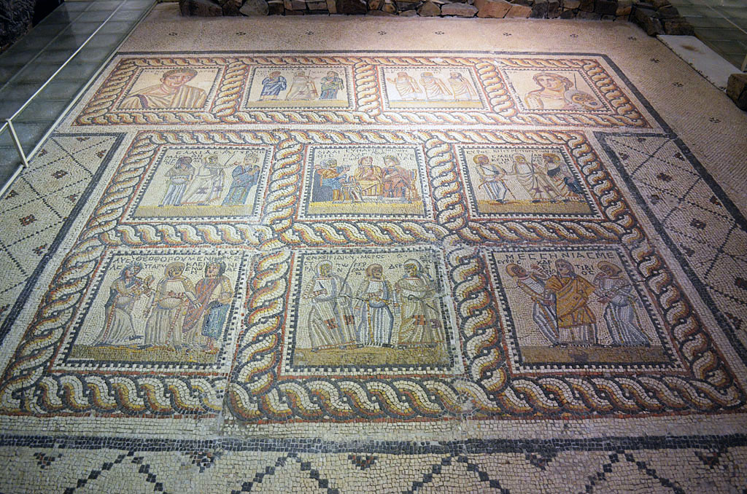
The mosaic floor of the Triclinium, depicting scenes from Menander's comedies, a Portrait of the Poet and the muse Thalia https://www.theatrum.de/285.html
Plokion
Synaristosai
?
Portrait of Menander
Thalia
Epitrepontes
Samia
Messenia
Theophoroumene
Encheiridion

Slide 7
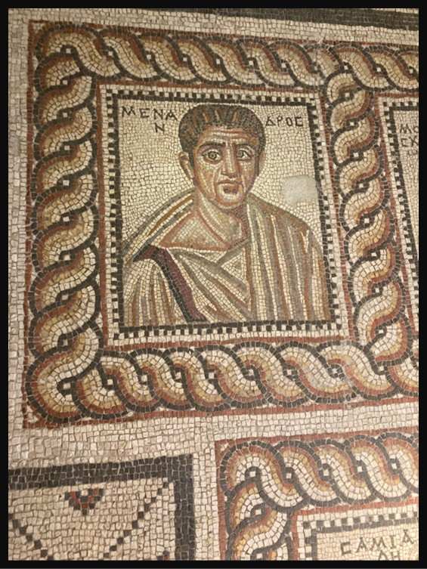
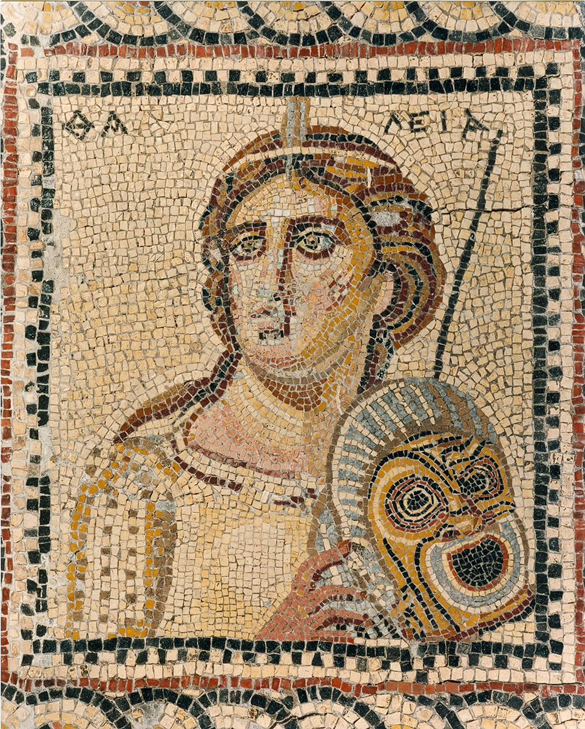
Details from the mosaic floor depicting the Portrait of Menander and that of the Muse Thalia holding a comic mask and a rod https://www.efales-ar.gr/en/ancient_site/the-house-of-menander-in-mytilene/#gallery-3190-6

Slide 8
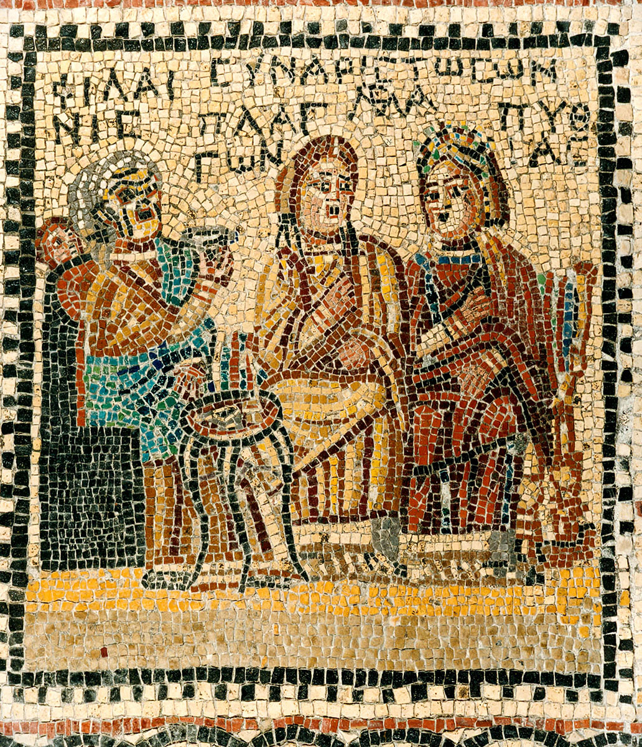
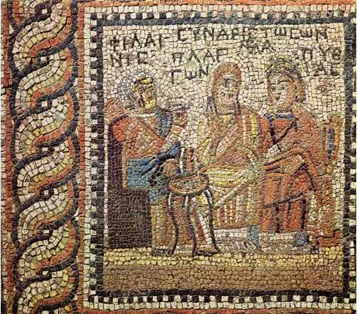
Detail from the mosaic floor of the Triclinium, depicting a scene from Menander's comedy ‘Synaristosai’ https://laudatortemporisacti.blogspot.com/2017/06/women-eating-lunch-together.html and https://www.efales-ar.gr/en/ancient_site/the-house-of-menander-in-mytilene/#gallery-3190-8

Slide 9
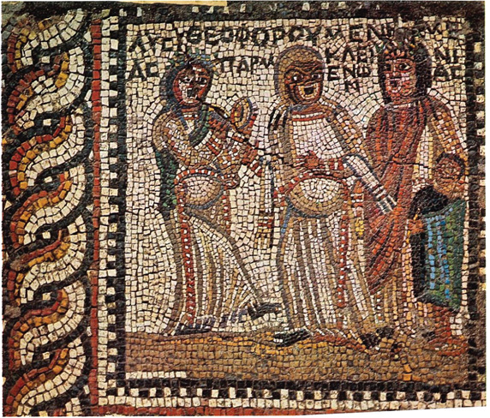
Detail from the mosaic floor of the Triclinium, depicting a scene from Menander's comedy ‘Theophoroumenē’ https://brill.com/view/journals/grms/10/1/article-p114_6.xml?srsltid=AfmBOor4cJOvelDNTY6QlaoypVvUhPji1LyGKE1JLUXE1GNlc8Qv54uN

Slide 10
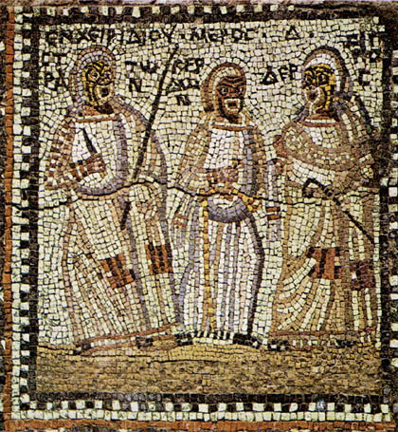
Mosaic scene from Act 4 of Menander's comedy 'Encheiridion' https://commons.wikimedia.org/wiki/File:Encheiridion_%28Dagger%29_Act_4_Mytilene_3cAD.jpg

Slide 11
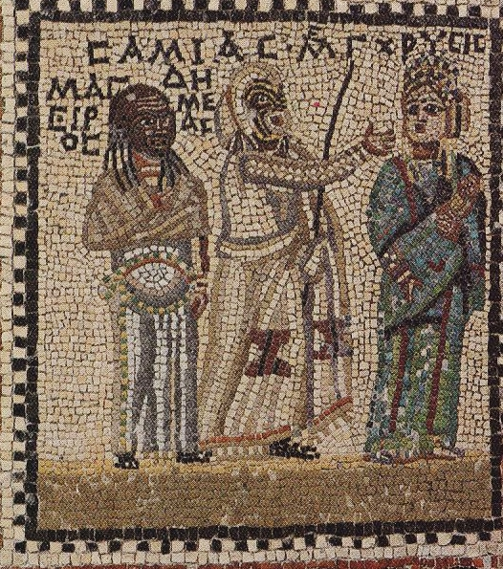
House of Menander
Mosaic panel with a representation of the comedy ‘Samia’ https://fillide.it/mitilene-la-casa-di-menandro-segnalazione/

Slide 12
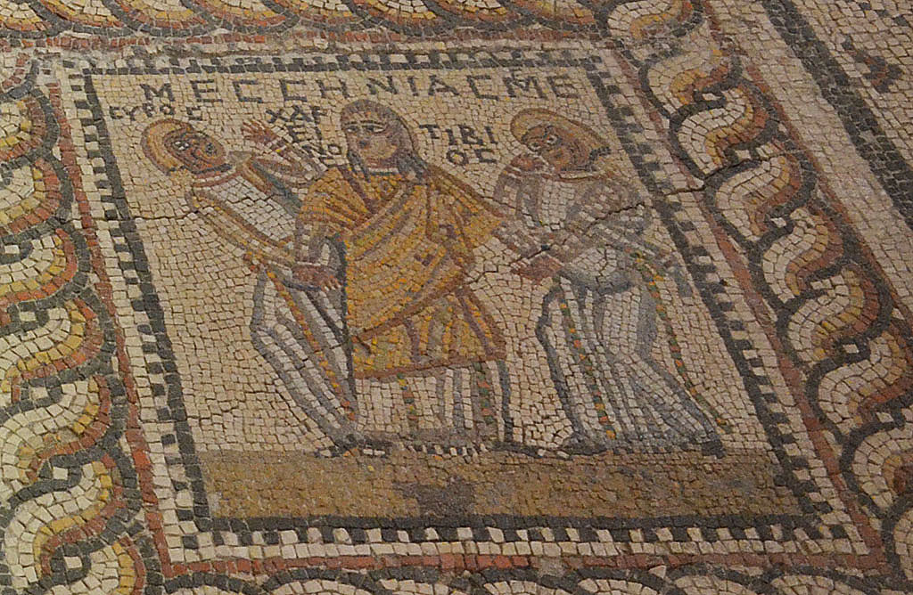
Detail from the mosaic floor of the Triclinium, depicting a scene from Menander's comedy
‘Messenia’ https://www.theatrum.de/2068.html

Slide 13
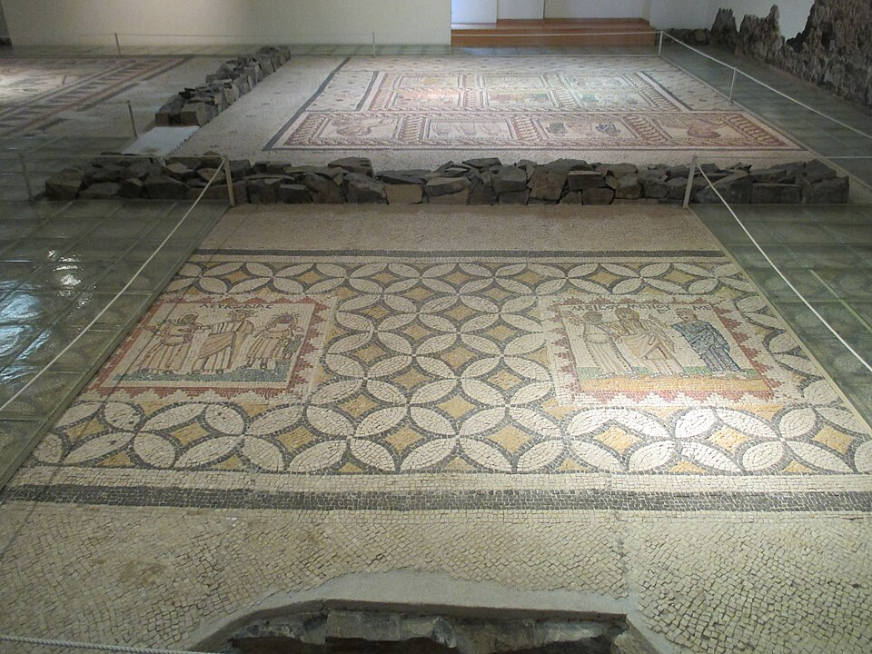
The Archaeological Museum of Mytilene, mosaics from the
House of Menander https://commons.wikimedia.org/wiki/File:Archaeological_Museum_of_Mytilene_-_House_of_Menander_02.jpg
?
Misoymenos

Slide 14
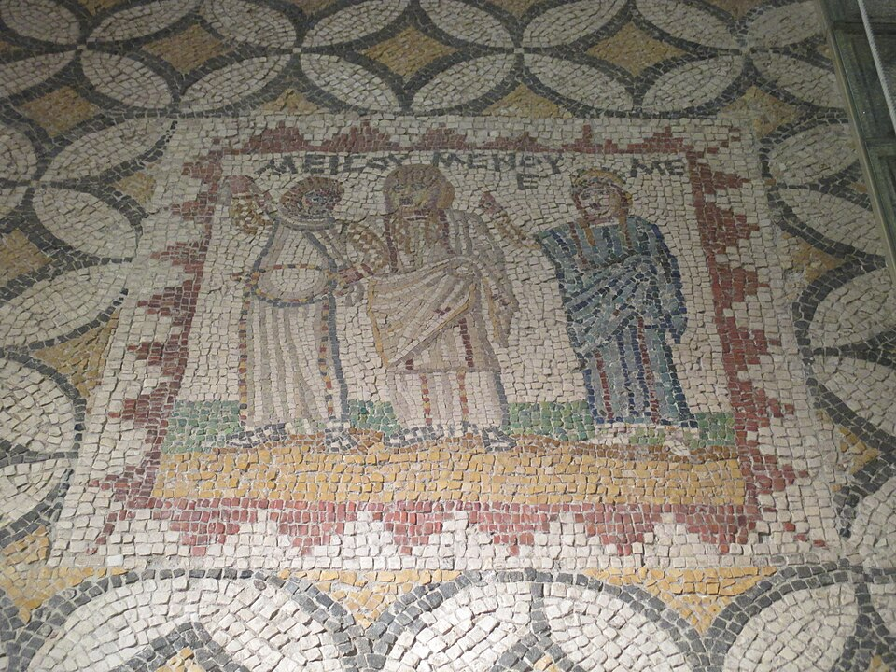
Detail from the mosaic floor of the Triclinium, depicting a scene from Menander's comedy ‘Misoumenos’ https://commons.wikimedia.org/wiki/File:Archaeological_Museum_of_Mytilene_-_House_of_Menander_03.jpg

Slide 15
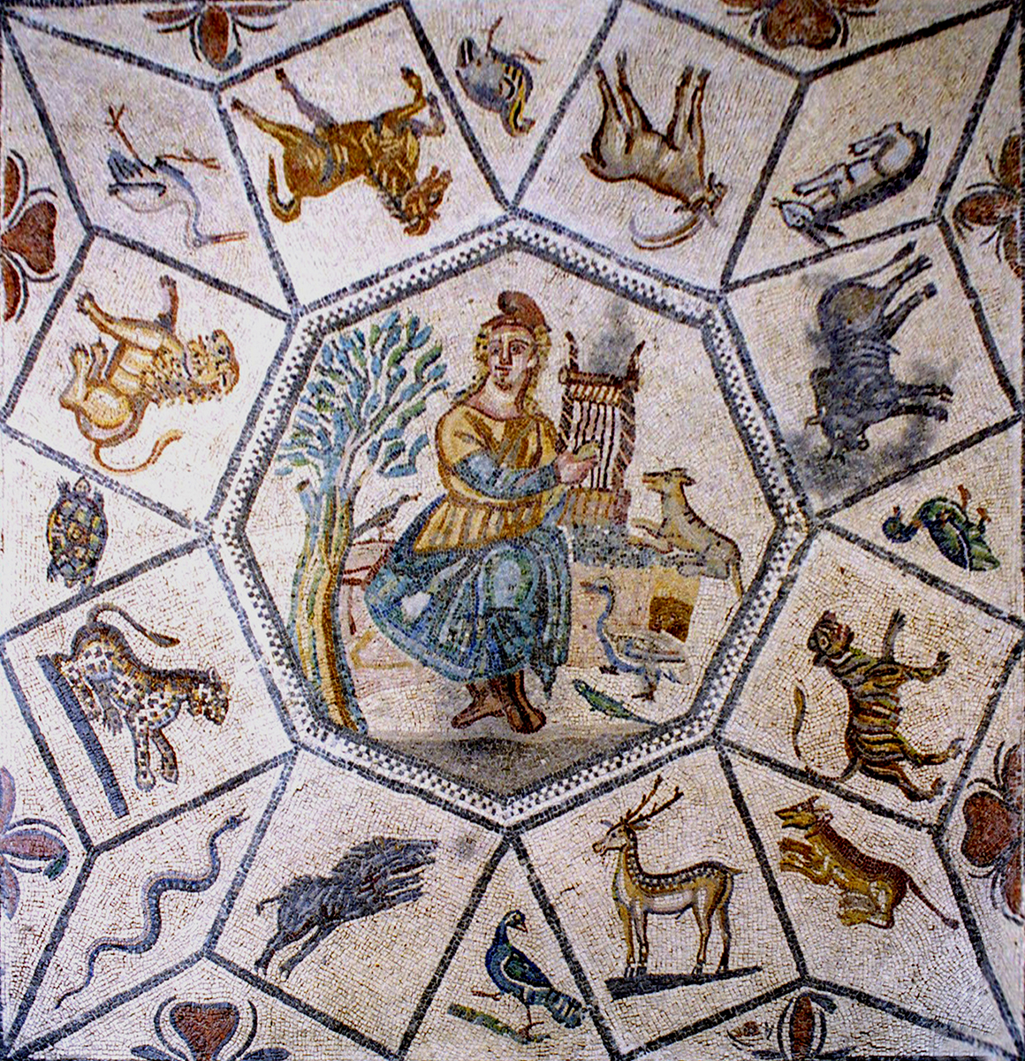
The mosaic floor from the so-called "hall" depicts Orpheus sitting on a rock playing his lyre, beguiling the animals and natural forces surrounding him.
Rectangular, triangular, and rhomboidal frames are lined up in a star-shaped configuration around the central octagon, in which animal figurines, typical samples of basic species, and plant motifs are shown. https://www.efales-ar.gr/en/ancient_site/the-house-of-menander-in-mytilene/#gallery-3190-7

Slide 16
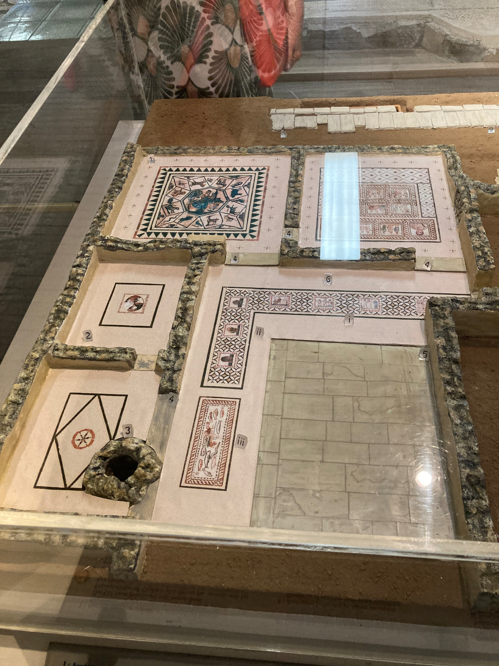
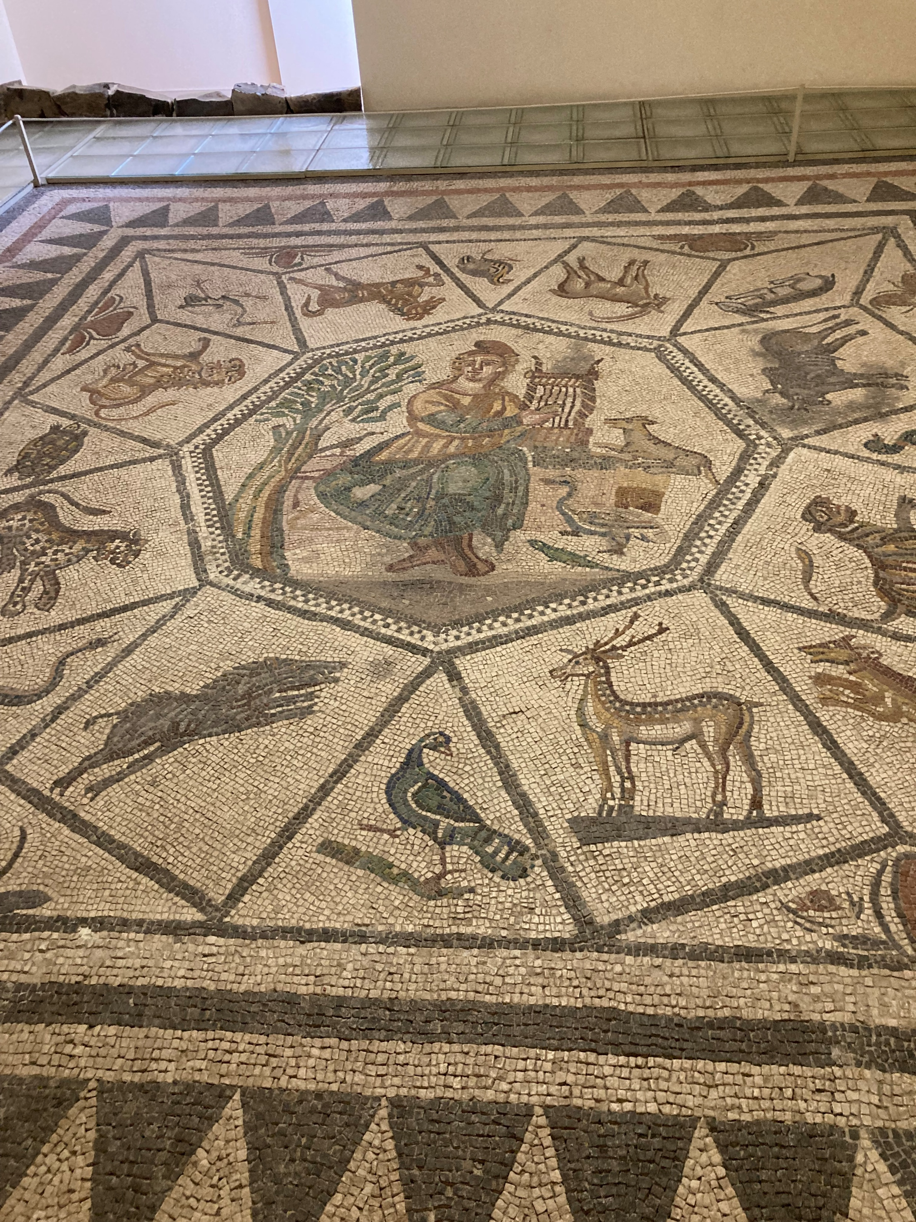
Photo credit: Amalia Spiliakou, Summer 2025

