Slide 1
11
Fayum
Portraits

Slide 2
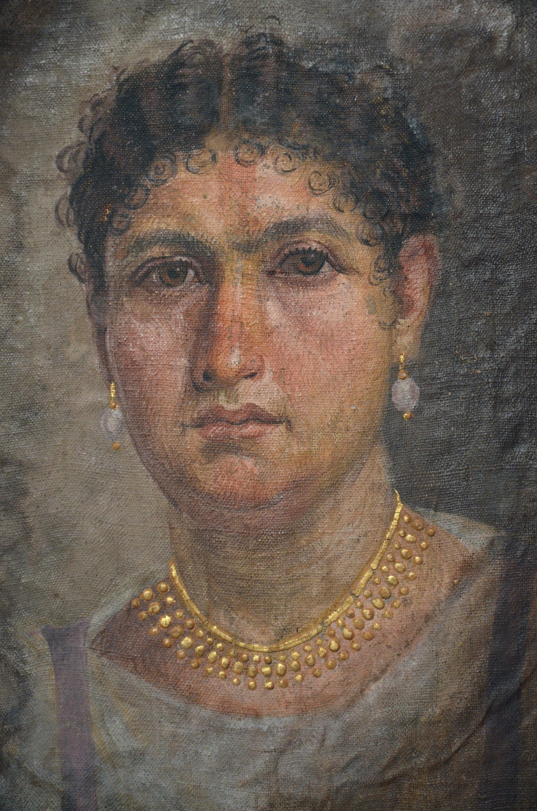
Portrait of Lady Aline, 24 AD, Tempera on Linen, H. 24 cm, Ägyptisches Museum Berlin, Germany https://www.worldhistory.org/image/2554/mummy-portrait-of-lady-aline/

Slide 3
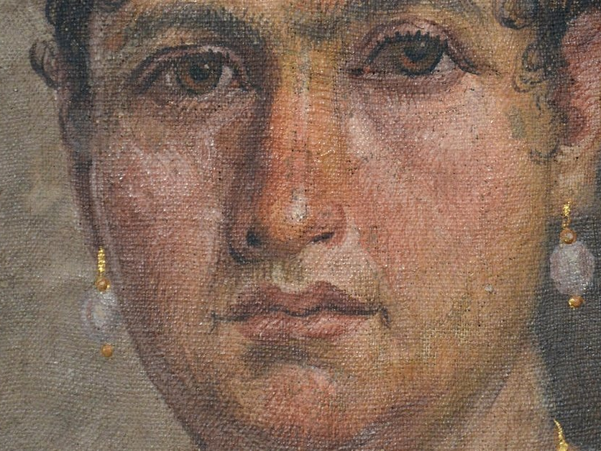
https://www.worldhistory.org/image/2554/mummy-portrait-of-lady-aline/

Slide 4
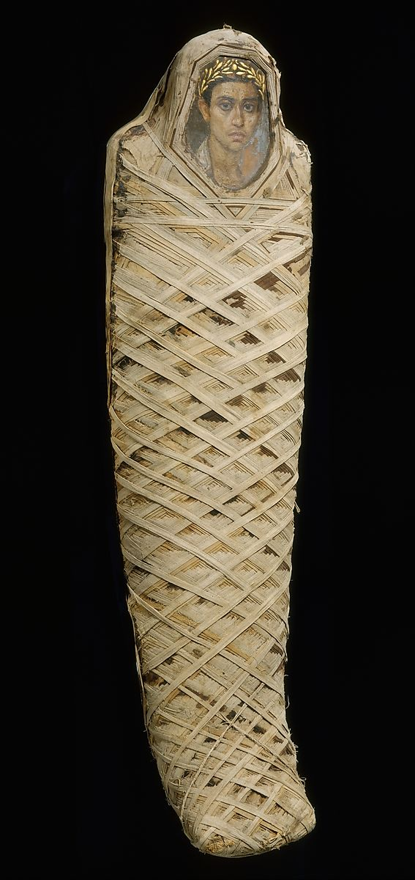
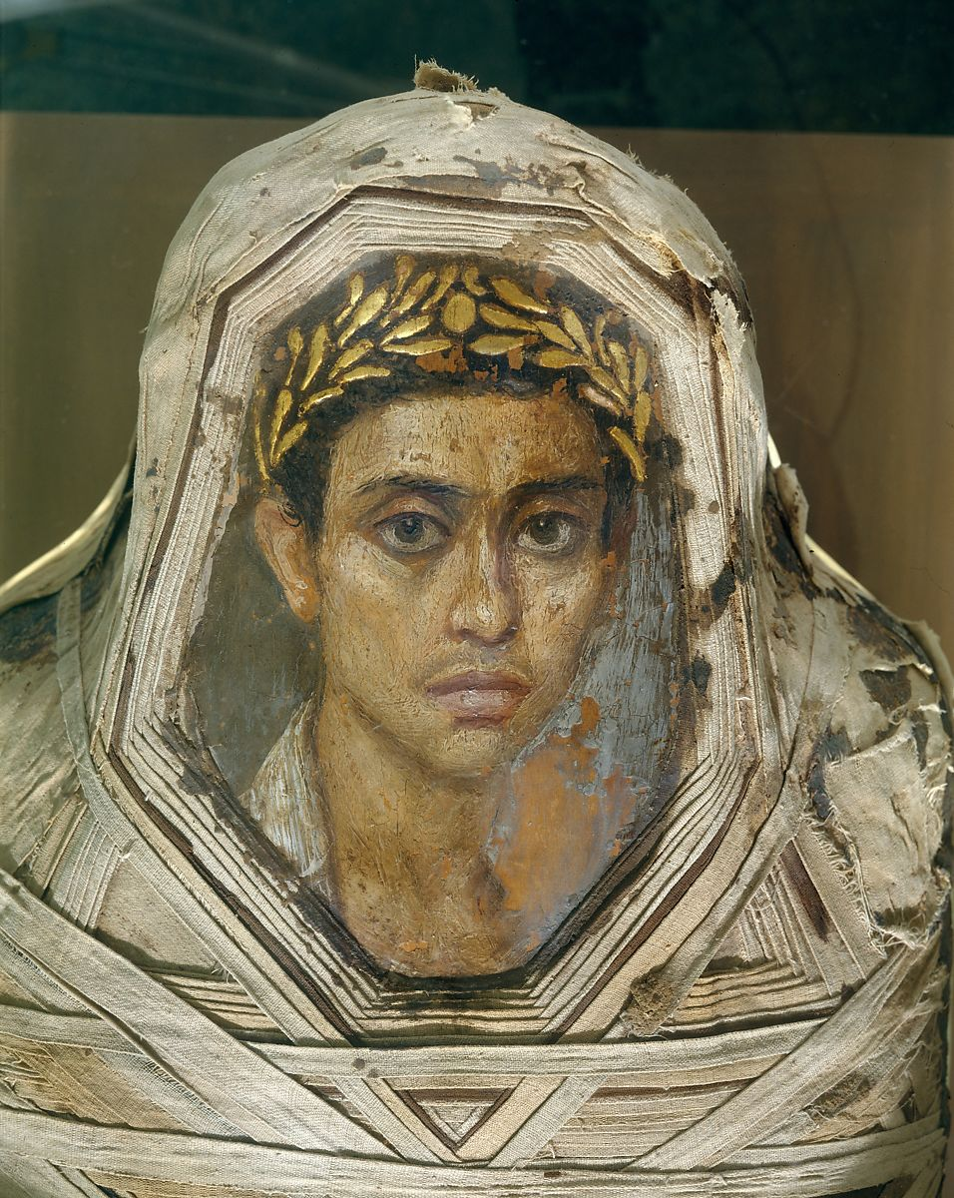
Mummy with an Inserted Panel Portrait of a Youth, 80–100 AD, Encaustic on Limewood, human remains, linen, mummification material, Panel as exposed: H. 38.1 cm. the MET, NY, USA https://www.metmuseum.org/art/collection/search/547697

Slide 5
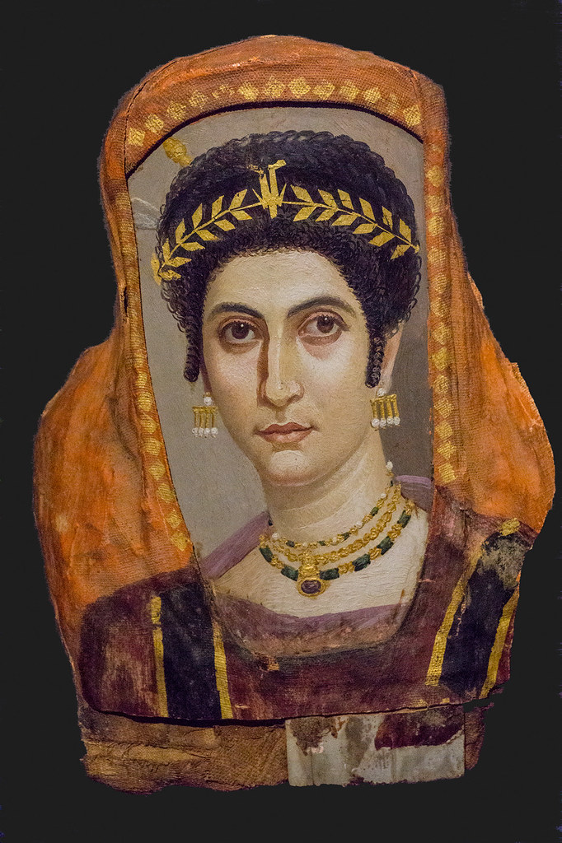
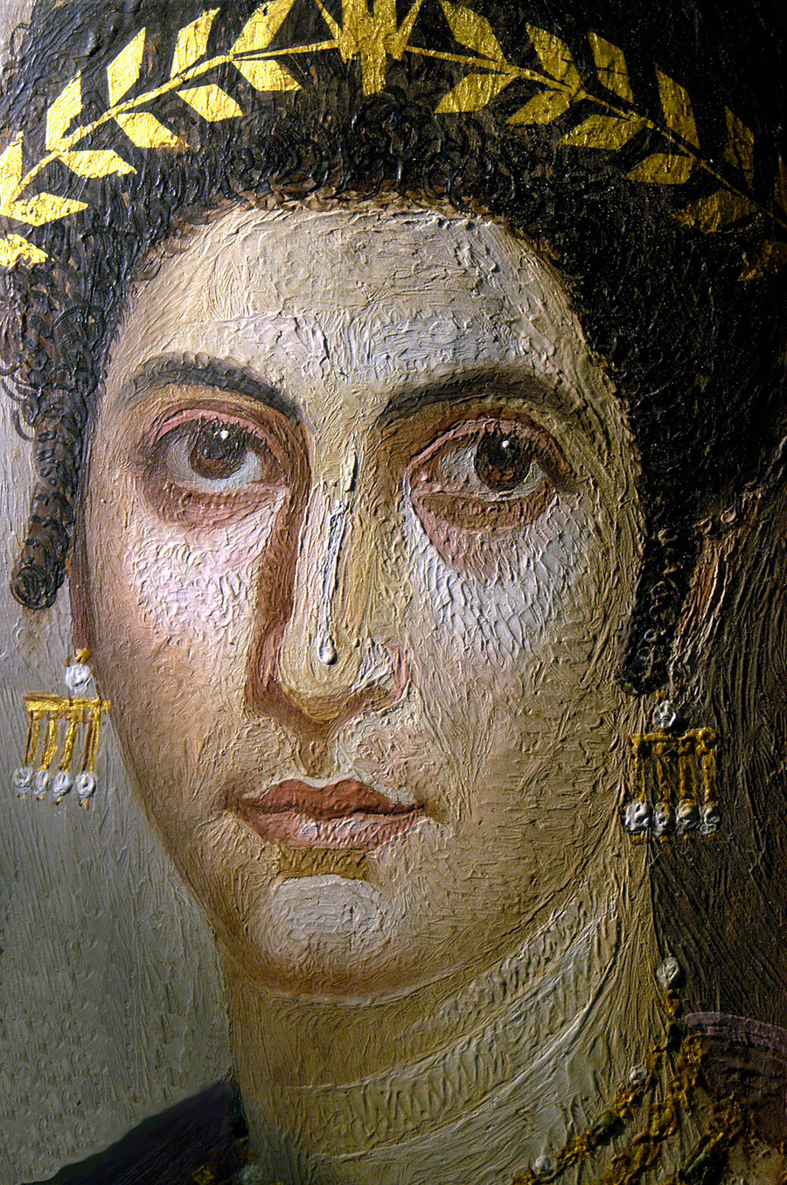
Mummy Portrait of a Woman, 100–110 AD, attributed to the Isidora Master, Encaustic on wood, gilt, linen, 48 × 36 × 12.8 cm, The J. Paul Getty Museum, CA, USA https://blogs.getty.edu/iris/unlocking-the-secrets-of-ancient-egyptian-funerary-portraits-through-modern-technology/ and https://www.flickr.com/photos/7448869@N03/29622098108

Slide 6
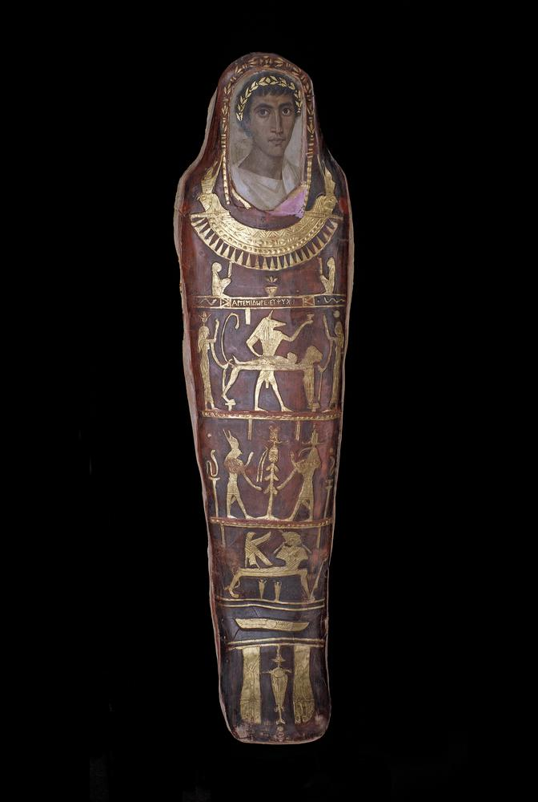
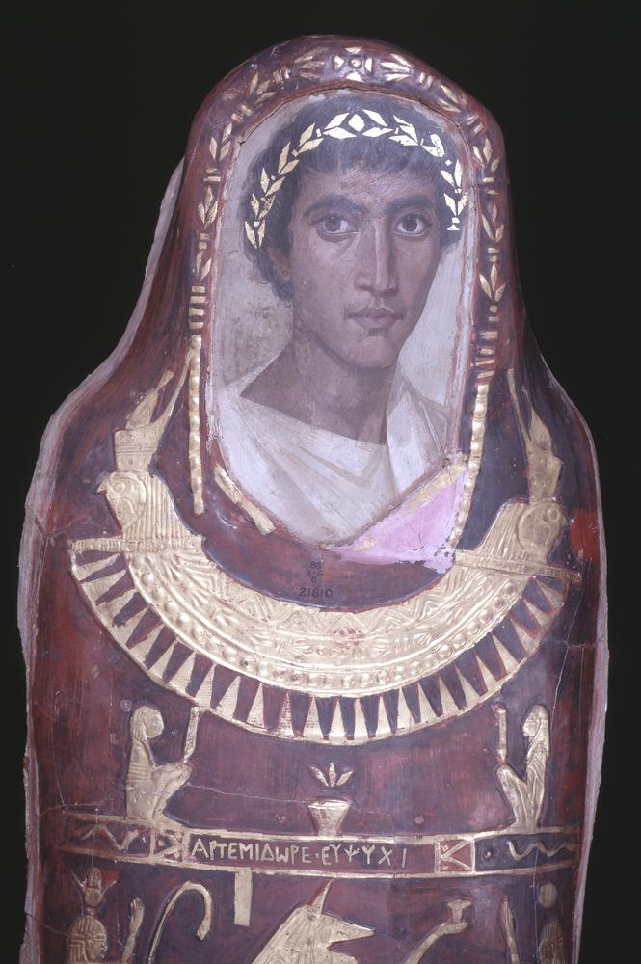
Mummy of a Greek youth, aged 19-21, named Artemidorus in a cartonnage body-case, early 2nd century AD, Encaustic on Linen, H. 171 cm, British Museum, London, UK https://blog.britishmuseum.org/depicting-the-dead-ancient-egyptian-mummy-portraits/

Slide 7
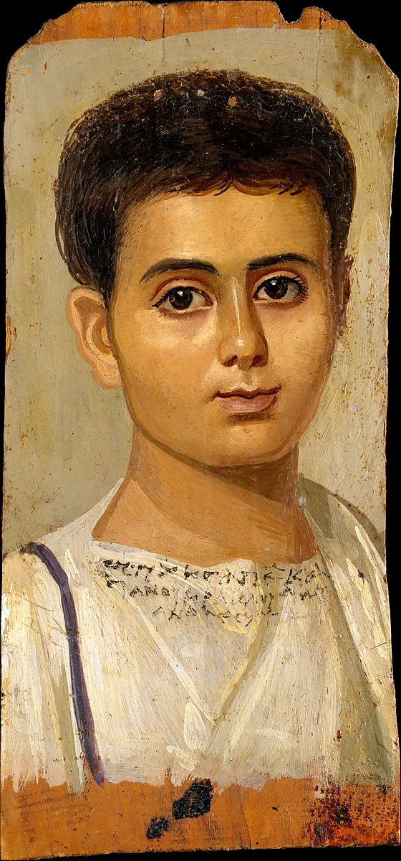
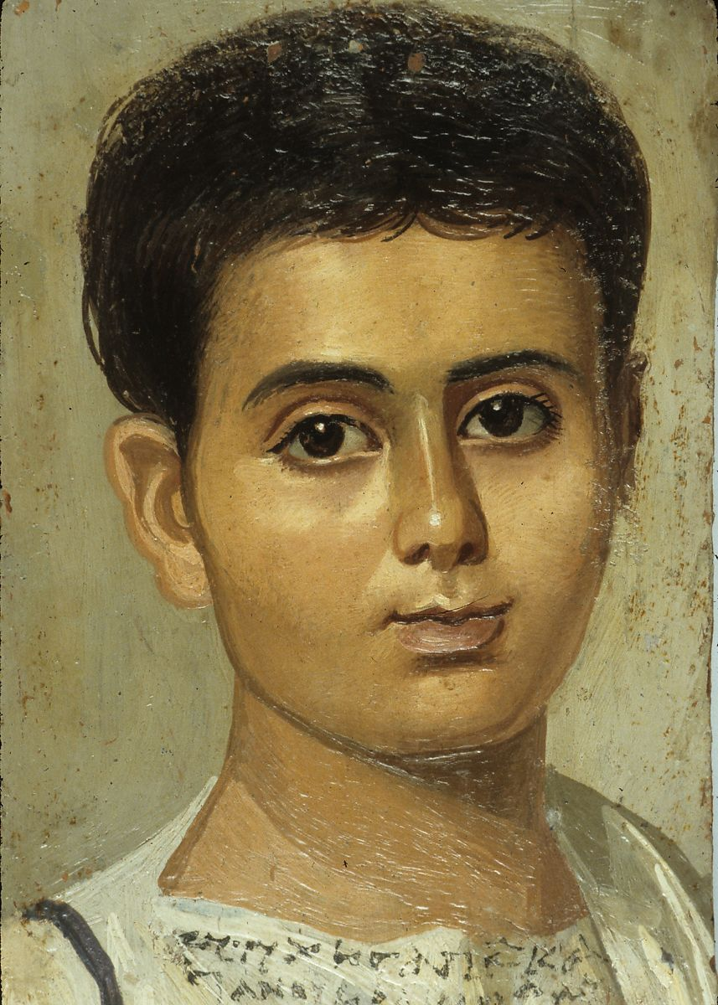
Portrait of the Boy Eutyches, 100–150 AD, Encaustic on Wood, h. 38 cm, the MET, NY, USA https://www.metmuseum.org/art/collection/search/547951

Slide 8
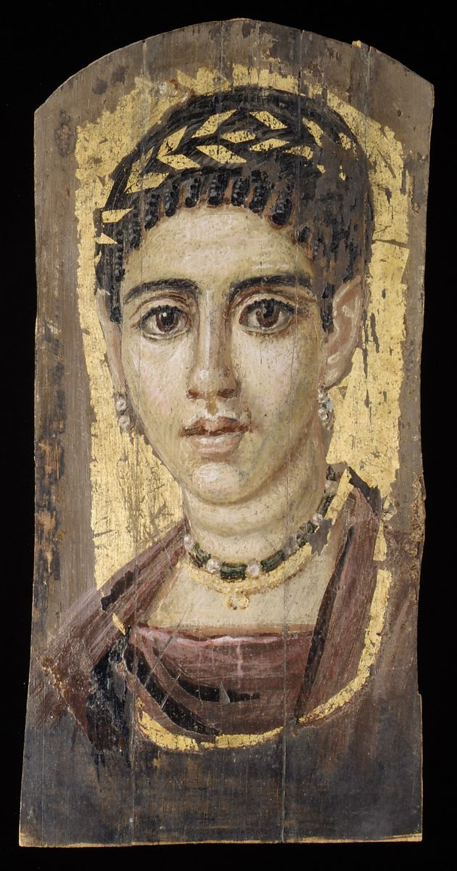
Portrait of a young woman with a gilded wreath, 120–140 AD, Encaustic, Wood, Gold leaf, H. 36.5 x, the MET, NY, USA https://www.metmuseum.org/art/collection/search/547861

Slide 9
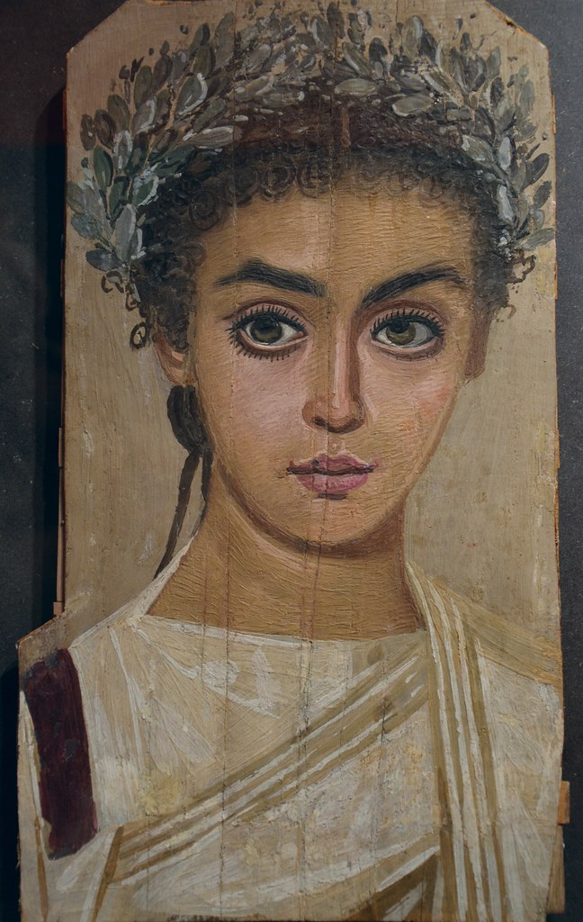
Portrait of a Girl, 120-150 AD, Encaustic painting on Sycamore wood, H. 35.5 cm, Liebieghaus, Frankfurt am Main, Germany https://www.flickr.com/photos/carolemage/14304151412

Slide 10
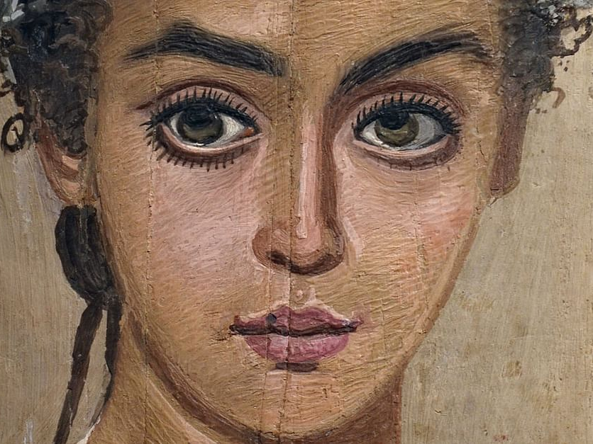
https://www.worldhistory.org/image/4266/mummy-portrait-of-a-girl/

Slide 11
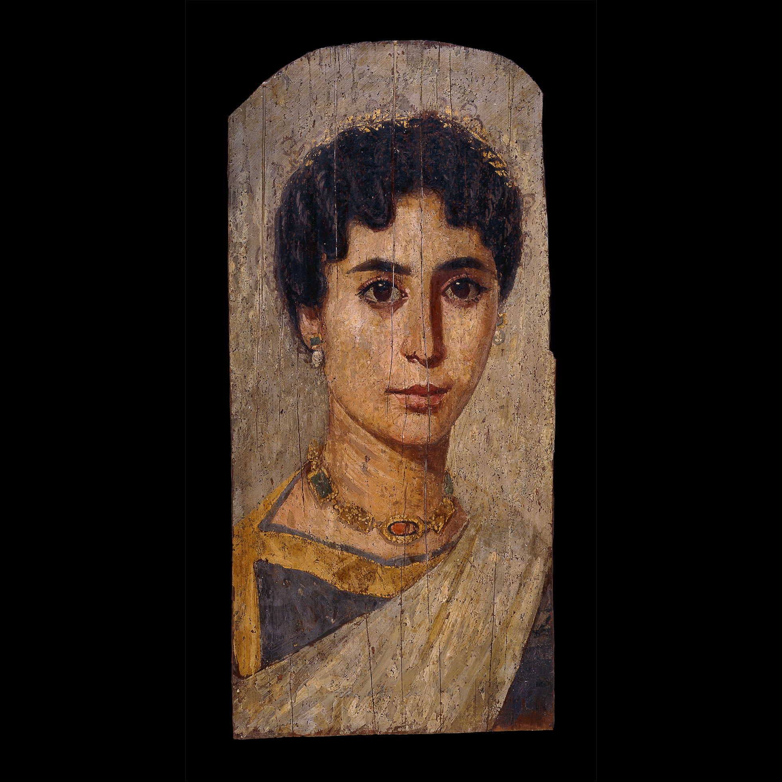
Portrait of a Woman,
160-170 AD, Encaustic on Lime Wood and Gold leaf, H. 55 cm, British Museum, London, UK https://blog.britishmuseum.org/depicting-the-dead-ancient-egyptian-mummy-portraits/

Slide 12
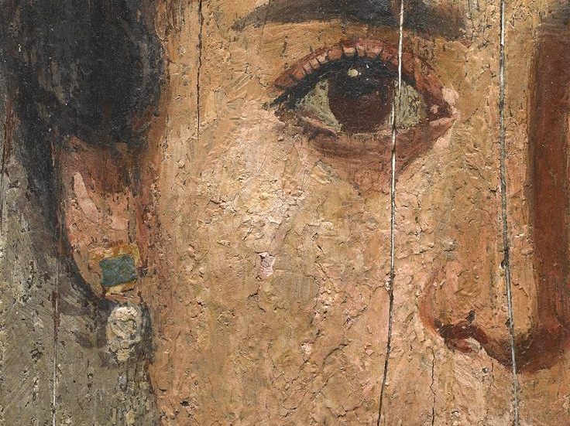
https://www.britishmuseum.org/collection/object/Y_EA65346

Slide 13
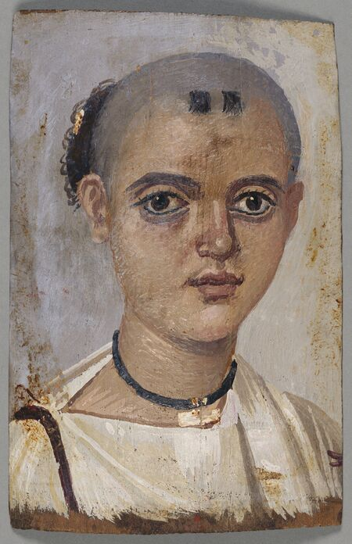
Mummy Portrait of a Youth, 150–200 AD, Encaustic on Linden Wood, 20.3 × 13 cm, The J. Paul Getty Museum, CA, USA https://www.artsy.net/article/artsy-editorial-unraveling-mysteries-ancient-egypts-spellbinding-mummy-portraits

Slide 14
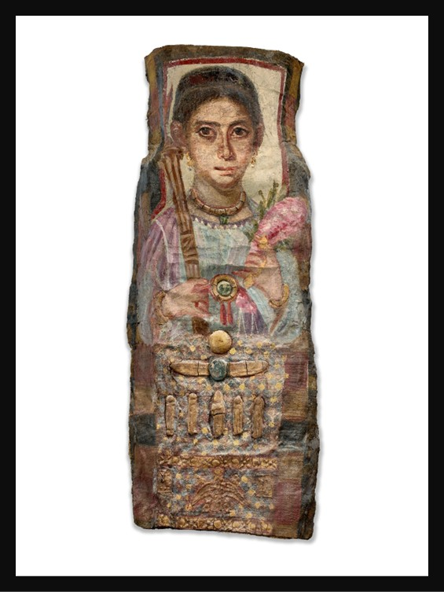
Mummy Portrait of a Lady, c. 225-250 AD, Encaustic painting on linen and motifs with gilded stucco, Height: 95.8 cm, Private Collection https://www.christies.com/en/lot/lot-6552510?ldp_breadcrumb=back

Slide 15
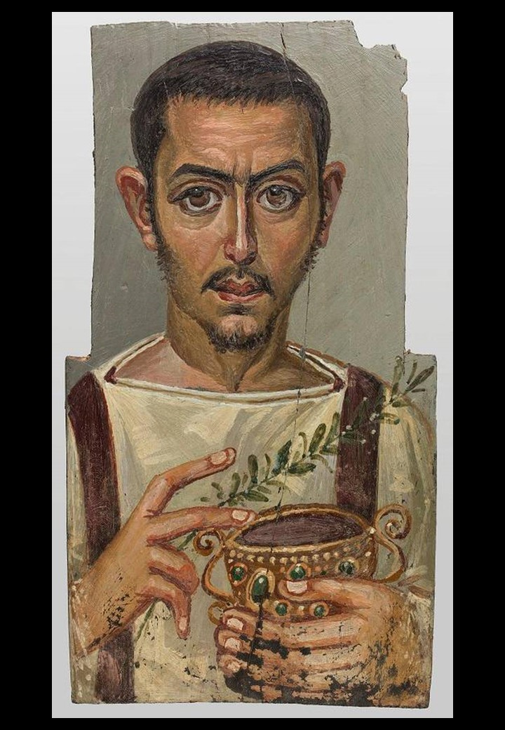
Funerary Portrait of a Man with a Cup, ca. 225-250 AD, Antinopolis (?), Egypt, Wax Paint on Wood, 42.7 x 23 x 0.9 cm, The Louvre Abu Dhabi https://www.thenationalnews.com/arts-culture/art/louvre-abu-dhabi-joins-global-research-project-to-analyse-ancient-mummy-portraits-1.1062790

