Slide 1
Masterpieces of Flowers and Birds
by Hokusai

Slide 2
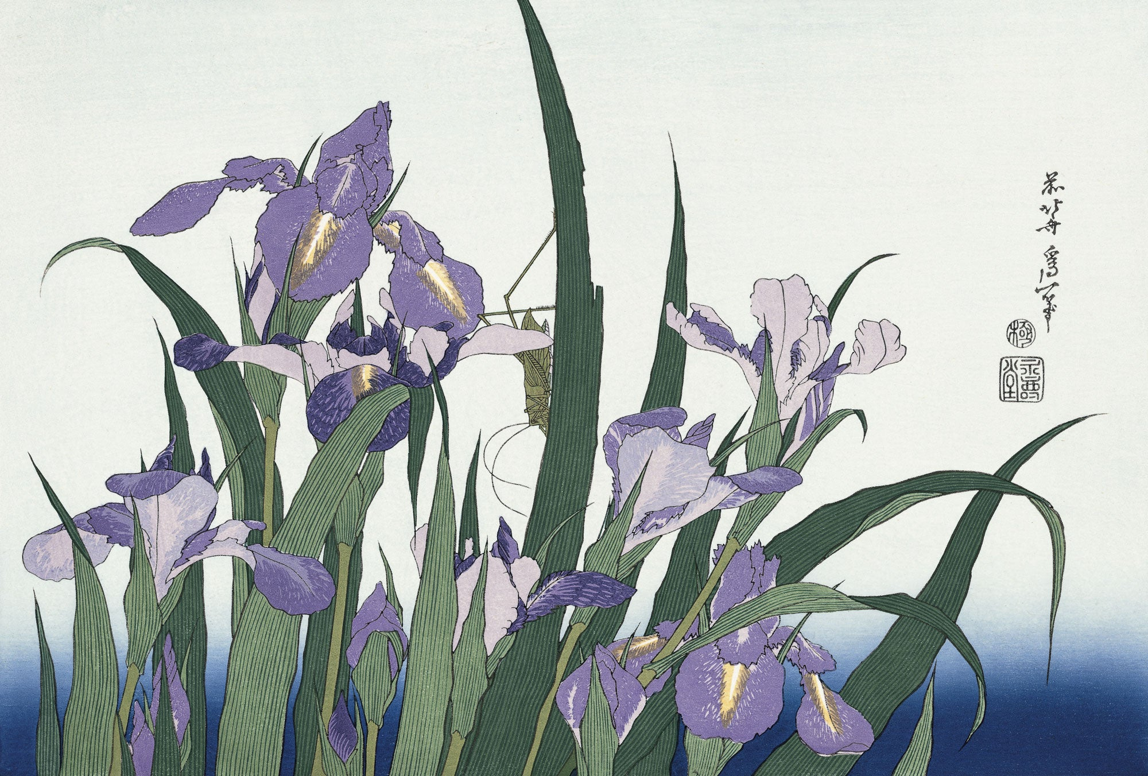
Blossoming Irises and Grasshopper

Slide 3
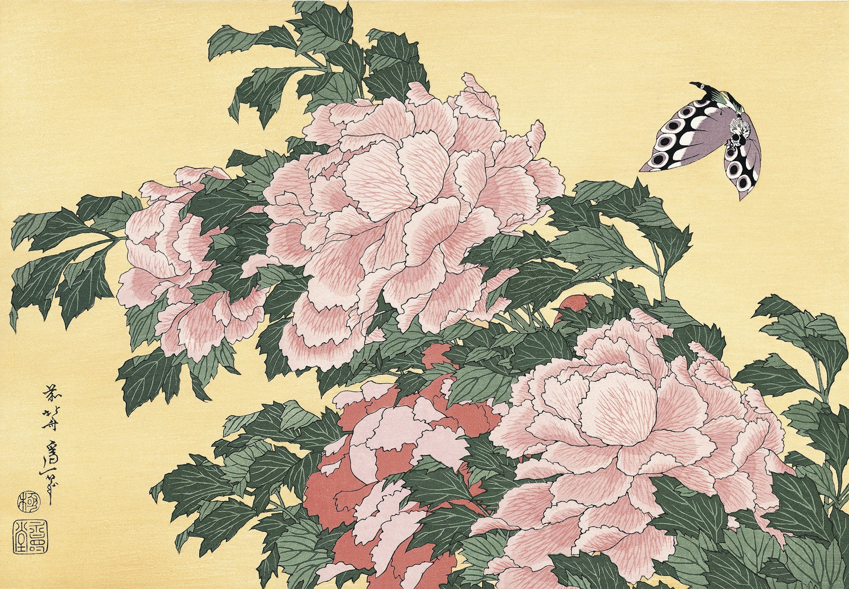
Tree-peony and Butterfly

Slide 4
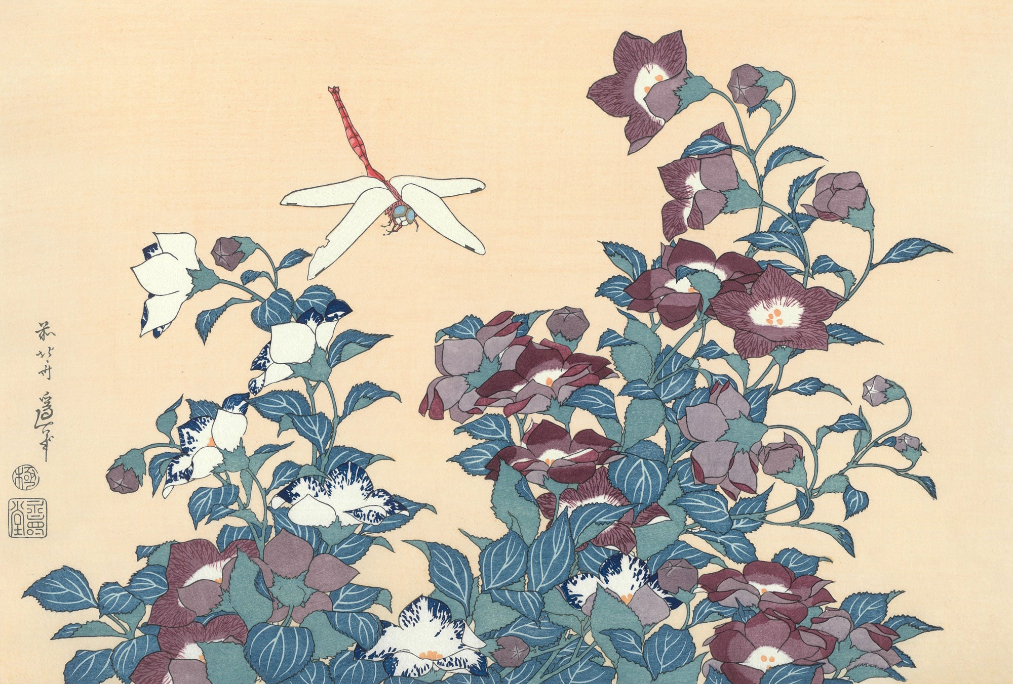
Bellflower and Dragon-fly

Slide 5
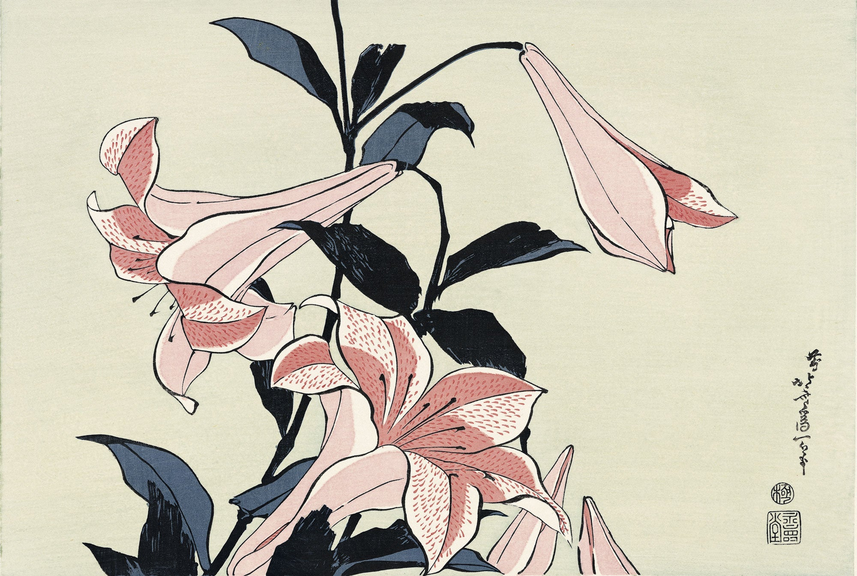
Lily

Slide 6
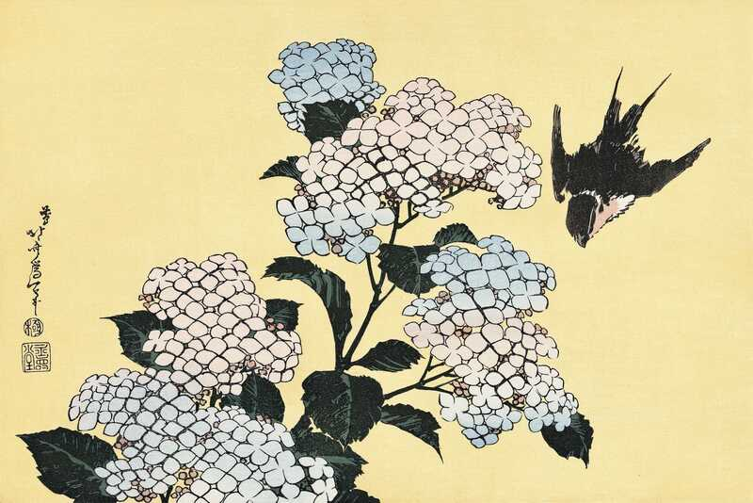
Hydrangea and a Swallow

Slide 7
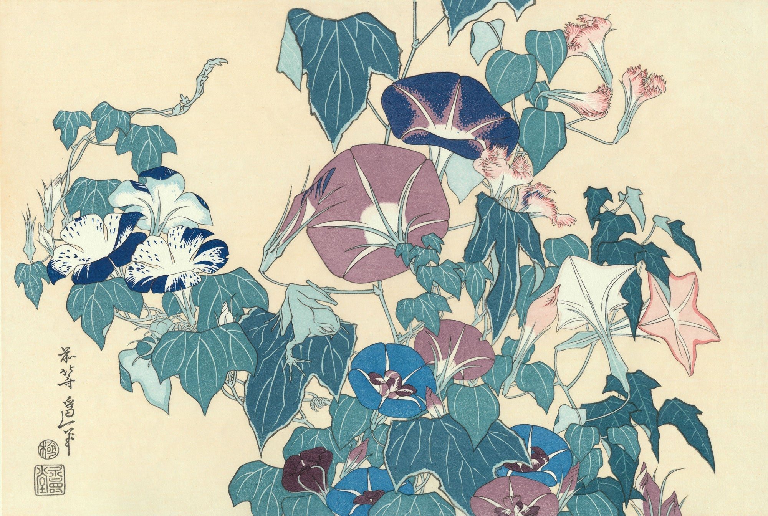
Morning-Glories and Frog

Slide 8
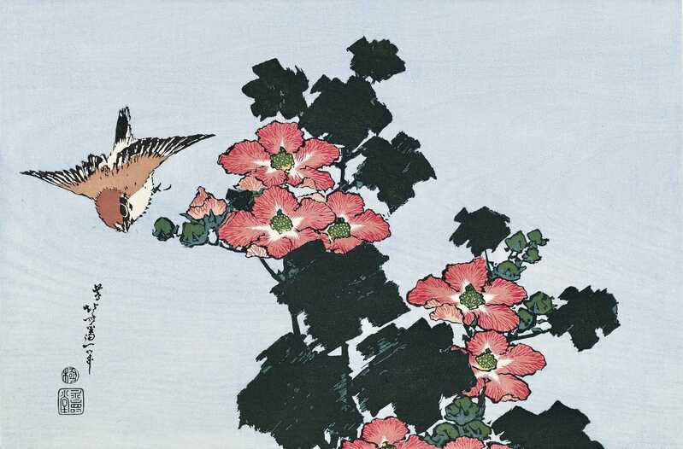
Hibiscus and Sparrow

Slide 9
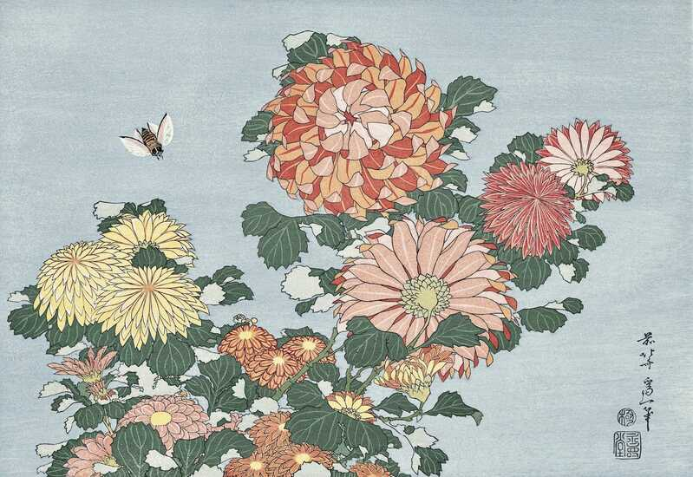
Chrysanthemums and a Deerfly

Slide 10
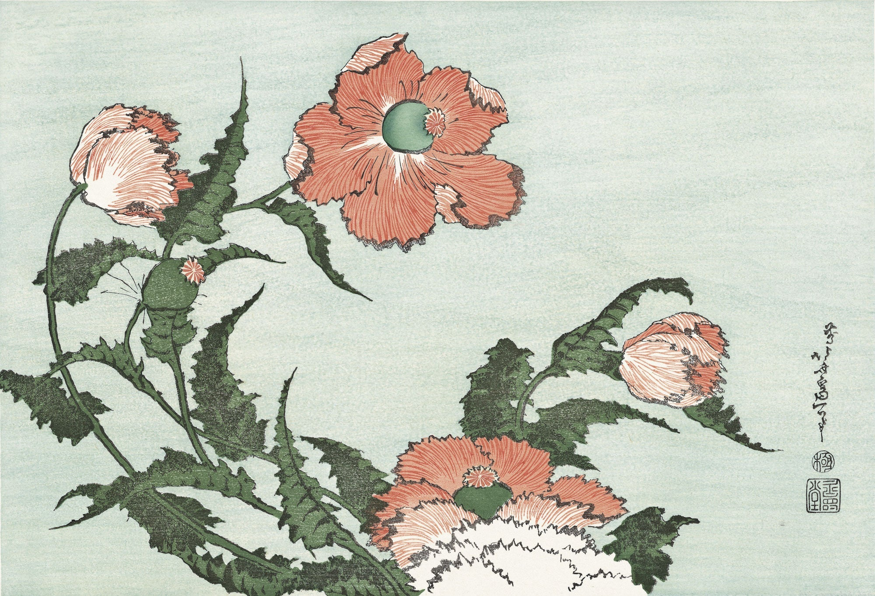
Poppies

Slide 11
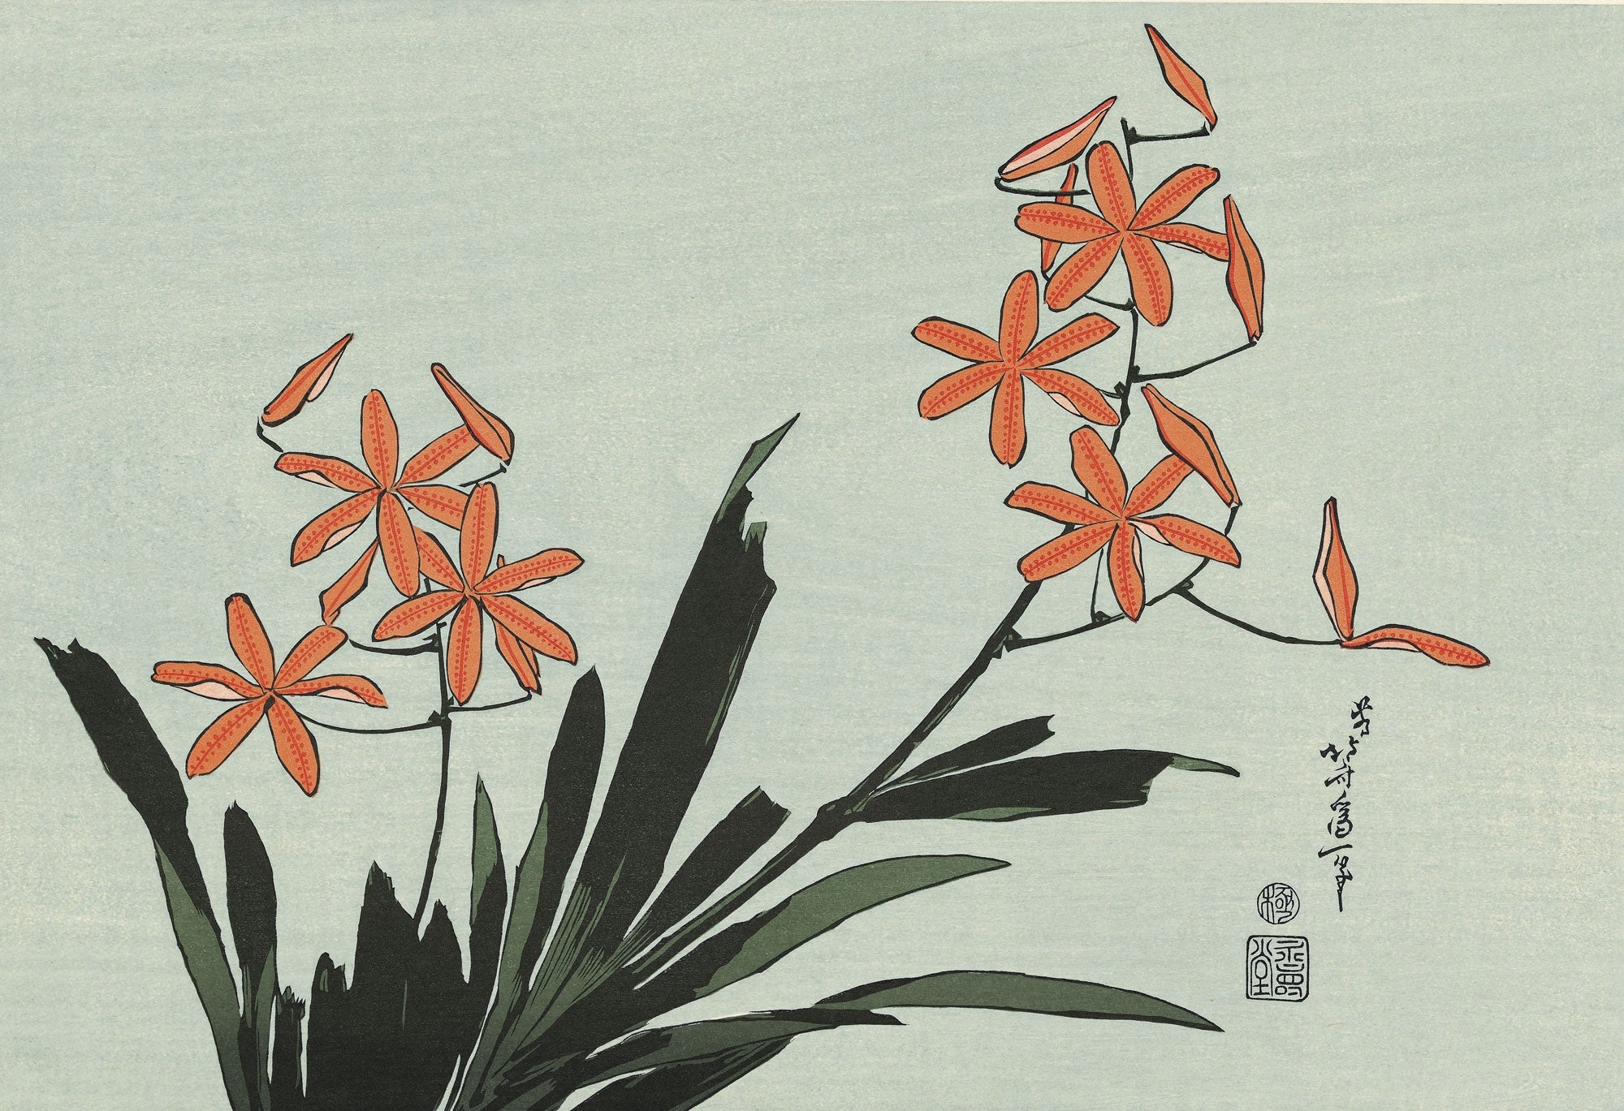
Orange Orchids

Slide 12
Photo Credit: https://store.adachi-hanga.com/en/collections/ukiyoe_ser_hkflowers?srsltid=AfmBOooWWev-D532b8JOoY-xxeVE3b3eQ51Groi8iZ5fl2nVskdOQre3

Slide 13
The END

