Slide 1
The Monastery of Nea Moni on the island of Chios
The Katholikon was built with the patronage of Emperor Constantine IX Monomachos between 1049–55

Slide 2
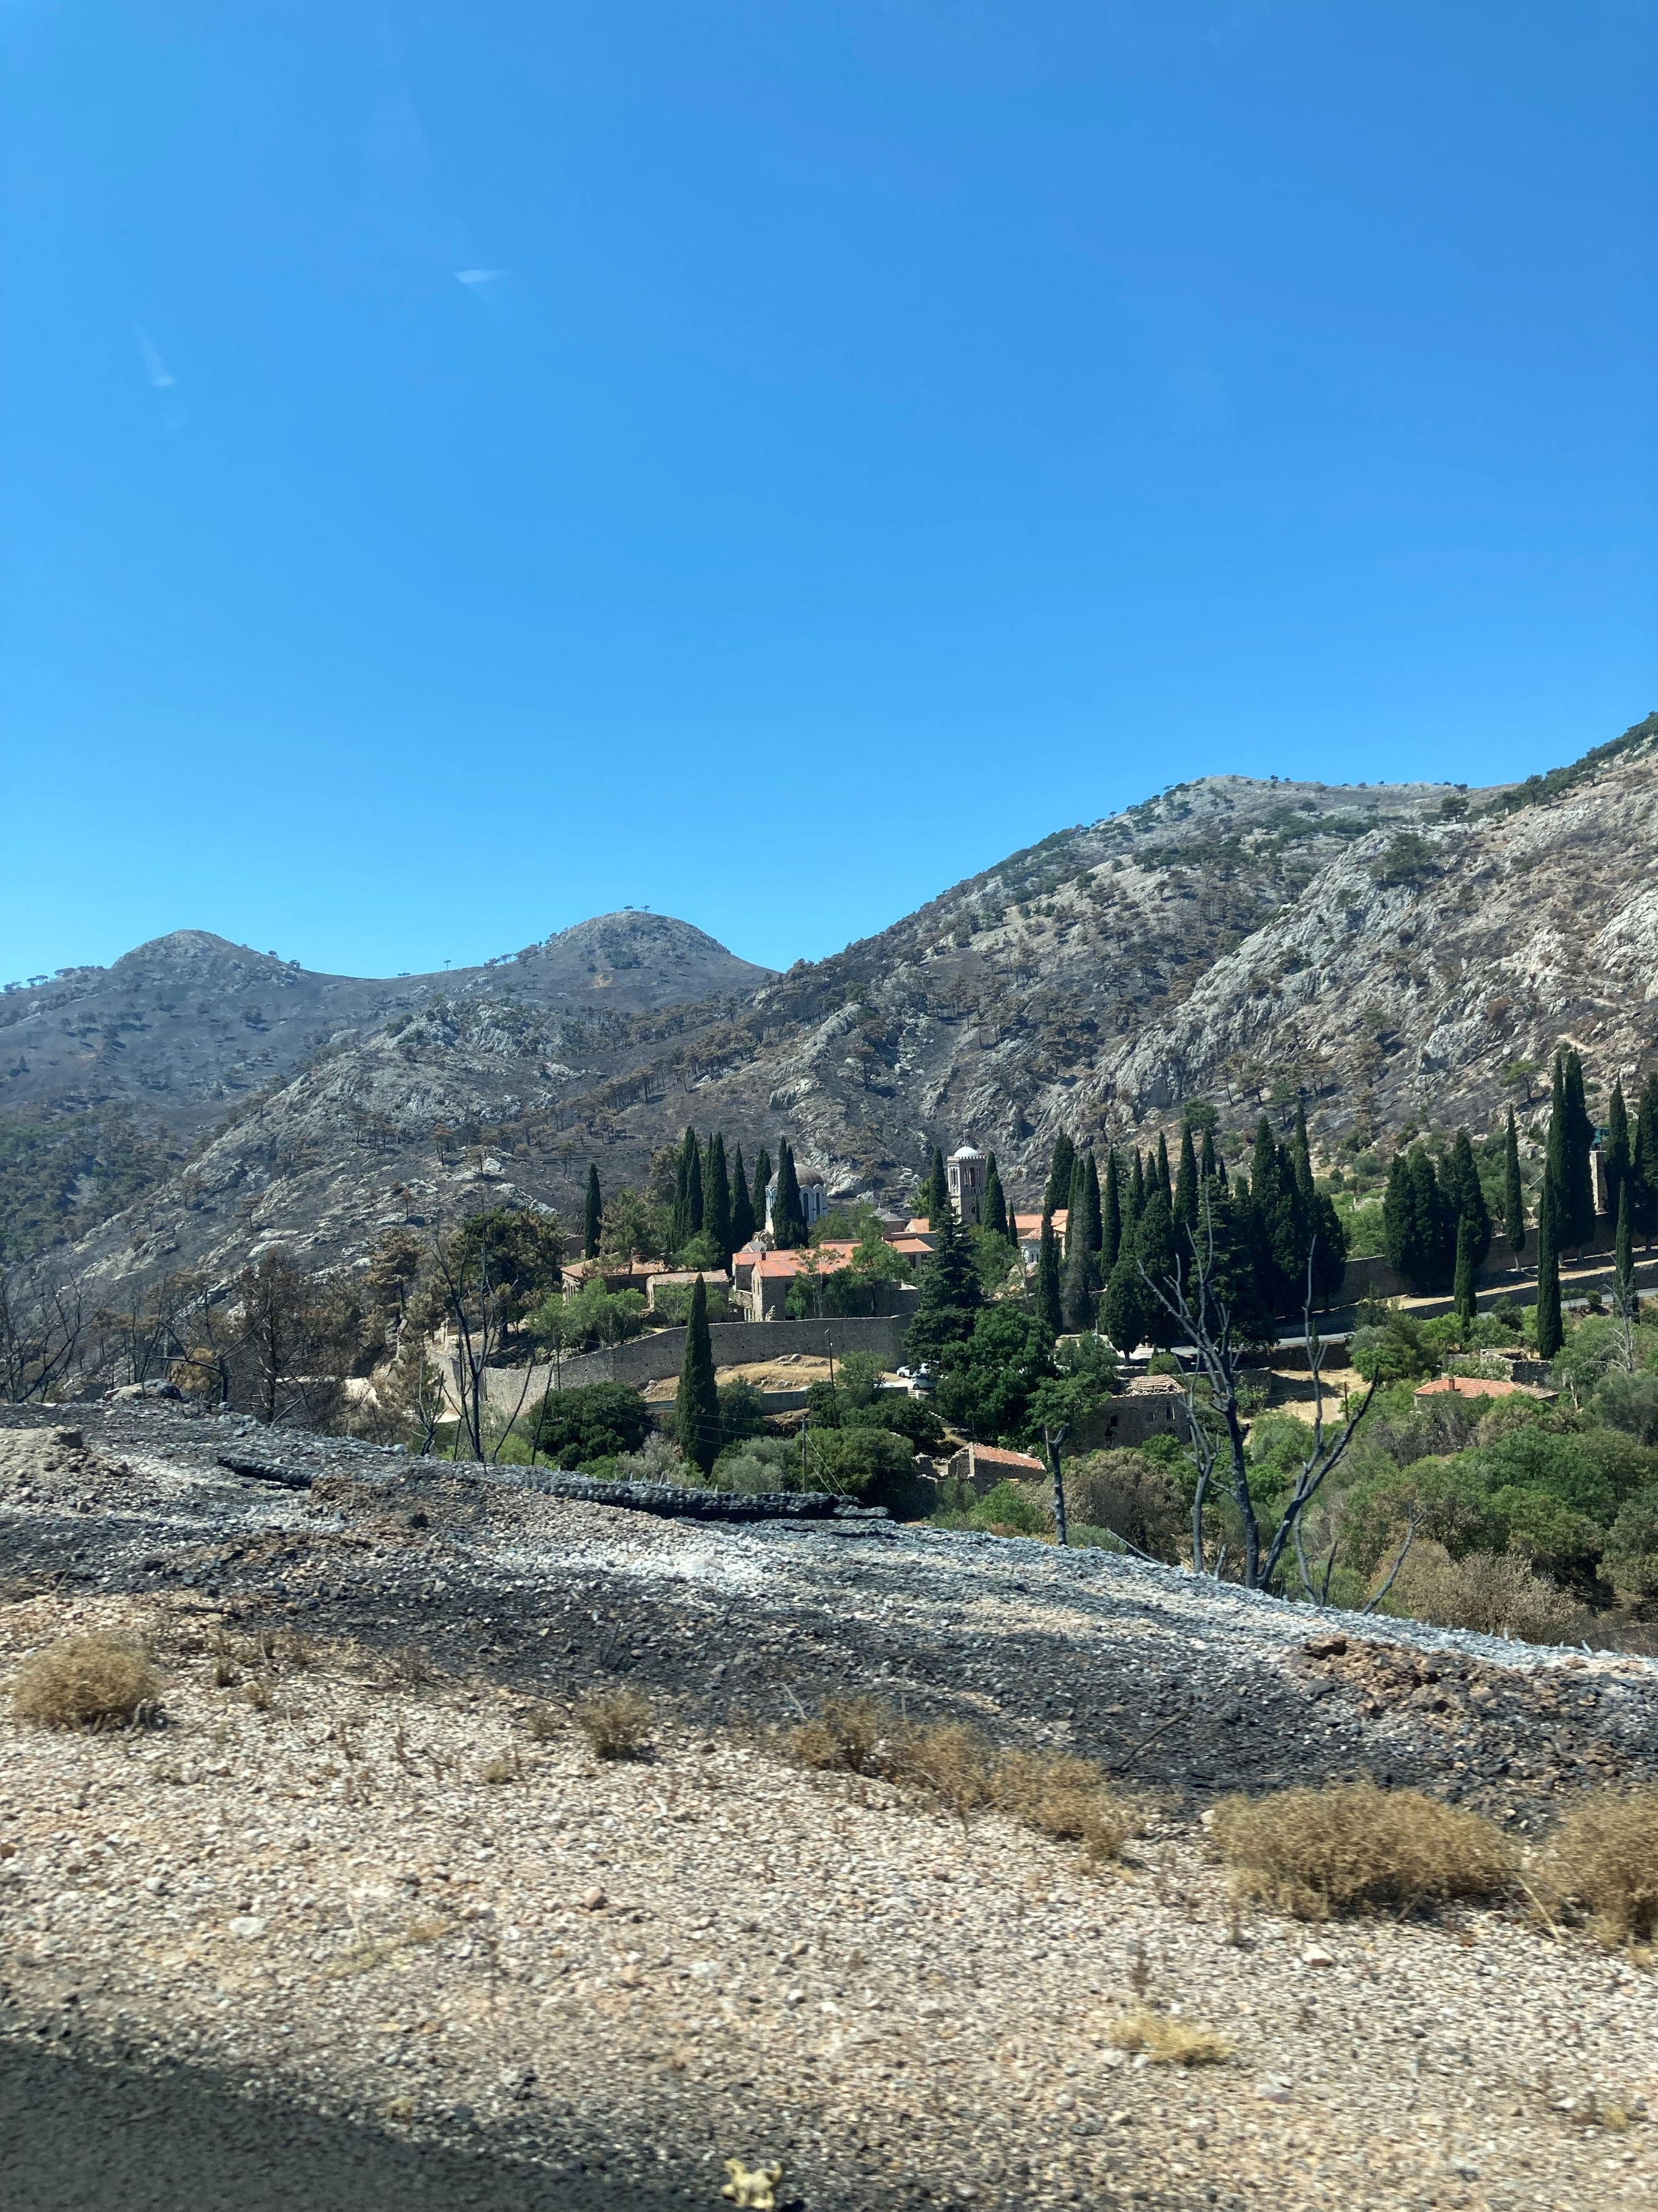
Nea Moni, Chios, 11th century
Photo Credit: Amalia Spiliakou, 2025

Slide 3
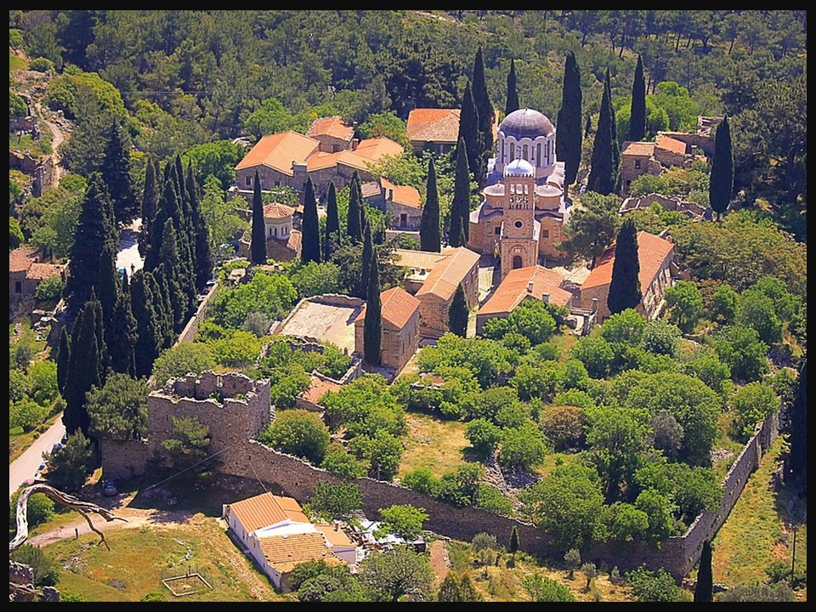
Nea Moni, Chios, 11th century https://el.wikipedia.org/wiki/%CE%9D%CE%AD%CE%B1_%CE%9C%CE%BF%CE%BD%CE%AE_%CE%A7%CE%AF%CE%BF%CF%85#/media/%CE%91%CF%81%CF%87%CE%B5%CE%AF%CE%BF:NEA_MONH.jpg

Slide 4
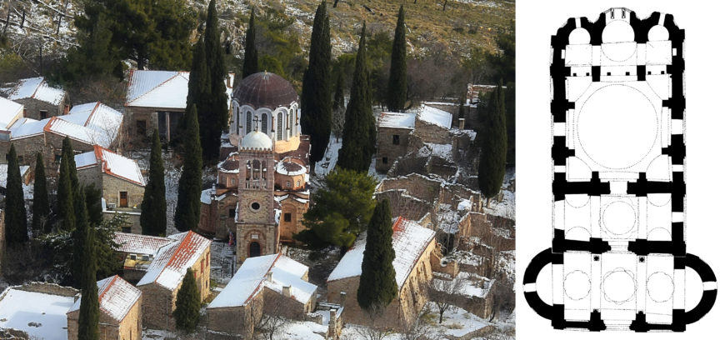
Left: View of Nea Moni from the west (photo: FLIOUKAS, CC BY-SA 4.0)
Right: Plan of katholikon of Nea Moni, Chios, 11th century (© Robert G. Ousterhout) https://smarthistory.org/mosaics-and-microcosm/

Slide 5
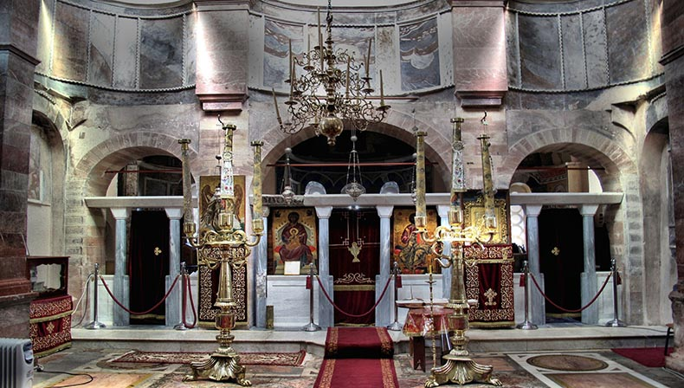
The Katholiko, Nea Moni, Chios https://www.pallasweb.com/deesis/byzantine-mosaics-of-nea-moni-on-chios.html

Slide 6
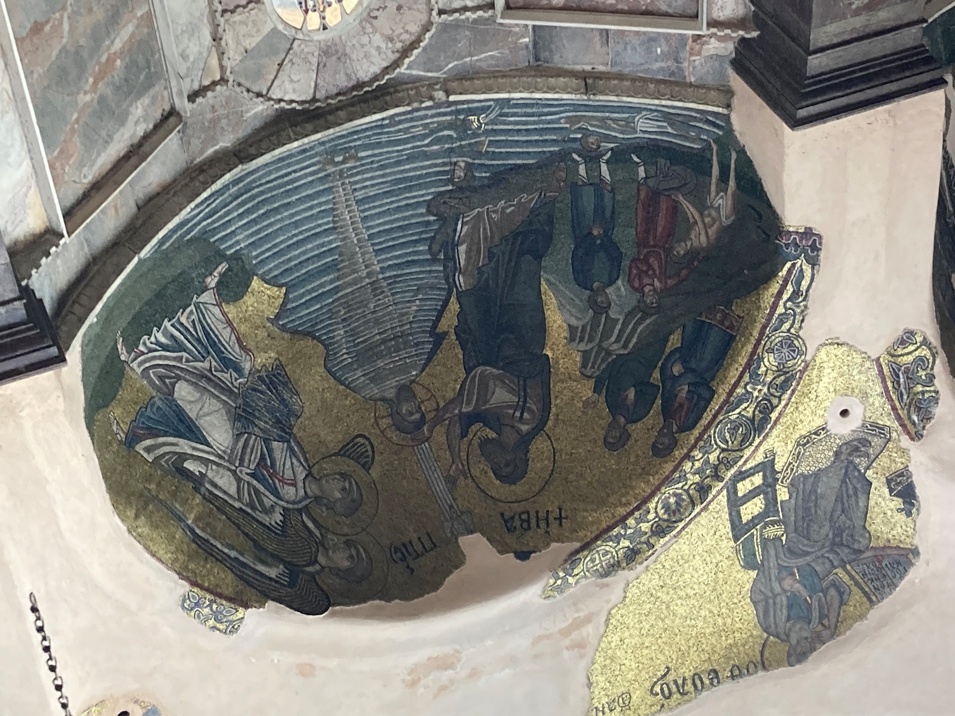
The Baptism of Christ, Nea Moni, Chios, 11th century – Photo Credit: Amalia Spiliakou, 2025

Slide 7
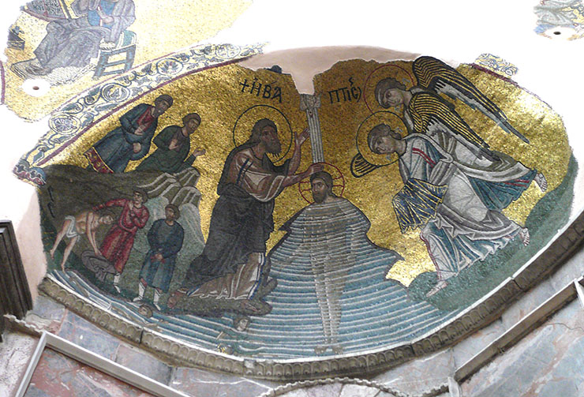
The Baptism of Christ, Nea Moni, Chios, 11th century https://www.pallasweb.com/deesis/byzantine-mosaics-of-nea-moni-on-chios.html

Slide 8
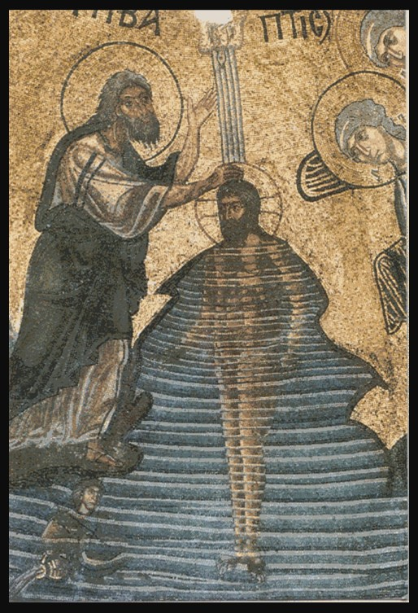
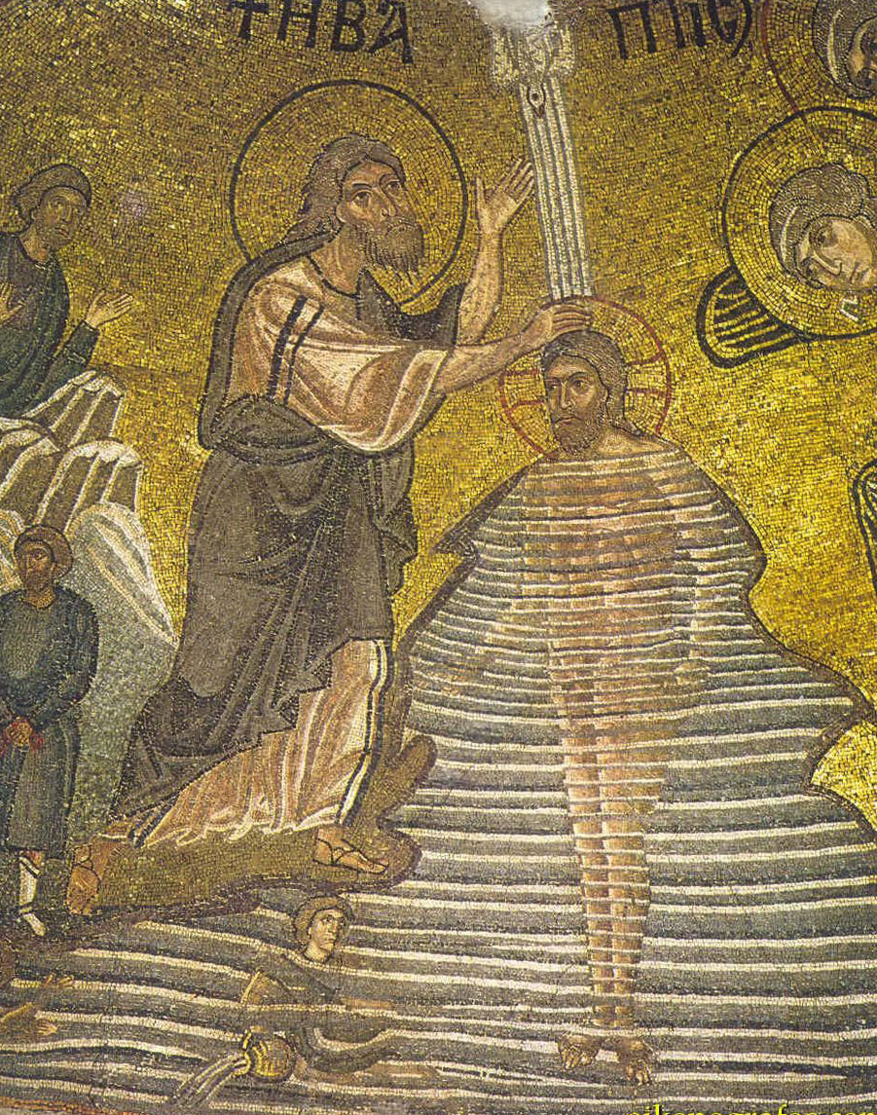
The Baptism of Christ, Nea Moni, Chios, 11th century https://www.pallasweb.com/deesis/byzantine-mosaics-of-nea-moni-on-chios.html

Slide 9
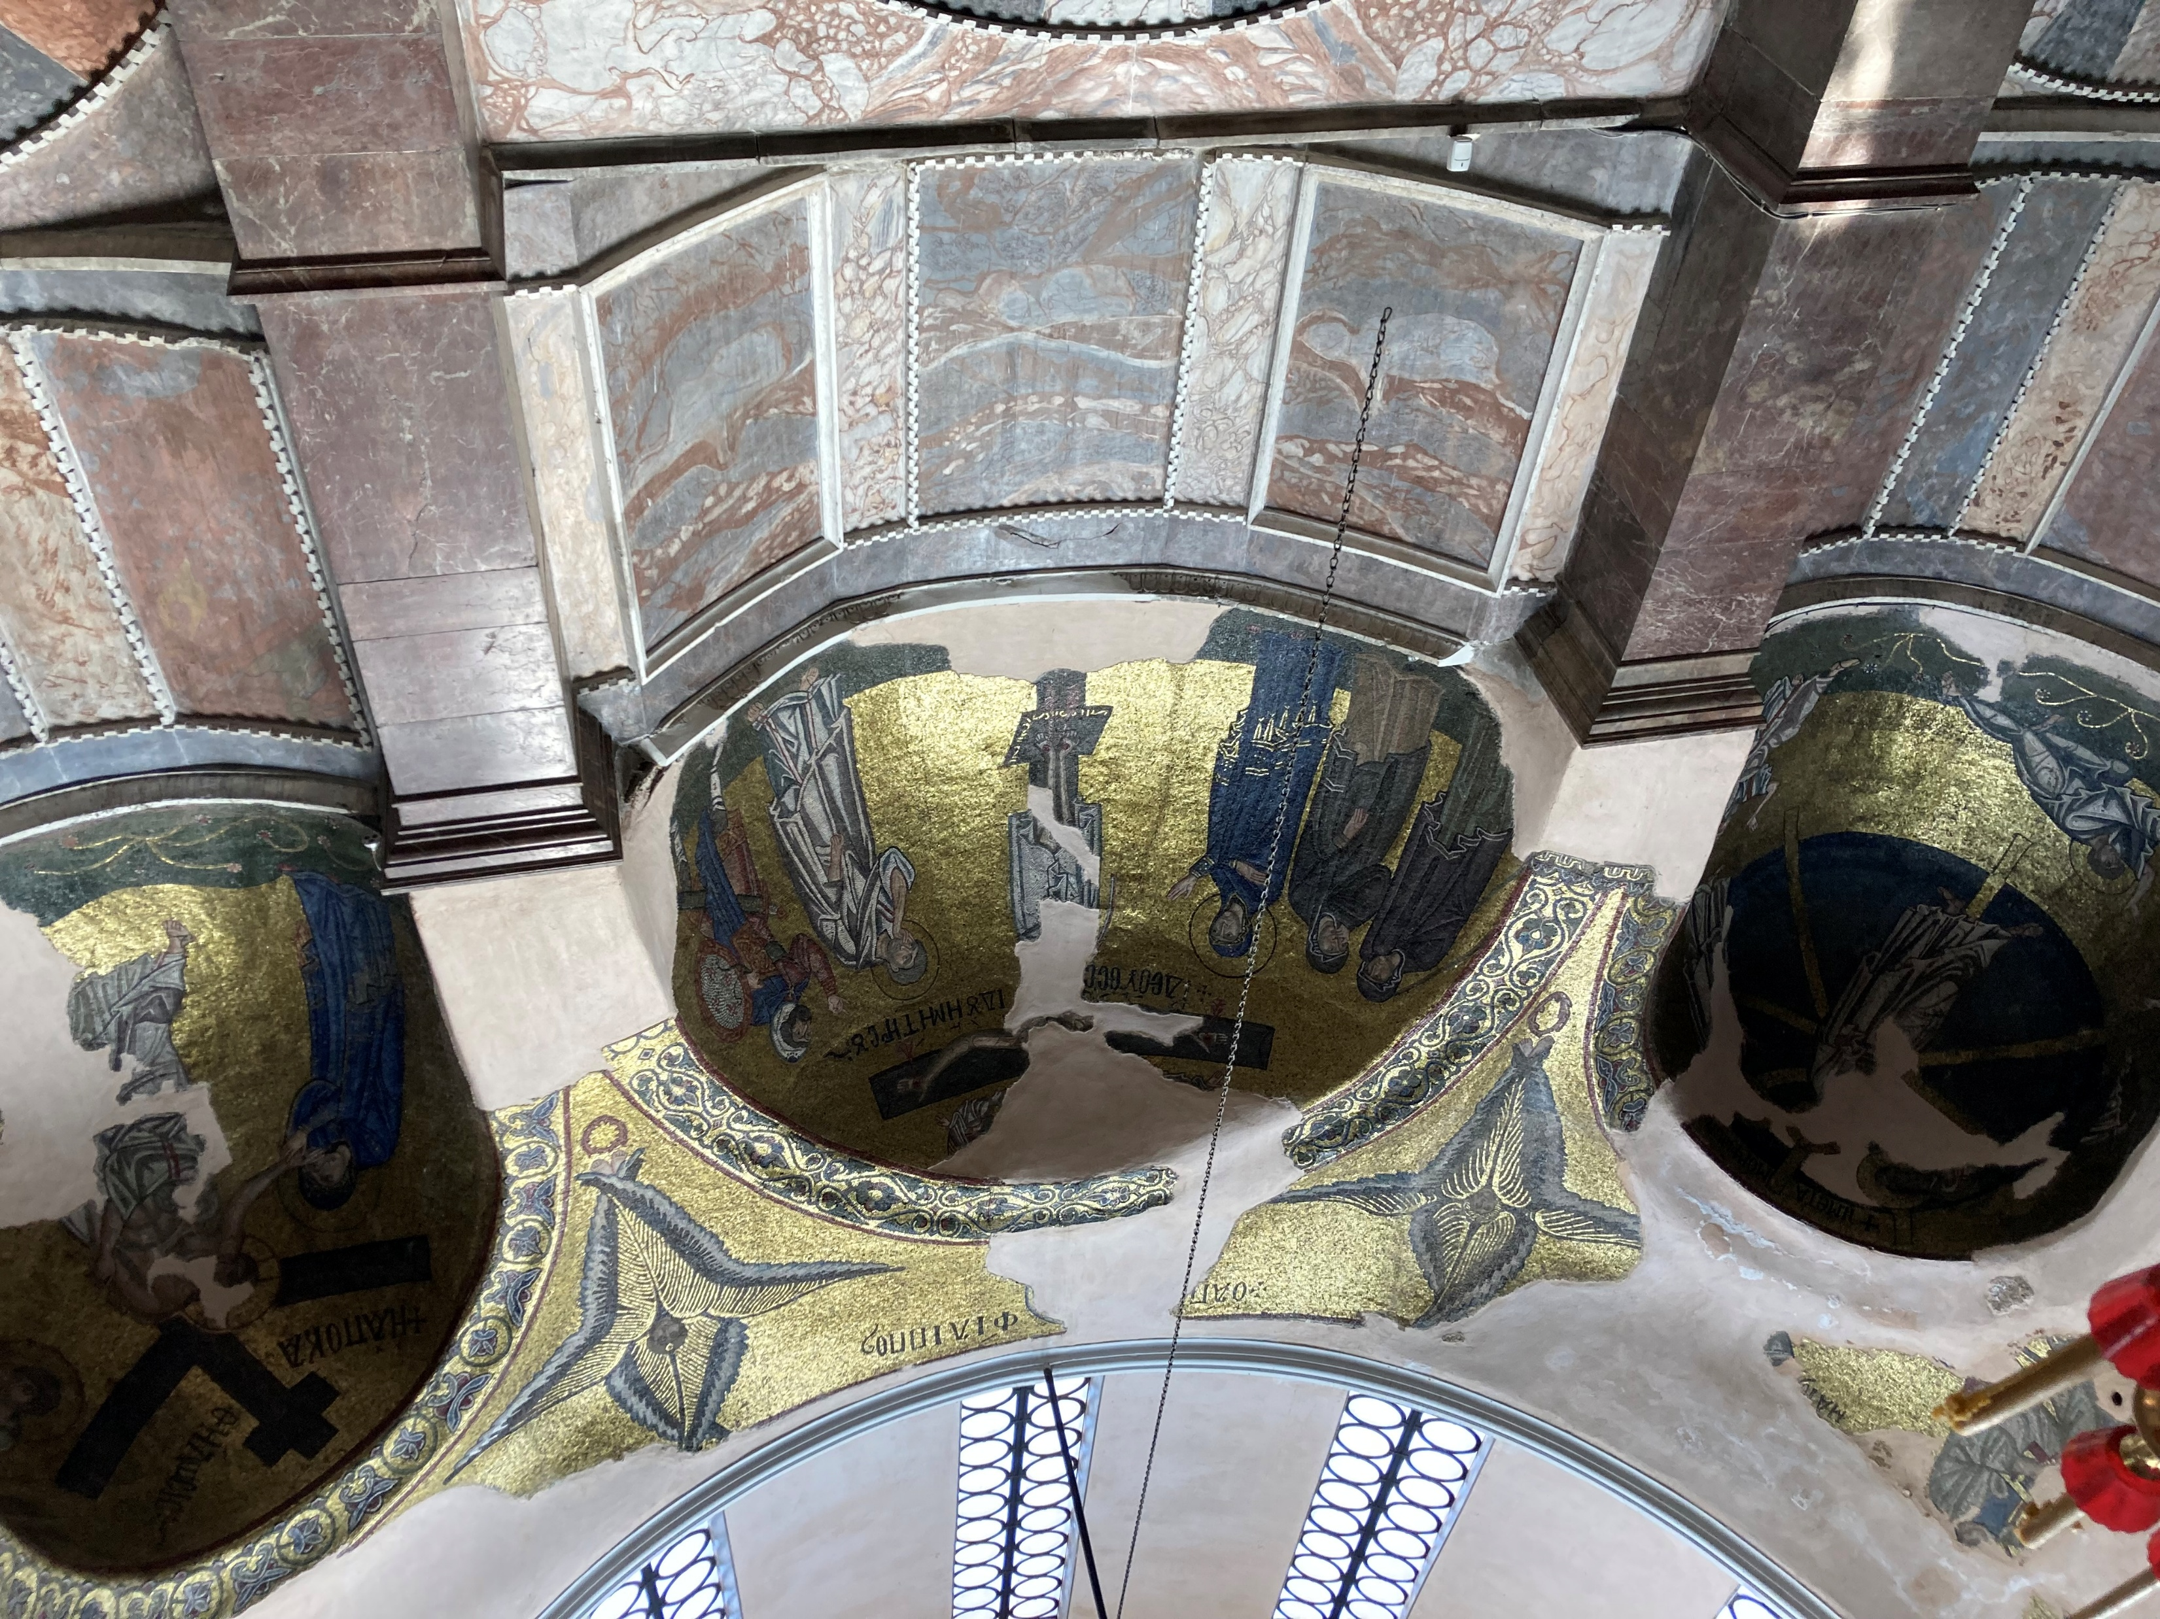
The Crucifixion of Christ, Nea Moni, Chios, 11th century – Photo Credit: Amalia Spiliakou, 2025

Slide 10
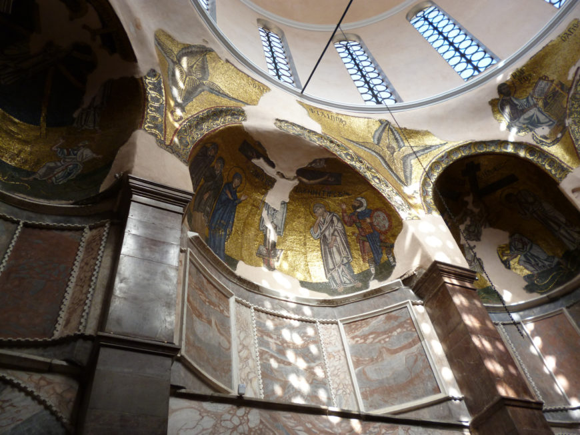
View of the Naos and the Crucifixion Mosaic, Nea Moni, Chios, 11th century (photo: Meltedrainbow, CC BY-SA 4.0) https://smarthistory.org/mosaics-and-microcosm/

Slide 11
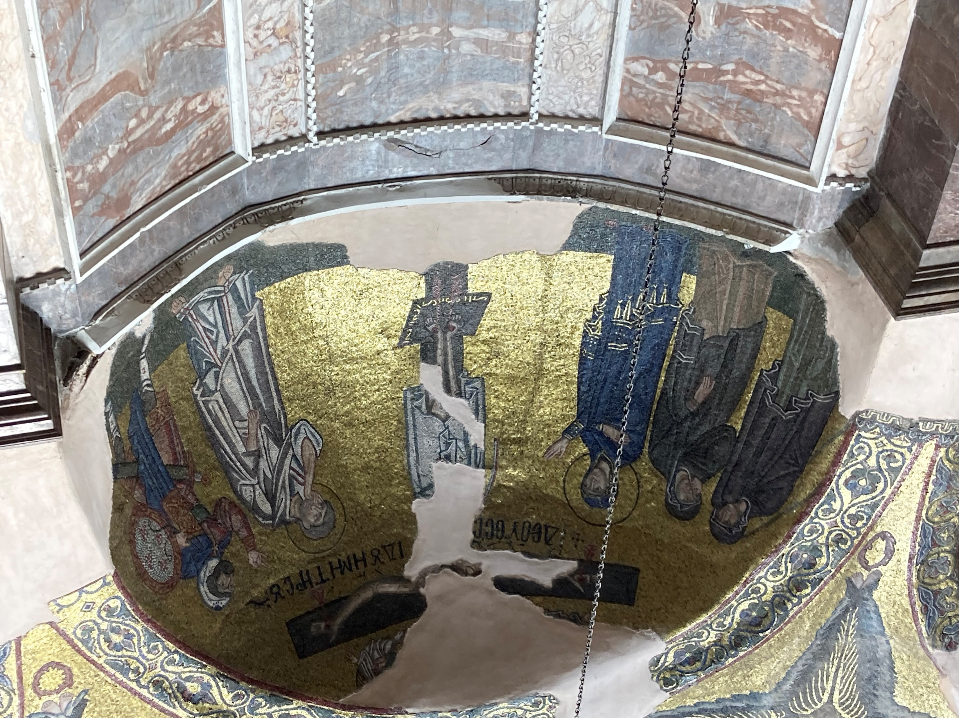
The Crucifixion of Christ, Nea Moni, Chios, 11th century – Photo Credit: Amalia Spiliakou, 2025

Slide 12
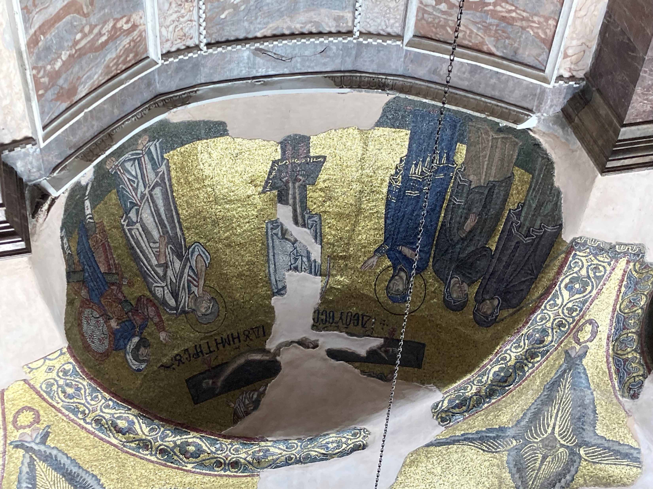
The Crucifixion of Christ, Nea Moni, Chios, 11th century – Photo Credit: Amalia Spiliakou, 2025

Slide 13
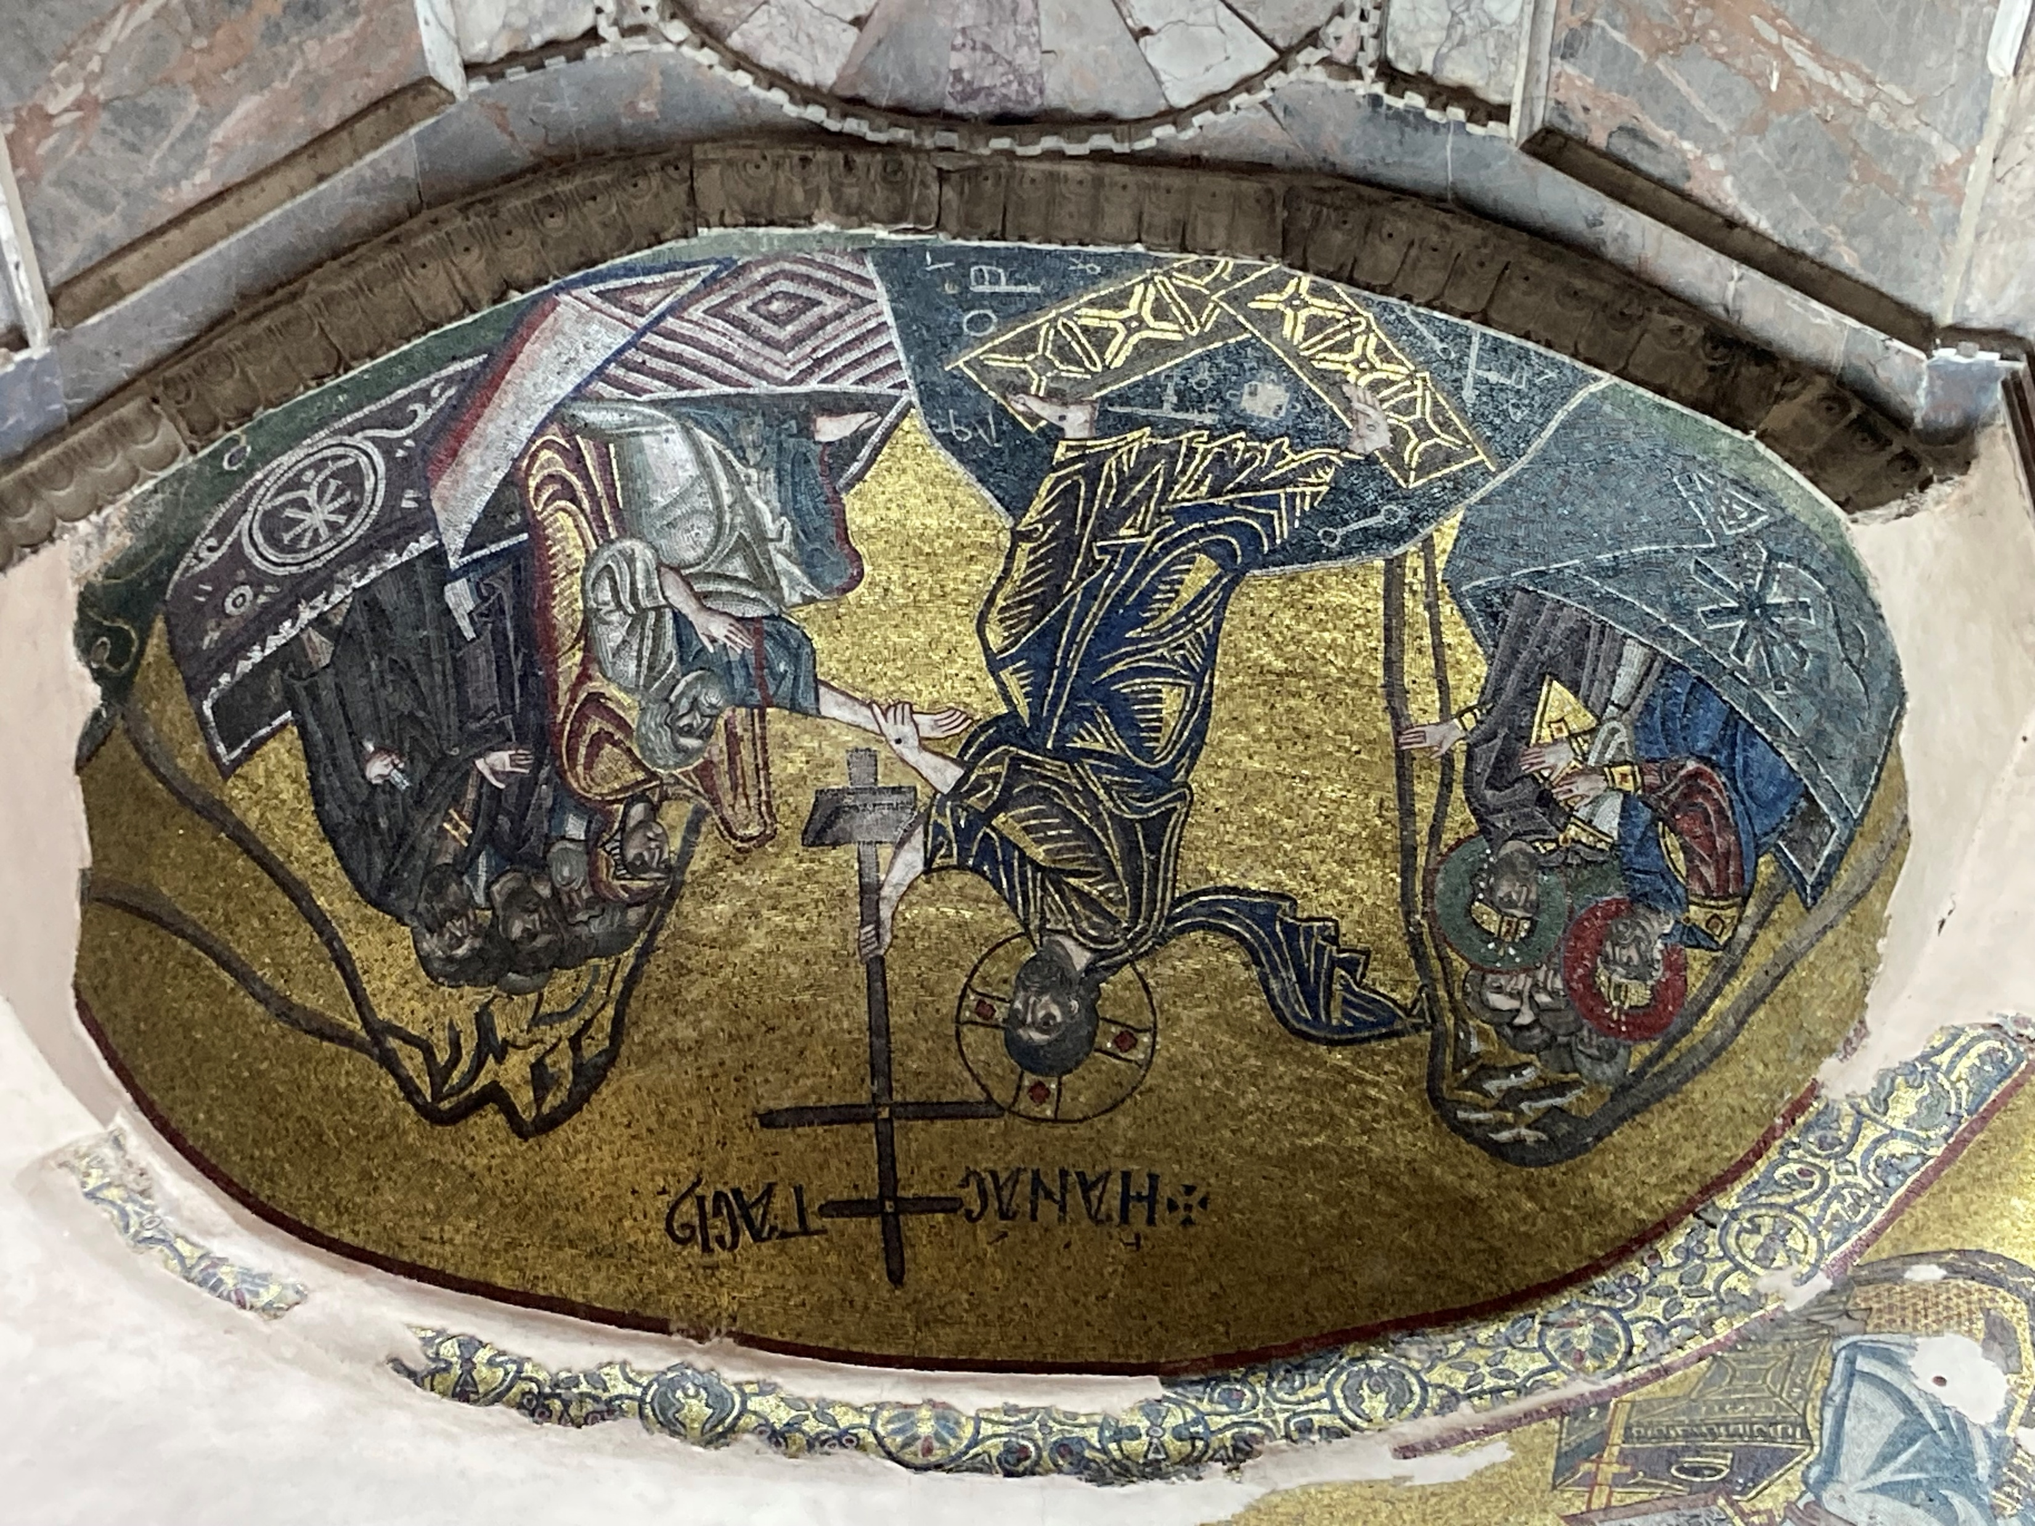
The Harrowing of Hell, Nea Moni, Chios, 11th century – Photo Credit: Amalia Spiliakou, 2025

Slide 14
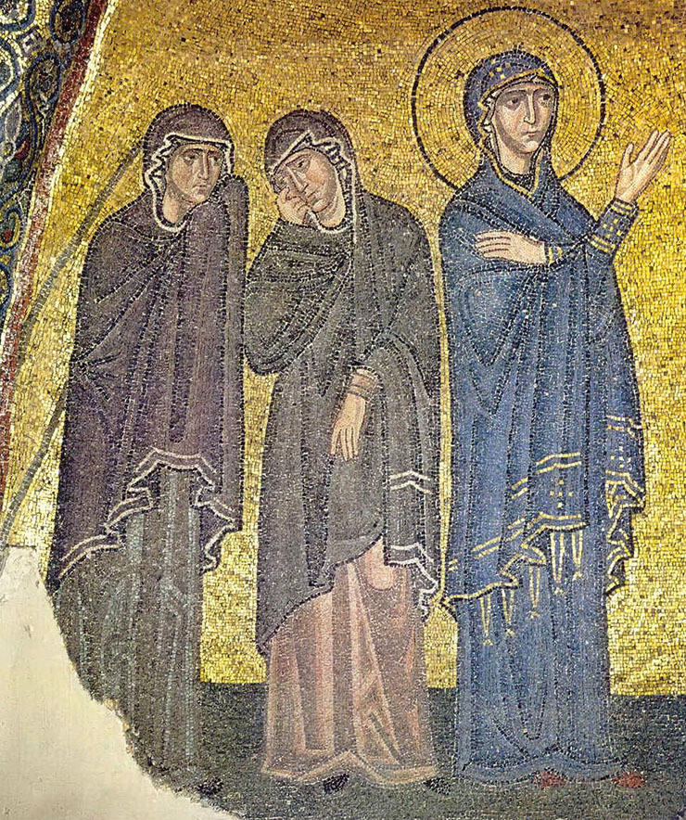
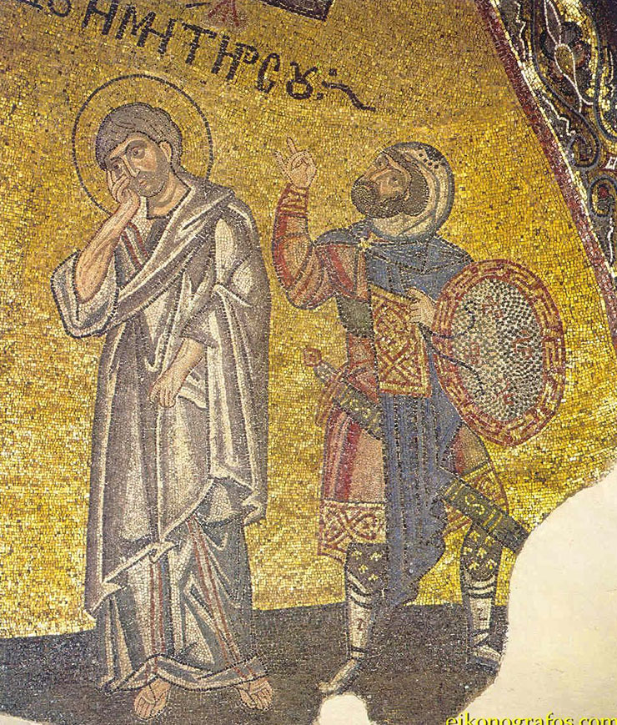
The Harrowing of Hell, Nea Moni, Chios, 11th century https://www.pallasweb.com/deesis/byzantine-mosaics-of-nea-moni-on-chios.html

Slide 15
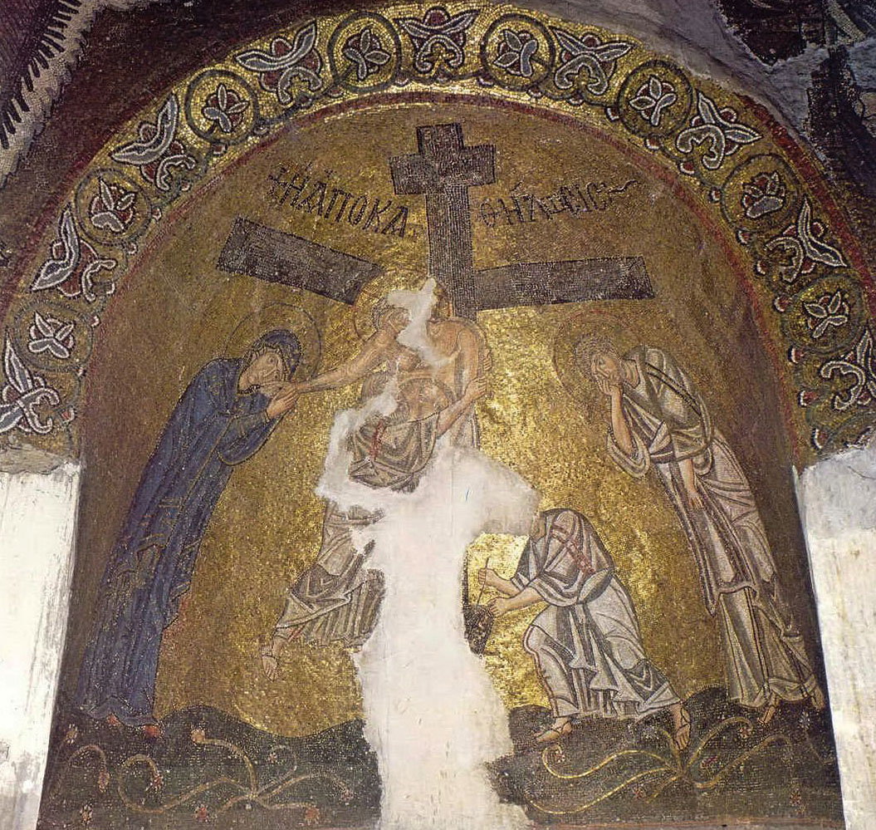
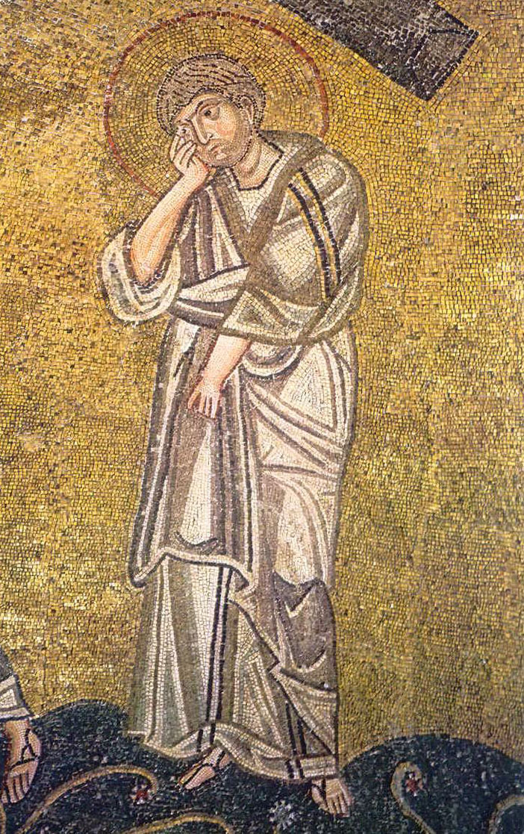
The Descent from the Cross, Nea Moni, Chios, 11th century https://www.pallasweb.com/deesis/byzantine-mosaics-of-nea-moni-on-chios.html

Slide 16
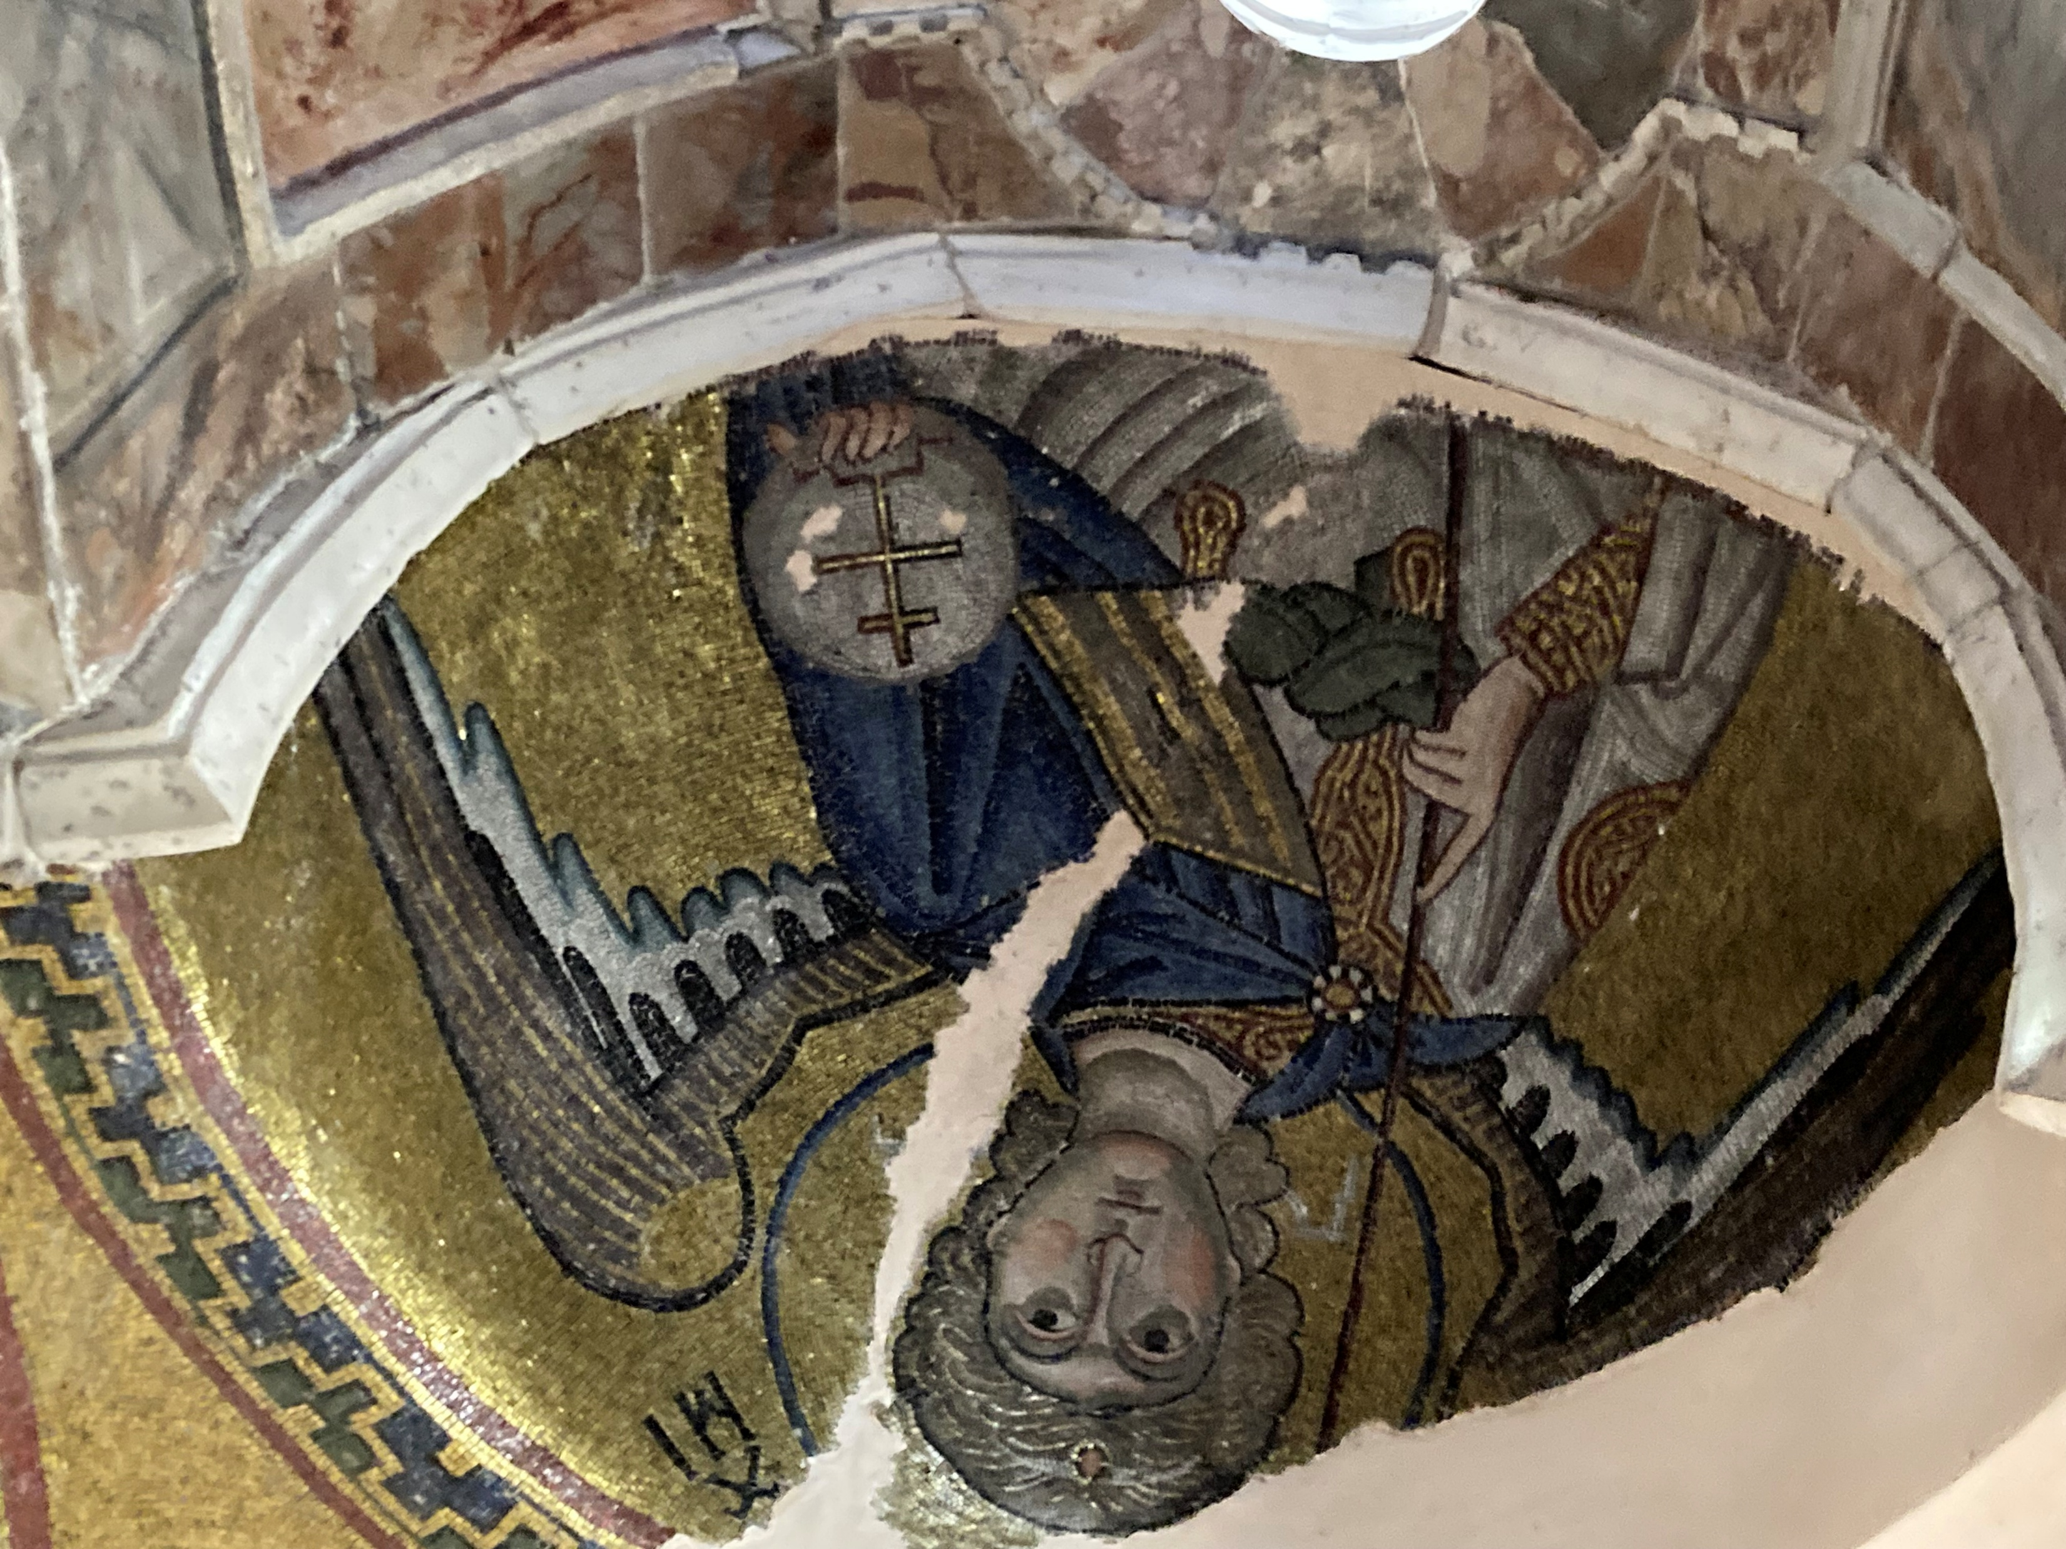
Archangel Michael, Nea Moni, Chios, 11th century – Photo Credit: Amalia Spiliakou, 2025

Slide 17
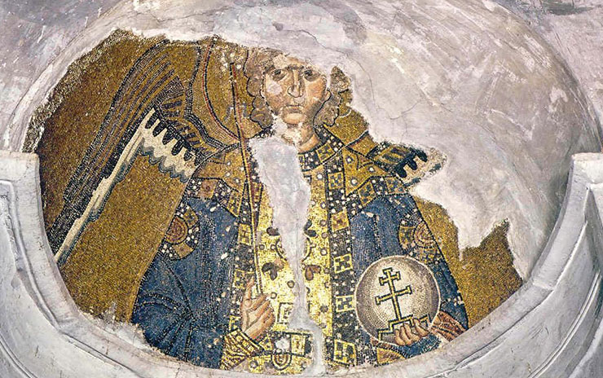
Archangel Gabriel, Nea Moni, Chios, 11th century https://www.pallasweb.com/deesis/byzantine-mosaics-of-nea-moni-on-chios.html

Slide 18
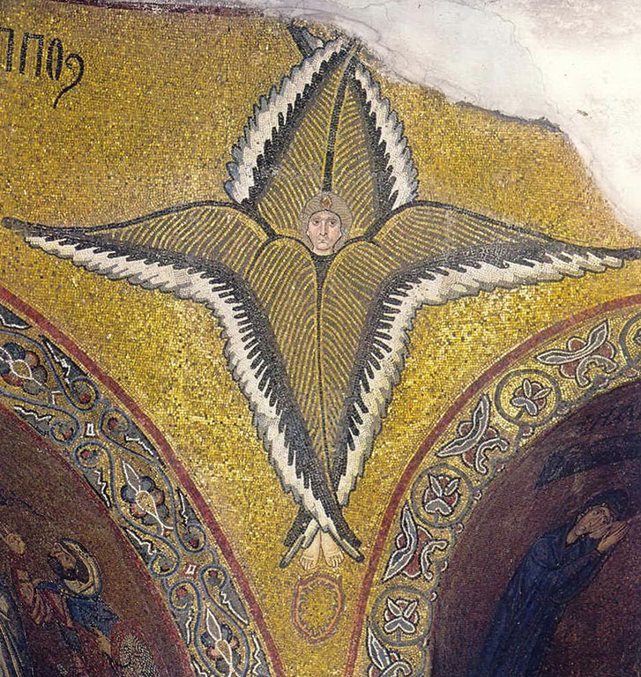
A winged Seraphim, Nea Moni, Chios, 11th century https://www.pallasweb.com/deesis/byzantine-mosaics-of-nea-moni-on-chios.html

Slide 19
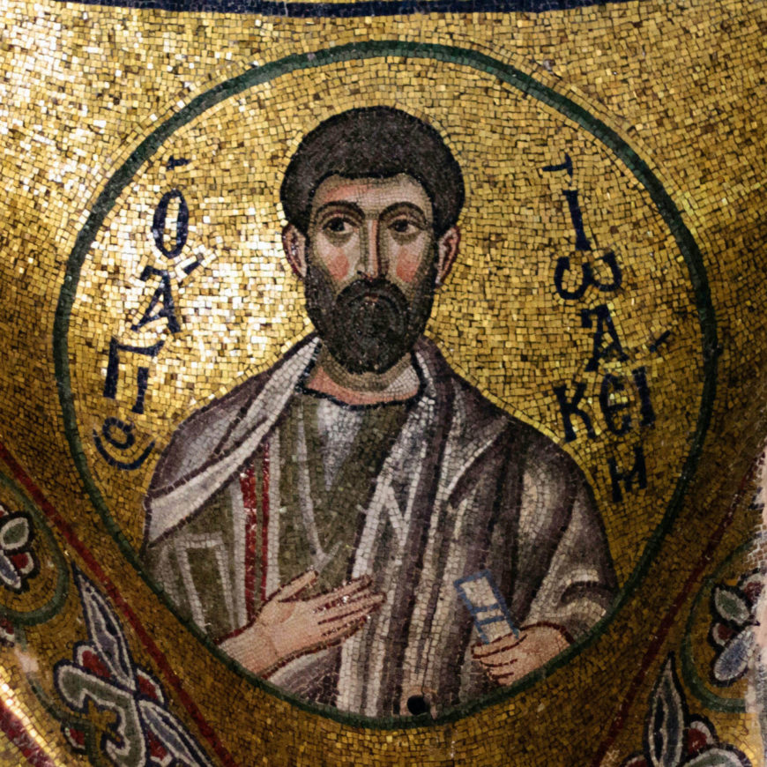
St. Joachim mosaic, 11th century, Katholikon, Nea Moni, Chios (photo: Marmontel, CC BY-SA 2.0) https://smarthistory.org/mosaics-and-microcosm/

