Slide 1

Etruscan Art
Etruscan Funerary Art and Practices
Tomb of the Jugglers - Tomba dei Giocolieri, circa 510 BC,
Necropoli dei Monterozzi,
Tarquinia, Italy

Slide 2
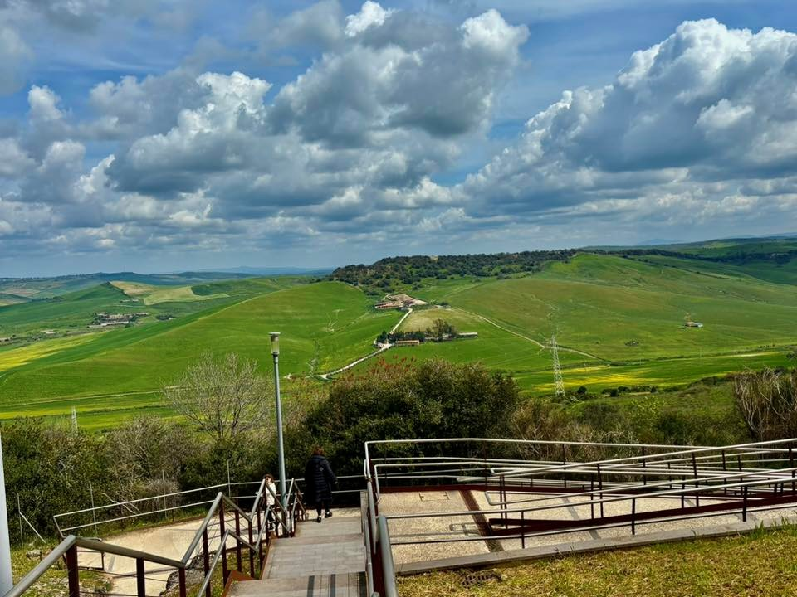
Etruscan Necropoli dei Monterozzi, Tarquinia, Italy
Photo Credit: Xanthippi Glavopoulou

Slide 3
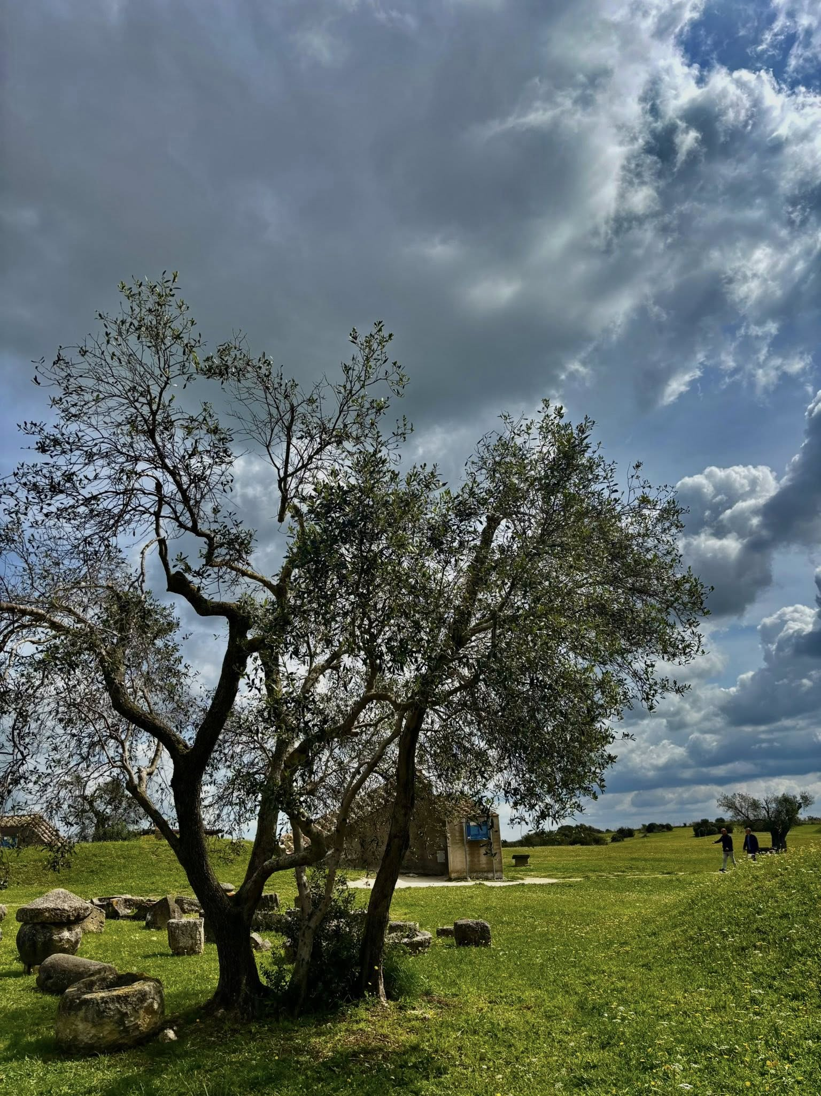
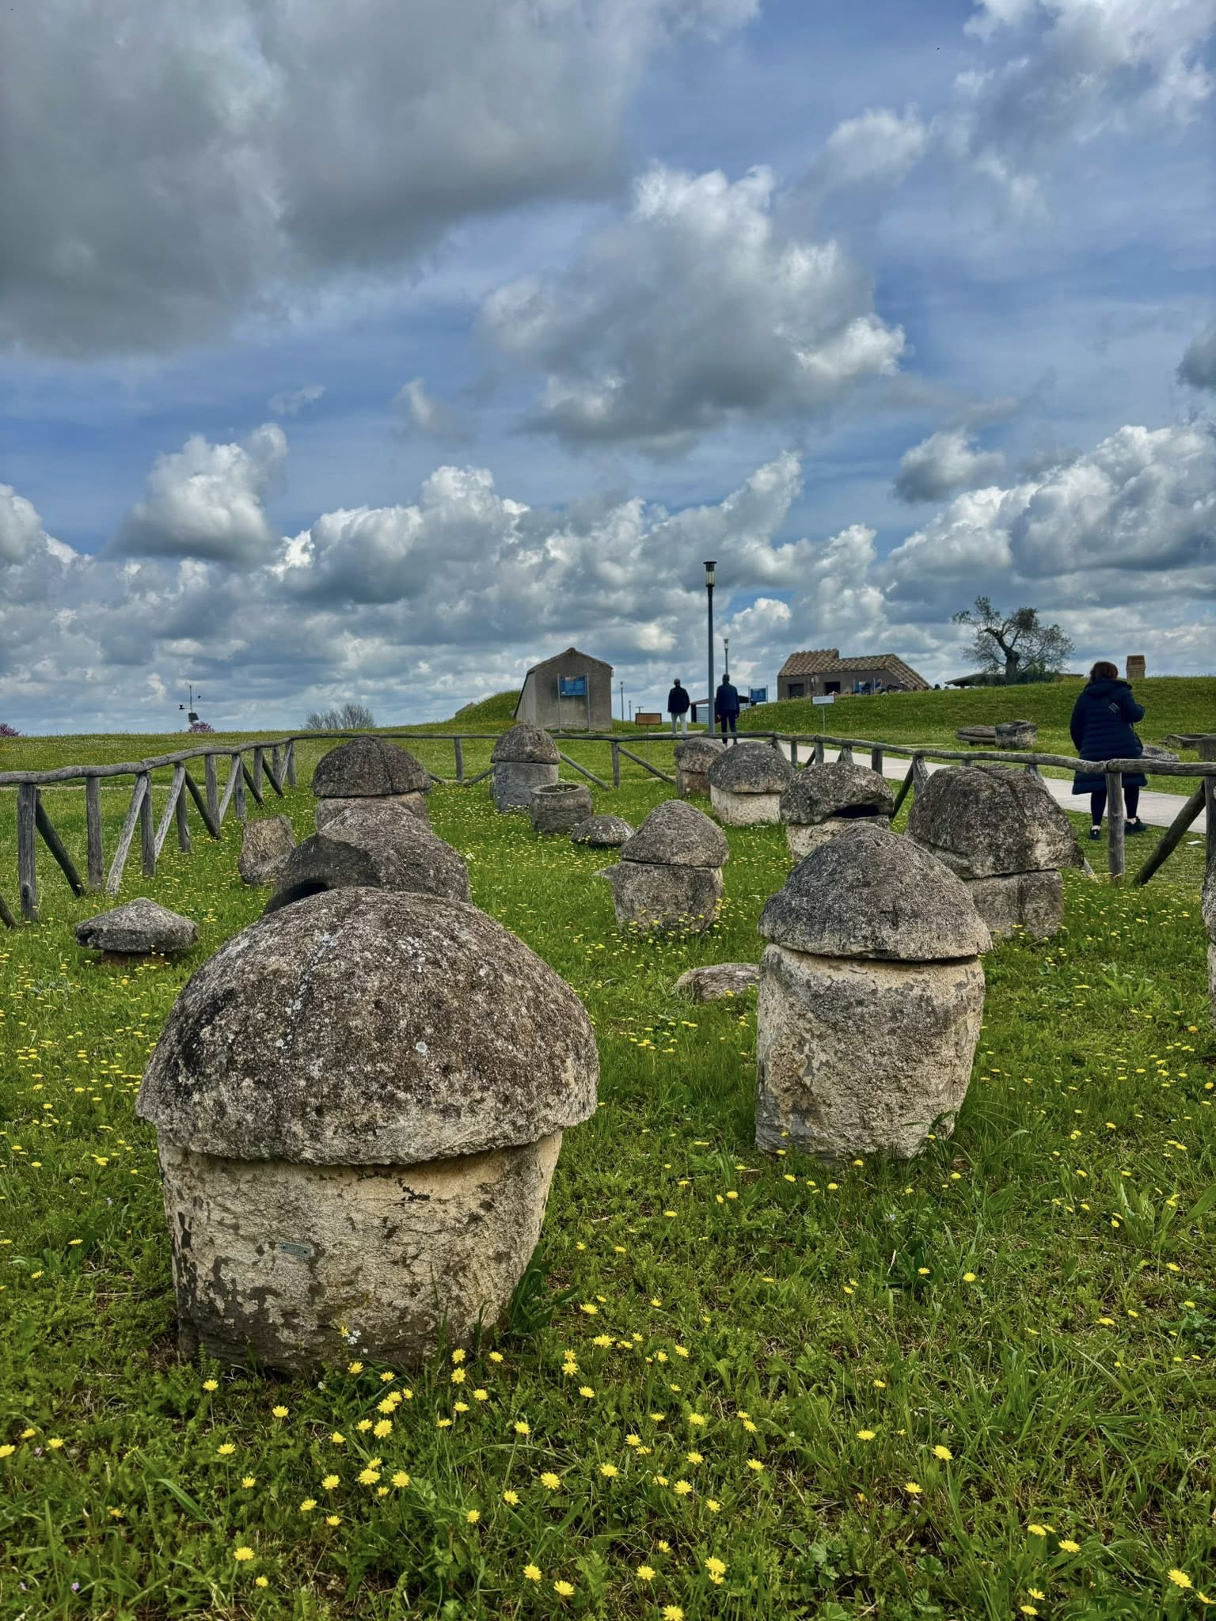
Etruscan Necropoli dei Monterozzi
Tarquinia, Italy
Photo Credit: Xanthippi Glavopoulou

Slide 4
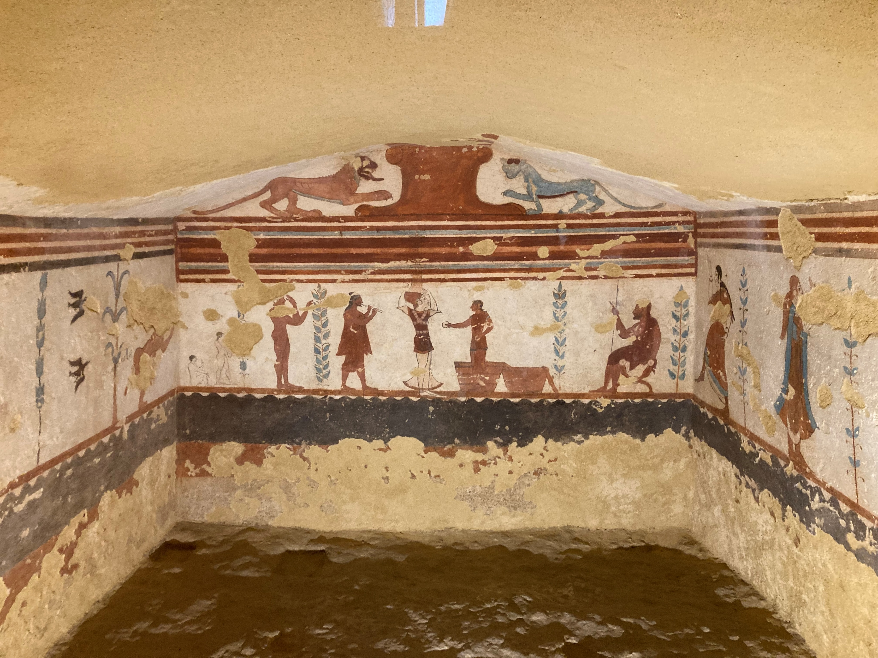
Etruscan Necropoli dei Monterozzi, Tarquinia, Italy
Photo Credit: Amalia Spiliakou

Slide 5
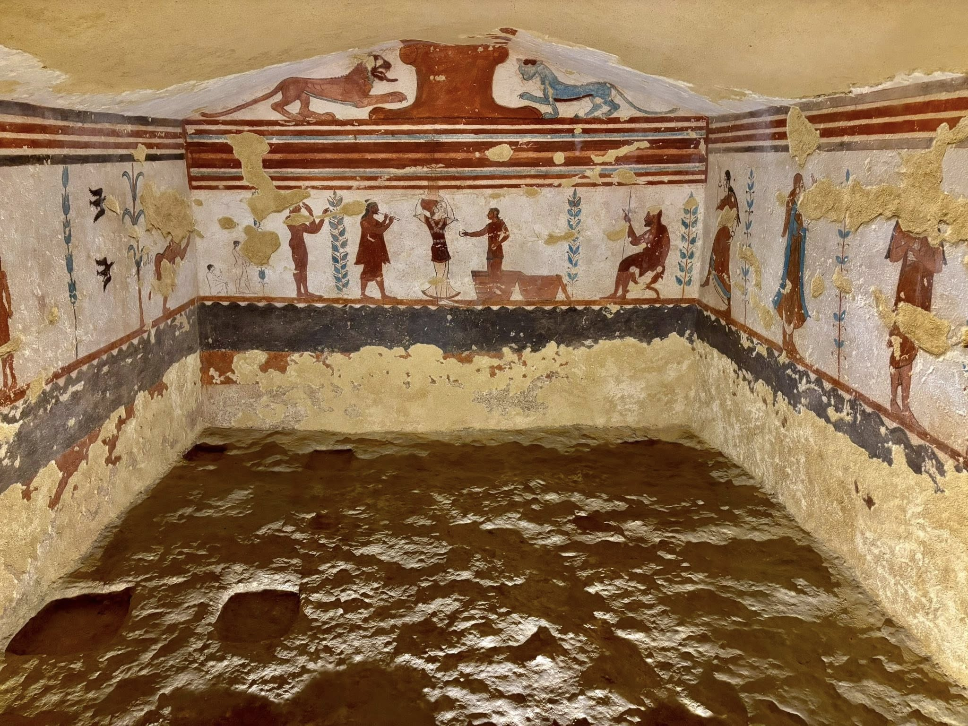
Etruscan Necropoli dei Monterozzi, Tarquinia, Italy
Photo Credit: Xanthippi Glavopoulou

Slide 6
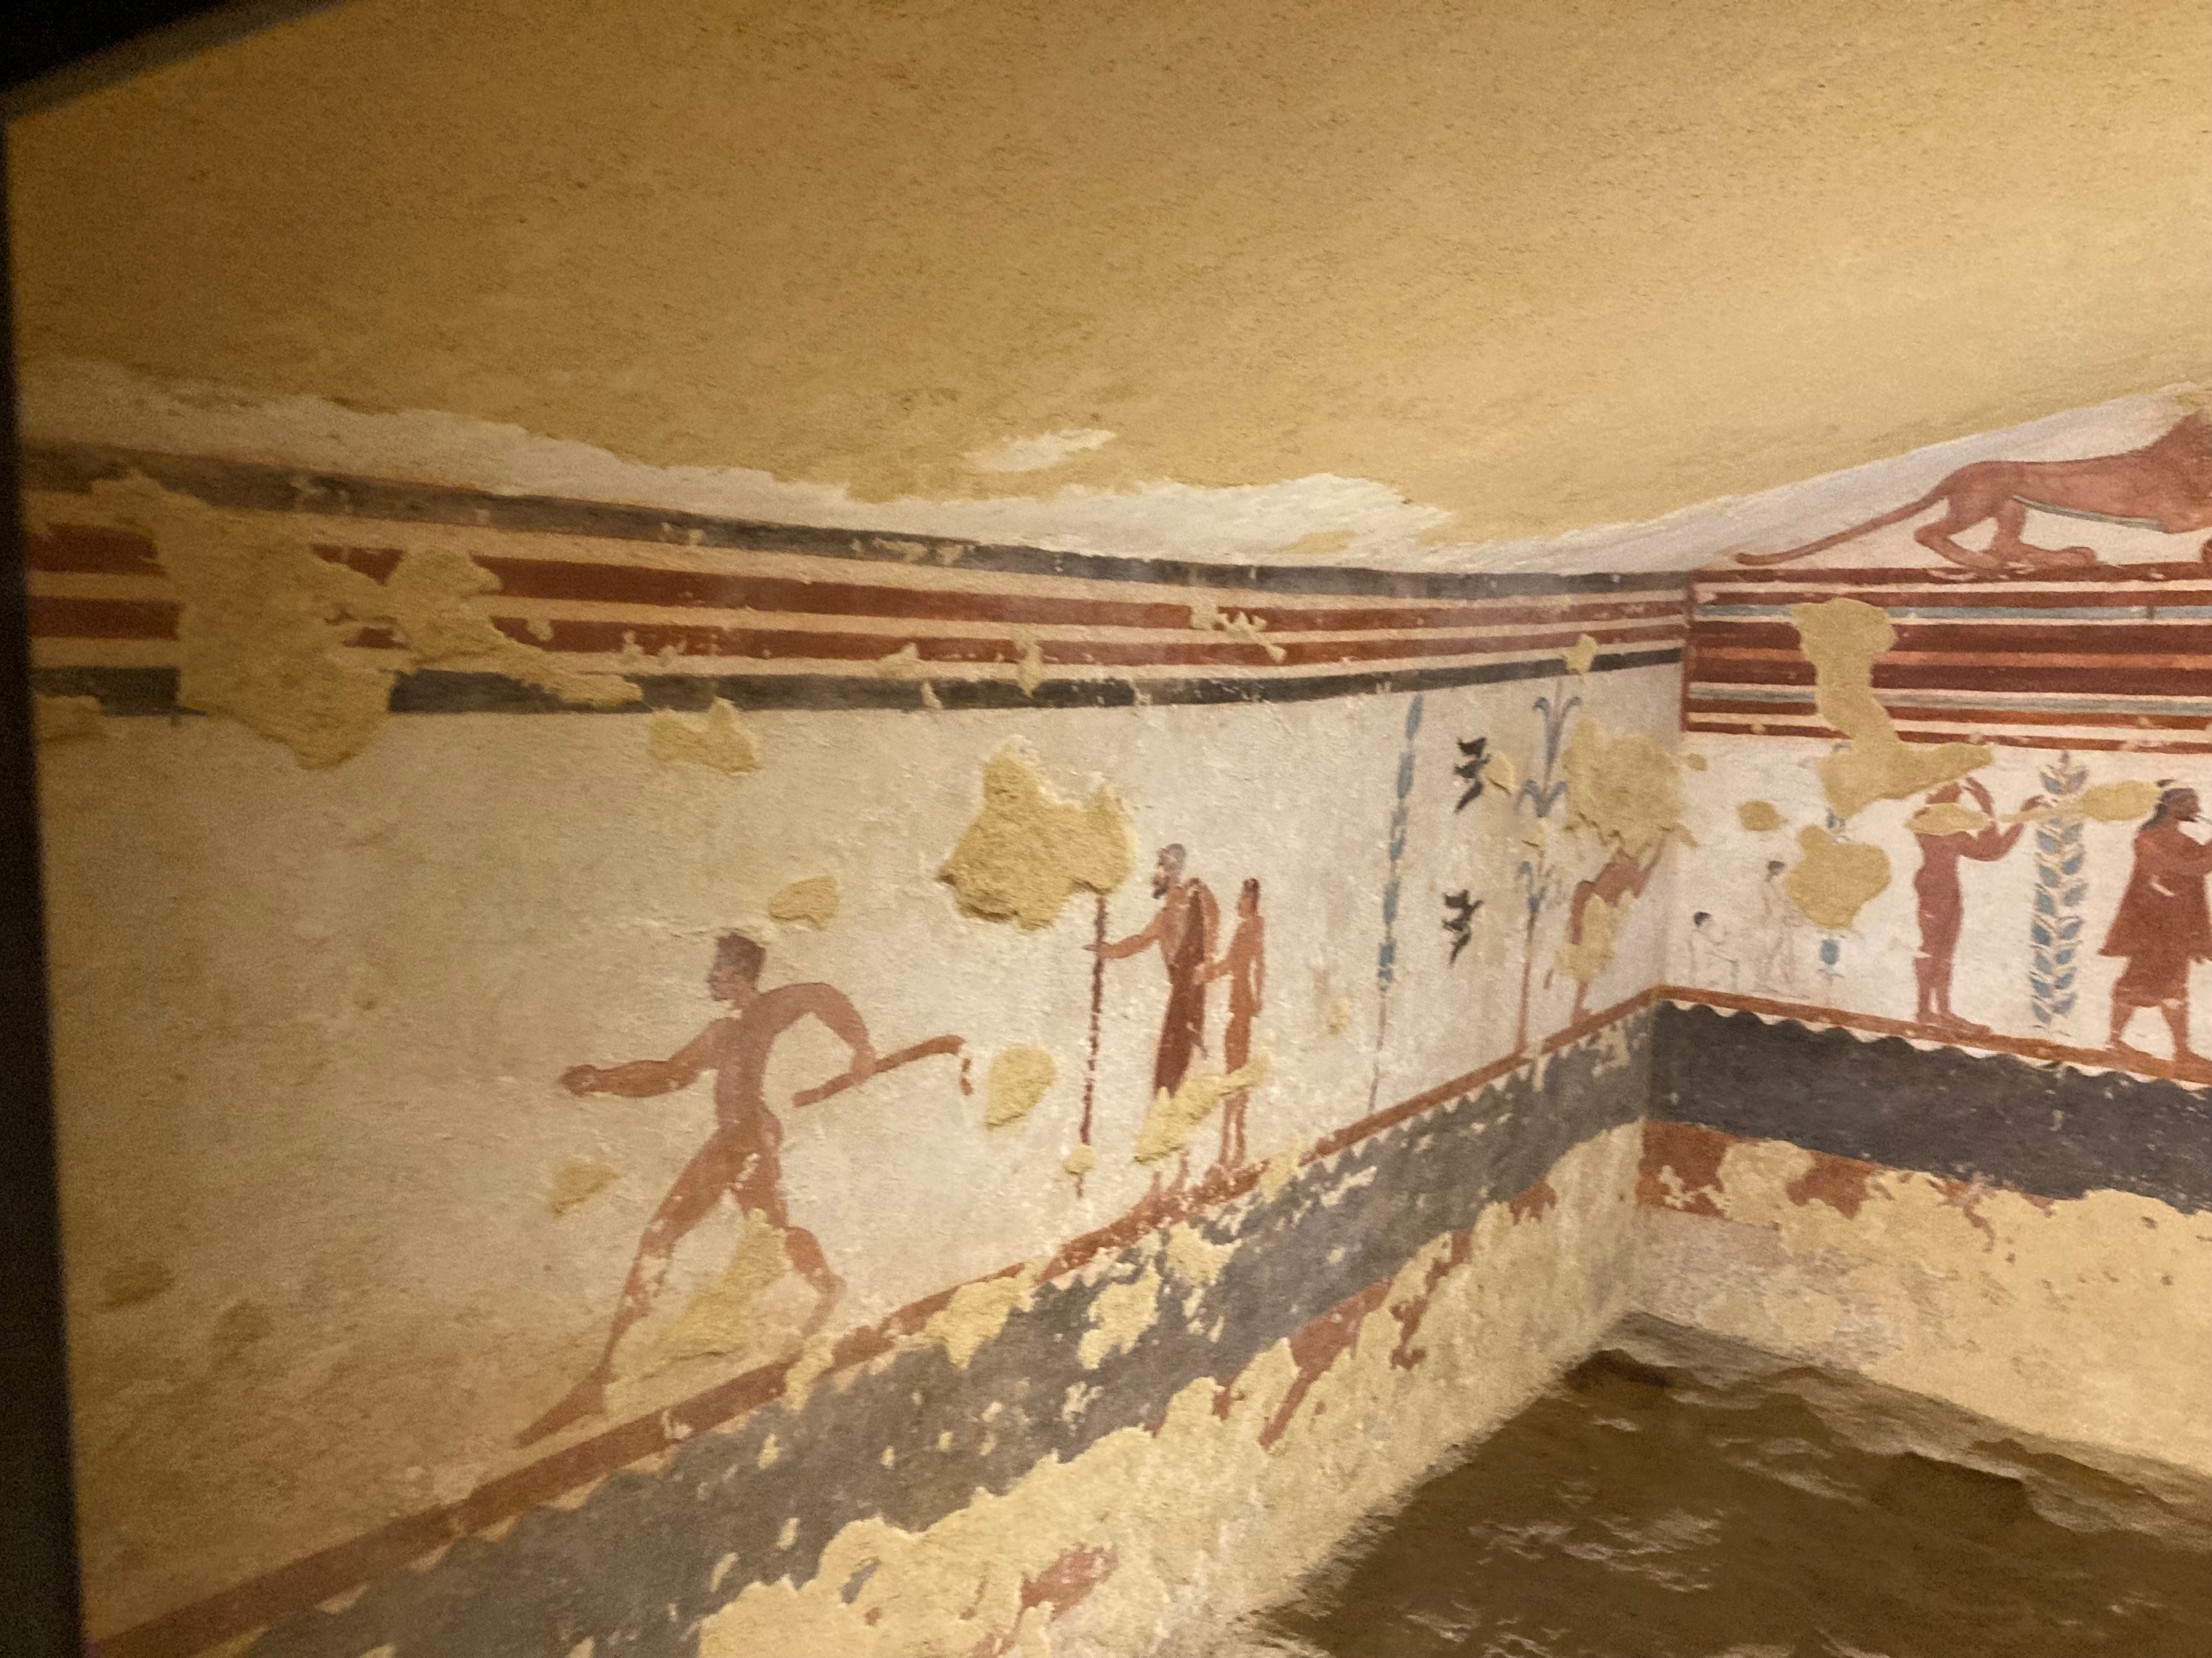
Etruscan Necropoli dei Monterozzi, Tarquinia, Italy
Photo Credit: Amalia Spiliakou

Slide 7
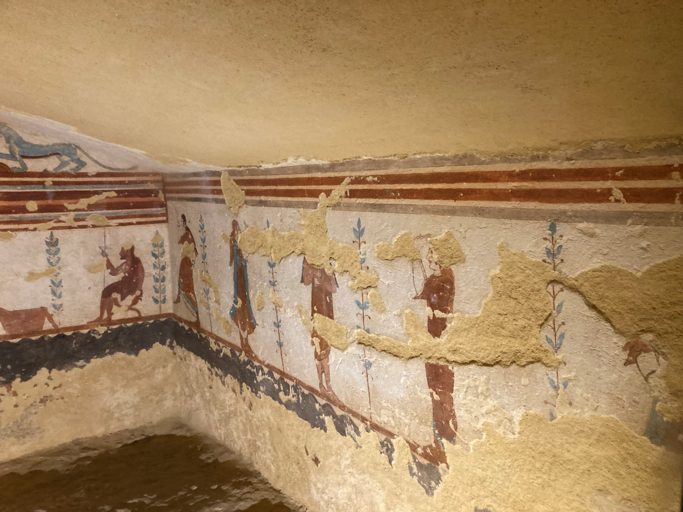
Etruscan Necropoli dei Monterozzi, Tarquinia, Italy
Photo Credit: Amalia Spiliakou

Slide 8
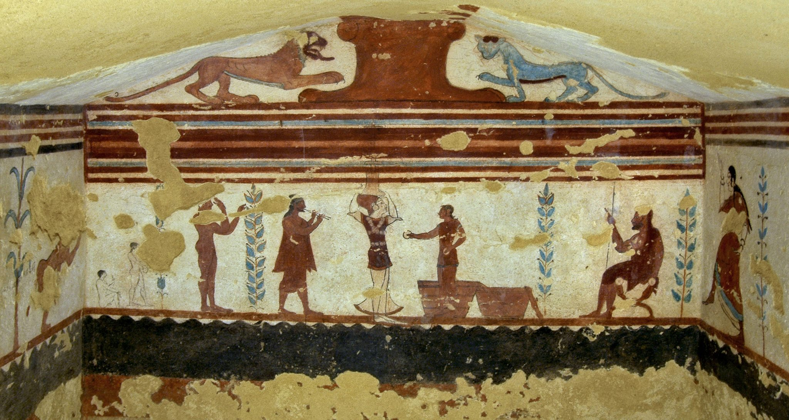
https://www.facebook.com/photo?fbid=437284729731005&set=a.437284779731000

Slide 9
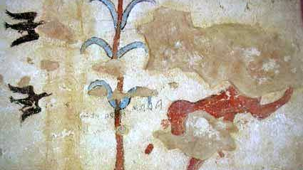
https://www.facebook.com/EpigraphieEtrusque/posts/tomba-dei-giocolieri-tarquinia-fine-vi-sec-sulla-parete-sinistra-chiudendo-la-sc/1491272614428258/

Slide 10
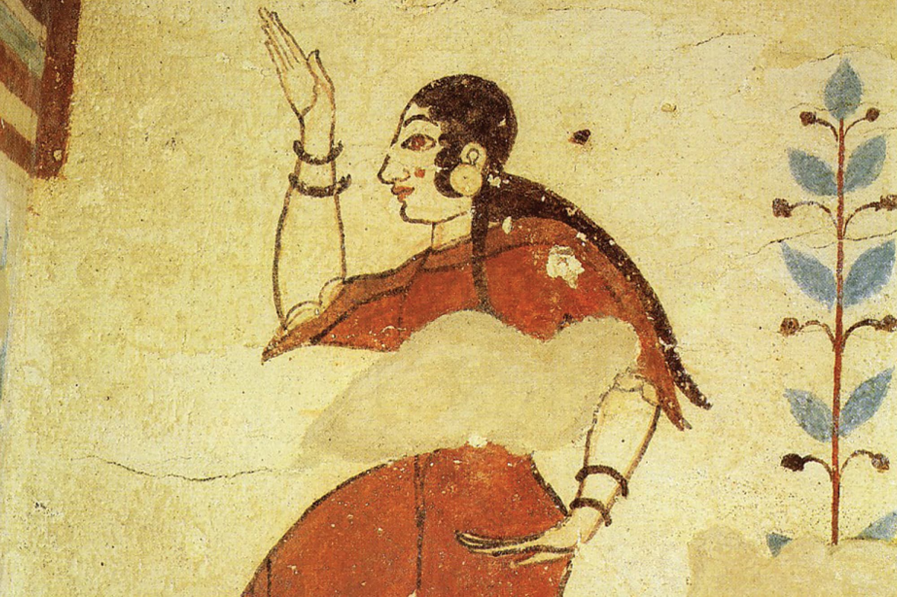
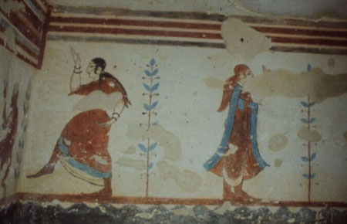
https://tarquiniaturismo.com/tomb-of-the-jugglers/?lang=en and https://archaeology.brown.edu/native-publications/tomba-delle-leonesse-and-tomba-dei-giocolieri-tarquinia

Slide 11
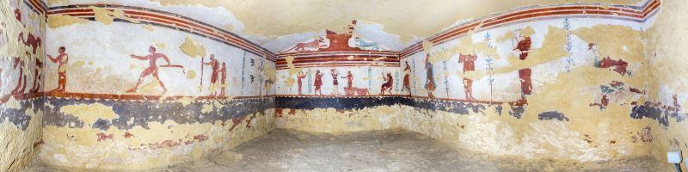
https://museovirtuale.unimi.it/asset/517?ids=508,509,510,511,512,513,514,515,516,517

Slide 12
The End…

