Slide 1
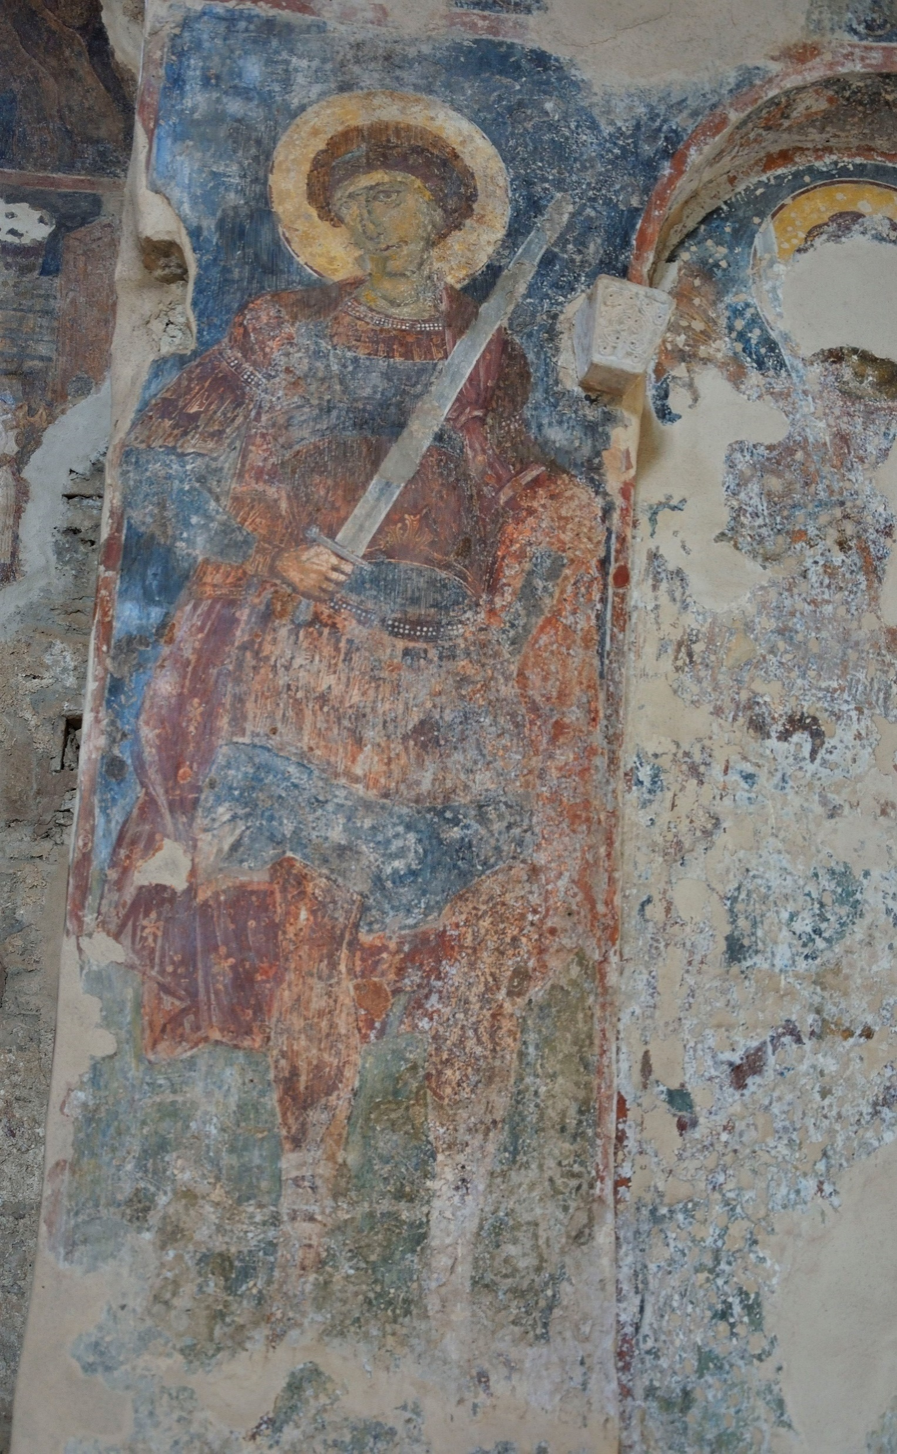
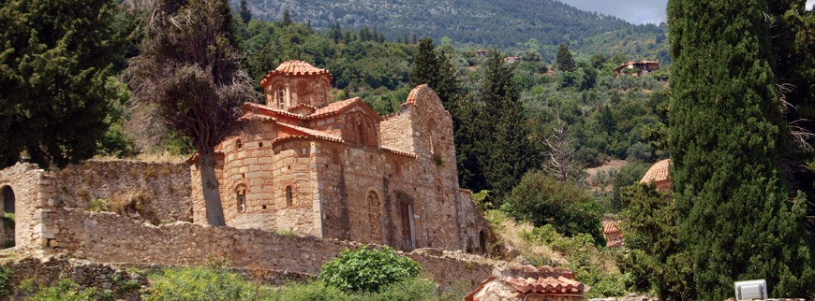
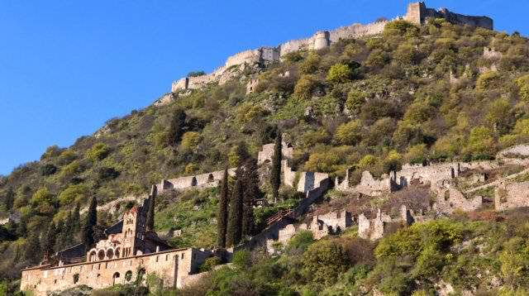
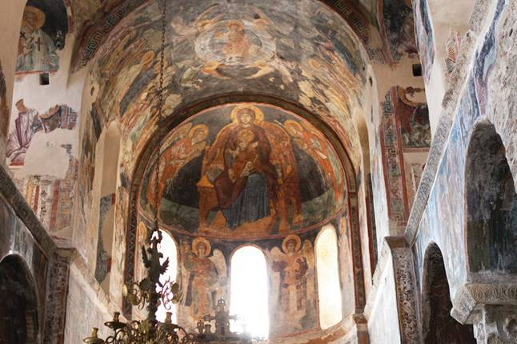
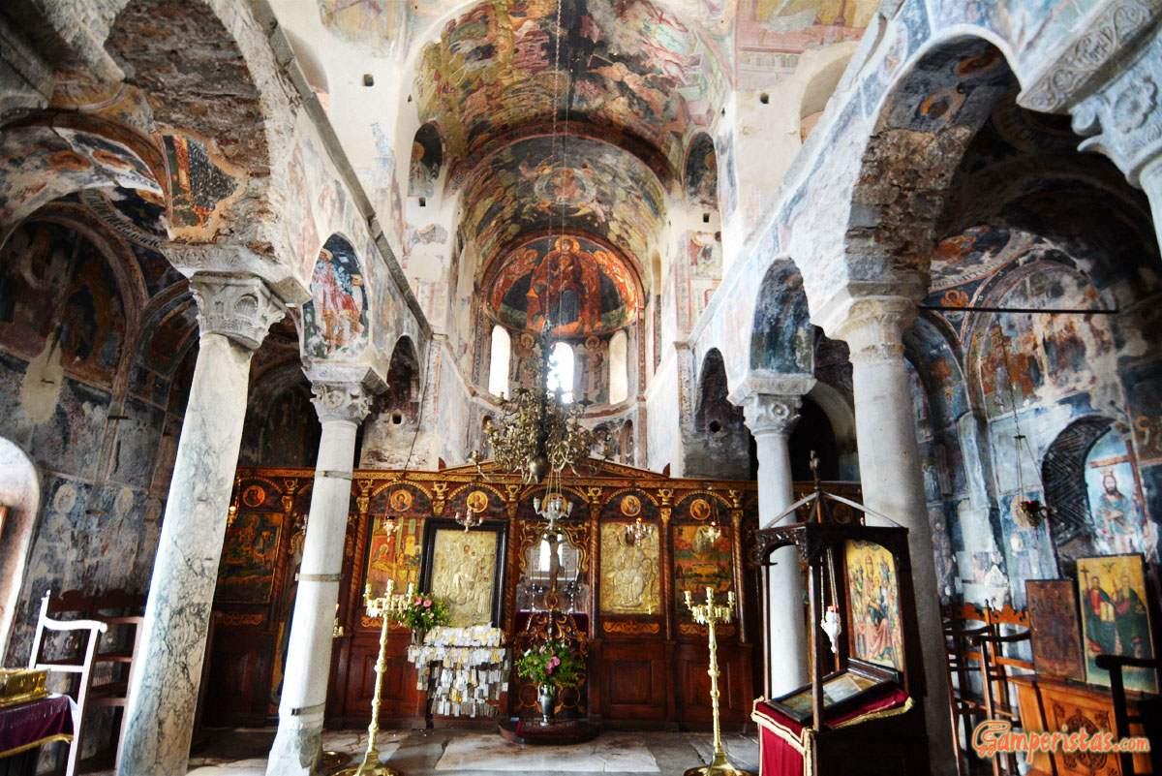
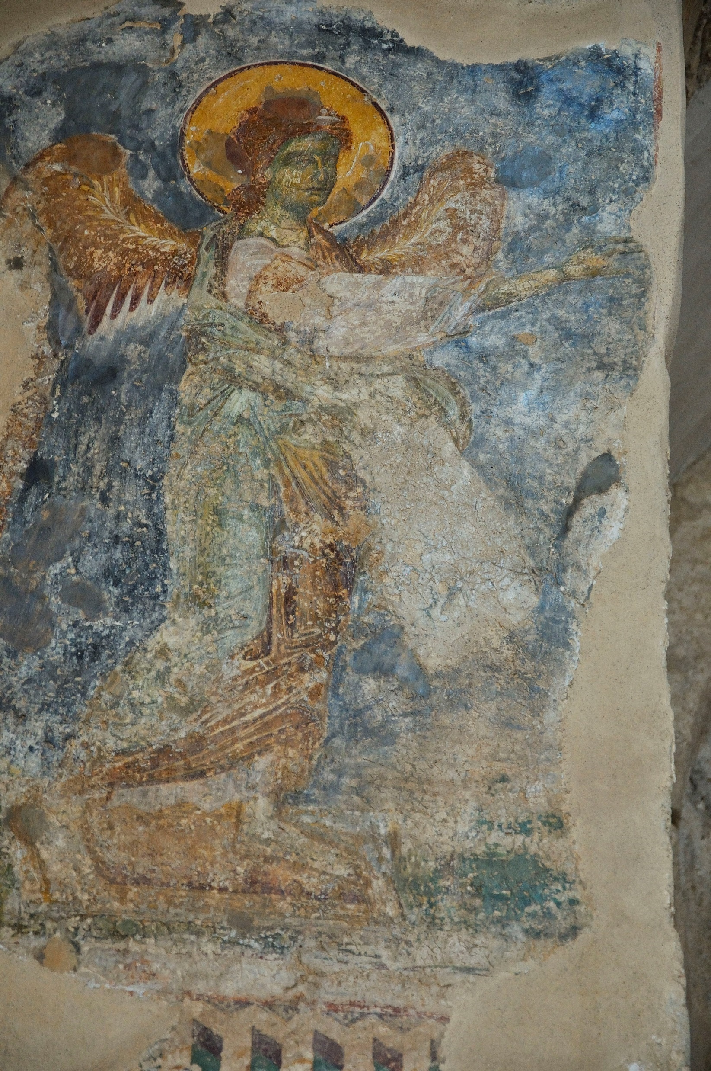
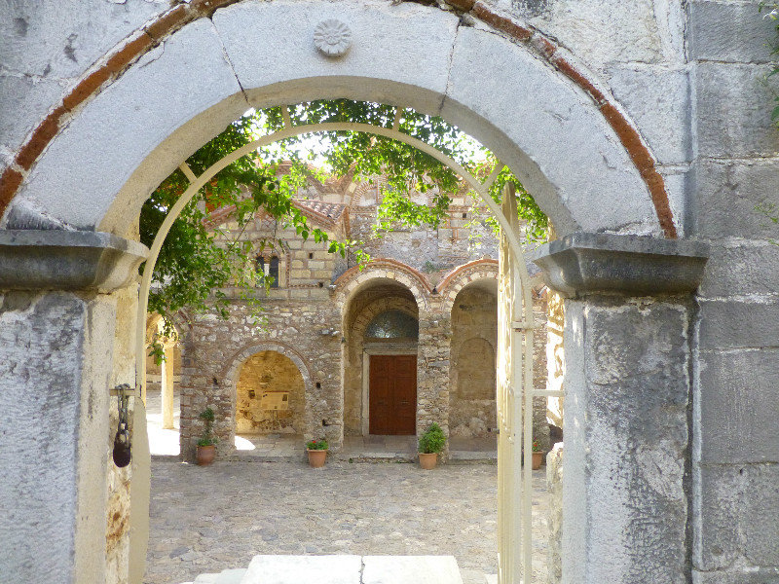
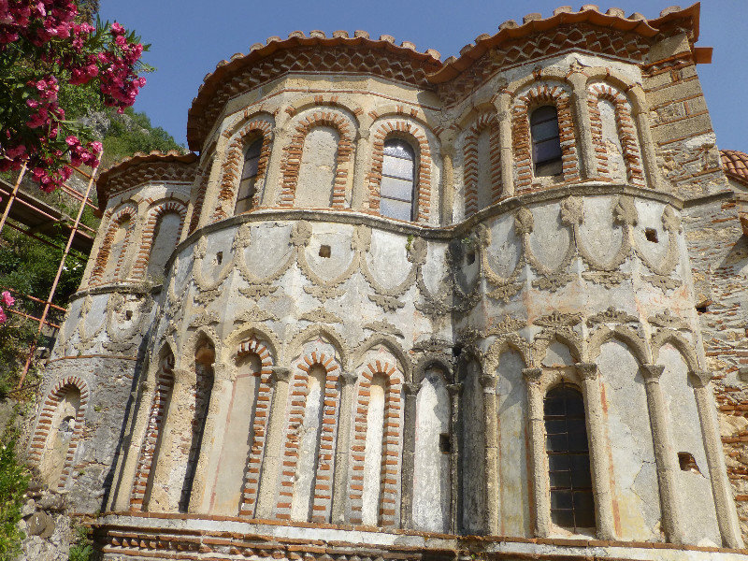
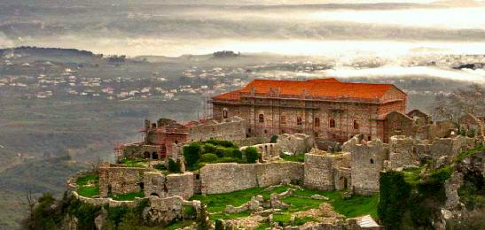
Mystras

Slide 2
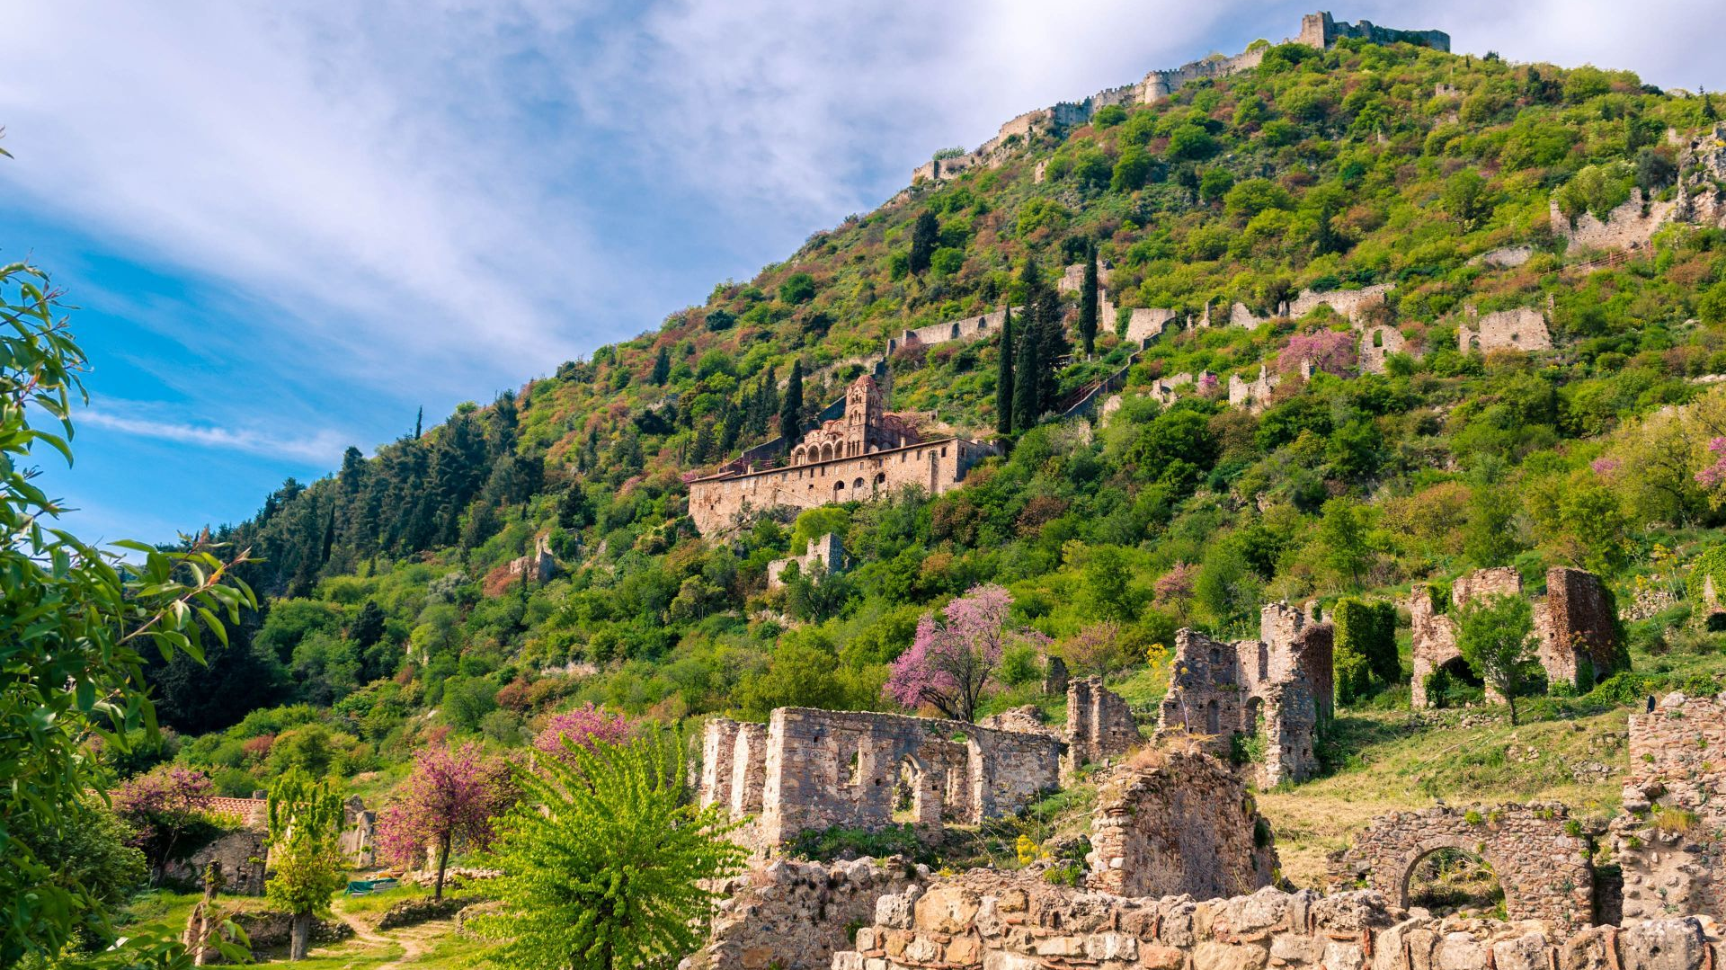
The Hill of Mystras in the Peloponnese, Greece, with the lower, middle and upper city and Villehardouin's Castle on the very top

Slide 3
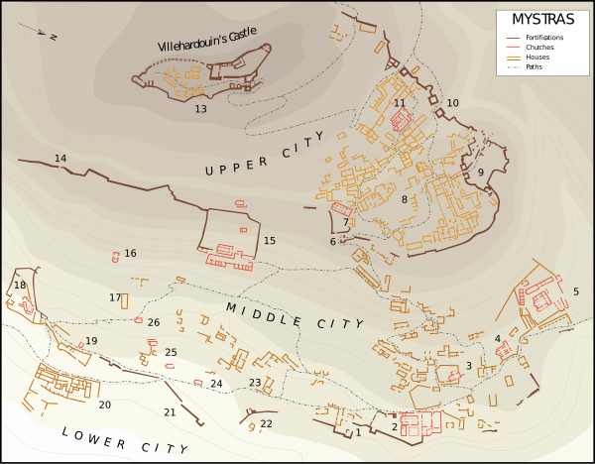
Plan of Mystras after works by G. Millet (1910) and M. Chatzidakis (1981).
1. Main entrance 2. Metropolis 3. Evangelistria Church 4. Church of Saints Theodores 5. Hodigitria-Afendiko 6. Monemvasia Gate 7. Church of Saint Nicholas 8. Despot's Palace and square 9. Nauplia Gate 10. Upper entrance to the citadel 11. Church of Hagia Sophia 12. Small Palace 13. Citadel 14. Mavroporta 15. Pantanassa 16. Church of the Taxiarchs 17. House of John Phrangopoulos 18. Peribleptos Monastery 19. Church of Saint George 20. Krevatas House 21. Marmara (entrance) 22. Aï-Yannakis 23. Laskaris' House 24. Church of Saint Christopher 25. Ruins 26. Church of Saint Kyriaki

Slide 4
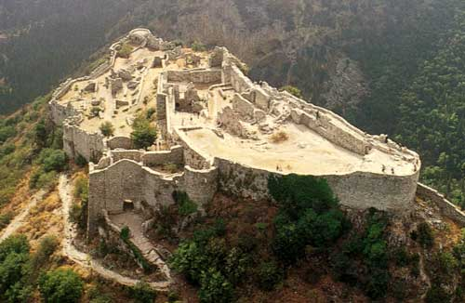
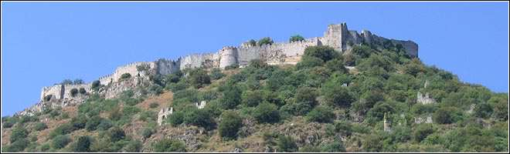
The Castle of Mystras a) The Fortification: The Frankish castle, featuring battlements and towers, was founded by William II de Villeharduin and later reinforced by the Greeks and the Turks. b) The Walls: The two fortified circuit walls, strengthened with tall rectangular towers, date to the Late Byzantine period.

Slide 5
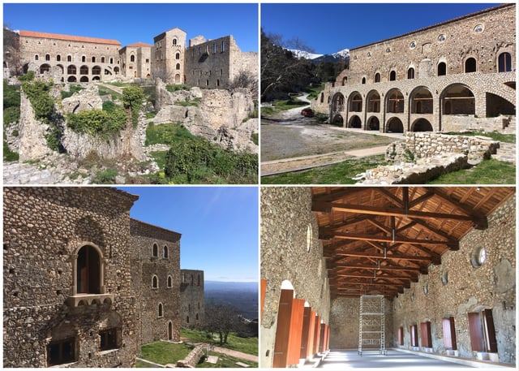
Palaces of the Mystras Despots (Kantakouzenoi and Palaeologoi)
Large building complex, L-shaped in plan, in the Upper Town of Mystra, built on a flat expanse overlooking the Evrotas valley. It contains many buildings of different functions, erected in different phases between the 13th and the 15th centuries.

Slide 6
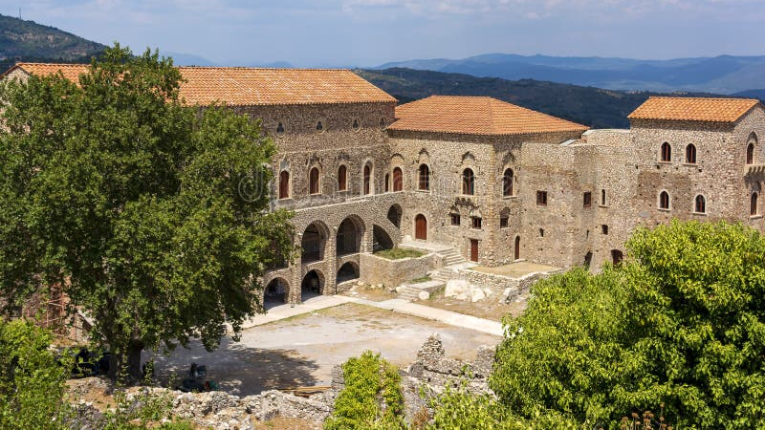

Slide 7
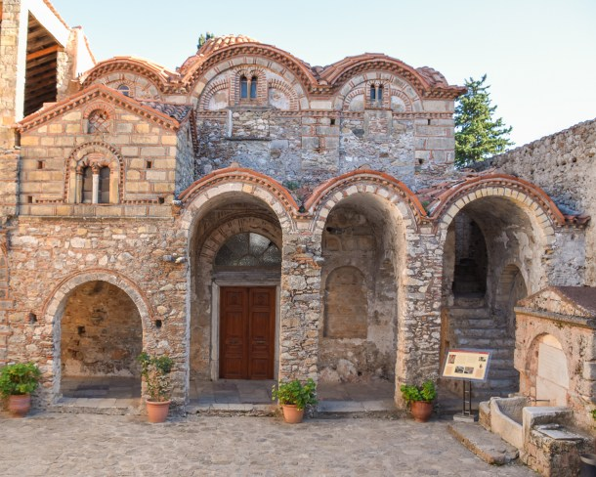
Cathedral of St. Demetrios
A mixed-type church: a three-aisled basilica with narthex and bell tower on the ground-floor, (13th century), and a cross-in-square church on the upper floor (15th century). The interior features wall paintings from c. 1270–1340, with the dome frescoes dating to the 15th century.

Slide 8
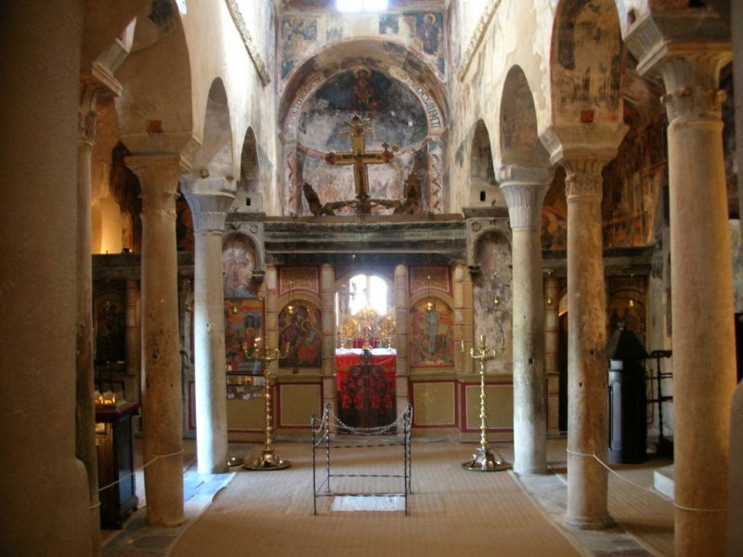
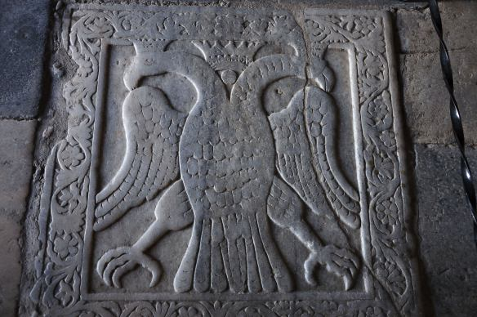

Slide 9
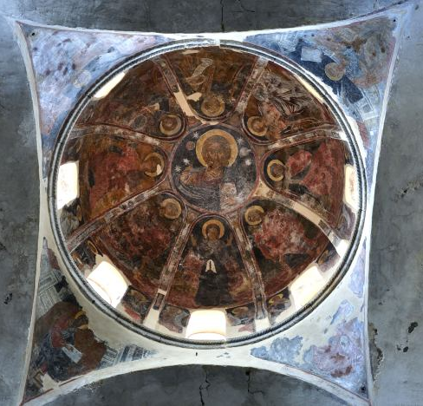
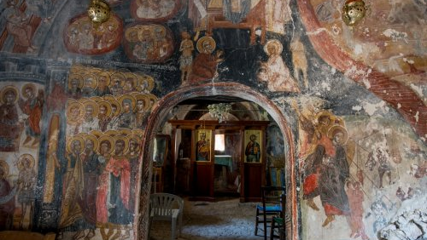

Slide 10
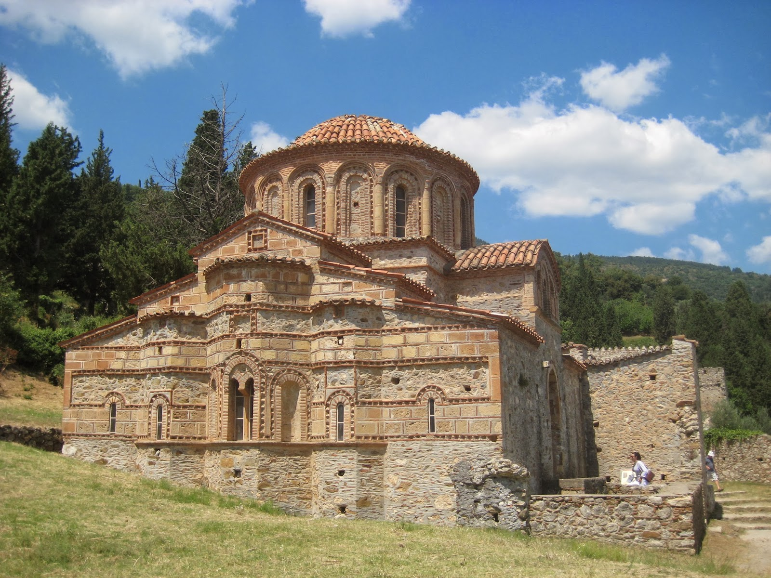
Church of Saints Theodore
It was built between 1290 and 1295 by the monks Daniel and Pachomios. It is of the octagonal type, with lateral chapels, and is decorated with wall paintings dating from the end of the 13th century.
The church features some stunning larger than life frescoes on the lower walls, mainly military saints and archangels.

Slide 11

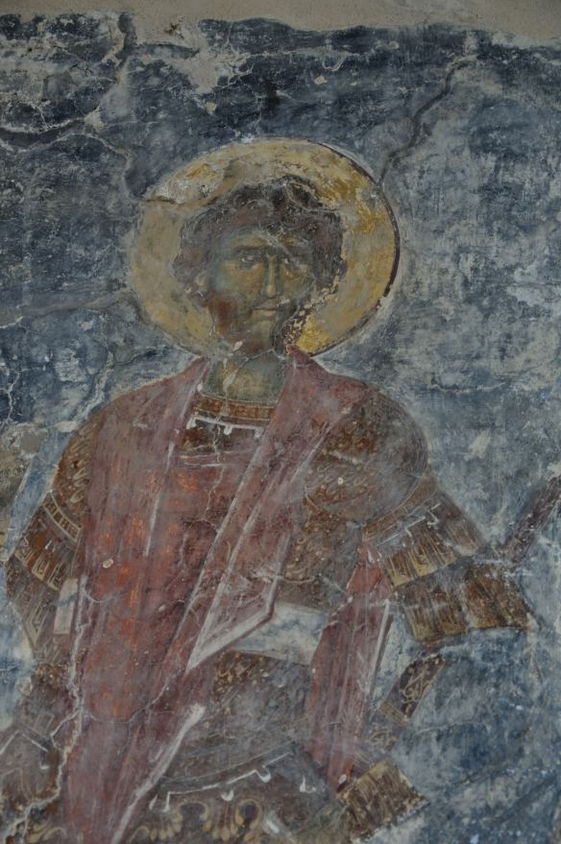
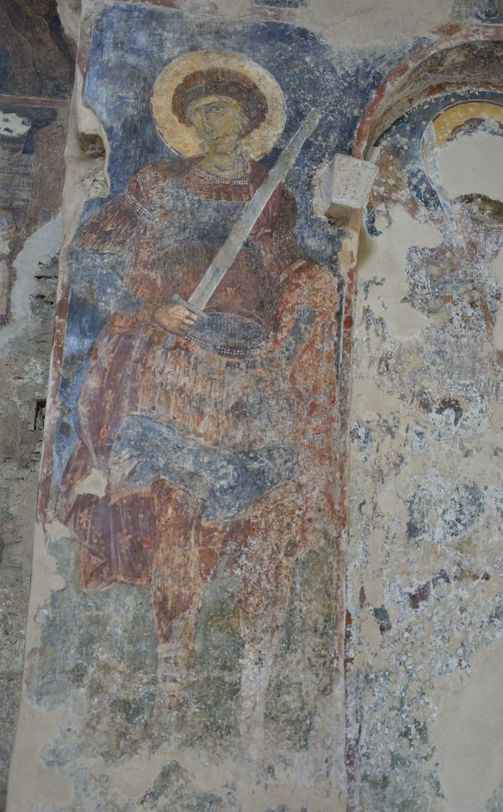

Slide 12
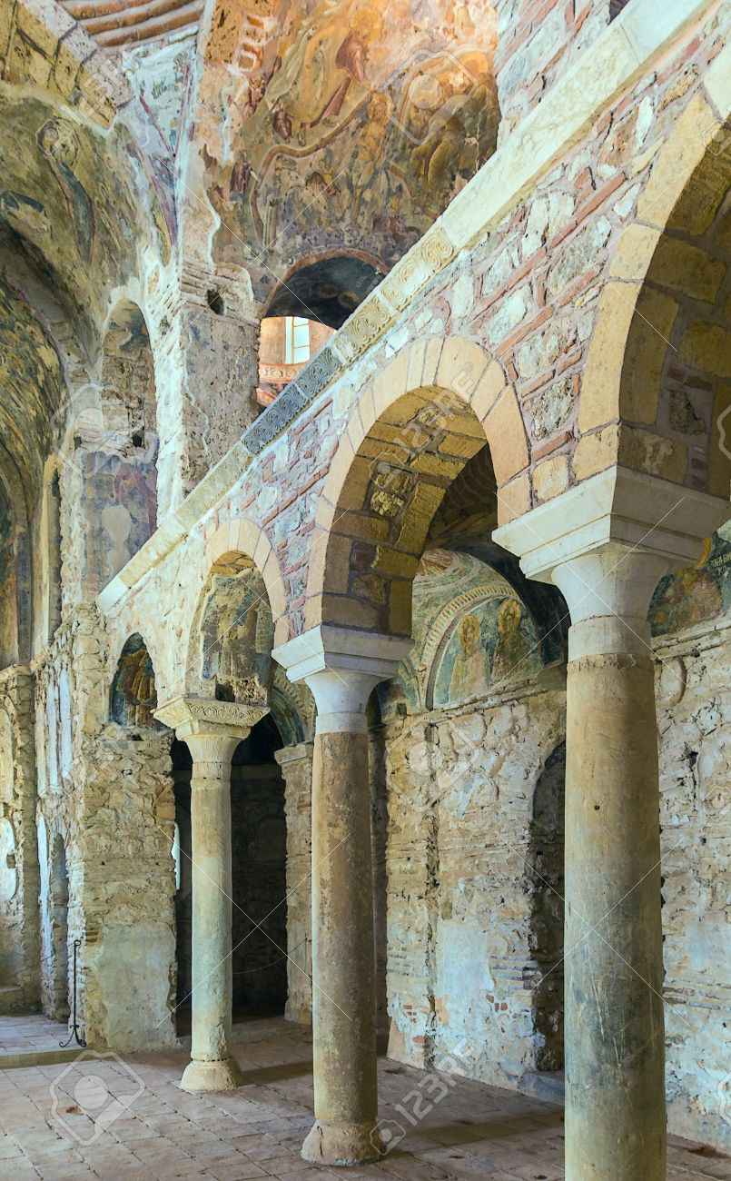
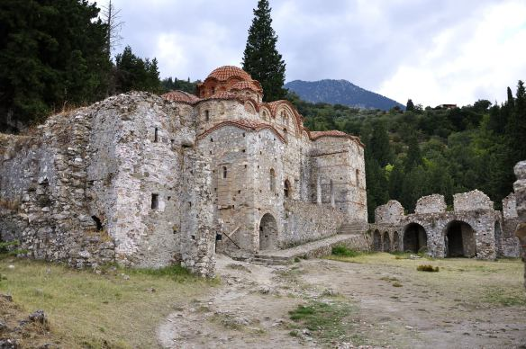
Church of Our Lady Hodegetria or Aphentiko
It was built in 1310 by abbot Pachomios. It belongs to the mixed architectural type with a narthex and lateral chapels and is decorated with excellent wall paintings, dated to 1312-1322.

Slide 13
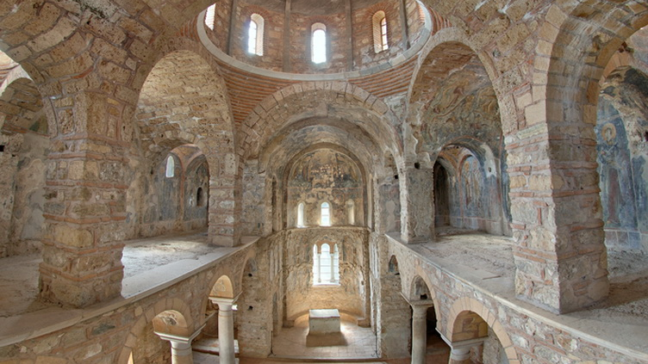

Slide 14
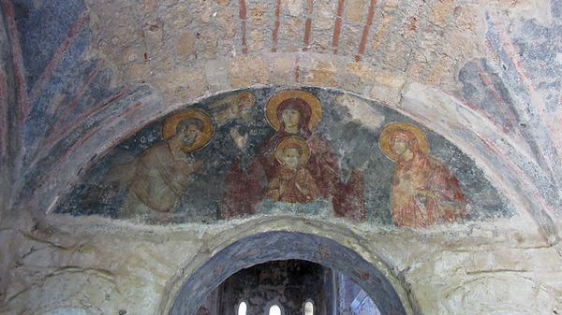

Slide 15
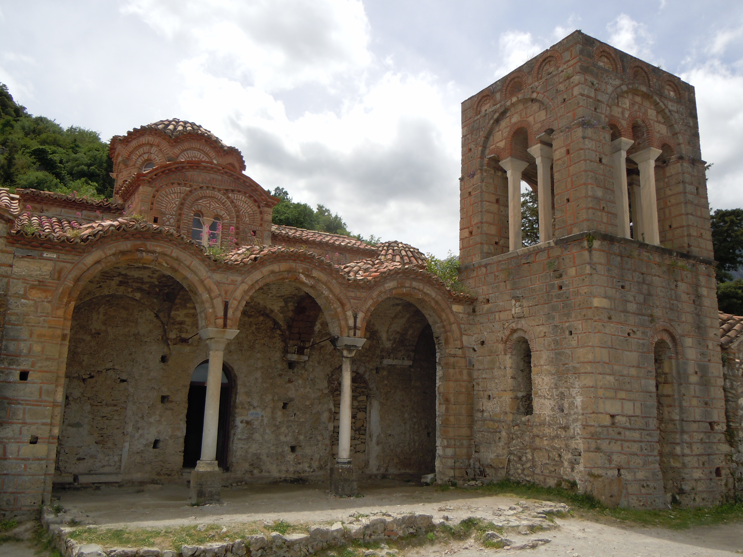
Church of Aghia Sophia (Holy Wisdom)
Domed, cross-in-square, two-column church, built in the middle of the 14th century. It has side chapels and a bell-tower. Remarkable wall paintings are preserved in the sanctuary and the chapels.

Slide 16
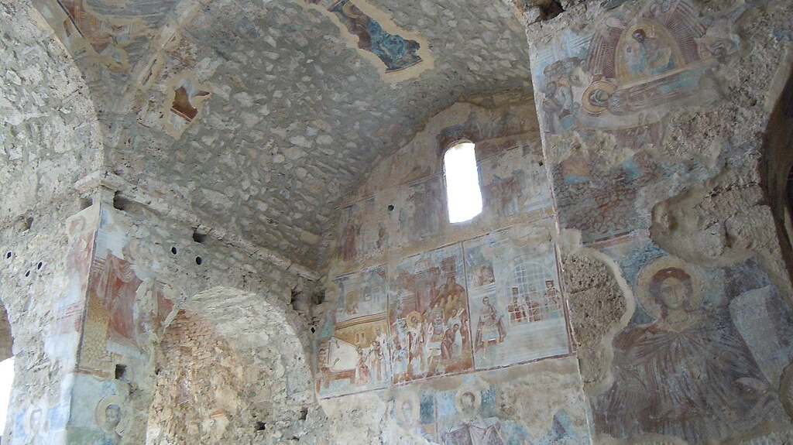

Slide 17
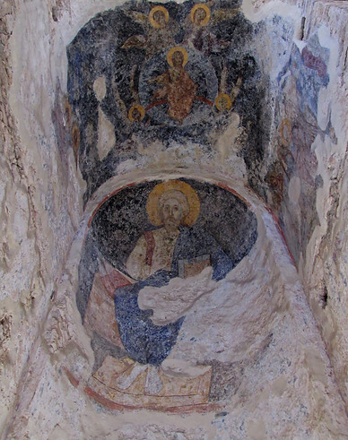
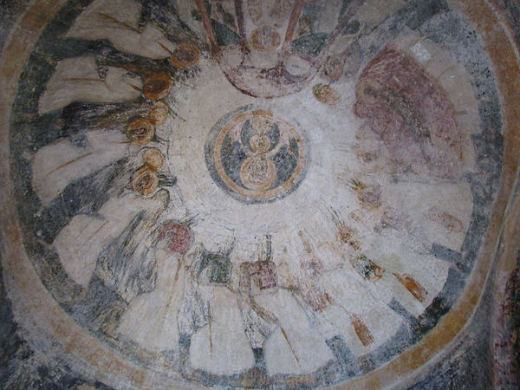

Slide 18
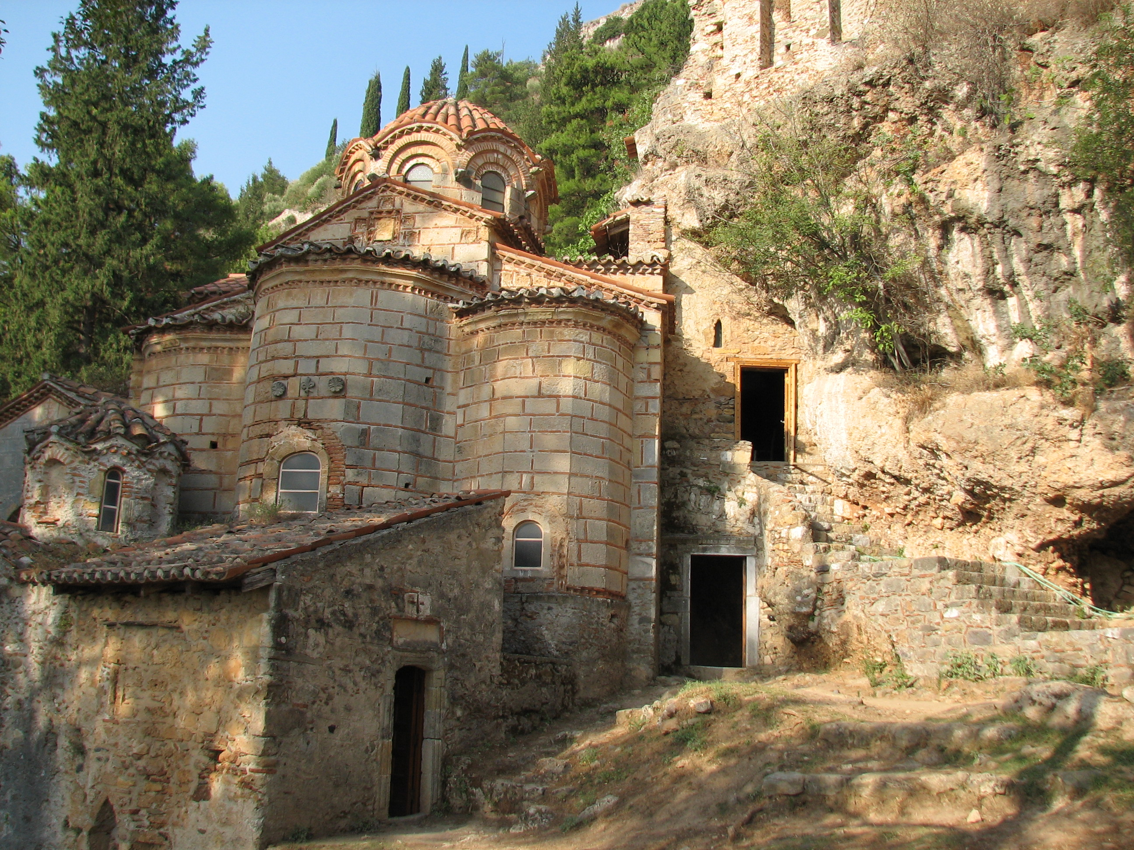
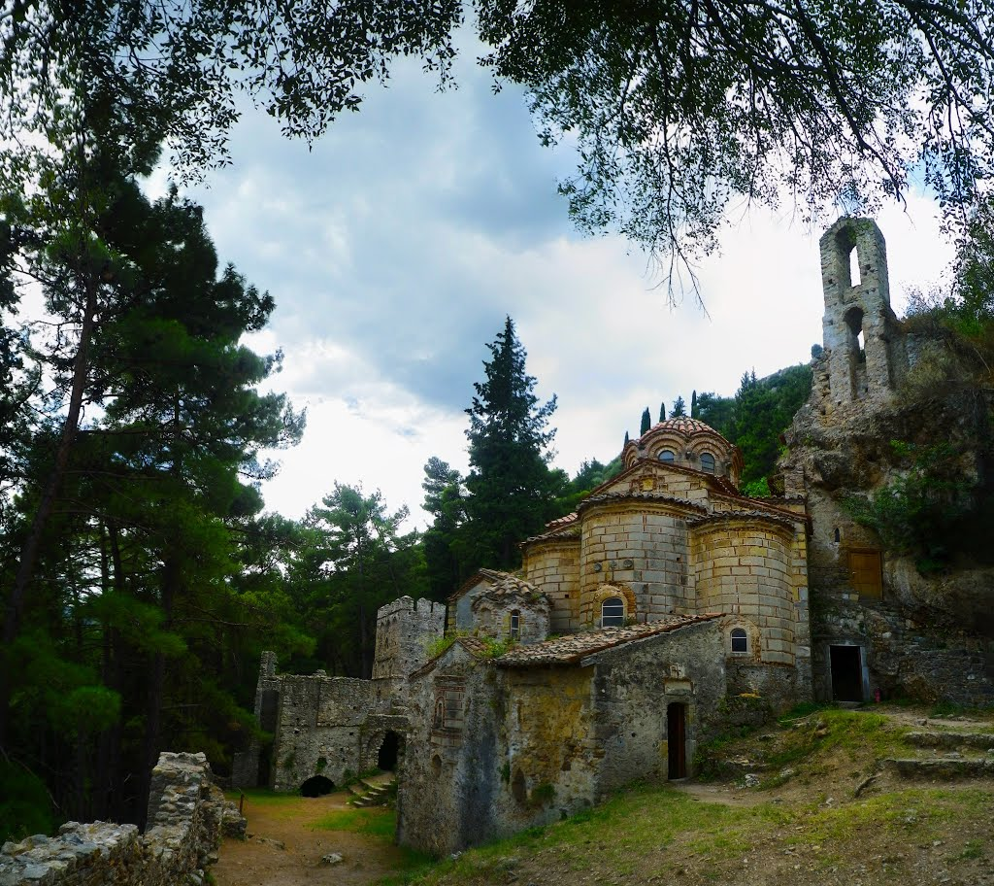
Monastery of Our Lady Peribleptos
The catholicon (main church) is a domed, two-column, cross-in-square church with chapels. Beside it stands the Tower-Refectory. The church is decorated with wall paintings of exceptional artistic quality, made by various artists of the third quarter of the 14th century.

Slide 19
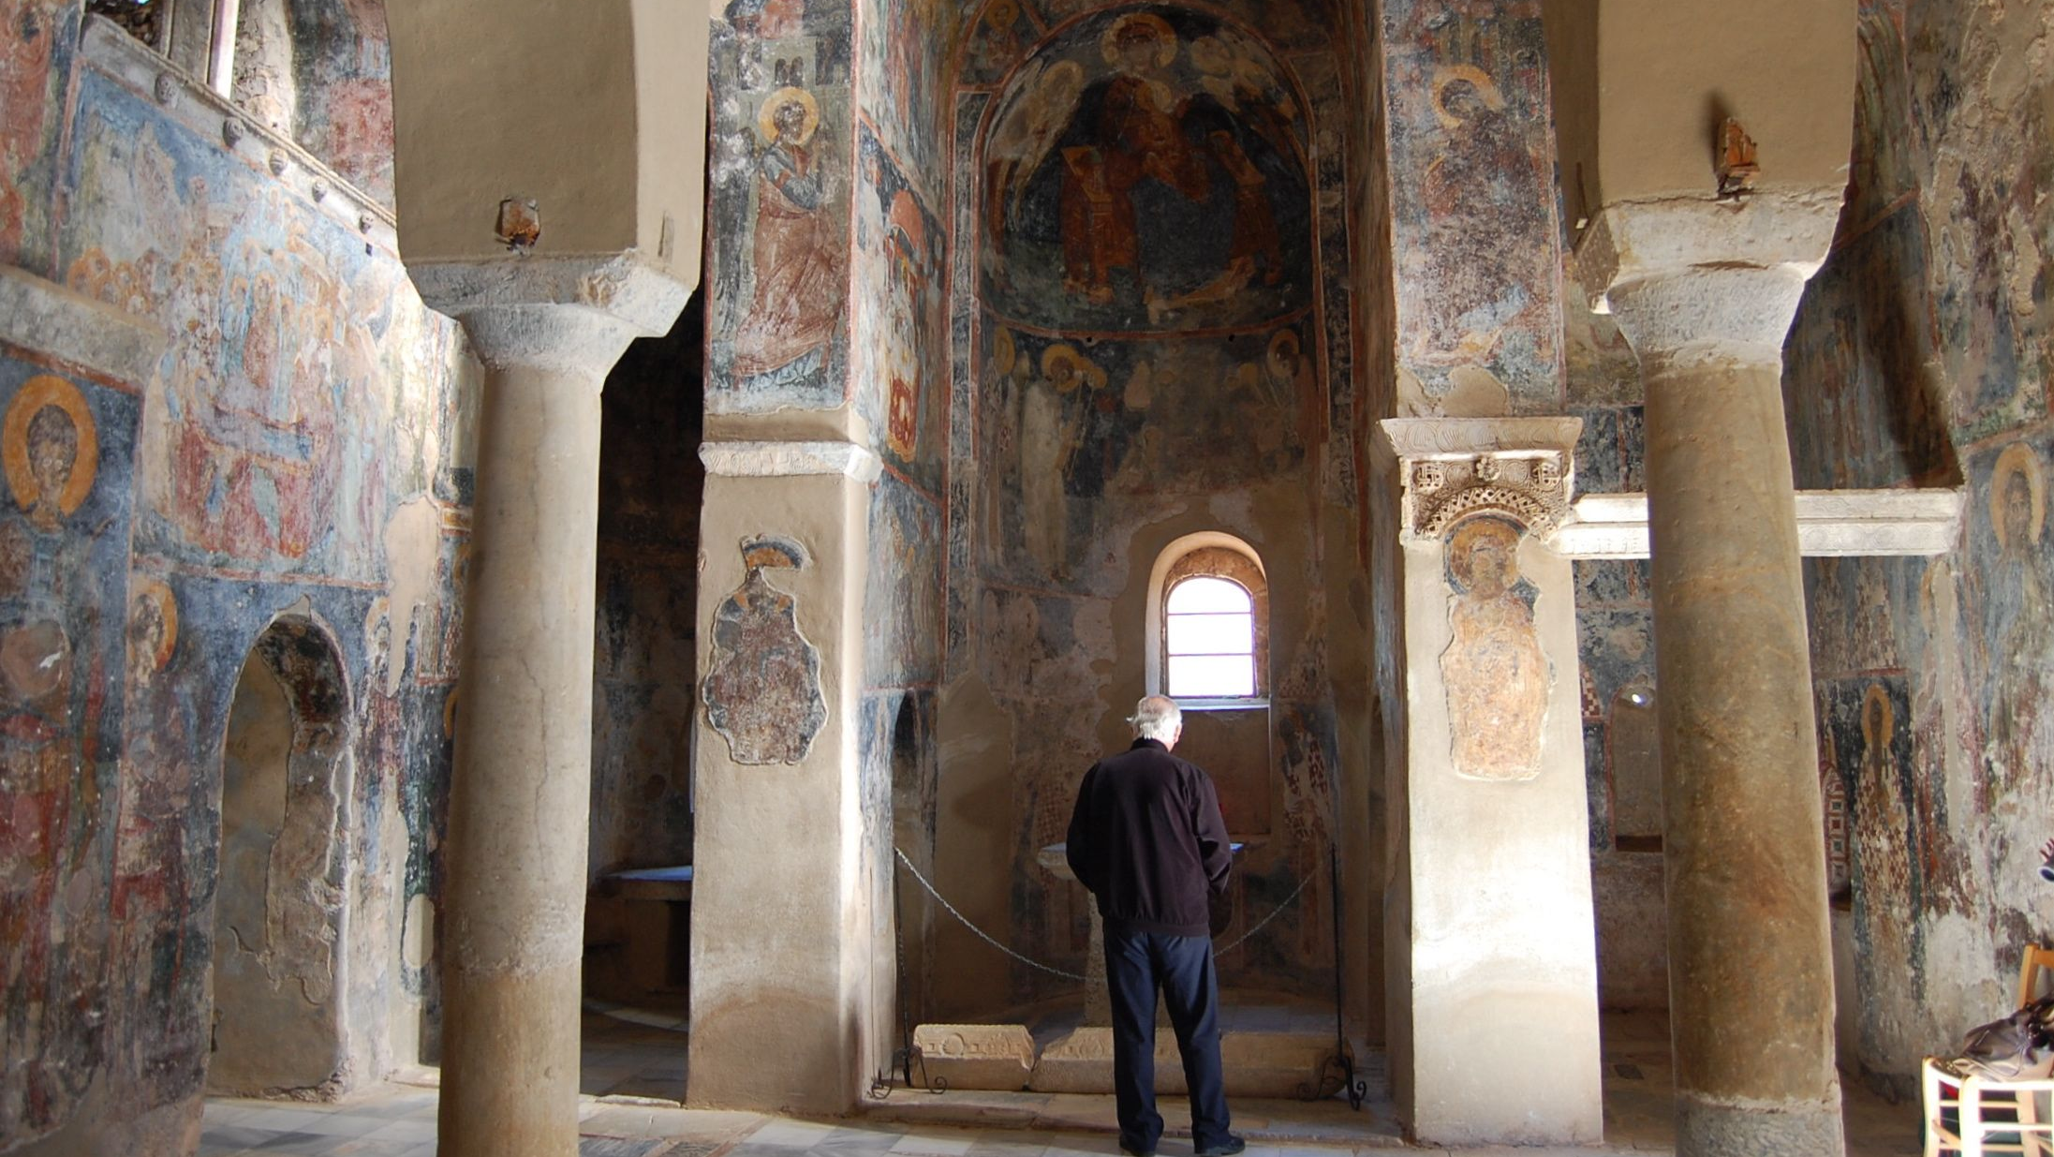

Slide 20
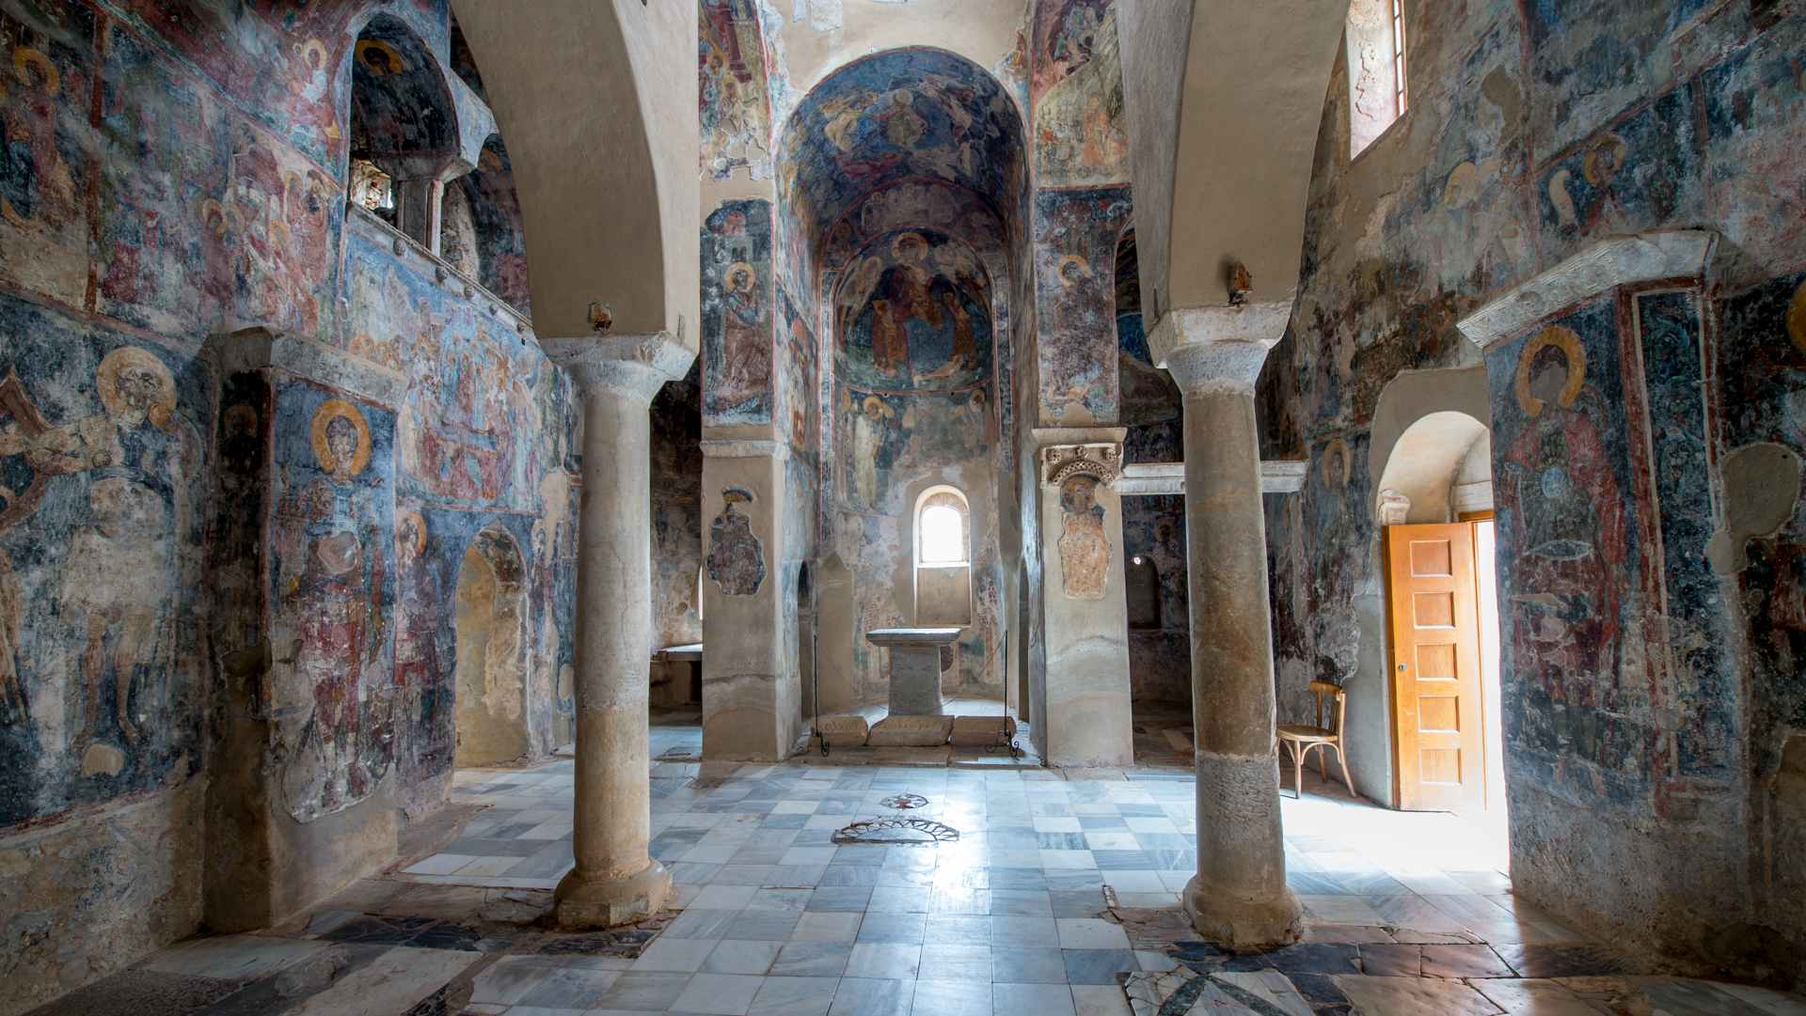

Slide 21
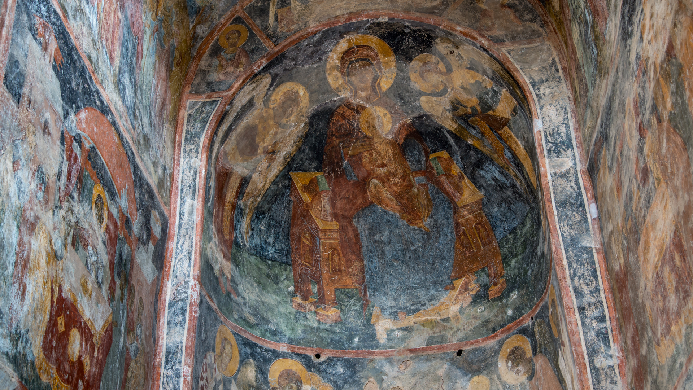

Slide 22
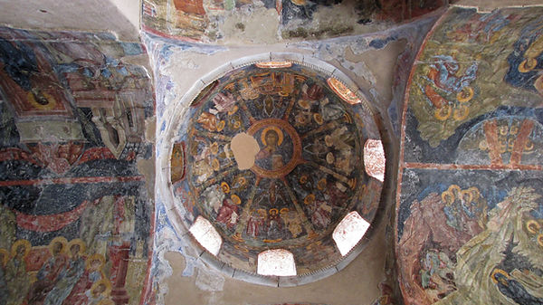

Slide 23
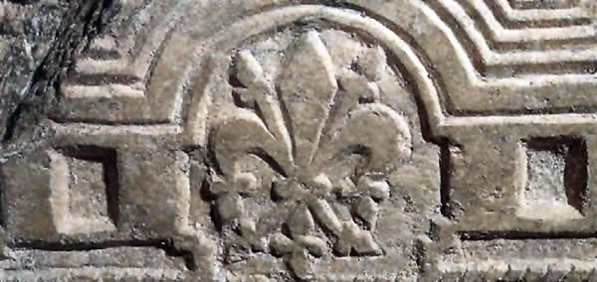
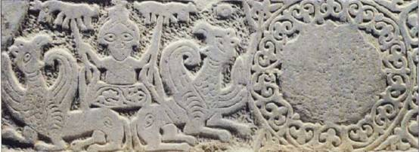
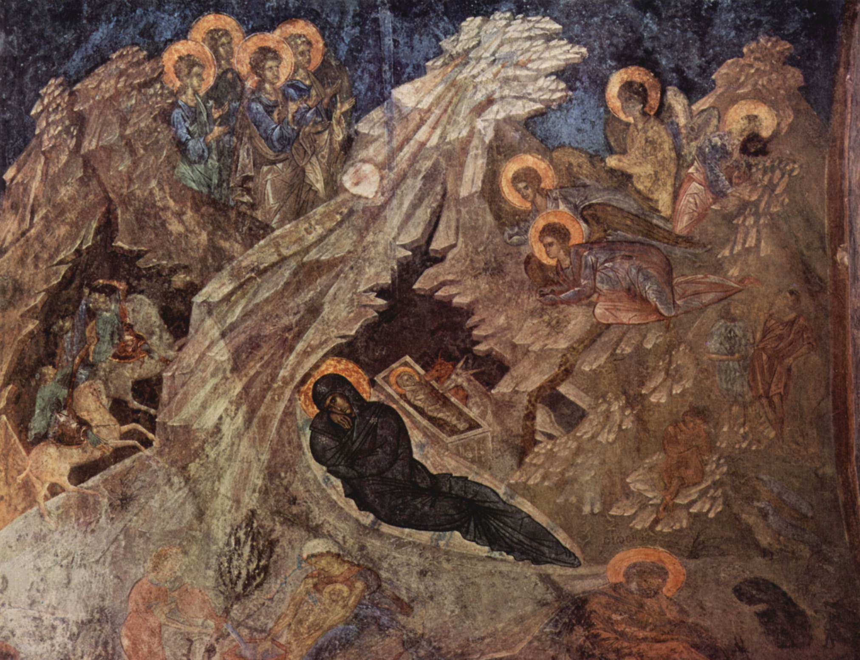
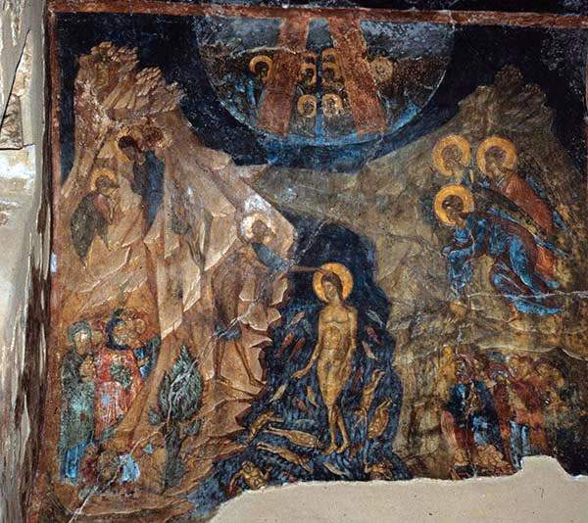

Slide 24
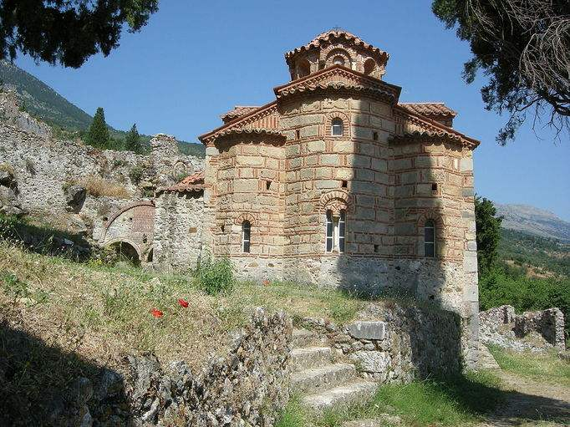
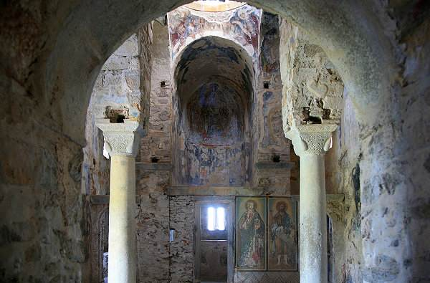
Church of Our Lady Evangelistria (of the Annunciation)
Domed, cross-in-square, two-column church decorated with wall paintings of the beginning of the 15th century.

Slide 25
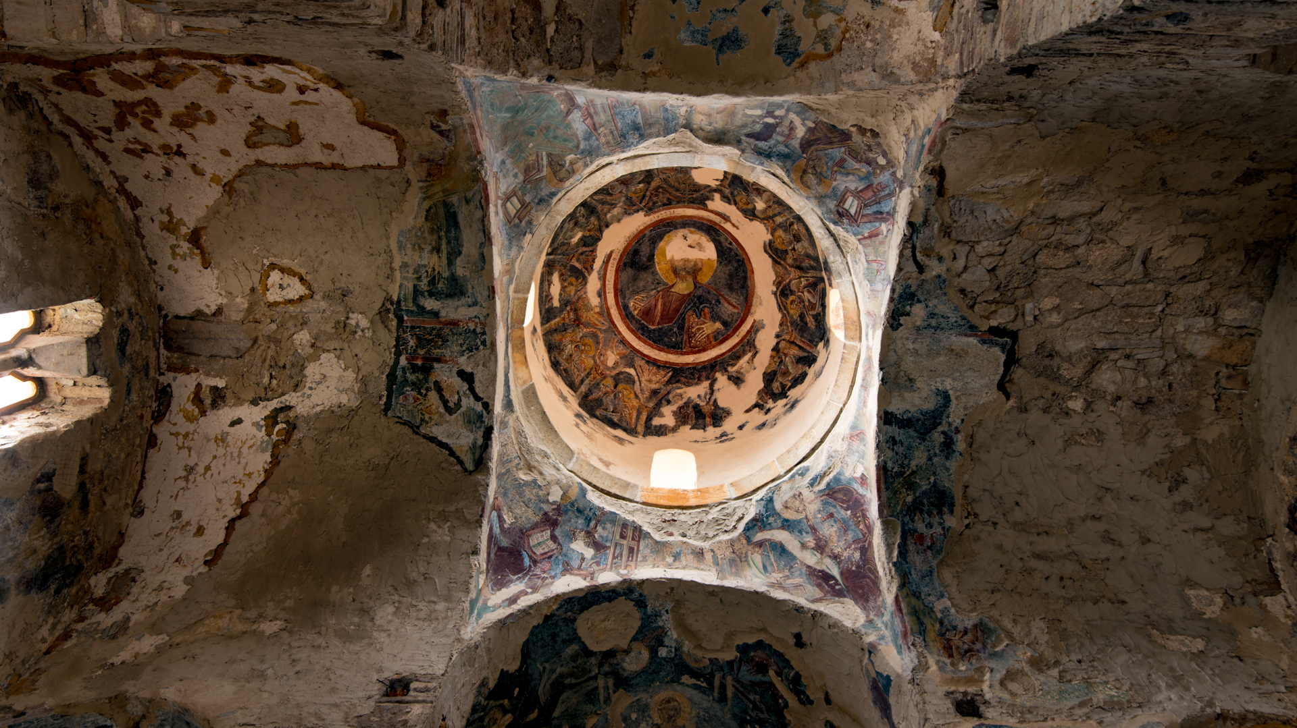

Slide 26
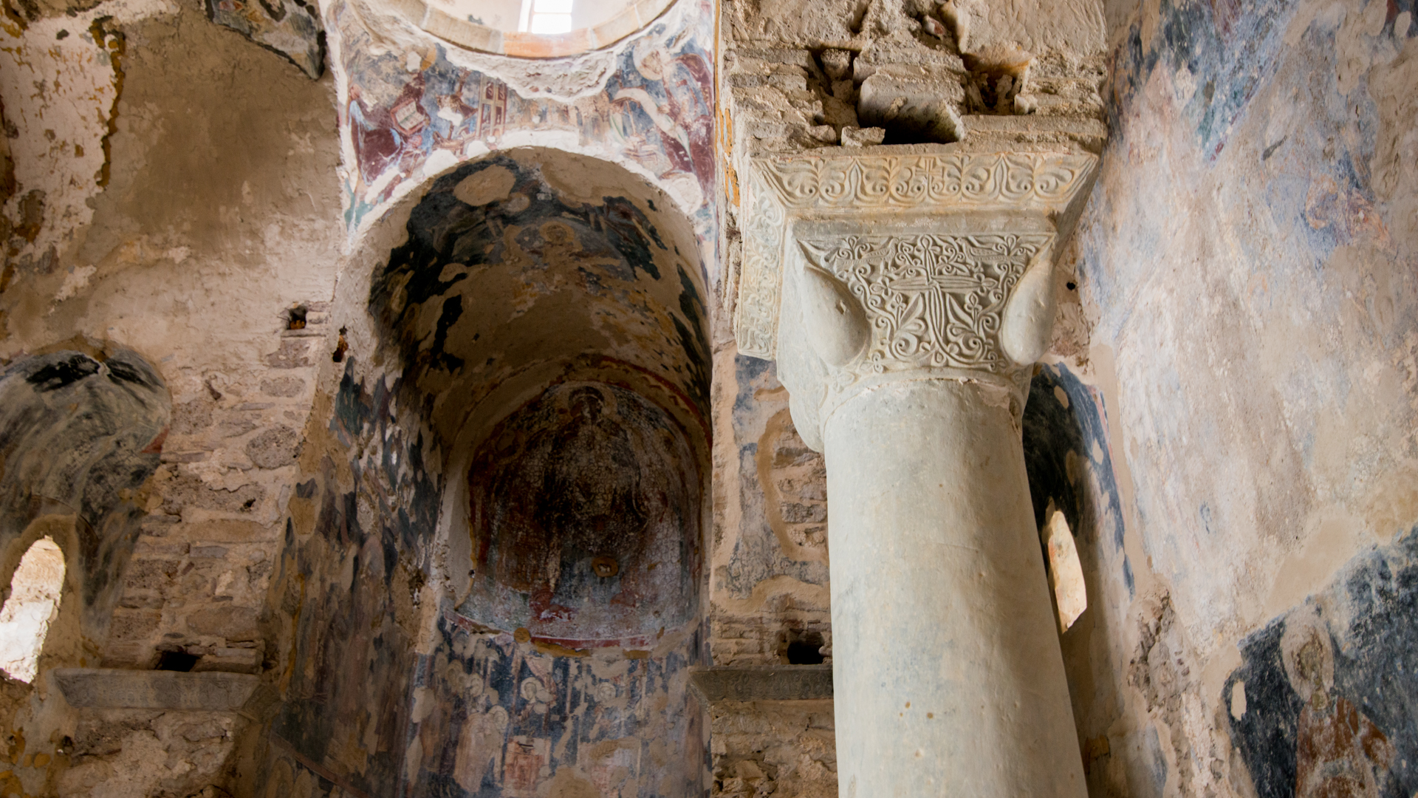

Slide 27
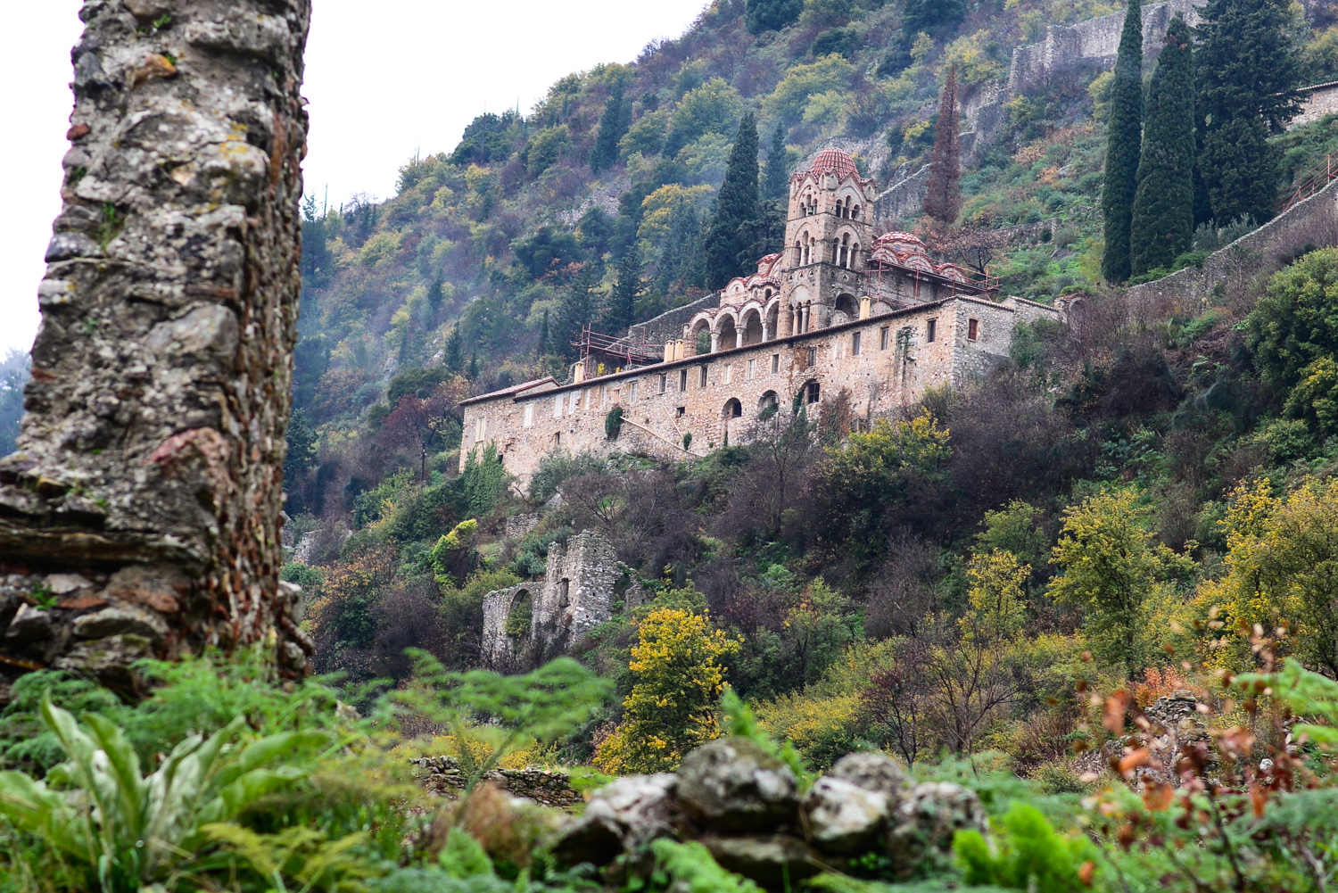
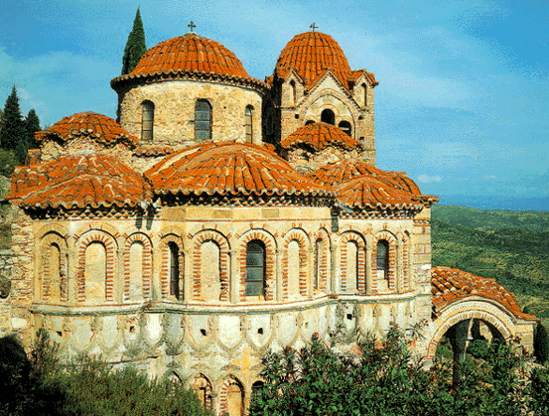
Monastery of Our Lady Pantanassa (the Queen of all)
The catholicon belongs to the mixed architectural type with exterior porticoes and a bell tower. Fine frescoes dated to ca. 1430 are preserved on the upper part of the church and in the sanctuary, while the wall paintings on the ground floor date from the 18th century.

Slide 28
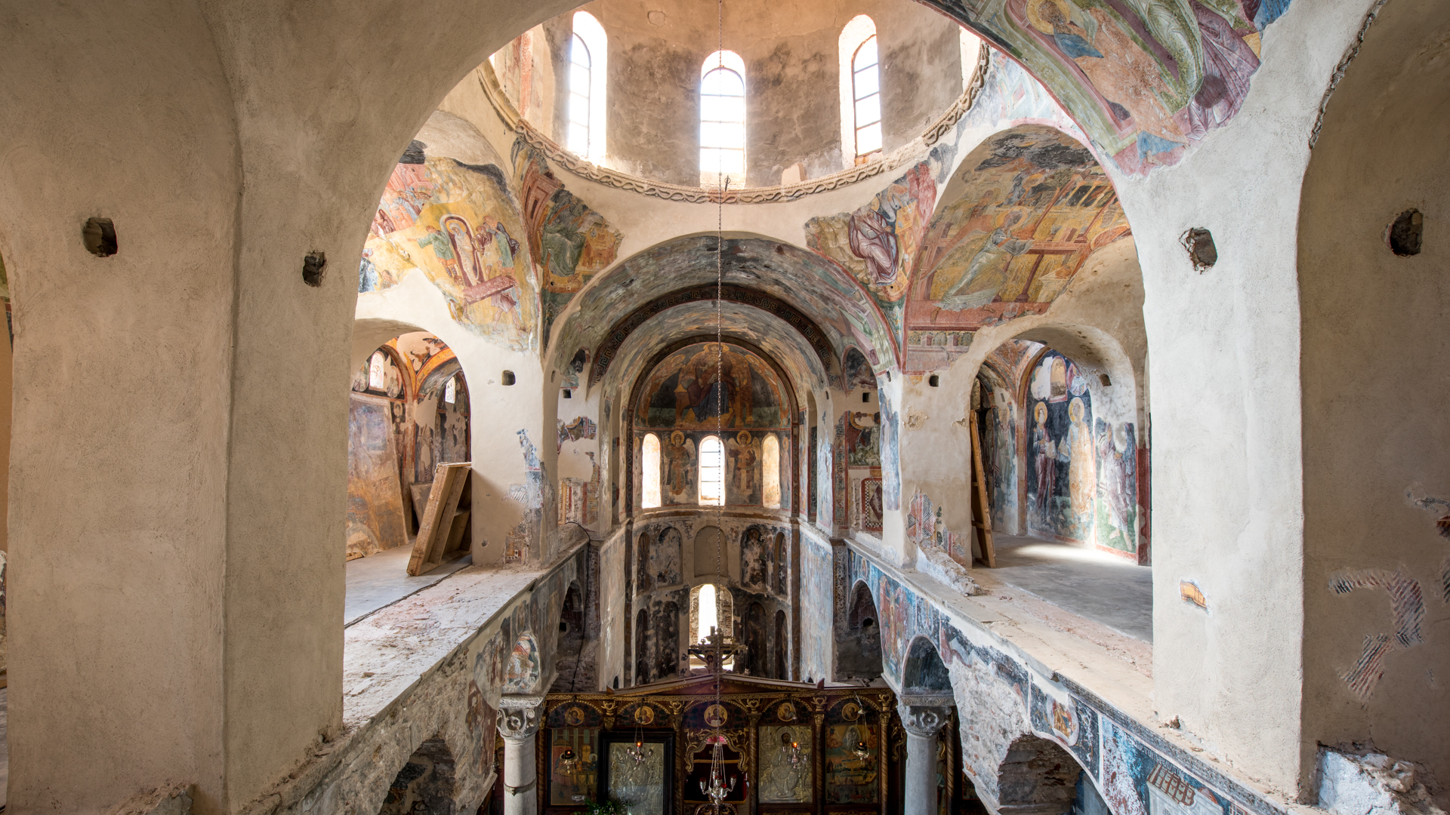

Slide 29
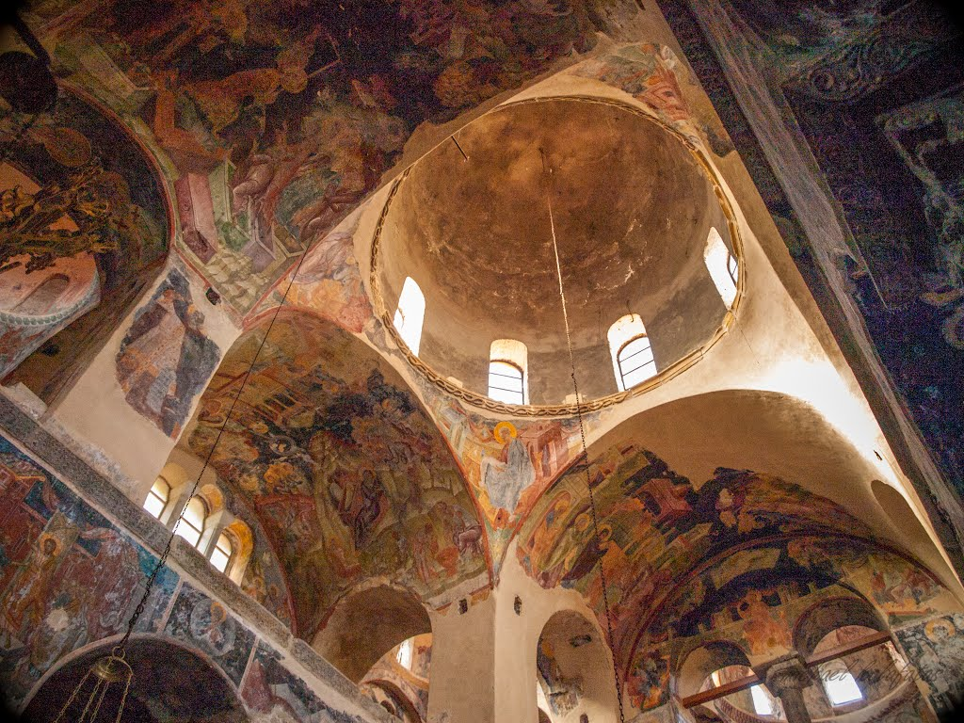
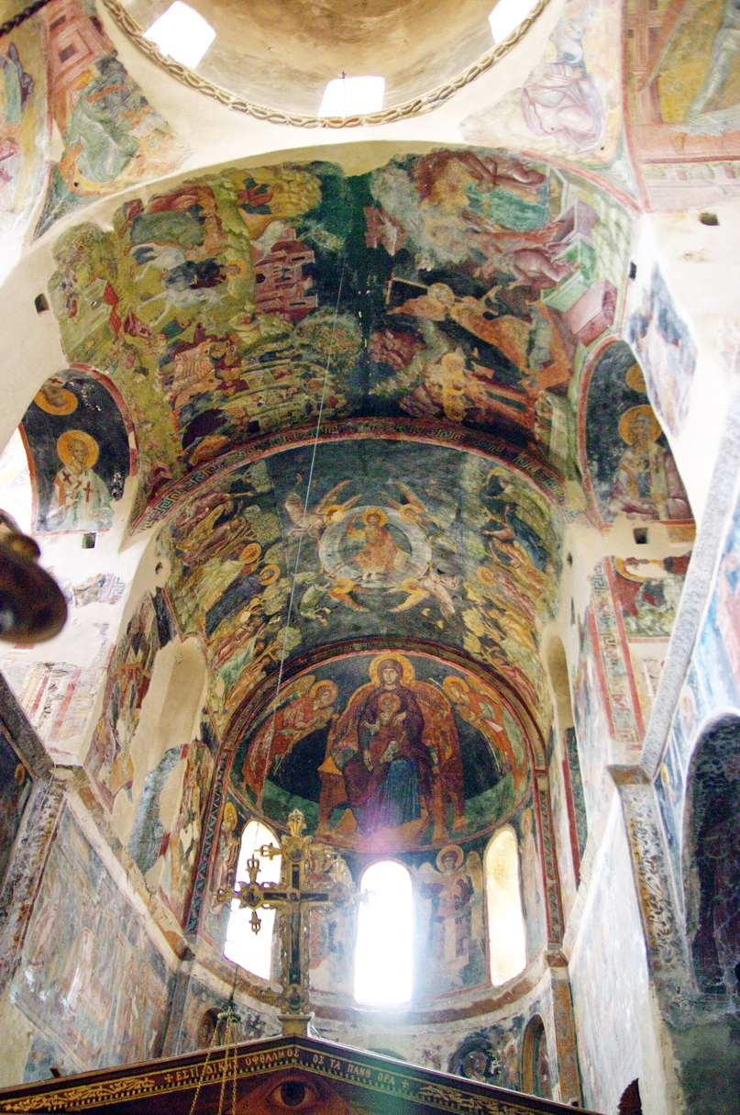

Slide 30



Slide 31
Credits http://www.yppo.gr/files/g_49623.pdf https://fotowriting.blogspot.com/2018/05/blog-post_22.html?spref=fb https://www.thebyzantinelegacy.com/peribleptos-mystras https://wordscene.wordpress.com/2012/05/28/mystras-last-outpost-of-byzantium-churches-and-frescoes/ https://www.kastra.eu/castleen.php?kastro=mystras https://www.dreamstime.com/palace-despots-upper-town-mystras-greece-image246853702 https://www.reddit.com/r/byzantium/comments/f0d1d8/palace_of_the_despots_of_morea_in_mystras_greece/ http://odysseus.culture.gr/h/3/eh352.jsp?obj_id=2397 https://notetotraveler.com/2017/10/18/the-church-of-saint-demetrios-in-mystras/ http://www.exploringbyzantium.gr/EKBMM/Page?name=monument&lang=en&id=51&sub=679&sub2=376 https://www.123rf.com/photo_21170319_interior-of-church-of-panagia-hodegetria-in-mystras-greece.html http://www.exploringbyzantium.gr/EKBMM/Page?name=monument&id=51&sub=679&sub2=376&lang=en&template=infokiosk https://www.religiousgreece.gr/el/attractions/iera-moni-brontohioy-i-n-agion-theodoron-panagias-odigitrias https://en.wikipedia.org/wiki/Hagia_Sophia,_Mystras

