Slide 1
James Abbott McNeill Whistler, 1834-1903
Ukiyo-e Prints

Slide 2
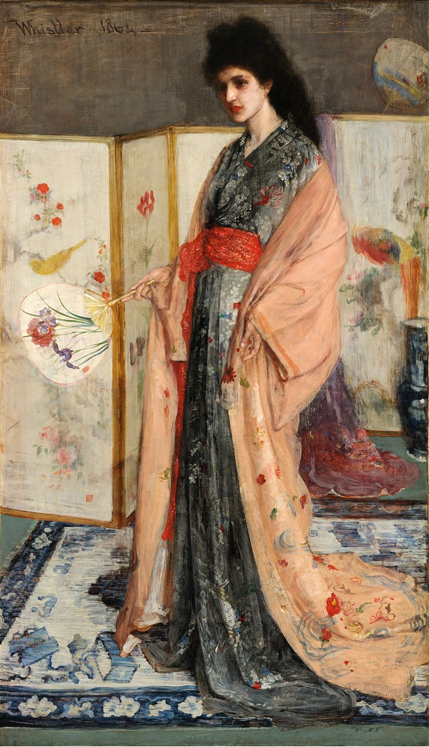
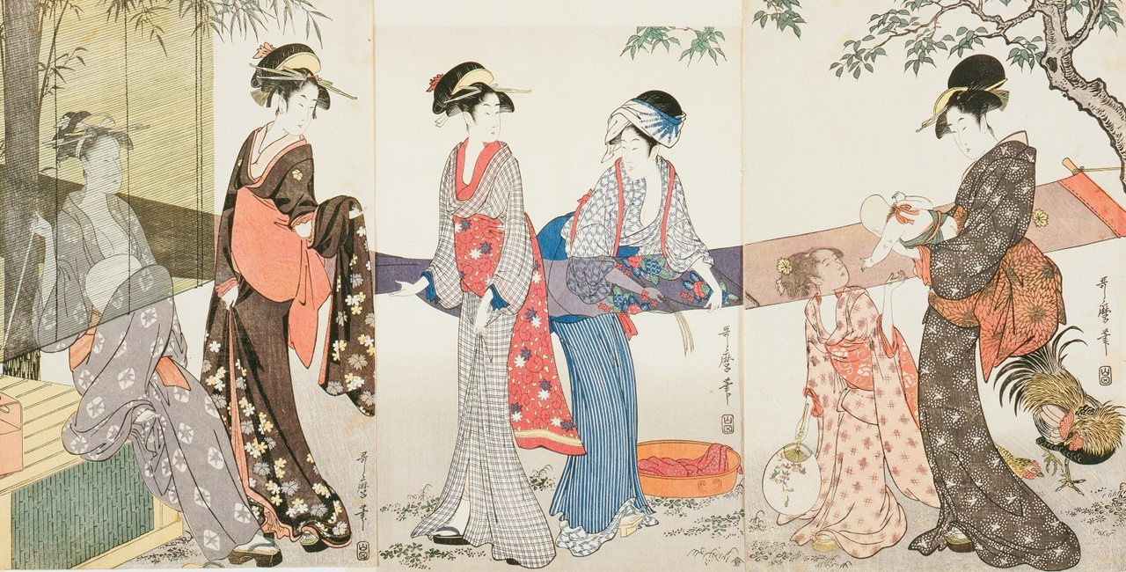
James Abbott McNeill Whistler, 1834-1903
Rose and Silver: The Princess from the Land of
Porcelain (Portrait of Christine Spartali), 1863-1865, Oil on canvas, 201.5x116.1 cm, Freer Gallery of Art, Smithsonian Institution, Washington DC, USA https://en.wikipedia.org/wiki/The_Princess_from_the_Land_of_Porcelain#/media/File:James_McNeill_Whistler_-_La_Princesse_du_pays_de_la_porcelaine_-_brighter.jpg
Kitagawa Utamaro, 1753-1806
Washing and stretching cloth, 1796-1797, Color woodblock print on paper, Triptych: each sheet 38.1 x 25.4 cm, NY Public Library, USA https://artvee.com/dl/drying-and-stretching-cloth/

Slide 3
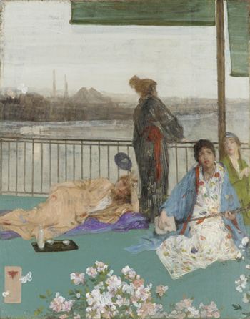
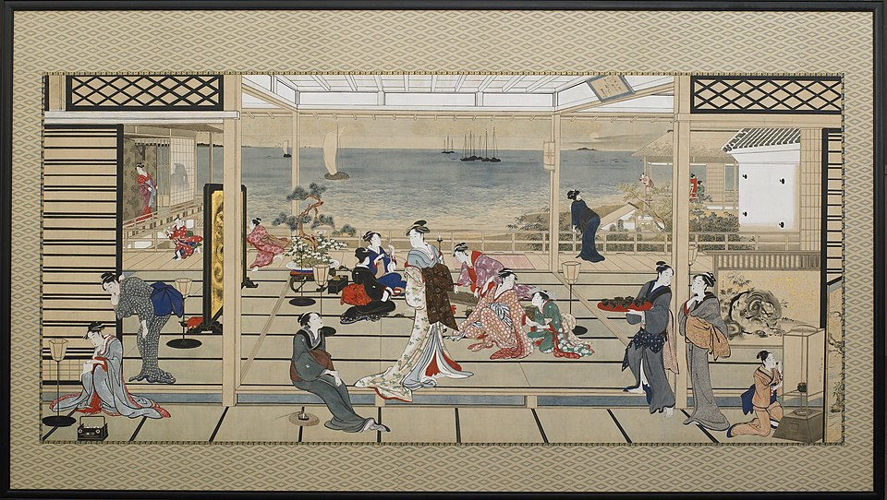
James Abbott McNeill Whistler, 1834-1903
Variations in Flesh Colour and Green - The Balcony, 1864-1870, additions 1870-1879, Oil on wood panel, 61.4x48.8 cm, Smithsonian Institution, Washington, DC, USA https://asia-archive.si.edu/object/F1892.23a-b/
Kitagawa Utamaro, 1753-1806
Moonlight Revelry at Dozo Sagami, early 19th century, Color woodblock print on paper, 202.2 x 356.0 cm, Freer Gallery of Art, Washington, DC, USA https://asia.si.edu/explore-art-culture/collections/search/edanmdm:fsg_F1903.54/

Slide 4
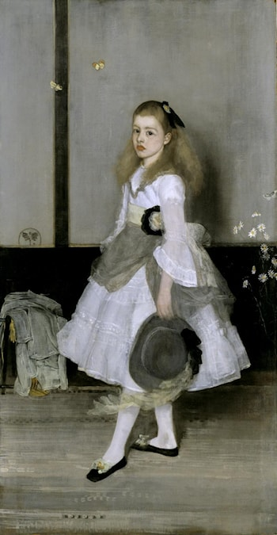
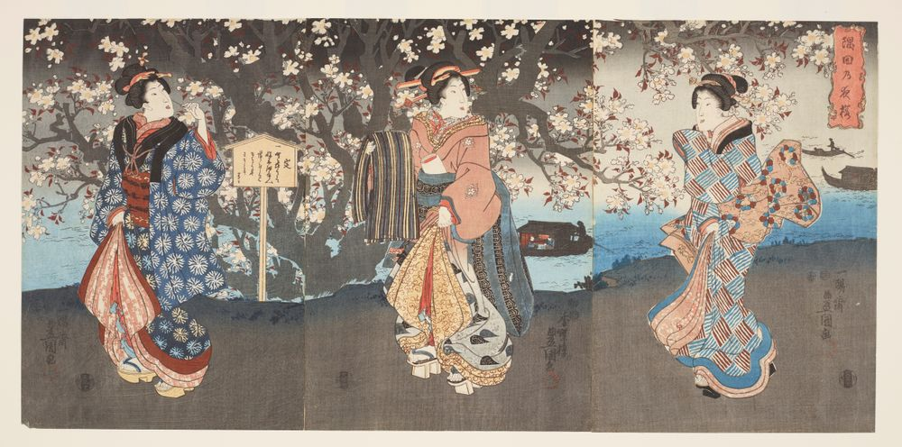
James Abbott McNeill Whistler, 1834-1903
Harmony in Grey and Green: Miss Cicely Alexander, 1872-1873, Oil paint on canvas, 190x98 cm, Tate Gallery, London, UK https://www.artrenewal.org/artworks/james-abbott-mcneill-whistler/harmony-in-grey-and-green-miss-cicely-alexander/4240
Utagawa Kunisada, 1786-1865
Three women viewing cherry blossom on a riverbank, , circa 1850, Color woodblock print on paper, 753x362 mm, Museum of New Zealand https://collections.tepapa.govt.nz/object/1528626?page=1&rtp=1&ros=1&asr=1&assoc=all&mb=c

Slide 5
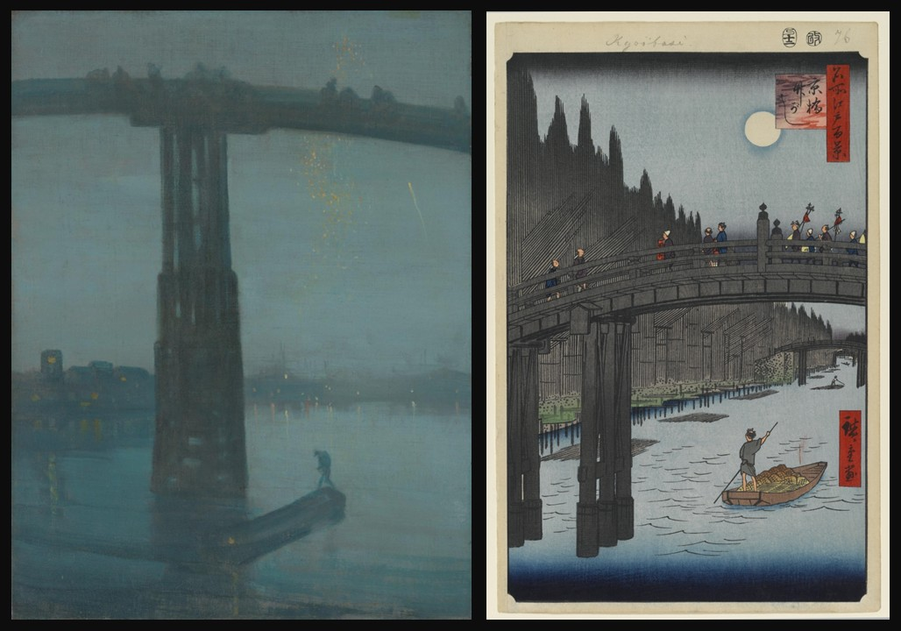
James Abbott McNeill Whistler, 1834-1903
Nocturne in Blue and Gold: Old Battersea Bridge, 1872, Oil on canvas, 66,6x50,2 cm, TATE Gallery, UK https://www.tate.org.uk/art/artworks/whistler-nocturne-blue-and-gold-old-battersea-bridge-n01959
Utagawa Hiroshige, 1797-1858
Bamboo Yards, Kyōbashi Bridge (12th Month, 1857), ca. 1856–58, Color woodblock print, 36x23.5 cm, Brooklyn Museum, USA https://commons.wikimedia.org/wiki/File:100_views_edo_076.jpg

Slide 6
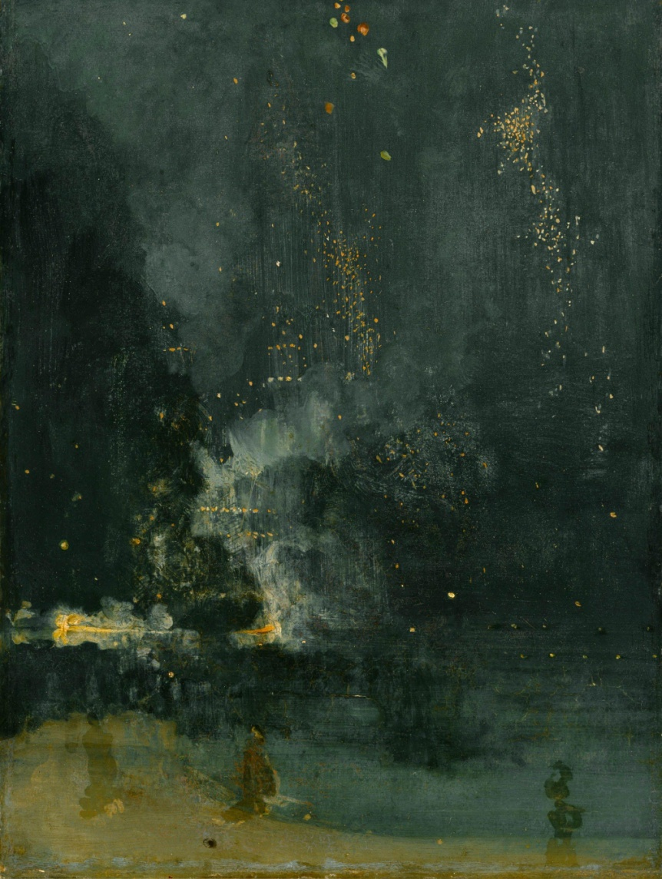
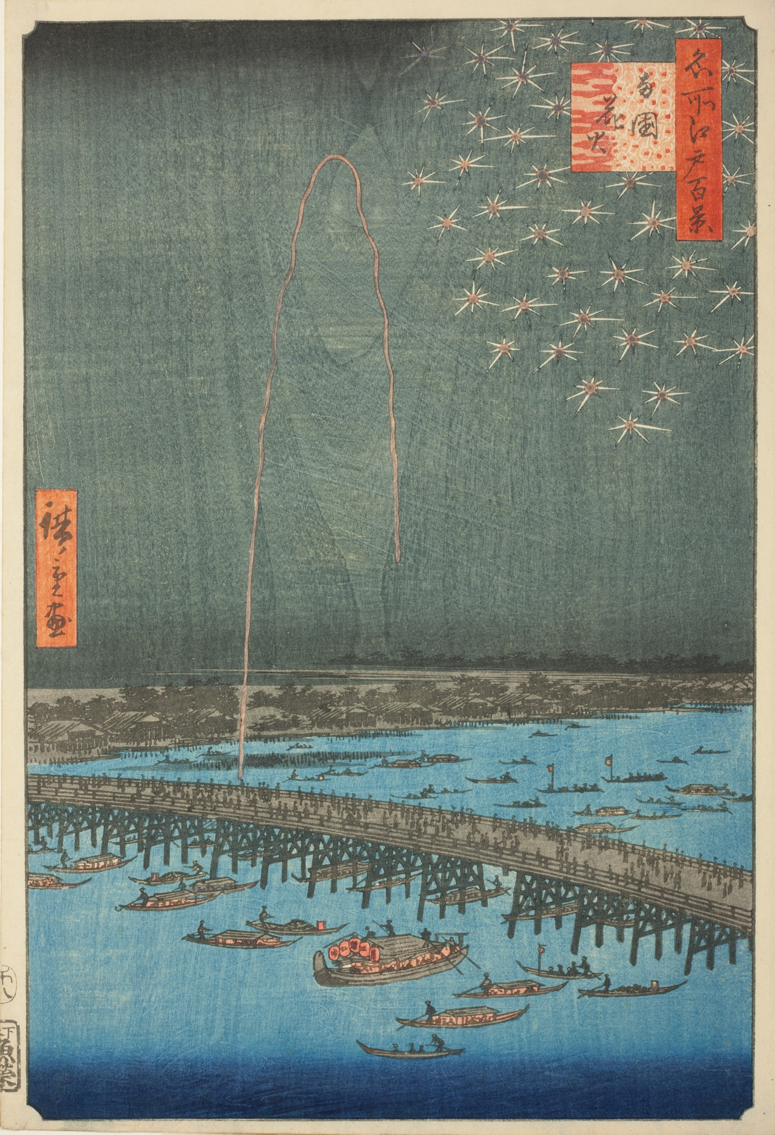
James Abbott McNeill Whistler, 1834-1903
Nocturne in Black and Gold: The Falling Rocket, 1875, Oil on canvas, 60.3x46.6 cm, Detroit Institute of Arts, USA https://en.wikipedia.org/wiki/Nocturne_in_Black_and_Gold_%E2%80%93_The_Falling_Rocket
Utagawa Hiroshige, 1797-1858
Fireworks at Ryōgoku (Ryōgoku Hanabi), 1856–58, Color Woodblock print, 36x24.1 cm, The Art Institute, Chicago, USA https://www.artic.edu/artworks/26522/fireworks-at-ry%C5%8Dgoku-ry%C5%8Dgoku-hanabi-from-the-series-one-hundred-famous-views-of-edo-meisho-edo-hyakkei

Slide 7
The End

