Slide 1
Ancient Greek
Funerary Stele

Slide 2
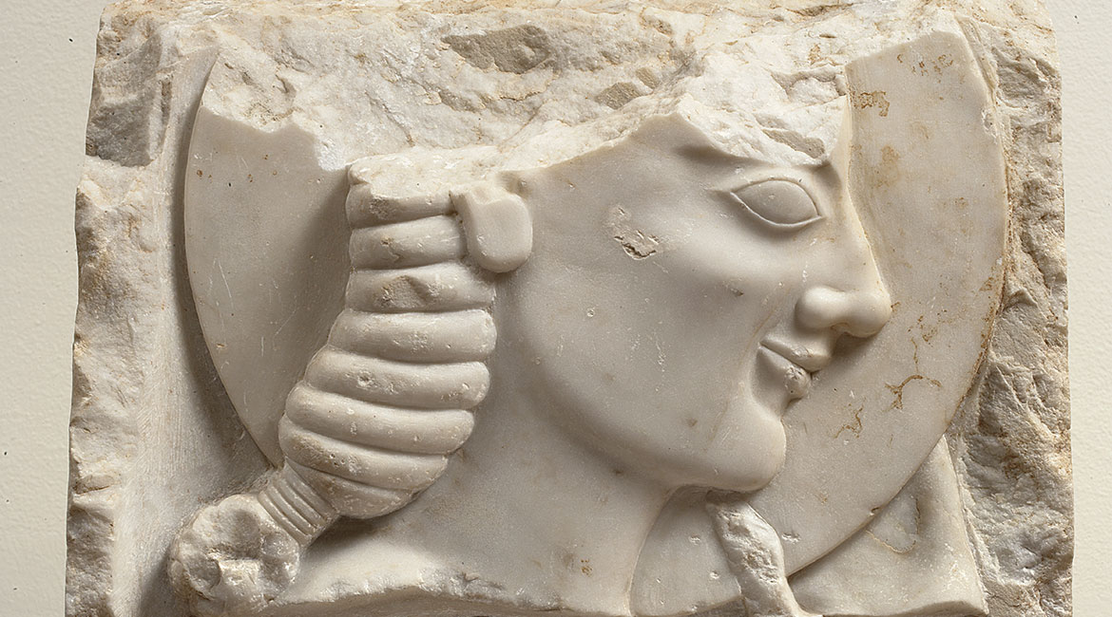
Part of a marble grave stele of an athlete, found in the Kerameikos, Athens, ca. 550 BC, Marble, Height: 0,35 m, National Archaeological Museum of Athens, Greece https://www.namuseum.gr/en/collection/archaiki-periodos/

Slide 3
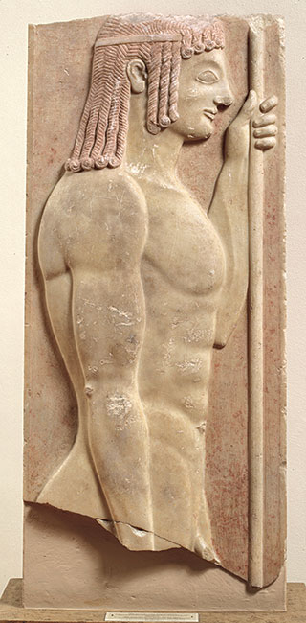
Marble grave stele of a young javelin-bearer, found in Athens, 550-540 BC, Marble, Total height of the stele: 4,5 m, National Archaeological Museum of Athens, Greece https://www.namuseum.gr/en/collection/archaiki-periodos/

Slide 4
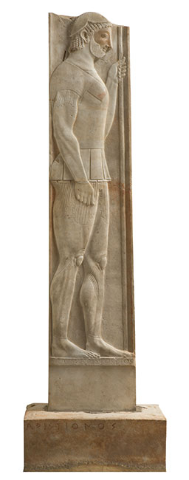
The marble grave stele of Aristion, work of Aristokles, found at Velanideza, Attica, ca. 510 BC, Marble, Height: 2,02 m, National Archaeological Museum of Athens, Greece https://www.namuseum.gr/en/collection/archaiki-periodos/

Slide 5
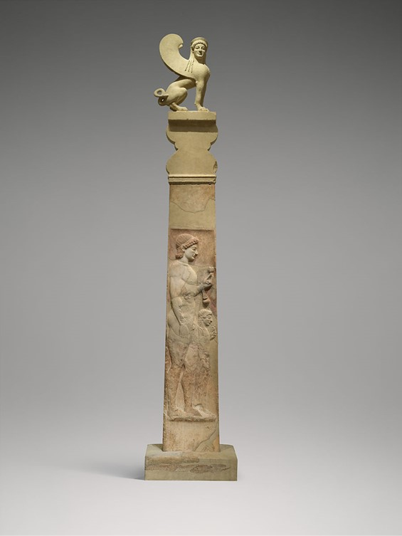
Marble stele (grave marker) of a youth and a little girl, ca. 530 BC, Marble, H. 423.4cm, the MET, NY, USA https://www.metmuseum.org/art/collection/search/256974

Slide 6
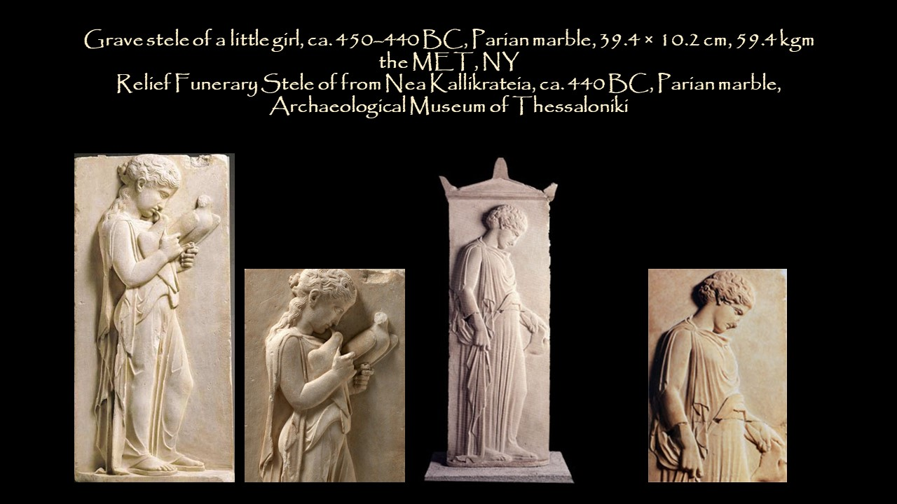

Slide 7
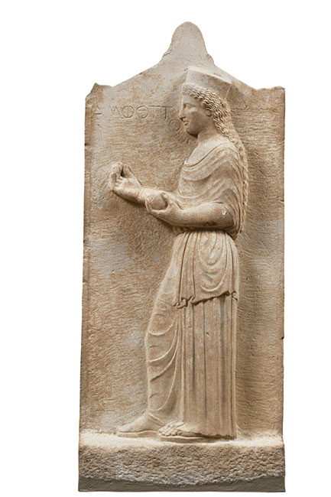
Grave stele of Amphotto from Thebes, ca. 440 BC, Marble, Height: o,81m, National Archaeological Museum of Athens, Greece https://www.namuseum.gr/en/collection/klasiki-periodos-2/

Slide 8
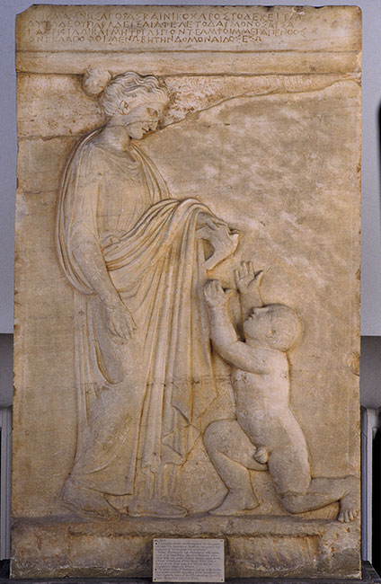
Marble Grave stele of Mnesagora and Nikochares from Vari, Attica, 420-410 BC, Marble, Height: 1,19 m, National Archaeological Museum of Athens, Greece https://www.namuseum.gr/en/collection/klasiki-periodos-2/

Slide 9
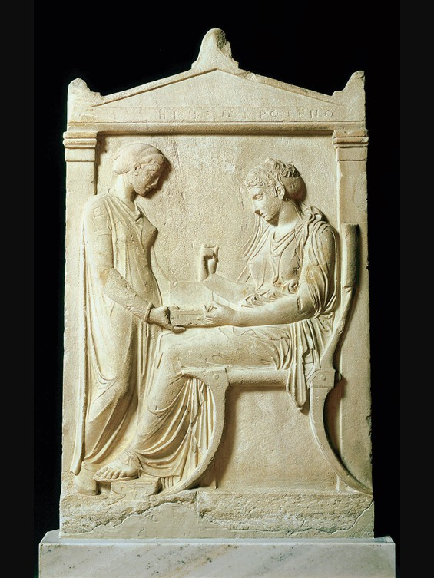
Attributed to Kallimachos architect and sculptor working in the second half of the 5th century BC,
Funerary Grave Stelae of Hegeso, c. 410-400 BC, found in Kerameikos, Pentelic Marble, 1,56 x 0,97 m, National Archaeological Museum of Athens, Greece https://www.namuseum.gr/en/collection/klasiki-periodos-2/

Slide 10
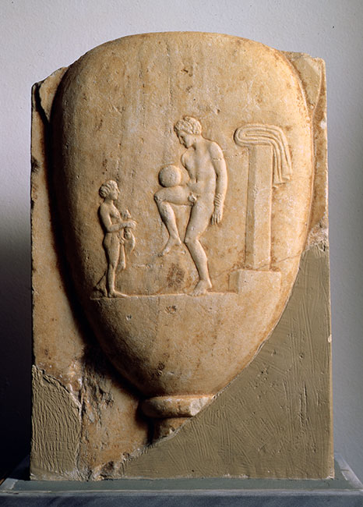
Part of a marble grave stele, found in Piraeus, 400-375 BC, marble, Height: 0,44 m, National Archaeological Museum of Athens, Greece https://www.namuseum.gr/en/collection/klasiki-periodos-2/

Slide 11
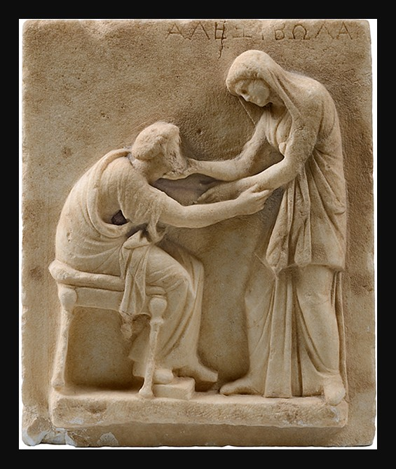
Alexibola: Funerary Stele with Scene of Greeting, early 3rd century BC, Marble, Archaeological Museum of Thera, Greece https://www.ias.edu/ideas/2017/chaniotis-world-of-emotions

Slide 12
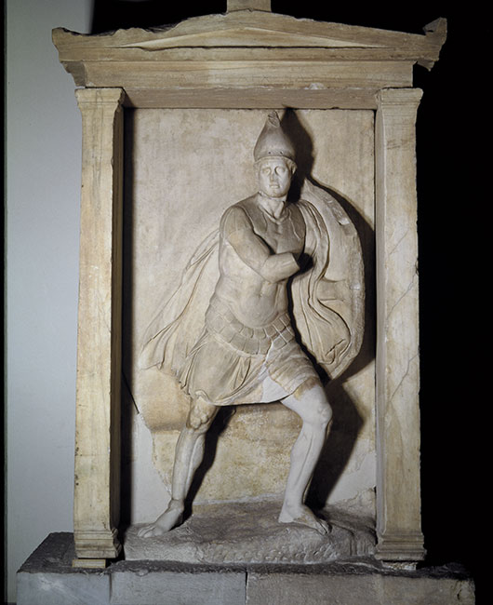
Marble funerary naiskos (small temple) of Aristonautes, found in the ancient cemetery of the Kerameikos, Athens, 350-325 BC, Marble, Height: 2,48 m, National Archaeological Museum of Athens, Greece https://www.namuseum.gr/en/collection/klasiki-periodos-2/

Slide 13
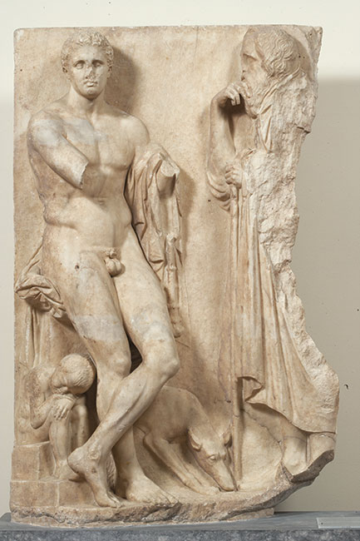
Marble grave stele of a youth, found in the bed of the Ilissos river in Athens, ca. 340 BC, Marble, Height: 1,68 m, National Archaeological Museum of Athens, Greece https://www.namuseum.gr/en/collection/klasiki-periodos-2/

Slide 14
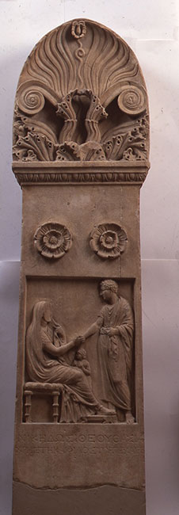
Marble grave stele, found on Tenos, Cyclades First half of the 2nd c. BC, Marble, Height: 1,56 m, National Archaeological Museum of Athens, Greece https://www.namuseum.gr/en/collection/ellinistiki-periodos-2/

Slide 15
The End

