Slide 1
Doris Lee, 1905–1983

Slide 2
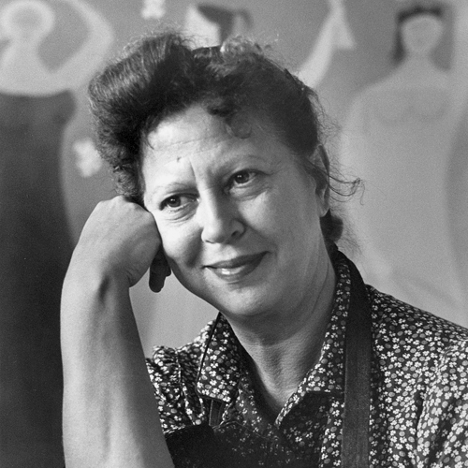
Photo by Roy Stevens; National Museum of Women in the Arts Library and Research Center Special Collections https://nmwa.org/art/artists/doris-lee/

Slide 3
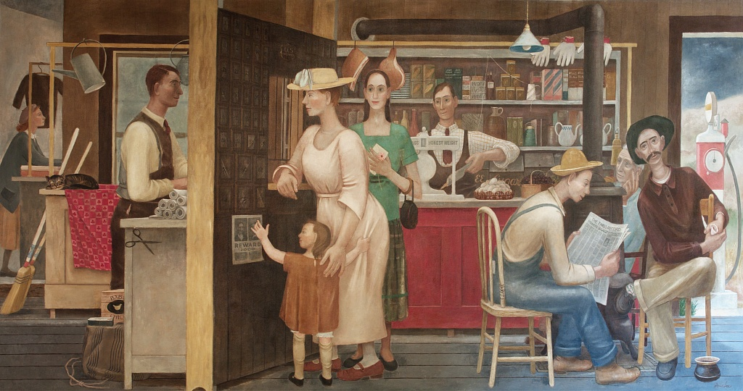
General Store and Post Office, 1930s, Mural, Ariel Rios Federal Building, Washington, DC, USA

Slide 4
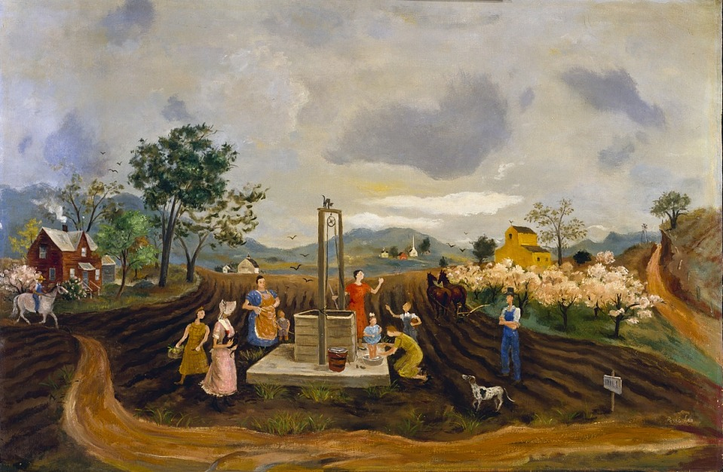
At the Well, 1930s-1940s, Oil on mounted on fiberboard,
76.5x114.8 cm, Smithsonian American Art Museum, Washington DC, USA https://americanart.si.edu/artwork/well-14500

Slide 5
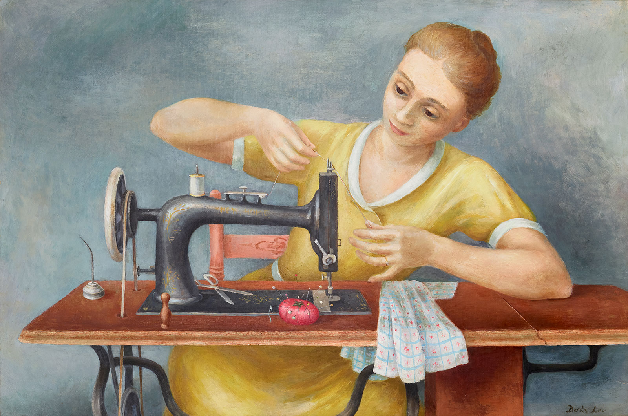
Girl Sewing, c. 1931,
Oil on canvas, 81x111 cm, The Wolfsonian, FL, USA https://wolfsonian.org/blog/2022/05/

Slide 6
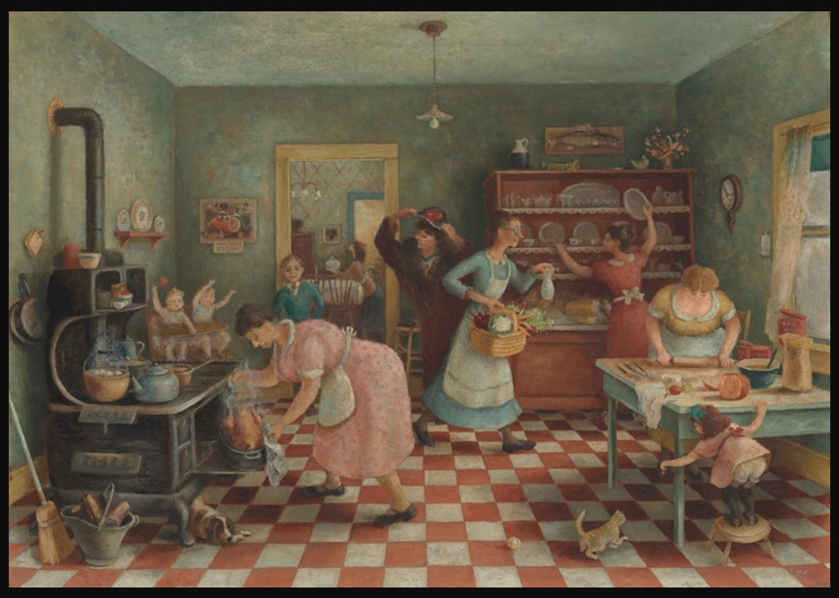
Thanksgiving, c. 1935, Oil on Canvas, 71.3x101.8 cm, The Art Institute of Chicago, USA https://www.artic.edu/artworks/21727/thanksgiving

Slide 7
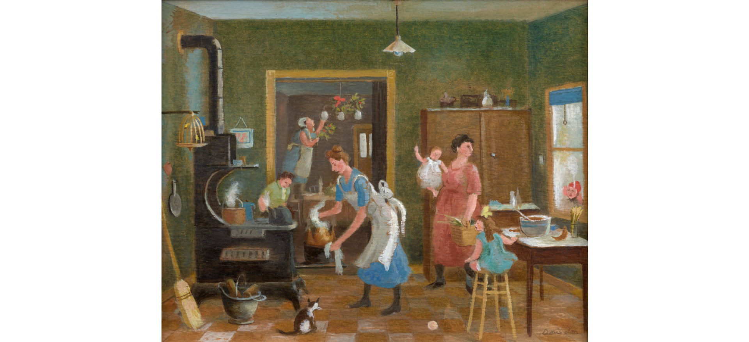
Home for the Holidays, ca. 1935, Oil on board, 24.1x29.2 cm, Private Collection https://www.artsy.net/artwork/doris-lee-home-for-the-holidays

Slide 8
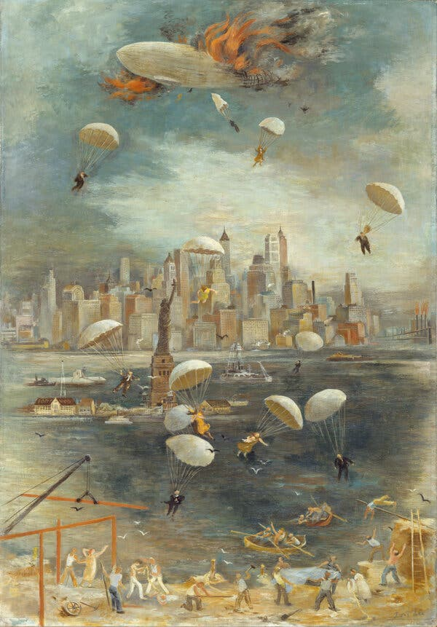
Catastrophe, 1936, Oil on canvas, 101.6 × 71.1 cm, the MET, NY, USA https://www.metmuseum.org/art/collection/search/487833

Slide 9
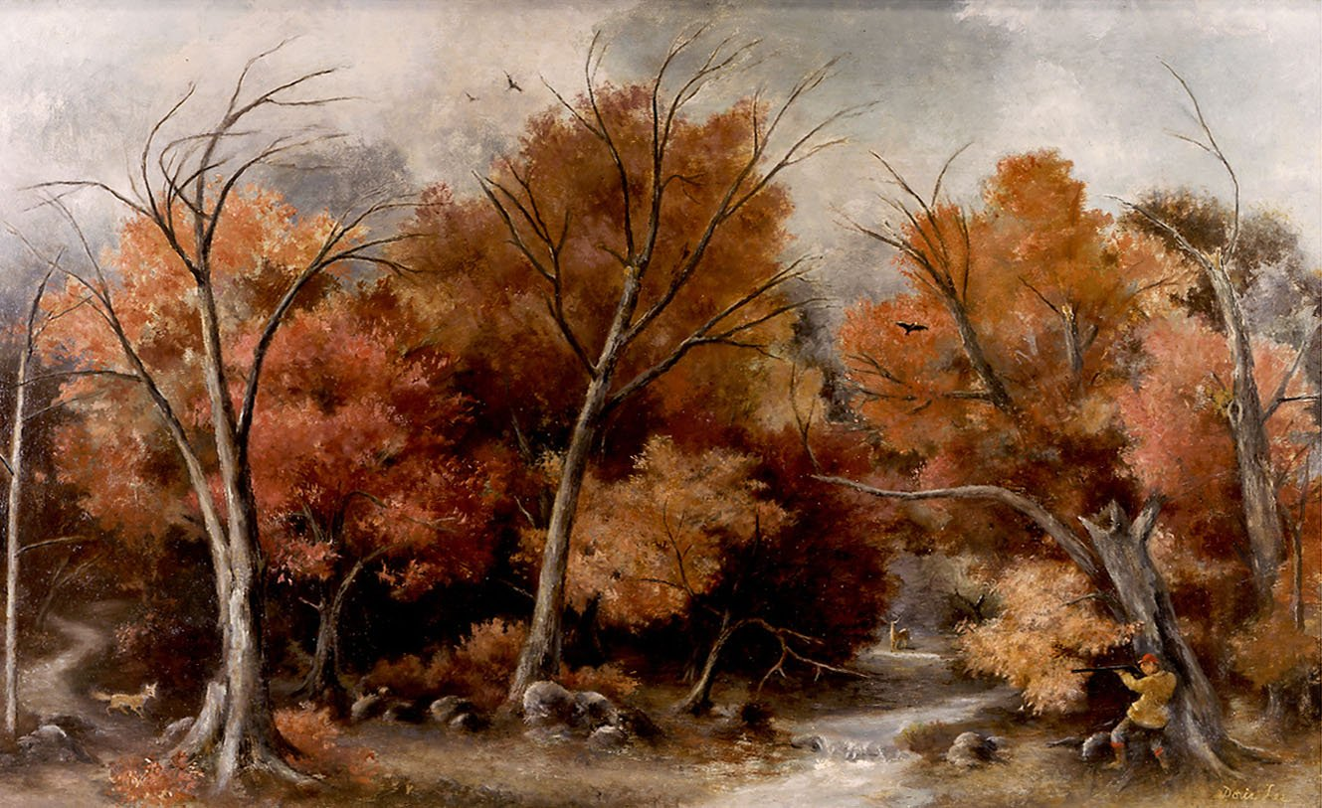
Autumn Landscape with Hunter, 1937, Oil on canvas, 55.88x88.9 cm, Private Collection https://www.dwigmore.com/doris-lee-estate

Slide 10
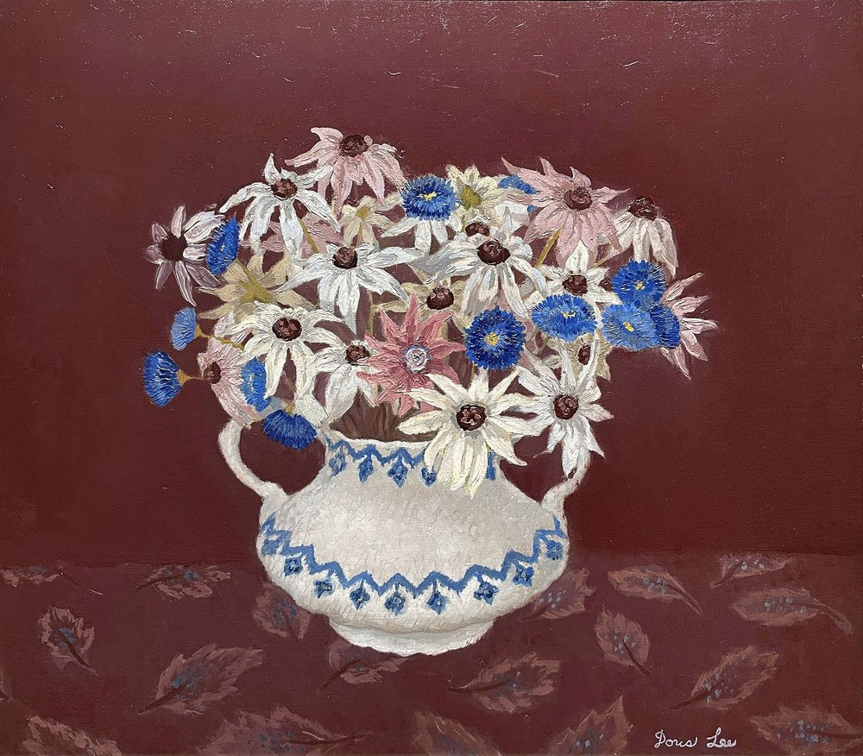
Vase of Flowers, c. 1940,
Oil on canvas, 40.64x45.72 cm, Private Collection https://www.dwigmore.com/doris-lee-estate

Slide 11
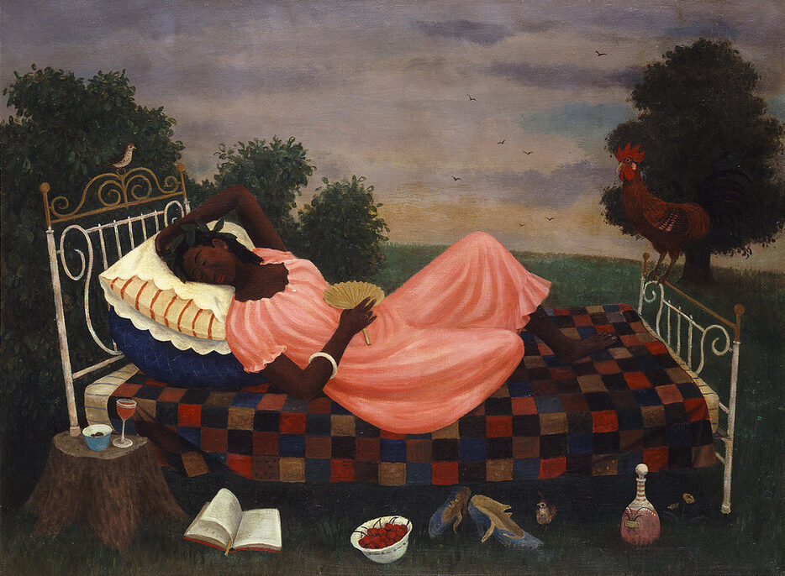
Siesta, 1944, Oil on canvas, 68.58x91.44 cm, National Museum of Women in the Arts, Washington DC, USA https://nmwa.org/art/artists/doris-lee/

Slide 12
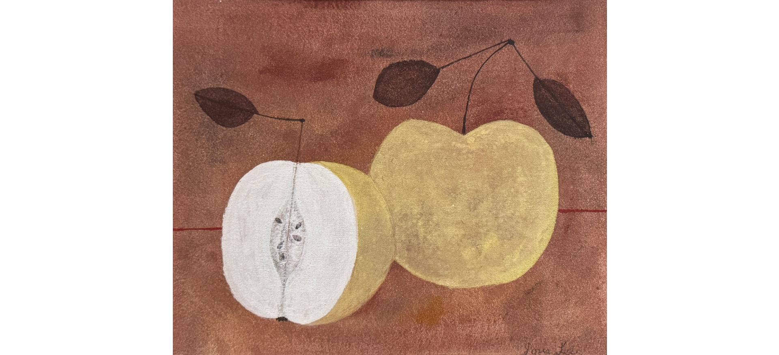
Apples, 1950s, Oil on canvasboard, 25.4 × 29.8 cm, Private Collection https://www.artsy.net/artwork/doris-lee-untitled-apples

Slide 13
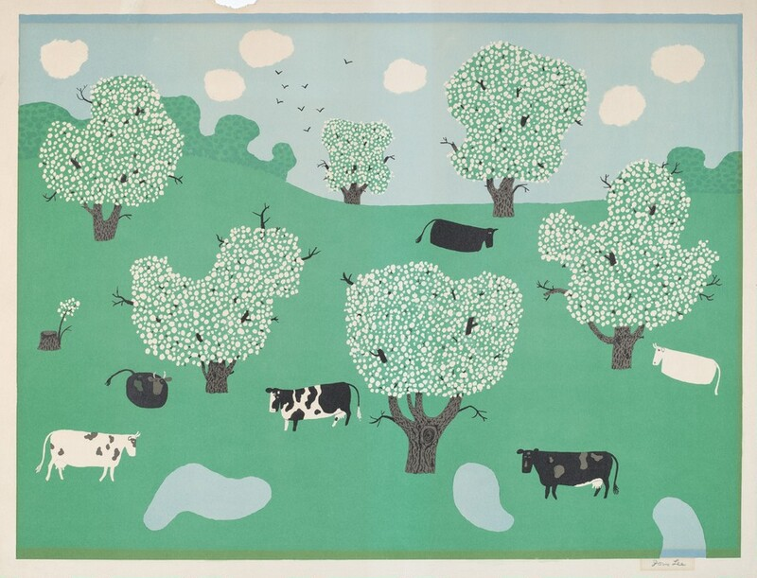
Blossom Time, 1959, Color lithograph,
45.8x61 cm, National Gallery of Art, Washington DC, USA https://www.nga.gov/artworks/145870-blossom-time

