Slide 1
Andrea della Robbia
1435-1525

Slide 2
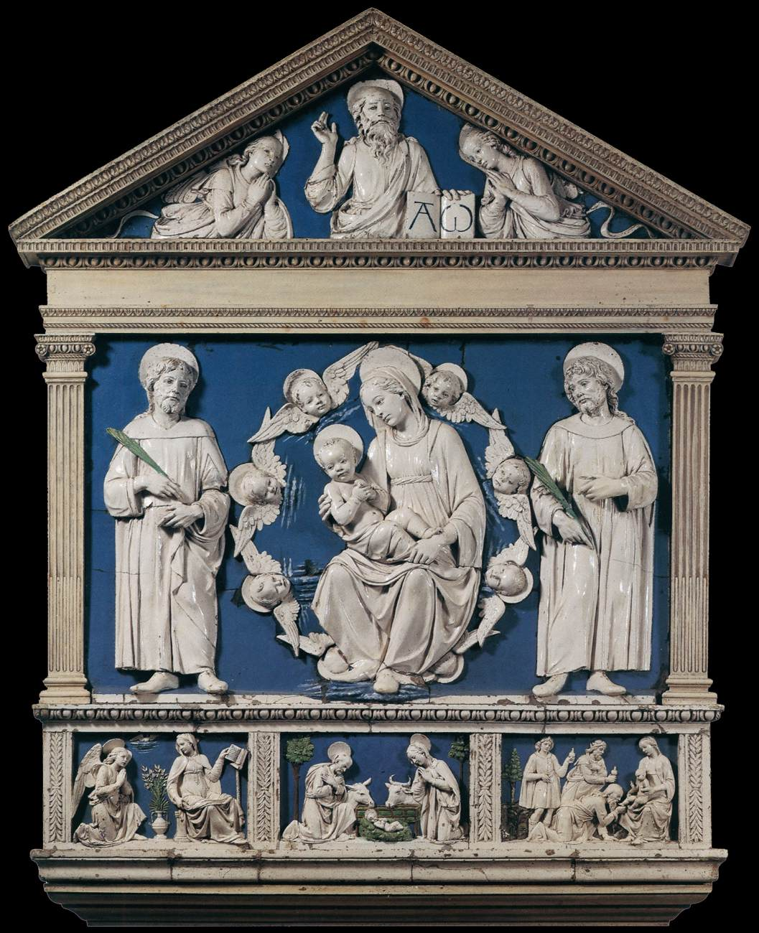
Andrea Della Robbia, 1435-1525
Madonna and Child between Sts Cosmas and Damian, c. 1466, Glazed Terracotta, 217 x 180 cm, Arciconfraternità della Misericordia, Florence, Italy https://www.wga.hu/frames-e.html?/html/r/robbia/andrea/misc/17andrea.html

Slide 3
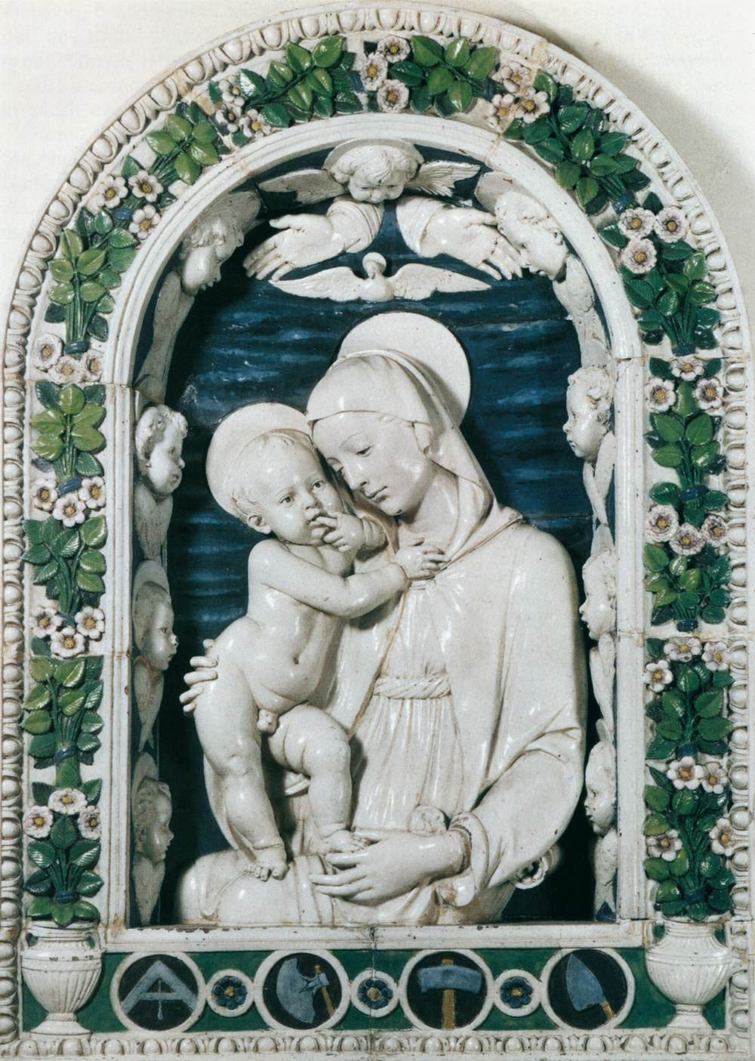
Andrea Della Robbia, 1435-1525
Madonna of the Stonemasons, 1475, Glazed Terracotta, 134 x 96 cm, Museo Nazionale del Bargello, Florence, Italy https://www.wga.hu/frames-e.html?/html/r/robbia/andrea/misc/17andrea.html

Slide 4
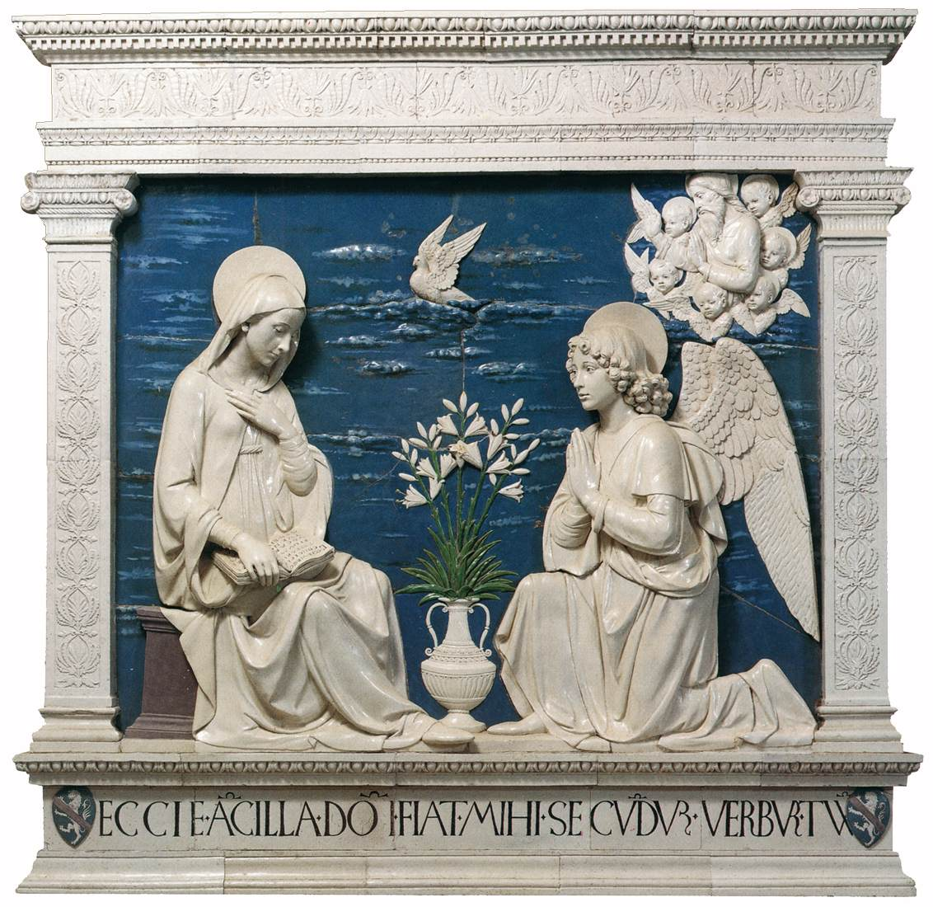
Andrea Della Robbia, 1435-1525
Annunciation, c. 1475
Glazed Terracotta, 210 x 210 cm, Chiesa Maggiore, La Verna, Italy https://www.wga.hu/frames-e.html?/html/r/robbia/andrea/misc/17andrea.html

Slide 5
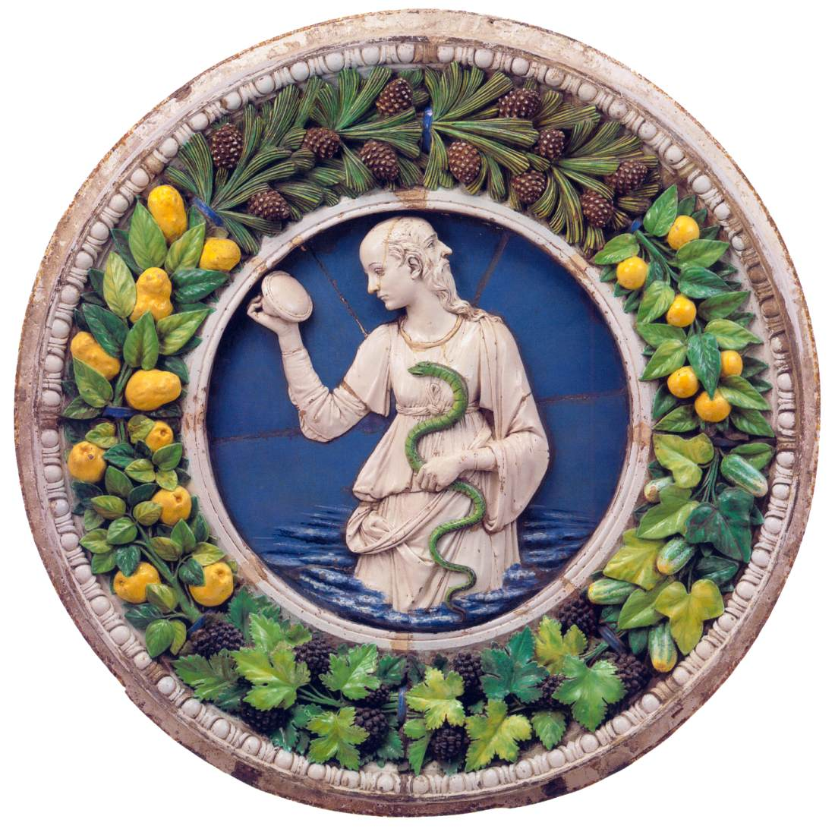
Andrea Della Robbia,
1435-1525
Prudence, c. 1475, Glazed Terracotta, Diameter: 165 cm,
Metropolitan Museum of Art, New York, USA https://www.wga.hu/frames-e.html?/html/r/robbia/andrea/misc/17andrea.html

Slide 6
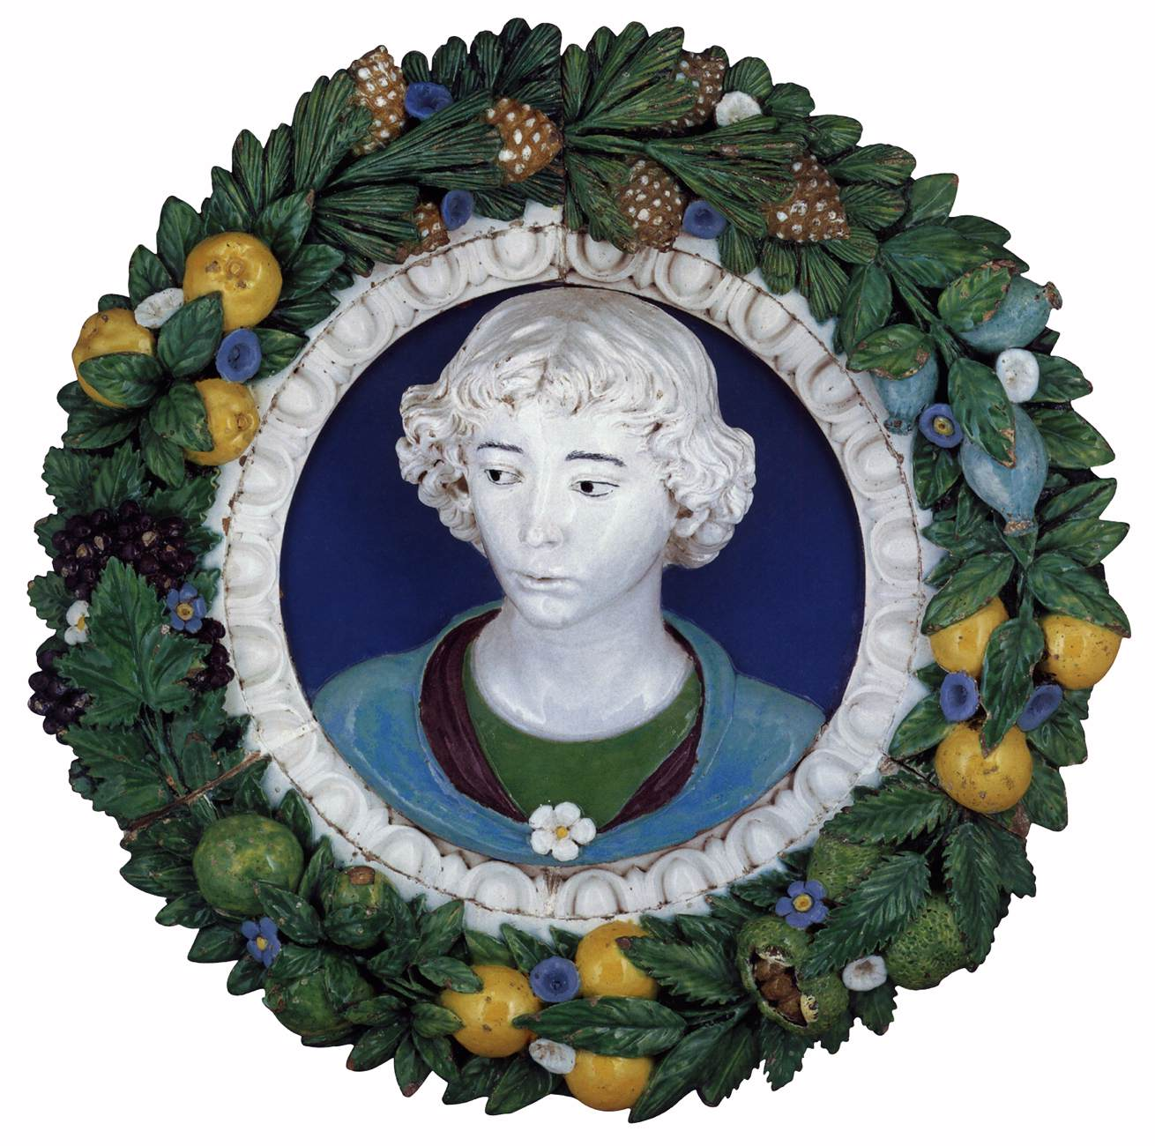
Andrea Della Robbia, 1435-1525
Relief Bust of a Young Man, 1470s, Glazed Terracotta, Diameter: 70 cm, Liechtenstein Museum, Vienna, Austria https://www.wga.hu/frames-e.html?/html/r/robbia/andrea/misc/17andrea.html

Slide 7
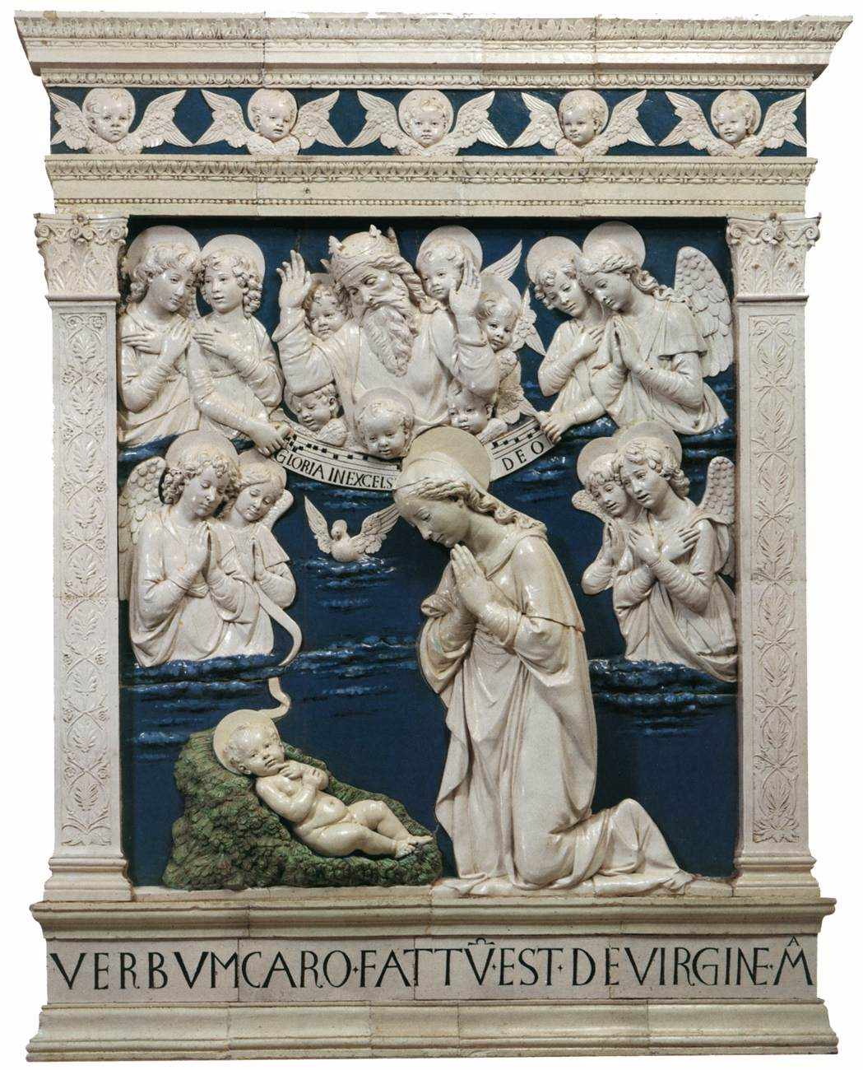
Andrea Della Robbia, 1435-1525
Nativity, 1479, Glazed Terracotta, 240 x 180 cm, Chiesa Maggiore, La Verna, Italy https://www.wga.hu/frames-e.html?/html/r/robbia/andrea/misc/17andrea.html

Slide 8
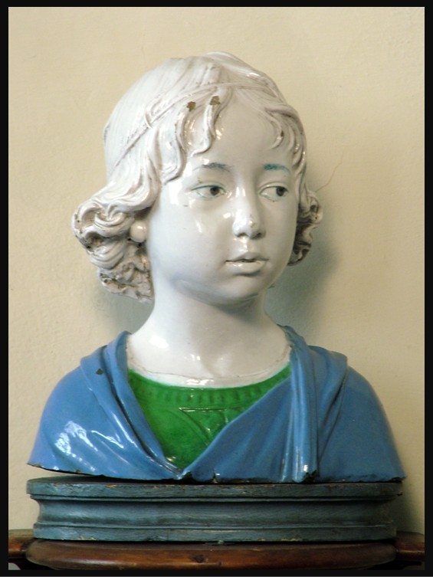
Andrea Della Robbia, 1435-1525
Portrait of a Child, ca 1475 - ca 1480, Glazed Terracotta, Height: 34 cm, National Museum of Bargello, Florence, Italy – Photo Credit: Amal;ia Spiliakou, April 2025

Slide 9
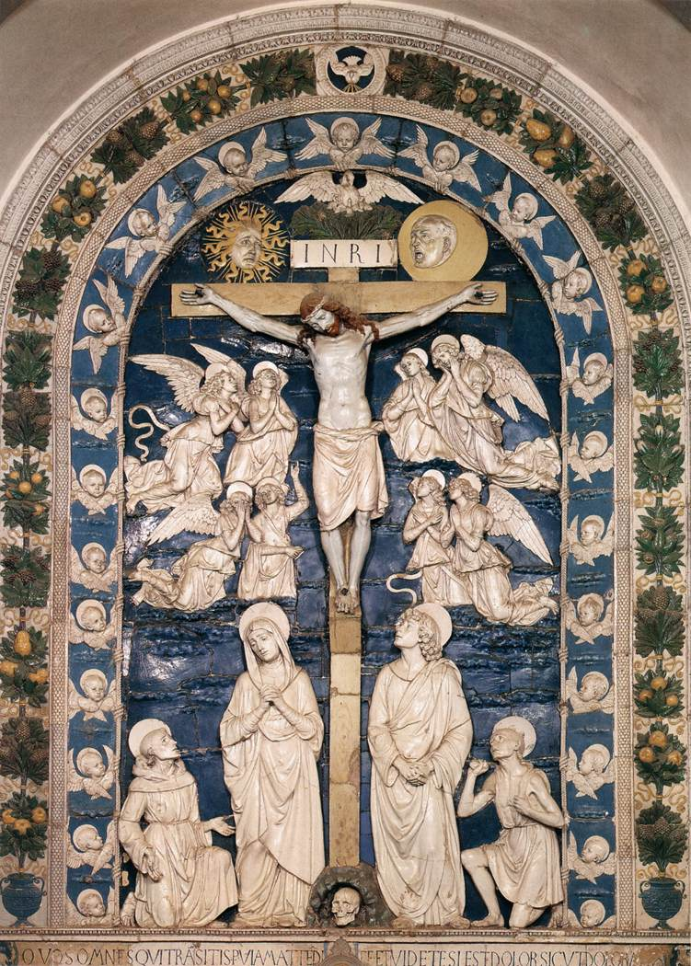
Andrea Della Robbia, 1435-1525
Alessandri Crucifixion, 1480-81, Glazed Terracotta, 600 x 420 cm, Chiesa Maggiore, La Verna, Italy https://www.wga.hu/frames-e.html?/html/r/robbia/andrea/misc/17andrea.html

Slide 10
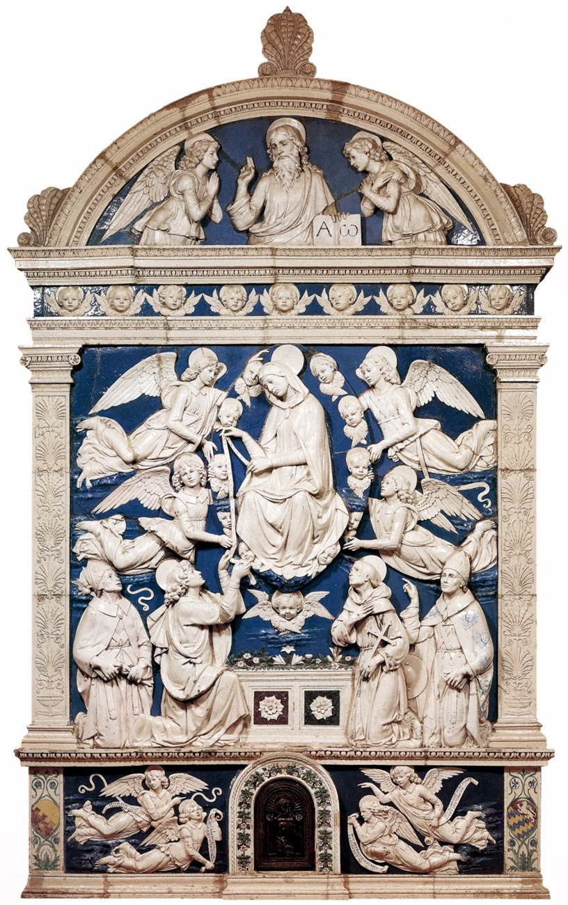
Andrea Della Robbia, 1435-1525
Madonna della Cintola, c. 1486, Glazed Terracotta, 388 x 236 cm, Chiesa Maggiore, La Verna, Italy https://www.wga.hu/frames-e.html?/html/r/robbia/andrea/misc/17andrea.html

Slide 11
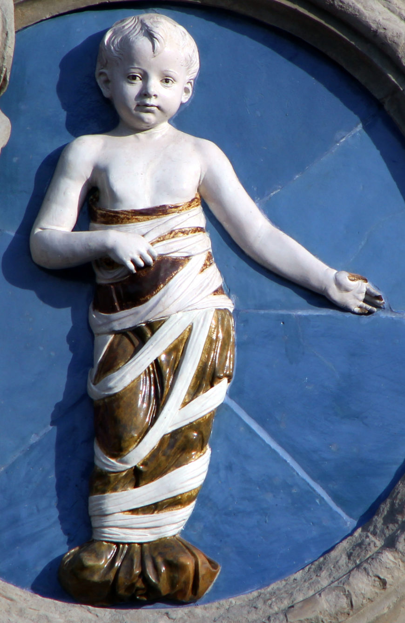
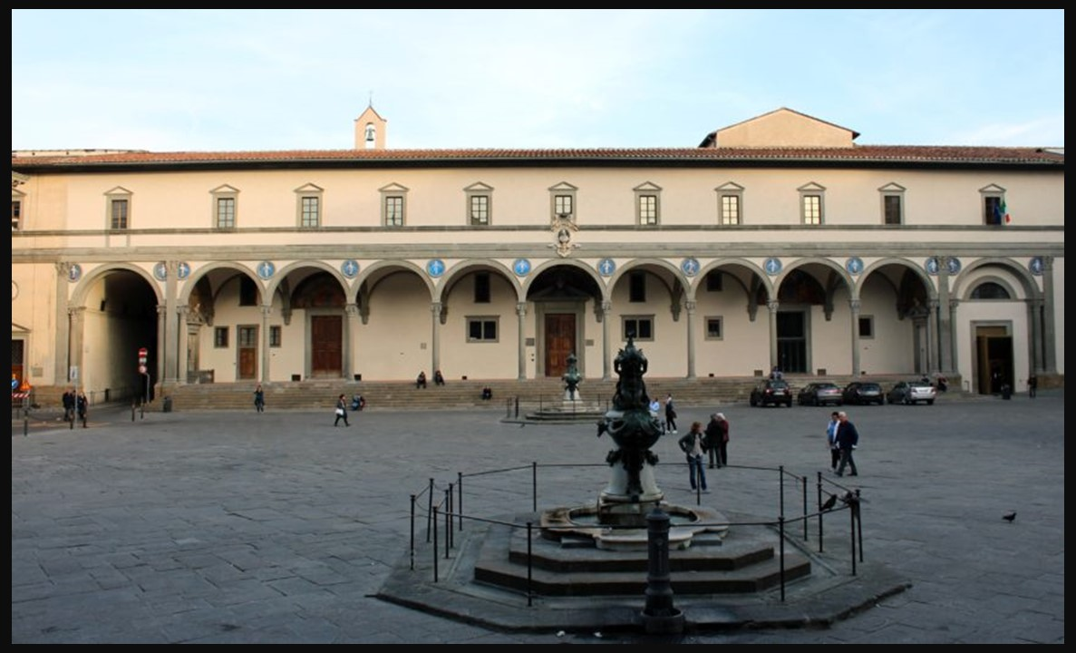
Designed by Filippo Brunelleschi, 1377-1446
Spedale degli Innocenti, Construction: 1417-1436, Piazza della Santissima Annunziata, Florence, Italy https://it.wikipedia.org/wiki/Spedale_degli_Innocenti
Andrea della Robbia, 1435-1525
Infant in Swaddling Clothes, 1487, Glazed Terracotta, Diameter about 100 cm, Ospedale degli Innocenti, Piazza della Santissima Annunziata, Florence, Italy https://smarthistory.org/andrea-della-robbia-bambini-ospedale-degli-innocenti/

Slide 12
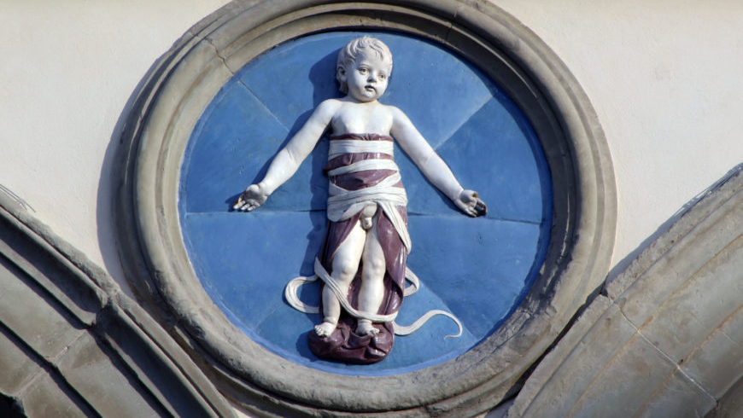

Slide 13
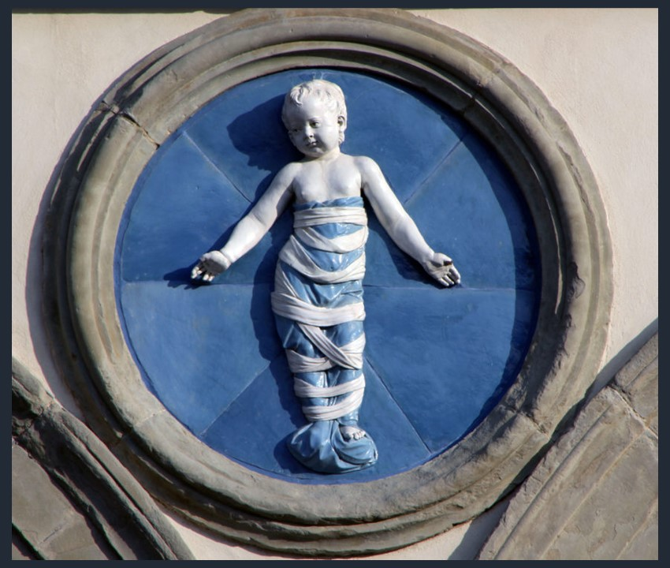
https://smarthistory.org/andrea-della-robbia-bambini-ospedale-degli-innocenti/

Slide 14
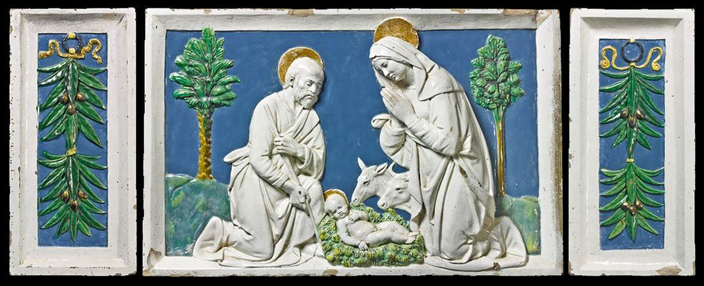
Andrea Della Robbia, 1435-1525
Nativity with Pilasters, 1490s, Partially gilt Glazed Terracotta, 41 x 63 cm (central scene), 41 x 19 cm (each pilaster), Private collection https://www.wga.hu/frames-e.html?/html/r/robbia/andrea/misc/17andrea.html

Slide 15
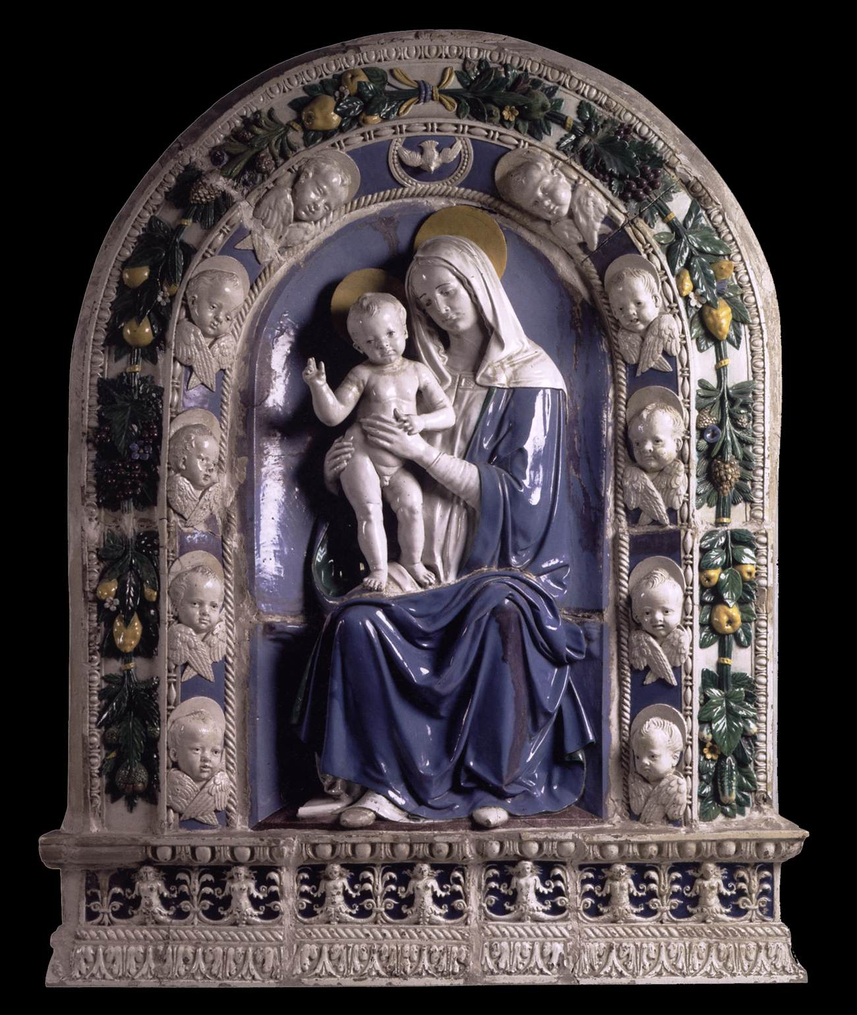
Andrea Della Robbia, 1435-1525
Madonna and Child, 1505-10, Glazed Terracotta, Height: 128 cm,
The Hermitage, St. Petersburg, Russia https://www.wga.hu/frames-e.html?/html/r/robbia/andrea/misc/17andrea.html

