Slide 1

Walter E. Spradbery
1889–1969
Posters
London Transport Museum in Covent Garden, UK
https://www.ltmuseum.co.uk/collections/stories/design/walter-ernest-spradbery-artist-war-and-peace
1889–1969

Slide 2
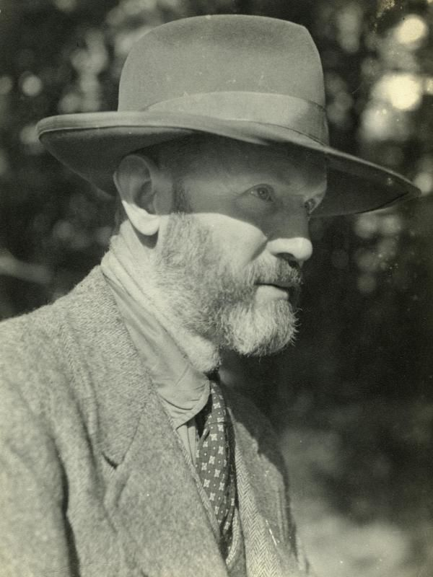
Informal portrait of Walter Spradbery, outdoors, with trademark Big Hat and tweed jacket, 1935 – 1945, London Transport Museum in Covent Garden, UK

Slide 3
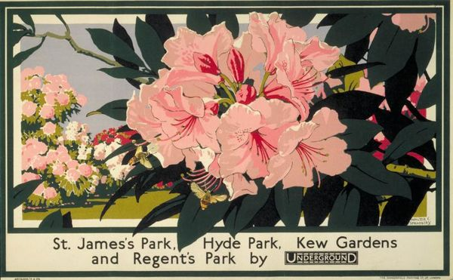
St James's Park, Kew Gardens, 1929, Poster, 286x464 mm, London Transport Museum in Covent Garden, UK

Slide 4
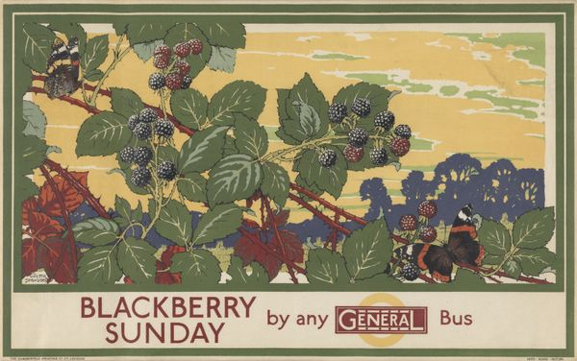
Blackberry Sunday by Any General Bus, 1929, Poster, 290x463, London Transport Museum in Covent Garden, UK

Slide 5
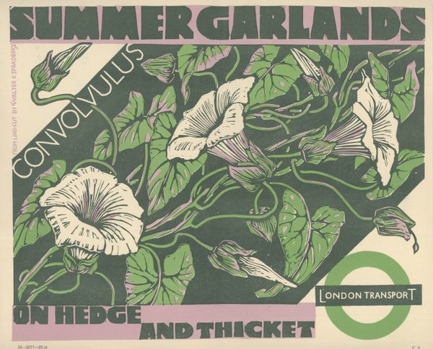
Summer garlands, 1936, Poster, 255x305, London Transport Museum in Covent Garden, UK

Slide 6
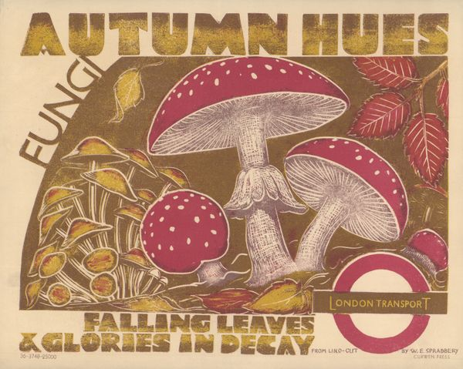
Autumn Hues, 1936, Poster, 255x318, London Transport Museum in Covent Garden, UK

Slide 7
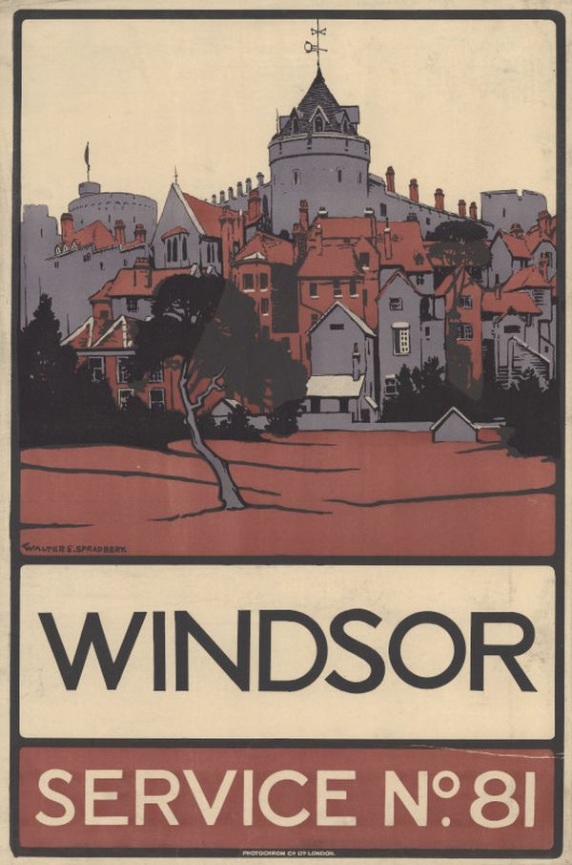
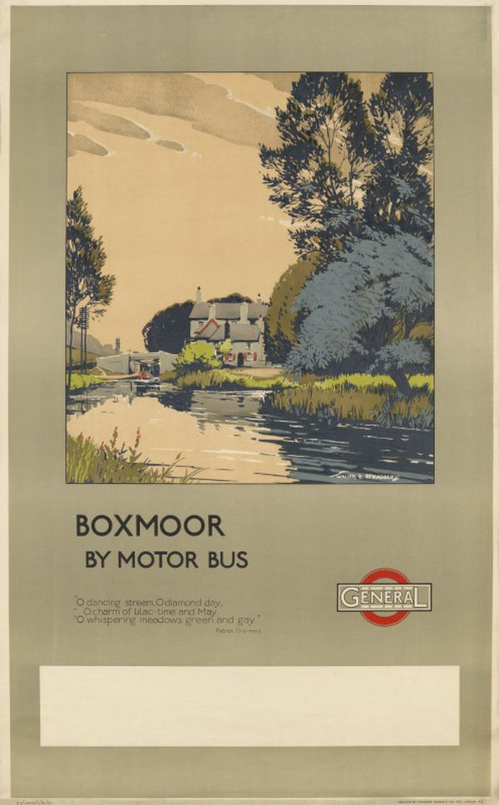
Windsor; service no.81, 1913, Poster, 762x508, London Transport Museum in Covent Garden, UK
Boxmoor by motor bus, 1921, Poster, 1016x631, London Transport Museum in Covent Garden, UK

Slide 8
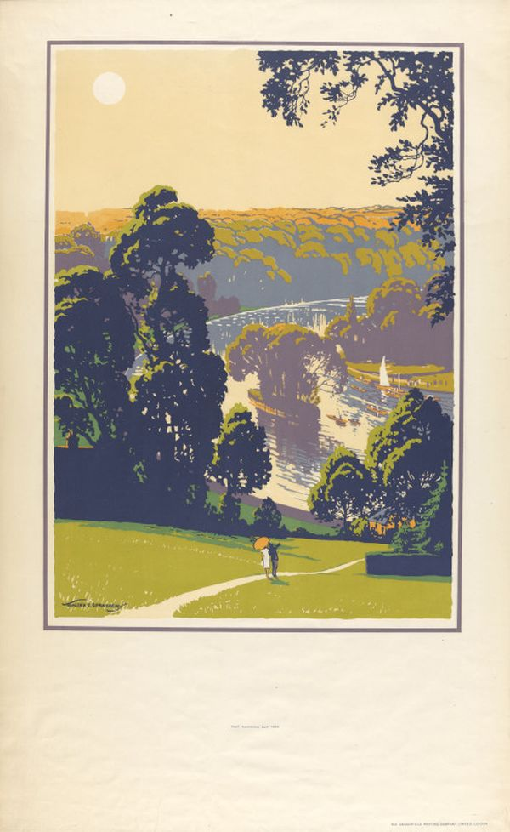
Richmond, 1927, Poster, 1016x635, London Transport Museum in Covent Garden, UK

Slide 9
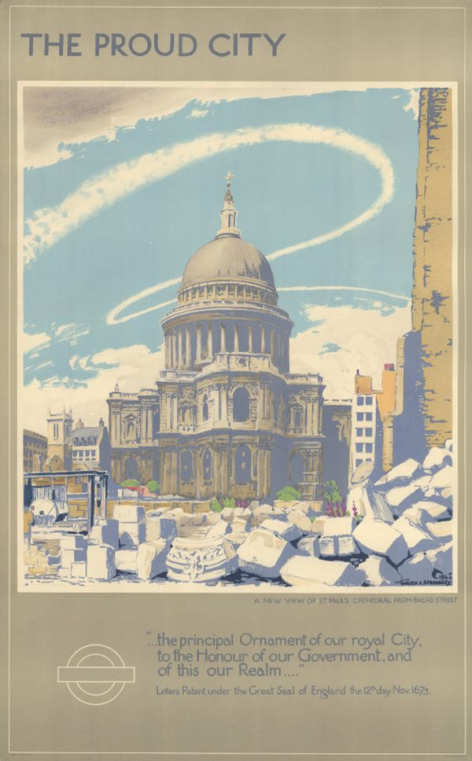
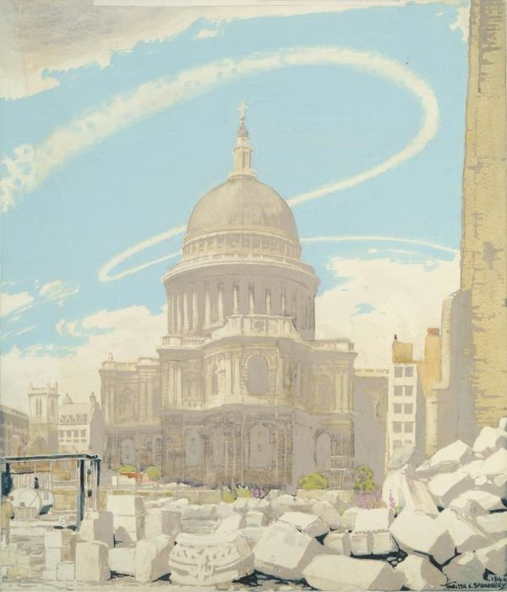
The proud city - St Paul's Cathedral, 1944,Poster, 1016x635, London Transport Museum in Covent Garden, UK

Slide 10
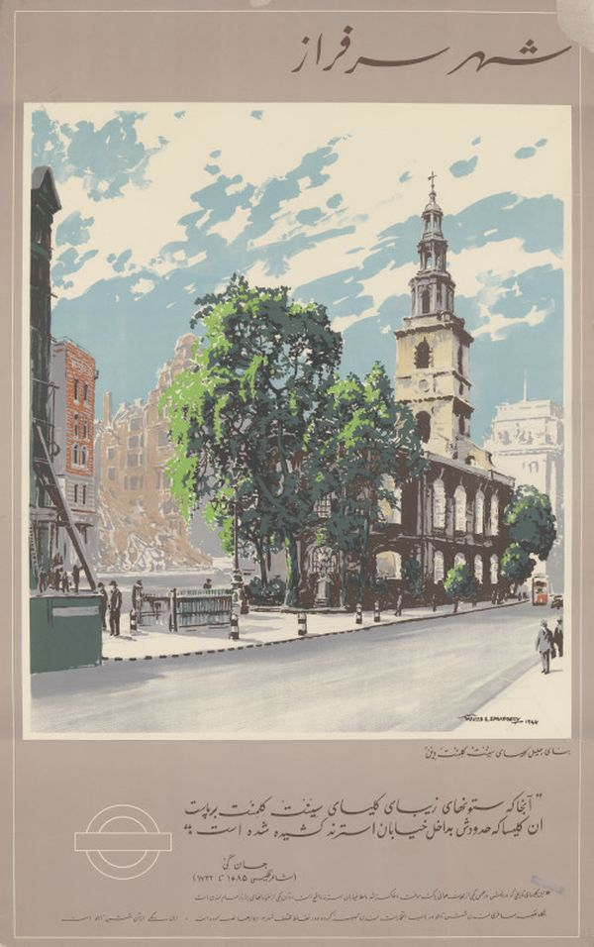
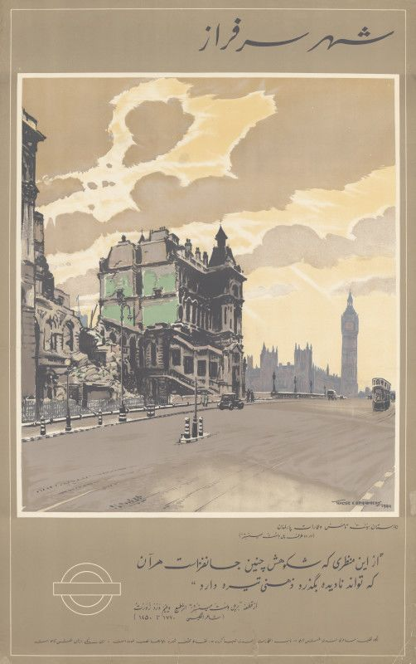
The proud city; the noble fabric of the church of St Clement Danes, text written in Farsi, 1944, Poster, 1016x635, London Transport Museum in Covent Garden, UK
The proud city; St Thomas's Hospital and The Houses of Parliament, text written in Farsi, 1944, Poster, 1016x635, London Transport Museum in Covent Garden, UK

Slide 11
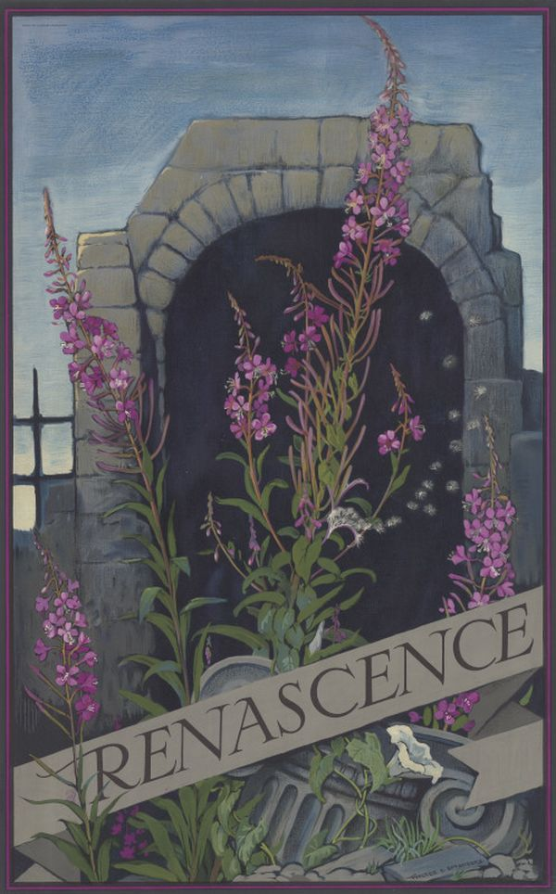
Renascence, 1945, Poster, 1016x635, London Transport Museum in Covent Garden, UK

Slide 12
The End

