Slide 1
The Ancient Settlement of Poliochne
on the island of Lemnos

Slide 2
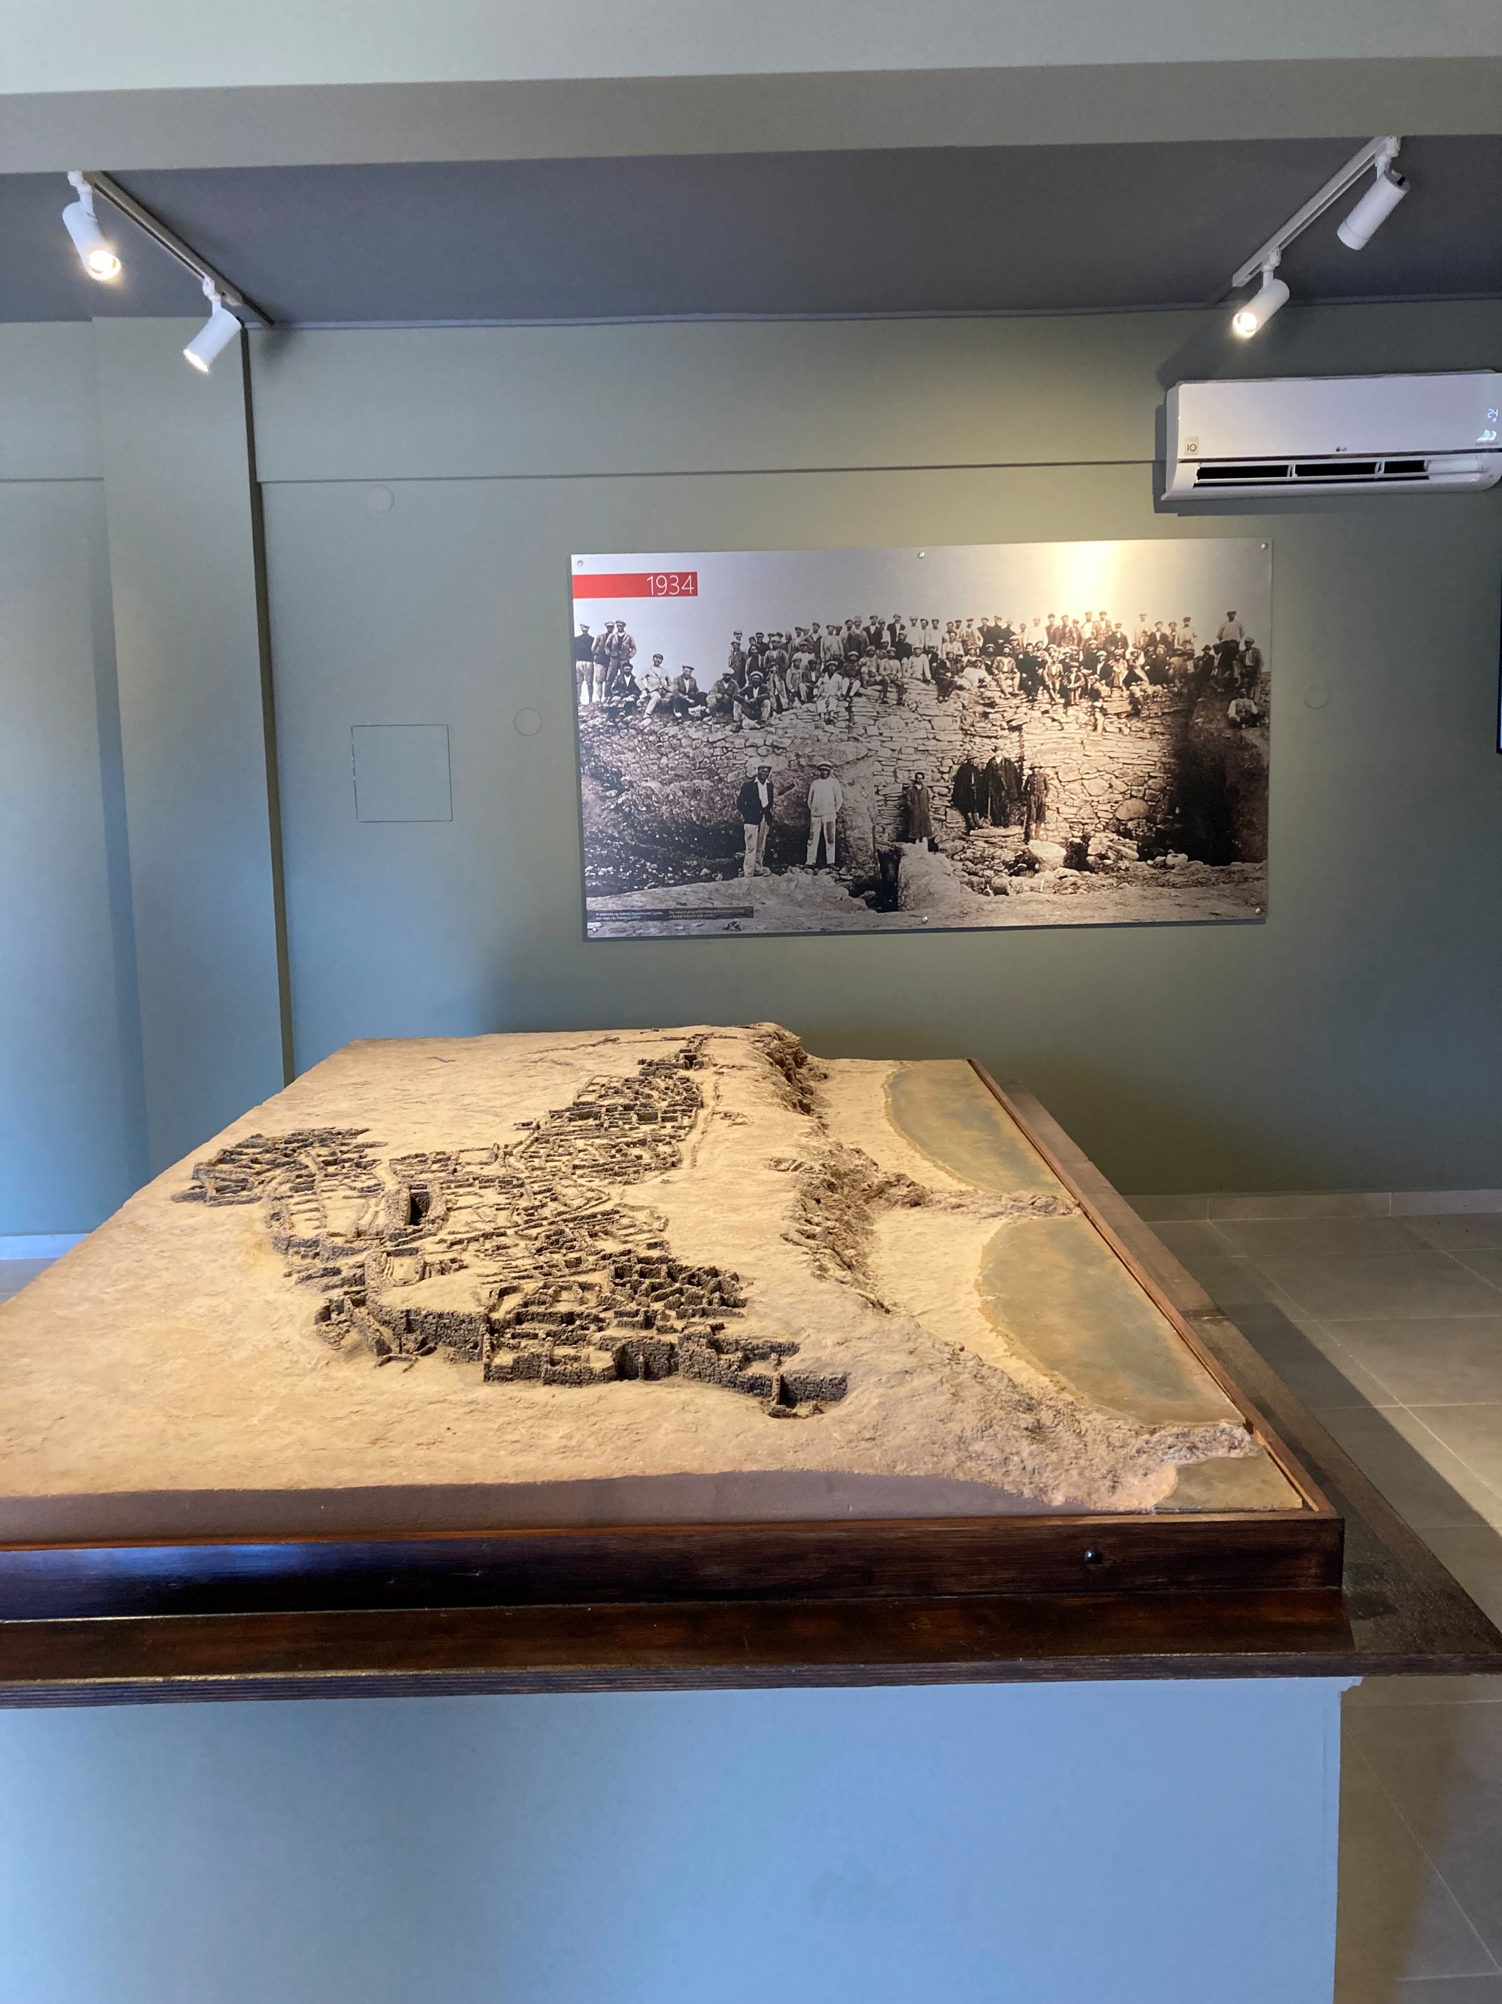
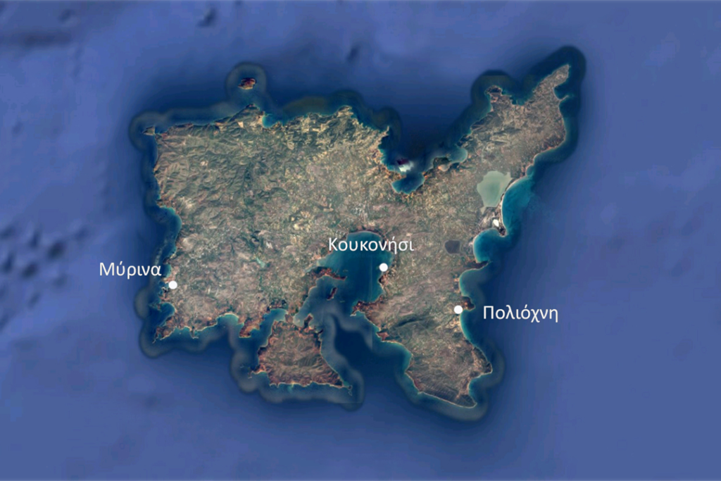
The prehistoric settlement at Poliochne lies in southwest Lemnos, about two kilometres from the present-day village of Kaminia in the wider area of Vroskopos, with the bay of the same name.
Photo Credit: Amalia Spiliakou:, July 2025 https://www.poliochne.gr/topography/?lang=en

Slide 3
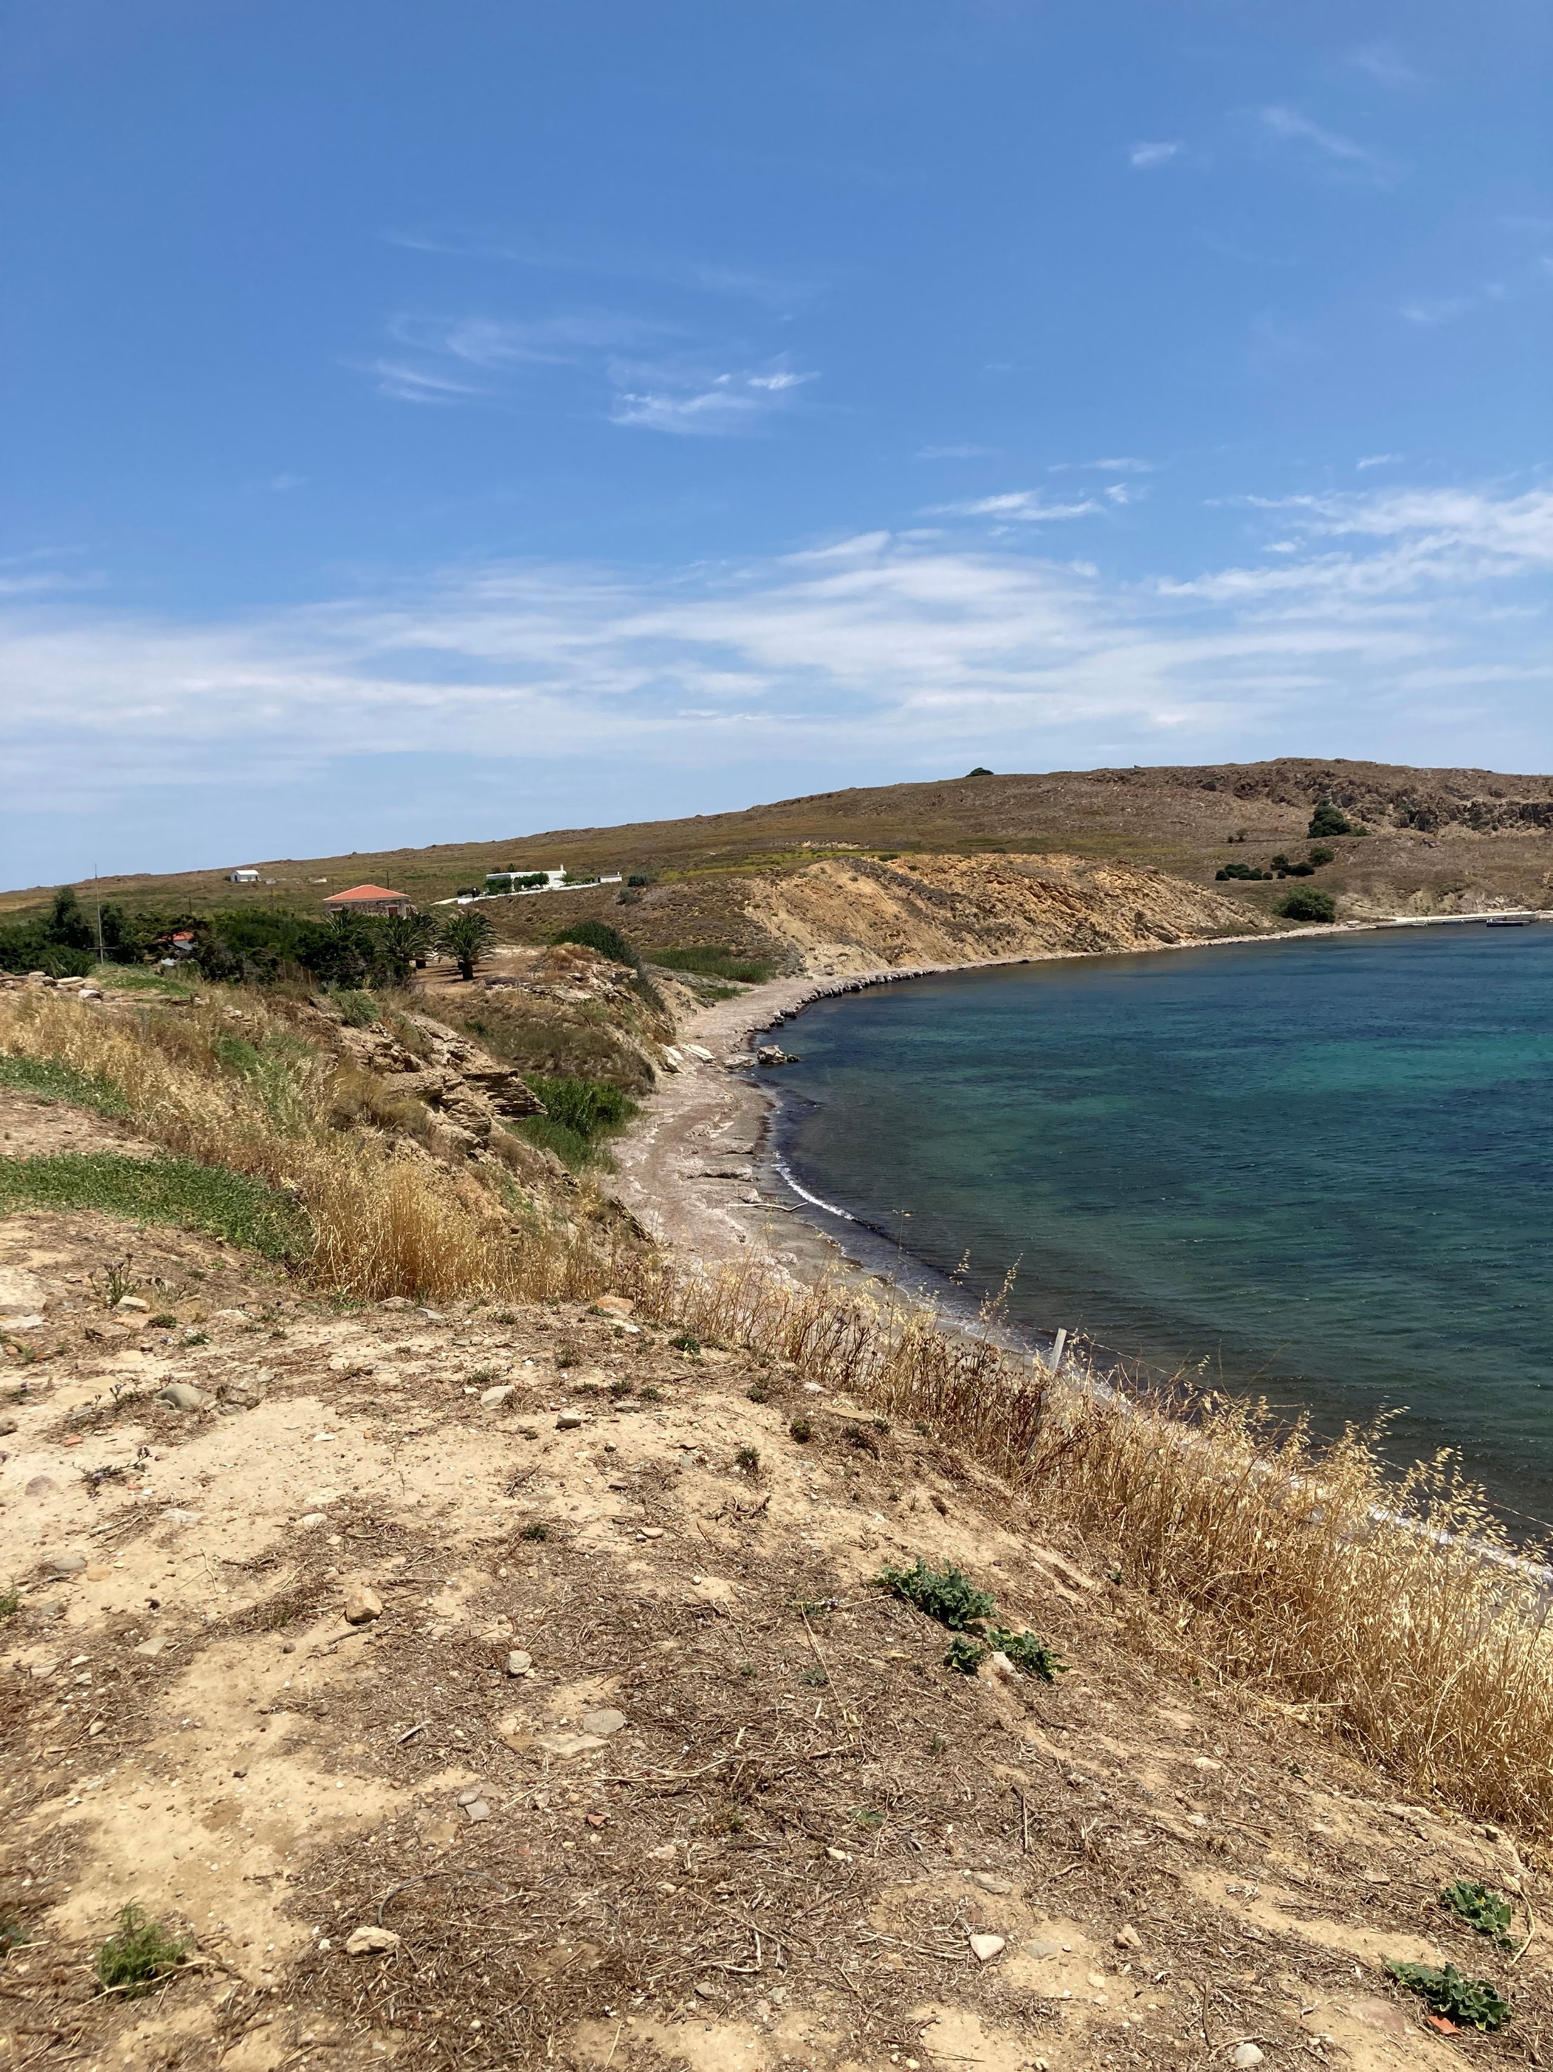
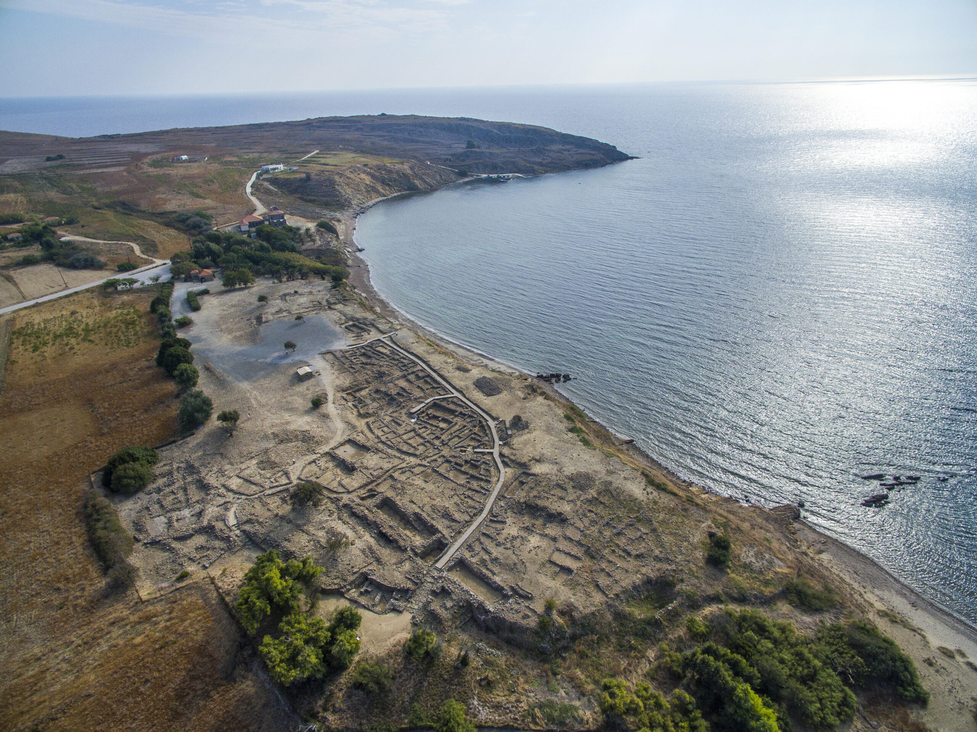
The hilltop location of Poliochne
Photo Credit: Amalia Spiliakou:, July 2025
Aerial view of the settlement of Poliochne from the southwest https://www.poliochne.gr/?lang=en

Slide 4
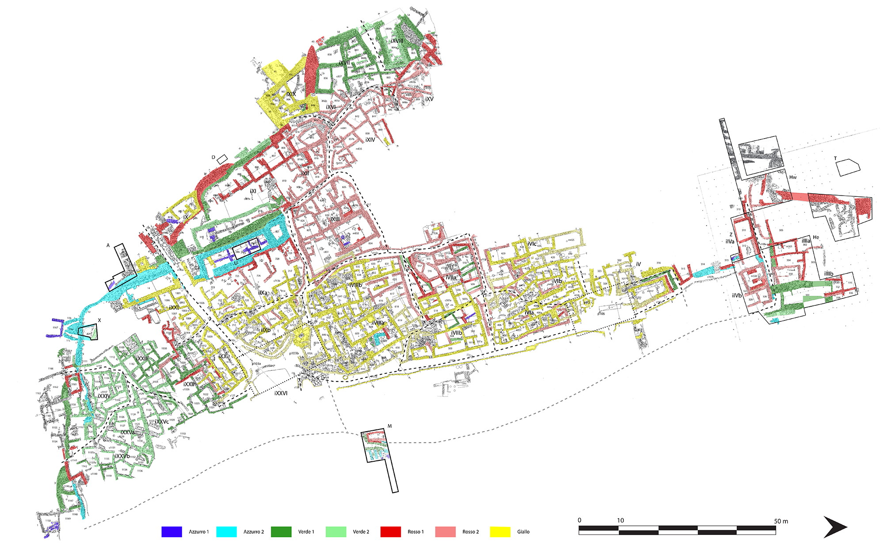
Plan of Poliochne with the building phases
Black Period 3700–3200 BC
Blue Period 3200–2700 BC
Green Period 2700–2400 BC
Red Period c. 2400–2200 BC
Yellow Period 2200–2100 BC
Brown Period c. 2000–1700/1600 BC
Purple Periods 1700/1600–1200 BC

Slide 5
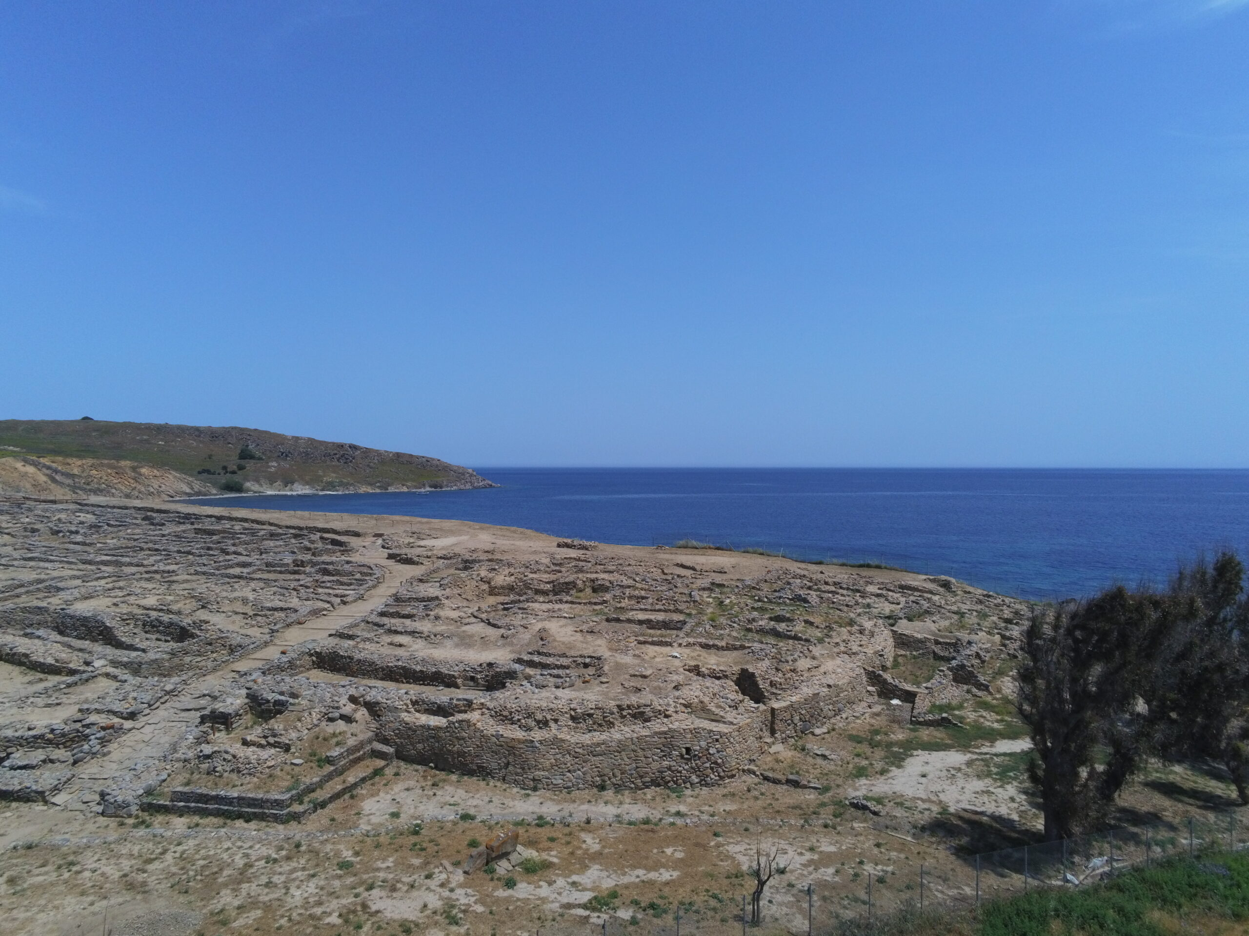
Aerial view of the settlement of Poliochne. In the foreground, the enclosure that enclosed the southwest part of the settlement. https://www.poliochne.gr/topography/?lang=en

Slide 6
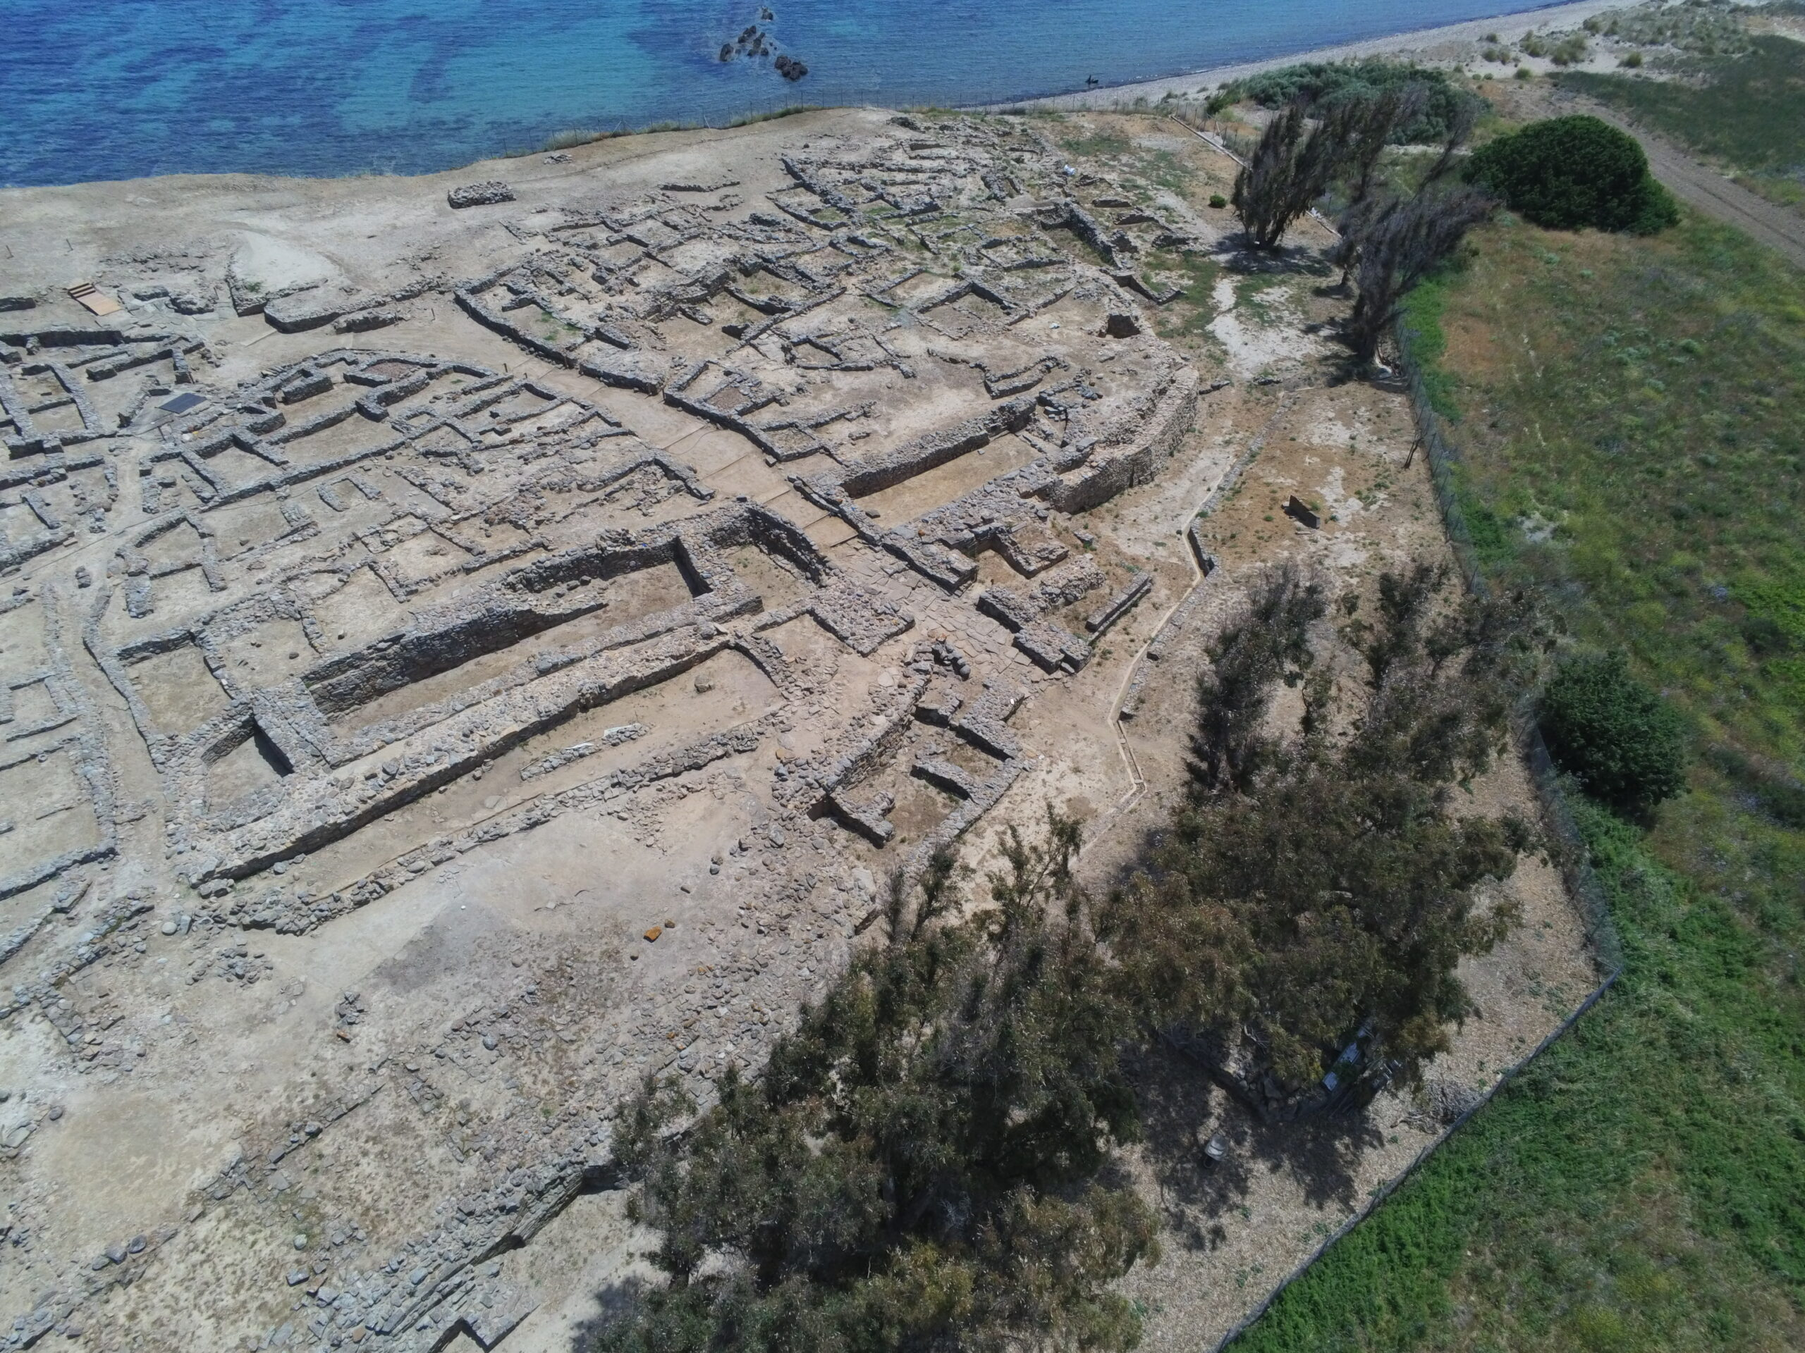
Aerial view of the southern sector of the settlement with the houses of the green Poliochne. https://www.poliochne.gr/topography/?lang=en

Slide 7
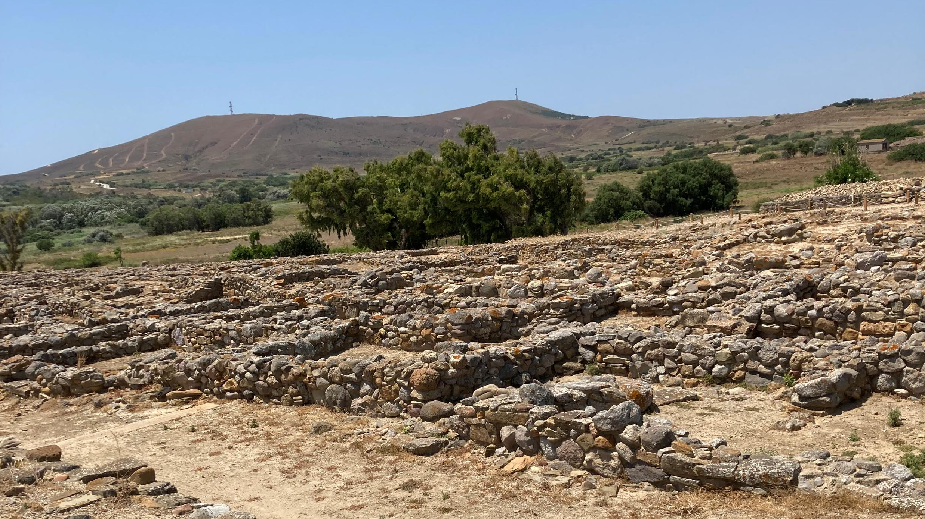
Photo Credit: Amalia Spiliakou, July 2025

Slide 8
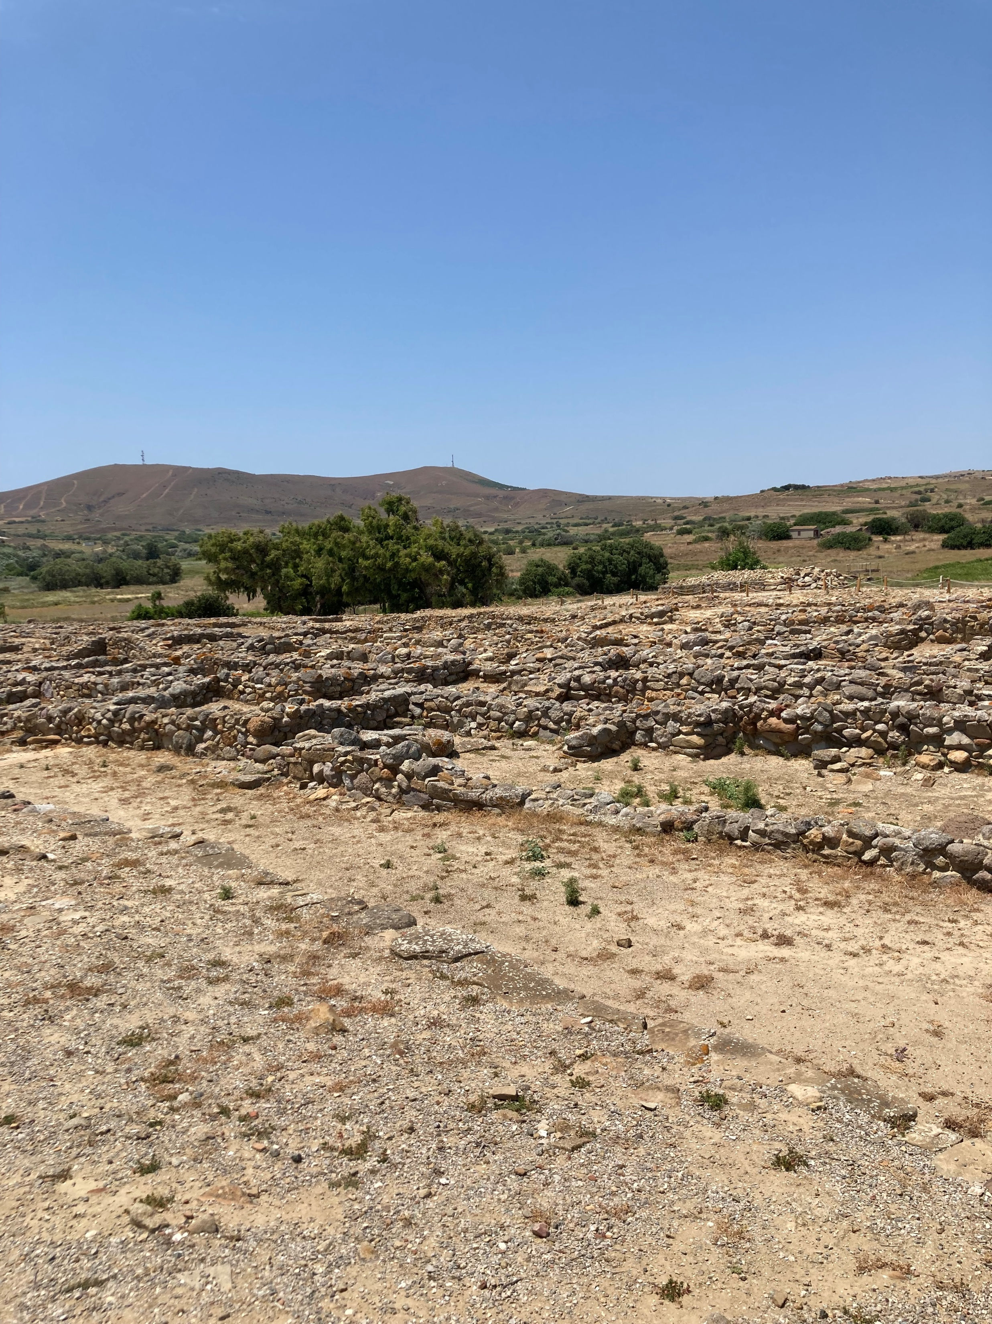
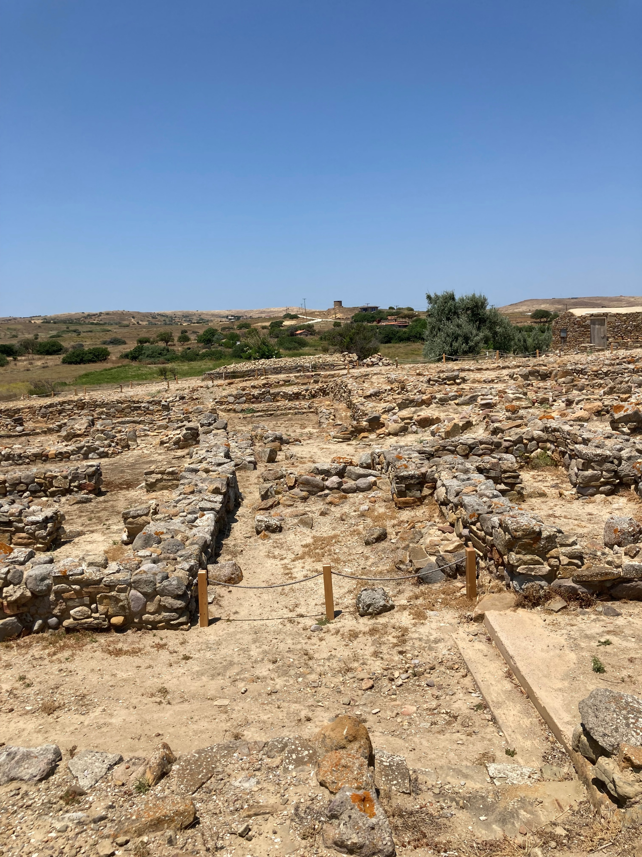
Photo Credit: Amalia Spiliakou, July 2025

Slide 9
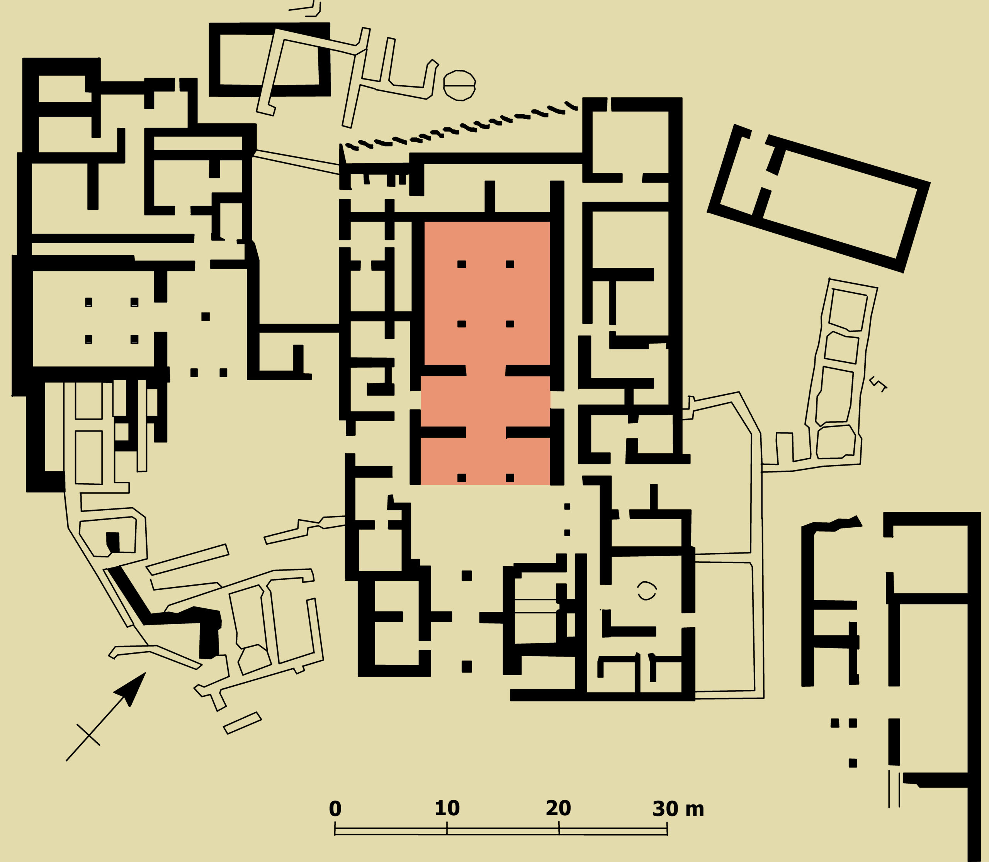
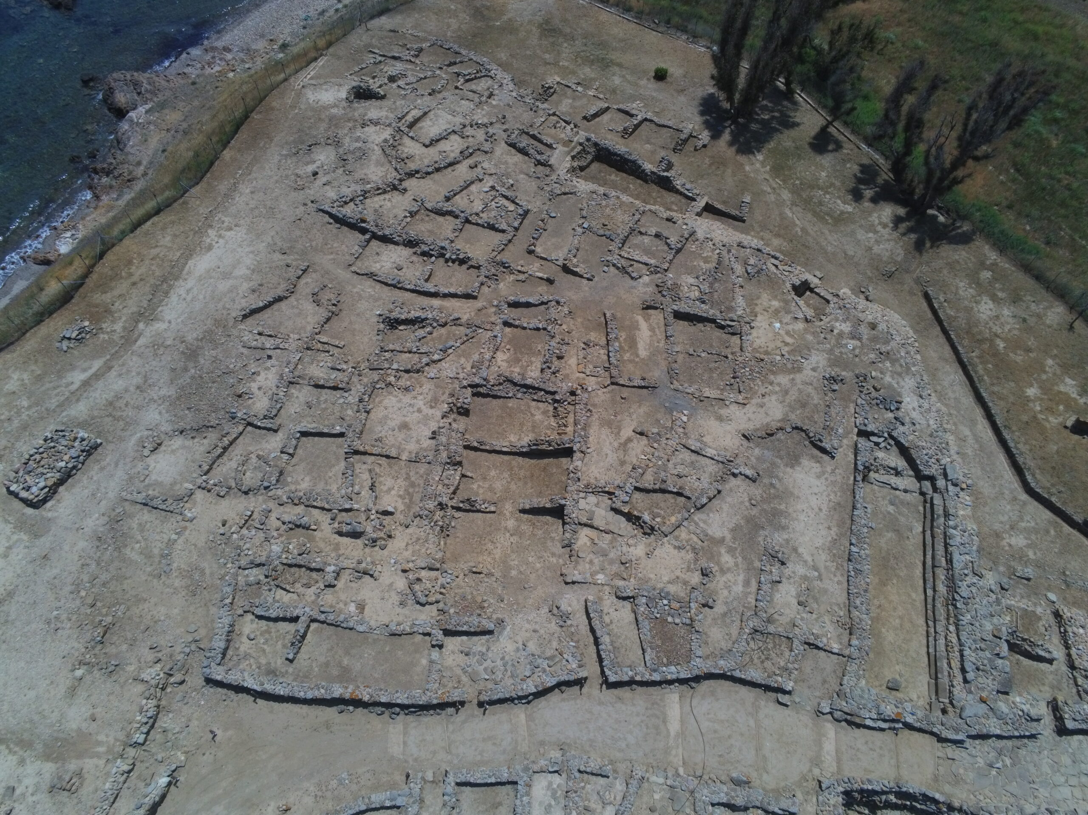
Aerial view of the southern part of the settlement of Poliochne. Buildings in the type of “Megaron” can be seen. https://www.poliochne.gr/topography/?lang=en https://www.poliochne.gr/houses/?lang=en

Slide 10
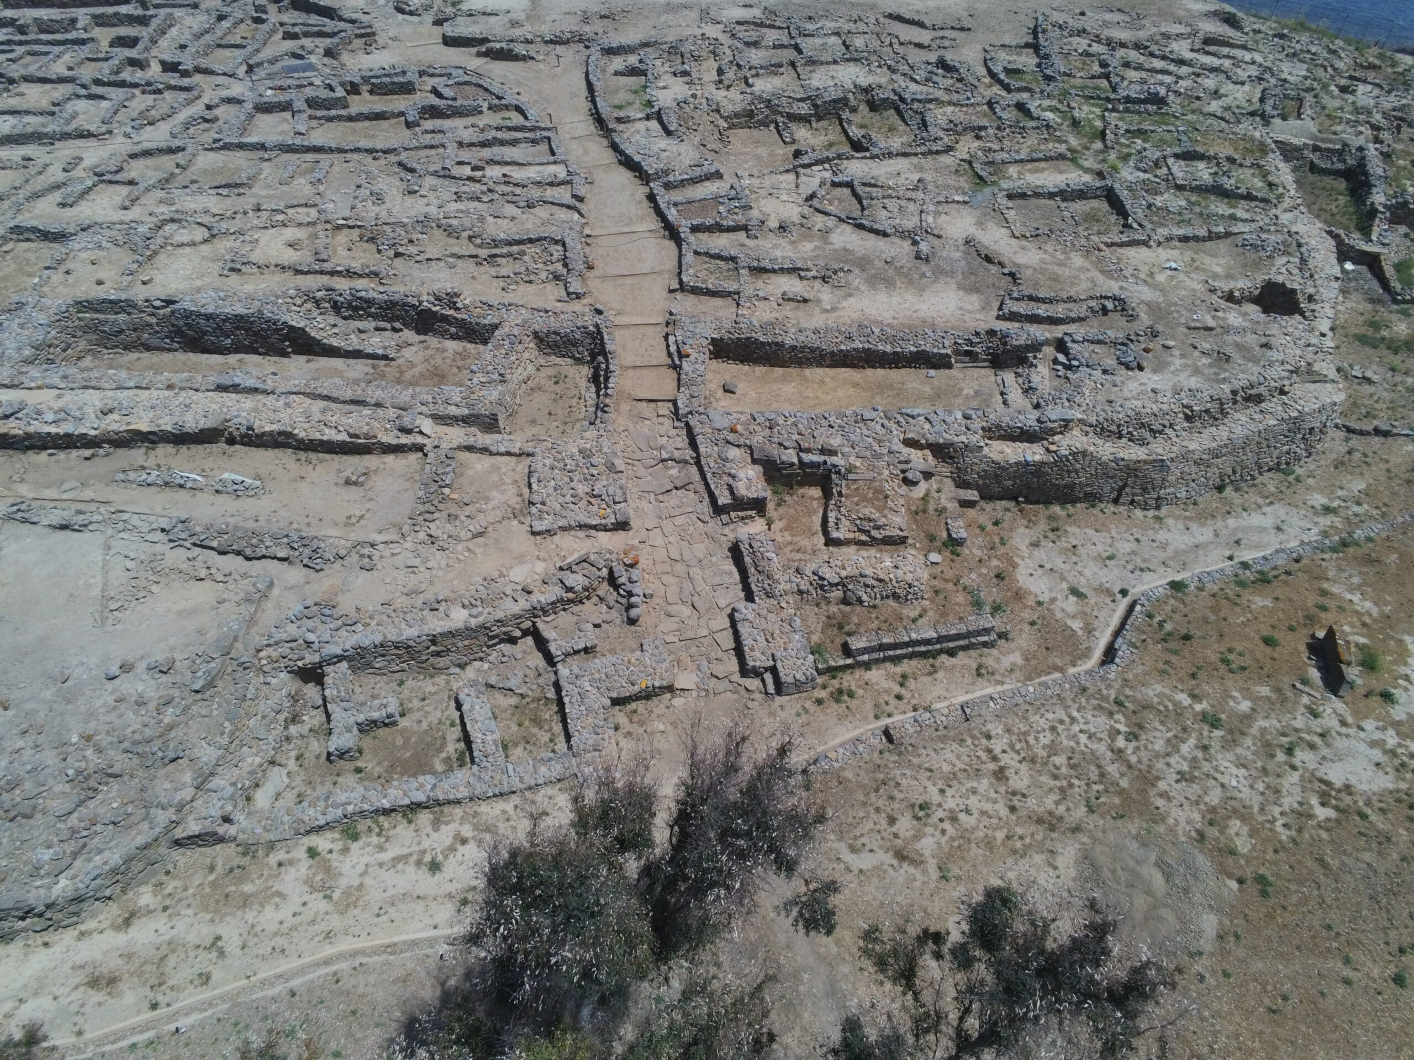
View of the western Gate https://www.poliochne.gr/central_gate/?lang=en

Slide 11
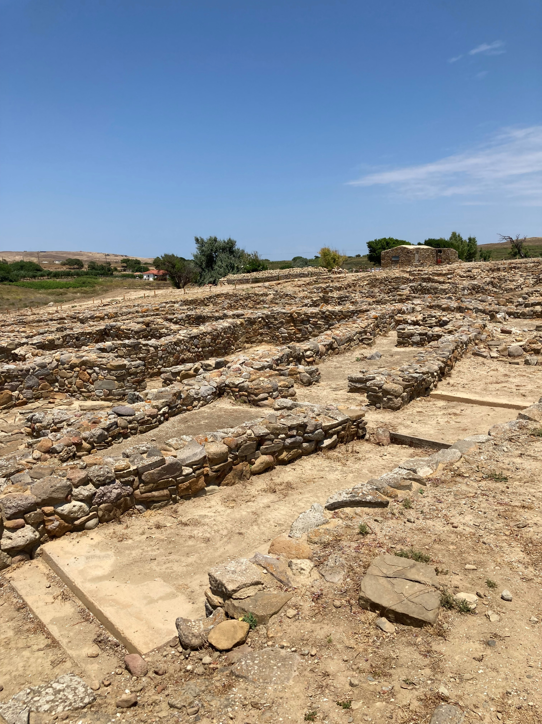
Opened in the west side of the settlement at Poliochne is the main gate, terminus also of the central thoroughfare 102. Both the street and the gateway appear to have been part of the first urban plan of the settlement, which is dated to the Blue period, and were kept unchanged throughout almost its entire existence, with some additions and local interventions.
Photo Credit: Amalia Spiliakou, July 2025 https://www.poliochne.gr/central_gate/?lang=en

Slide 12
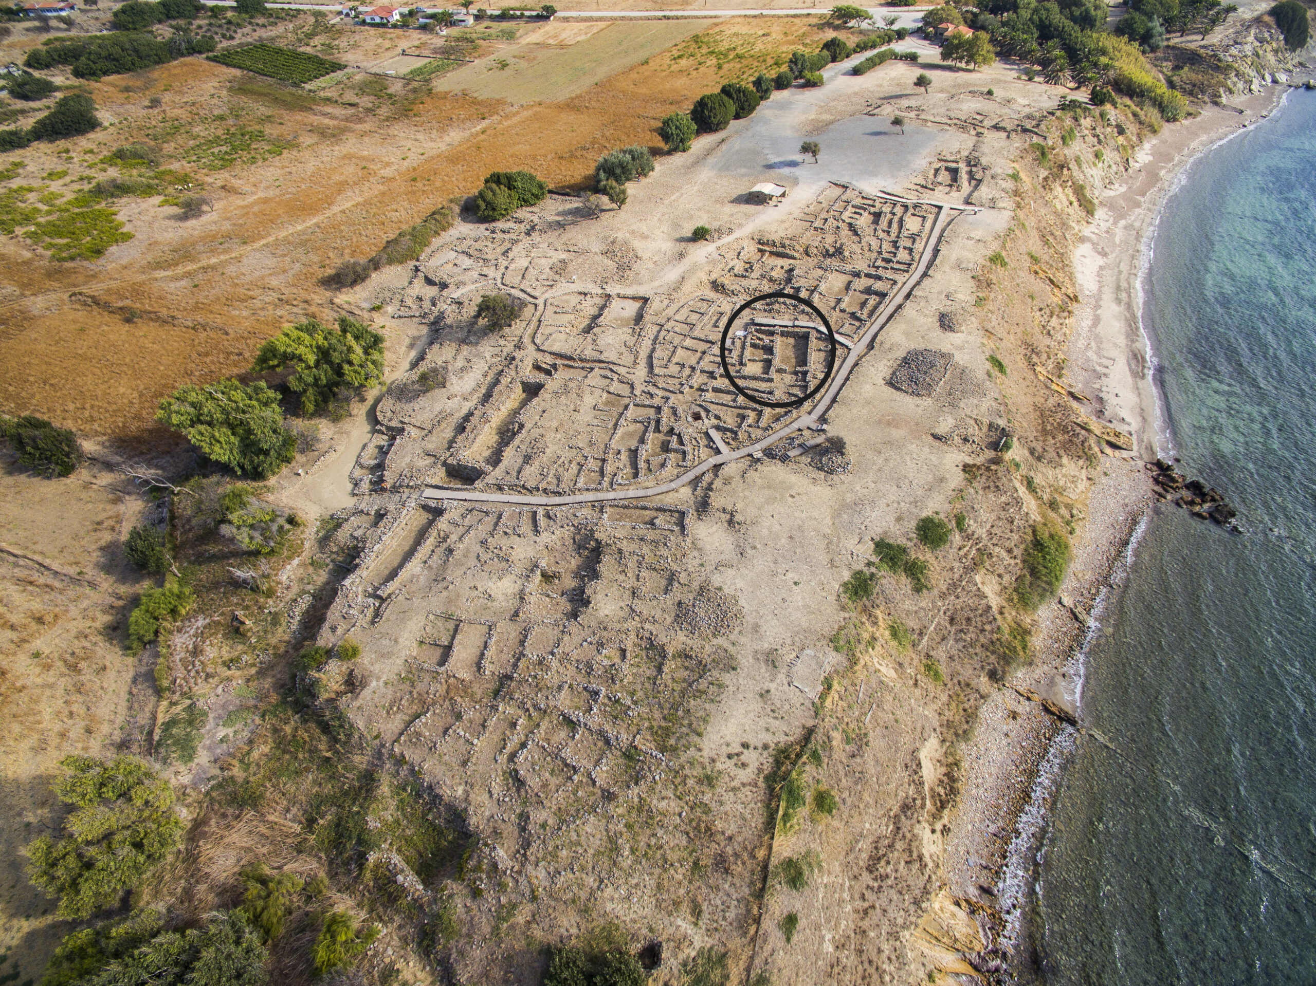
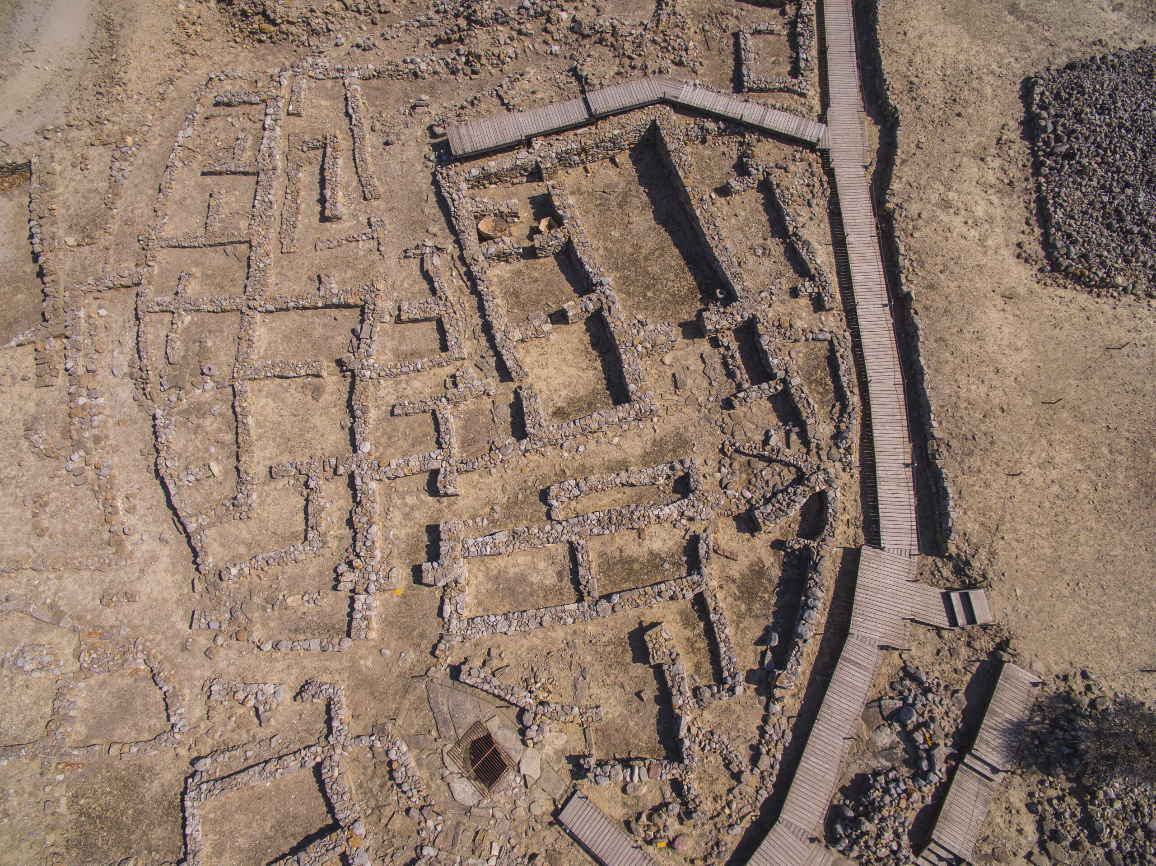
Aerial photograph of Poliochne with the location of building A marked. https://www.poliochne.gr/megaro_605/?lang=en

Slide 13
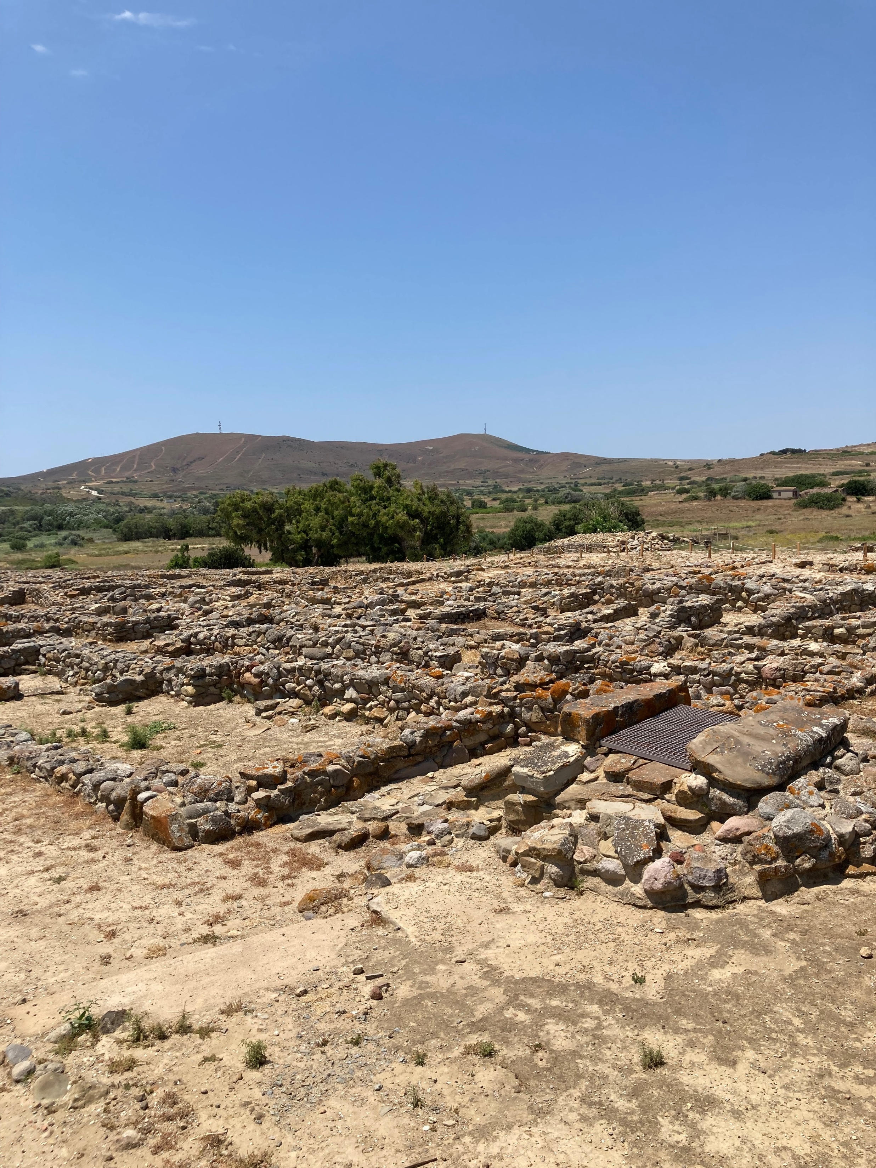
Photographs of Poliochne with the location of the Settlement’s Well marked.
Photo Credit: Amalia Spiliakou,July 2025 https://www.poliochne.gr/megaro_605/?lang=en

Slide 14
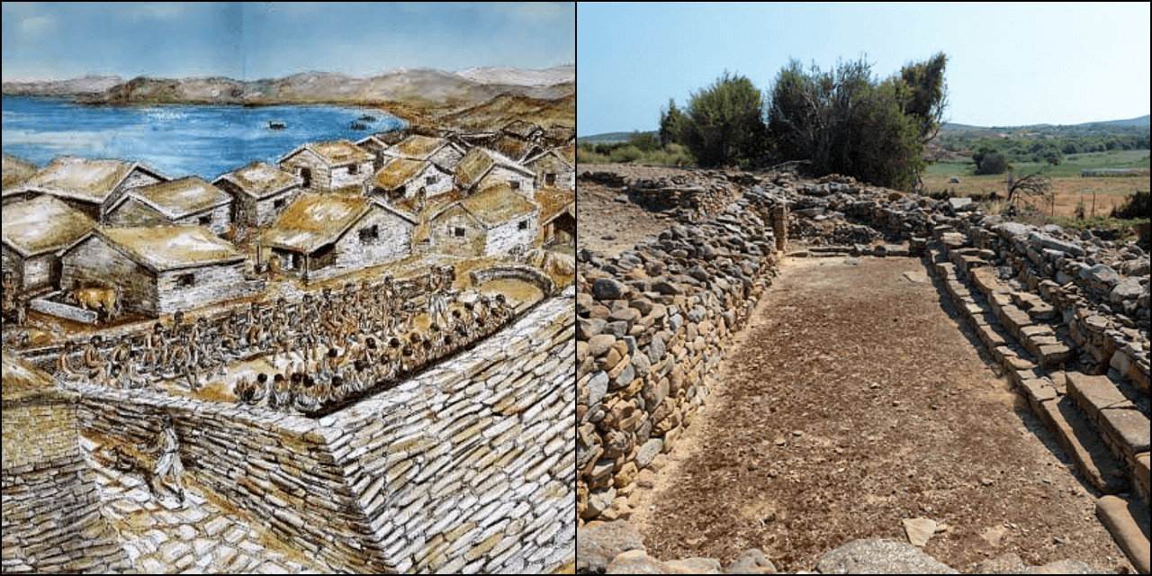
One of the most intriguing aspects of Poliochni is the evidence of democratic structures within its society. Central to this is the "Bouleuterion," a communal meeting space that points to the practice of collective decision-making, It served as a gathering place for the city’s inhabitants to discuss and decide on matters of common interest, reflecting an early form of democratic governance. https://www.thearchaeologist.org/blog/poliochni-of-lemnos-the-oldest-city-in-europe-and-a-cradle-of-democracy

Slide 15
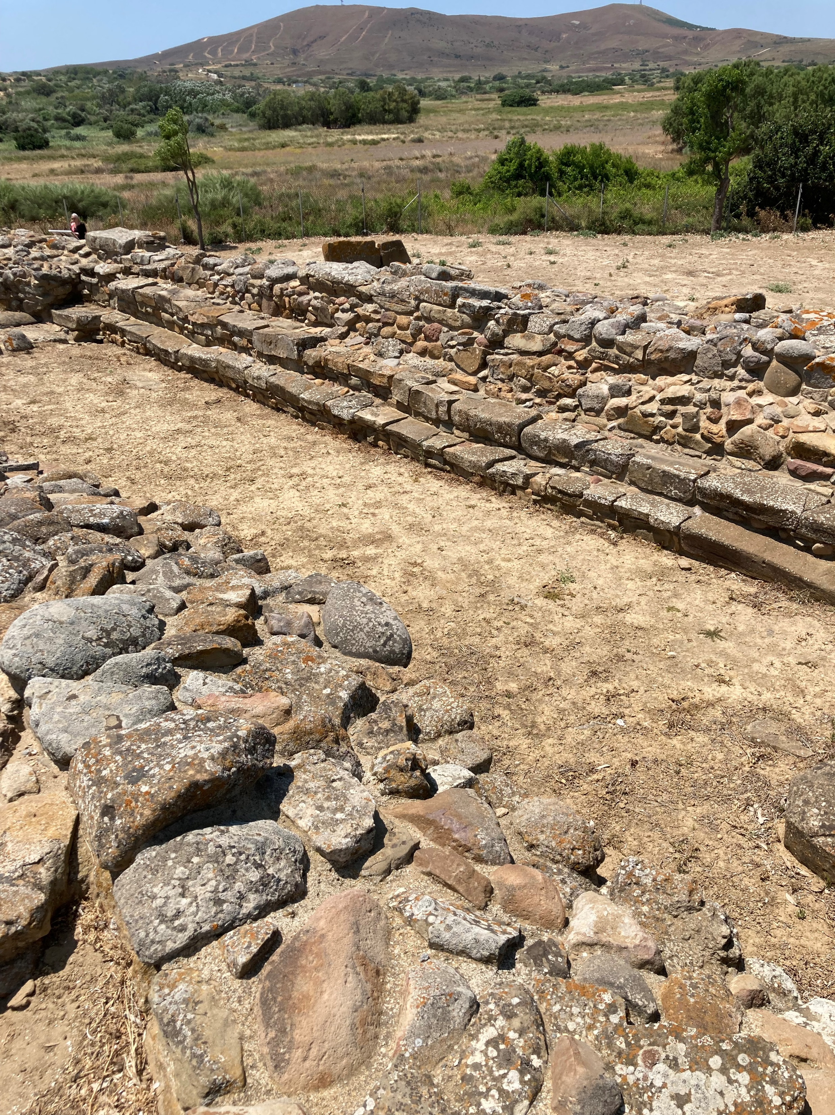
The "Bouleuterion,“
Photo Credit: Amalia Spiliakou, July 2025

Slide 16
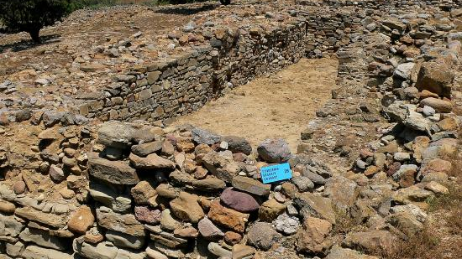
https://www.tripadvisor.it/LocationPhotoDirectLink-g189478-d4889101-i127949411-Archaeological_Site_Poliochni-Lemnos_Northeast_Aegean_Islands.html

Slide 17
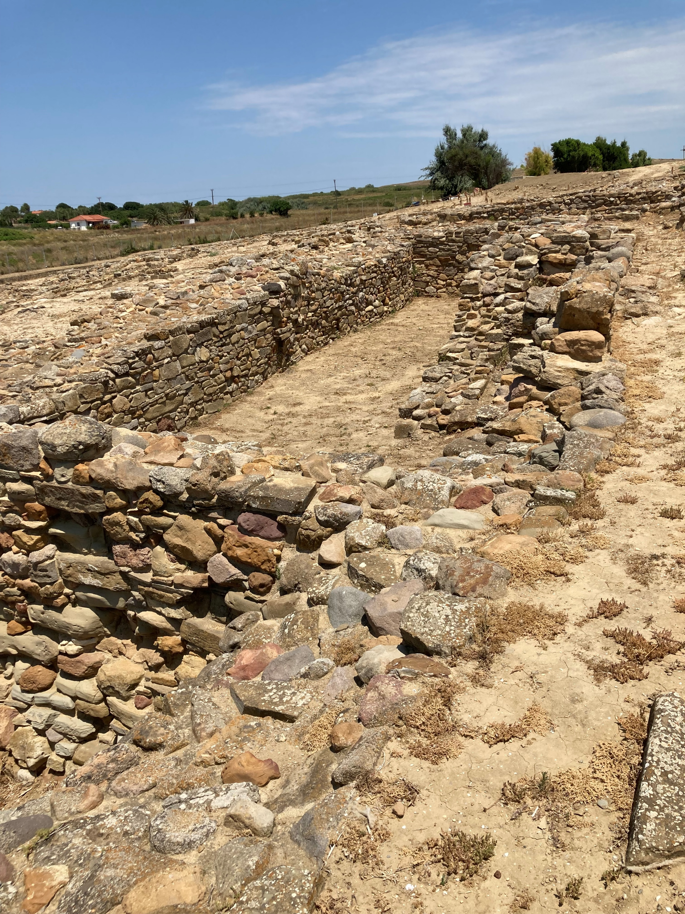
Photo of the ‘Granary’ of the Blue Period
Photo Credit: Amalia Spiliakou, July 2025

Slide 18
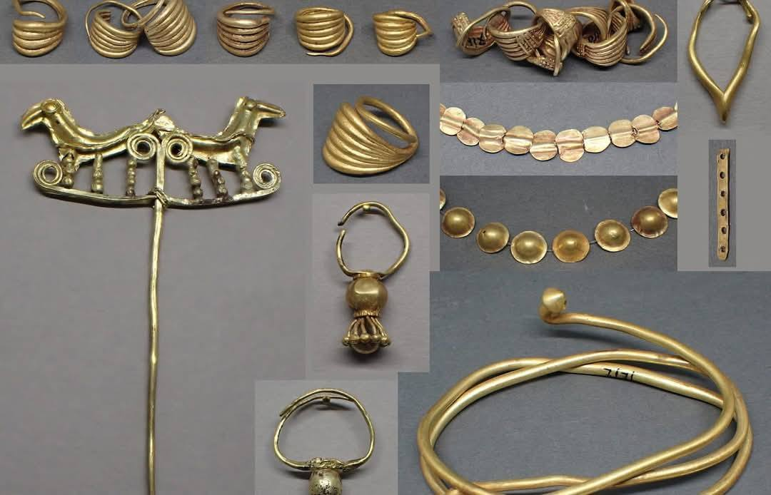
Gold treasure from Poliochne
National Archaeological Museum of Greece, Athens, Greece https://www.facebook.com/photo/?fbid=478677561949127&set=pcb.1658416574882060

Slide 19
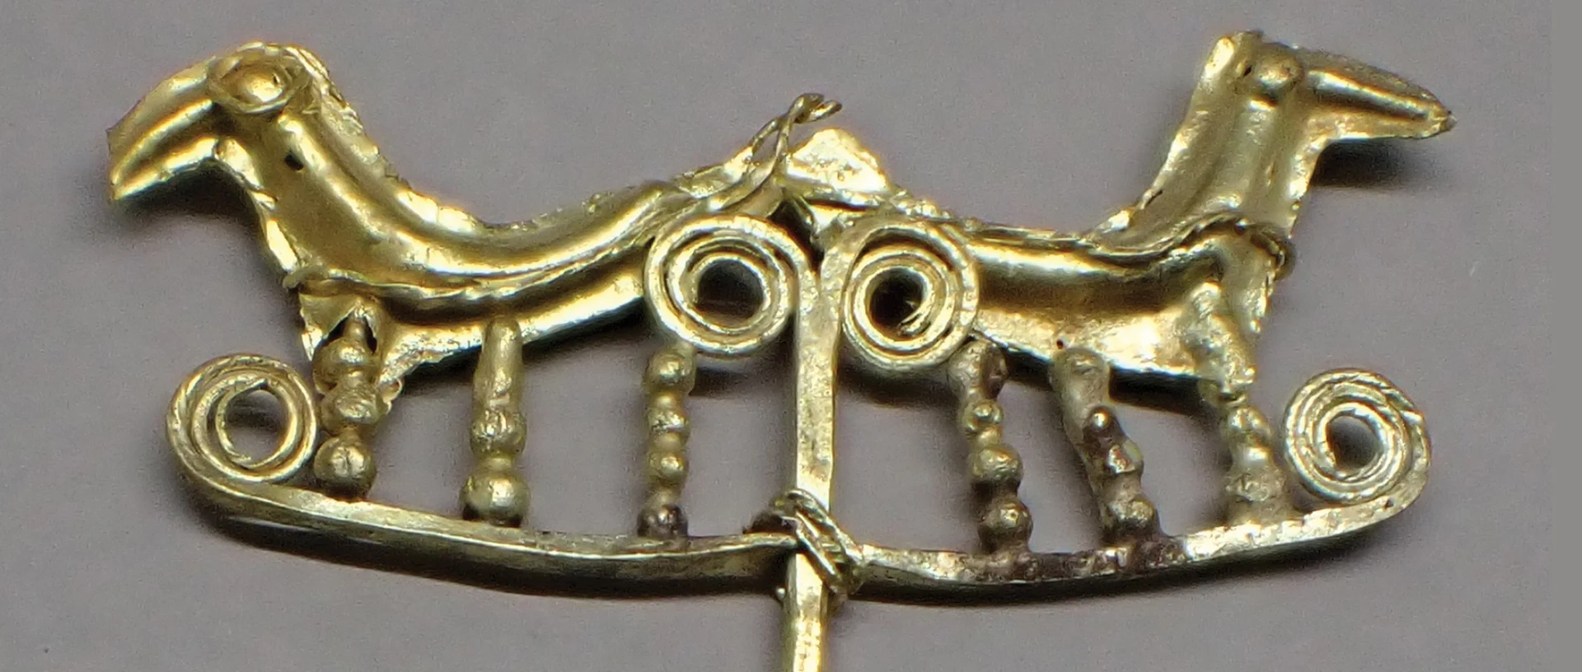
https://www.oeaw.ac.at/en/news/gold-aus-troia-poliochni-und-ur-hatte-denselben-ursprung-1-1

Slide 20
More photos taken during my July 2025 trip to Poliochne…

Slide 21
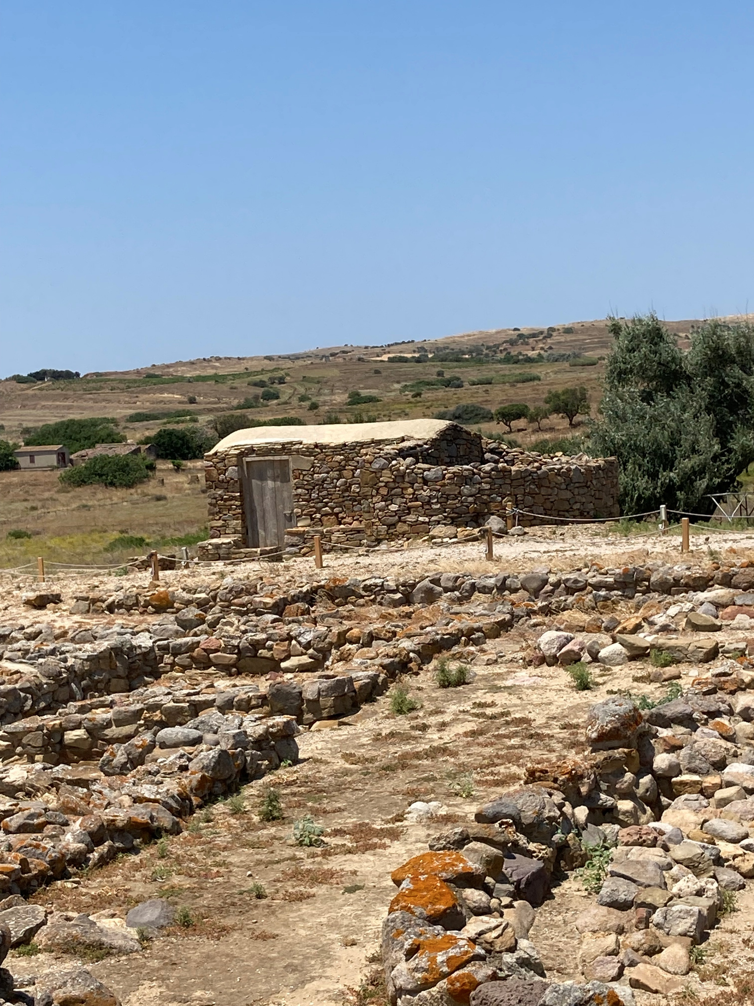
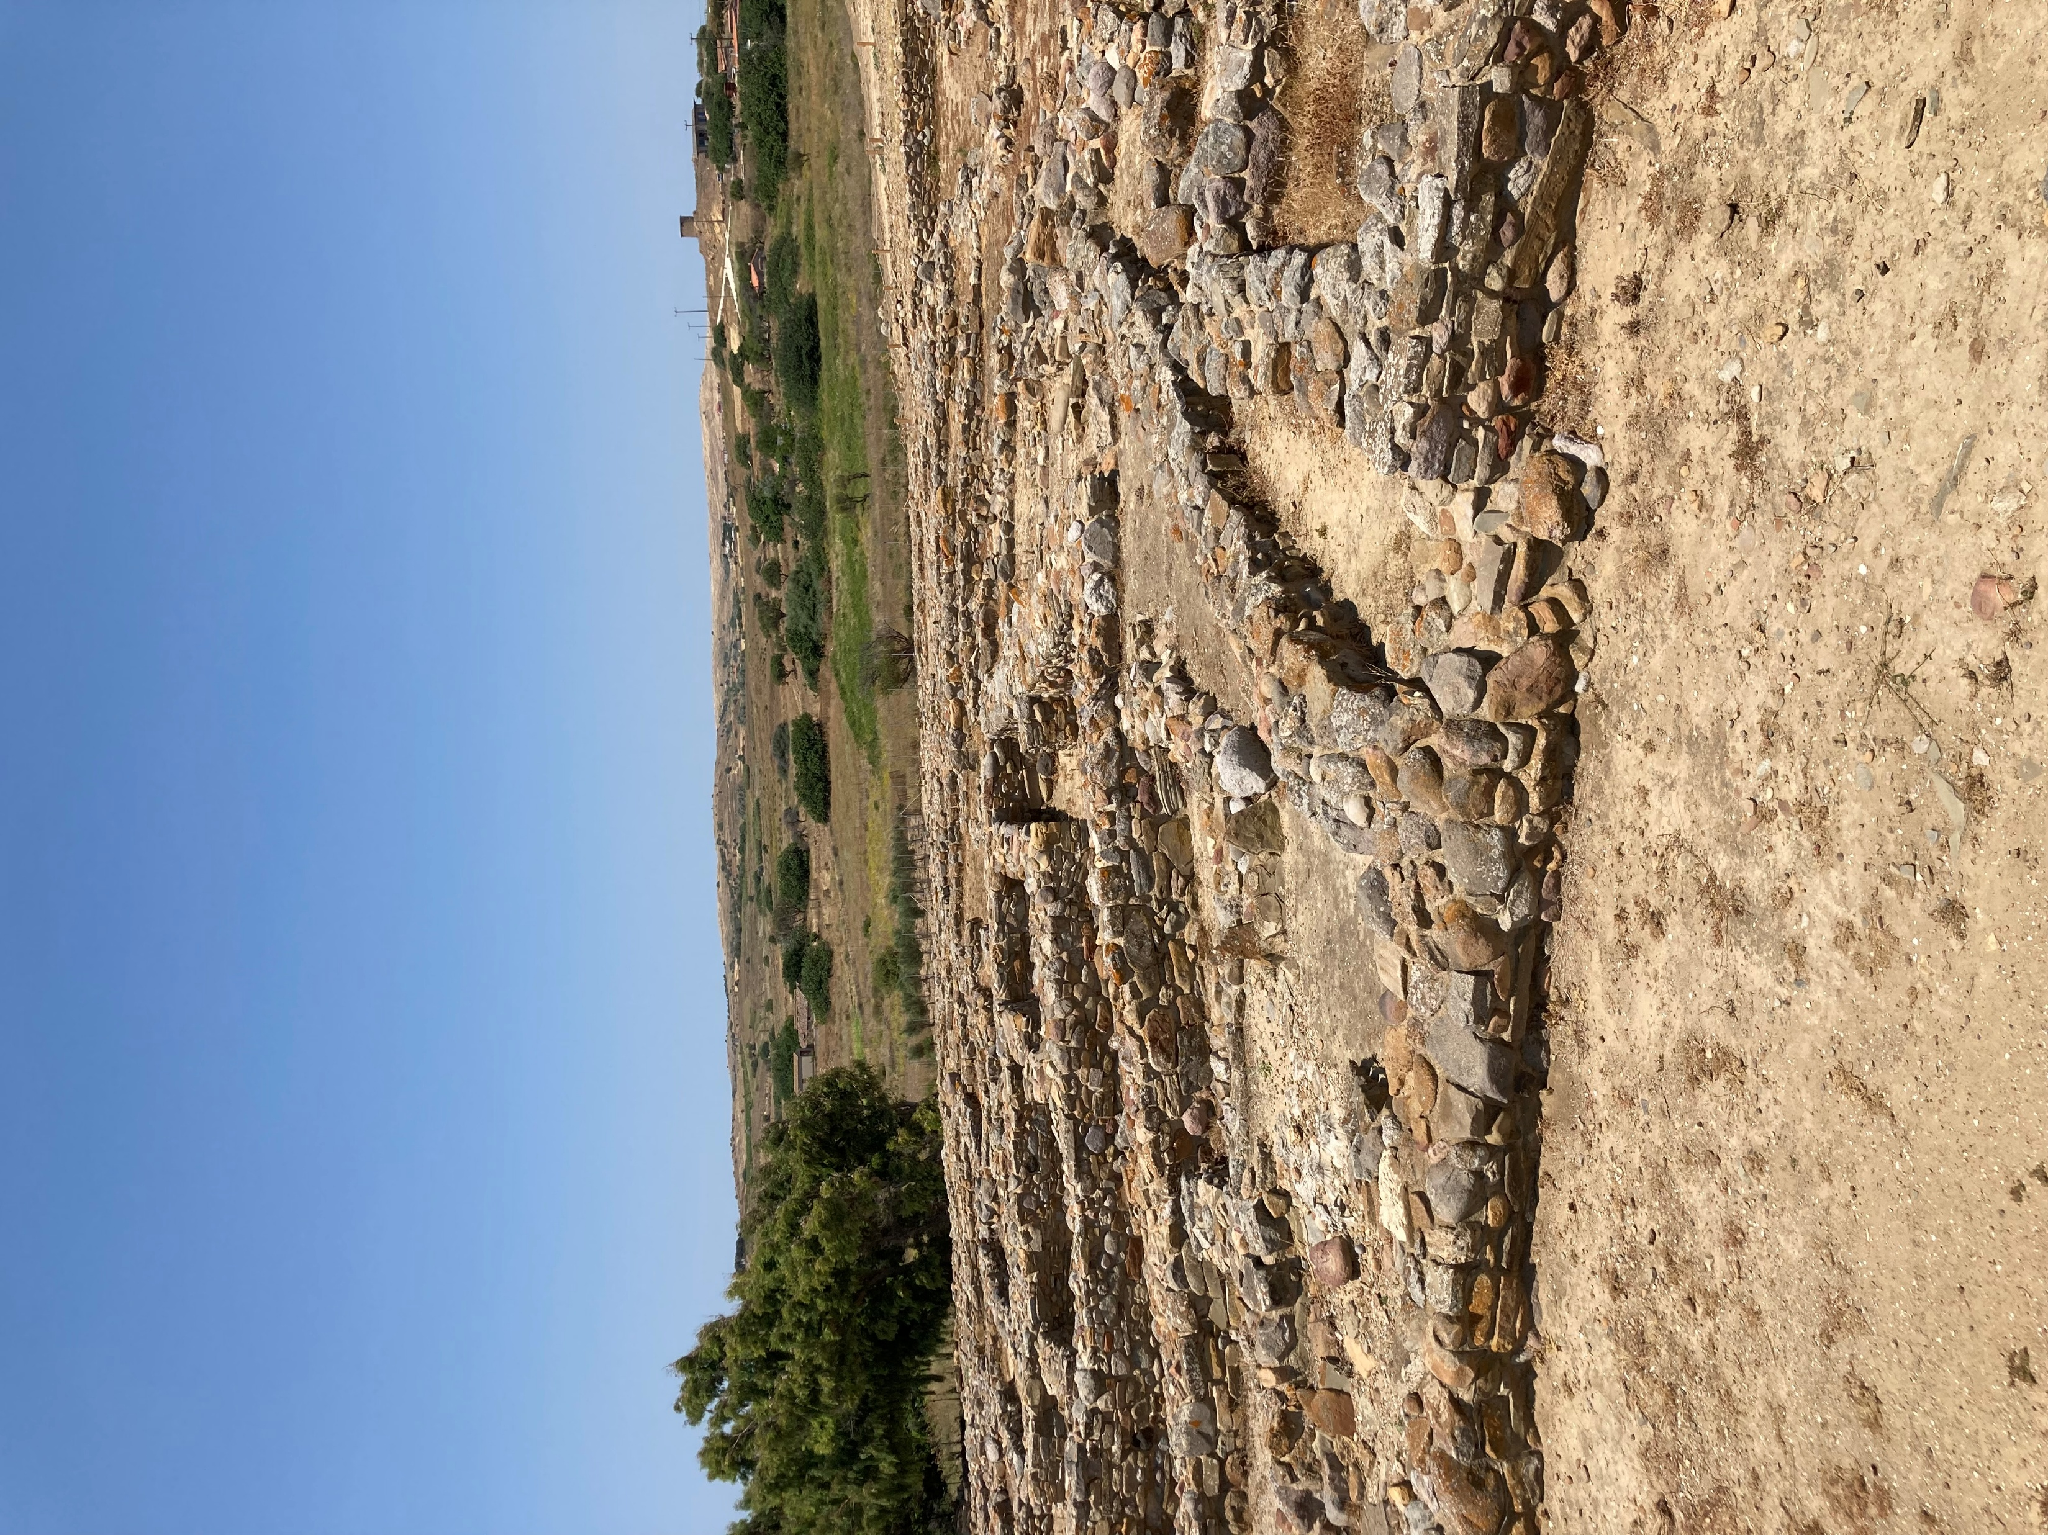

Slide 22
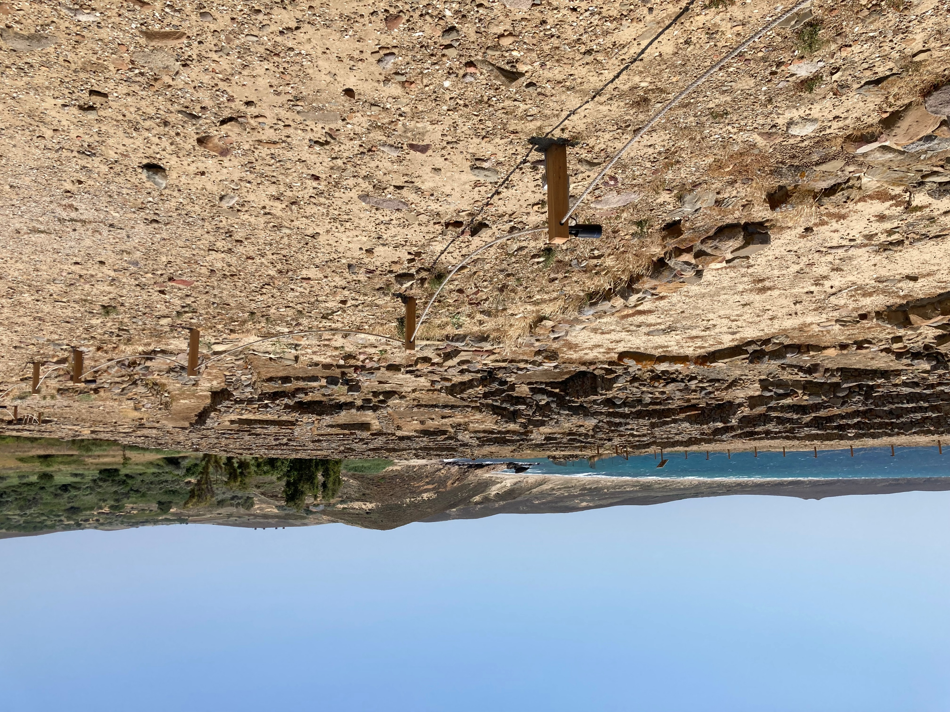

Slide 24
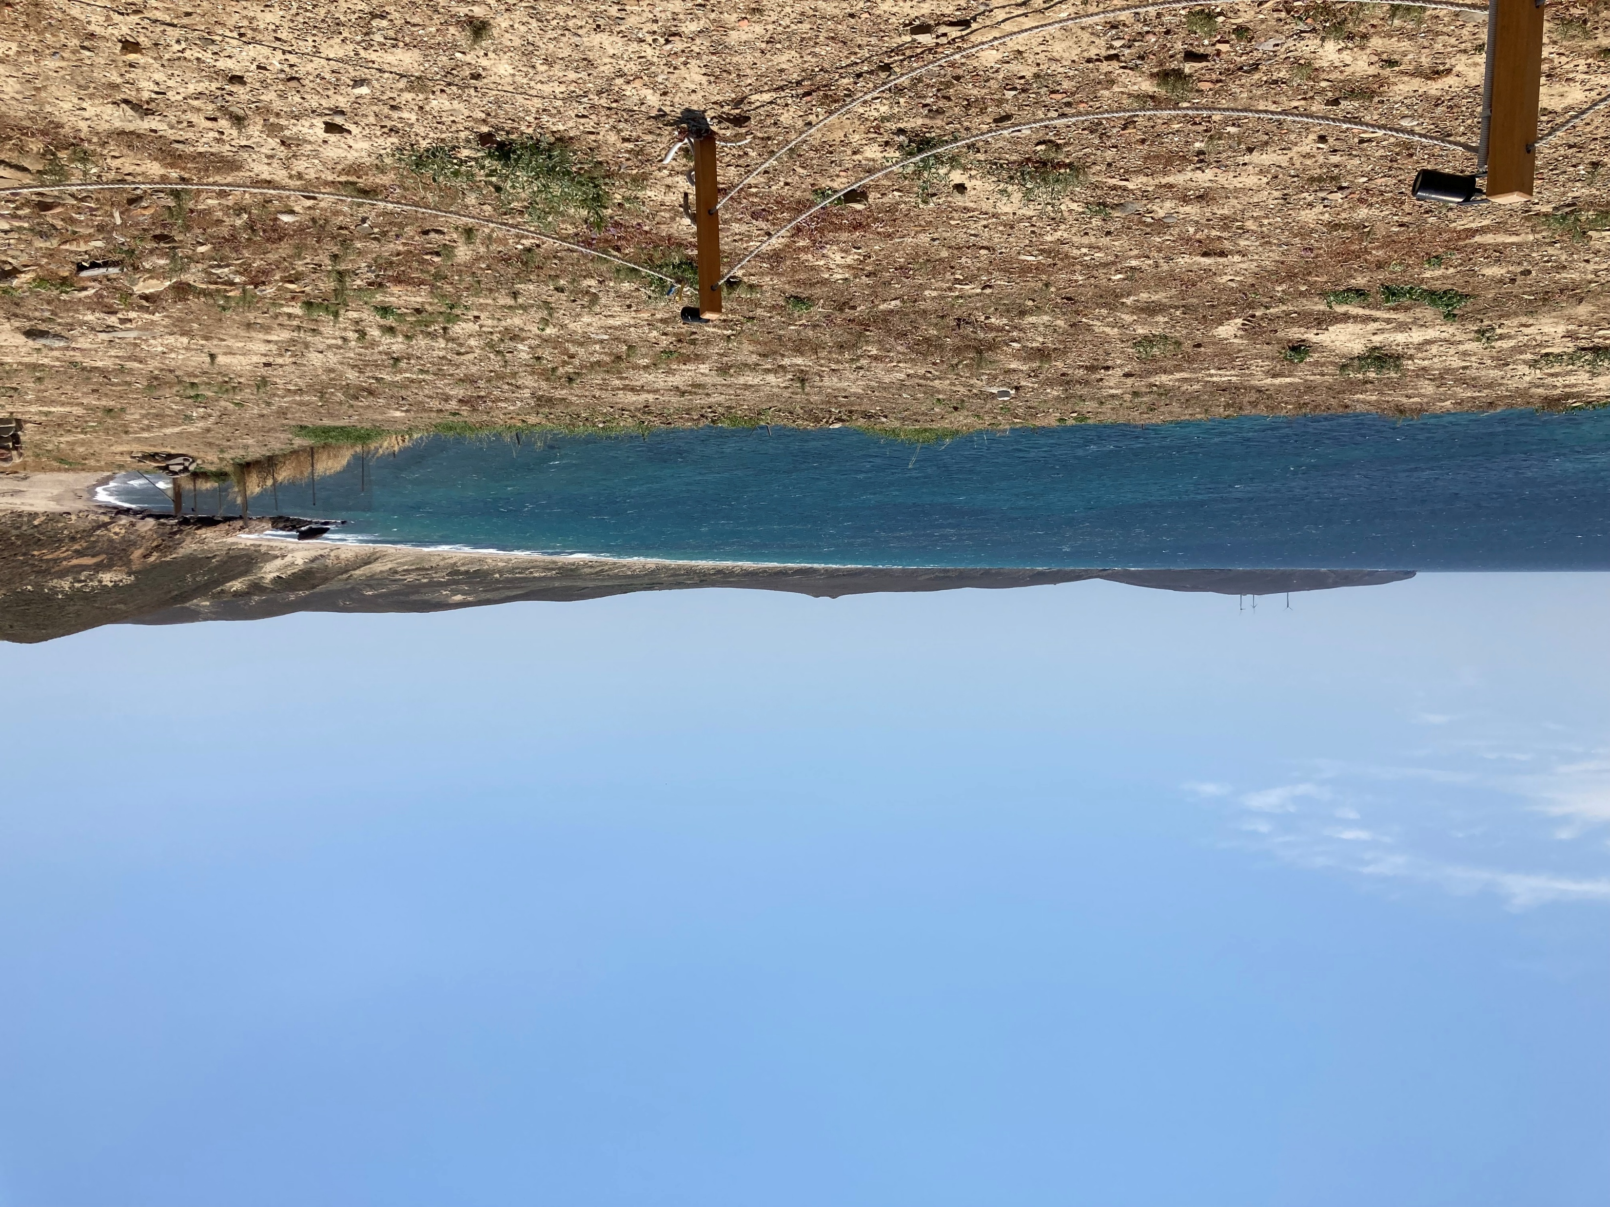

Slide 25
The End

